Slide 1
Simulation of photoelectron path in GasPixel detector
Serge Smirnov/MEPhI
Degrad - program to simulate photoelectron tracks in gaseous detectors by S.Biagi
Fortran code: http://consult.cern.ch/writeup/magboltz
Auger cascade model for electron thermalisation in gas mixtures produced by photons or particles in electric and magnetic fields. Current version is 2.6 (03-Dec-2014)
Allows calculation of number of clusters/cm and cluster size for particle tracks
Input parameters:
Xe(80%) + CO₂(20%)
primary particle: X-ray, E = 6, 10, 15, 20, 25 keV
E_{field} = 900 V/cm (anti parallel to primary particle direction)
Output:
No of electrons for each event and x, y, z and t for each thermalized electron
Toy MonteCarlo to simulate the drift of the cloud including the transverse diffusion:
drift gap: 3.0 cm
transverse diffusion: 250 um/sqrt(cm)

Slide 2
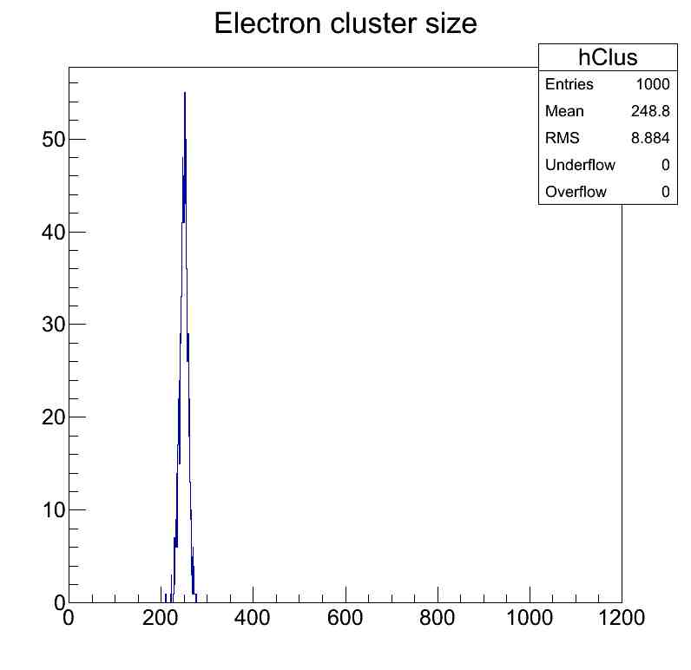
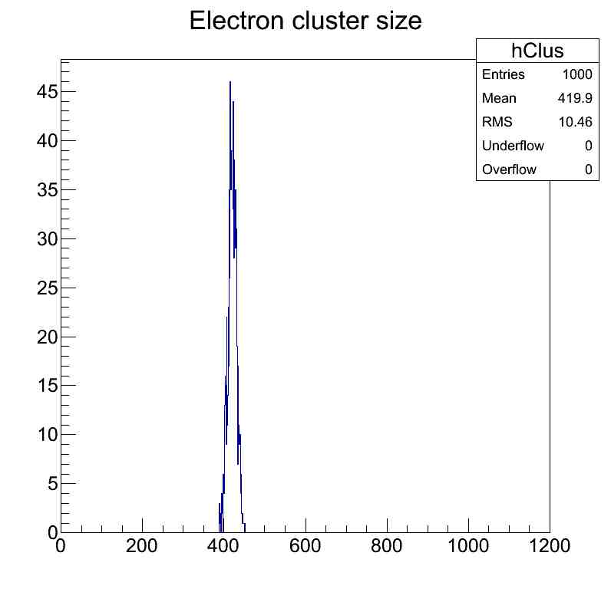
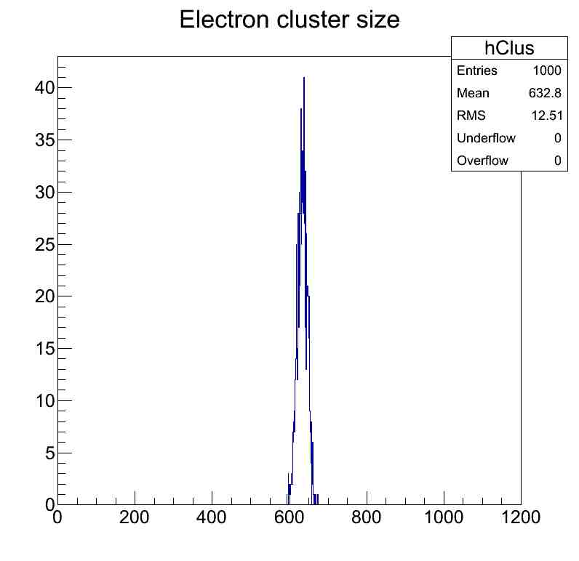
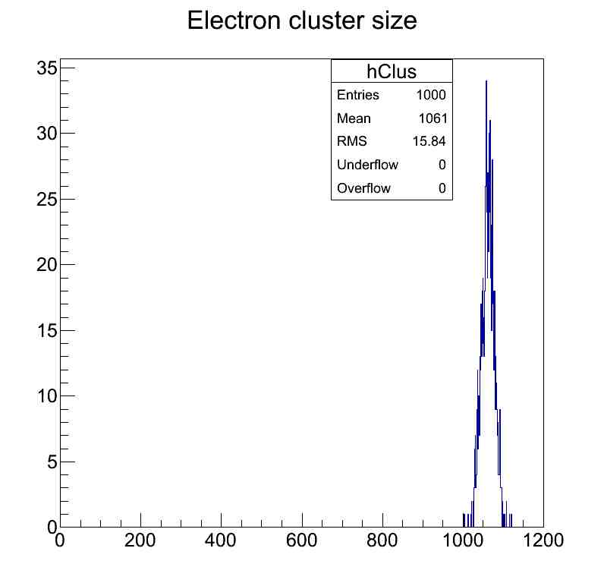
Electron cluster size for different primary photon energies
6 keV
10 keV
15 keV
25 keV

Slide 3
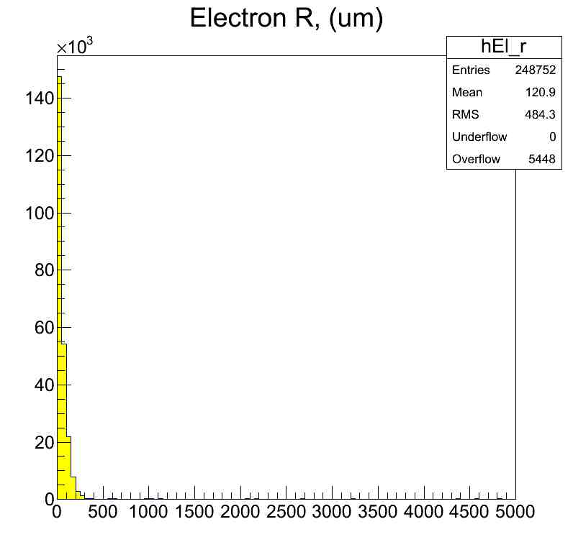
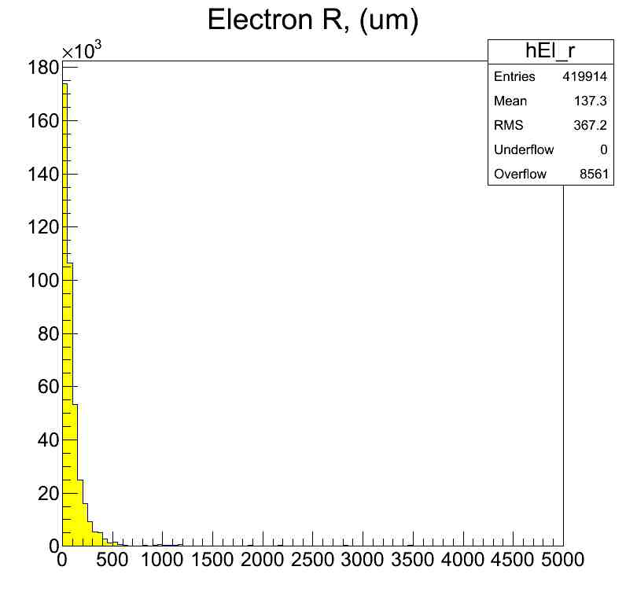
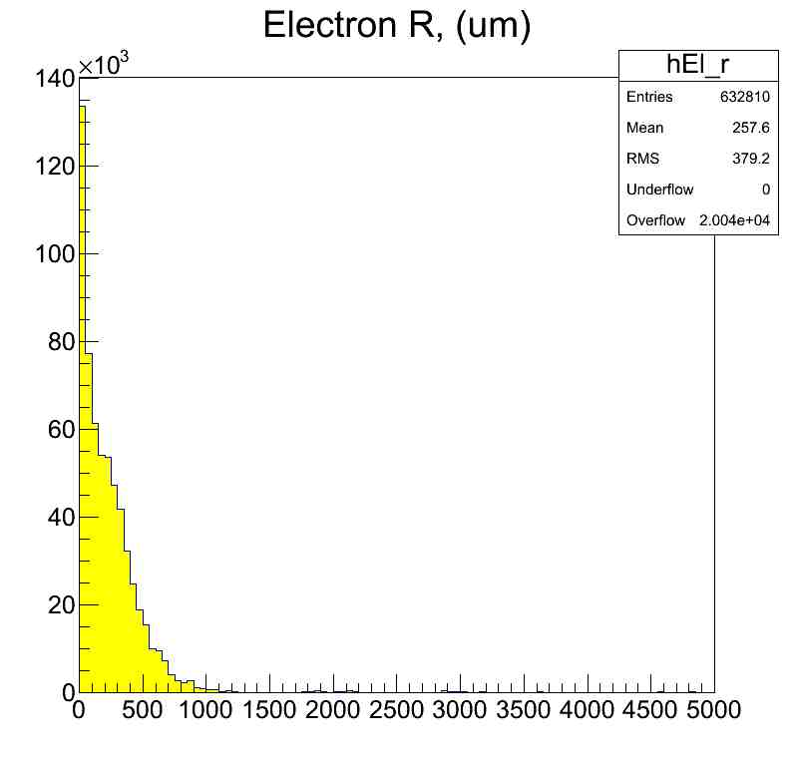
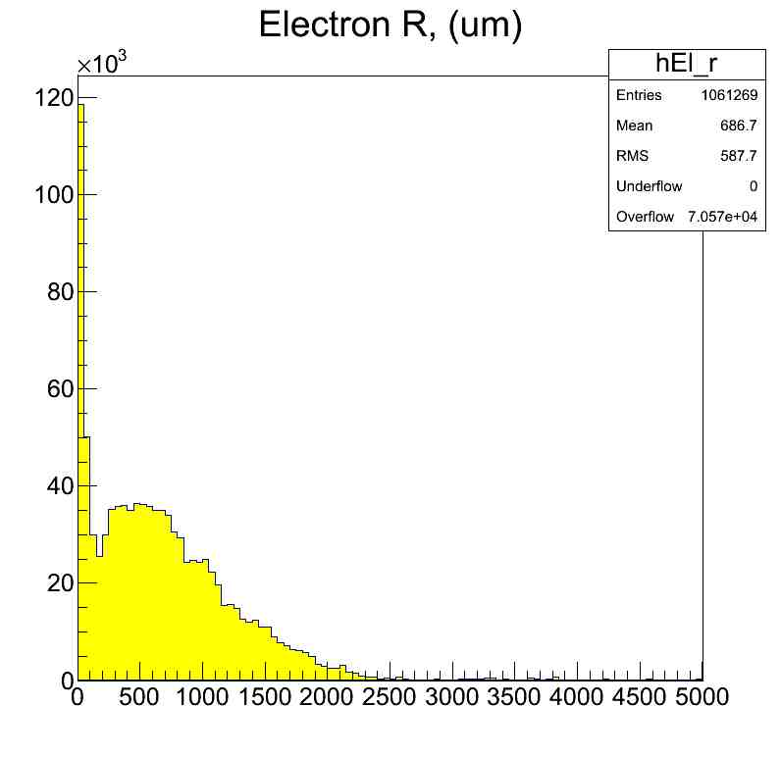
Cluster radius (um), no diffusion
6 keV
10 keV
15 keV
25 keV

Slide 4
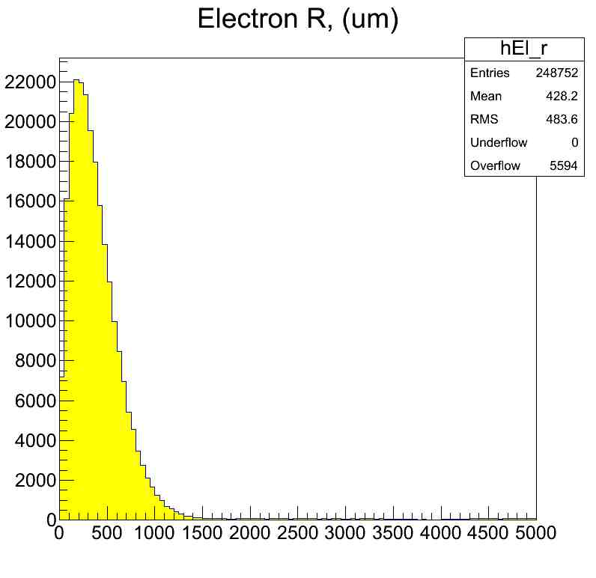
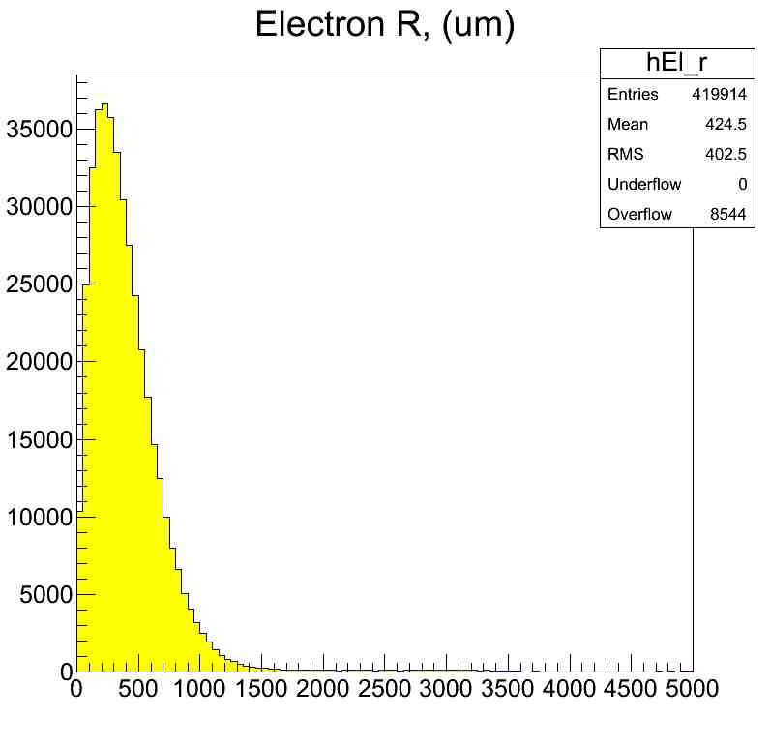
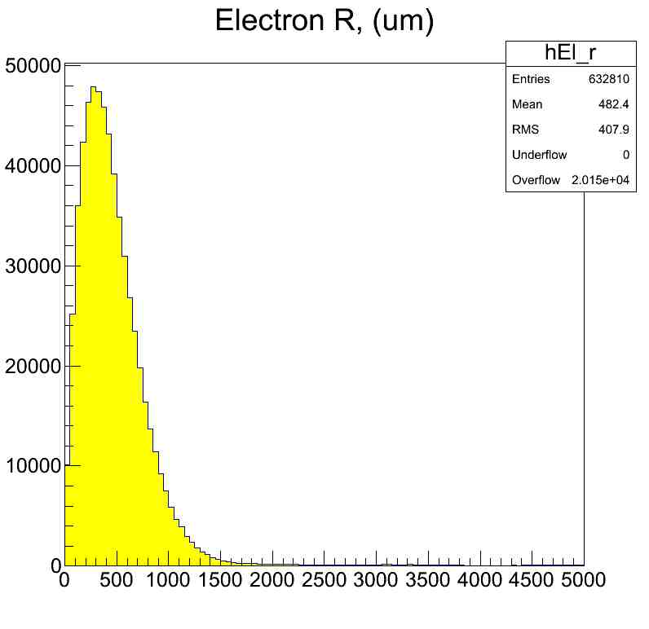
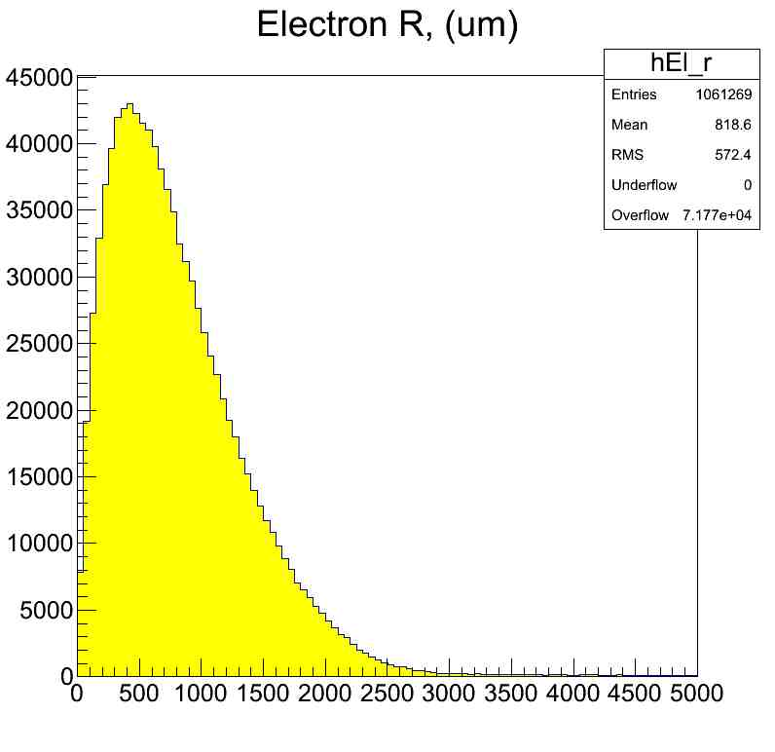
Cluster radius (um), diffusion 250 um/sqrt(cm)
6 keV
10 keV
15 keV
25 keV

