Slide 1
Geant4 TR

Slide 2
Configuration
Radiator:150 foils
62 um with 2 mm gaps
0.92 g/cm3
Air gaps
Detector:
XeCO2 volume 3 cm
Distance 2 m
Simulation was performed for two model of G4 radiators:
1. Geant4 model regular XTR (in, after)
2. Geant4 transparent radiator (in, after)
2m
He
OR
0m
He
XeCO2

Slide 3
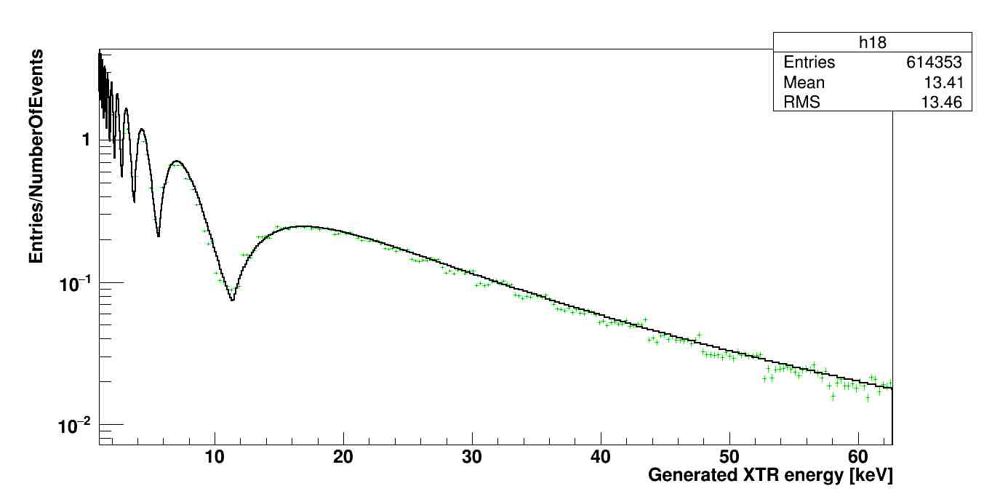


Generated spectrum e- 20 GeV
Radiator program $γ=40000$
G$eant4 γ=40000$

Slide 4
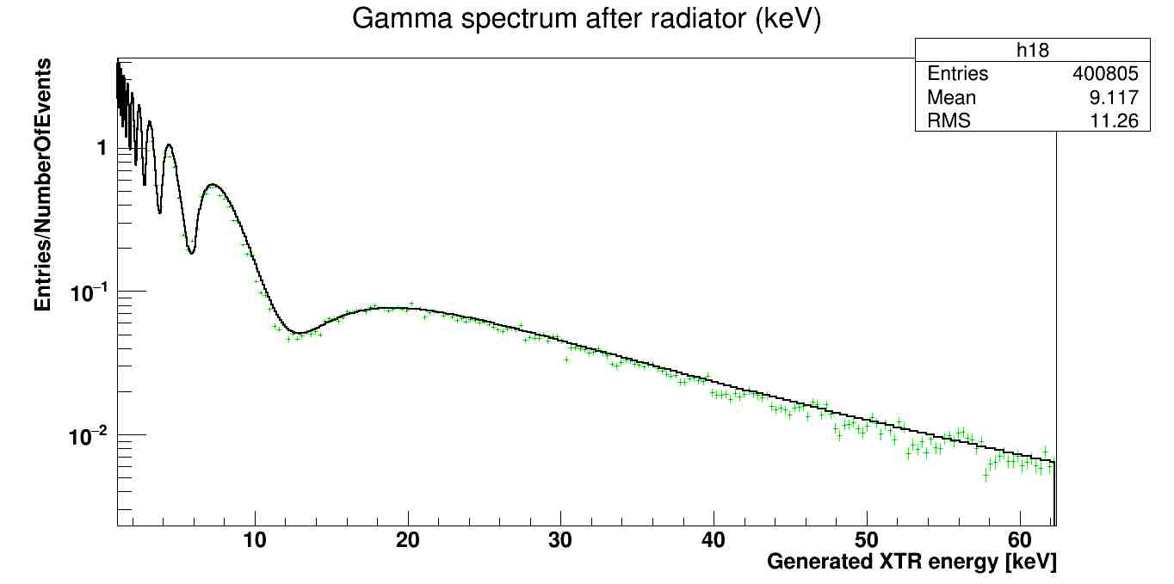


Generated spectrum e- 3 GeV
Radiator program $γ=6000$
G$eant4 γ=6000$

Slide 5
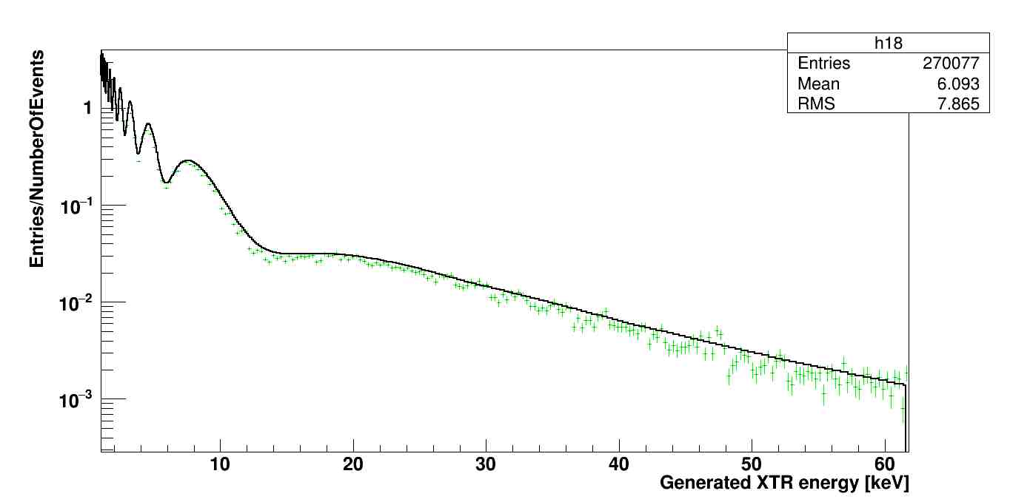


Generated spectrum e- 1.5 GeV
Radiator program $γ=3000$
G$eant4 γ=3000$

Slide 6
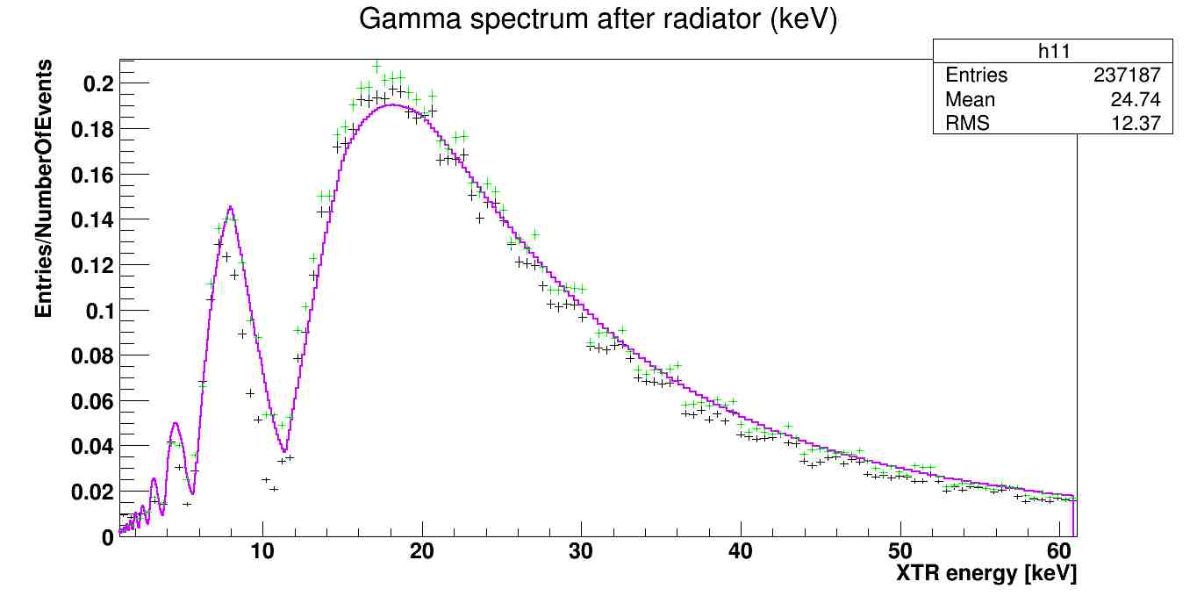

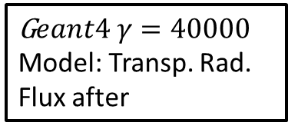
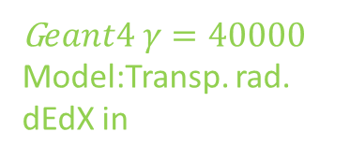
XTR spectrum after radiator e- 20 GeV
Radiator program $γ=40000$
G$eant4 γ=40000$
Model:Transp. rad. dEdX in
G$eant4 γ=40000$
Model: Transp. Rad. Flux after

Slide 7
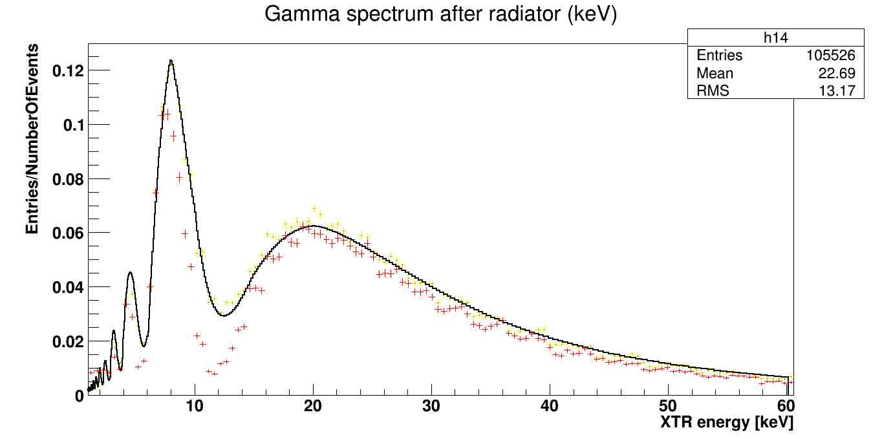

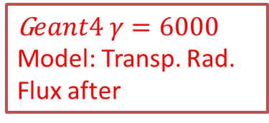
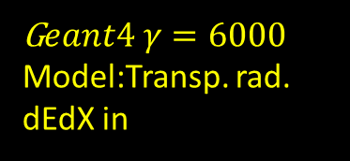
XTR spectrum after radiator e- 3 GeV
Radiator program $γ=6000$
G$eant4 γ=6000$
Model:Transp. rad. dEdX in
G$eant4 γ=6000$
Model: Transp. Rad. Flux after

Slide 8
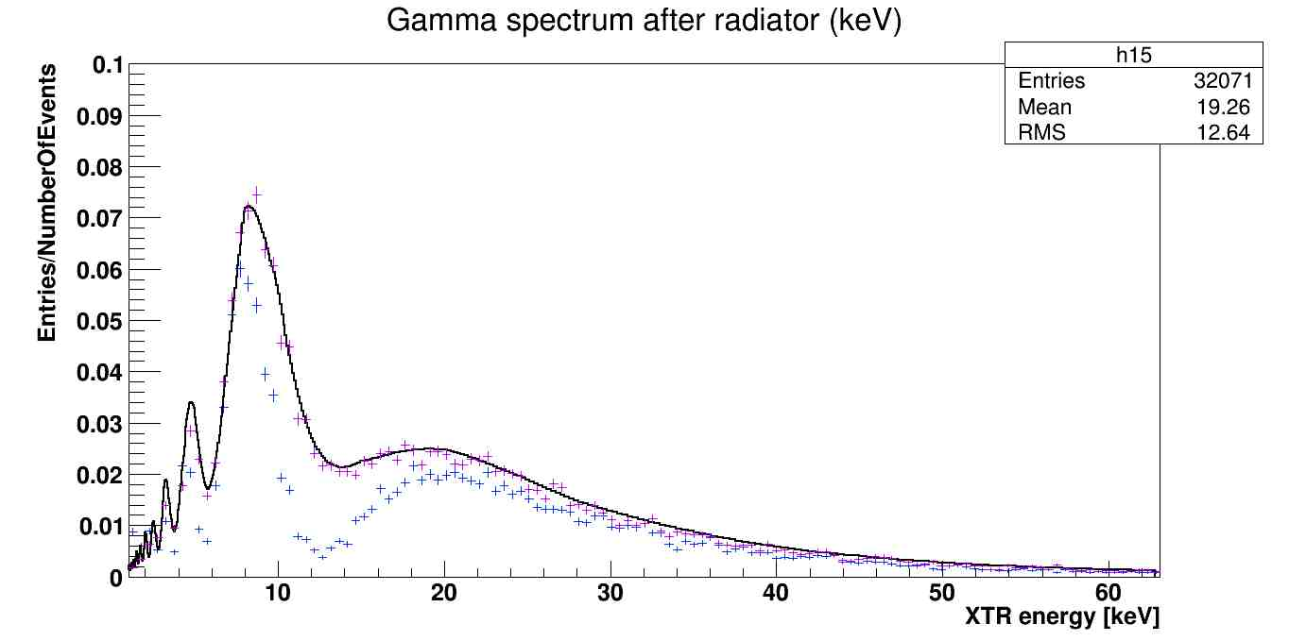

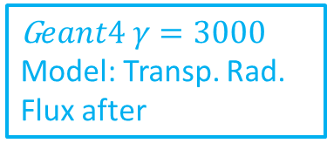
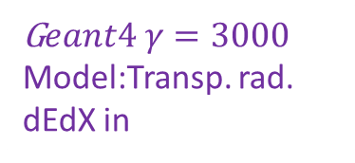
XTR spectrum after radiator e- 1.5 GeV
Radiator program $γ=3000$
G$eant4 γ=3000$
Model:Transp. rad. dEdX in
G$eant4 γ=3000$
Model: Transp. Rad. Flux after

Slide 9
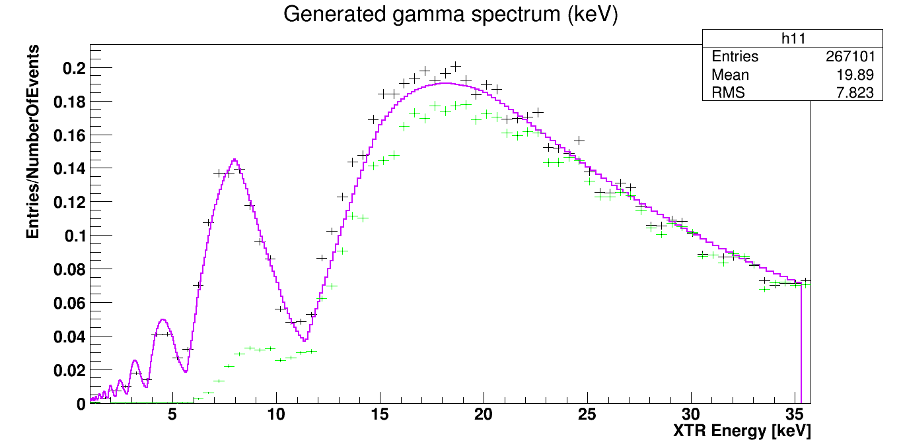
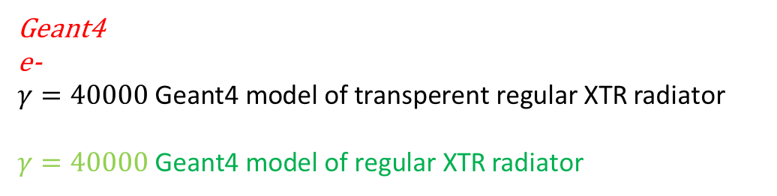

XTR spectrum after radiator e- 20 GeV
Radiator
e-
$$γ=40000$$
Geant4
e-
$γ=40000 \text{Geant}\text{4 }\text{model} \text{of} \text{transperent} \text{regular} \text{XTR}$ radiator
$γ=40000$ $\text{Geant}\text{4 }\text{model} \text{of} \text{regular} \text{XTR}$ radiator

Slide 10
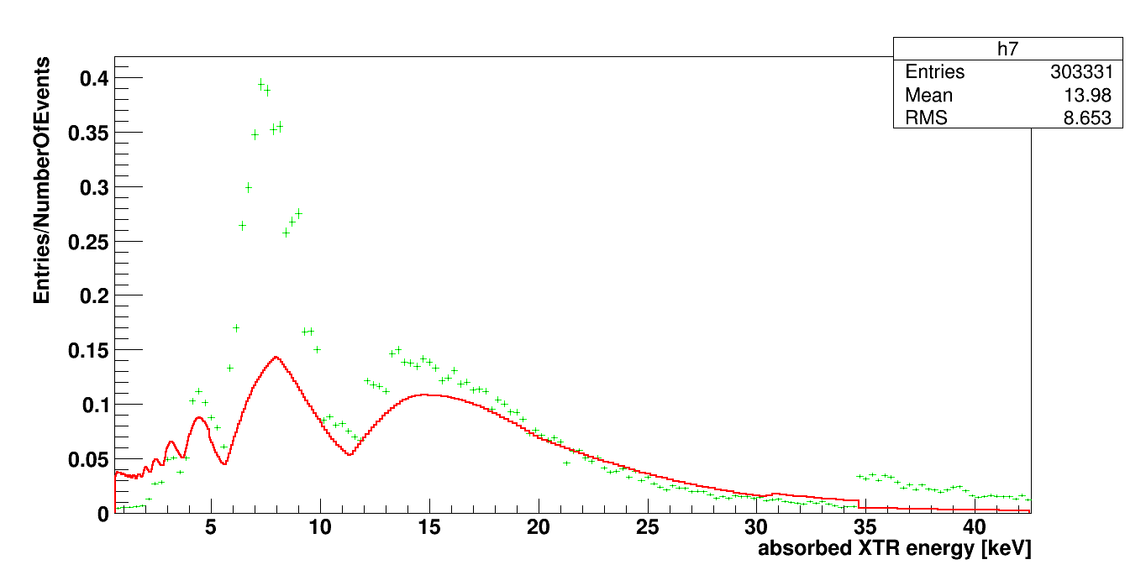
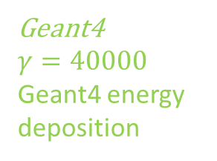
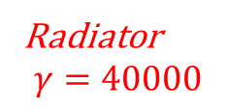
Absorbed XTR spectrum in XeCO2 volume e- 20 GeV
Geant4 $γ=40000$
Geant4 energy deposition
Radiator
$$γ=40000$$

Slide 11
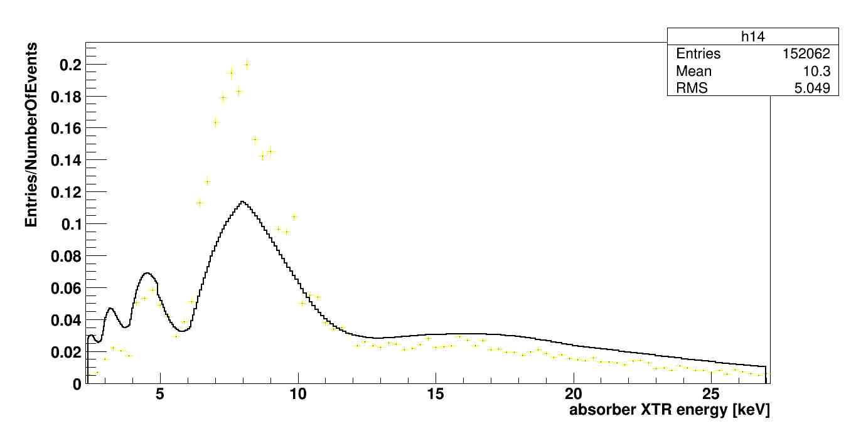
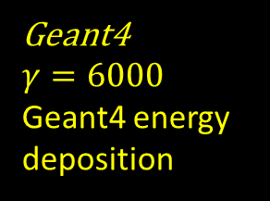
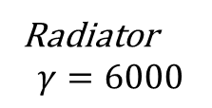
Absorbed XTR spectrum in XeCO2 volume e- 3 GeV
Geant4 $γ=6000$
Geant4 energy deposition
Radiator
$$γ=6000$$

Slide 12
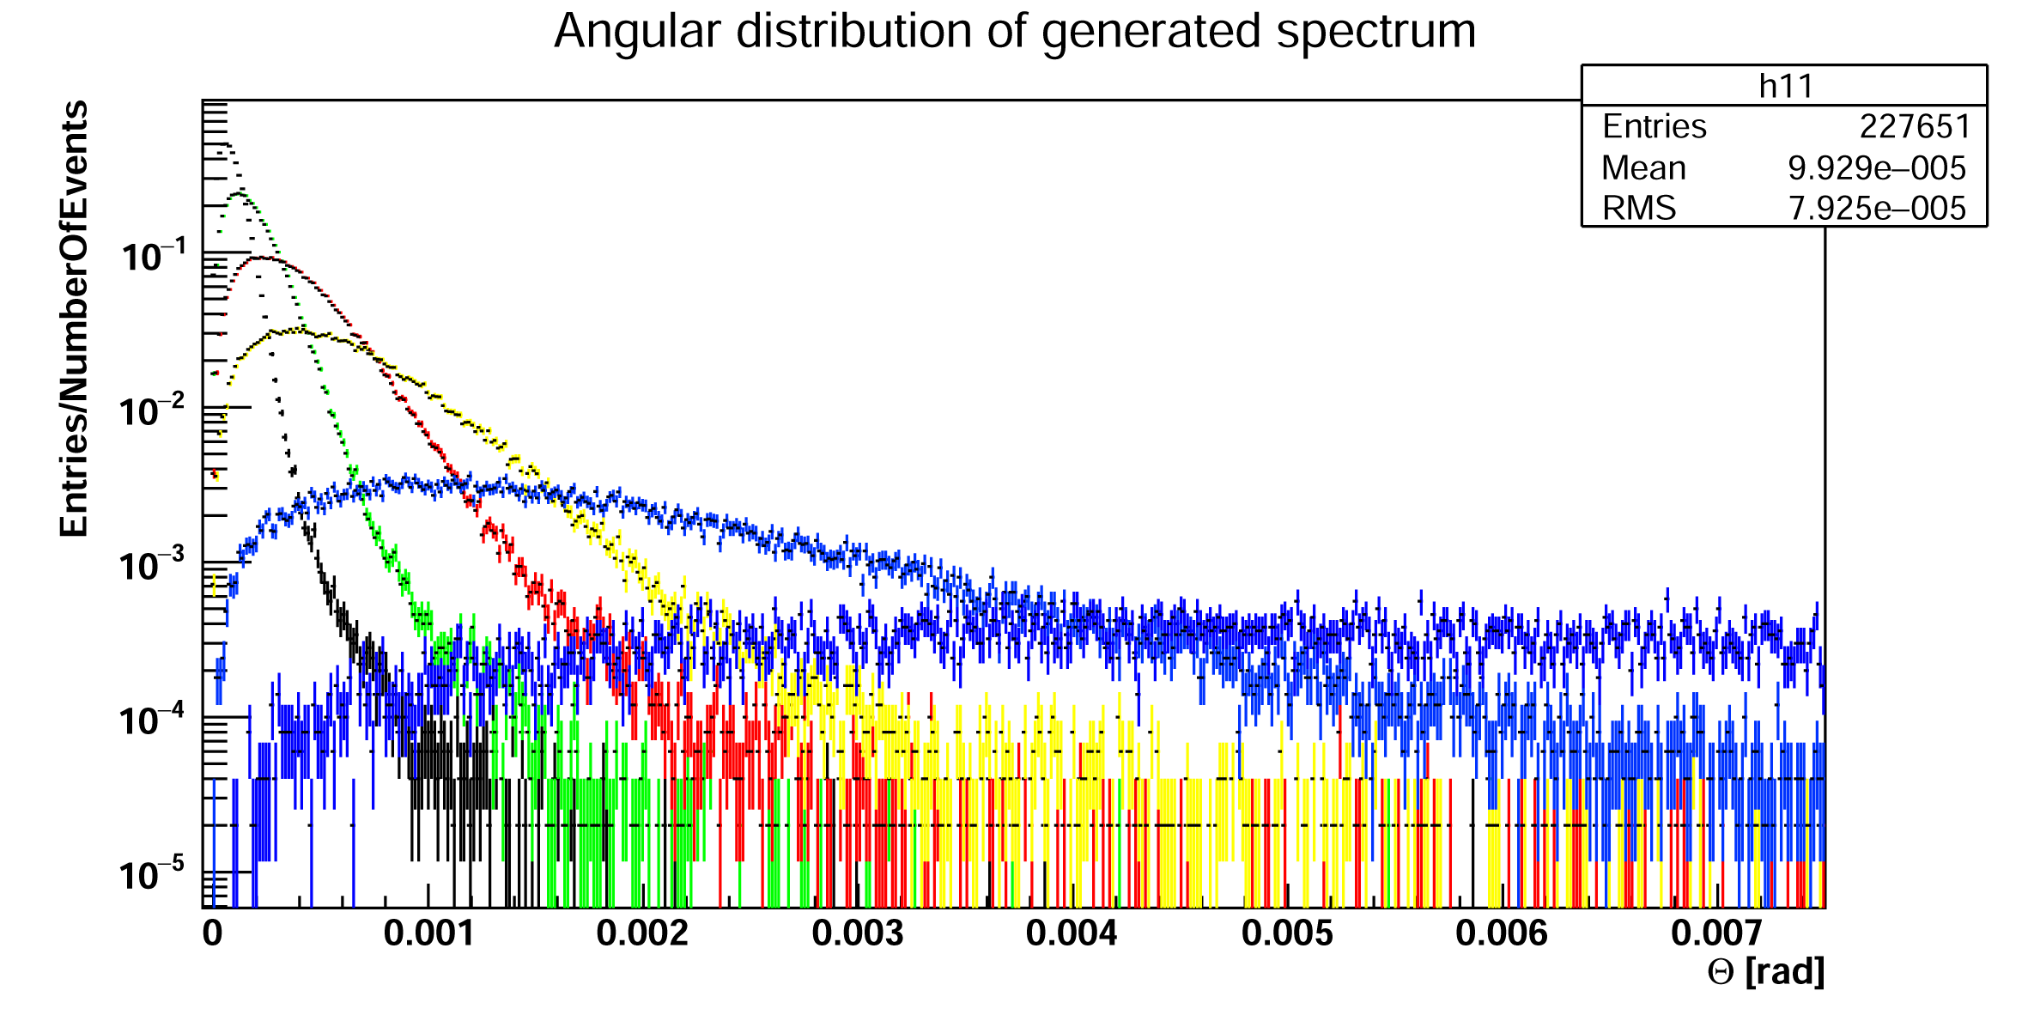

For this distribution
Geant4 model regular XTR radiator with dE/dX = G4 transparent radiator with dE/dX
Geant4
e-
$$γ=40000$$
$$γ=20000$$
$$γ=10000$$
$$γ=6000$$
$$γ=2000$$
$$γ=400$$

Slide 16
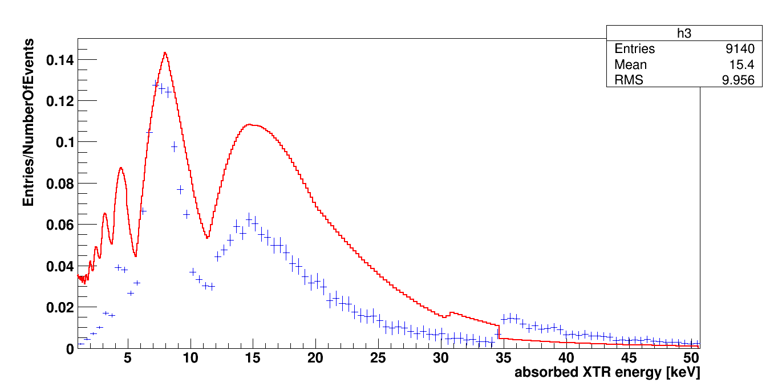
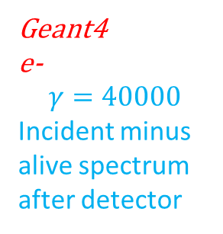

G4 transparent radiator with dE/dX
Absorbed in XeCO2 XTR spectrum
Radiator
e-
$$γ=40000$$
Geant4
e-
$$γ=40000$$
Incident minus alive spectrum after detector

Slide 17
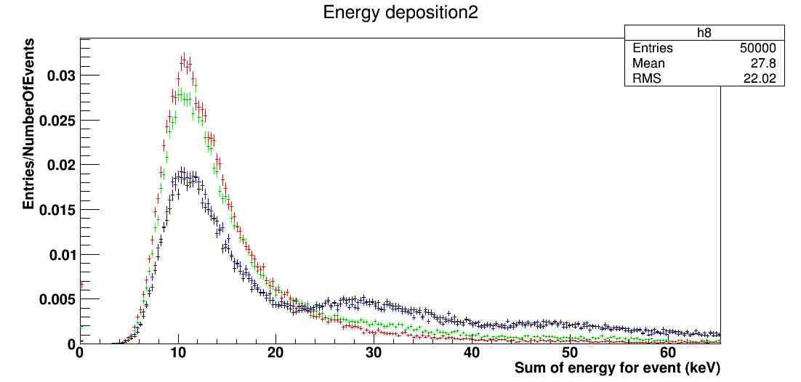

Geant4 model regular XTR radiator with dE/dX
Energy Deposition in XeCO2 volume for all particles
e-
$$γ=40000$$
$$γ=20000$$
$$γ=4000$$
$$γ=2000$$

Slide 18
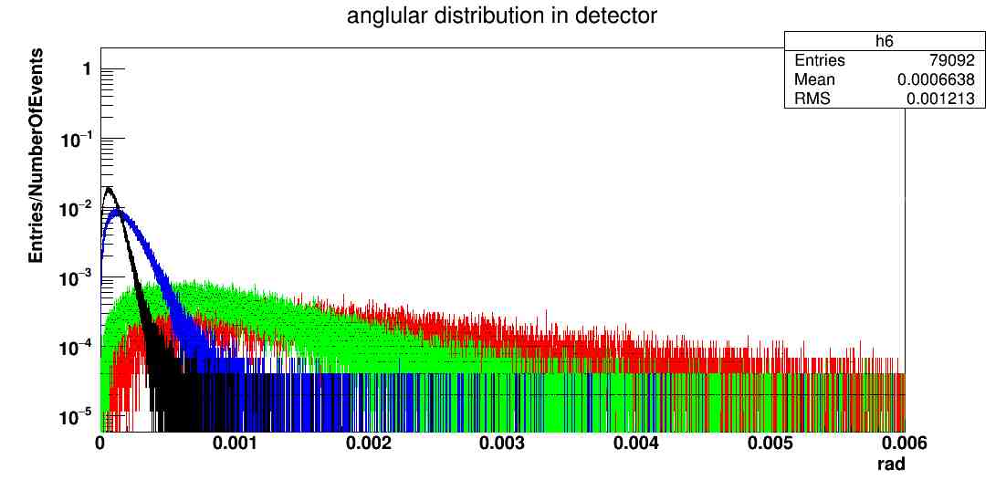

Geant4 model regular XTR radiator with dE/dX
for TR photons
e-
$$γ=40000$$
$$γ=20000$$
$$γ=4000$$
$$γ=2000$$

Slide 19
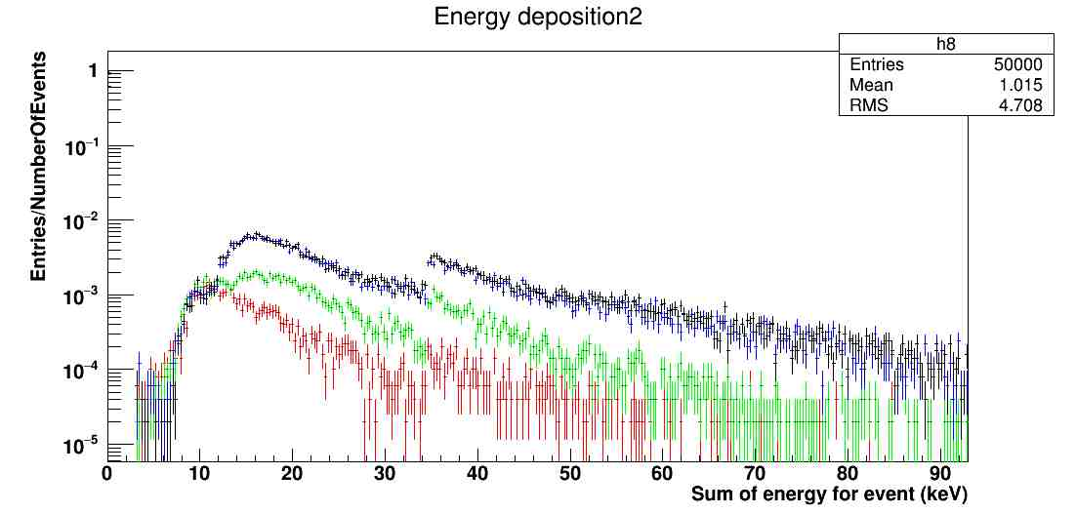

G4 transparent radiator with dE/dX
Energy Deposition in XeCO2 volume for GAMMA
e-
$$γ=40000$$
$$γ=20000$$
$$γ=4000$$
$$γ=2000$$
Xe K-shell

Slide 20
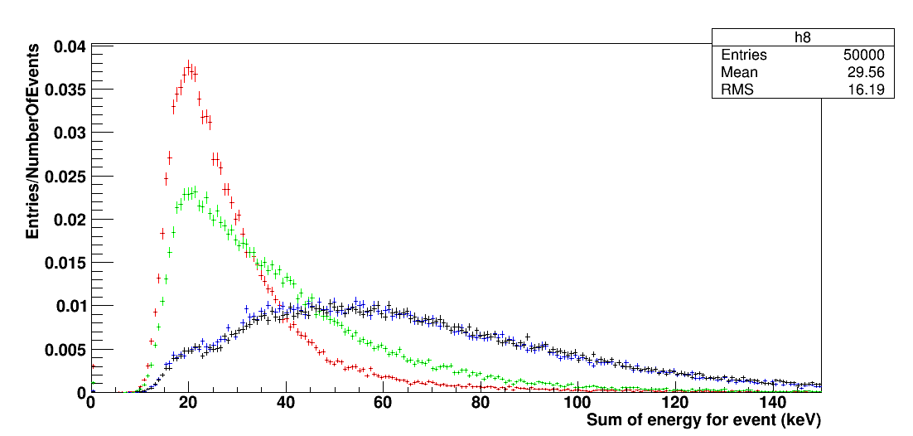

G4 transparent radiator with dE/dX
Energy Deposition in XeCO2 volume for all particle
e-
$$γ=40000$$
$$γ=20000$$
$$γ=4000$$
$$γ=2000$$

Slide 21
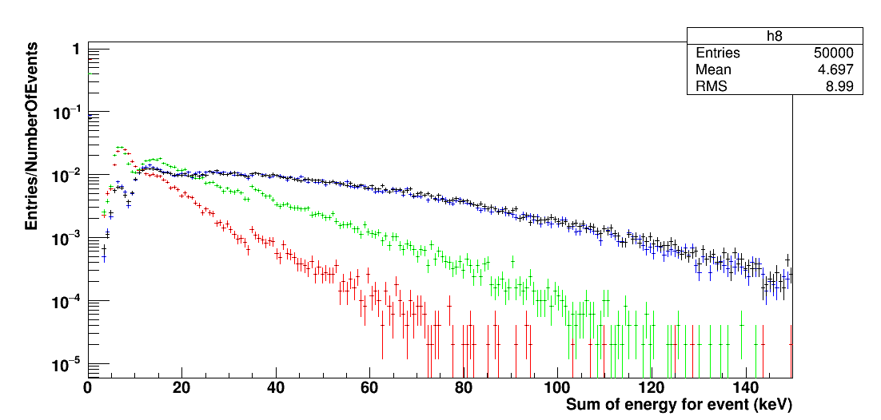
G4 transparent radiator with dE/dX
Energy Deposition in XeCO2 volume for GAMMA
e-
$$γ=40000$$
$$γ=20000$$
$$γ=4000$$
$$γ=2000$$
Next slide is the same but not in log scale

Slide 22
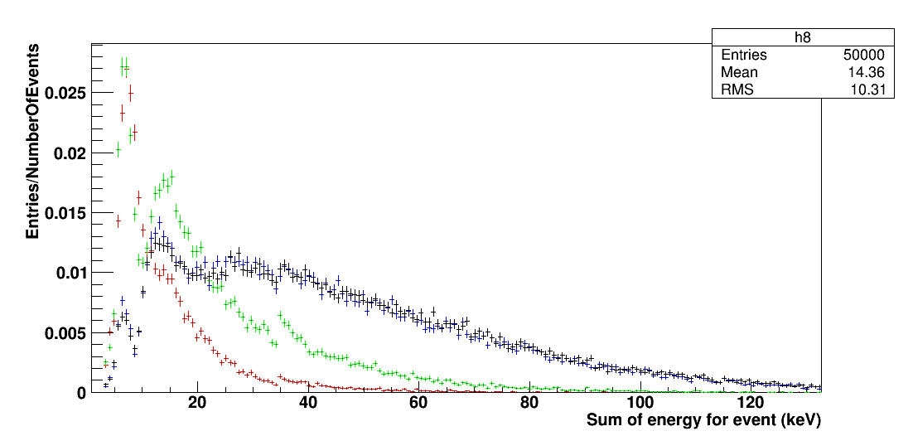
G4 transparent radiator with dE/dX
Energy Deposition in XeCO2 volume for GAMMA
e-
$$γ=40000$$
$$γ=20000$$
$$γ=4000$$
$$γ=2000$$

Slide 23
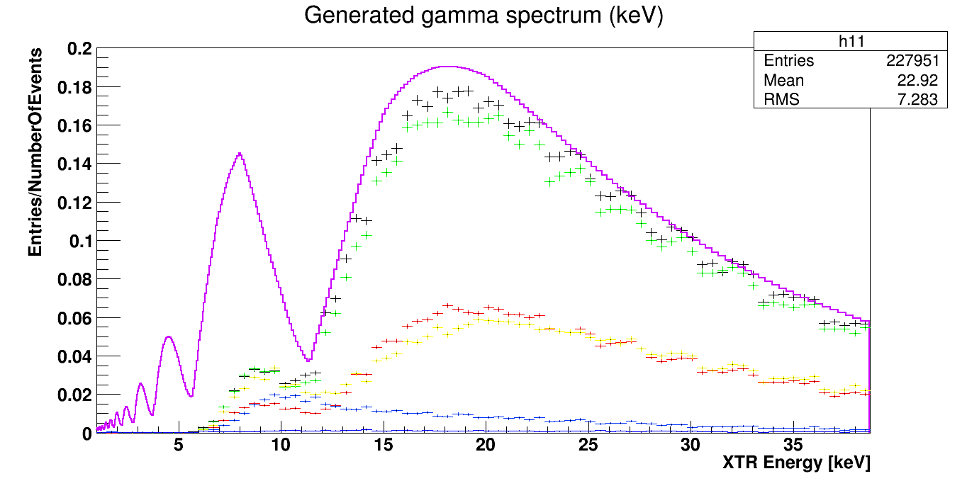


Geant4 model regular XTR radiator with dE/dX
Geant4
e-
$$γ=40000$$
$$γ=20000$$
$$γ=10000$$
$$γ=6000$$
$$γ=2000$$
$$γ=400$$
Radiator
e-
$$γ=40000$$
NumberOfEvents = 50000 primary e-

Slide 24
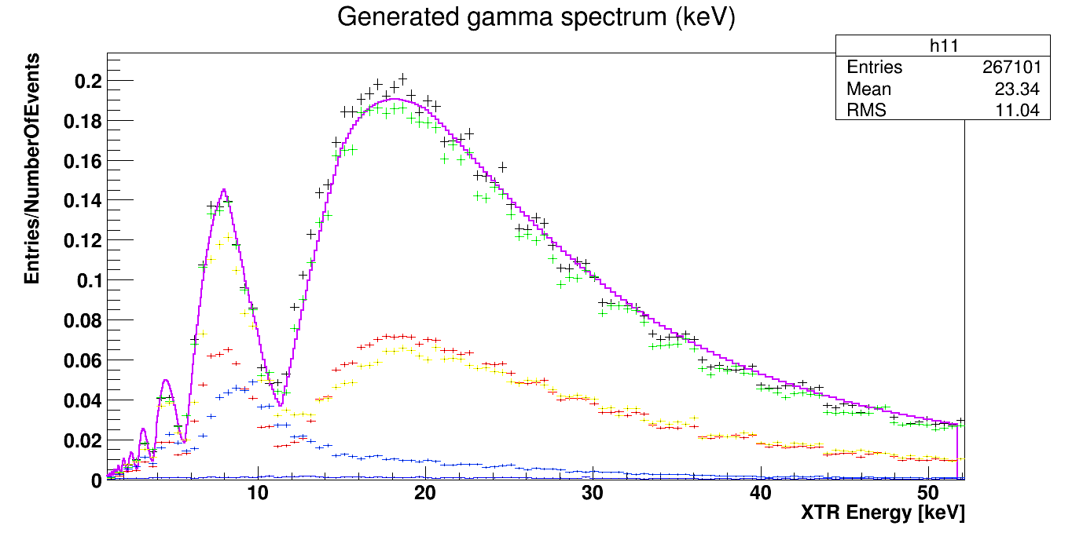

G4 transparent radiator with dE/dX
Radiator
e-
$$γ=40000$$
Geant4
e-
$$γ=40000$$
$$γ=20000$$
$$γ=10000$$
$$γ=6000$$
$$γ=2000$$
$$γ=400$$

