Slide 1
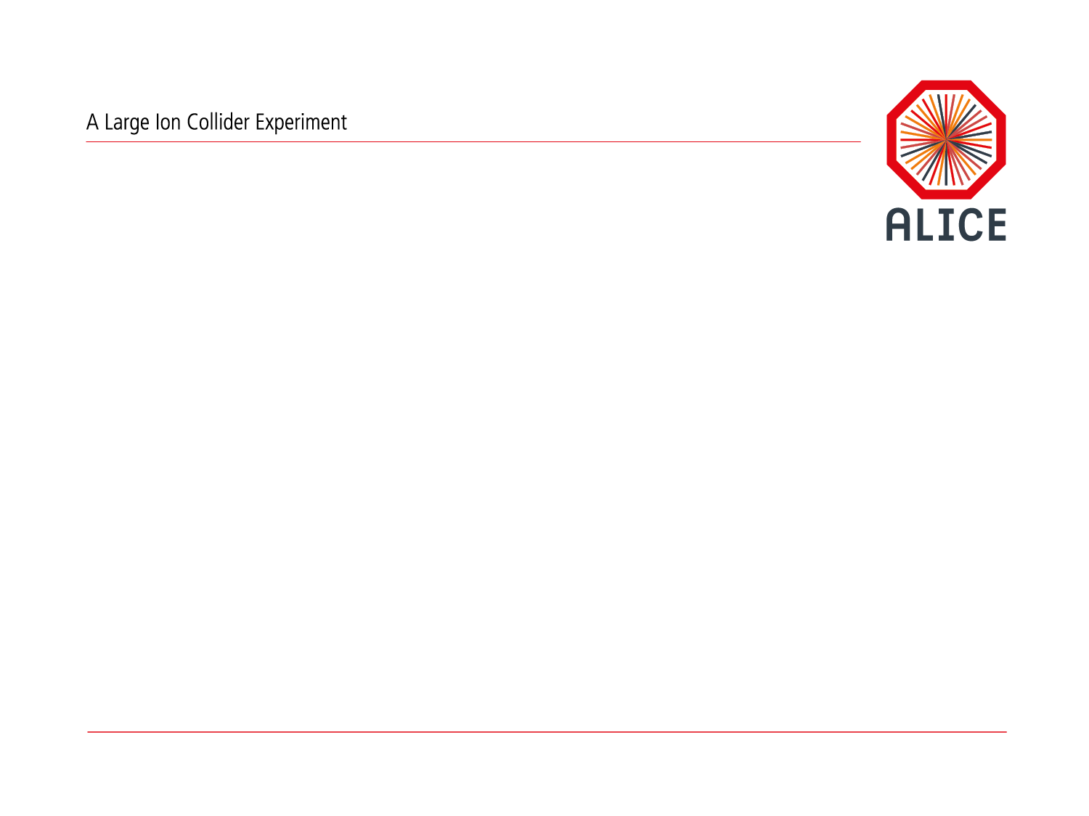
O² Project Status
Pierre Vande Vyvre

Slide 2
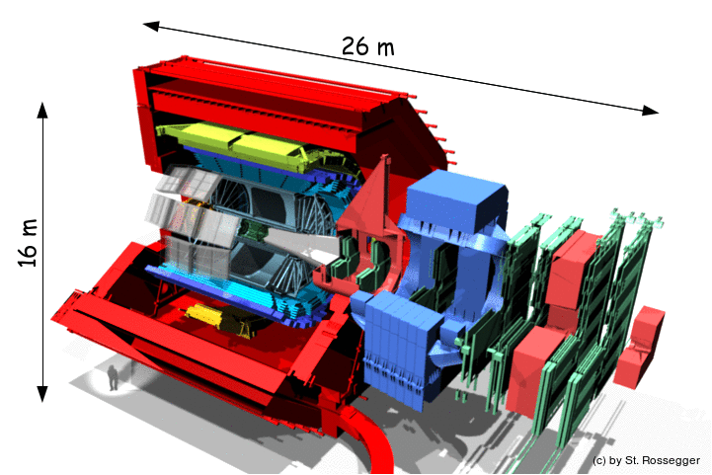
ALICE Upgrade
LHC after LS2: Pb–Pb collisions at up to L = 6 10²⁷ cm⁻²s⁻¹ ⇒ interaction rate of 50kHz
New Inner Tracking System (ITS)
improved pointing precision
less material ->
thinnest tracker at the LHC
Muon Forward Tracker (MFT)
new Si tracker
Improved MUON pointing precision
Time Projection Chamber (TPC)
new GEM technology for readout chambers
continuous readout
faster readout electronics
MUON ARM
continuous readout electronics
New Central Trigger Processor
Entirely new
Data Acquisition (DAQ)/ High Level Trigger (HLT)
TOF, TRD, ZDC
Faster readout
New Trigger
Detectors (FIT)

Slide 3
ALICE O² in a nutshell
Unmodified raw data of all interactions shipped from detector
to online farm in triggerless continuous mode
Requirements
LHC min bias Pb-Pb at 50 kHz
~100 x more data than during Run 1
Physics topics addressed by ALICE upgrade
  Rare processes
  Very small signal over background ratio
  Needs large statistics of reconstructed events
  Triggering techniques very inefficient if not impossible
50 kHz > TPC inherent rate (drift time ~100 µs)
Support for continuous read-out (TPC)
  Detector read-out triggered or continuous
HI run 3.4 TByte/s
Baseline correction and zero suppression
Data volume reduction by zero cluster finder. No event discarded.
Average compression factor 6.6
500 GByte/s
Data volume reduction by online tracking.
Only reconstructed data to data storage.
Average compression factor 5.5
90 GByte/s
New computing system
Read-out the data of all interactions
Compress these data intelligently
by online reconstruction
One common online-offline
computing system: O²
Paradigm shift compared to approach for Run 1 and 2
90 GByte/s
Data Storage: 1 year of compressed data
Bandwidth: Write 170 GB/s Read 270 GB/s
Capacity: 60 PB
20 GByte/s
Tier 0, Tiers 1 and
Analysis Facilities
Asynchronous (few hours) event reconstruction with final calibration

Slide 4

Hardware Facility
270 FLPs
First Level
Processors
(FLPs)
1500 EPNs
Event Processing
Nodes
(EPNs)
34 Storage
Servers
68 Storage
Arrays
Detectors
Switching
Network
Storage
Network
9000 Read-out
Links
Input: 270 ports
Output : 1500 ports
Input: 1500 ports
Output : 34 ports
3.3 TB/s
500 GB/s
RD and WR 340 GB/s

Slide 5
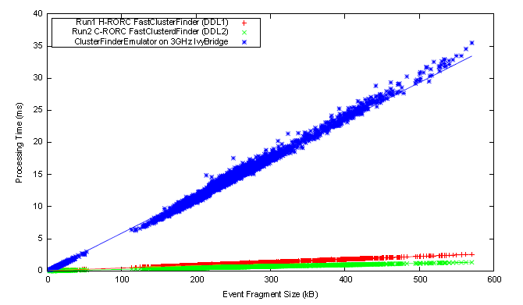

Technology: Hardware acceleration with FPGA
FPGA
Acceleration for TPC cluster finder versus a standard CPU
25 times faster than the software implementation
Use of the CRU FPGA for the TPC cluster finder

Slide 6
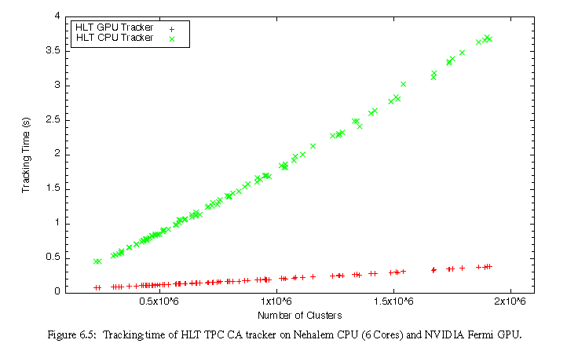
Technology: Hardware acceleration with GPU
GPU
TPC Track Finder based on the Cellular Automaton principle to construct track seeds.
It is implemented for OpenMP (CPU), CUDA (Nvidia GPU), and OpenCL (AMD GPU).
1 GPU replaces 30 CPU cores and uses 3 for I/O
Use of GPUs for the TPC track finder in the EPNs

Slide 7
Dataflow simulation
Trade-off: precision vs execution time
Hierarchical simulation:
  Global system
  Use as input parameters the results of more detailed of some subsystems
Detector read-out simulation
CTP+LTU
HB/Trigger
Full/Busy
FLP
CRU
GBT
TPC User Logic
GBT
BC
FLP
Memory
ZS
Buffer
PCIe
CF
MPX

Slide 8
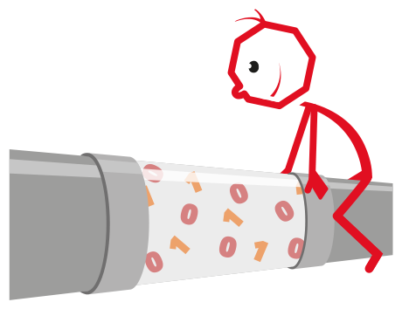
CWG3: Read-out simulation model
Additional PCIe
Traffic
Buffer Full Signal
FLP
Mem.
PCIe
Data size
TPC data with
Pb-Pb beams
Arrival rate
Deterministic
Poisson
Pipeline processing :
with appropriate
parameters for :
-Latency Distribution
-Data Reduction Distribution
can describe all 4 queueing models
(M/M/1, D/G/1, D/M/1, G/G/1 )
Circular Queue
4-8 kB Buffers
Sending Buffers
To FLP Memory
PCIe traffic distribution
& rate
Exponential
Based on realistic data
Estimate the probability of data loss as input to the full simulation

Slide 9
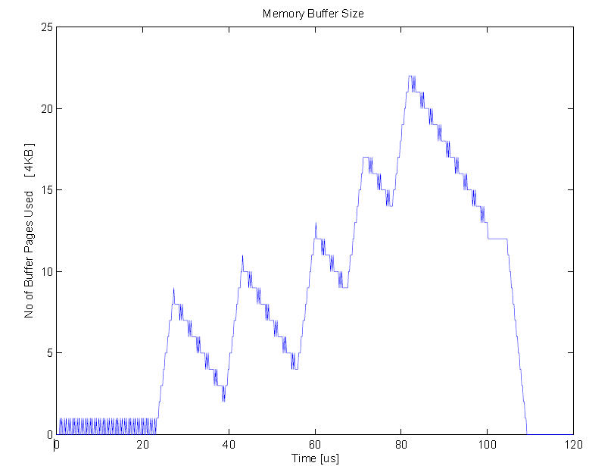
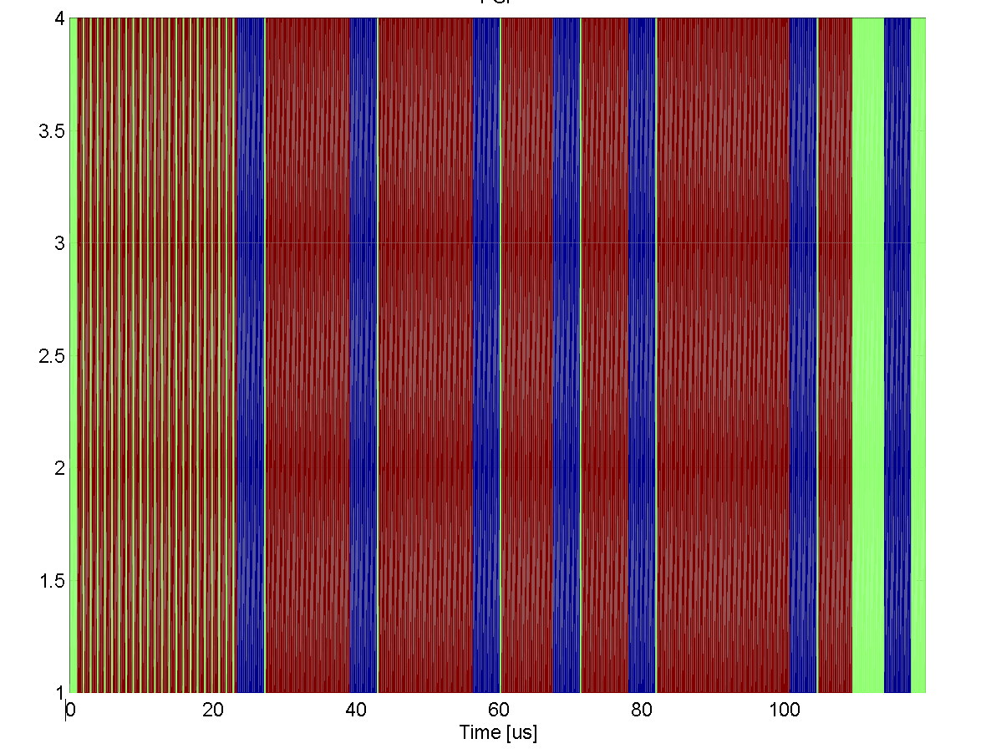
Dataflow simulation
1 TPC drift time
Green – not used
Blue - used by the system
Red – Transfer data

Slide 10
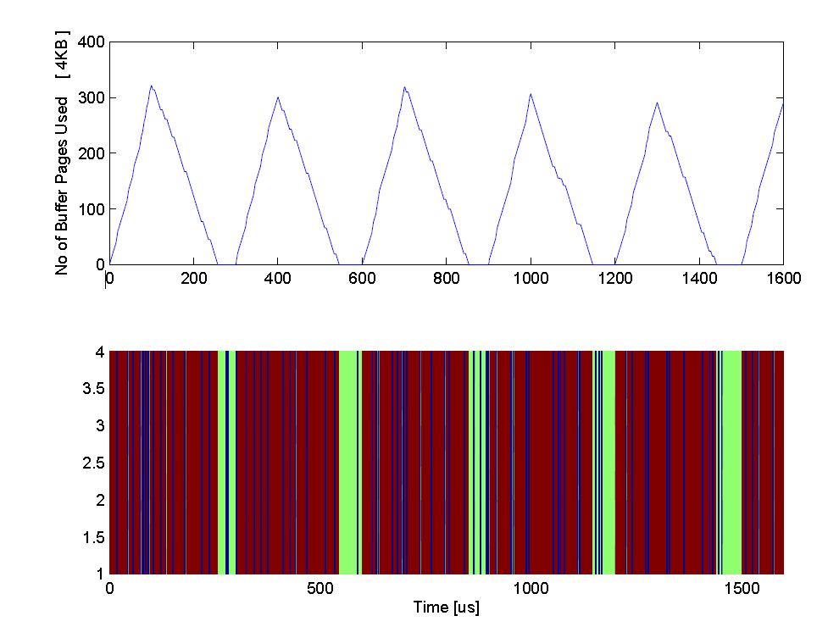
Triggered read-out mode
1 out of 3 triggers can be read-out

Slide 11
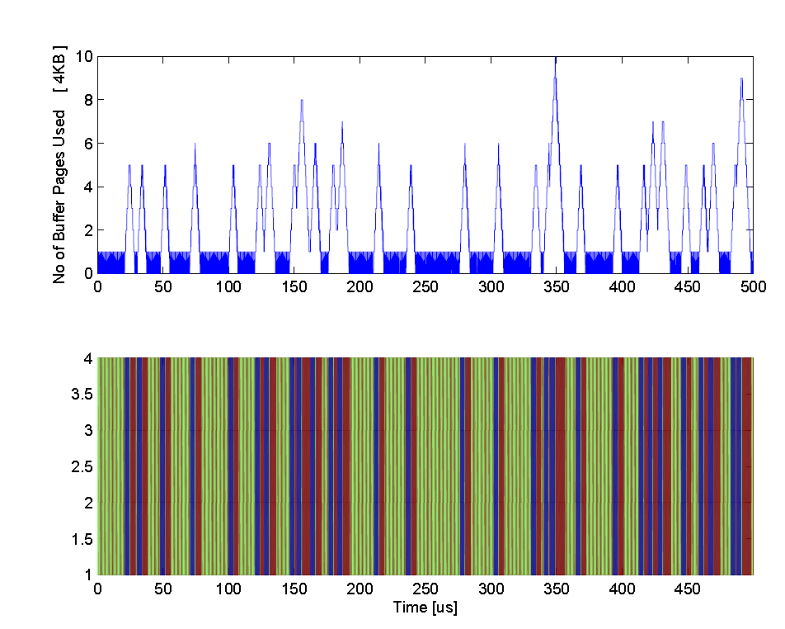
Continuous read-out mode
I. Legrand
PCI

Slide 12
CWG3 : Detector read-out
Development of the O2 detector readout
Schedule of detectors test requires a solution before
the availability of the CRU and O2 sw development
Transition period using the hw developed for Run 2 (C-RORC) and the DAQ software
C-RORC + GBT receiver firmware => G-RORC
Minimize the development on the present system
Prepare the CRU firmware
C-RORC + GBT data source firmware => CRU data source board

Slide 13
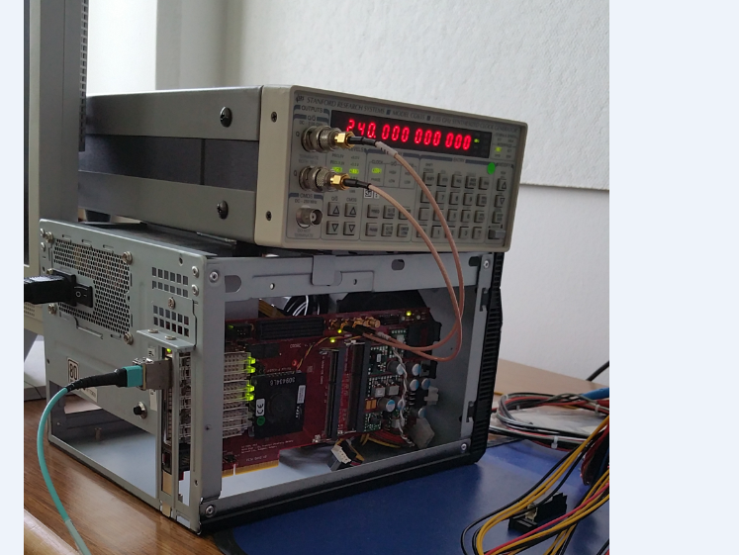
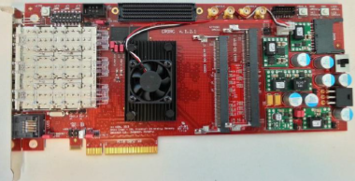
G-RORC: GBT data generator and receiver
Use of the hw developed for Run 2 (C-RORC) during the transition period
C-RORC + GBT link firmware => G-RORC
Detector Data Generator (DDG): 8 GBT links each one with an internal data generator.
Read-out: triggered and continuous modes implemented.
G-RORC
G-RORC
Pattern
Generator
TRG
Data
GBT-Link #1
GBT-Link #1
Pattern
Generator
GBT-Link #2
GBT-Link #2
DMA
Controller
PCIe Gen 2 x4
Pattern
Generator
GBT-Link #3
GBT-Link #3
…
…
CLK Ref
240 MHz
Pattern
Generator
GBT-Link #8
GBT-Link #8

Slide 14
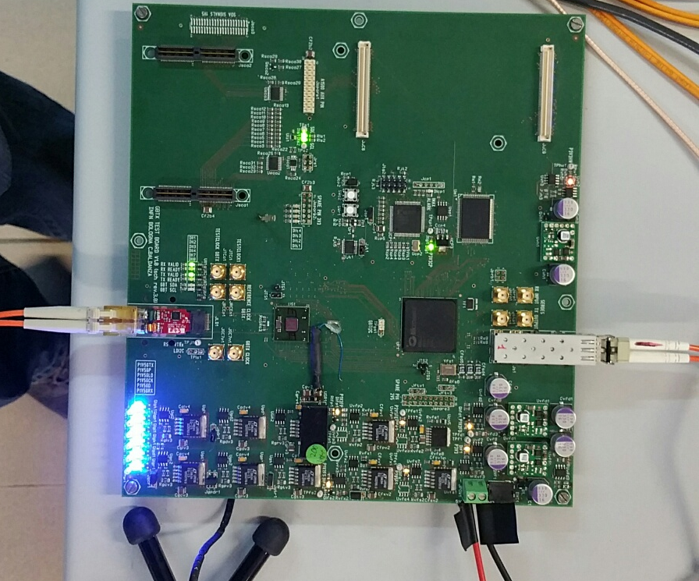
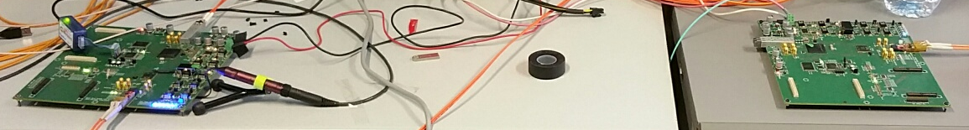
G-RORC for detector read-out
  GBT packet readout
  Tested in the lab using 8 GBT links
  Detector electronics development
    FIT: loop-back test
  Triggered read-out
    ITS: read-out prototype card
    TOF: 2 prototype cards at up to 340 kHz
  Continuous read-out
    TPC: 1 FEC card

Slide 15
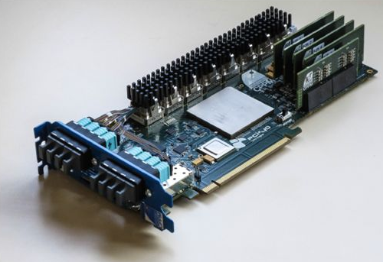
CRU driver status
CRU driver: based on PDA, tested on CENTOS 7.
CRU DAQ API
  Higher-level C++ API
  Serverless architecture: channel ownership handled by a client library
  Uses file locks and shared memory for synchronization and persistent state
  Uses Huge Pages (hugetlbfs)
  for DMA buffer to minimize SG list
  Currently in usable prototype state for
  C-RORC, but still undergoing a lot
  of development and testing
  CRU support being worked on
CRU DCS API: progressing in parallel.

Slide 16

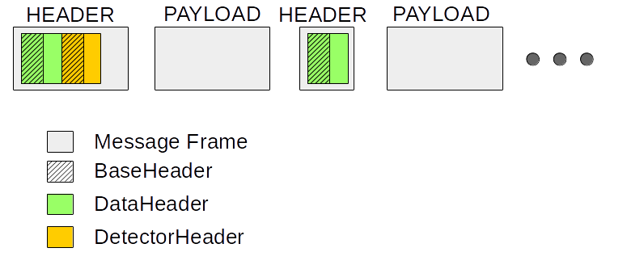
CWG4: Raw data format
Message consists of multiple parts (separate header and payload message parts).
The header message part consists of one or multiple headers
Each header is derived from a BasicHeader with the general information (e.g. unique number, type, flag for next header)
The payload is described by the DataHeader derived from BaseHeader
Optional headers follow, e.g. detector specific header with trigger information, time frame specific header

Slide 17

Analysis data format
ESDs
List of vertexes and tracks
(New)
AODs
Non-persistent?
Should provide an interface as close as possible to existing AODs
Main issues:
Association of “tracks” to “interactions” (=vertexes) is ambiguous for secondaries
Need to be able to navigate [track → vertex] and [vertex → track]
(the same secondary track can be compatible with more than 1 vertex)
Can use tracks timing information to select candidates to run the V0 finder
Build the list assigning a fake time reflecting time resolution and expected pile-up
Build list of vertexes/tracks
  with fake time information and
  vertex ↔ association
Adapt a simple analysis task to run on new format
  Create non-persistent AOD on the fly from list?
Depending on the results of this execise, extend to PWG benchmark tasks
Mimics the time frame obtained as output of the reconstruction in run3

Slide 18


CWG6 & 7: Calibration &
Reconstruction
R. Shahoyan
C. Zampolli
Due to the work on the Run 2 TPC data issues there was limited progress on the specific Run3 program but it is essential for Run 3 to address these issues.
ITS
Simulation: skeleton for digitization is ready but need to be finalized (M.Fasel)
Reconstruction: work on ITS standalone (CA) reconstruction on GPU in progress (M.Puccio)
Compression: classifier for indexing cluster topologies is ready (L.Barioglio), Huffman compression to be implemented.
TPC
Simulation: geometry, mapping of electronics channels to new pads and digitizer implemented, TPC added to simple simulation chain.
SC Distortions correction: not exactly O2 development, but the concept designed for Run3
is successfully deployed for Run2 distortions correction

Slide 19
CWG6 & 7: Calibration &
Reconstruction
Feed-back loop (TPC Vdrift calibration)
After bug fixes cluster Z assignment in
HLT reconstruction differs by 0.5 mm
from offline reconstruction
(was up to ~3 cm w/o online calibration)
Remaining differences are due to the
absence of real-time P,T sensors
information in the HLT
inconsistency in trigger time computation leading to
slight shift in Z
possible differences in HLT and offline tracks
Deployed HLT framework is ready to run other tasks: TPC QA is currently commissioned
Online TPC space-charge distortions calibration (HLT prototype)
Work started on implementation in HLT of current offline SCD calibration with residuals
Requires new TRD reconstruction (absent in HLT) with online tracklets (as in Run3) and matching of ITS standalone tracks with TPC (Ole Schmidt)
D.Rohr
New: Z_HLT_Calib. – Z_Offline, mm
Old: Z_HLT_Default – Z_Offline, cm

Slide 20
CWG9 : Data Quality Control
Development progressing rapidly
Detailed review of the detectors needs
ALICE Experiment
QC Servers
Possibility of using EPNs or dedicated machines
FLP
~1%
RAW, Sub-TF
[Baseline correction
Zero suppression]
Local Aggregation
RAW QC
RAW QC
RAW QC
Extra QC tasks
Extra QC tasks
Time Slicing
Data Reduction 0
Calibration 0
Advanced QC
RAW QC
RAW QC
Sub-TF QC
QC objects
Web Server
& REST API
QC objects
+ quality
Legend
Automatic Checks
QC
Repo
QC Task
QC objects (e.g. histo)
QC Infrastructure
QC objects + quality
O2 Dataflow step
Physics data transport
Specific
Web
App
Specific
Web
App
Specific
Web
Applications

Slide 21
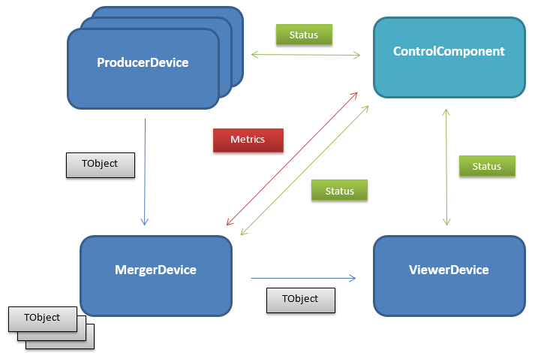
Merger prototyping
General purpose merger to merge efficiently ROOT objects (histograms, trees)
Usage
  Merging of QC objects
  Possibility to merge calibration, reconstruction and analysis objects, …
Integrated in the ALICE O² framework based on FairROOT
Scaling and monitoring via Dynamic Deployment System (DDS)
Systematic benchmarking to characterize the different software elements

Slide 22

CWG10 : Control status
DDS v1.2 released on 06-07-2016
  dds_intercom_lib
  SLURM plugin (+ ssh and localhost)
Ongoing tests with
  DDS + FairMQ
  State Machine + Zookeeper
  Goal is to
    Provide feedback to developers
    Identify possible limitations
  Use QC as test bench
    Multiple processes
    Multiple devices in single process
Ongoing evaluation of Apache Mesos based “solutions”:
  Mesos DDS plugin
  Mesosphere DC/OS
  CISCO Mantl

Slide 23
CWG10 : Configuration status
Configuration library
  Simple put/get interface
  Allow processes to read/write configuration from repository
  Supports multiple backends
    From file
    From etcd
Etcd
  Distributed key-value store
  Performance tests look
  promising
    14M parameters retrieved in
    less than 2s
    More details here

Slide 24
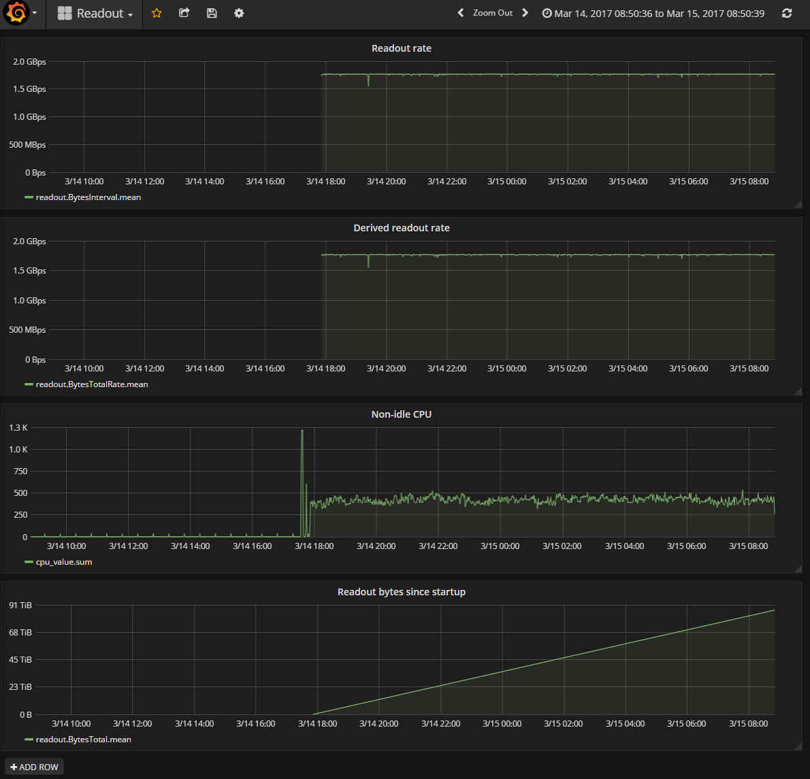
CWG10 : Monitoring status
Monitoring library
  Send application specific values
  to monitoring system
  Perform self-monitoring
  of processes (CPU, mem)
  Generate derived metrics
  (rate, average)
  Support multiple backends
  (cumulatively)
Monitoring backends
  Logging
  MonALISA
  InfluxDB

Slide 25
Services running in O2 development cluster
Monitoring: MonALISA
  sensors installed on all nodes
  service and repository running on mon server
Monitoring: collectd + influxdb + grafana
  collectd running on all nodes (cpu + mem + network)
  influxdb running on mon server
  grafana running on web server, available here
Configuration: etcd
  etcd server running on 10G server (will be moved to conf server)
  etcd-browser running on web server, available here

Slide 26

CWG13 : DDS
Improve RMS plug-in framework.
Based on experience we gained by developing localhost, SSH, MESOS, and SLURM plug-ins, we are going to improve the DDS plug-in framework even more further to reduce the amount of code plug-in developers need to write when developing DDS plug-ins. This should help to get more plug-ins for different RMS from outside developers with much less effort and to improve the plug-in development in overall.
Support key versions in DDS key-value propagation machinery.
In order to implement a dynamic topology update feature (add/remove/replace user tasks on demand in runtime) and to keep key-value propagation being consistent, we need to have versioned keys.
Implement a PBS/OpenPBS plug-in for DDS.
Open to our users a possibility to deploy their tasks on PBS clusters.
Implement an LSF plug-in for DDS.
Open to our users a possibility to deploy their tasks on LSF clusters.
Improve DDS User’s manual and technical specs/API docs.
We are constantly working on documentation for DDS.

Slide 27
CWG13 : aliBuild
Giulio
aliBuild 1.3 has been released :
  General usability improvements
  aliDoctor utility to diagnose your system with human readable error messages
  Improved support for Ubuntu architectures
  Usage of Google Analytics (completely anonymous and optional)
Documentation at http://alisw.github.io/alibuild/

Slide 28

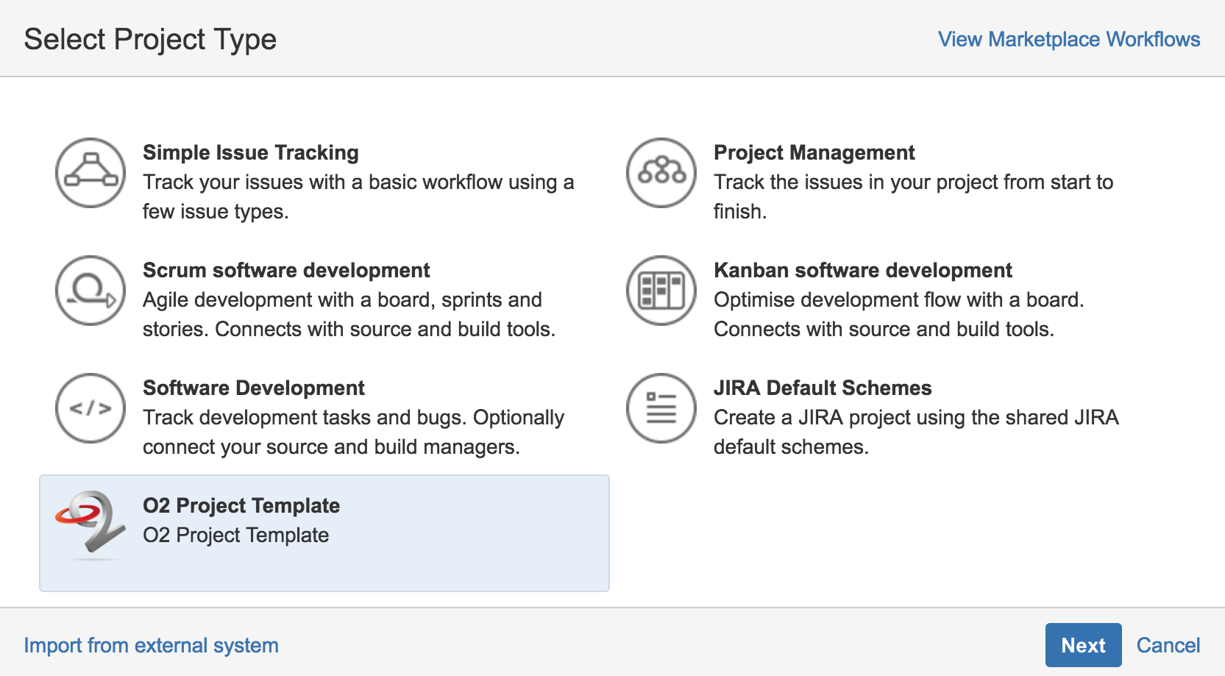
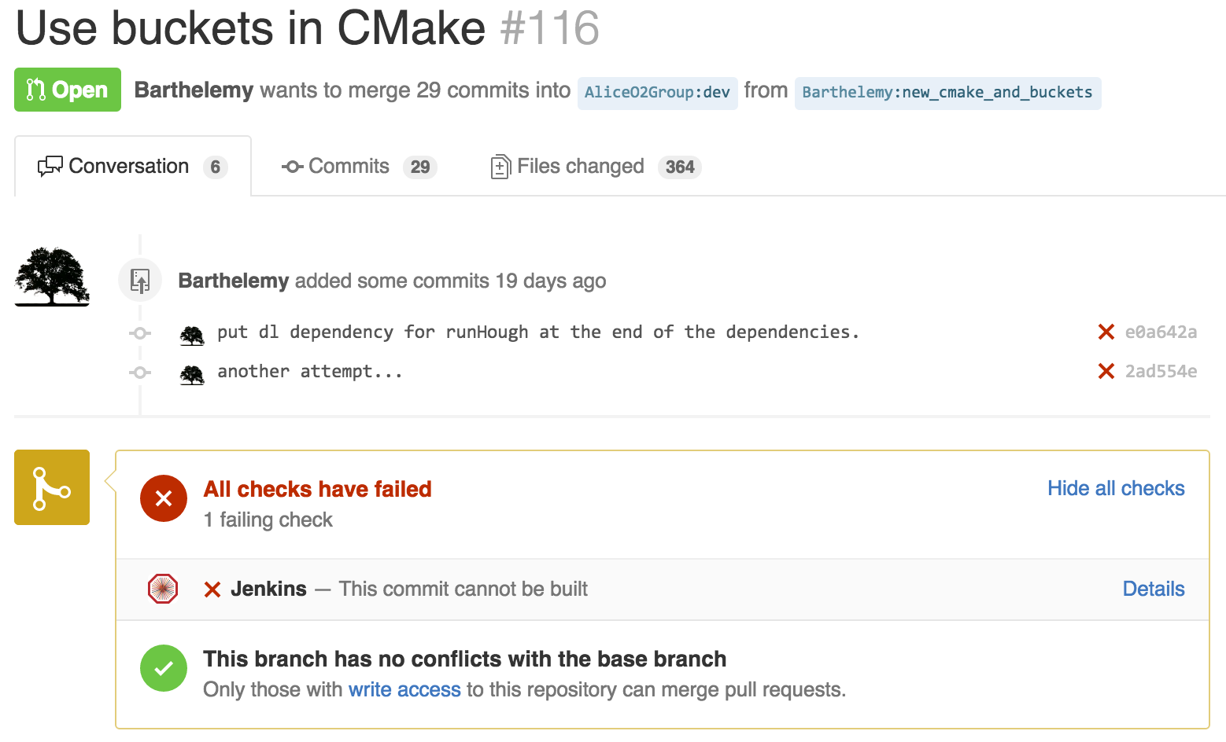
CWG11: Software process (1)
Focus on enabling O2 developers to work, and having their work reviewed, as quickly as possible - with more refinements added as we go.
Infrastructure for testing all GitHub pull requests to O2 with Jenkins
Interface to add new O2 projects to JIRA
Defined a CMake example directory organization with tests too
Giulio

Slide 29
CWG11: Software process (2)
Giulio
Definition of the policies of the Git repositories: (almost) done
Automatic tool where CERN users can map their GitHub account to their CERN account by simply clicking on a link. Need to change the permissions to AliceO2 to allow more admins to merge pull requests.
Project management and progress report in JIRA: done
Currently being used. Progress report visualization via Gantt charts.
Display of test results and trends: pending
We do not have any test to display. We have addressed the problem of the project CMake structure first in order to enable developers to add tests.
Enforcing code quality and formatting rules: in progress
Evaluation of our first tool, SAS (github.com/dpiparo/SAS) completed: it does not look either mature or easy to maintain yet. Currently evaluating CodeChecker (github.com/Ericsson/codechecker), considered by GSI for FairRoot too.

Slide 30
Conclusion
Lots of progress since 18 months…
But some delay on critical items
New WP structure put in place

