Slide 1
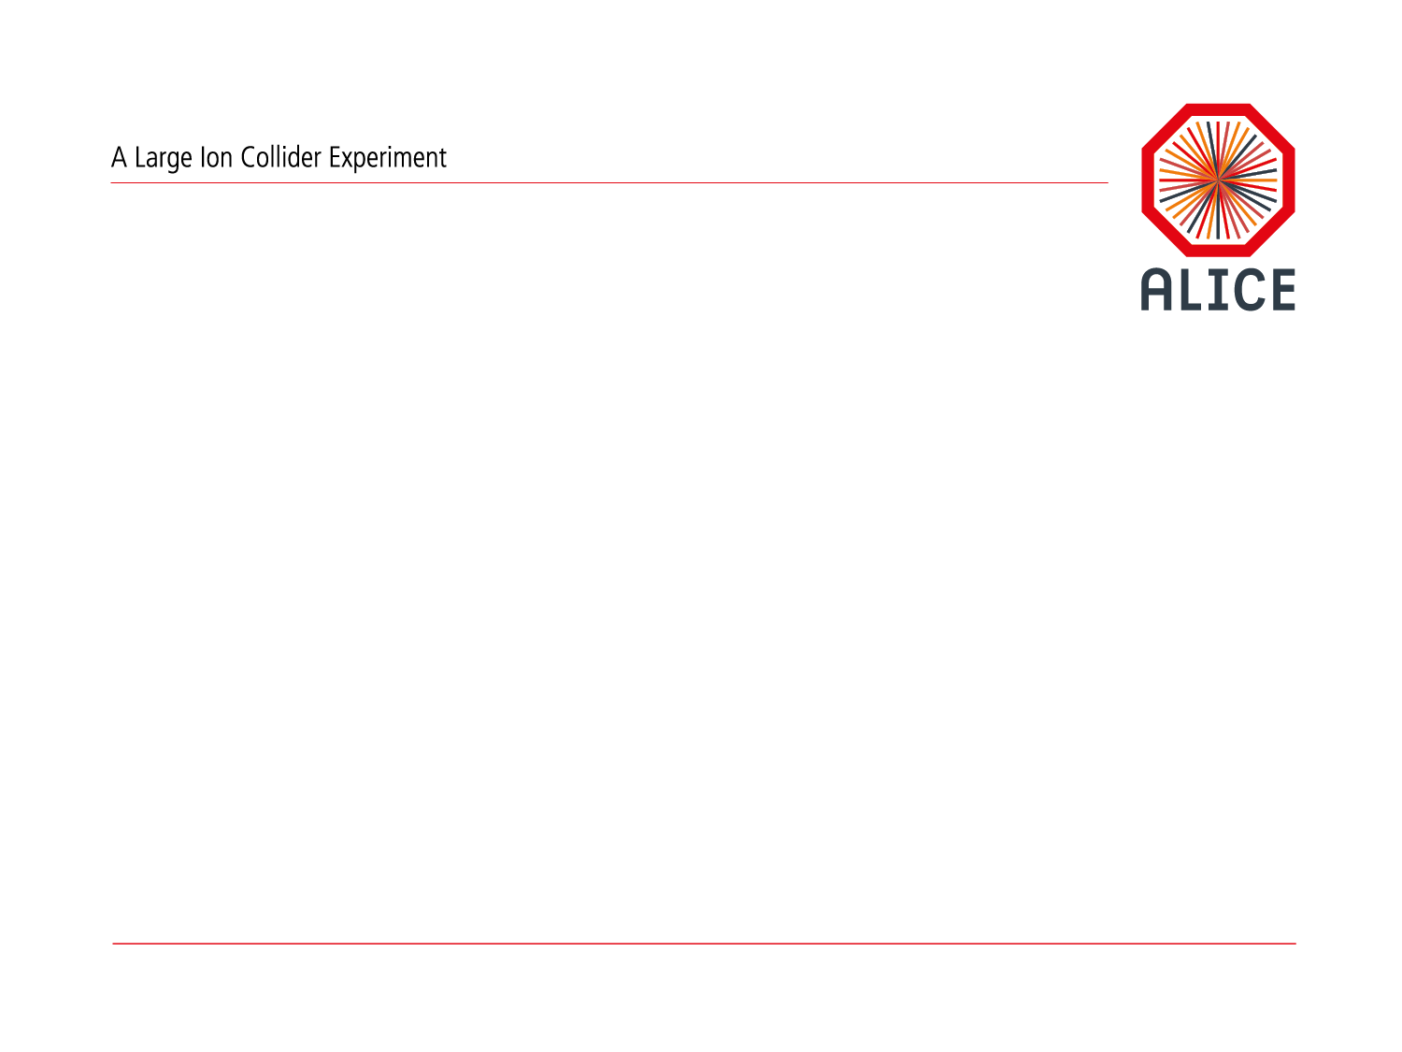
O² Project – Phase 2
Predrag Buncic

Slide 2

Timeline
2020
2019
2018
Commissioning
10 % data challenge
Simulation challenge
2017
Test Time Frame
Reconstruction and simulation for ITS and TPC
2015
O2 TDR accepted by the LHCC.
2016
2014
Work started in CWG structure
First milestones achieved and delayed
CWG structure
Work on TDR started

Slide 3
Time to draw the line…
R&D phase of the project
  The goal was to write TDR and test possible solutions.
  Learn how to work together in CWG structure.
  Shared responsibility (by construction).
  Decisions by consensus in plenary meeting.
Implementation phase of the project
  The goal is to deliver well defined system components (hardware and software) following the strict schedule.
  Work will be organized in Work Packages.
  Institutional responsibility for the WP.
  Decisions and milestones follow-up by the O2 Technical Board.

Slide 4
O2 Project Management
Monthly O2 plenary meetings
  Decisions by consensus
Weekly O2 Steering Board meeting
  Following project progress
Bi-monthly O2 plenary meetings
  Information exchange and technical presentations.
Bi-monthly O2 Technical Board meeting
  TB meeting schedule interleaved with plenaries.
  Attended by the WP leaders and SB members.
  Progress and milestone follow-up, ensuring coherence of WPs, preparation of decisions for confirmation by O2 Steering Board.
O2 Steering Board
  Weekly project follow-up, long term planning meetings twice per year.

Slide 5
Work Packages
http://goo.gl/QZUE1d

Slide 6
WP1 – Data Model
Deliverables
  Description of ALICE data model in terms of human and machine readable format that is maintainable over time.
    Includes all data structures that are exchanged between hardware and software devices or stored to a file.
  Development of AOD data model that is specifically adapted for efficient use with ALFA/FairMQ transport.
  Development of software needed to support 1) and 2).
Participating institutes: FIAS, CERN
WP Leader: Mikolaj Krzewicki

Slide 7
WP2 – Data Flow and System Simulation
Deliverables
  Develop a tool for detailed simulation of network topologies for O2 facility allowing for quick evaluation of various scenarios.
  Develop a tool for coarse simulation of O2 system components allowing for quick estimate of computing resource needs.
  Extend 2) to estimate overall long term computing needs during Run 3 and 4 considering O2 and Grid resources.
Participating institutes: CERN, Split
WP Leader: Iosif Legrand

Slide 8
WP3 – Common tools and infrastructure
Deliverables
  Develop and support common software tools used by all WPs such as:
    software build and distribution tool;
    continuous integration and release testing tools.
  Implement and document software lifecycle procedures and protocols.
  Provide general user support and in particular 1) and 2).
Participating institutes: CERN
WP Leader: Dario Berzano

Slide 9
WP3 – Common tools and infrastructure
Deliverables
  Develop software components that are unique to ALICE and do not belong to a common ALFA layer.
  Integration with CCDB (Parameter Manager).
  Software provided by the other WPs and the detector groups integrated into common software framework.
  Common framework for unit and functional tests.
  Monitor framework performance and proactively work on software optimization.
Participating institutes: CERN, GSI
WP Leader: Giulio Eulisse

Slide 10
WP4 – O2 Software Framework
Deliverables
  Develop software components that are unique to ALICE and do not belong to a common ALFA layer.
  Integration with CCDB (Parameter Manager).
  Software provided by the other WPs and the detector groups integrated into common software framework.
  Common framework for unit and functional tests.
  Monitor framework performance and proactively work on software optimization.
Participating institutes: CERN, GSI
WP Leader: Giulio Eulisse

Slide 11
WP5 – Data distribution and load balancing
Deliverables
  Sub-time frame building on FLP nodes.
  Time frame building on EPN nodes.
  Load balancing of FLP->EPN traffic.
  Interface to Common Trigger Processor (CTP).
Participating institutes: FIAS, CERN
WP Leader: Gvozden Neskovic

Slide 12
WP6 – Detector readout
Deliverables
  GBT read-out with the G-RORC (firmware and software) as a temporary solution before the RCU is available.
  DDL2 read-out with the C-RORC (firmware and software) for the detector who will use the DDL2 after LS2.
  GBT read-out with the CRU (firmware and software).
  DCS interface with the CRU (firmware and software).
Participating institutes: CERN, Budapest
WP Leader: Filippo Costa

Slide 13
WP7 – Quality Control
Deliverables
  QC framework including basic QC client, API, repository, checkers and benchmark.
  Data Sampling and merging infrastructure allowing correlation and trending supporting alarms and notifications.
  Assist software development by detectors teams including infrastructure and procedures to validate detectors software
Participating institutes: CERN, CERN, Warsaw, Krakow, Jammu, INFN, COMSATS
WP Leader: Barthelemy Von Haller

Slide 14
WP8 – Control, Configuration and Monitoring
Deliverables
  Control
    Resource allocation and scheduling.
    A set of control agents that represent and control system components such as (FLP and EPN nodes, detectors and partitions).
    Bookkeeping and GUI.
  Monitoring.
    Deploy end-to-end monitoring system that collects and presents monitoring information.
  Configuration
    Deploy end-to-end configuration system that stores and distributes process parameters
Participating institutes: CERN, Bari, IFI Frankfurt, KMUTT Bangkok, NPI Prague
WP Leader: Vasco Chibante

Slide 15
WP9 – Event Display
Deliverables
  Adapt and improve the current ALICE event display for use within ALICE O2 software framework while maintaining the end extending the existing functionality
Participating institutes: WUT

Slide 16
WP10 – CCDB
Deliverables
  Adapt the current OCDB to use cases and constraints of O2 building on a proven architecture:
    database for metadata queries;
    blob/object store for data;
    time and run based access keys (for backward compatibility).
  API for CCDB access from the O2 framework
    Extend/Adapt FairRoot Parameter Manager for this purpose.
  Import existing OCDB data into new format and provide a service for database access and performance evaluation.
Participating institutes: CERN, GSI
WP Leader: Costin Grigoras

Slide 17
WP10 – CCDB
Deliverables
  Common data transport layer based on FairMQ with 0MQ, nanomsg interfaces and low level bindings to the network fabric using libfabric abstraction.
  Performance evaluation of FairMQ using various network technologies and topologies.
  Distributed Deployment System (DDS) for deployment of process graphs (topologies).
  Common parameter manager as CCDB interface.
  Performance evaluations of different message passing serialization protocols.
Participating institutes: GSI, CERN
WP Leader: Mohammad Al-Turany

Slide 18
WP12 – Simulation
Deliverables
  Up-to-date description of geometry in O2 framework and materials for all detectors.
  Detector response (digitization) software for all detectors.
  Simulation output compatible with timeframe format.
  Support for simulation QA, navigation and comparison between reconstruction and simulation.
  Simulation performance monitoring and improvement.
  Integration with new transports and geometry models
    Geant V, VecGeom.
  Support for fast and parameterized and fast simulation.
  Unified interfaces to modern MC generators.
Participating institutes: CERN (+detector projects)
WP Leader: Sandro Wenzel

Slide 19
WP13 – Reconstruction and Calibration
Deliverables
  Develop reconstruction and calibration components of the O2 software framework.
  Coordinate development and integration of detector specific reconstruction and calibration algorithms.
  Assure that overall data compression factor following the synchronous reconstruction meets TDR requirements.
  Monitor computing and physics performance of the reconstruction and calibration code and keeping it compatible with the available computing capacity.
Participating institutes: CERN (+detector projects)
WP Leader: Ruben Shahoyan
l

Slide 20
WP14 – Analysis framework and facilities
Deliverables
  Refactoring of the current analysis framework and OADB to comply with O2 architecture covering use cases of
    filtering, skimming, augmentation, user specific formats, bookkeeping.
  Converters from the old to new AOD format.
  Analysis Facility infrastructure (software and hardware) capable of processing multi-PB datasets within 12h and providing:
    high performance cluster file system (1PB+);
    low latency and high throughput network;
    software distribution compatible with O2 needs;
    micro-services compatible scheduler.
  Support for organized analysis running on the AF infrastructure.
Participating institutes: CERN, GSI
WP Leader: Peter Hristovl

Slide 21
WP15 – Data Management
Deliverables
  Identify or develop a solution for data management that spans the O2 facility and Grid scale:
    60 PB in O2;
    500 PB across the participating Grid tiers.
  Identify or provide a uniform data access method that adheres to AAA procedures compatible with Grid requirements
  Provide a horizontally scalable storage service without a single point of failure that meets the requirements of O2 facility in terms of data volume throughput and I/O ops/s.
  Provide a solution to access or migrate legacy data and metadata to a new system.
Participating institutes: CERN
WP Leader: Latchezar Betev

Slide 22
WP16 – Computing Room CR1 (FLP)
Deliverables
  Installation of the infrastructure (power, fibres).
  Installation and configuration of the FLPs and the CRUs.
  Installation and configuration of the computing services.
  Installation and configuration of the control and data networks.
  Installation and configuration of the system and application software.
  Operation and support of the CR1 farm.
Participating institutes: CERN, FIAS
WP Leader: Ulrich Fuchs

Slide 23
WP17 – Computing Room CR0 (EPN)
Deliverables
  Installation/validation of the infrastructure.
  Installation and configuration of the EPN nodes.
  Installation and configuration of the computing services.
  Installation and configuration of the control and data networks.
  Installation and configuration of the system and application software.
  Operation and support of the CR0 farm.
Participating institutes: FIAS, CERN
WP Leader: Johannes Lehrbach

Slide 24
WP Summary table
WP | Title | Leading Institute | WP Leader
1 | Data Model | FIAS | Mikolaj Krzewicki
2 | Data Flow and System Simulation | CERN | Iosif Legrand
3 | Common tools and infrastructure | CERN | Dario Berzano
4 | O2 Software Framework | CERN | Giulio Eulisse
5 | Data distribution and load balancing | FIAS | Gvozden Neskovic
6 | Detector readout | CERN | Filippo Costa
7 | Quality Control | CERN | Barthelemy Von Haller
8 | Control, Configuration and Monitoring | CERN | Vasco Chibante
9 | Event Display | WUT | t.b.c.
10 | CCDB | CERN | Costing Grigoras
11 | ALFA | GSI | Mohammad Al-Turany
12 | Simulation | CERN | Sandro Wenzel
13 | Reconstruction and Calibration | CERN | Ruben Shahoyan
14 | Analysis framework and facilities | CERN | Peter Hristov
15 | Data Management | CERN | Latchezar Betev
16 | Computing Room CR1 (FLP) | CERN | Ulrich Fuchs
17 | Computing Room CR0 (EPN) | FIAS | Johannes Lehrbach

Slide 25














Still working together!
By re-aligning the responsibilities for the WPs with projects where predominant competence exist we do not want to abandon the O² spirit.
On the contrary, we must continue working together closer that before for this project to have any chance to succeed!

