Slide 1
CT-PPS considerations R. Bruce, R. dDe Maria, M. Giovannozzi Acknowledgements: G. Arduini, S. Fartoukh, E. Métral, Y. Papaphilippou

Slide 2
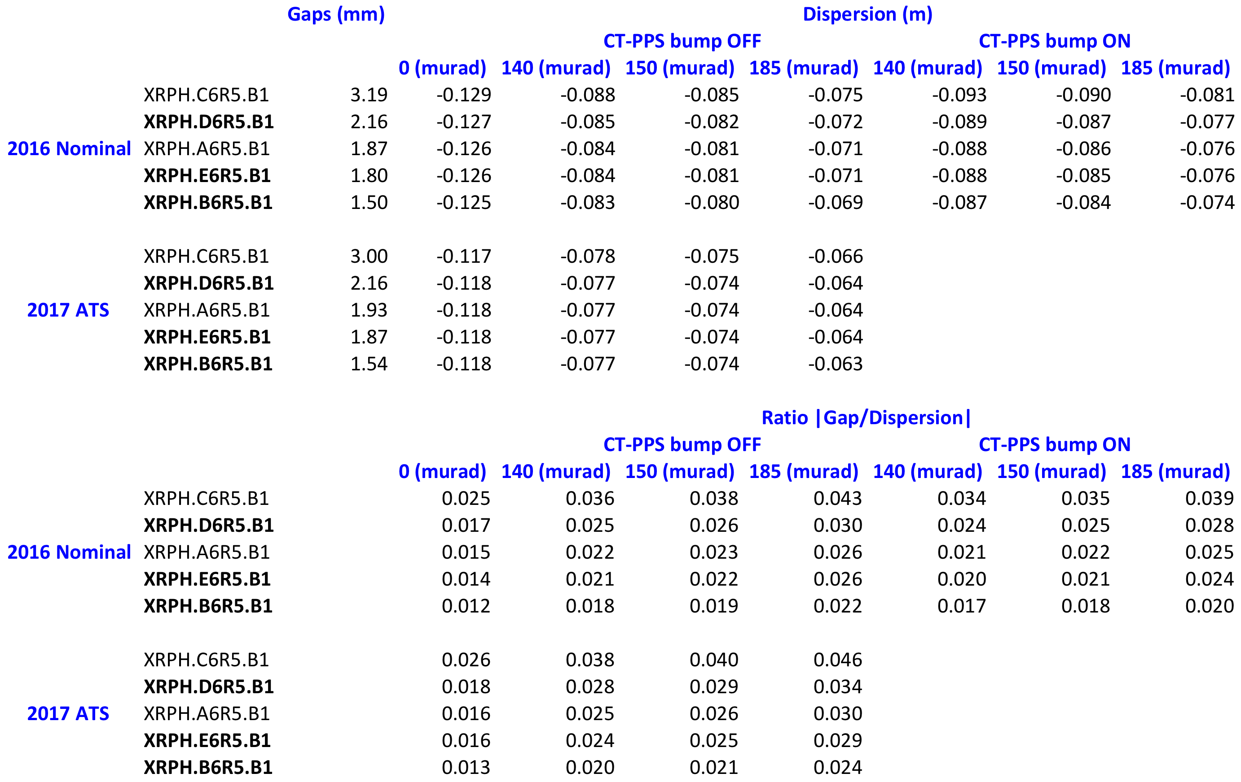
CT-PPS Beam 1 XRPs gaps and dispersion

Slide 3
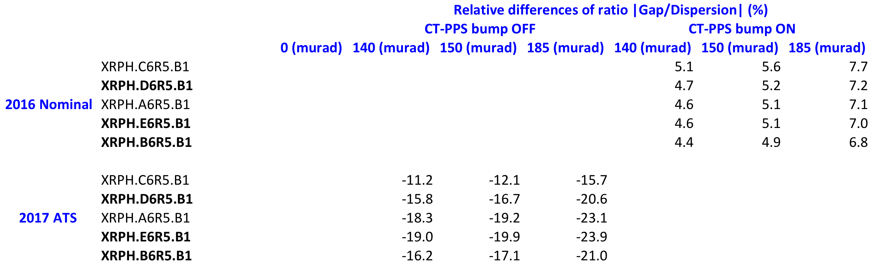
CT-PPS Beam 1 XRPs gaps/dispersion differences

Slide 4
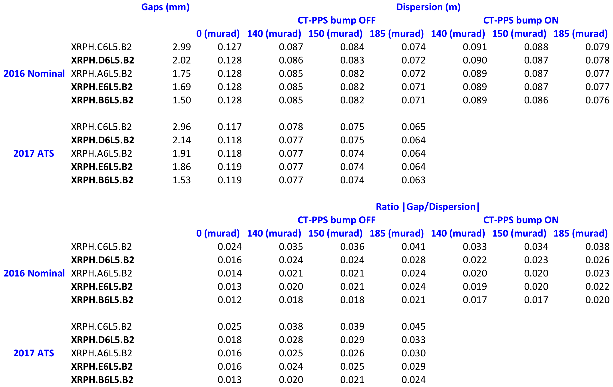
CT-PPS Beam 2 XRPs gaps and dispersion

Slide 5

CT-PPS Beam 2 XRPs gaps/dispersion differences

