Slide 1

ALICE Offline Week
29/03/2017
Offline Week - Introduction
Predrag Buncic
CERN

Slide 2
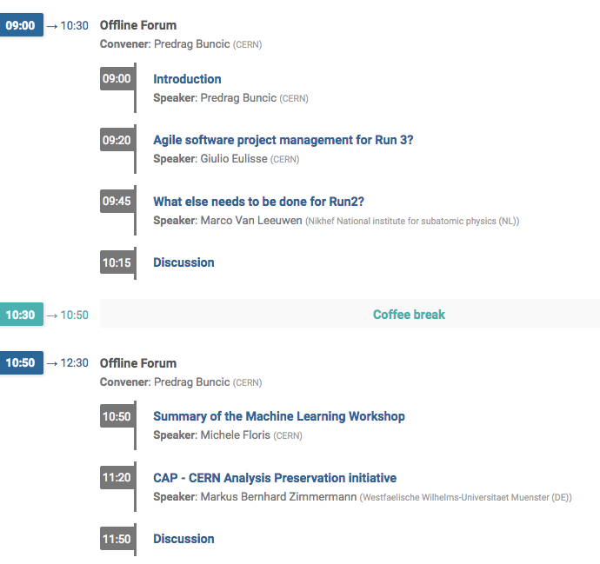
Offline Forum

Slide 3
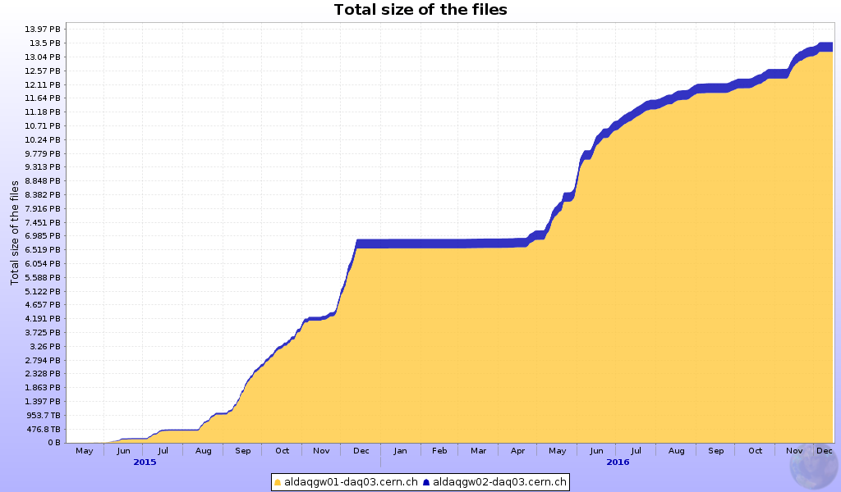
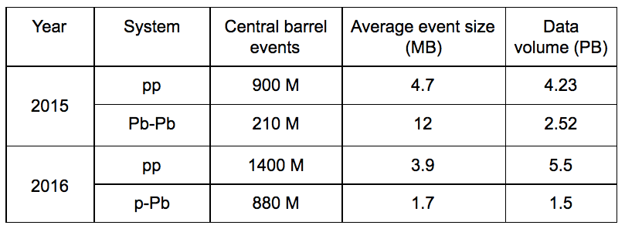
p-p
No HLT
compression
p-A
End of year
stop
Pb-Pb
p-p
HLT + ROOT
compression,
Low IR
p-p
HLT compression,
High IR

Slide 4
Data processing status
The TPC track distortion correction algorithms have been finalized and fully validated with both pp and 2015 Pb-Pb data at various interaction rates.
  Thanks to Ruben and Barrel Tracking Group!
This has allowed us to start RAW data processing of the
  2015 Pb-Pb
  2016 p-Pb period
  longest pp data taking periods, both from 2015 and from 2016
  complete 2015 and 2016 data for di-muon spectrometer
The associated Monte-Carlo simulation, anchored to the conditions data and distortion corrections from the RAW data calibration cycles was completed in the beginning of 2017
  in time for Quark Matter
Full processing of remaining 2015 and 2016 data is ongoing

Slide 5

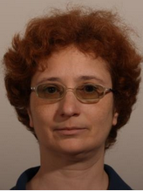
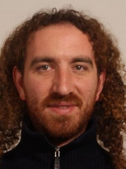
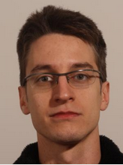
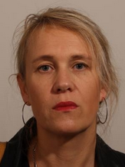
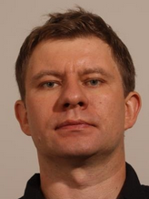
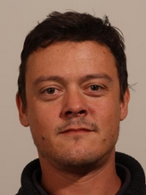
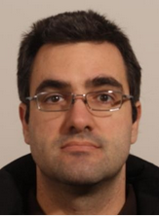
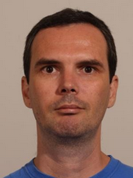
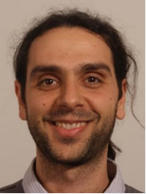
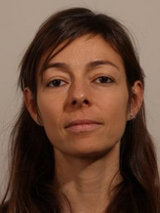
The DPG in alphabetical order:
More this afternoon….

Slide 6
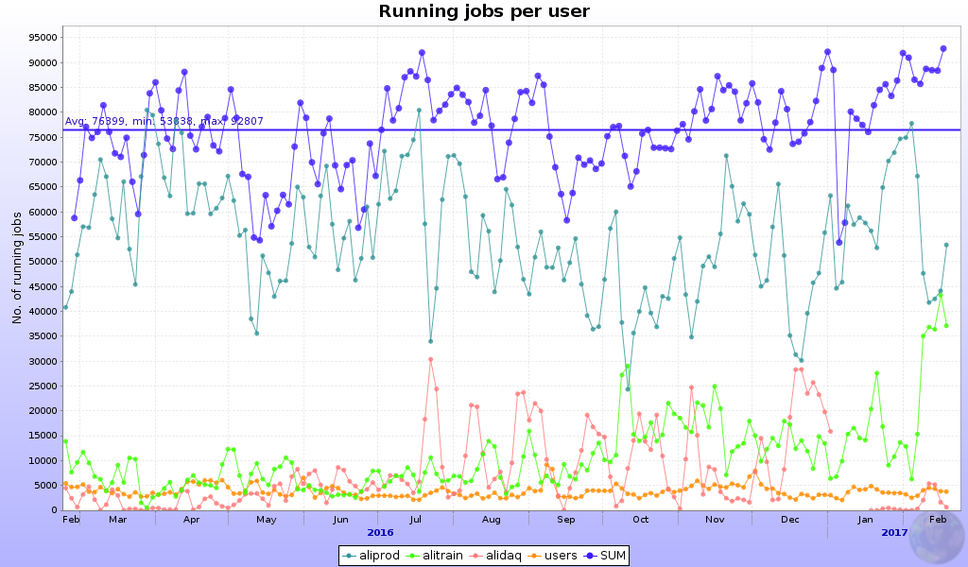
Grid usage
High grid usage, good utilization of opportunistic resources
  Average 76K parallel jobs, record 112K jobs
  ALICE HLT cluster provides 4K jobs (5% of total)
More tomorrow morning…

Slide 7
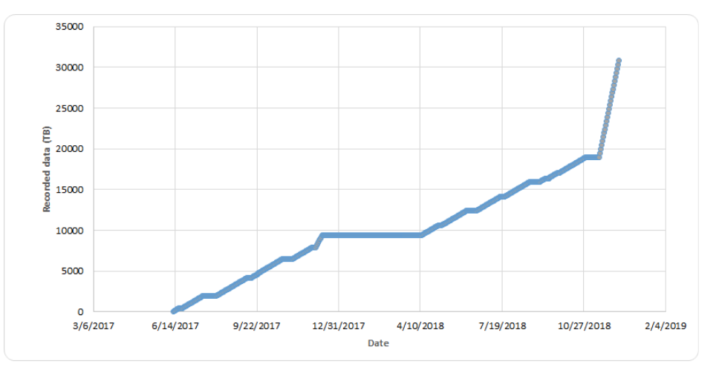
Expectations for 2017 and 2018
During pp data taking mode will be set to limit the TPC readout rate to 400 Hz
  The goal is to reach the statistics objective set for Run 2 in all trigger categories as well as at the reference energy of 5.02 TeV
  The total amount of data recorded will be 17.5 PB
During the Pb-Pb run in 2018, assuming the HLT compression of a factor of 6 we anticipate a total readout rate of 10 GB/s
  The total amount of data recorded will be 12 PB

Slide 8
Beyond Run 2…
Preparations for Run 3
  For well known reasons the offline experts were busy fixing problem with Run 2 reconstruction/calibration
  This has delayed work on Run 3 by one year
We are need to re-focus development effort on Run 3
  Run 2 software will have to go into maintenance mode
  We should really try not to vary data taking conditions too much as this can trigger new problems and require more expert time
More this morning…

Slide 9
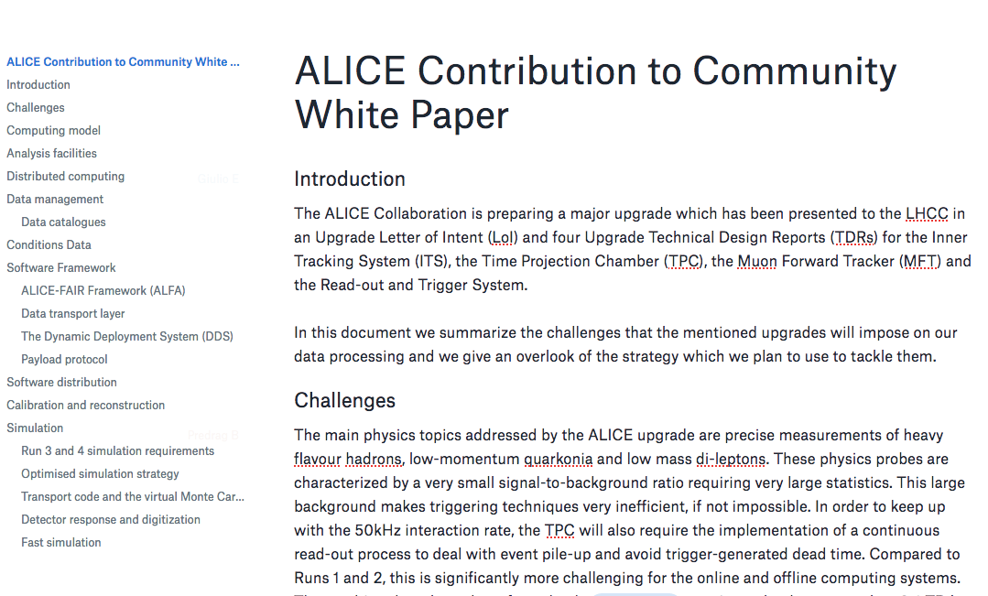
ALICE and HSF CWP
The US NSF ‘S2I2’ project proposal & Conceptual roadmap for HL-HLC era computing
Well, this happened yesterday but the work will continue…

Slide 10

Timeline
2020
2019
2018
Commissioning
10 % data challenge
Simulation challenge
2017
Test Time Frame
Reconstruction and simulation for ITS and TPC
2015
O2 TDR accepted by the LHCC.
2016
2014
Work started in CWG structure
First milestones achieved and delayed
CWG structure
Work on TDR started

Slide 11
Work Packages
O2: From CWGs to WPs…
http://goo.gl/QZUE1d
More on Friday and in years to come…

Slide 12
WP Summary table
WP | Title | Leading Institute | WP Leader
1 | Data Model | FIAS | Mikolaj Krzewicki
2 | Data Flow and System Simulation | CERN | Iosif Legrand
3 | Common tools and infrastructure | CERN | Dario Berzano
4 | O2 Software Framework | CERN | Giulio Eulisse
5 | Data distribution and load balancing | FIAS | Gvozden Neskovic
6 | Detector readout | CERN | Filippo Costa
7 | Quality Control | CERN | Barthelemy Von Haller
8 | Control, Configuration and Monitoring | CERN | Vasco Chibante
9 | Event Display | WUT | t.b.c.
10 | CCDB | CERN | Costing Grigoras
11 | ALFA | GSI | Mohammad Al-Turany
12 | Simulation | CERN | Sandro Wenzel
13 | Reconstruction and Calibration | CERN | Ruben Shahoyan
14 | Analysis framework and facilities | CERN | Peter Hristov
15 | Data Management | CERN | Latchezar Betev
16 | Computing Room CR1 (FLP) | CERN | Ulrich Fuchs
17 | Computing Room CR0 (EPN) | FIAS | Johannes Lehrbach
More in the next talk…

Slide 13
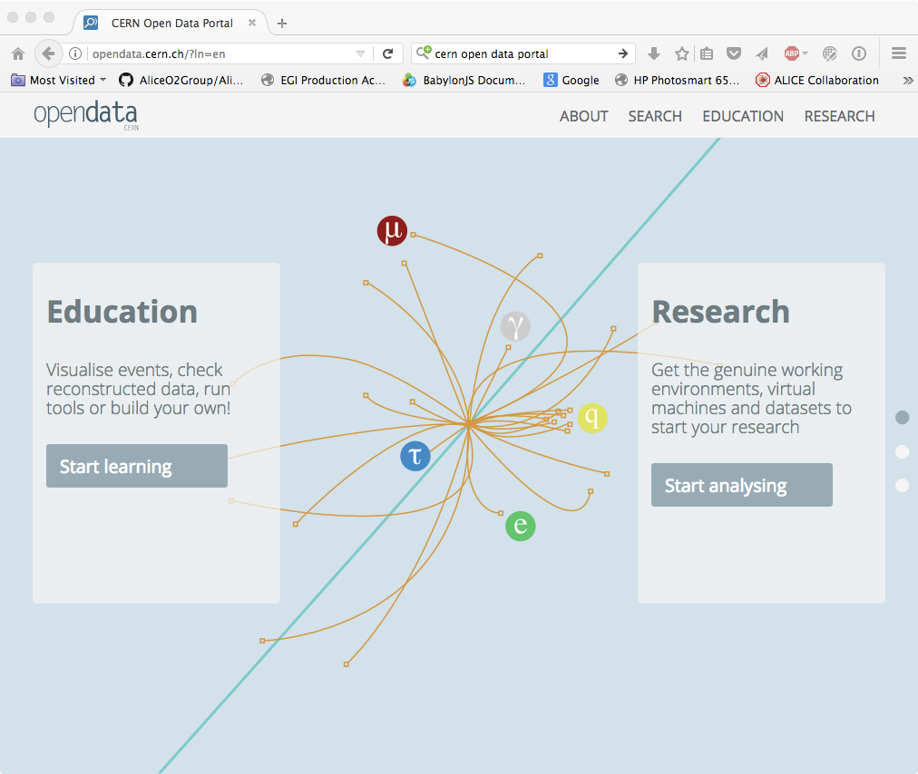
More in the last talk of this morning …

