Slide 1
Data Processing Group activities: status and plans
ALICE Offline week, March 29th 2017

Slide 2
Outline
Data Processing: status and plans
  Reconstructions from 2016
  Status and Plans for 2017
Monte Carlo productions: status and plans
  Summary of QM campaign
  Status and Plans for 2017
Towards 2017 data taking
Analysis QA
AliDPG status and plans
What is down the pike
Conclusions

Slide 3
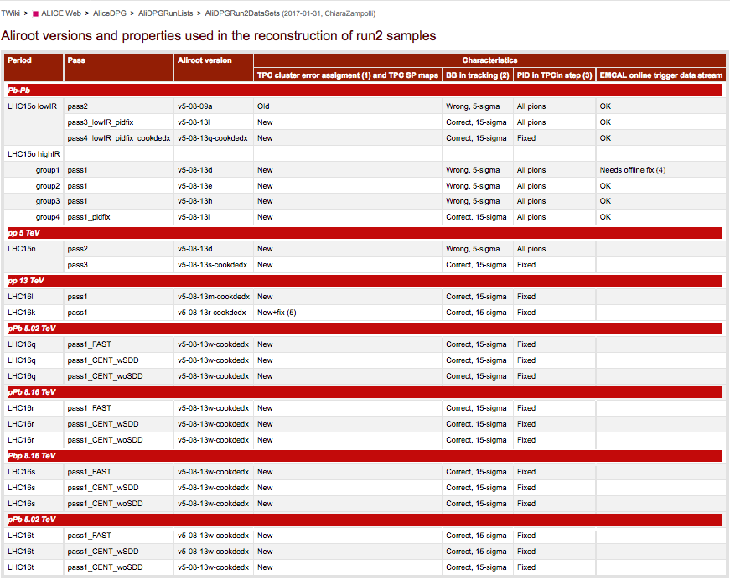
Data reconstruction campaign in 2016
2015 PbPb, 5 TeV (LHC15o)
2015 pp, 5 TeV (LHC15n)
2016 pp, 13 TeV (LHC16k, l)
2016 pPb, 5 TeV (LHC16q)
2016 pPb, 8 TeV (LHC16r)
2016 Pbp, 8 TeV (LHC16s)
2016 pPb, 5 TeV (LHC16t)
From: https://twiki.cern.ch/twiki/bin/view/ALICE/AliDPGRun2DataSets

Slide 4
Data reconstruction campaign in 2017
Period | B field | IR (kHz) | N runs(*) | INT7 triggers (M) | CPass time (d) | PPass time (d)
LHC16f | Low B- (**) | 5-70 | 25 | 61 | 1.6 | 1.9
LHC15l | B+ | 400 | 124 | 31 | 13.3 | 7.2
LHC16i | B+ | 200-600 | 21 | 38 | 2.4 | 2.0
LHC16o | B+ | 120 (**) | 122 | 64 | 4.0 | 6.6
LHC16p | B+ | 120 | 42 | 24 | 2.4 | 3.4
LHC16g | B- | 75-120 | 20 | 32 | 1.1 | 1.3
LHC16m | B+ | 120 (**) | 45 | 37 | 2.6 | 4.3
LHC16h | B+ (**) | 120-200 (**) | 91 | 113 | 5.3 | 5.2
LHC16j | B+ | 240 | 58 | 80 | 4.7 | 3.8
(*) with SPD, SDD, SSD, TPC, TRD
(**) few runs with different settings

Slide 5
Data reconstruction campaign in 2017
Period | B field | IR (kHz) | N runs(*) | INT7 triggers (M) | CPass time (d) | PPass time (d)
LHC16f | Low B- (**) | 5-70 | 25 | 61 | 1.6 | 1.9
LHC15l | B+ | 400 | 124 | 31 | 13.3 | 7.2
LHC16i | B+ | 200-600 | 21 | 38 | 2.4 | 2.0
LHC16o | B+ | 120 (**) | 122 | 64 | 4.0 | 6.6
LHC16p | B+ | 120 | 42 | 24 | 2.4 | 3.4
LHC16g | B- | 75-120 | 20 | 32 | 1.1 | 1.3
LHC16m | B+ | 120 (**) | 45 | 37 | 2.6 | 4.3
LHC16h | B+ (**) | 120-200 (**) | 91 | 113 | 5.3 | 5.2
LHC16j | B+ | 240 | 58 | 80 | 4.7 | 3.8
LHC16f: PPass completed, Good run lists completed
LHC15l: PPass ongoing
LHC16i: PPass completed
LHC16o: CPass completed
LHC16p: CPass completed
LHC16g: CPass starting
(*) with SPD, SDD, SSD, TPC, TRD
(**) few runs with different settings

Slide 6
Data reconstruction campaign in 2017
Period | B field | IR (kHz) | N runs(*) | INT7 triggers (M) | CPass time (d) | PPass time (d)
LHC16d | B- | 1.5-5.5 | 26 | 21 + 42 | 1.2 | 1.1
LHC16e | B- | Up to 600 | 34 | 70 + 81 | 2.4 | 2.0
LHC15i | B+ | 30-300 | 112 | 162 | 7.9 | 7.1
LHC15g | B+ (**) | 1-380 | 13 | 35+4 | 2.1 | 1.2
LHC15h | B+ (**) | 20-500 | 50 | 136+23 | 6.8 | 3.1
LHC15j | B+ | 300-400 | 21 | 330 | 10.5 | 6.3
LHC15k | B- | 1-350 | 124 | 60 | 0.7 | 1.3
Few issues during processing: CASTOR, grid
Detector response very fast and timely! Thanks!!
(*) with SPD, SDD, SSD, TPC, TRD
(**) few runs with different settings

Slide 7
Data reconstruction campaign in 2017
Period | B field | IR (kHz) | N runs(*) | INT7 triggers (M) | CPass time (d) | PPass time (d)
LHC16d | B- | 1.5-5.5 | 26 | 21 + 42 | 1.2 | 1.1
LHC16e | B- | Up to 600 | 34 | 70 + 81 | 2.4 | 2.0
LHC15i | B+ | 30-300 | 112 | 162 | 7.9 | 7.1
LHC15g | B+ (**) | 1-380 | 13 | 35+4 | 2.1 | 1.2
LHC15h | B+ (**) | 20-500 | 50 | 136+23 | 6.8 | 3.1
LHC15j | B+ | 300-400 | 21 | 330 | 10.5 | 6.3
LHC15k | B- | 1-350 | 124 | 60 | 0.7 | 1.3
Few issues during processing: CASTOR, grid
Detector response very fast and timely! Thanks!!
By the end of May it could be possible to start 2015 data – caveat: from May on, data taking!
(*) with SPD, SDD, SSD, TPC, TRD
(**) few runs with different settings

Slide 8
Monte Carlo campaign for QM
Almost 50 productions requested for QM
  HUGE ACTIVITY
All done but 1 production, postponed (AMPT for PWG-CF, code was not ready)

Slide 9
Running productions
Running:
  Geant4
    With old AliRoot → to compare to data
    With new AliRoot → to test Geant4/AliRoot compatibility
  GA production anchored to 15o with PYTHIA embedded jet-jet events
In standby:
  HF productions anchored to 16k, 16l (ALIROOT-7125)
    In standby waiting for confirmation by requestors on the tag to use
  DQ production anchored to 15n (ALIROOT-7153)
    In setup phase, configuration being discussed with requestors
  DQ production anchored to 16f (low-B) (ALIROOT-7130, ALIROOT-7156)
    Waiting for DPG tag for CustomGenerator + general purpose MC for LHC16f (T0 OCDB update)
Done:
  GA production, extension of previous, anchored to 12c-I
  MC anchored to pPb for ZDC studies

Slide 10
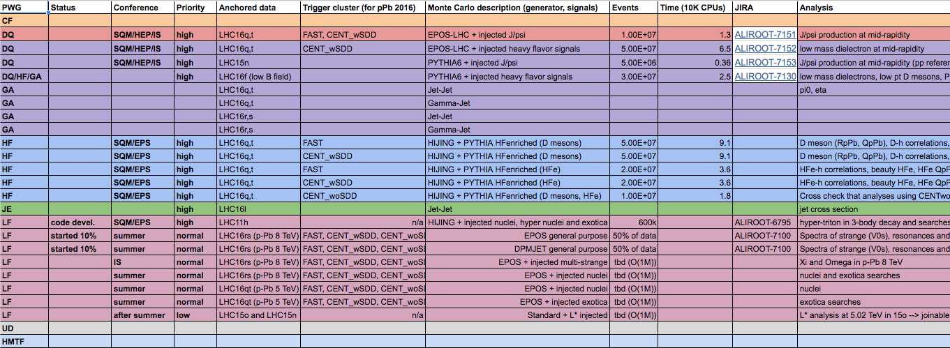
Next Monte Carlo productions
General purpose p-Pb simulations
  Two cycles with two different event generators (EPOS-LHC, DPMJET)
  Three productions per cycle, matching the 3 data reconstructions (CENT_wSDD, CENT_woSDD, FAST)
    3 (periods) x 3 (reco) x 2 (generators) = 18 productions
    PWG-dedicated productions won’t be split per period
  Waiting for new AliRoot tag (with new AOD variables) to restart it
PWG input for next MC collected here

Slide 11
Next Monte Carlo productions
PWG-specific production always need a General-Purpose MC for QA and validation of MC settings
Proposal to be discussed with PB:
  Define default settings for Gen Purp MC (generator, sampling – minimum number of events to allow QA)
    NB. Productions can always be extended at a later stage with more statistics if needed

Slide 12
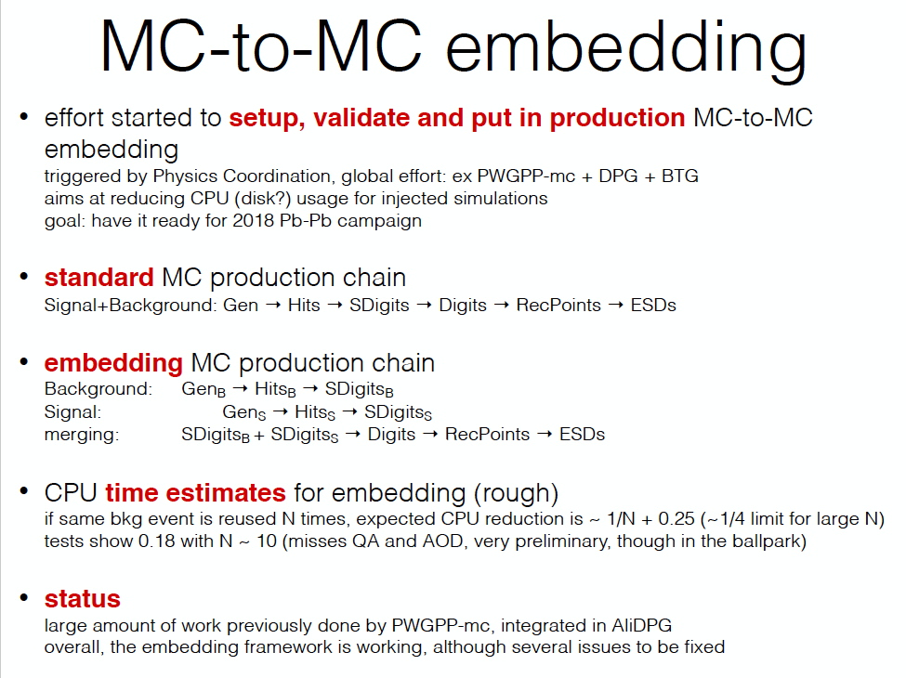
See Ruben’s talk tomorrow

Slide 13
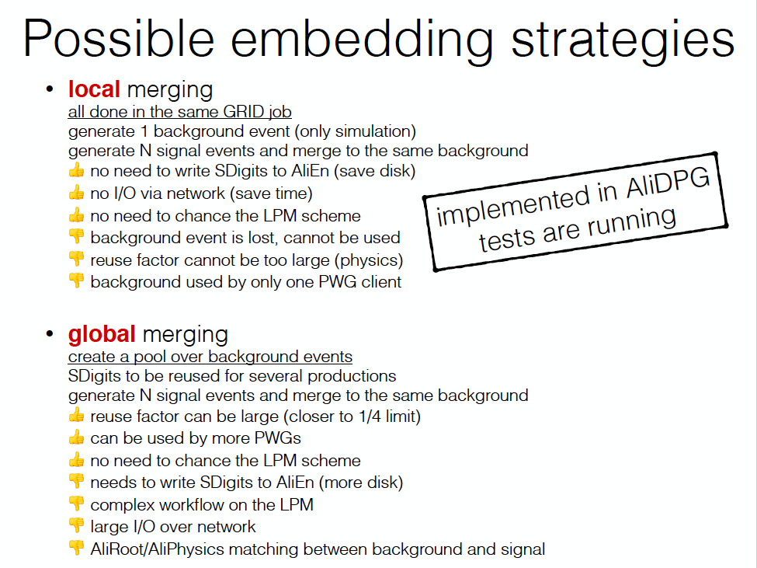
Needs more discussion on how to setup the LPM chain
Can be combined with “local” merging

Slide 14
Towards 2017 data taking: calibration needs
TPC calibration
  For every field polarity we need low and high intensity runs before going to standard CPass
    Each run with at least 2 M tracks (~30 mins for pp); low (~10 kHz) and high IR (~120 kHz)
Detector alignment
  Main goal: try to remove the bias seen in the impact parameter
  Statistics: cosmics can be used, but also beam data are needed
    Central Barrel:
      With full ITS, TPC, TRD and TOF in the readout
        Cosmics: ~50M of back-to-back triggers (C0OB3) for B+,B- and B0 each (the trigger rate w/o ITS in the trigger ~90Hz -> 1 week of running @ 100% eff per polarity)
        pp data: ~10M pp triggers at IR<20kHz for B+ and B- each. B0 preferable also
    MUON:
      Cosmics with MTR trigger
  The alignment procedure takes ~1 month for data filtering and analysis
  The data collected until the new alignment is available will need a new ppass
Others
  AD cosmics + HV scan in quiet beam with collisions

Slide 15
Towards 2017 data taking: improved HLT Cluster Finder
Improvements in the TPC cluster finding and data compression in the HLT for the 2017 data taking
New cluster finder implemented in software
  FPGA implementation ongoing
  Tested on 2015 low-intensity data
New features
  Improved rejection of noise clusters heavily seen in 2016, maintaining the current physics performance
    Performance could indeed slightly improve, because noise clusters could disturb tracking
  Improved compression algorithm using track model compression, data format improvement, arithmetic encoding
    Ongoing
Additional benefits:
  Split cluster flag available, to be used for improved dE/dx calculation
  HLT tracks can be used as seeds for offline, reducing memory footprint and computing time
More in Mikolaj’s talk later today and in Reconstruction session tomorrow

Slide 16
Analysis QA
GOAL(s):
  check quality of the data (real and simulated) for physics analysis
  verify stability of results after changes in AliPhysics/OADB
  spot issues which can be relevant for analyses of different PWGs
In Run-1 this was done (also) using AnalysisQA lego train(s)
  Not used regularly since quite some time
For QM, the AnalysisQA was dealt with cross-PWG meetings on Friday morning, which will continue
  Very useful to define event selection cuts, track selection criteria…
Ongoing effort to:
  Put back in operation the AnalysisQA lego train
  Discussion and (re)definition with PWGs of the goals and possible updates of this AnalysisQA tlego rain

Slide 17
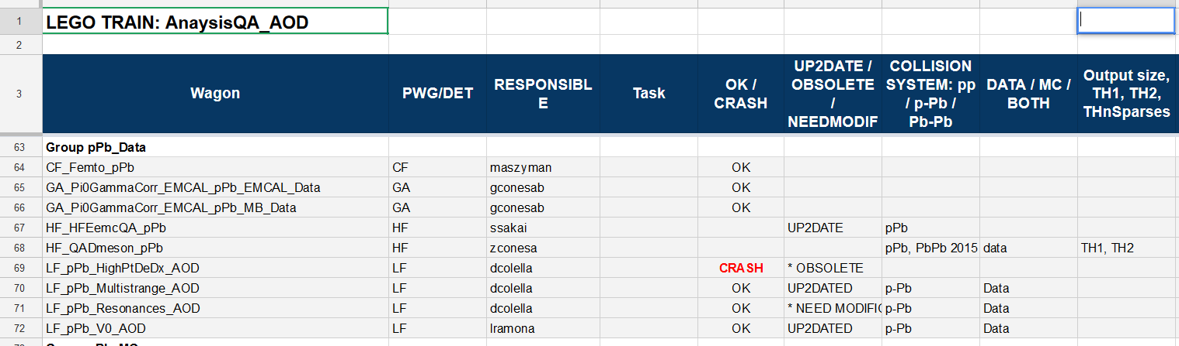
Analysis QA lego train
Used in Run1 to launch simple analysis QA checks provided by each PWG
  E.g. electron identification plots, invariant mass distributions …
  Simple (and automatized) analysis macro+script to spot issues
Put back in operation the AnalysisQA lego train (JIRA: PWGPP-281)
  First phase: inventory and test of existing wagons (traced in google sheet)
    Confirm wagons that are OK and update those that need modifications (PWGs, ongoing)
    Remove obsolete and duplicated wagons (ongoing)
    Run some test trains (one per collision system) and verify the output files
  Second Phase: update macro and script for automatized checks and plots

Slide 18
AliDPG package: News
Data:
  CPass0, CPass1, PPass moved to and taken from AliDPG in production
    New JDL tag to allow to recognize the different passes – especially useful for muon_calo pass (with different AOD train)
  Still missing:
    Merging of calibration trees (FilteredTrees, ResidualTrees, TOF tree, T0 tree), QA and AODs
    Integrate with Release Validation
Monte Carlo:
  New directory AliDPG/MC/CustomGenerators with subfolders per PWG to allow people to commit (through pull-requests) their custom generators without touching the “central” configuration, and being under a version-controlled system

Slide 19
AOB coming down the pike
From the CB we received the suggestion to implement a test facility to test the several PWG-specific generator configuration
  Overlap with QA tools?
Service tasks (6 months FTE)
  Many opportunities in the DPG
    QA tools, AOT, MC testing
    Please (students, team leader, detector responsibles…) contact us (with your CV) if interested!
QA train on AOD at production time
  Tracking-QA task (including checks on AOD-track filter bits)
  Check physics selection and centrality information stored in AODs
  Verify contents and integrity of delta-AODs
  …
  → Feedback on this would then be needed as for the detector QA when no (semi)automatic check possible

Slide 20
Summary
DPG is working on the next goals, after QM campaign
  Manpower always welcome!
New tools provided to the analyzers to understand and deal with the data
  New Twiki’s always available (not mentioned here)
Data reconstruction will focus on 2016 and 2015 pp data samples till 2017 data taking starts
  QA activities will be very high – need responsive and well-organized QA experts
Monte Carlo focusing on p-Pb and pp simulations for next conferences
Development of MC-to-MC embedding targeted at next Pb-Pb campaign
Preparation of 2017 data taking ongoing
QA tools will be summarized in this session (next talks)
AOT activities continue to develop
  Not presented here, but details will be given in the DPG plenary session at the next mini-week (Apr 4)

Slide 21
BACKUP

