Slide 1
Electronics needs for SciFi testing and commissioning
C. Joram for the LHCb SciFi team
LHCb Electronics Meeting
13.04.2017

Slide 2
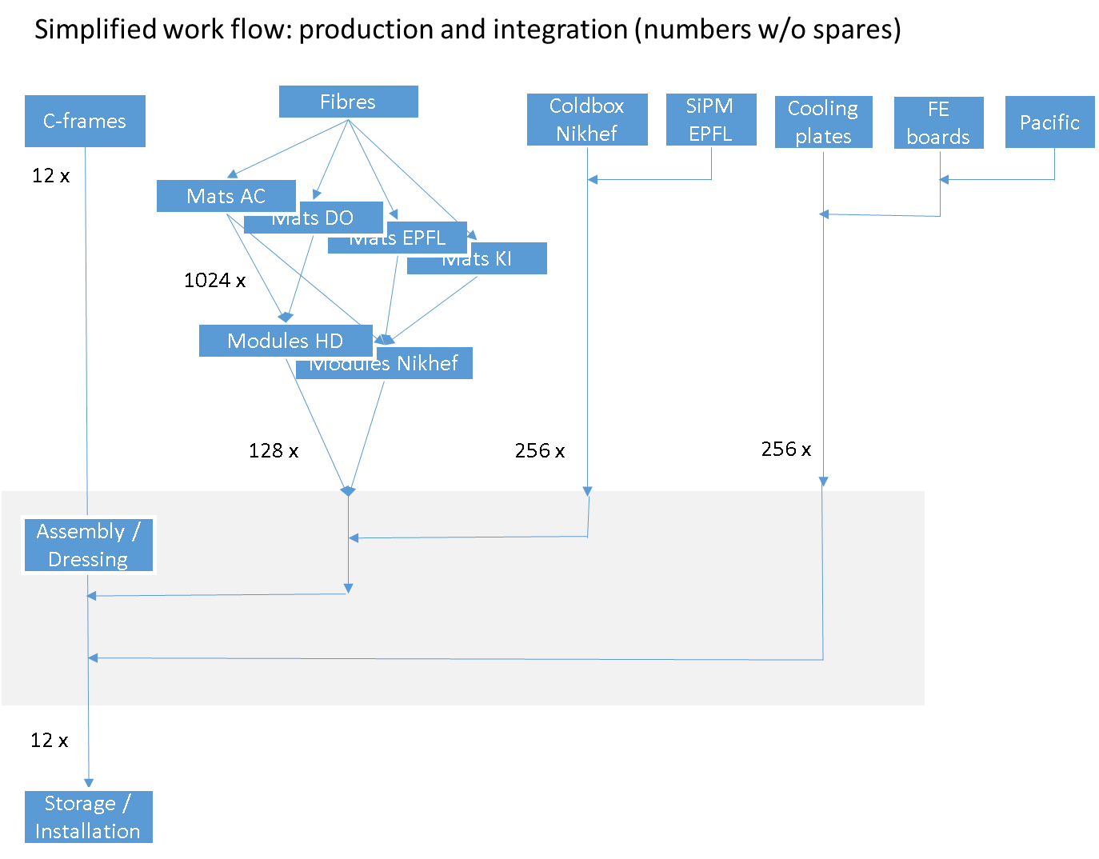
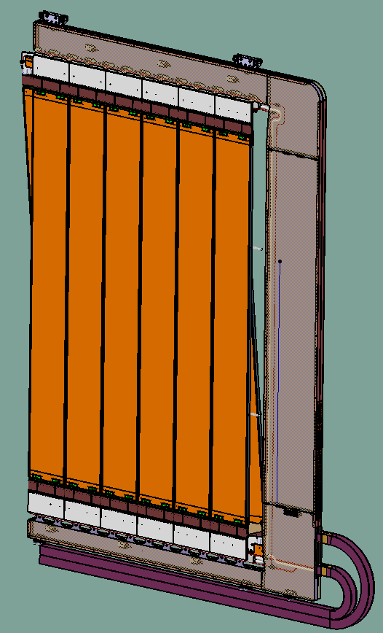
~4 m
FE
At CERN, point 8
~ 7 m
12 x
Testing
1 full C-frame

Slide 3
SciFi in numbers
SciFi = 128 fibre modules → 256 Front-ends (FE)
1 FE = 16 SiPM arrays = 16 data links + 2×2 (bidirectional) ECS/TFC links
1 FE = 100 W power
1 full C-frame = 5 + 5 or 6 + 6 modules (vertical + stereo) = 20 or 24 FE = 3 kW
1 full C-frame = 320 or 384 SiPM arrays / data links, 80 or 96 ECS/TFC links
2 master boards
PCIe40
(up to 48 data links + bi-d. ECS/TFC link)
SciFi
base
unit
16 SiPM arrays (@ -40 C)
16 data links
2 ECS/TFC links

Slide 4
Need 1:
Reception of Cold Boxes at point 8
Cold boxes (loaded with 16 SiPMs) will be (re-)mounted on fibre modules (2 CB per module)
Tests shall verify: functional SiPMs, good optical alignment, light tightness, gas tightness.
Use of a fully analog SPIROC readout system. Detection of light from light injection system.
“Standard” central support needed (mechanical infrastructure, cabling, power supplies, desktop+internet+disks, etc.)
>5 m

Slide 5
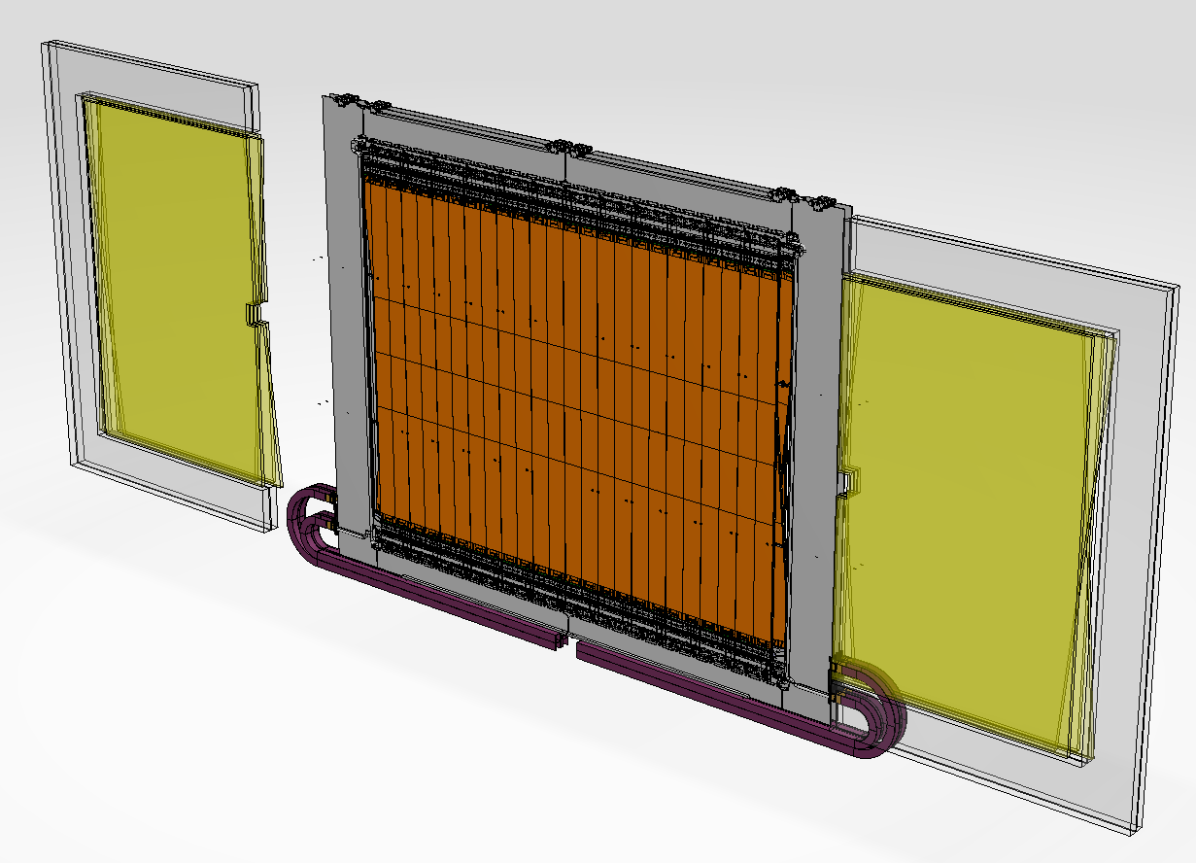
Need 2: C-Frame Tests
Assumptions
C-fames will be fully tested before installation:
SiPMs cooling to -40º C (Novec system)
SiPM biased (“HV”)
Water cooling of electronics
Test of full front-end electronics
Thermally (Novec), the 12 Cold Boxes at the top (or bottom) form one circuit. → test all together.
Minimum configuration: 2 upper/lower half layers
Preferred configuration: full C-frame
6 modules (25000 channels) (12 modules, 50000 chan)
12 (24) FE w/ 192 (384) data links
and 48 (96) control links
LV power supplies: 1.8 kW (3.6 kW)
Water cooling: 1.5 kW (3.0 kW)

Slide 6
C-Frame Tests: Infrastructure
Water cooling:
1.5 (3.0) kW cooling at 20º C
Novec manifold
Water cooling
Bias Voltage:
CAEN System, 96 (192) channels
FE electronics
FE electronics
Novec lines
Low Voltage:
6 (12) Maraton PS channels
(use of a splitter box →1 channel / 2 FEs)
Cold-Box
Cold-Box
SiPM arrays
Novec cooling system: 1 (2) kW T = -50ºC at chiller
module
module
~124mm

Slide 7


C-Frame Tests: DAQ System
Minimum (preferred) configuration:
Portable DAQ System
Optical data links:
16 (32) MPO connections
1 SOL40
4 (8) TELL40
Control links (bidirect.):
2 (4) MPO connections

Slide 8
Portable Mini-DAQ System
Portable DAQ System
Necessary Software:
Fast and slow-control
Event building
Event handling and event storage
1 SOL40, 4 (8) TELL40
1 SOL40
4 (8) TELL40
In addition we need the support by the DAQ team to operate this large system (~1/12th of final system)!

Slide 9
Need 3:
1 FE Tester (2048 PACIFIC channels) to test, debug and repair
FE tester developed by SciFi group
Perform diagnosis and re-test after repair
Assumes a miniDAQ-based readout and control
T_{SiPM} = ambient. FEE cooled by water at 15°C.
Readout / control by MiniDAQ1/2

Slide 10
Summary
 | LHCb SciFi: Estimates of infrastructure needs for detector testing during integration
 | SPIROC based RO system for 1 ROB (16 SiPM) for reception control
1 | central support | Location | Start date | LV power supply |  | HV power supply |  | LV cabling |  | PCIe40 |  | Optical fibres |  |  | Cooling |  |  | Total el. Power
 |  |  |  | type | # chan | type | number | type | number | TELL40 | SOL40 | number | length | connectors | coolant | power | T_op
 | no | SX8 (clean box) | 4/2018 | lab | some | CAEN | 32 | stan-dard | some | 0 | 0 | / | / | / | none | none | ambient | marginal
 | PACIFIC based RO system for 1 full C-frane (24 FE) for commissioning and testing
2 | central support | Location | Start date | LV power supply |  | HV power supply |  | LV cabling |  | PCIe40 |  | Optical fibres |  |  | Cooling |  |  | Total el. Power
 |  |  |  | type | # chan | type | # chan | type | number | TELL40 | SOL40 | number (data/ control) | length | connectors | coolant | power | T_op
 | yes | 3852 | 4/2018 | Maraton | 12 | CAEN | 192 | 35mm2 | 12 | 8 | 1 | 384/96 | 20 m | MPO | Novec | 1 kW | -40 at SiPM
 |  |  |  |  |  |  |  |  |  |  |  |  |  |  | H2O | 3 kW | ambient | 3 kW
 | PACIFIC based RO system for 1 FE (16 SiPM) for debugging and repair
3
 | central support | Location | Start date | LV power supply |  | HV power supply |  | LV cabling |  | PCIe40 |  | Optical fibres |  |  | Cooling |  |  | Total el. Power
 |  |  |  | type | # chan | type | # chan | type | number | TELL40 | SOL40 | number (data/ control) | length | connectors | coolant | power | T_op
 | yes | 3852 | 4/2018 | Maraton | 1 | CAEN | 8 | 35mm2 | 1 | 1 | 1 | 16/4 | 20 m | MPO | H2O | 100 W | ambient | 100 W

Slide 11
Screen shot from module testing in Heidelberg (SPIROC readout)

