Slide 1
FNAL E683:
Photoproduction of Jets
Don Lincoln
(Marj’s Second* Ph.D. Student, first to stay in academia)
* Chris Moore was #1

Slide 2
Quantum Chromodynamics [General Primer]
Jet
ISR
Underlying
Event
Hard Scatter
Fragmentation
Parton
Density
Jet
Photon
Calculable at Leading Order [LO] perturbation theory [1980 – 1990s]
Calculable at Next to Leading Order [NLO] perturbation theory [1990 – 2000s]
Intractable in perturbation theory [present]

Slide 3
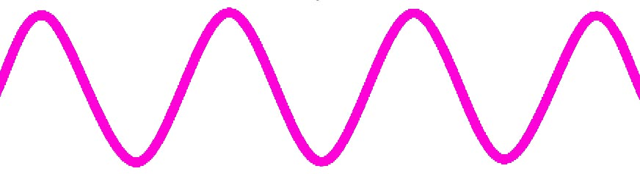
Photoproduction processes [E683 Primer]
u
g
d
d
u

Slide 4
E683 Initial Goals
Study jet production by γp scattering
Compare with πp (E609, E683) and pp scattering (E609)
Study A-dependencies of photon scattering (H, D, Be, C, Al, Cu, Sn, Pb)
Cross-sections (e.g. scattering probabilities, binned in p_{T})
Photon structure functions

Slide 5
E683 History
Year | Spokesperson | Status | Institutions
1981 | Cormell | Unconsidered | ANL, FNAL, Lehigh, Athens, UPenn, Rice, Wisconsin
1982 | Cormell | Deferred | ANL, FNAL, Lehigh, Athens, UPenn, Rice, Wisconsin

Slide 6
Interlude: Historical context
Higgs Field
CP Violation
Solar Neutrino Problem
Quarks Proposed
Don Born
Gluon Discovered
(3 jet events)
Hadronic Jets [UA1]
E683 Proposed
Scaling
QCD Developed
1964
1979
1981
1960
1970
1980
Jets in e⁺e⁻
Notes:
Bjorken, Feynman Gross, Politzer & Wilczek

Slide 7
E683 History
Year | Spokesperson | Status | Institutions
1981 | Cormell | Unconsidered | ANL, FNAL, Lehigh, Athens, UPenn, Rice, Wisconsin
1982 | Cormell | Deferred | ANL, FNAL, Lehigh, Athens, UPenn, Rice, Wisconsin
1983 | Cormell | Deferred | ANL, FNAL, Lehigh, Athens, UPenn, Rice, Wisconsin
1984 | Cormell | Approved | ANL, FNAL, Lehigh, Athens, UPenn, Rice, Wisconsin
1985 | Cormell | Approved | Arizona, FNAL, Lehigh, Rice, Vanderbilt, Wisconsin
1986 | Corcoran | Approved | Arizona, FNAL, Lehigh, Rice, Vanderbilt, Wisconsin
1987 | Corcoran | Approved | Ball State, Houston, Lehigh, Maryland, Michigan, UTAustin, Rice, Vanderbilt, Wisconsin
1988 | Corcoran | Approved | Ball State, Iowa, Maryland, Michigan, Rice, Vanderbilt
1990 | Corcoran | Test Run
1991 | Corcoran | Run | Ran June 1991 – January 1992

Slide 8
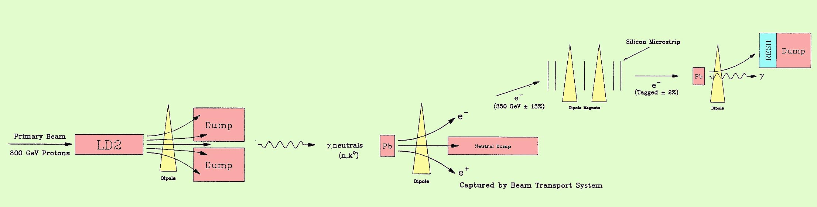
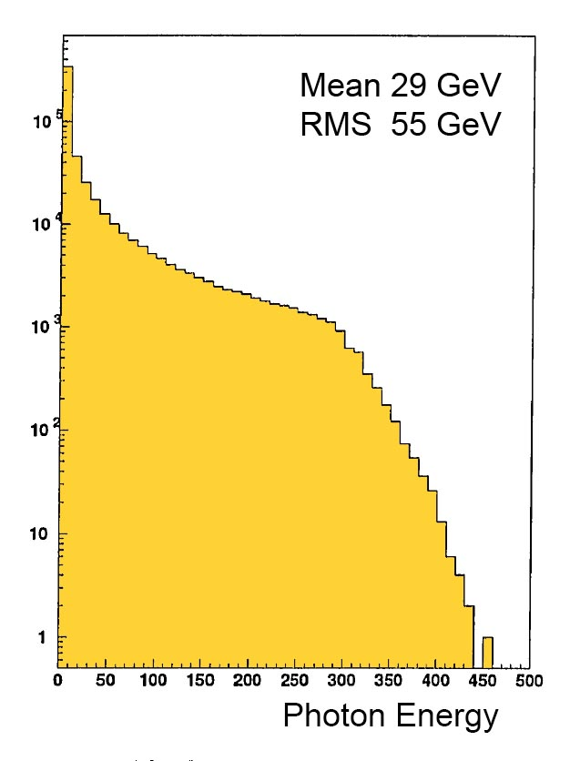
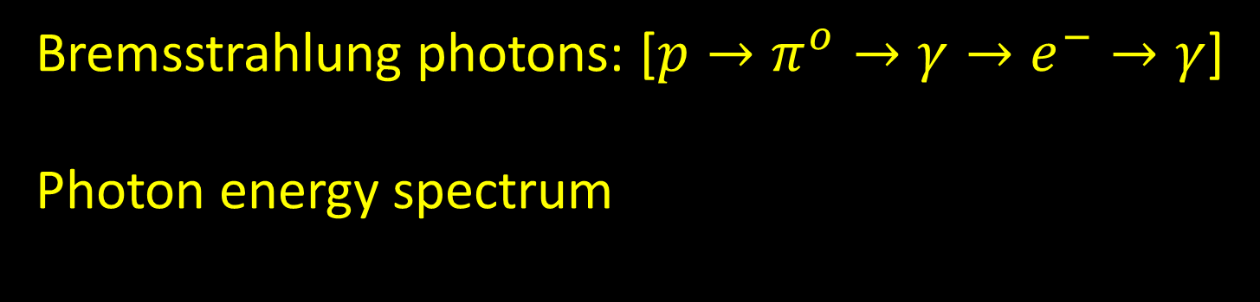
E683 Beamline: Highest energy real photon beam in the world
Bremsstrahlung photons: [$p→π^{o}→γ→e^{−}→γ$]
Photon energy spectrum

Slide 9
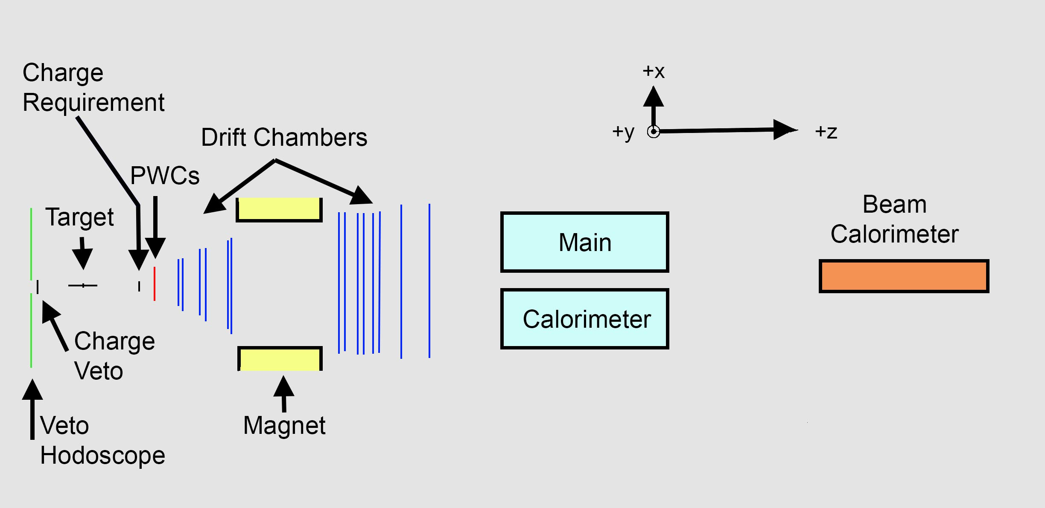
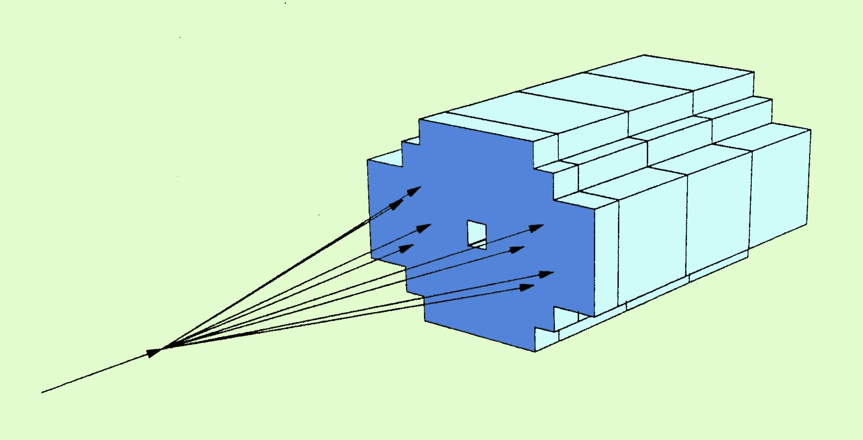

Slide 10
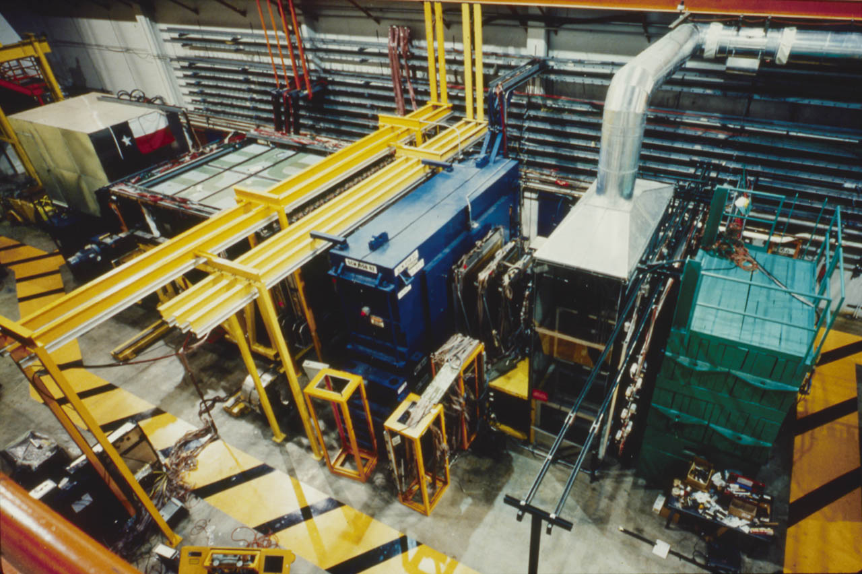

Slide 12
Working on the E683 calorimeter

Slide 13
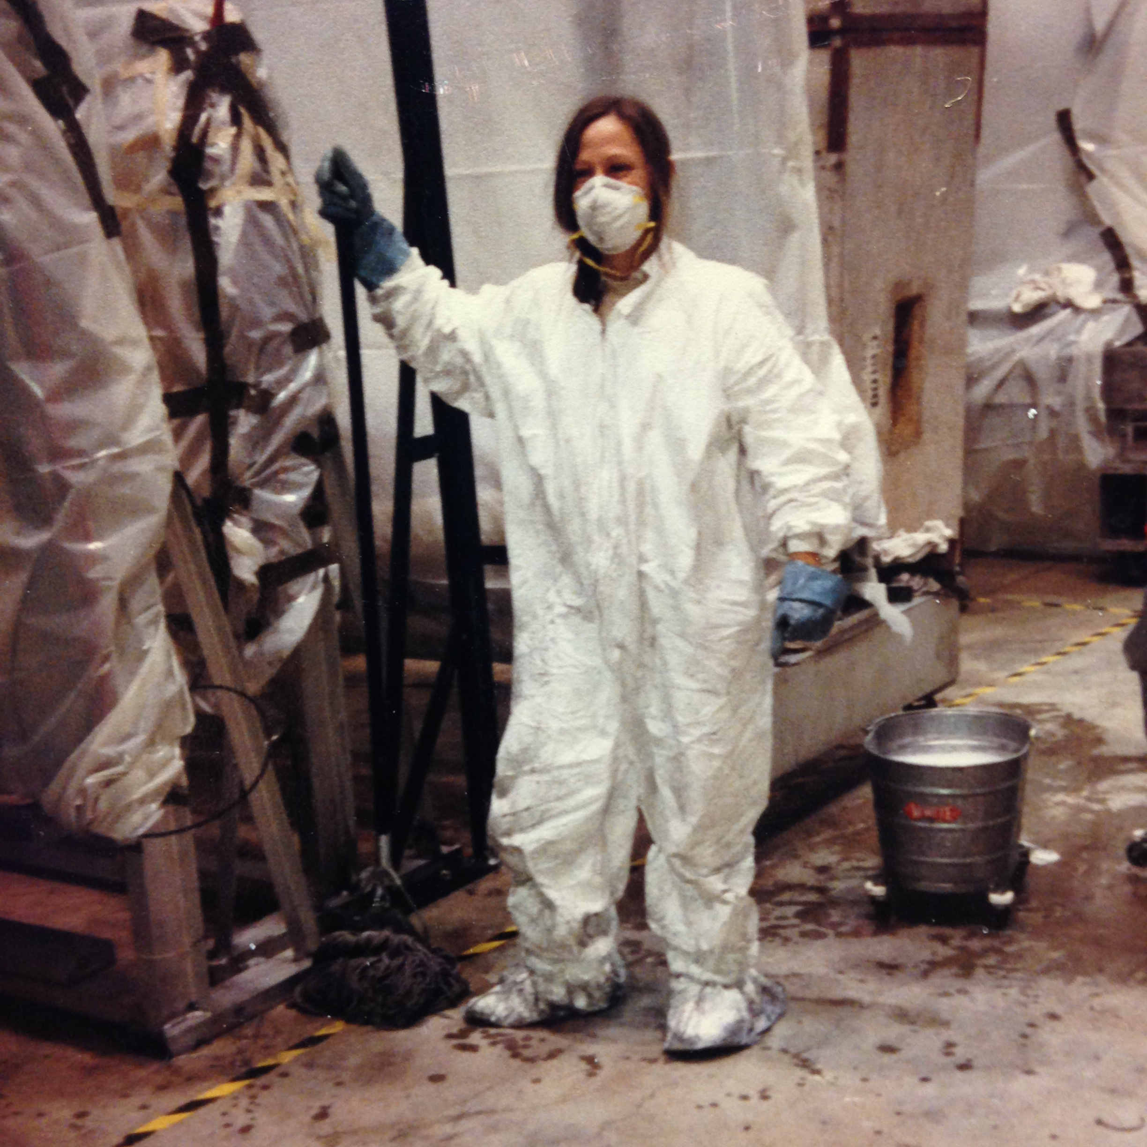
Leading by example…
Cleanup after 1987 fire in the “Wide band” hall where the E683 experiment was damaged.
That was fun. Not.

Slide 14
E683: Ph.D. Theses
Q. Zhu (Rice, 93) A study of photon-nucleus collisions at high transverse energy
D. Naples (Maryland, 93) A-Dependence of photoproduced jets and comparison with hadroproduction
D. Lincoln (Rice, 94) Observation of jet photoproduction and comparison to Monte Carlo simulation
M. Traynor (Rice, 96) Search for evidence of photoproduction of higher-twist ACD events at Experiment 683 at Fermi National Accelerator Laboratory
C. Halli (Maryland, 97) Studies of hydrogen and deuterium di-jet production
G. Morrow (Rice, 98) Experimental Observation of the photon structure function at 21 GeV
published
Photo courtesy of Donna Naples
unpublished
+ 5 M.A. theses
Marj working on the E683 calorimeter with Gordon Mutchler, Rice professor.

Slide 15
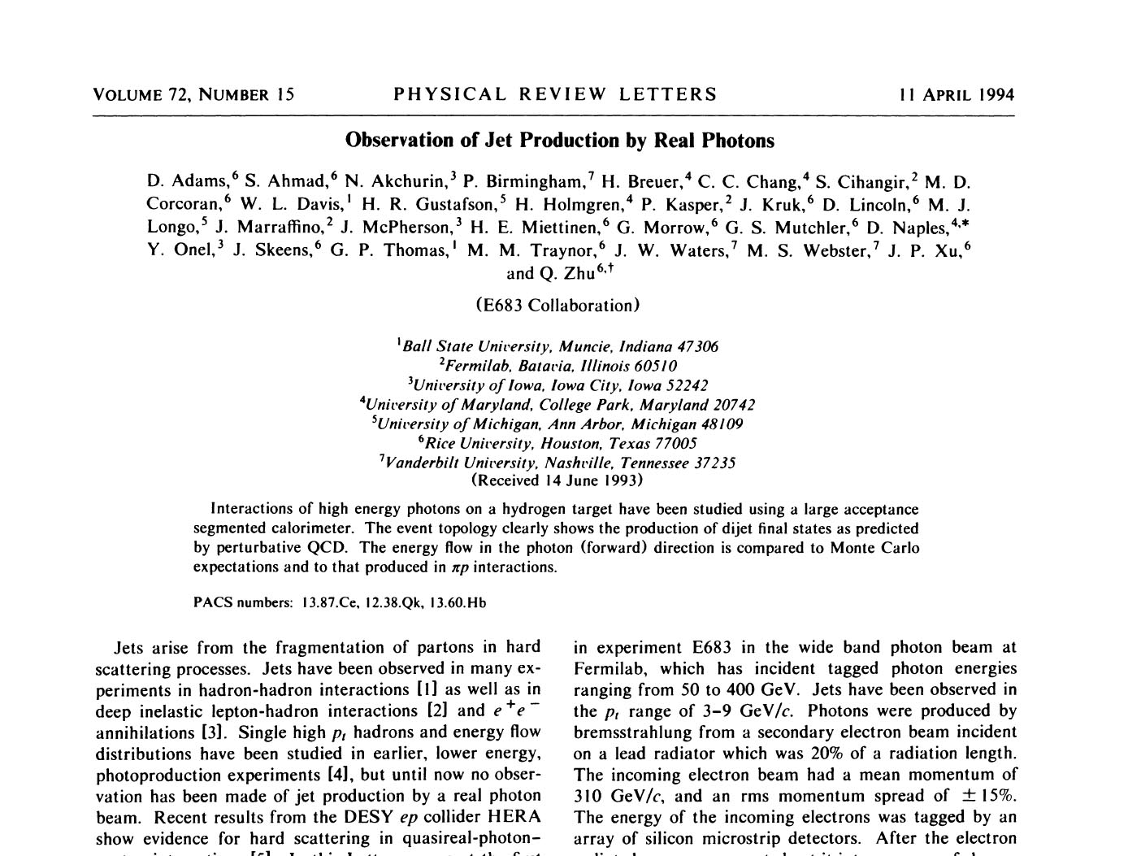
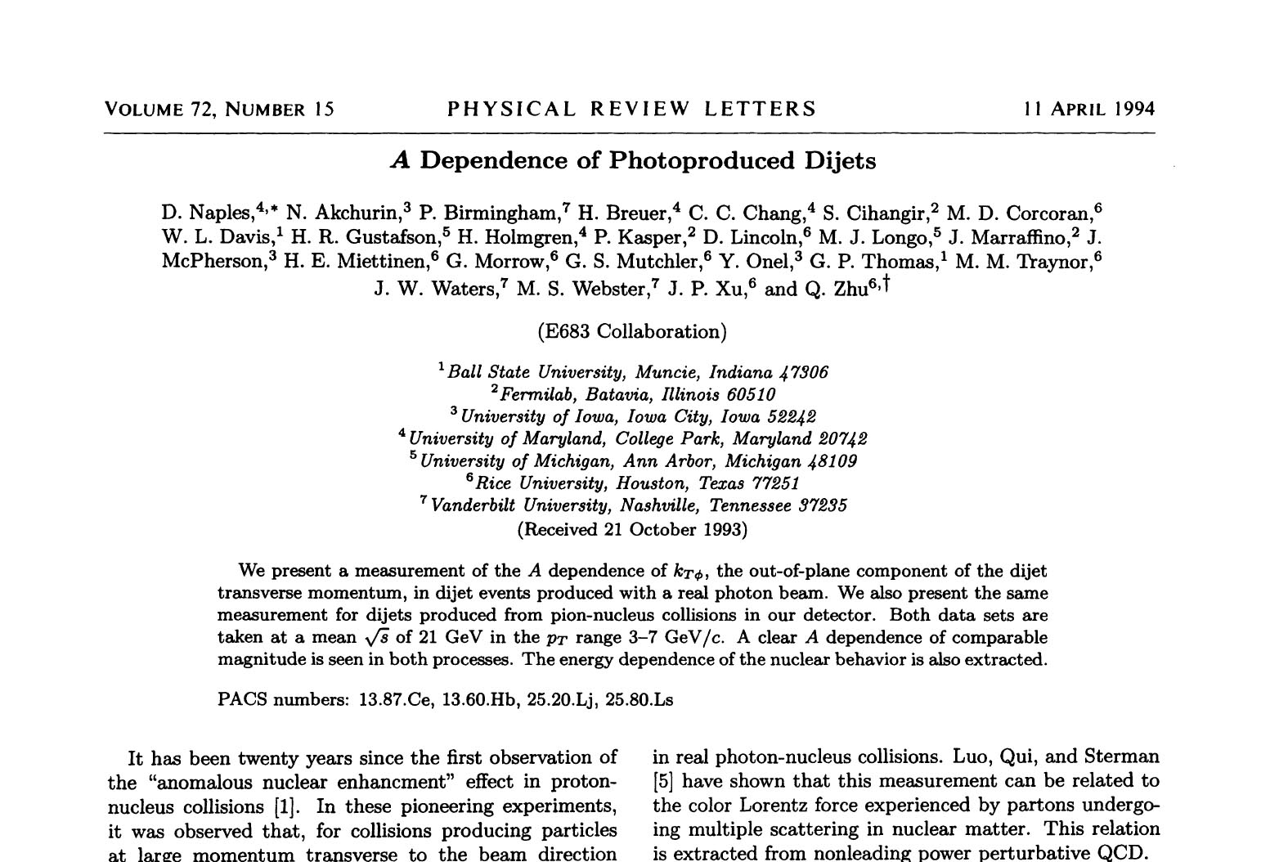
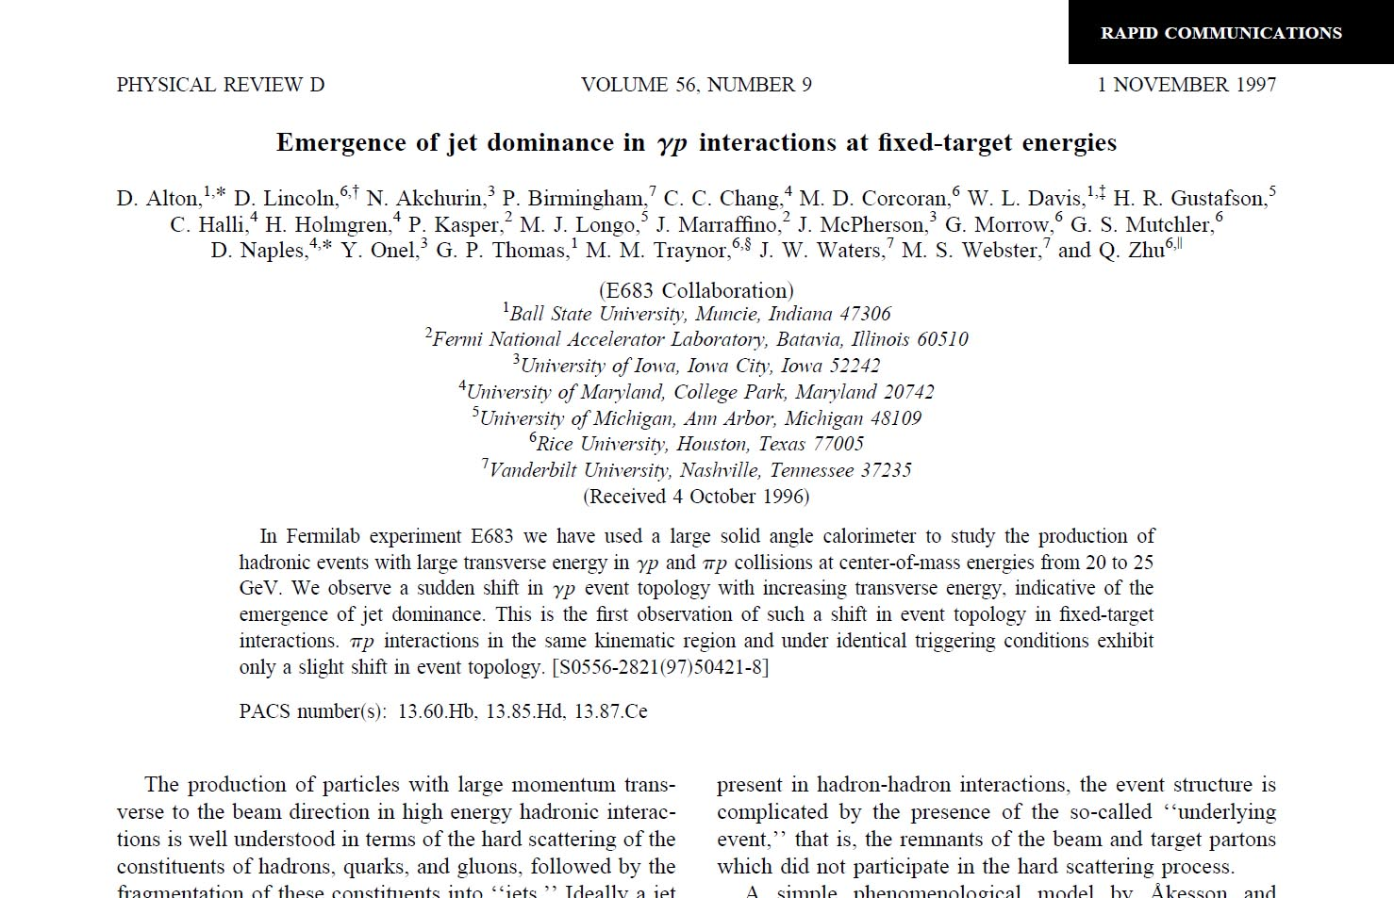
3 papers
Basic message:
Non-perturbative
QCD is required

Slide 16
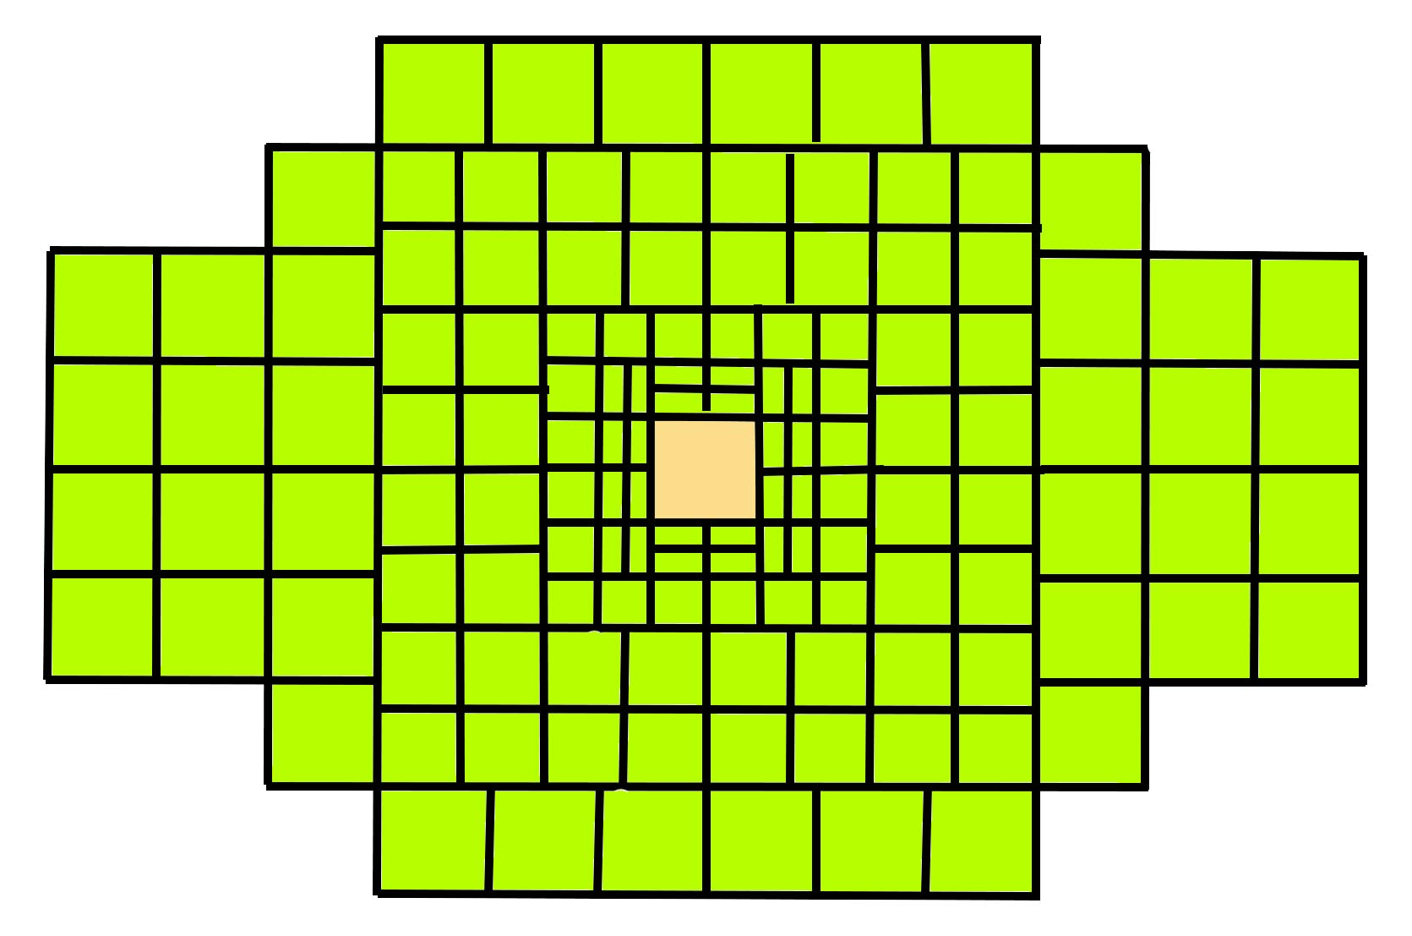
Modern jet-centric mindset
[perturbative QCD dominated]
Jet studies at such low energy in hadron interactions is problematic
CM energy ~ 20 GeV
Typical jet transverse energy ~ 3 GeV
Non-perturbative QCD scale ~3 – 5 GeV
Trigger biases?

Slide 17
1970 – 1980s mindset
[low E_{CM} jet process not yet observed]
Jet studies at such low energy in hadron interactions is problematic
CM energy ~ 20 GeV
Typical jet transverse energy ~ 3 GeV
Non-perturbative QCD scale ~3 – 5 GeV
Trigger biases?

Slide 18
QCD
Phase Space

Slide 19
QCD
Phase Space

Slide 20
QCD
Phase Space

Slide 21
QCD
Phase Space

Slide 22
QCD
Phase Space

Slide 23
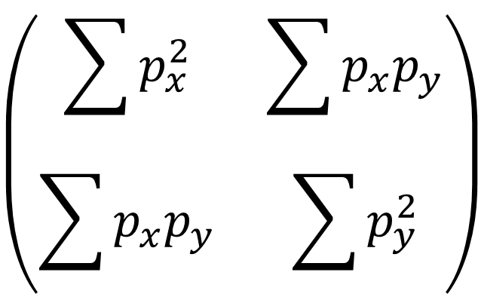

Planarity: Geometrical variable
$$\left(\begin{matrix}\sum{p_{x}^{2}} & \sum{p_{x}p_{y}} \\ \sum{p_{x}p_{y}} & \sum{p_{y}^{2}}\end{matrix}\right)$$
Find eigenvalues (λ_{max}, λ_{min}) and eigenvectors
Define planarity
$P=\frac{λ_{max}−λ_{min}}{λ_{max}+λ_{min}}$
Define transverse momentum fraction
$x_{⊥}=\frac{\sum{\left|{\vec{p}}_{⊥}\right|}}{E_{CM}}$
P = 1
P = 0

Slide 24
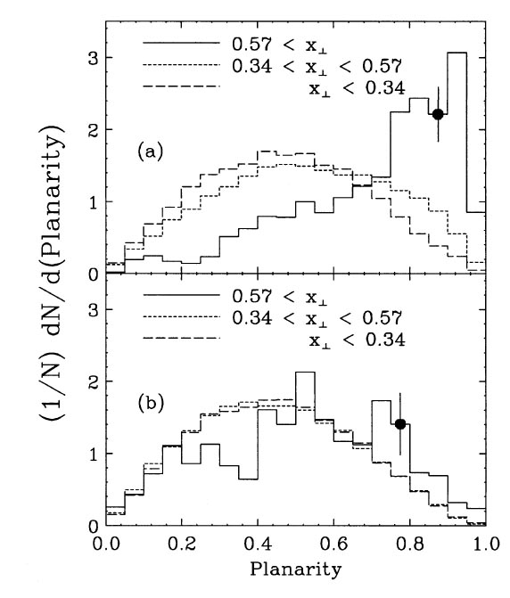
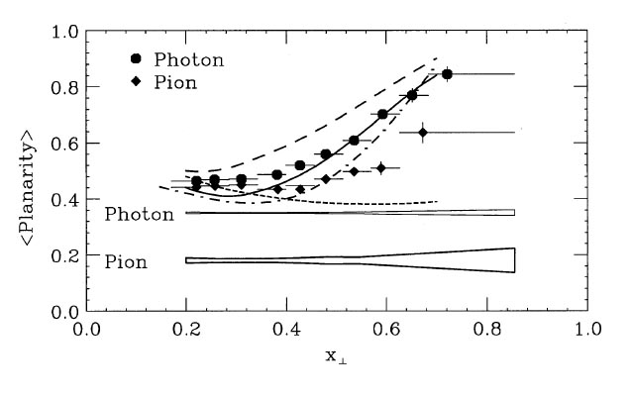
γp scattering
πp scattering

Slide 25
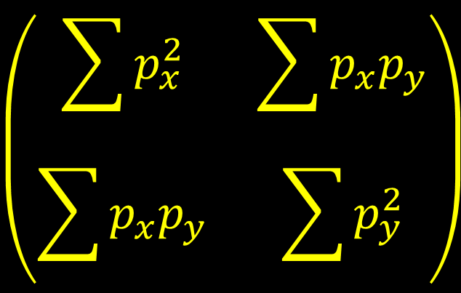

λ₂
$$\left(\begin{matrix}\sum{p_{x}^{2}} & \sum{p_{x}p_{y}} \\ \sum{p_{x}p_{y}} & \sum{p_{y}^{2}}\end{matrix}\right)$$
Δφ
λ₁
$${dE_{⊥}}/{d\left(Δφ\right)}$$
Jet Area Ratio =
+
0
π
Δφ

Slide 26
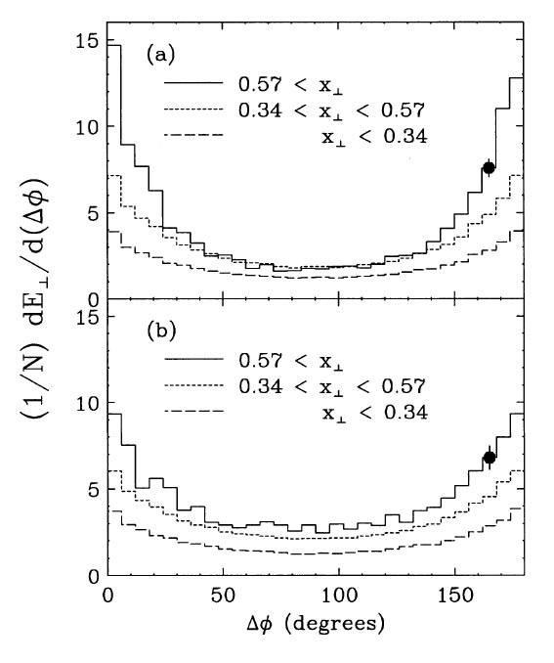
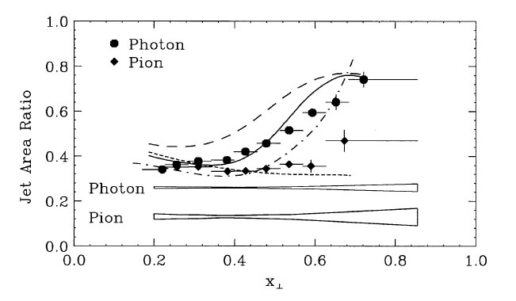
Jet production in γp scattering becomes evident at lower
transverse energy than in πp scattering.
γp scattering
πp scattering

Slide 27
E683 Summary
Experiment had grand goals
  Measure jet cross section & determine jet structure
Energy scale very low for perturbative QCD tests
  Non-perturbative effects dominated many measurements
Experimental goals realigned to explore this tricky theoretical realm in which perturbation techniques are ineffective.
6 Ph.D. theses, 5 M.A. theses, 3 papers in PRL or PRD-RC
None of this would have been possible without Marj

Slide 28
Photon Structure [momentum fraction]
Photon momentum fraction

Slide 29
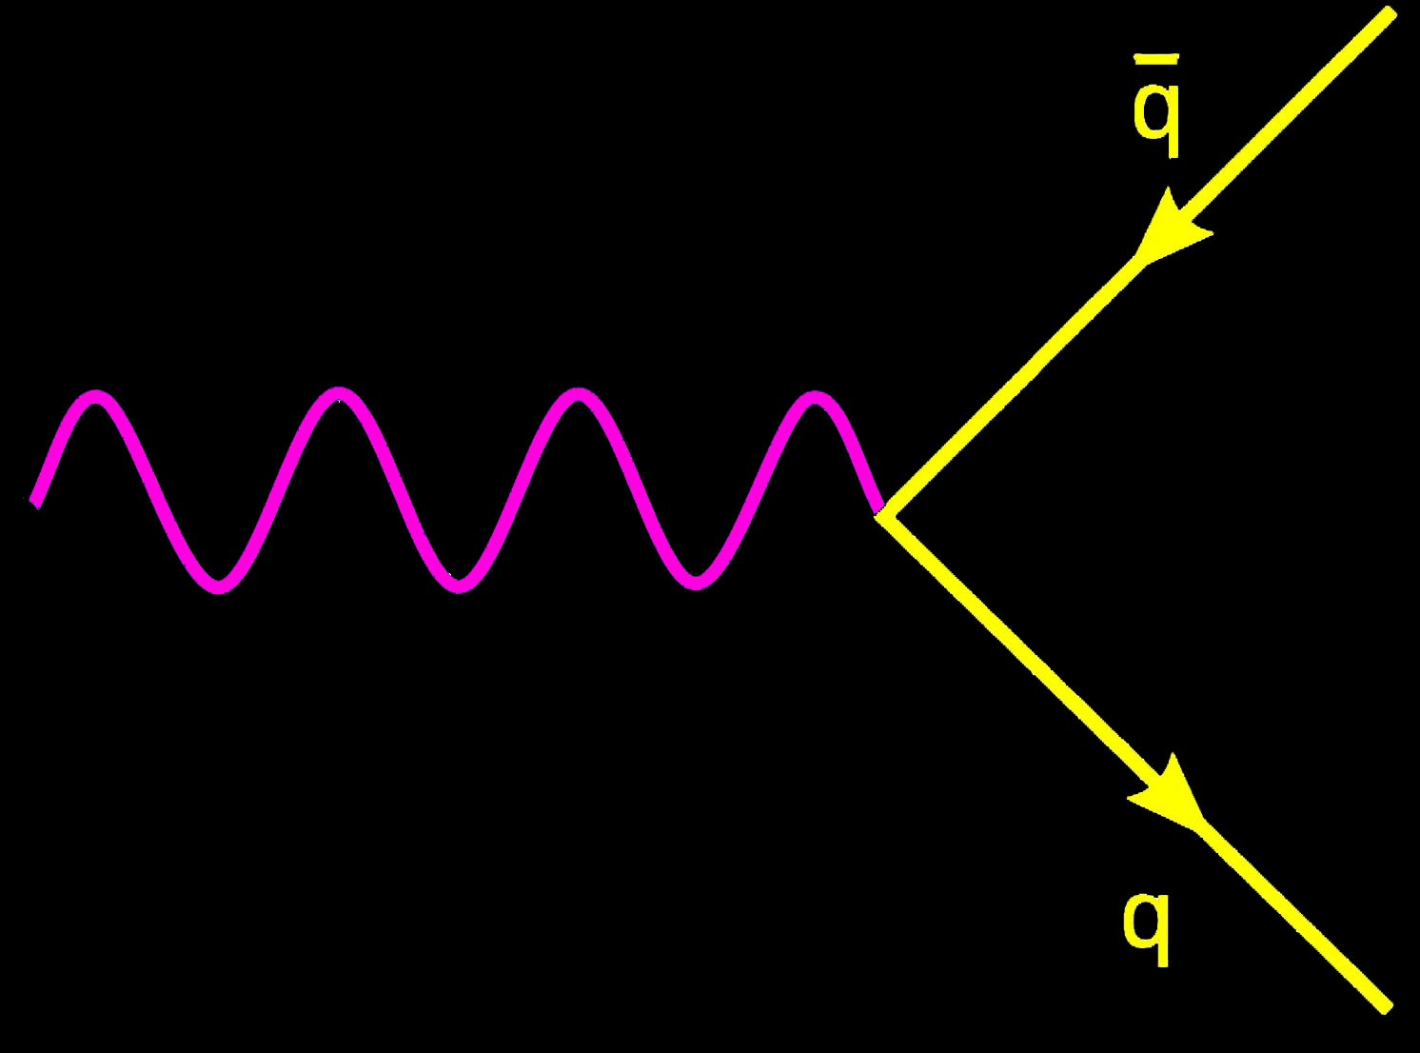
Photon Structure [momentum fraction]
Photon momentum fraction

Slide 30
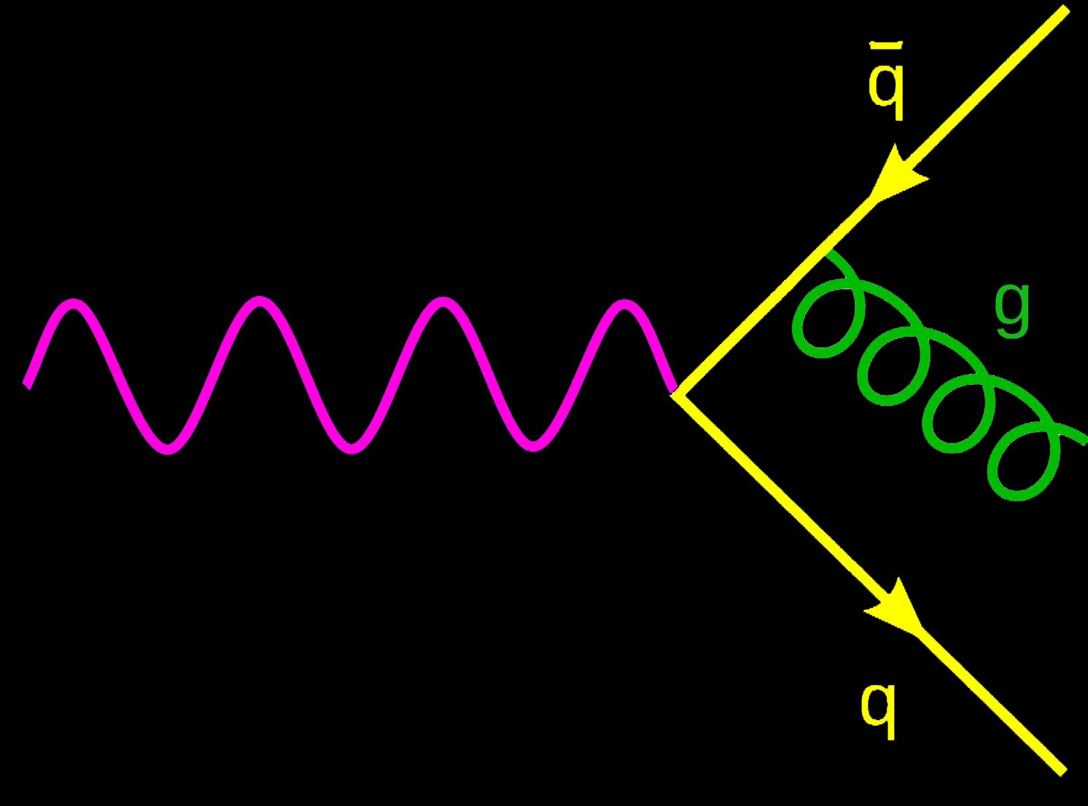
Photon Structure [momentum fraction]
Photon momentum fraction

Slide 31
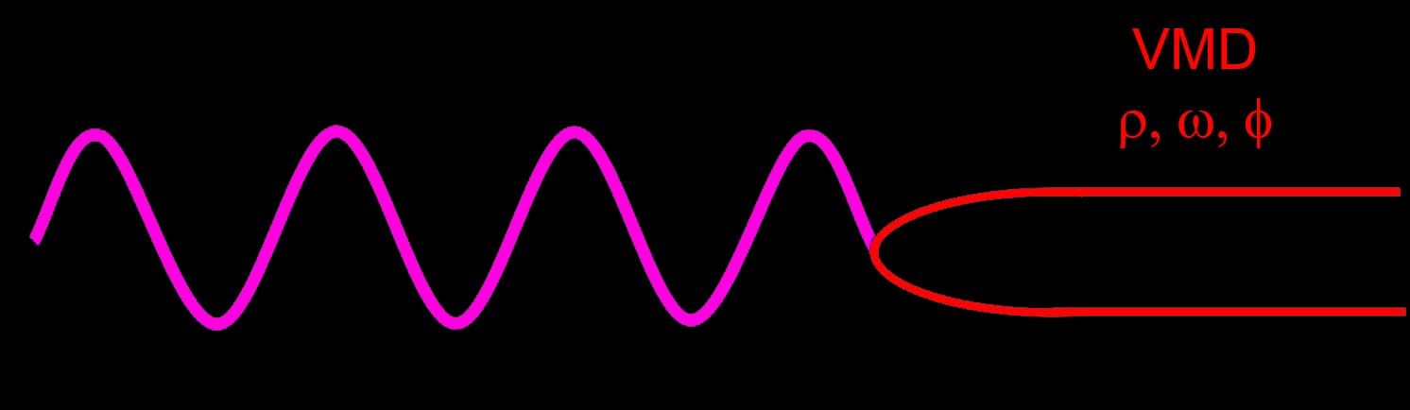
Photon Structure [momentum fraction]
Photon momentum fraction

Slide 32
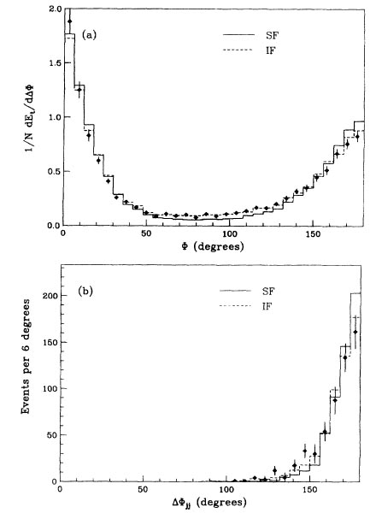
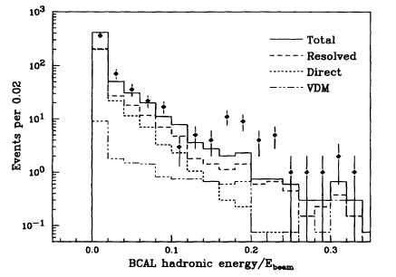
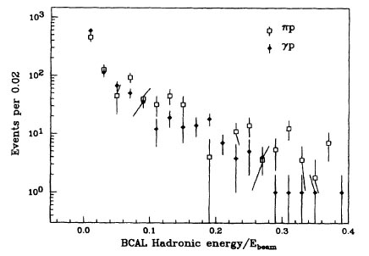

Slide 33
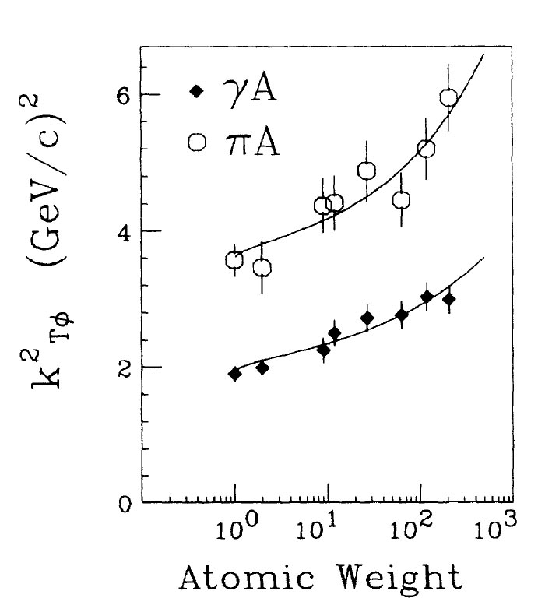
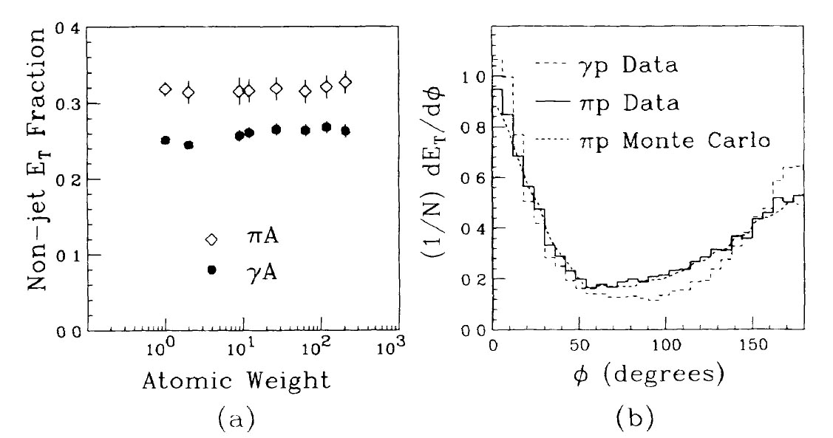
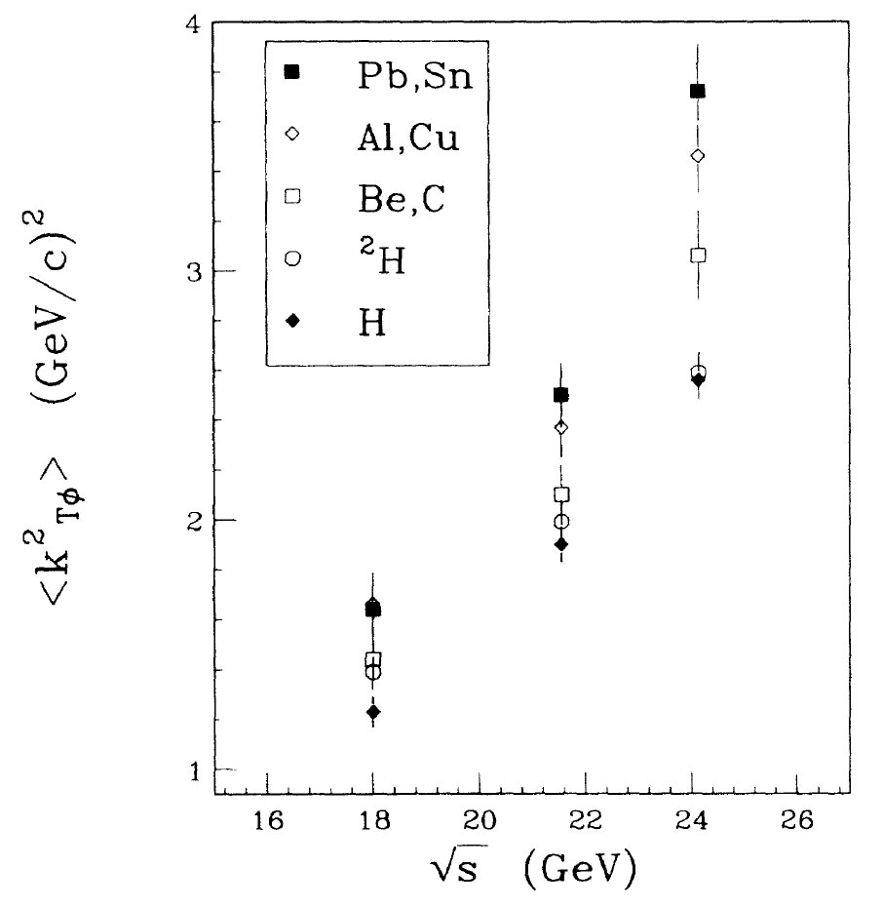

Slide 34
