Slide 1
LHC BE-BI activities in EYETS 2016/17

Slide 2
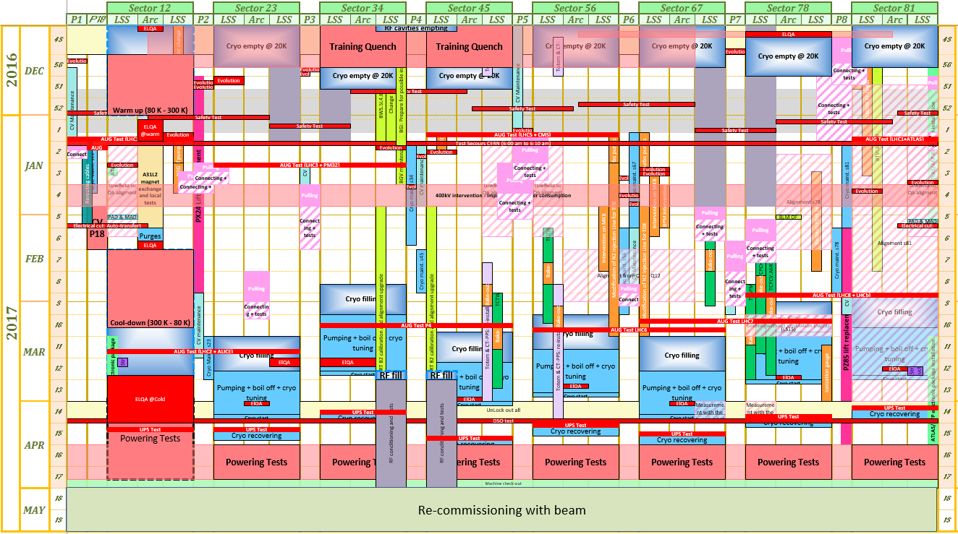
LHC EYETS comes to the last phase

Slide 3
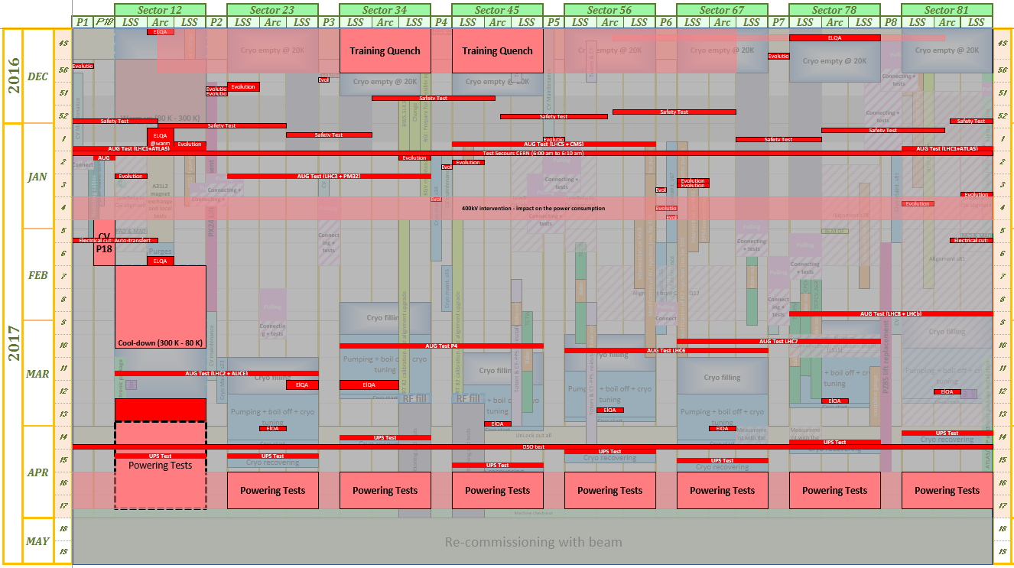
LHC EYETS Constraints

Slide 4
General Information
Sector 1-2 will close 24th March
→ BI activities planned to be finished by 21st March
LSS 4 Left and Right will close 24th March 14h00
Remaining sectors to be baked
A6R5, A4L7, A5L7, B4L7, A1L8

Slide 5
BL Section

Slide 6
ML, PI and PM Sections

Slide 7
QP Section
On the collimator side, still need to connect 2 collimators in Pt 7 and the TCL in 4L5.
Next week start the commissioning of the 2TCTW in Pt 5

