Slide 2
Some significant experiences of HSE unit support to structural safety problems at CERN
Marco Andreini
HSE-SEE-XP

Slide 3

What’s the structural demand?
Dead loads (e.g. self weight)
Imposed or live loads
Environmental loads
Accidental loads
Earthquake loads
What’s the capacity?
Measure of the capability of a structure and its elements to withstand the applied loads
Greek myth of Σίσυφος (Sisyphus)

Slide 4
What’s the structural demand?
Dead loads (e.g. self weight)
Imposed or live loads
Environmental loads
Accidental loads
Earthquake loads
What’s the capacity?
Measure of the capability of a structure and its elements to withstand the applied loads
Greek myth of Σίσυφος (Sisyphus)

Slide 5
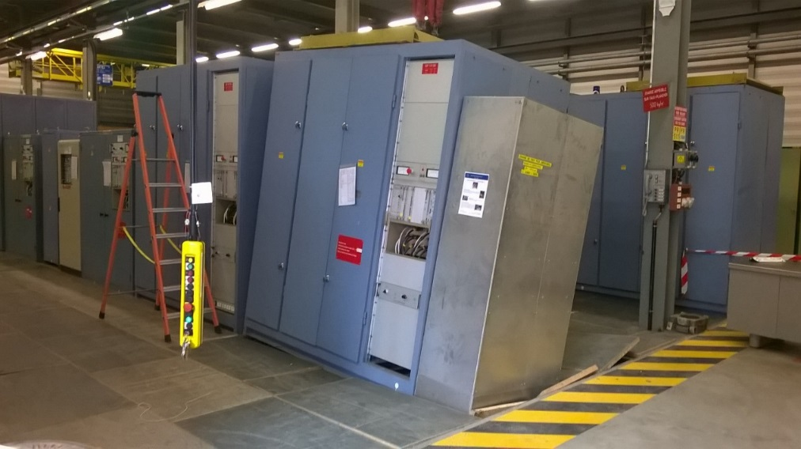
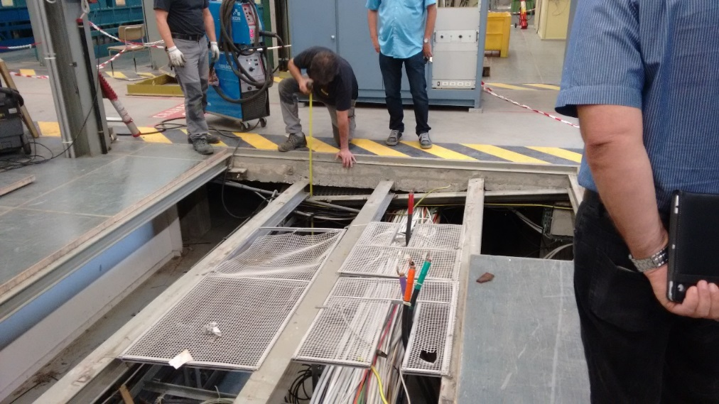
Ante-fact: The structural failure at BA1 – September 3rd, 2015
The structural failure occurred to the false floor of the Building BA1 and supporting an electrical converter has been caused by the self-weight of such an equipment.
The structure consisted in a steel frame grid, composed of H-profiles arranged in a single way and restrained to an adjoining concrete slab by means of an L profile.

Slide 6
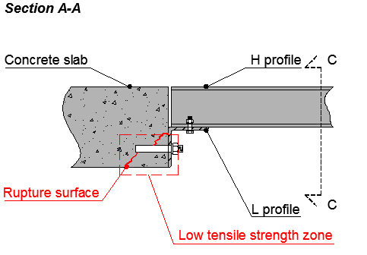
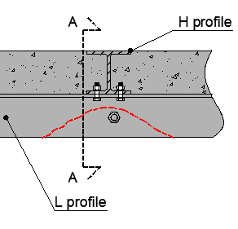
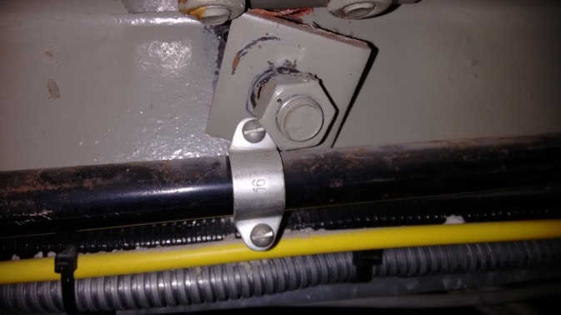
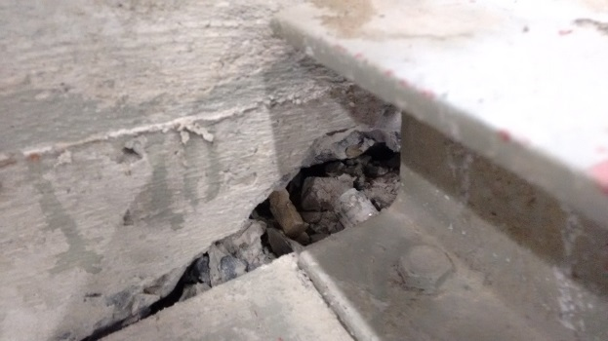
Description of the joint parts collapsed
The failure has been generated by the loss of bearing capacity of the L-profile connection
1
The failure occurred in a low tensile strength zone, in the neighbourhood of one of the bolts

Slide 7
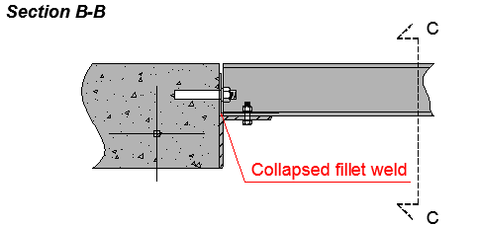
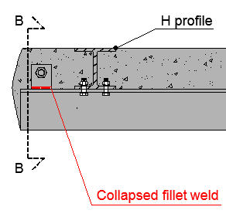
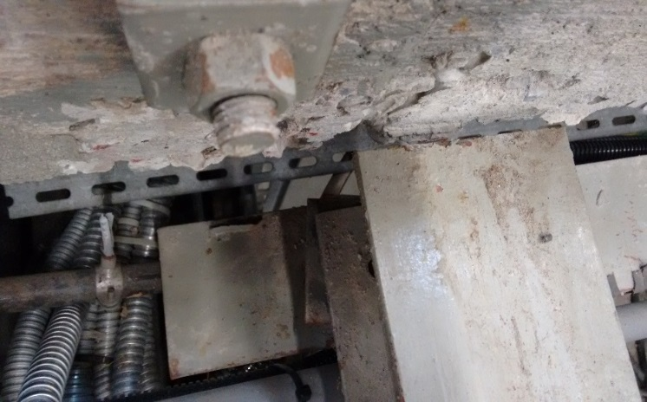
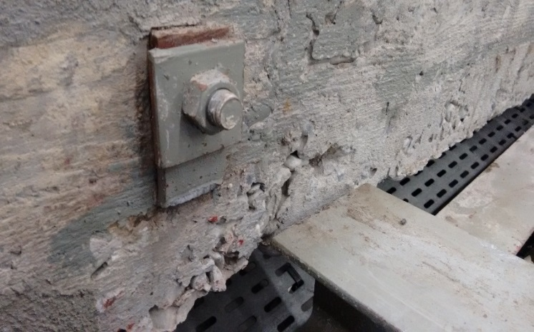
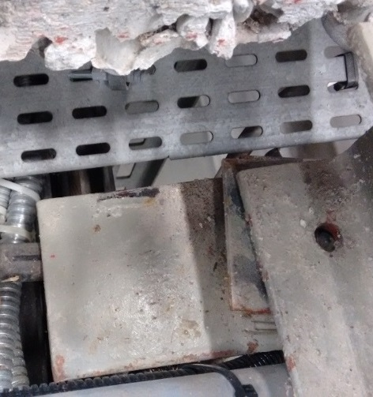
Description of the joint parts collapsed
The failure has been generated by the loss of bearing capacity of the L-profile connection
2
Rupture of the fillet weld between the additional steel plate and the horizontal flange of the L profile

Slide 8
What we understood
The structural detail failed at BA1 was recurrent even in all the BAs
The load patterns of BA1 is similar in all the BAs
Some propping intervention were required to allow the maintenance of the electrical components underneath the false floors
Materials and equipment movements could be allowed using pallet trucks and crane only in some selected areas
Requests to HSE in the YETS and EYETS
May I go underneath the false floor of BAX on Y/01/16?

Slide 9
Procedure adopted by HSE for each request
Check if the activity has to be carried out in unsafe zone
Check on-site the possibility to install some props with DIMENSIONE and SMB/SE/CEB before the day Y
if yes
- Assess the props under uncertain loads
- Check on-site the correct installation of the props
if no
- Steel brackets: check the availability of the components at the CERN store with SMB/SE/CEB and the feasibility with welders of DIMENSIONE
if yes
- Proceed supervising building and installing the brackets
if no
- Contact the SMB/SE/DOP (Synaxis) for a variation in function of what is available at CERN store. If the time required for the design of this variation is > Y, perform an “in house” assessment.
- Check on-site the correct installation of the brackets.
Update the loadbearing capacity maps
Allow/Forbid access

Slide 10
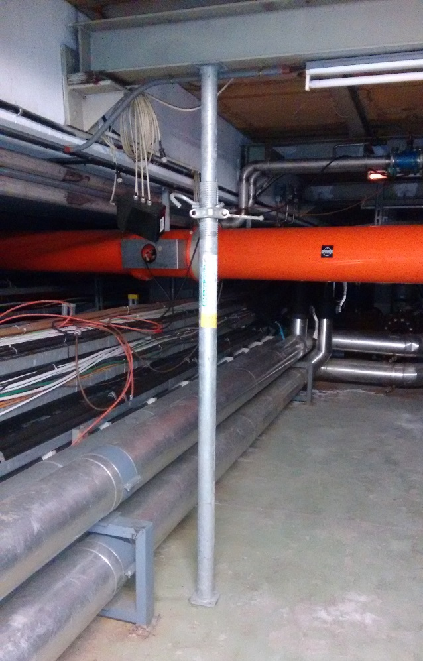
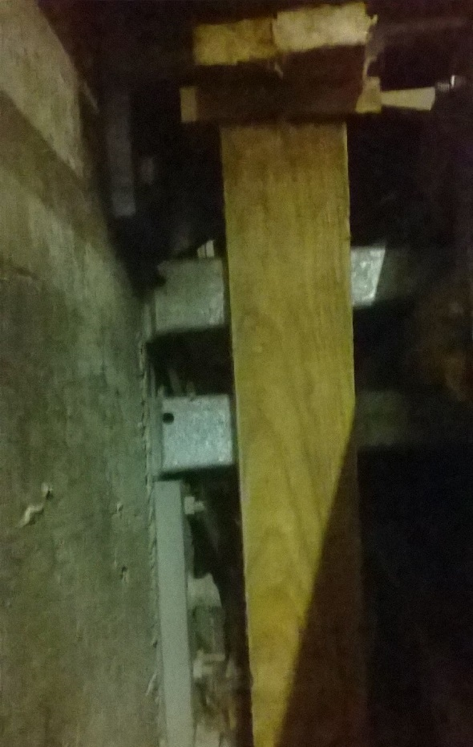
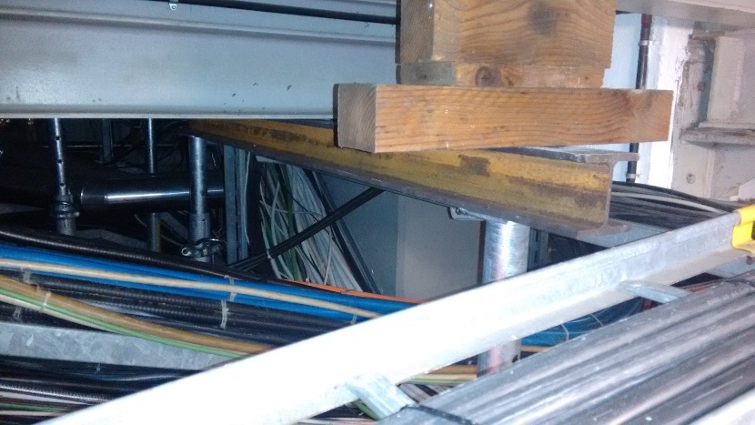
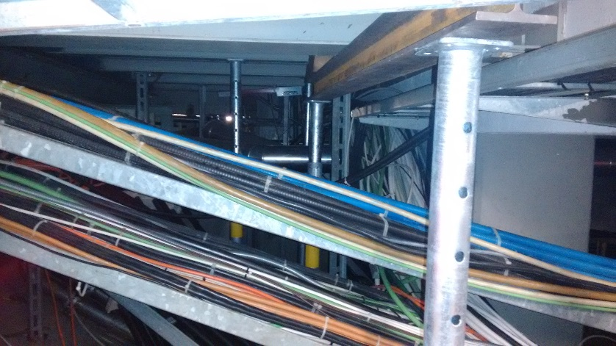
Compensatory measures installed by DIMENSIONE and assessed/validated by HSE

Slide 11
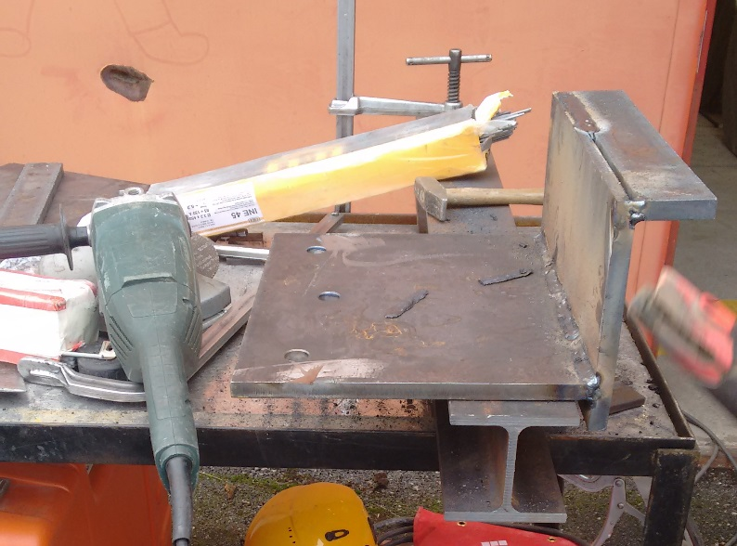
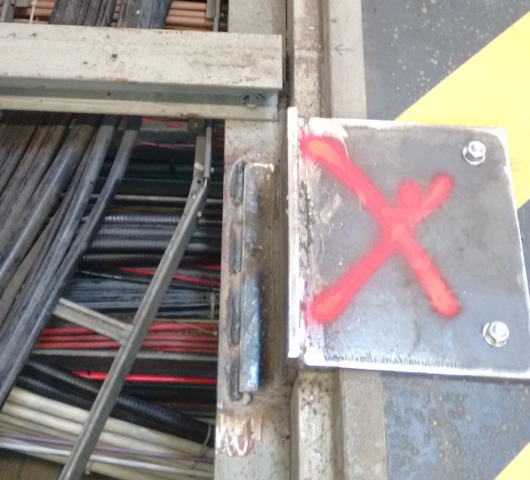
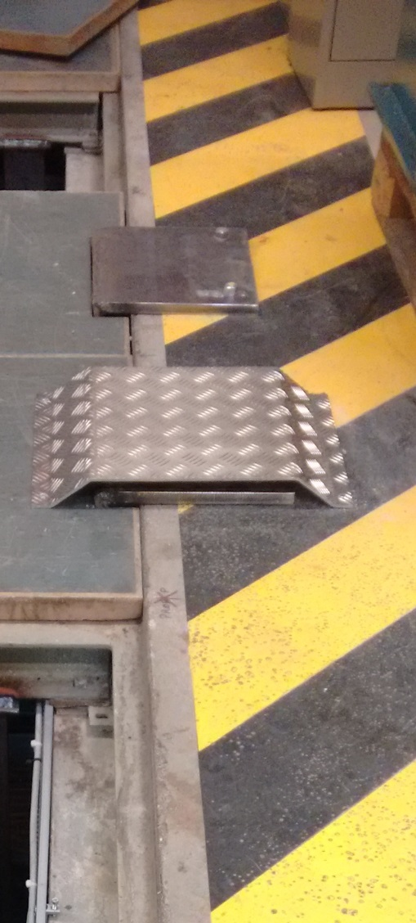
Compensatory measures installed by DIMENSIONE and assessed/validated by HSE

Slide 12
Example of Loadbearing Capacity Maps – BA3 – 18/12/15

Slide 13
Example of Loadbearing Capacity Maps – BA3 – 19/01/16

Slide 14
Example of Access Maps – BA3 – 18/12/15

Slide 15
Example of Access Maps – BA3 – 19/01/16

Slide 16
What’s the structural demand?
Dead loads (e.g. self weight)
Imposed or live loads
Environmental loads
Accidental loads
Earthquake loads
What’s the capacity?
Measure of the capability of a structure and its elements to withstand the applied loads
Greek myth of Σίσυφος (Sisyphus)

Slide 17
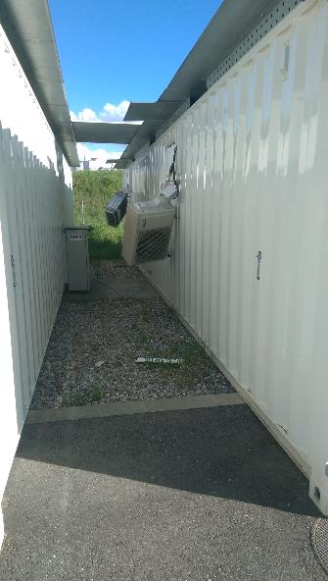
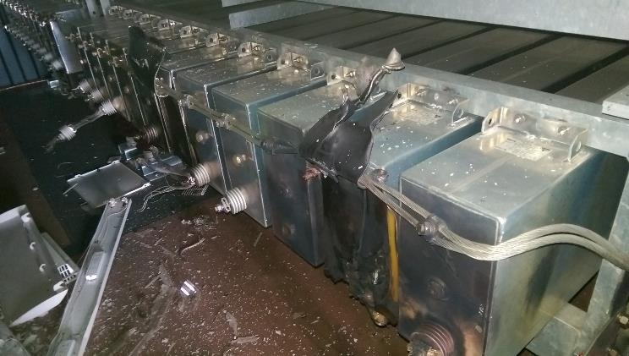
Preliminary Conclusions
Ante fact: POPS recommissioning of the faulted DC1 converter
Since February 2016 POPS was running in degraded mode
Re-commissioning was foreseen on Wednesday the 27th of April 2016
From TE presentation on
POPS DSP1 fault
FOM 03 May 2016
A number of tests were performed:
Visual inspection;
Pre-charge at nominal DC voltage.
Etc.
POPS was restarted in normal mode but at 17.54 the DSP1 capacitor bank failed in short circuit.
Short circuited capacitors
Technical explanation not found yet. Difficult to think it was a coincidence;
No IGBT fault nor short circuit detected;
DC1 repairing seems ok;

Slide 18
Activities under the supervision and with the support of HSE-SEE-XP
Explosion analysis and safety assessment of the new capacitor banks for POPSB to be installed at Building 245
Explosion analysis and safety assessment of the new capacitor banks for POPS to be installed in new containers
Design strategy adopted with TE: acting on the preventing and mitigating interventions / monitoring system remains the same.

Slide 19
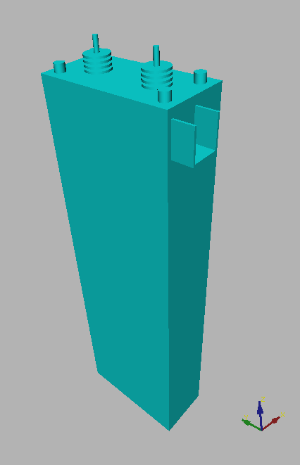
Accident Scenario
Explosion accidents can occur in consequence of electric faults in oil insulated electrical components.

Slide 20

Accident Scenario
Gaseous pyrolysis products
Explosion accidents can occur in consequence of electric faults in oil insulated electrical components.
An electric arc inside the component causes the pyrolysis of part of the oil ...
Pyrolysis reaction
Electric arc

Slide 21


Accident Scenario
Gaseous pyrolysis products
When the internal pressure reaches the withstand capability of the enclosure, a primary explosion scenario takes place: the enclosure fails, violently releasing the oil and gaseous products herein contained.
oil

Slide 22
Accident Scenario
oil mist
When the internal pressure reaches the withstand capability of the enclosure, a primary explosion scenario takes place: the enclosure fails, violently releasing the oil and gaseous products herein contained.
Part of the oil jet is turned into oil mist and forms an explosive atmosphere together with the gaseous pyrolysis products.
The liquid phase oil forms a pool...
liquid oil pool

Slide 23
Accident Scenario
Secondary Explosion scenario
Two subsequent fault scenarios can take place, if an ignition source is available:
secondary explosion scenario
pool fire scenario
Pool fire scenario

Slide 24
Methodological approach
external
effects
modelling enclosure
structural response
geometry data (concrete and rebars)
electric system characteristic data
enclosure characteristic data
geometry data
flammable amount and composition
turbulence field
internal
effects
pressure field
flame front
arc energy
modelling
electrical
fault
modelling
primary
explosion
modelling
secondary
explosion
modelling
structural
response
operation conditions
fault location
arc duration
pyrolysis reaction duration
oil mist amount
cloud position
ignition position
ignition delay
venting layout
configuration of doors&panels
material data
boundary conditions
other loads
load combinations

Slide 25
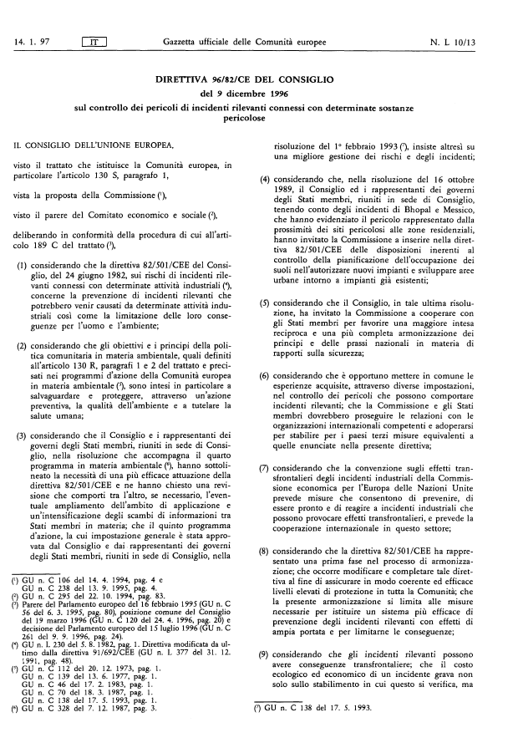

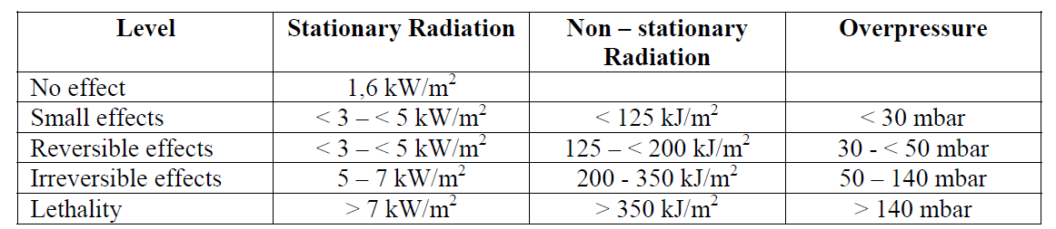
Checking external and structural effects
Definition of admissible threshold values
External Effects: Seveso directives
Structural Effects:
Building 245: Serviceability Limit State (SLS) - The material shall not present any irreversible damage

Slide 26
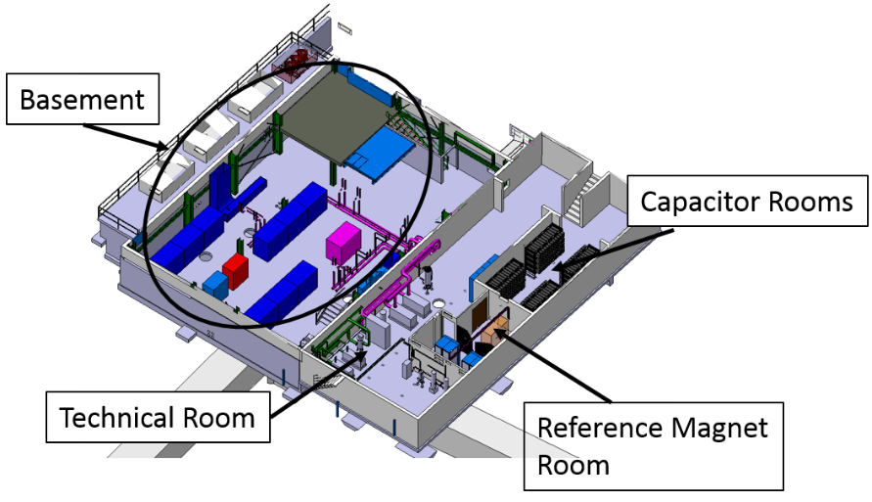
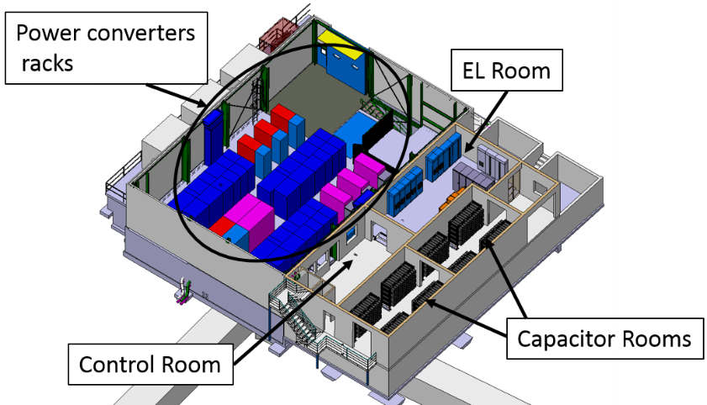
Building 245 – POPS-B
The Technical Building is divided in the following main rooms listed by floor:
Ground floor
Technical Room (S-402) with the pumping station equipment and the electrical cabinets needed for its operation;
One room for capacitor banks (S-401);
Reference Magnet room (S-403) with magnetic field measuring equipment (a magnet and some electronics).
First floor
Two rooms for capacitor banks (R-401 and R-403);
EL Room (R-004) with electric switchgears and UPS systems.

Slide 27
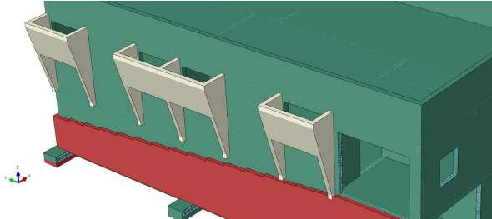
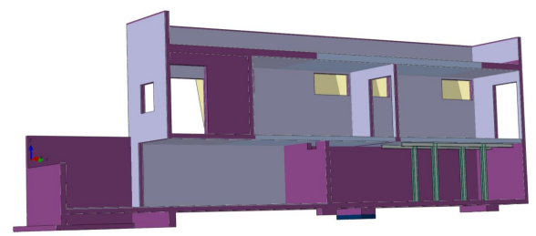
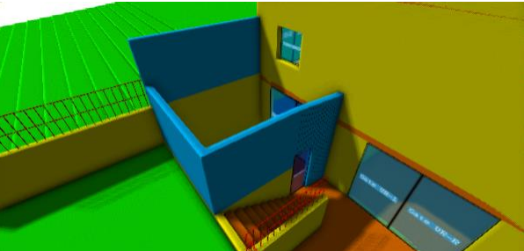
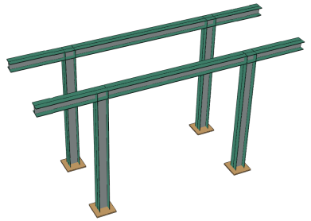
B 245 - Retrofitting strategy
  Realize compartments: blast resisting doors
  Additional venting areas and RC barriers
  Structural stiffnesses and reinforcements

Slide 28
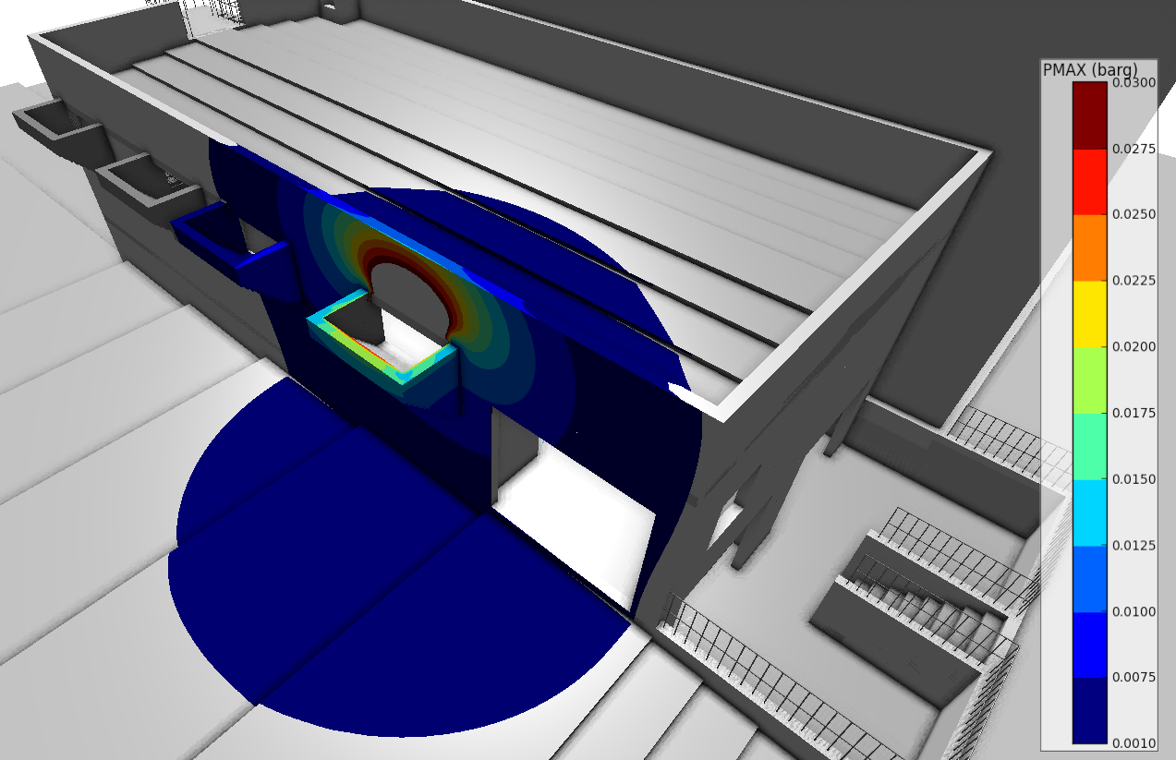
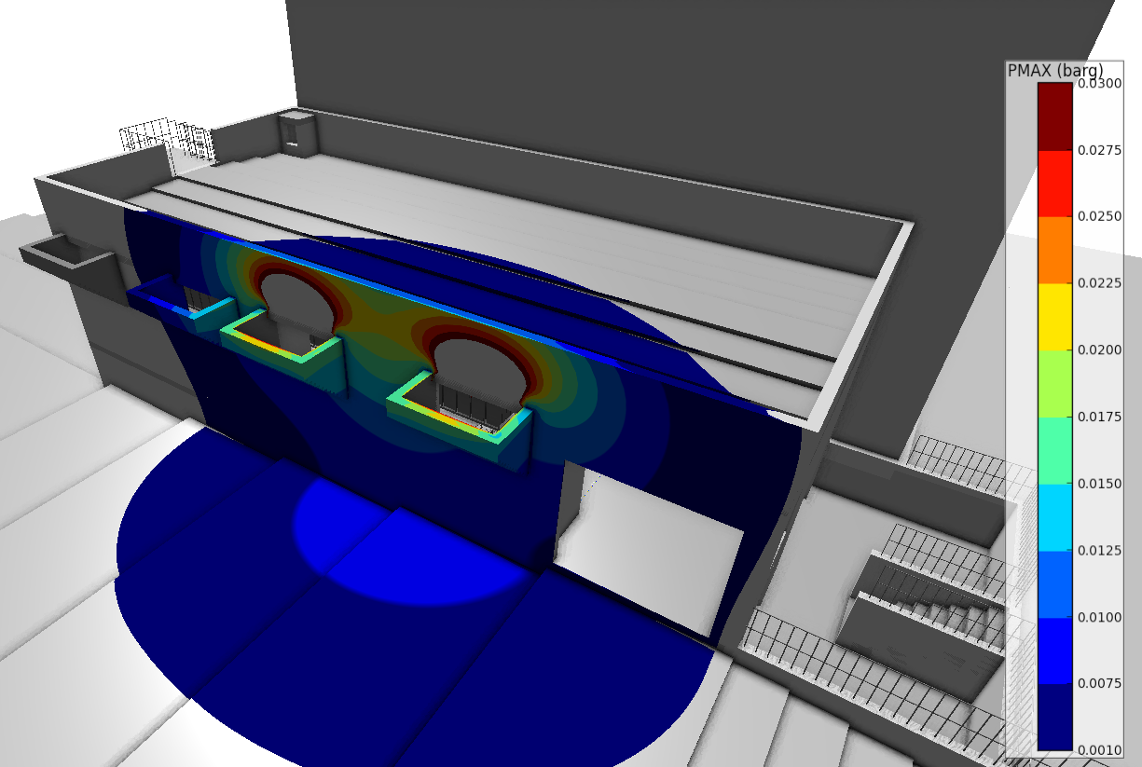
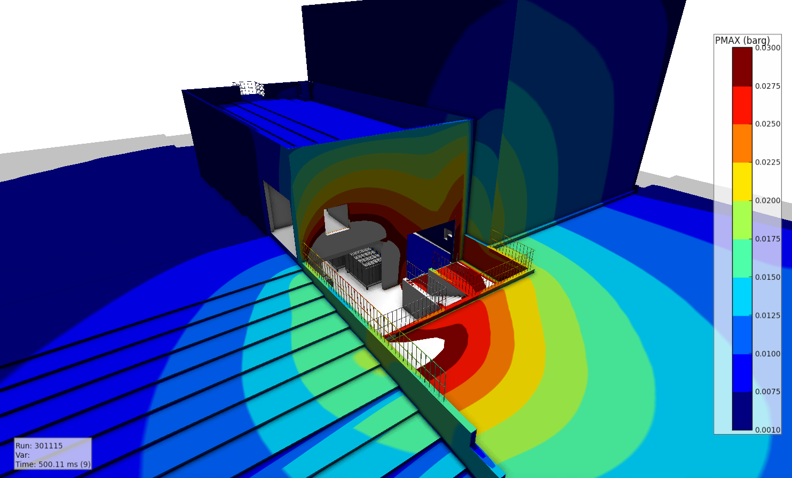
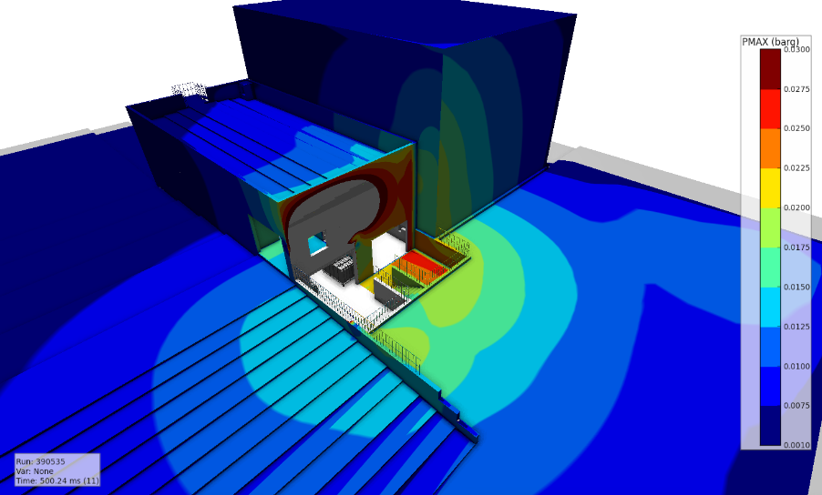
B245: External pressure
First floor: 1 venting area
First floor: 2 venting areas
Ground floor without barriers
Ground floor with barriers

Slide 29
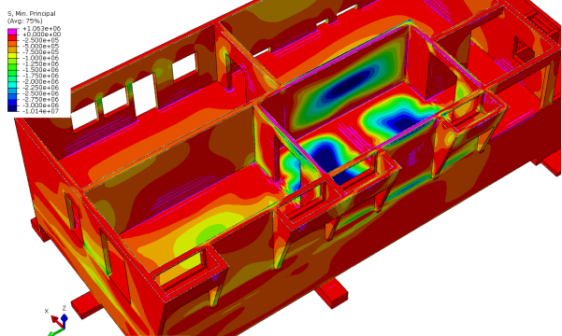
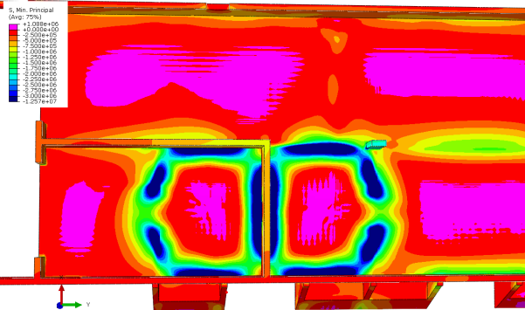
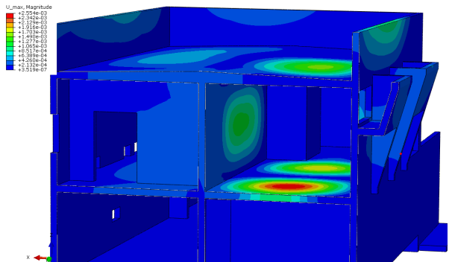
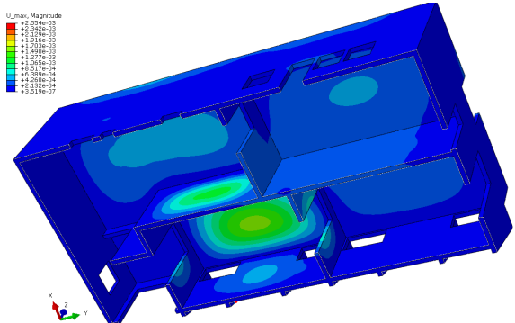
B245: Structural Members – Internal Stress / Displacement

Slide 30
What’s the structural demand?
Dead loads (e.g. self weight)
Imposed or live loads
Environmental loads
Accidental loads
Earthquake loads
What’s the capacity?
Measure of the capability of a structure and its elements to withstand the applied loads
Greek myth of Σίσυφος (Sisyphus)

Slide 31
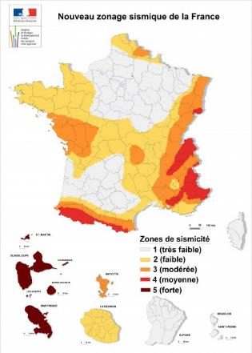
Seismic Hazard Map
What the standards say for CERN
Peack Gorund Acceleration having a probability of exceedance of 10% in 50 years, that means:
Return Period = 475 years
Frequence = 0.002/year
Décret nº 2010-1255 du 22 octobre 2010:
Seismic zone 3;
Reference peak ground acceleration on type A ground, a_{gR} equal to 1.1 m/s^{2;}
Design ground acceleration a_{g} is equal to a_{gR} times the importance factor γ_{I}

Slide 32
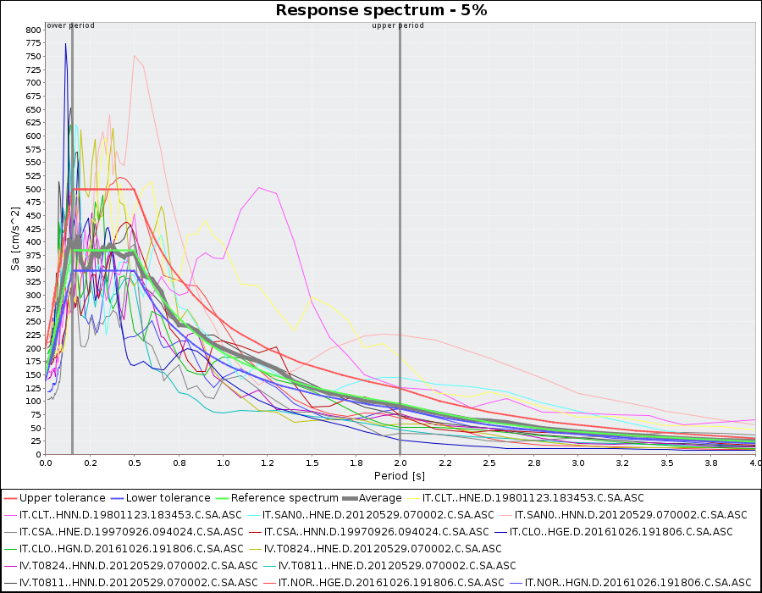
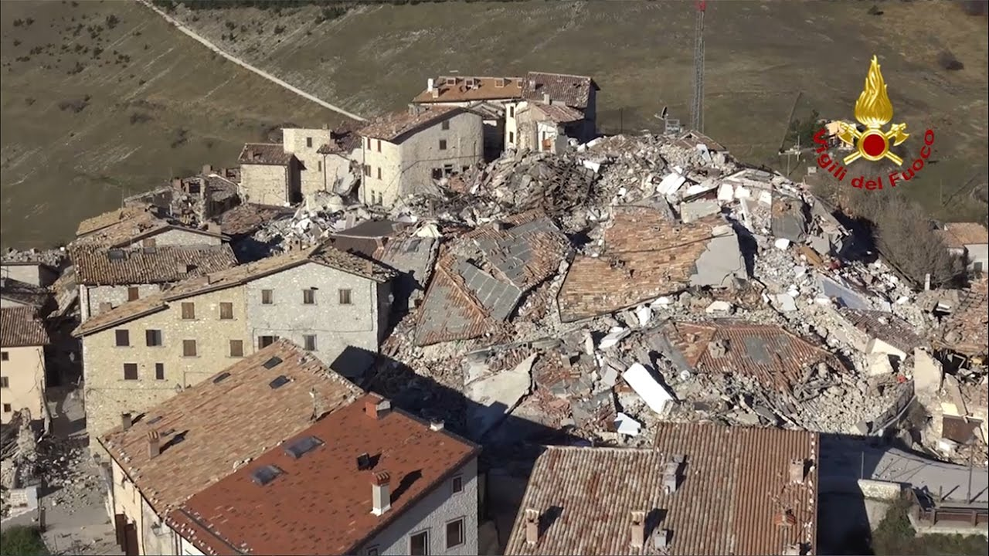
Seismic Hazard Map
What the standards say for CERN
Reference peak ground acceleration on type A ground, a_{gR} equal to 1.1 m/s^{2;}
Castelluccio di Norcia (Italy – 2016)

Slide 33
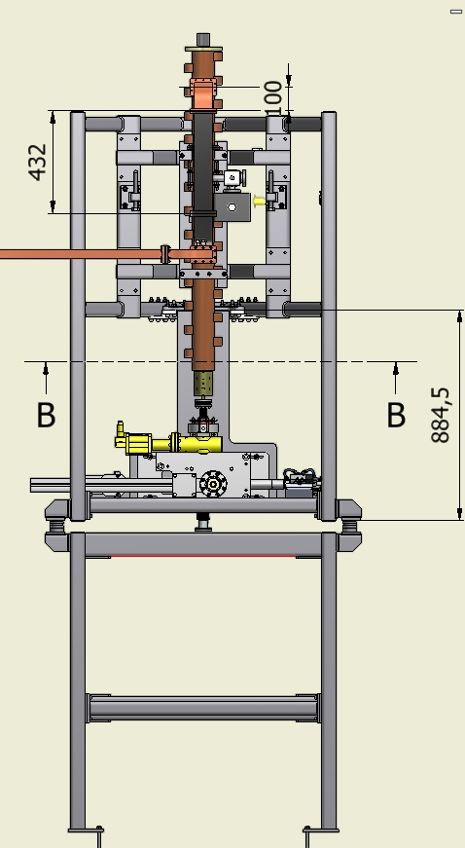
GBAR - LINAC supporting structure
During the HSE validation of the calculation note of the supporting structure:
Part 1 - Documents required for the installation
Buckling assessment of the structural members according to the par. 6.3 of the EN 1993-1-1
Part2- Documents required for the validation before using
Structural Assessment of the members and the joints under the seismic loads: the simplified equivalent static analysis shown in the Annex E of the EN 1992-4-1 may be adopted.
Reviewed anchor assessment accounting for horizontal loads.

Slide 34
GBAR - LINAC supporting structure
Base joint reinforcements:

Slide 35
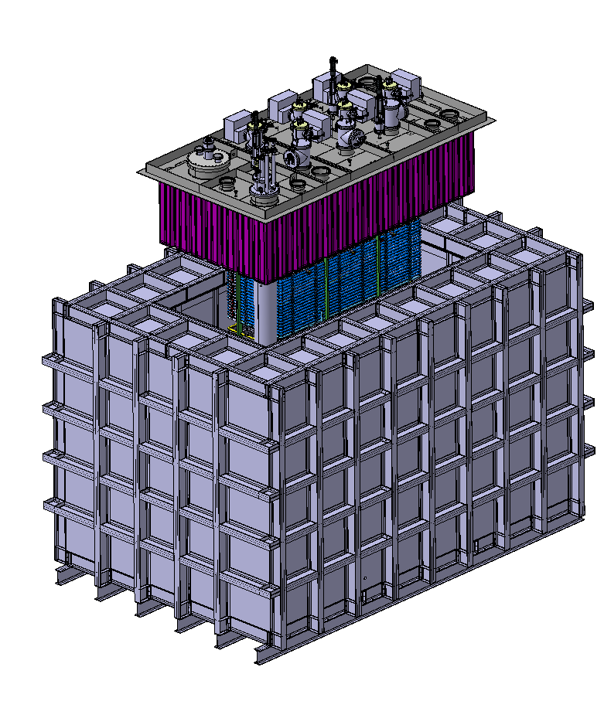
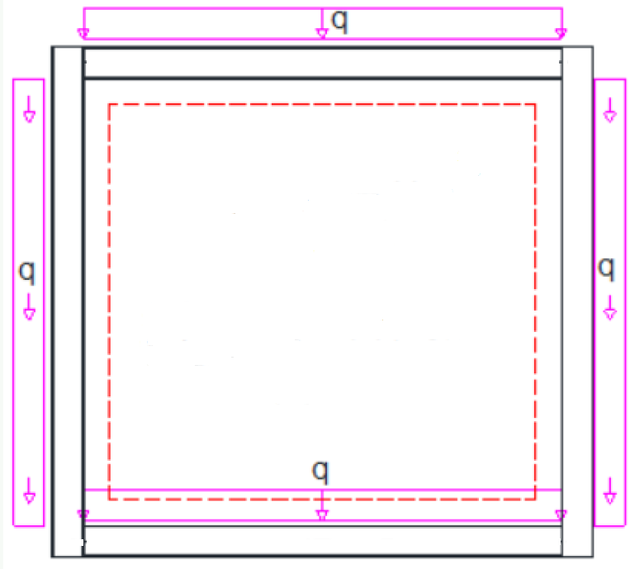
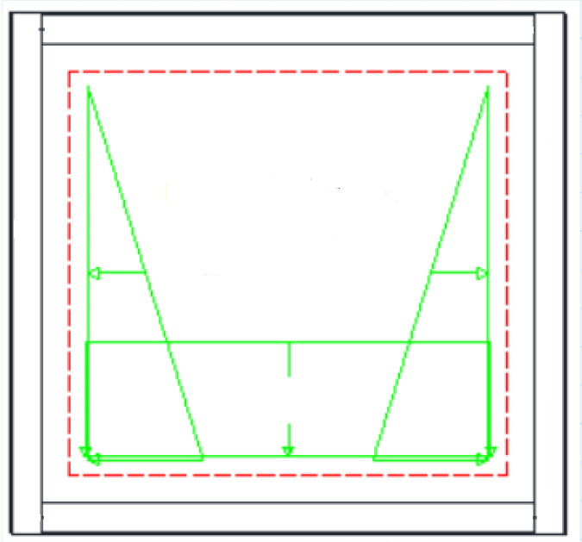
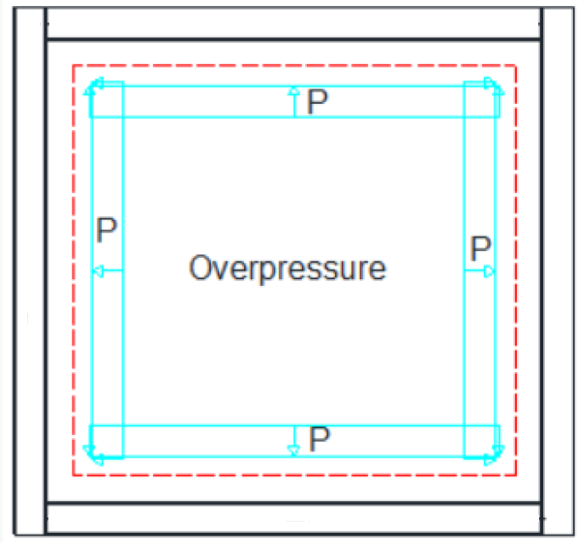
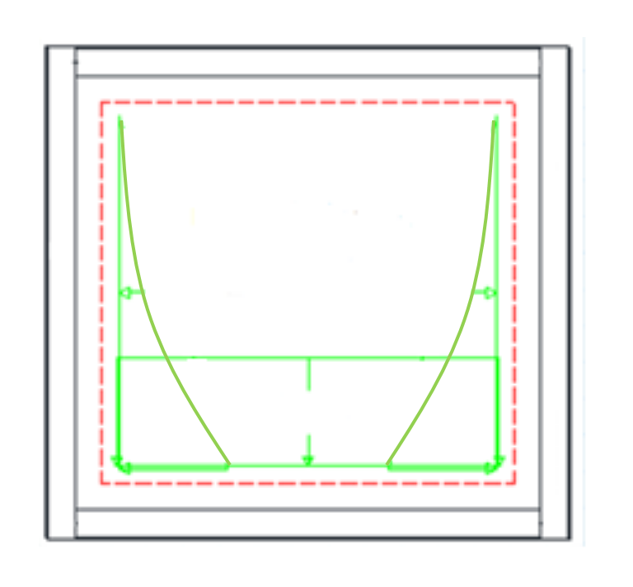
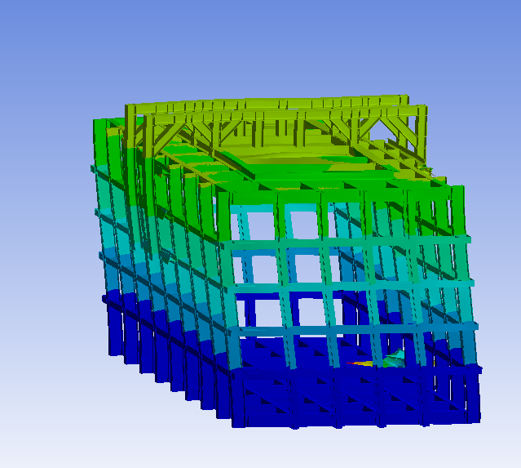
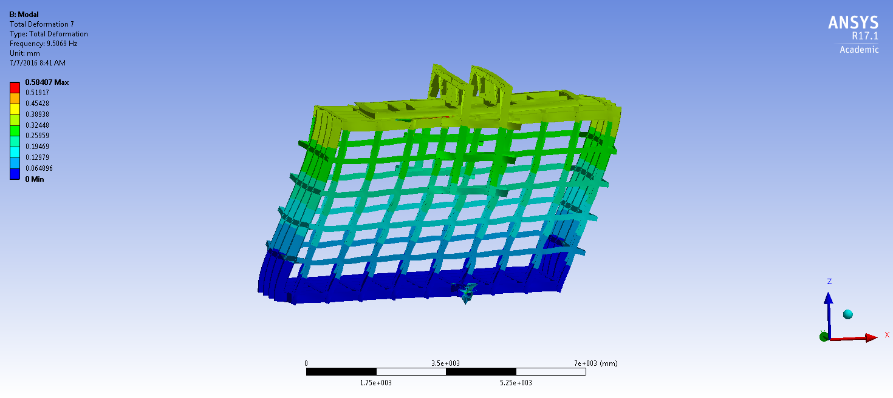
ProtoDUNE Detectors
Self weight
Hydrostatic pressure
Design pressure
Earthquake
Extra-pressure

Slide 36
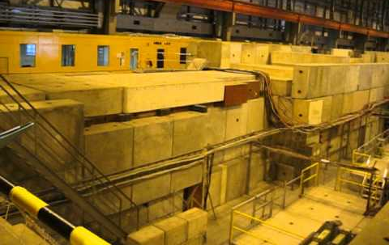
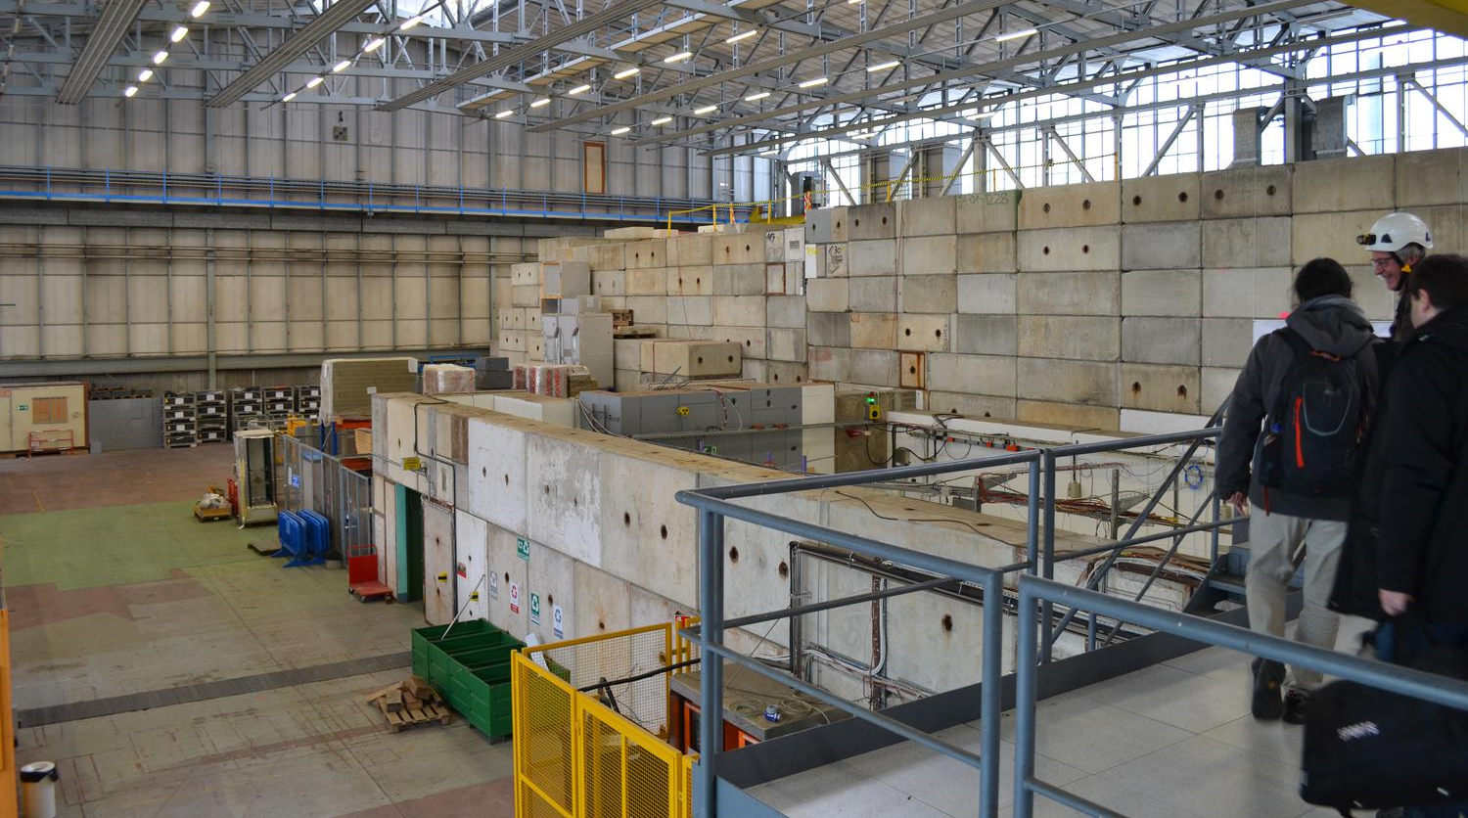


Shielding Block Constructions
EHN1
EA
LHCb
AD Hall

Slide 37


Shielding Block Constructions
A specific research modelling software (‘LMGC90’) has been developed at the Université de Montpellier (FR) ‘to describe’ the interfaces and to allow simulations with 3D finite element models of the structures
A collaboration with academic institutes are going to be established to realize experimental tests (shaking table) for the calibration of model unknown parameters for monolithic or more complex structures
EA

Slide 38
Conclusions
  Dead and Live loads may cause structural failures in elements and details not adequately designed and/or executed
  Loads produced by explosions: advanced CFD and FE analyses allowed to
  characterize and compare different venting solutions for blast mitigation
  provide input (blast loads data) for subsequent structural assessment or design
  check solution admissibility with respect to external and structural effects
  select optimal solution
  Earthquake loads: main seismic vulnerability sources at CERN are
  Non structural elements having a significant weight (equipment, installation components, etc.)
  Reinforced Concrete Building designed and realized following out-of-date standards
  Liquid retaining structures of significant dimensions
  Shielding Block Constructions

