Slide 2

HL-LHC buildings : acoustical modelling
Quentin Goestchel
HSE-SEE-SV

Slide 3
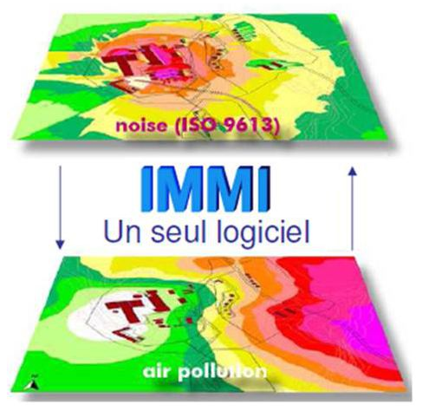
Table of contents
Basic mapping
Sound sources model
Sound transmission loss index
Numerical sound propagation
Simulation results
Internship objectives

Slide 4
Internship objectives
dB Vib predictive model
Global modelling of existing situation is needed
HiLumi-project building permit
Notes:
Master degree student, end-year intership. Will present you the main purpose of my work. HiLumi building permit, an acoustic modeling has been carried out → dBVib company
However, a global modeling is needed, which take account of the existant facilities. In order to know if CERN will have to invest in noise protection.

Slide 5
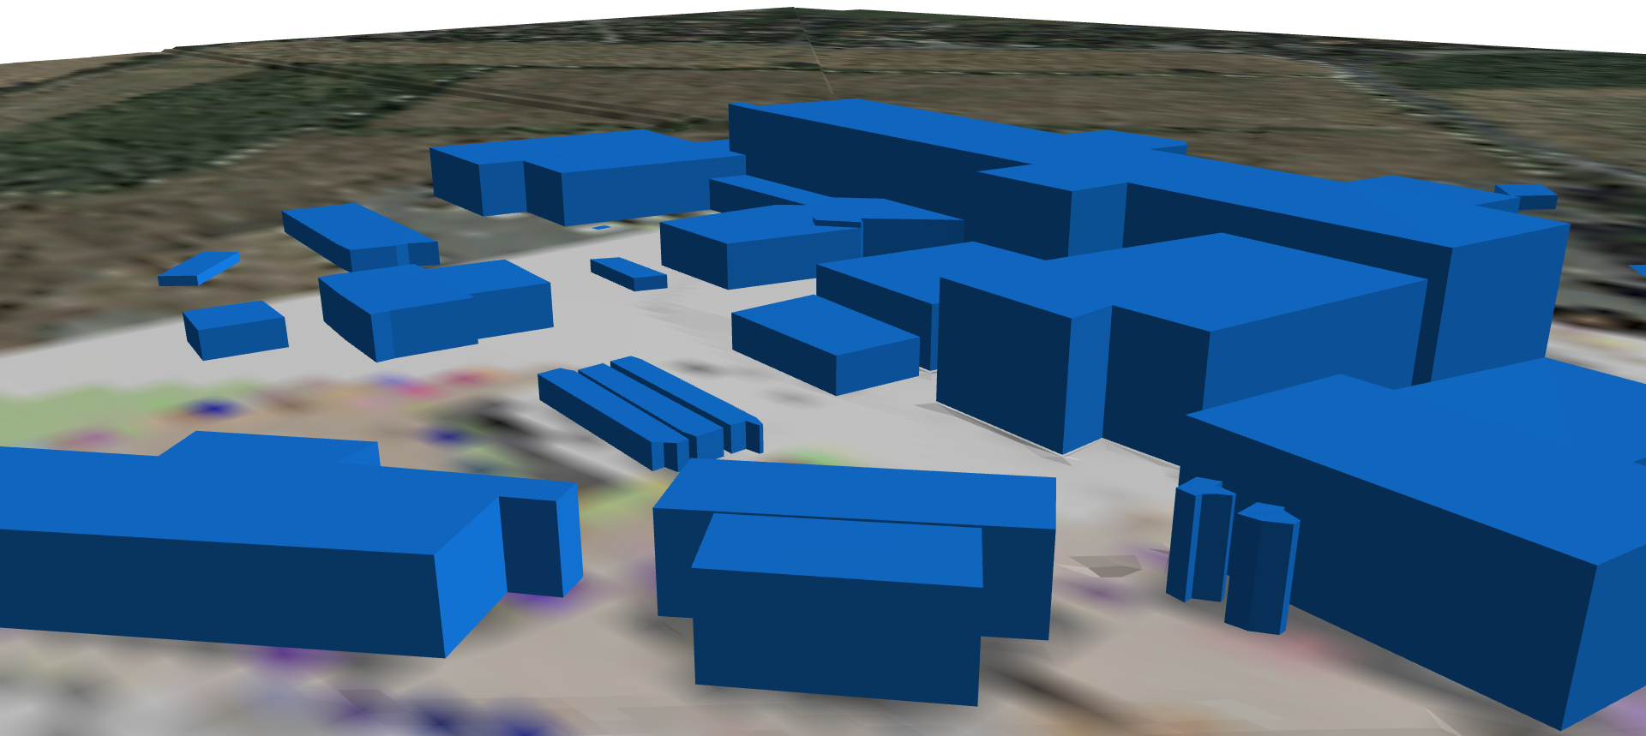
Basic mapping
Building shapes & background images:
SMB-SE-DOP& Google Maps
Point 5 buildings
Notes:
SHV file which contains the geometrical data of all the buildings. Represented by geometrical basic shapes. File format compatible with AutoCAD software.
Background image is imported through google maps, and has to be positioned to correspond with the shv file.

Slide 6
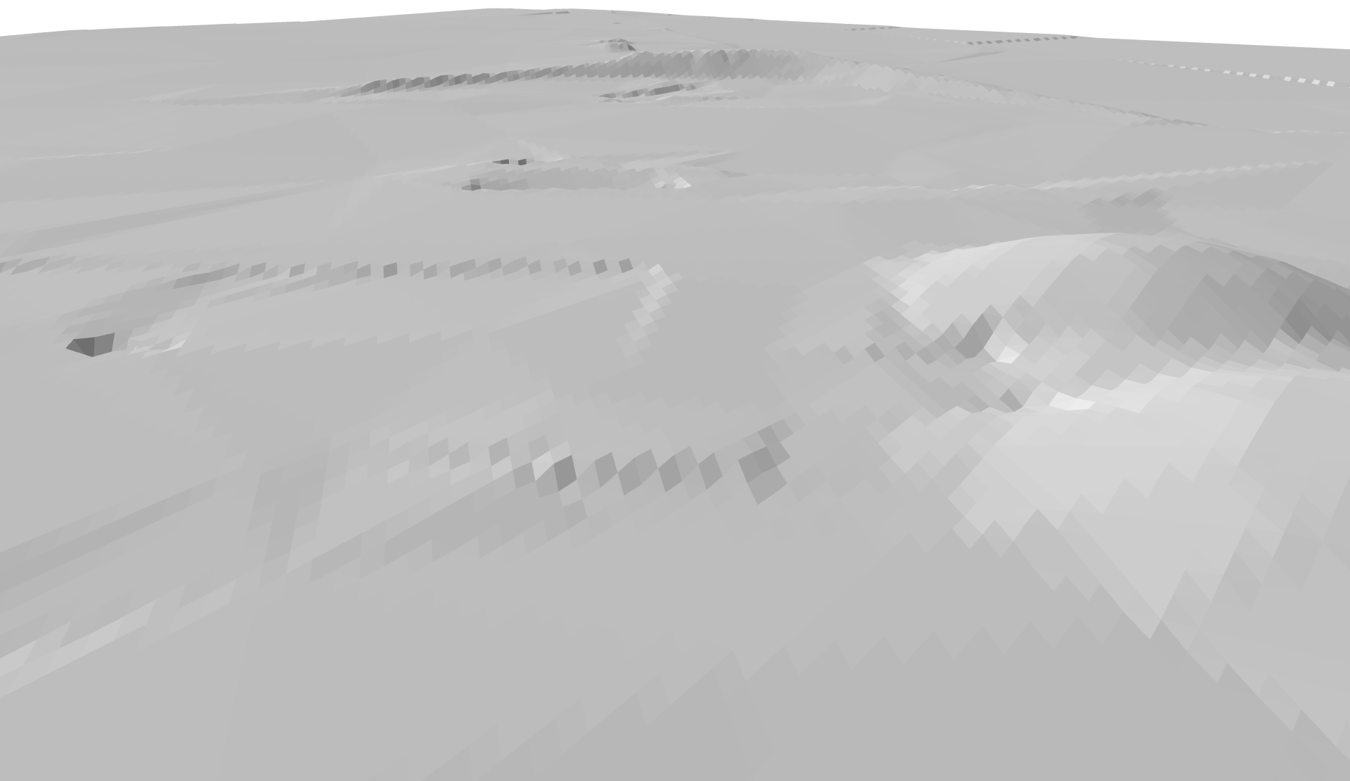
Basic mapping
Topography:
MNT « Modèle Numérique de Terrain » SMB-SE-DOP
Drone measured points, sorted as (X,Y,Z) in a .CSV file
3D visualisation of SMB altitude points
Notes:
For a precise modeling, MNT numerical model is used. Measured by drone, the altitude points enable a really precise modeling of the topography
Picture: Point 1 topography visualized thanks to that method

Slide 7
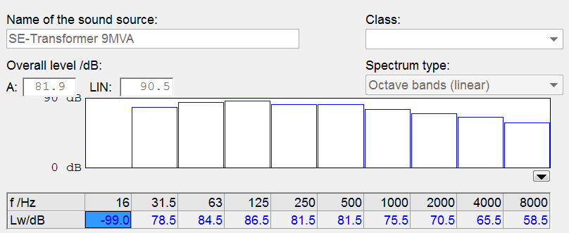
Sound sources
Punctual & surface sound sources:
Transformers
Fans
Falling water
Spectral data provided by CERN or constructors
Notes:
The most difficult thing is not to model the source but to find the spectral data. I mainly used dBVib data and constructors data for the main sound sources. I am still looking for data for some other sources.

Slide 8
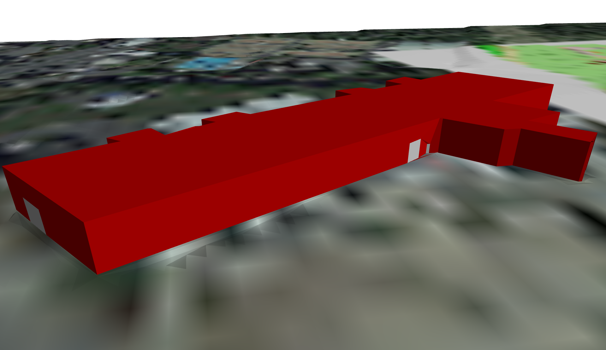
Sound sources
Openings edition
Acoustics insulation definition
Allocation to the building
Spectral intern source definition
On-site measurements
Noisy buildings:
Notes:
The red parts are surface sound sources. Automatically created thanks to this procedure. Sound level meter. Database of emission spectra . Acoustics insulation of the wall.
Unfortunately, The software is not designed to manage the distribution of sources inside the volume, the uniform volume is higher than it could be, so it models the worst case.

Slide 9
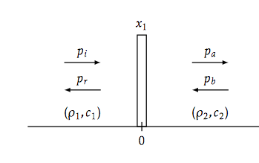
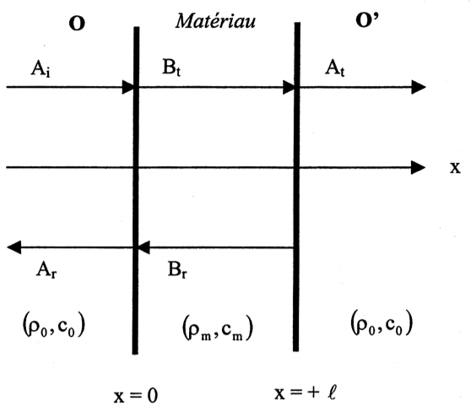
Transmission loss index
Models
Homogeneous-rigid material model :
Porous-elastic material model :
Notes:
Acoustics insulation of the wall → calculated through two different models
First one, only density per unit area is taken into account. The mechanisms inside the material are not modelled
Second one, porosity and elasticity of the material are taken into account.

Slide 10
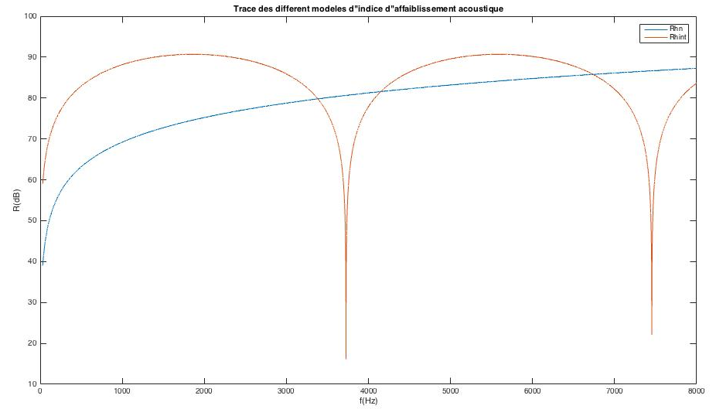
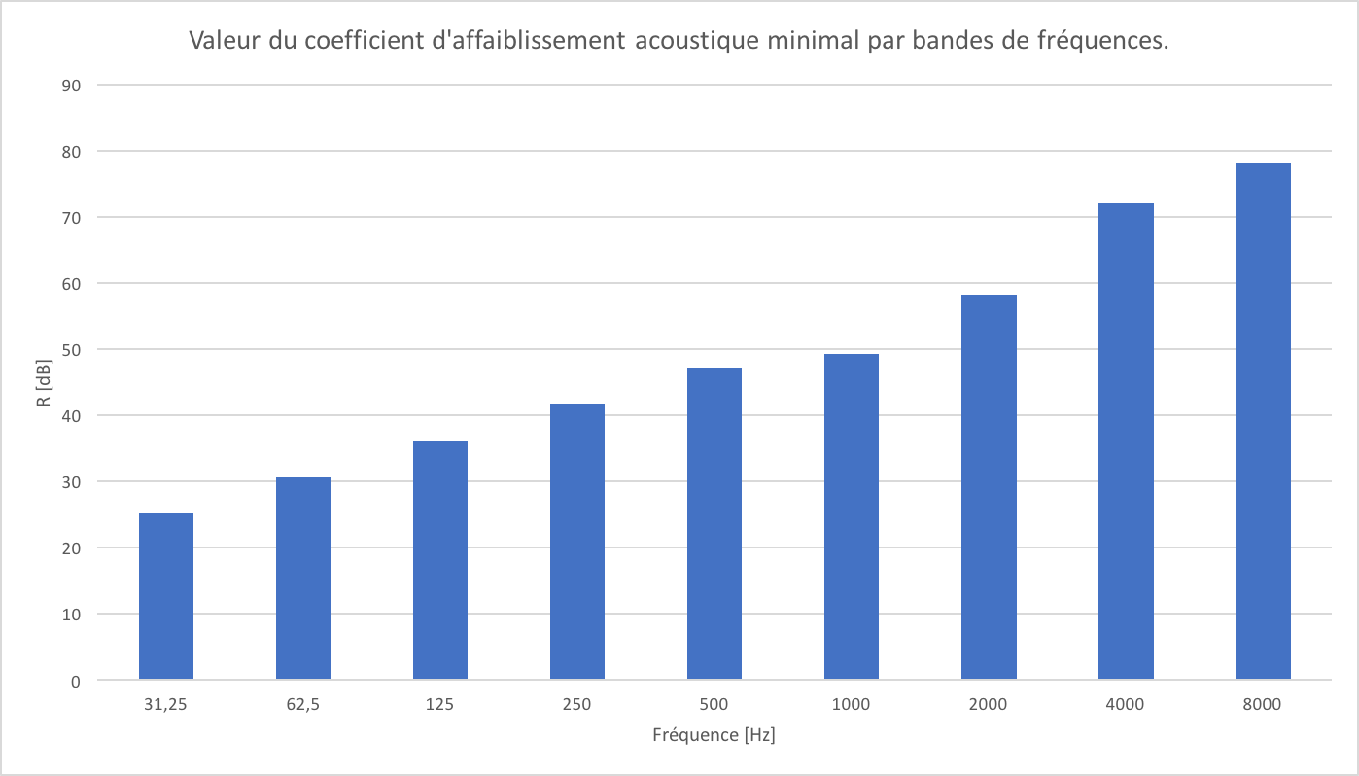
Transmission loss index
Utilisation
Numerical integration per frequency band + minimum
Notes:
In order to calculate the index, I plotted the functions of both models. Then I took the minimum of the values per frequency band, to stay in the worst case.

Slide 11
Numerical propagation
Favorable case: positive vertical gradient of sound celerity from source to receiver
Homogeneous case: null vertical gradient of sound celerity from source to receiver
Hypothesis: Two cases of applicability
Notes:
Noy I will explain the numerical method used by the software. It’s quite simple, but it needs some computational power. Here are the two cases of applicability:
Null vertical gradient: The sound celerity is the same everywhere
Positive gradient: linked to temperature, humidity

Slide 12
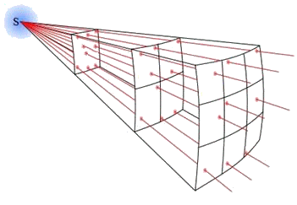
Numerical propagation
Method:
Discretization of noise sources
Determination of sound power per frequency band
Calculation of probability of favourable conditions
Search for propagation paths between each source and receiver
On each propagation path
Calculation of the attenuation
Calculation of the long-term sound level
Local calculation of the long-term sound level
Notes:
as if the software was playing pool, it throws away sound rays, and the procedure is:
Distribute the sound power level per unit area

Slide 13



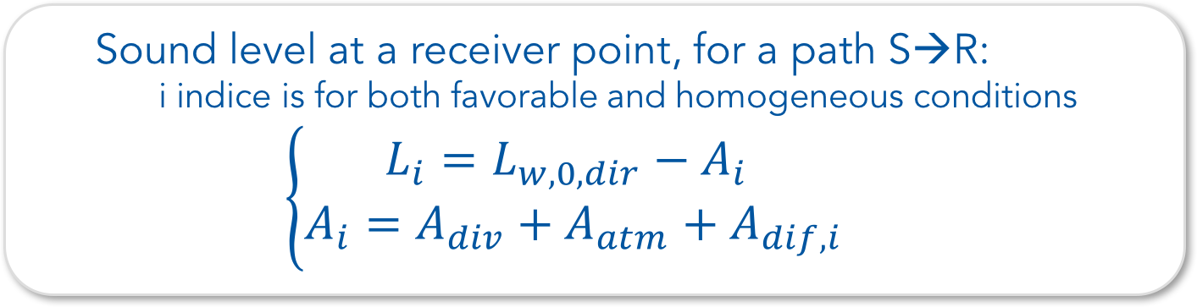
Numerical propagation
Calculation & total long-term sound level:
  Sound level at a receiver point, for a path S→R:
  i indice is for both favorable and homogeneous conditions
  $$\left\{\begin{matrix}L_{i}=L_{w,0,dir}−A_{i} \\ A_{i}=A_{div}+A_{atm}+A_{dif,i}\end{matrix}\right.$$
  The total Long-term sound level, at point R:
      For one frequency band, summing all energies from the N paths
    $$L_{tot,LT}=10×log⁡\left(\sum_{n}{{10}^{\frac{L_{n,LT}}{10}}}\right)$$

Slide 14




Numerical propagation
Geometrical divergence:
  $$A_{div}=20×\log\left(d\right)+11$$
Atmospheric absorption:
  $$A_{atm}=α_{atm}∙d/1000$$
    Value and calculation of $α_{atm}$ are detailed in ISO 9613-1
Notes:
Where d is the distance of the path

Slide 15
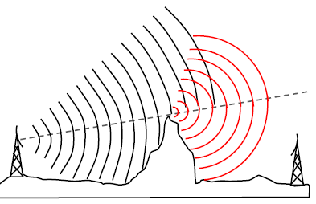
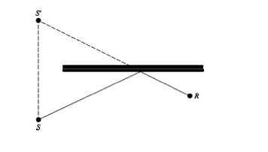

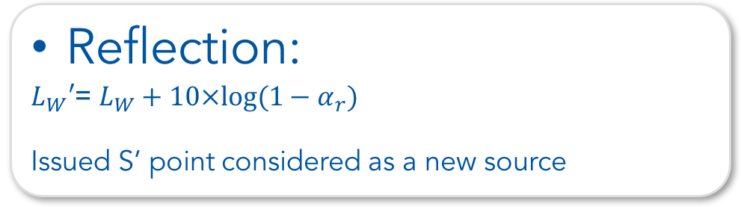
Numerical propagation
Diffraction:
$A_{dif}$term is calculated for ground and obstacles
Reflection:
$L_{W}′$= $L_{W}+10×log⁡(1−α_{r})$
Issued S’ point considered as a new source
Notes:
Diffraction create sound power losses
And reflection increase the number of sources

Slide 16
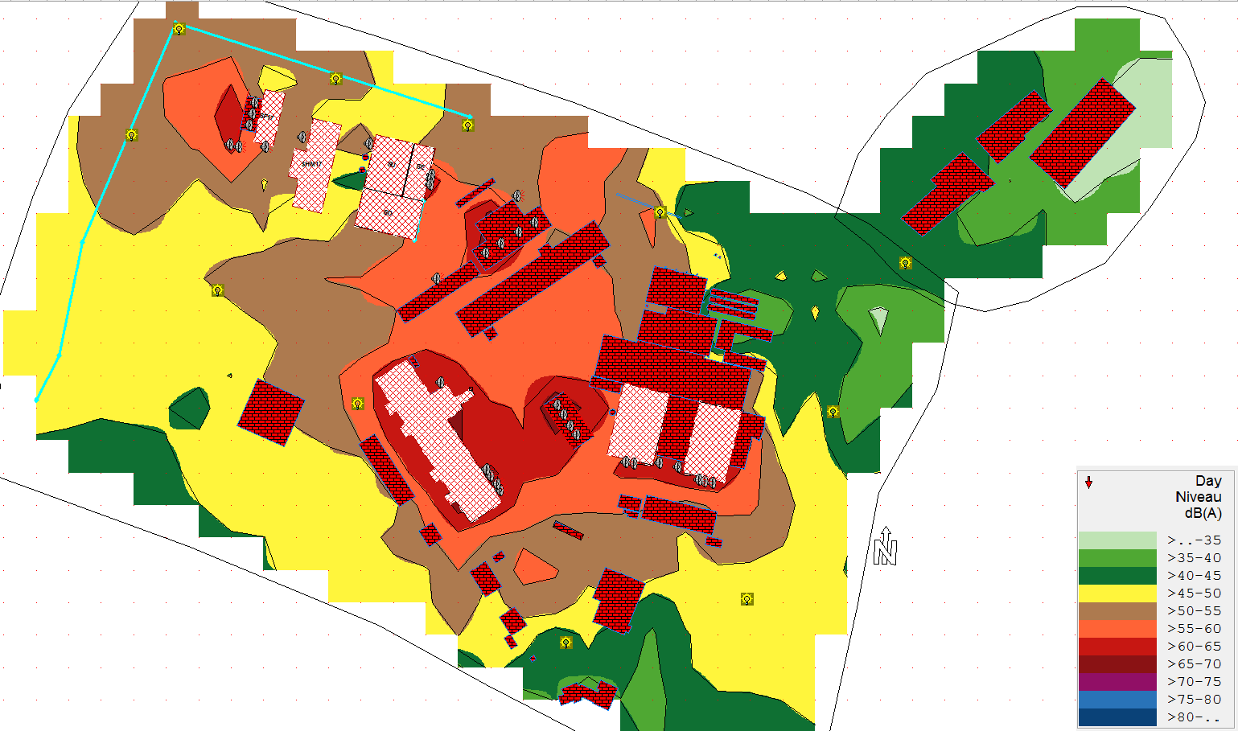
Results
Point 1(Suisse)
HL-LHC buildings
Farm
« Ordonnance sur la protection contre le bruit du 15 décembre 1986 »
SX1
BA6
Legal sound level in the resident house :
Day : 56 dB(A)
Night : 46 dB(A)
Notes:
The rule to follow is
At cern, the sound level is the same at night and day

Slide 17
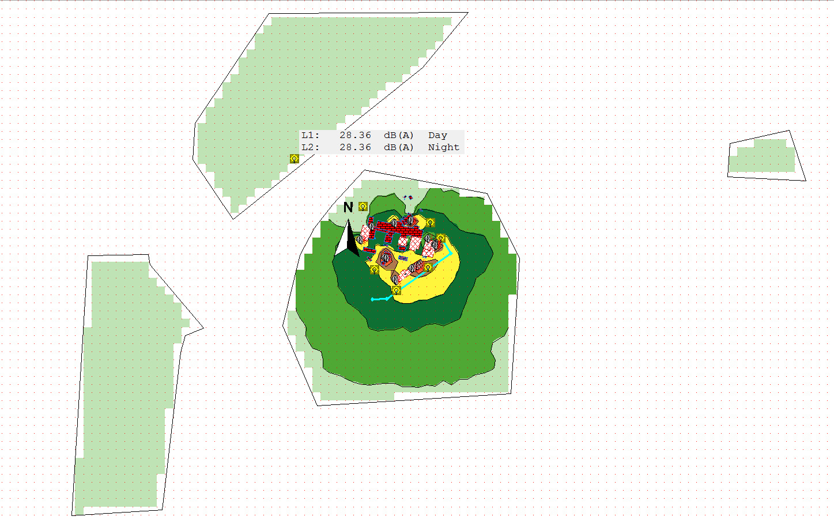
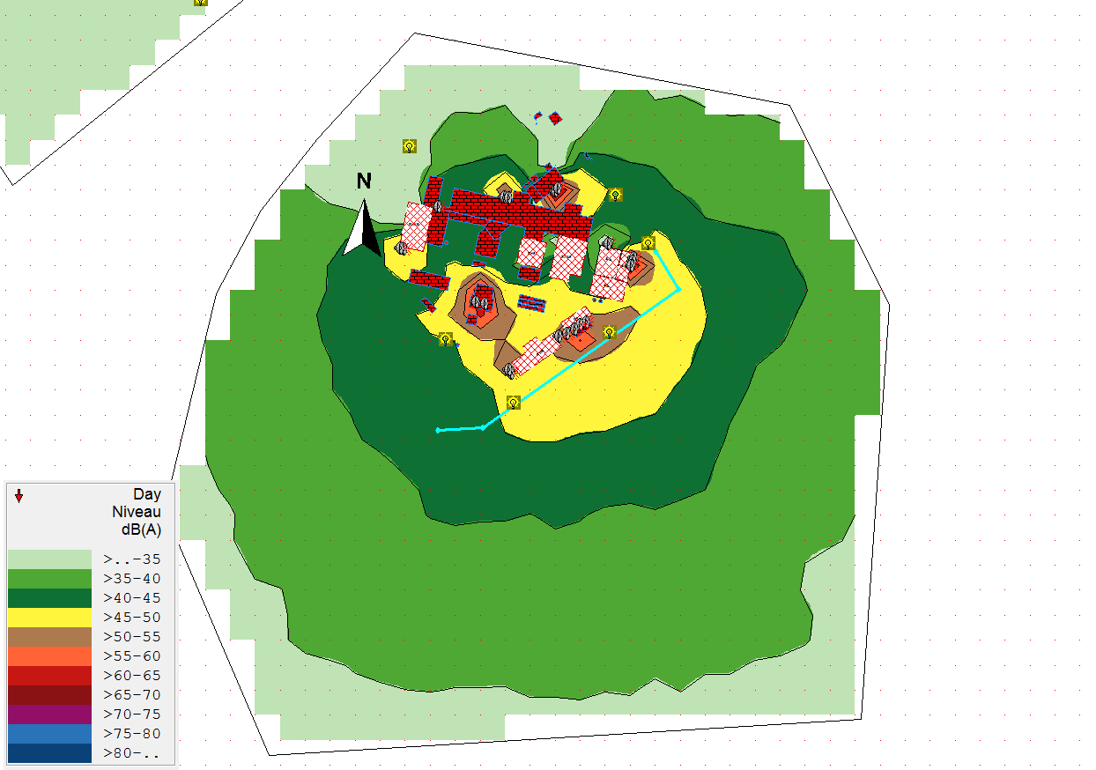
Results
Point 5(France)
« Arrêté du 23 janvier 1997 »
Residential area
Legal Levels at CERN limit:
Day : 70 dB(A)
Night : 60 dB(A)
Residential area
Emergence reglemented zone:
Day: 39 dB(A)
Night: 32,5 dB(A)
Notes:
Emergence: difference between Residual sound level (without CERN) and measured sound level can’t exceed a value in reglemented area.

Slide 18
Conclusion
Sound levels from the model respect the regulation
Some points of the model correspond with reality
There is points with a 35 dB(A) gap between the model and reality
The model needs to be reajusted

Slide 19
Bibliography
Cnossos-EU
ISO 9613-1
IMMI help document – Wölfel
Le guide des systèmes thermiques et acoustiques Arval – Arcelor Mittal
Sujet et correction de l’agrégation de Génie Civil 2004
Acoustique : conception et mise en œuvre - Bruxelles Environnement

