Slide 1
Hexavalent Chromium
& Nickel compounds
Biomonitoring in
Electroplating
workshop
September 2017
Diaine Annabelle

Slide 2
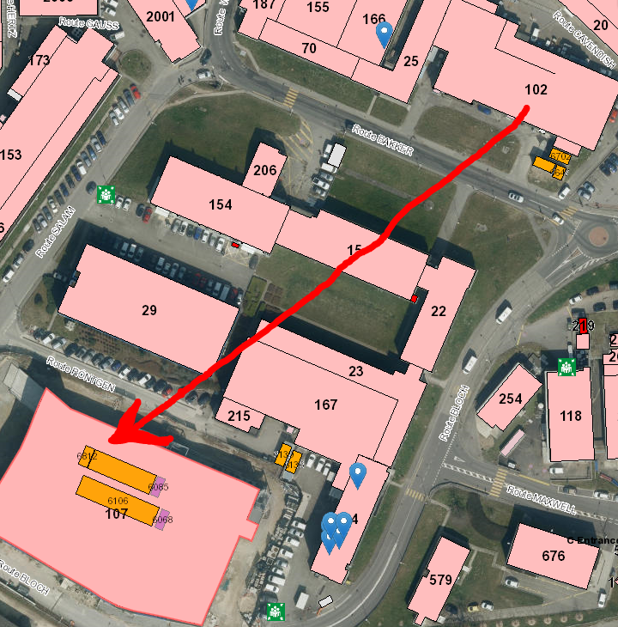
Objective: Risk assessment for nickel and chromium exposure in electroplating activity
Context of relocation of electroplating activity from B102 to B107
Chromium and Nickel exposure in B102:
Electroplating workshop
Hexavalent chromium (Cr VI) in chromic acid plating baths
Soluble nickel (Ni) compounds in nickel plating baths : sulphate, chloride, nickel sulfamate
6 Employees, no subcontractors

Slide 3
Introduction to toxicology
Toxicity
Received dose
Absorption
Duration of exposure
Excretion

Slide 4
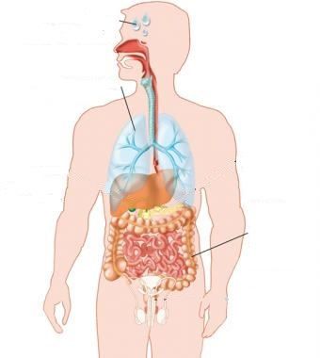
Introduction to toxicology
Toxicity
Cr VI
Acute toxicity: digestive disorder, encephalopathy, death…
Chronic toxicity:
                Pulmonary cancer
                ENT cancer
                Skin and respiratory sensitisation
Notes:
2 types of toxicity: Acute → one massive exposure, chronic→ frequent exposure with low level
confiremed risk of cancers for lungs and ENT

Slide 5
Introduction to toxicology
Toxicity
Ni compounds
Acute toxicity: none
Chronic toxicity:
Respiratory and skin sensitisation
Pulmonary cancer (Oxide and sulphate nickel +++ )
Nasal cavity cancer
Notes:
the main Confirmed risk is a respiratoy and skin senstisation wich can cause eczema, asthma, rhinitis...

Slide 6
Introduction to toxicology
Absorption
CUTANEOUS
Chromium VI
Respiratory: 50-85%
Digestive: 10%
Cutaneous: 4%
Nickel compounds
Respiratory: 25-60%
Digestive <10%
Cutaneous < 1%
RESPIRATORY
DIGESTIVE
Notes:
3 routes of absorption
respiratory 50 to 85% of the substance breathed
digestive: when the substance is eaten, for exemple because of hands not clean

Slide 7
Introduction to toxicology
Excretion
Metabolism of
Chromium VI in Chromium III
Nickel compounds in Nickel metal
Urinary elimination for Nickel and Chromium III
Notes:
Excretion = important to know for each substances because it permit to choos the biological test and to interpret it after.

Slide 8

Received dose
First assessment by metrology in ambiant air in 2015
Results << Interpretative Standards (AEV from SUVA 2015 ref 1903.f)
Analysis of Chromium VI <1 µg.m-3 (AEV SUVA: 5 µg.m-3)
Analysis of Nickel between < 1 and 2 µg.m-3 (AEV SUVA: 50 µg.m-3)
→No acute toxicity
→Chronic toxicity?
Notes:
Very low compared to IS.
The IS choosen were the average exposure values proposed by the SUVA, the main (“mèin”) occupational accident and sikness insurance funds (“feund”)
Chromium less than 1 microgram per cubic meter werheas the average exposure value was 5 microgram.m-3

Slide 9
Objective: Risk assessment for nickel substances and hexavalent chromium exposure in electroplating activity
Advantages of biomonitoring vs metrology:
More precise results for low received doses
Considering all routes of absorption, all sources of exposure and individual factors
Point zero before relocation and impact of relocation on chemical exposure
Notes:
I

Slide 10
Methods
Chromium | Nickel
2 Urinary tests T₀ and T₁
Not specific to occupational exposure and not specific to Cr VI compound | Not specific to occupational exposure and sulfate nickel compound
Sample after break from work T₀
Sample at the end of the week of work T₁
Dietary and lifestyle questionnaire
Last month exposure to all Chromium forms (Cr 0, III, VI) | Recent exposure to all Nickel compounds
Versatile activity : traceability by tracking invoicing of 102 activities
Notes:
2test because these tests are not specific for occupational exposure neither for specific chromium or nickel compounds
It give information on last month exposure to all chromium forms: III, 0, VI and of recent exposure to all nickel compounds
So to know the exposure in work to cr VI and nickel compounds using in electroplating we did 2 samples: after break from work , after 4week of full time work
We did also a dietary lifestyle questionnaire to know exposure to Cr III, nickel and Cr VI in extra professional life
We have track the invoicing of the electroplating workshop because the employees do very various tasks, more or less likely to expose to chromium and nickel. With tracking billing it can help to explain then if there are differences in the results.

Slide 11
Results compared to interpretative standards:
Results not complete
T₀ compared to RBV (limit in average population)
Nickel : 1µg/L-0,7µg/L- 1,8µg/L < French RBV 3 µg/L
Chromium : 0,2 µg/L - 0,3 µg/L - 0,2 µg/L - < French RBV 0,65 µg/L
T₁ compared to LBV (limit in occupational exposure)
Nickel : 0,4µg/L Swiss IBV: 40μg/L
Chromium : 0,3µg/L French IBV: 2,5 µg/L

Slide 12
Continuation:
Depends on the results
Workstation visit if results over interpretative values
→ Review of hygiene measures
→ Review of particularly exposing tasks
Probable regular biomonitoring
In any cases: Maximum reduction in the risk exposure
→ Maximum substitution of Chromium VI and Nickel
→ Process automation testing

Slide 13
Thank you for your attention

