Slide 1
SWAN: service for web based analysis
D. Castro, E. Tejedor, D. Piparo, P. Mato
E. Bocchi, J. Moscicki, M. Lamanna
https://swan.web.cern.ch
Mar 14th, 2018
Octave Conference

Slide 2
Introduction

Slide 3
Motivation
Analysis only with a web browser
  Available everywhere and at anytime
  Integrated with other analysis ecosystems : ROOT, R, Python, ...
Easy to use (but powerful)
  No local installation and configuration needed
Create easily sharable scientific results: plots, data, code
Integration with CERN resources
  Access software, user/experiments data, mass processing power

Slide 4
SWAN
Notes:
Pilot service since June 2016

Slide 5
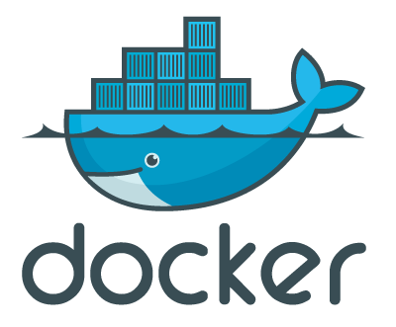





Integrating services
Infrastructure
Software
Storage

Slide 6
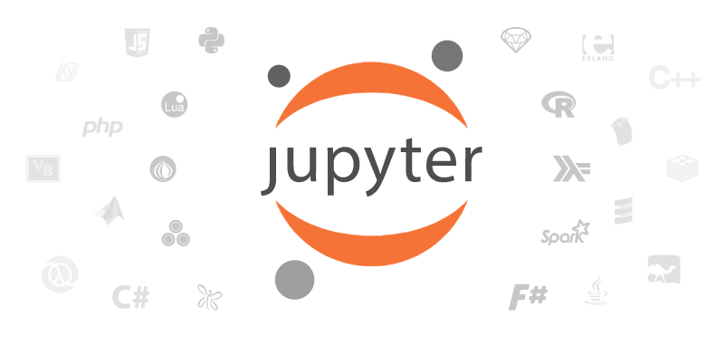
Jupyter - The Notebook as Interface
A web-based interactive interface and platform that combines code, equations, text and visualisations
  Ideal for sharing/collaboration
  … In a nutshell: an “interactive shell opened within the browser”
Many supported languages (kernels)
  In SWAN: Python, ROOT C++, R and now Octave
Interactive, usually lightweight computations
Very useful for some use cases
  Final steps of an analysis, Exploration, Teaching, documentation and Reproducibility

Slide 7
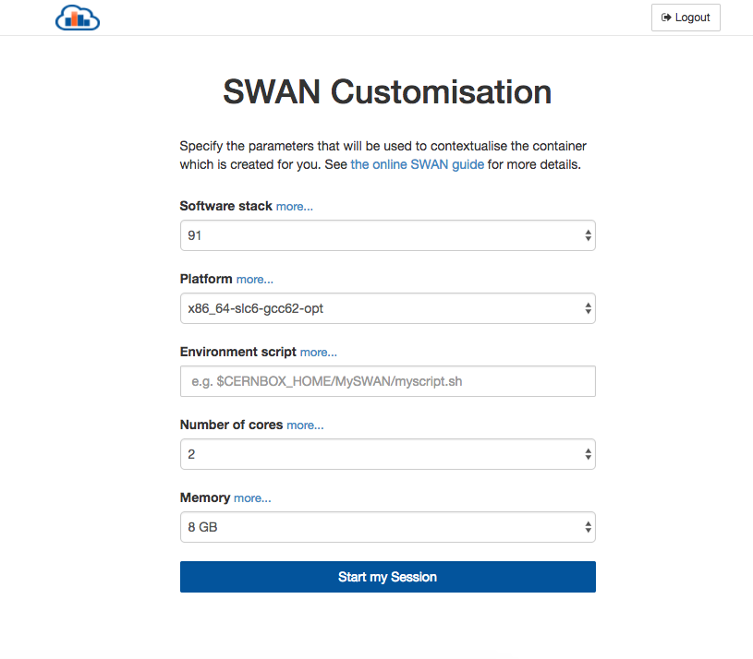
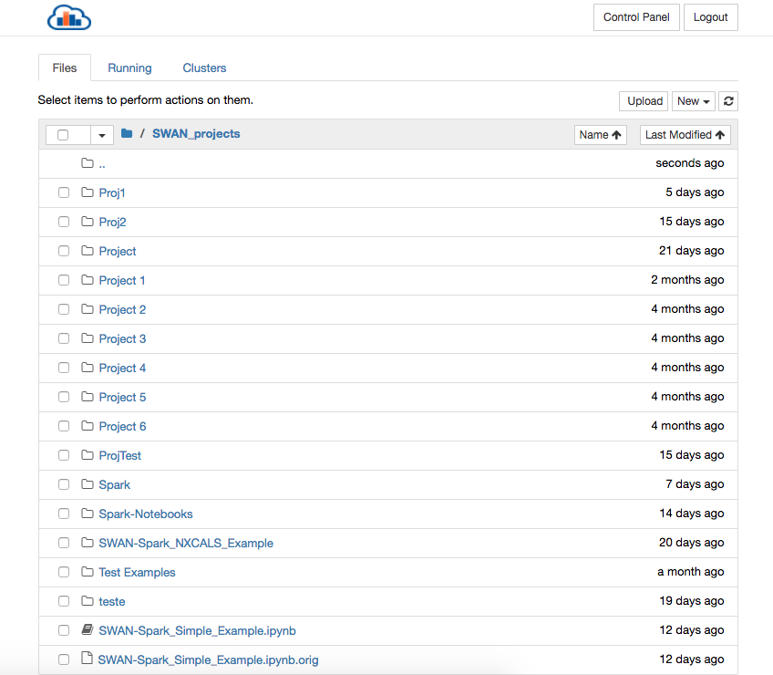
Jupyter - The Notebook as Interface

Slide 8
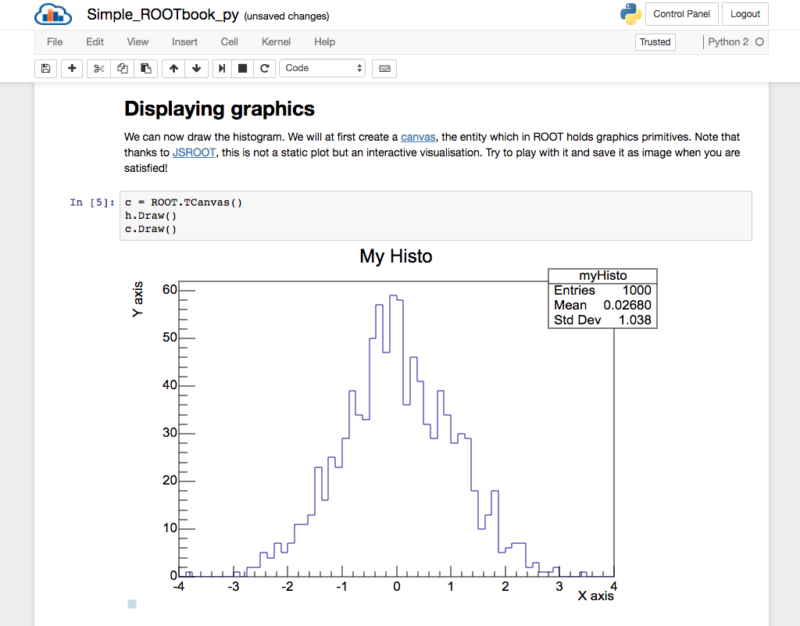
Text
Code
Graphics

Slide 9
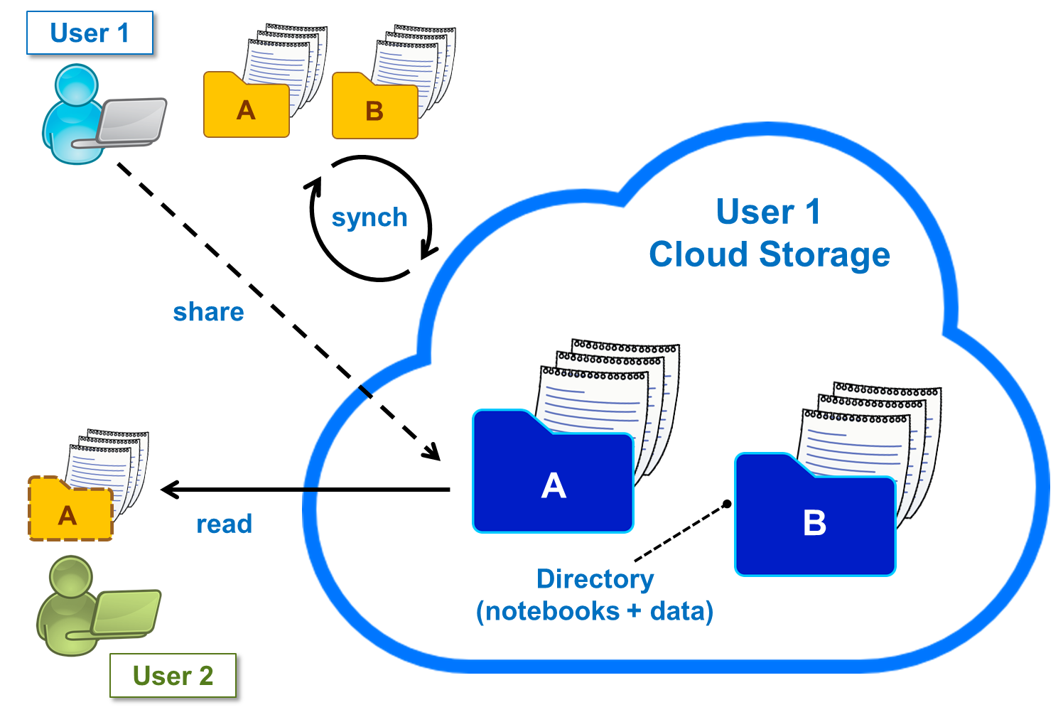

Storage
Uses EOS mass storage system
  All experiment data potentially available
User personal space, synchronized through CERNBox
  All files synced across devices, the cloud and other users

Slide 10
Software
Software distributed through CVMFS
  ”LCG Releases” - pack a series of compatible packages
  Software used by researchers is available
Possibility to install other libraries in user local storage
LCG Release
CERN Software
User Software

Slide 11



Architecture
SSO
Web portal
Container Scheduler
User 1
User 2
...
User n
CERN Resources
EOS
(Data)
CVMFS
(Software)
CERNBox
(User Files)

Slide 12
Boxed
Containerized version of all the infrastructure
  Includes EOS, CERNBox, CVMFS and all Swan services (Jupyter Docker image, JupyterHub)
  Available in https://github.com/cernbox/uboxed
Easily deployable on premises
  Installable in Linux systems
  Based on Docker Compose

Slide 13
SWAN and the community
Notes:
Is it being used?

Slide 14
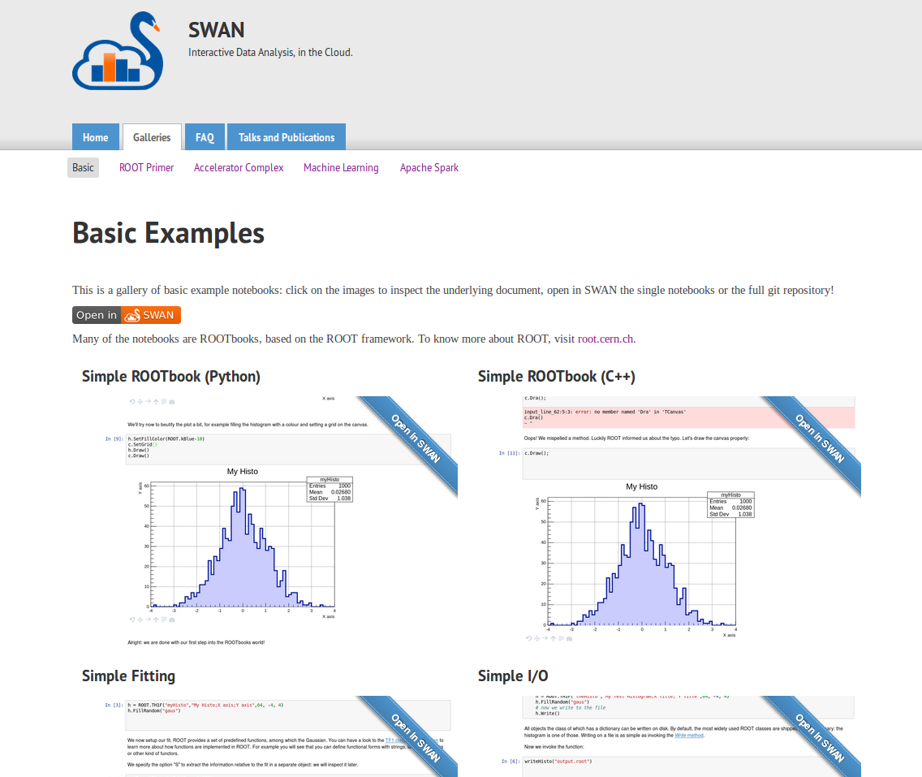
SWAN user community
Example notebooks at swan.web.cern.ch
SWAN development is guided by our user community
  New features (libs, kernels, ...) are requested by users from their real usage needs
Gallery of examples
  Made in collaboration with our users
  Almost 50 notebooks in 7 categories
Access with only a click

Slide 15
Recent developments

Slide 16
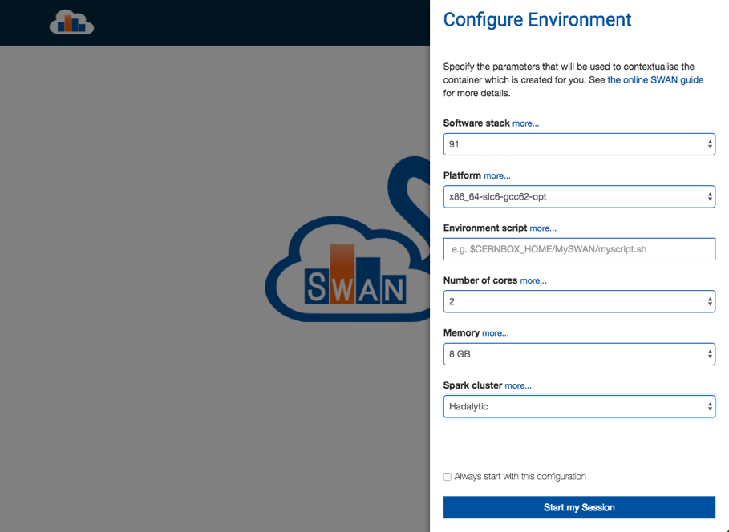
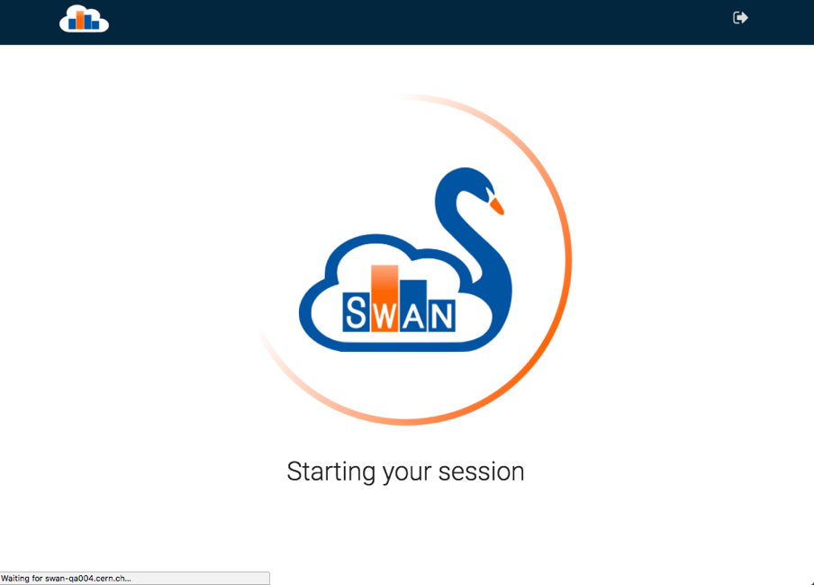
New User Interface

Slide 17
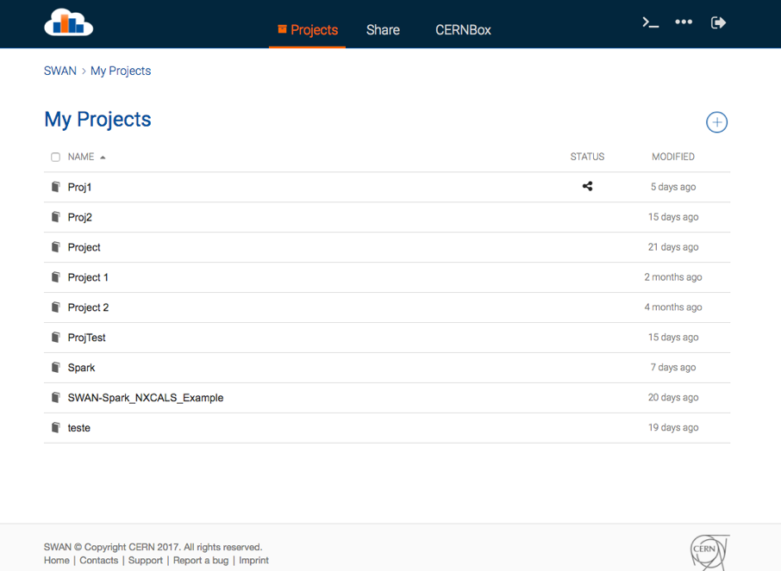
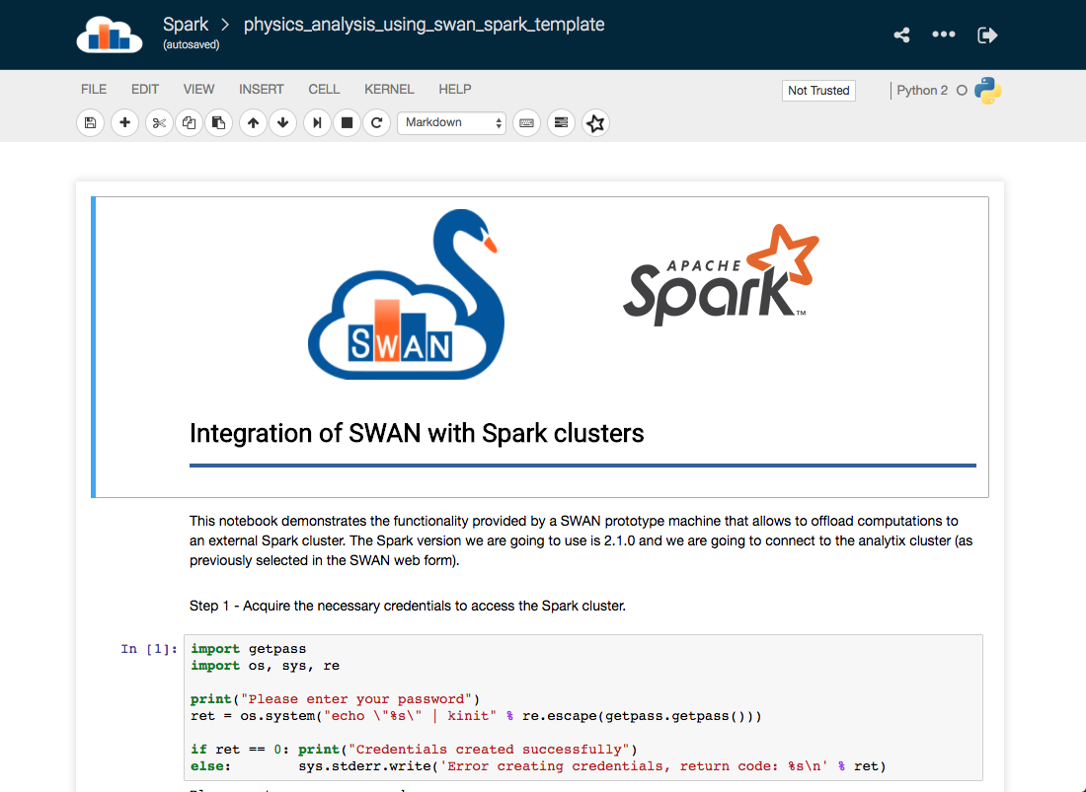
New User Interface

Slide 18
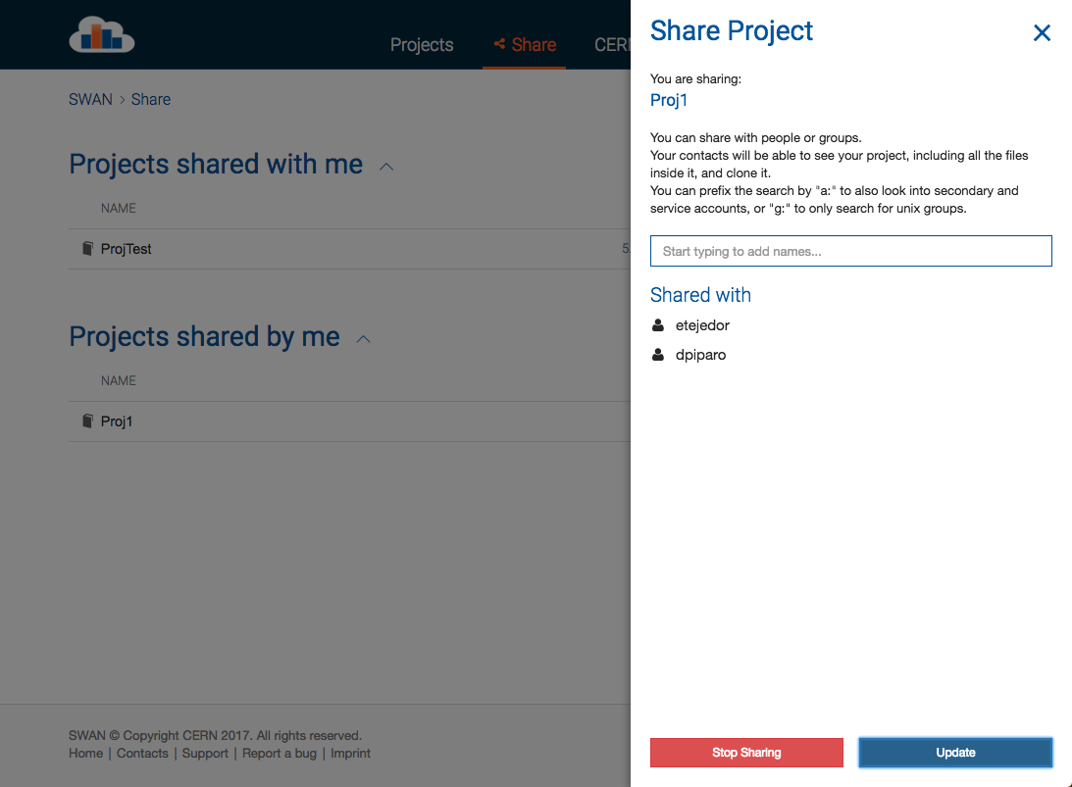
Sharing made easy
Sharing from inside SWAN interface
Users can share “Projects”
  Special kind of folder that contains notebooks and other files, i.e. input data

Slide 19
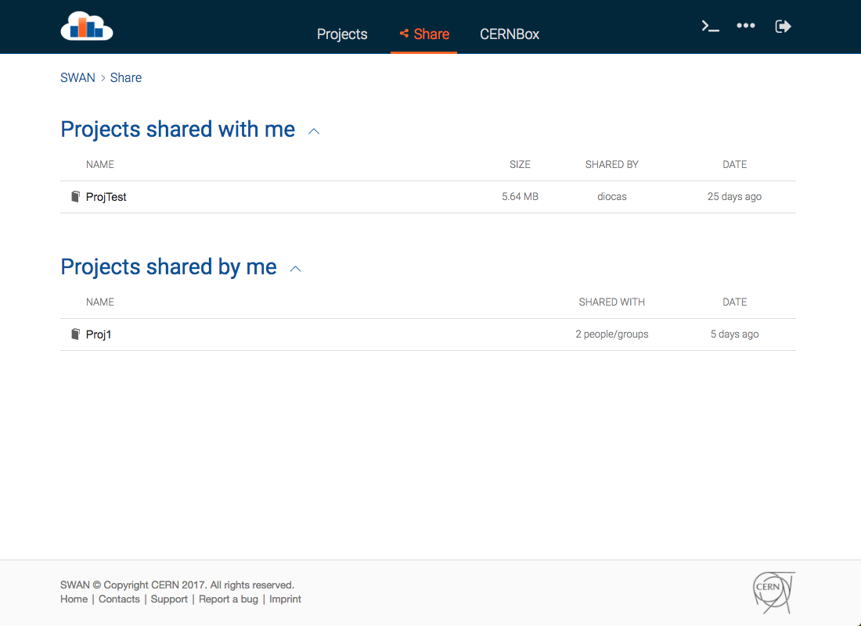
Sharing made easy
Users can clone a shared Project directly from the interface
  Jupyter doesn’t allow concurrent editing

Slide 20

Integration with Spark
One of the features requested by the community
  Team from the Beams department
Allow users to connect to CERN Spark Clusters to submit jobs
User Notebook
Spark Cluster
Spark Master
Spark Worker
Python task
Python task
Python task

Slide 21
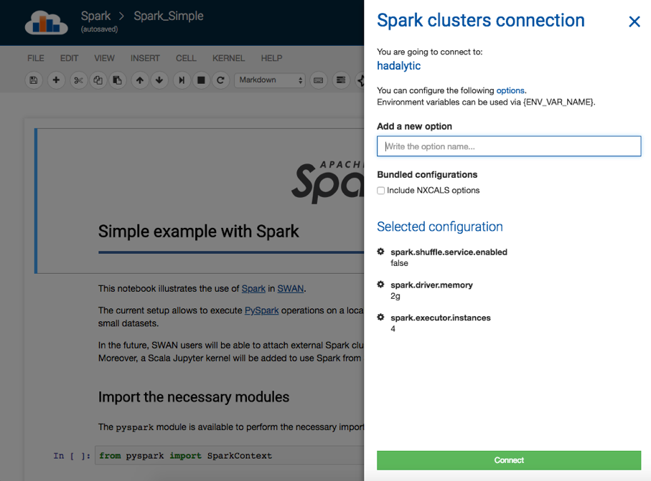
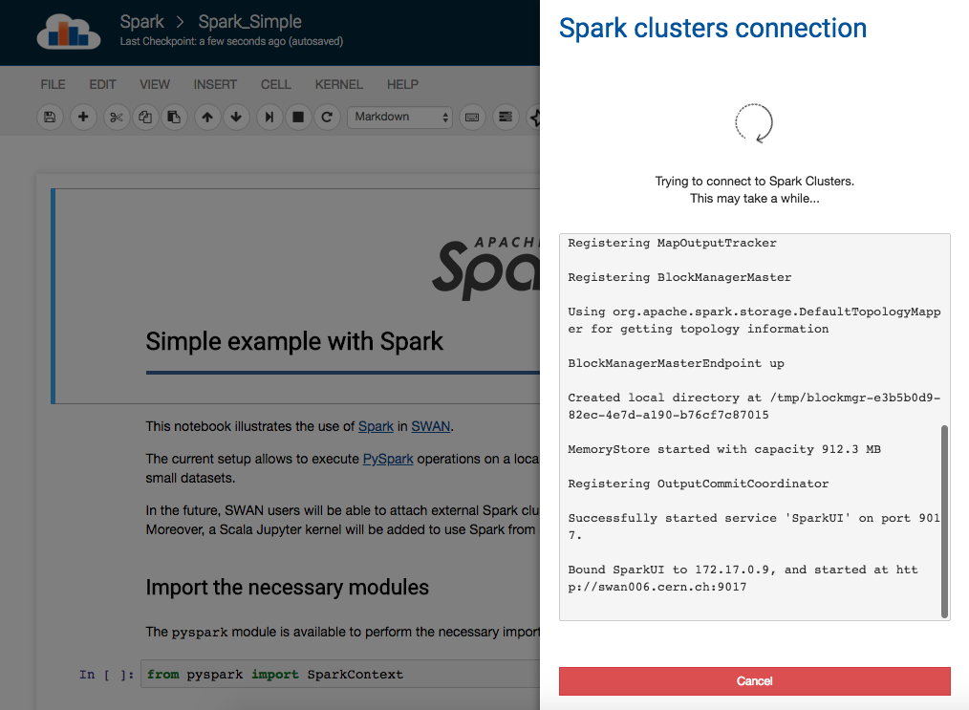
Integration with Spark

Slide 22
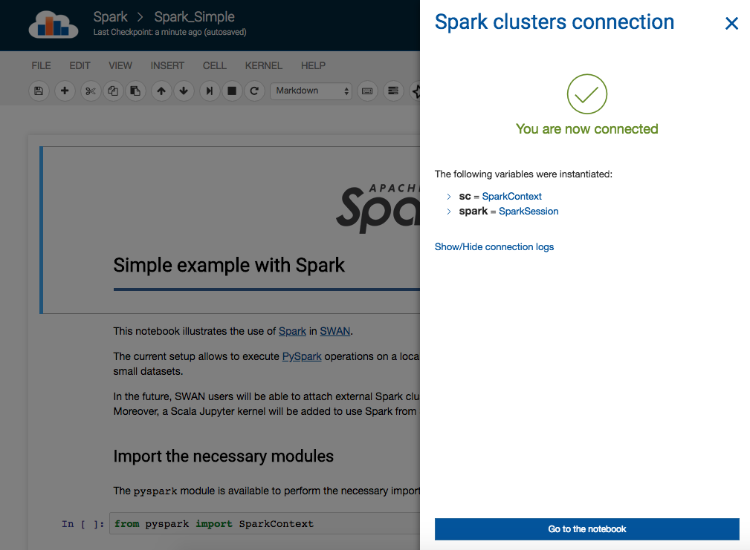

Slide 23
Demo

Slide 24
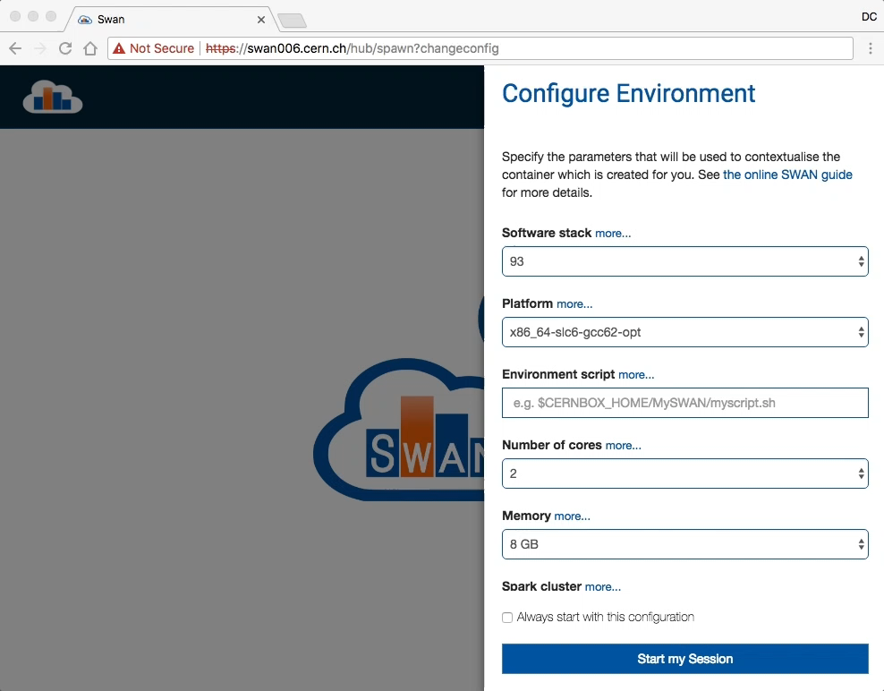

Slide 25
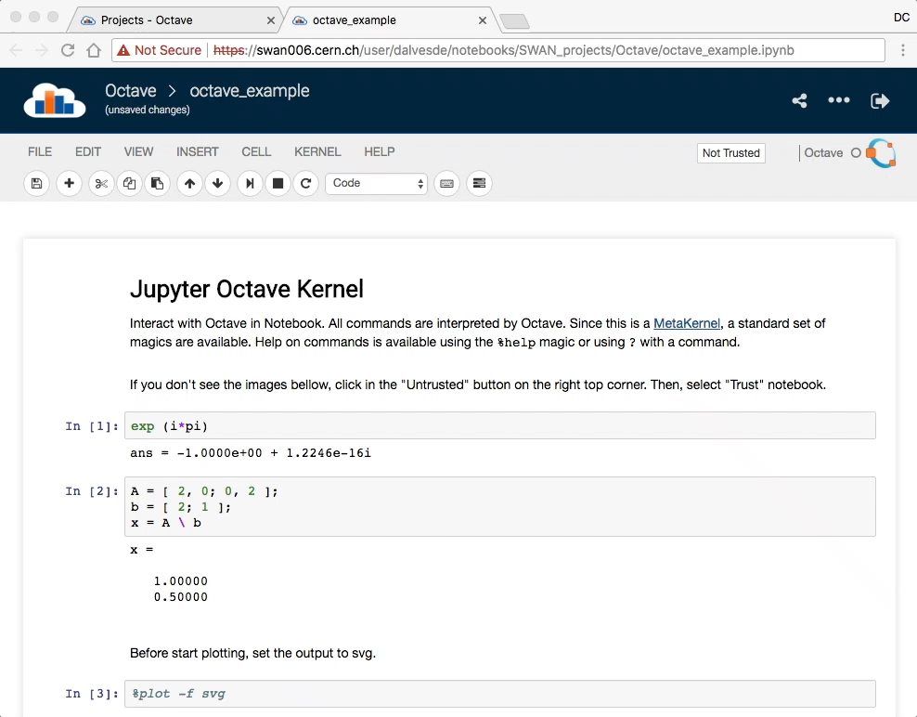

Slide 26
Conclusion

Slide 27
Conclusion
SWAN is a CERN service that provides Jupyter Notebooks on demand
SWAN promotes a cloud based analysis model where users can do analysis only with their browser
SWAN federates CERN services for software, storage and infrastructure so that users can find what they need in the service
SWAN fosters collaboration and results sharing between scientists
SWAN is an Interface for Mass Processing Resources (Spark)

Slide 28
SWAN: service for web based analysis
Thank you

