Slide 1
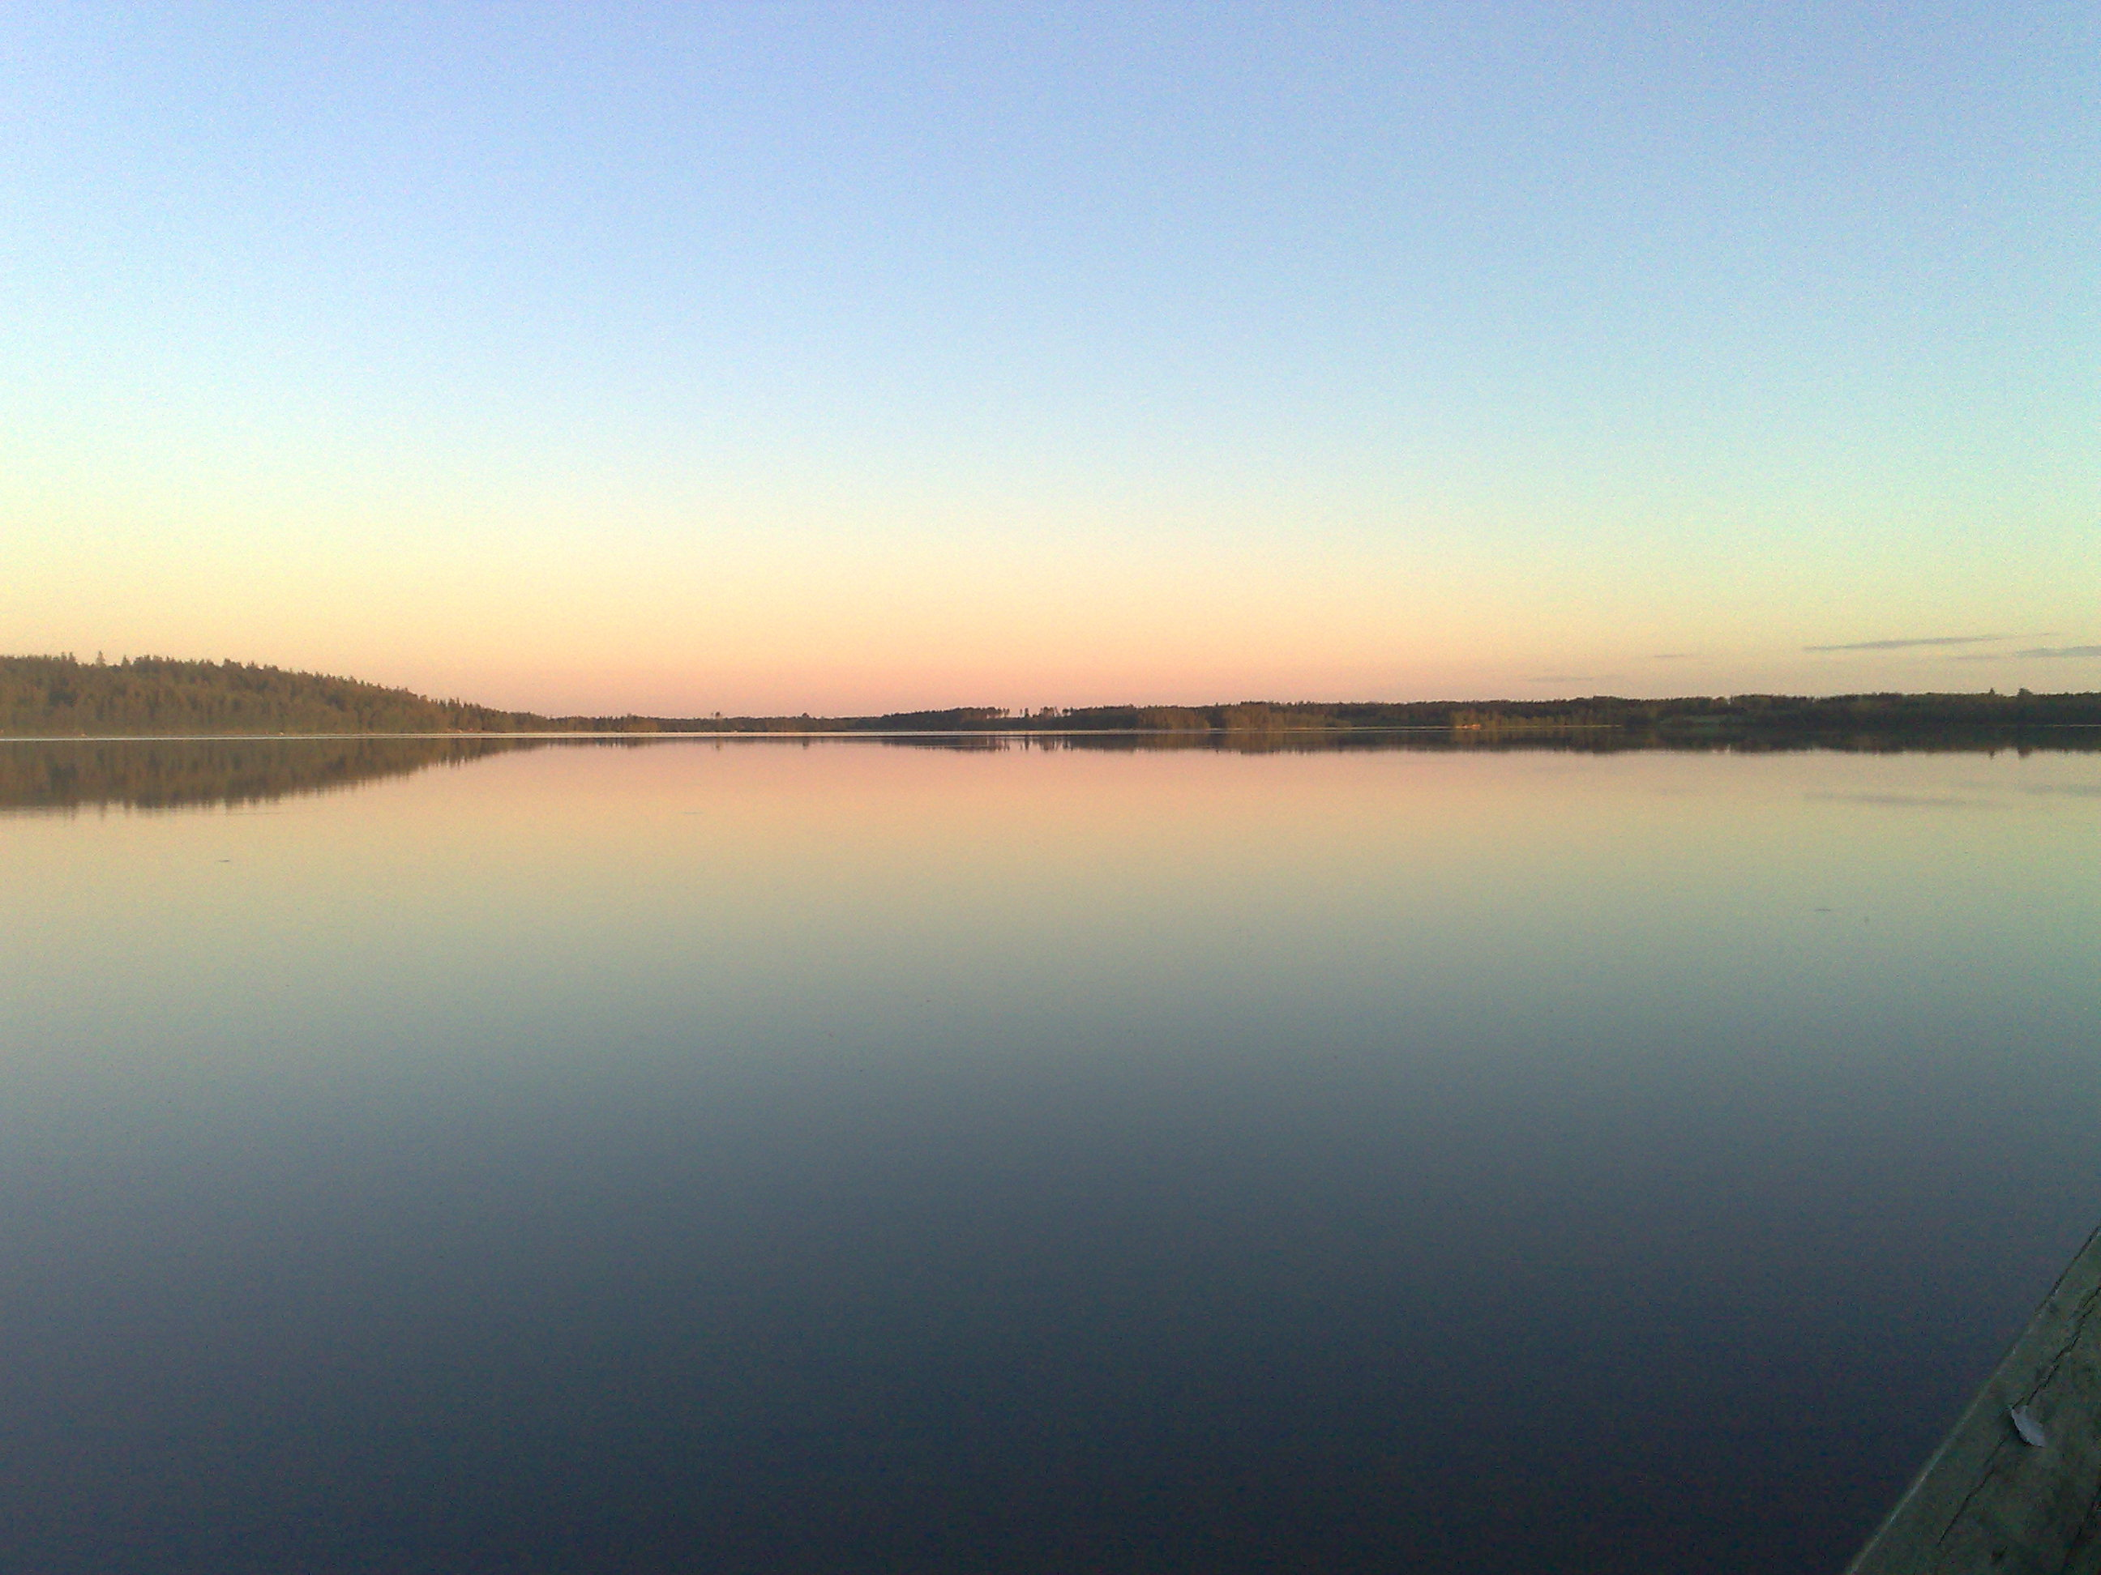

OVERVIEW FINLAND
Restricted ECFA
Helsinki 19 May 2017

Slide 2
Overview
General background
Research in particle physics
Performance indicators
Last RECFA visit to Finland 2010
Next 5 years
Notes:
2
2

Slide 3
General background

Slide 4
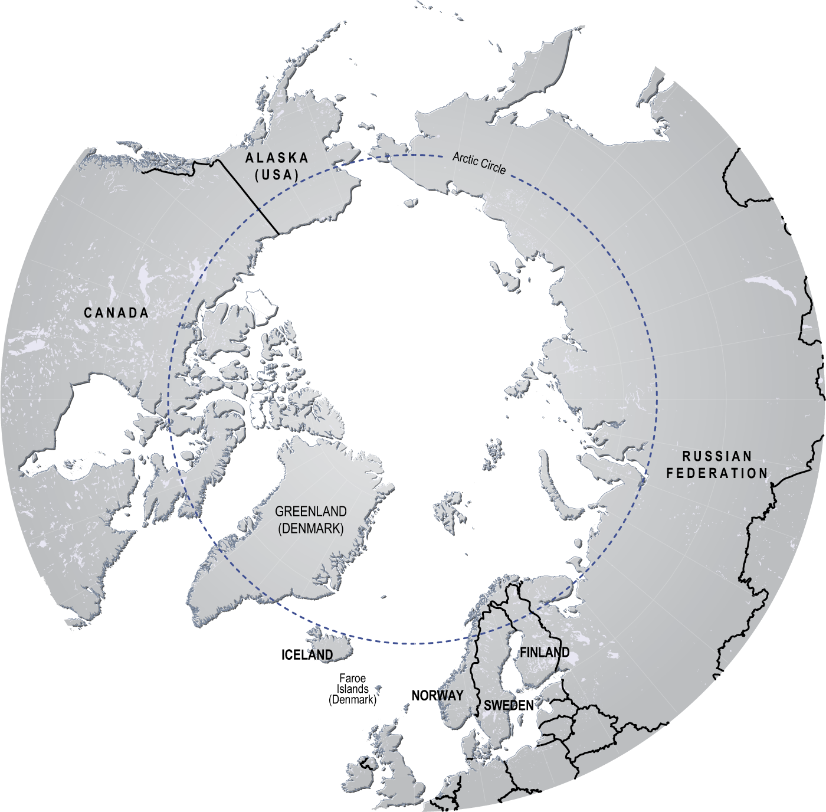
2017: Finland 100 years
Numbers from 2015:
Population 5.5 M
GDP per capita 38 223 €
GDP 209 G€, public debt 63.6% of GDP
Economic growth +0.2%, exports -0.2%
Unemployment rate 9.4%
Stable Nordic country, globally leading rankings in eg. education, state stability, equality, freedom of press, women’s health, low infant mortality

Slide 5
Expenditure in R&D

Slide 6
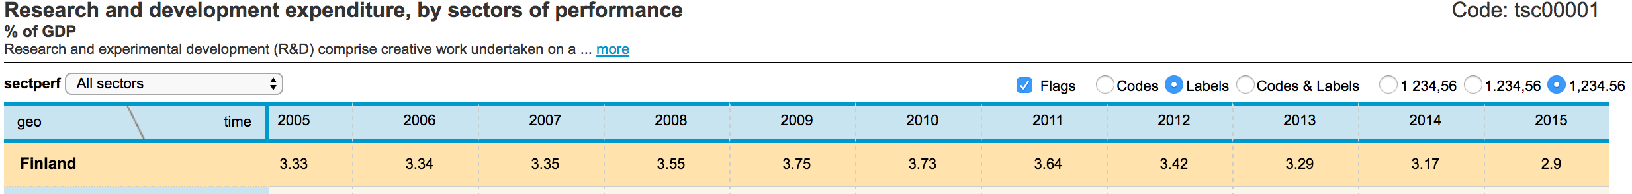
R&D intensity [%] in 2015 | 2.89% Private business 1.94% Public sector 0.95%

Slide 7
Science and technology graduates; patents

Slide 8
Research in universities, funding sources 2015
Source | Funding [M€] | Fraction [%]
Ministry to universities | 820 (total funding 1 910) | 56
Academy of Finland | 275 | 19
TEKES | 110 | 8
EU | 59 | 4
Companies | 55 | 3.8
Other national public | 50 | 3.5
National foundations | 49 | 3.4
Other international | 32 | 2.2
TOTAL | 1 450 | 100

Slide 9
Research in particle physics

Slide 10
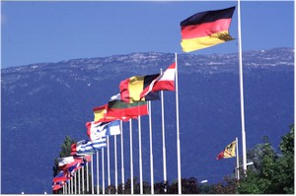
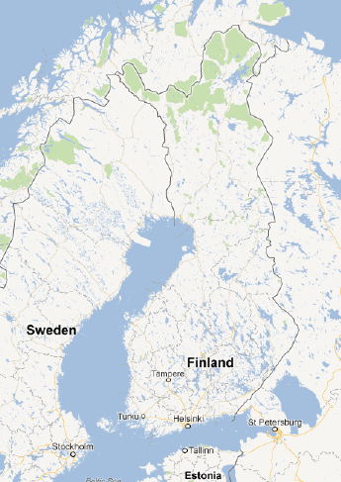
CERN and national organization
Finland joined CERN 1991
Helsinki Institute of Physics, HIP, founded in 1996
National CERN Strategy:
  Forefront particle and nuclear physics
  Applied research in accelerators, instrumentation and computation
  Research training
  Enhance technology know-how of Finnish companies
  Science education and public awareness
CERN from 1996, FAIR from 2010
Currently 5 universities
UJ
TUT
UH
AU
LUT

Slide 11









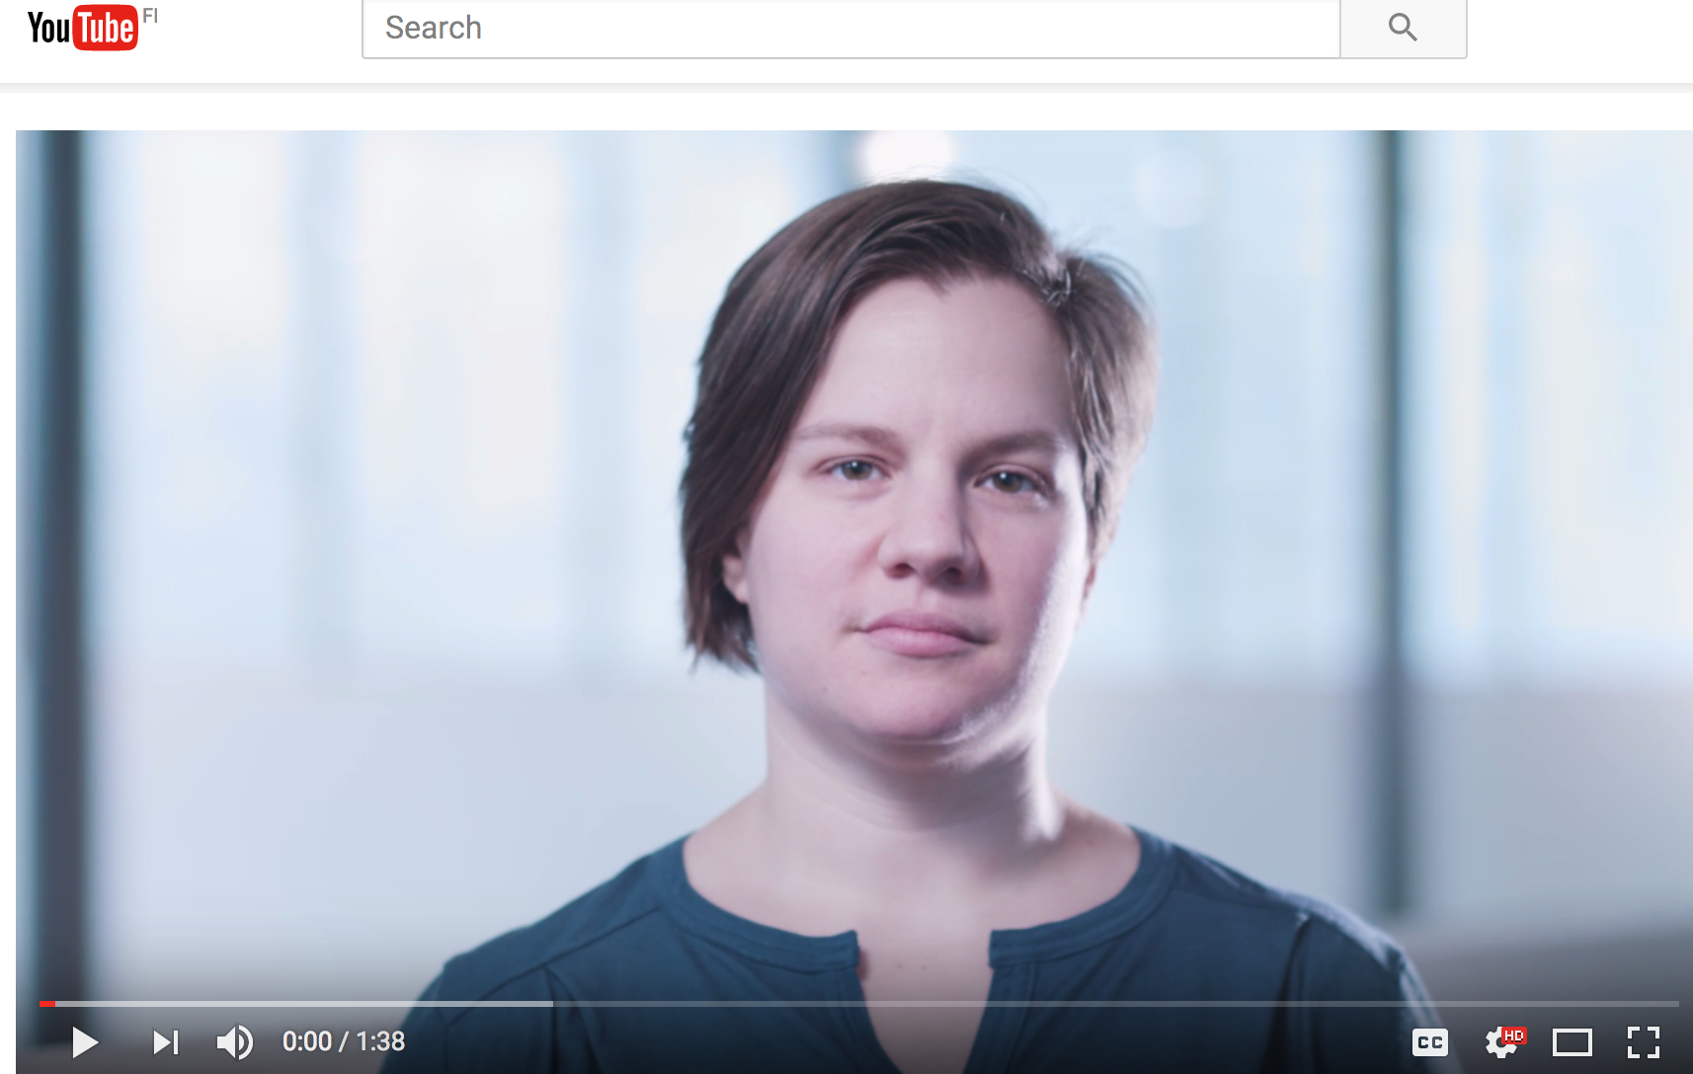
Partners
https://youtu.be/UTTkVzioSU8

Slide 12
HIP organization
Project-based: 3-year projects (renewable)
Well-defined management structure
  Board: stakeholders
  Scientific Advisory Board: yearly review and recommendations to the Board
  Director, Steering group, Project leaders
Common facility: detector laboratory
HIP personnel: about 80 FTE/y including scholarships.
About 50 FTE funded with basic funding, 30 FTE with external funding.
Project oriented: no permanent research staff. Permanent technical staff (7).
Annual Report 2016
http://www.hip.fi/wp-content/uploads/2013/09/HIP-Annual-Report-2016.pdf

Slide 13
HIP funding
HIP funding is for operations: M&O costs, salaries of HIP researchers and students, travels, computing.
Investments (like upgrades): we apply for external, competitive research infrastructure funding from Academy of Finland.
k€ | 2017 | 2016 | 2015 | 2014 | 2013
Ministry | 3 200 | 3 505 | 3 644 | 3 590 | 3 500
UH: host, result based, doctoral school (investments) | 579* | 825 (27) | 913 (156) | 912 (172) | 908
Other univ: result based | 335 | 335 | 335 | 335 | 335
SUM | 4 114* | 4 665 | 4 892 | 4 837 | 4 743
External | 1 259 | 1 405 | 1 325 | 840 | 974
* administration moved outside of HIP budget to University
services, estimated value 241k€

Slide 14
Human resources in fields relevant to RECFA
Finland | Particle physics experiments at CERN | Heavy ion experiments at CERN | Nuclear physics experiments at CERN (other?) | Experiments elsewhere: particle physics exps at accelerators (incl. nu) | Experiments elsewhere: astroparticle exps, GW exps, other neutrinos | Detector R&D | Computing R&D and operations | Accelerators R&D and operations | Theory | SUM
Physicists permanent [FRA] | HY 3 | JY 2 | HY 6 |  |  | HY 2 | HY 1 | JY 3 | HY 7 JY 5 TY 1 | 30
Physicists fixed term [FRA] | HY 7 | JY 2 HY 1 | JY 7 |  | OY 2 | HY 3 |  | HY1 JY 1 | JY 6 HY 17(part) + 13(cosmo) | 60
PhD students [FRA] | HY 10 AY 1 |  | JY 2 |  |  | LUT 3 |  | HY 2 | HY 21(part) + 19(cosmo) JY 10 TY 3 | 71
Engineers (degree) [FRA] |  |  |  |  |  | HY 2 | HY 1 JY 1 |  |  | 4
Technicians [FRA] |  |  |  |  |  | HY 1 |  |  |  | 1
TOTAL | 21 | 5 | 15 |  | 2 | 11 | 3 | 7 | 102 (70 particle, 32 cosmo) | 166
TOTAL/ Population [1/million inhab.] | 3.8 | 0.9 | 2.7 |  | 0.4 | 2.0 | 0.5 | 1.3 | 18.5 | 30.2
TOTAL/GDP [1/G€] | 0.1 |  |  |  |  |  |  |  | 0.5 | 0.8

Slide 15
Faculty and fellows at universities, research profiles
University of Helsinki: CMS, TOTEM, CLOUD, theory, cosmology
  Particle physics – experiment: 2 co-funded profs (HIP+UH), 1 prof – NEW, 1 co-funded tenure-track prof (HIP+UH) – NEW, 1 visiting professor* – NEW
  Particle physics – theory: 3 profs, 2 lecturers, 2 res. fellows (AoF**) including 1 ERC CoG
  Cosmology – theory: 1 prof, 2 lecturers, 1 visiting professor – NEW, 1 res. fellow (AoF**)
University of Jyväskylä: ALICE, ISOLDE, FAIR, underground+DUNE, theory, cosmology
  Particle physics – experiment: 1 prof, 1 lecturer, 2 co-funded university researchers (HIP+UJ) – NEW
  Particle physics and cosmology – theory: 3 profs, 2 lecturers (of which 1 also res. fellows (AoF**) and ERC CoG)
  Nuclear physics – experiment: 4 profs, 1 lecturer, 5 univ. res, 2 res. fellows (AoF**)
  Nuclear physics – theory: 1 prof, 1 research prof***, 1 res. fellow (AoF**)
* 4 year visiting professor funded by TEKES innovation agency
** 5 year research fellow funded by Academy of Finland
*** 5 year research professor funded by Academy of Finland

Slide 16
Faculty and fellows at universities, research profiles
Aalto University
  Applied fields: materials science, information technology, engineering
  Materials science – theory
Tampere University of Technology
  Applied fields: instrumentation and accelerator technology, IT, robotics
Lappeenranta University of Technology
  Applied fields: instrumentation and electronics
  Participates in CMS

Slide 17
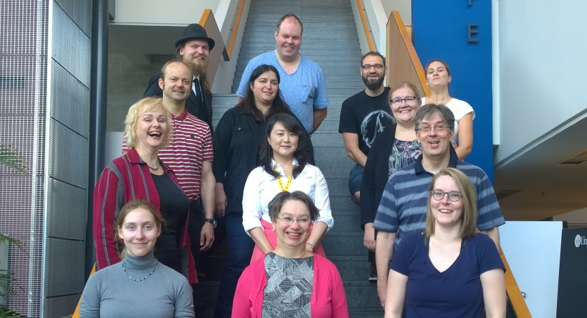
Particle physics in Finland:
Average 18% women.
Detector lab 29%
CMS and TOTEM 27%
Theory projects 13%
Technology 13%
Nuclear matter 0% (ALICE, ISOLDE, FAIR)
Academic career M/F
Academic career in science and engineering M/F
Academic career in physics, University of Helsinki M/F

Slide 18
Projects with societal impact
Education and open data project
Technology programme
  Accelerator technology: R&D of CLIC RF structures – HIP, UH, Aalto
  Green Big Data – HIP, Aalto, foreign partners
  Finnish Business Incubation Centre (BIC) at CERN – HIP, TUT, CERN
  Novel instrumentation for safety, security and safeguards – HIP, national radiation safety agency STUK, IAEA
  Radiation metrology – HIP, STUK

Slide 19

Industrial activation events
CERN roadshow in Finland, 6 April 2017 at Aalto Design Factory
  http://events.hip.fi
  CERN Procurement-, Knowledge Transfer- ja HR-divisions
  150 participants including ~50 companies, govt agencies, career services
1-3 November 2017, Finland-100 Roadshow at CERN

Slide 20
HIP Summer student programme
~16 master-level students from HIP member universities sent to CERN for summer projects
Supervision by Finnish scientists at CERN
Projects:
  Experimental particle physics
  Instrumentation
  Nuclear physics
  Mechanics and engineering
  Computing, information technology
  Technology transfer

Slide 21
Performance indicators

Slide 22
Publications
TOTAL in 2016 | 340
Theory programme | 83
CMS and TOTEM | 109
Nuclear matter programme | 69
Technology programme | 13
Planck | 50
Cloud | 16

Slide 23
MSc and doctoral degrees, trainees, visits
In 2016
PhD/PhD(tech) | 7
MSc/MSc(tech) | 14
Summer students, CERN | 16
Summer students, ESRF | 1
High school groups | 18
Teacher groups | 1

Slide 24
Last RECFA visit in Finland 2010

Slide 25
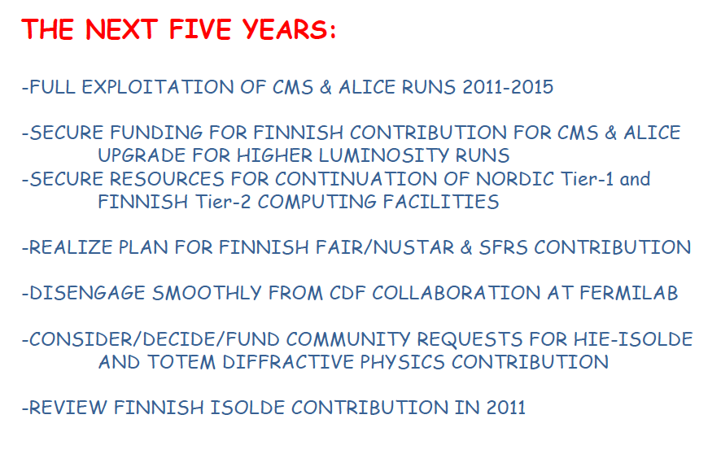
HIP director D.-O. Riska at RECFA-Finland 2010:
✔
✔✖
✔
✔
✔
✔
✔

Slide 26

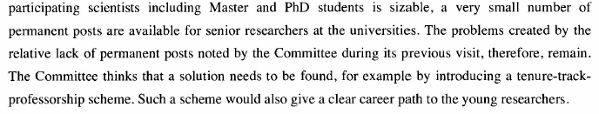
RECFA letter to minister Virkkunen 22 Nov 2010
Role of HIP
-now: performing well, although organizational changes have taken place.
Lack of faculty positions
-now: situation has improved significantly.

Slide 27
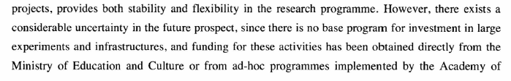
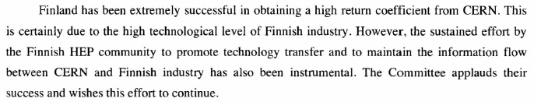
Investments
-now: Research Infrastructure committee created in Academy of Finland, more stable situation. Upgrade funding obtained for CMS+ALICE Phase 1.
Technology transfer
-now: decline in industrial return, Big Science industry activation (TEKES) terminated. HIP has initiated new activities.

Slide 28
THE NEXT FIVE YEARS 2017-2021
Full exploitation of CMS and ALICE runs 2 and 3
Secure funding for Finnish contributions for CMS and ALICE Phase-2 upgrades
Further development of Cloud-computing resources and joint Nordic computing facilities
FAIR facility and experiments: in-kind contributions, ramp up experimental activities
Improved industrial return from CERN, reinforced technology transfer activities and project work (BIC, IdeaSquare, Aalto Design Factory, ATTRACT)
Maintain present level of school activities, develop further open data exploitation
HIP renewal: potential new HIP partners: STUK, VTT; potential synergies with neighbouring research fields (eg. fusion research)

Slide 29
Concluding remarks
High energy physics in Finland: high research return from CERN. Good national coordination. Many organisational changes.
Active school programme
New efforts to boost industrial activation
From RECFA 2010:
  Research targets met.
  Situation with permanent faculty: good progress.
  Reverse progress in industrial activation and technology transfer. New initiatives being taken.

Slide 30
Backup slides

Slide 31
CLOUD experiment
HIP project: participation in the CLOUD experiment at CERN
Multidisciplinary research: atmospheric science with particle beams – measure nucleation
Helsinki group world-leading in atmospheric particle research and instrumentation development
Group leader prof. Markku Kulmala was nominated as Academician in 2017

Slide 32
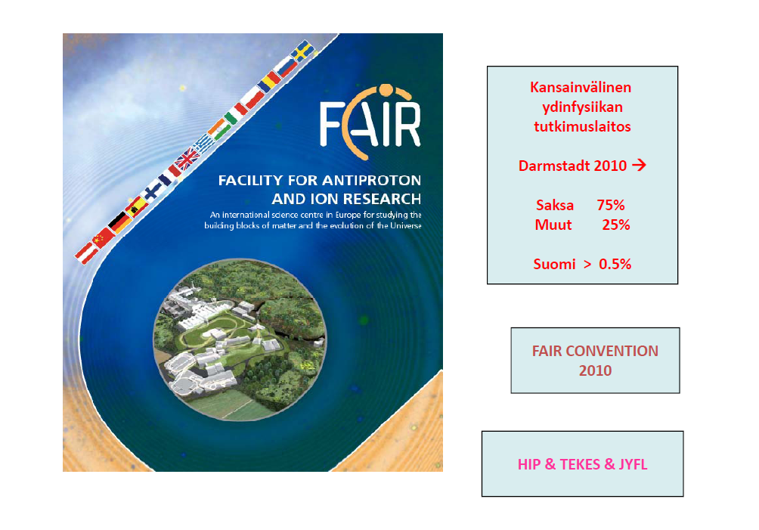
FAIR
International facility for heavy ion and antiproton research
Near Darmstadt
Germany 75 %
Russia 17 %
Others 8 %
Finland-Sweden ~ 1 %
Accelerator in-kind 3.4 M€
NUSTAR Collaboration
Future: APPA collaboration
CBM Collaboration
Construction: 2017-2025

Slide 33
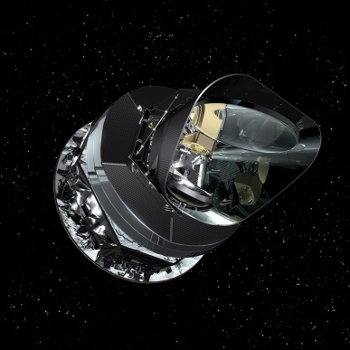
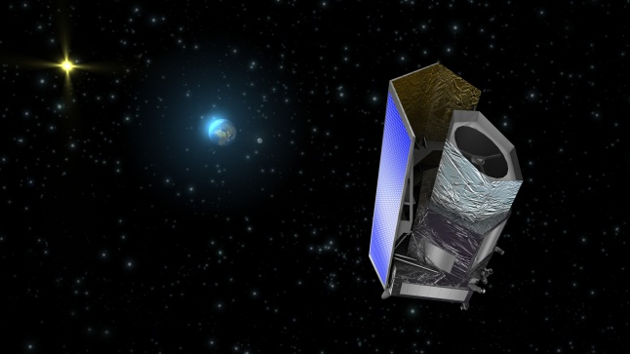
Planck and Euclid cosmology space missions
HIP project: participation in Planck and Euclid (ESA) space missions
Planck
  HIP Planck project: data analysis
Euclid
  Next major cosmology mission
    main focus: dark energy
  Launch 2020
  Finnish responsibilities: One of the 8+ Euclid Science Data Centers, and participation in several Euclid science working groups
Hannu Kurki-Suonio

Slide 34
Scientific Advisory Board 2016-2020
Scientific Advisory Board: yearly review and recommendations to the Board
Prof. Barbro Åsman, Stockholm University (chair)
Prof. Barbara Erazmus, CERN and CNRS
Prof. Nigel Glover, Durham University
Dr.(tech) Kalle Härkki, Outotec Executive Vice President – President of Minerals Processing Business Area
Dr. Manfred Krammer, CERN
Prof. Gunther Rosner, Glasgow
Prof. Wolfram Weise, TU Munchen

Slide 35
Recent changes in HIP
2016: HIP moved to Faculty of Science, University of Helsinki. No change in the management or finances.
2016: Administrative staff moved to University services. This happened in all units in University of Helsinki.
2018: HIP will retain its own budget. Otherwise faculties will become the smallest budgeting units.

Slide 36
Refereed journal articles

Slide 37
Where do PhDs in physics go?
PhD’s graduated before 2013, employment 2016: in physics 62% were employed in universities and research institutions, 38% in other sectors: non-academic public sector, private sector
General structural problem in the Finnish private sector: only 5% of people in R&D positions in private companies have a doctoral degree

Slide 38
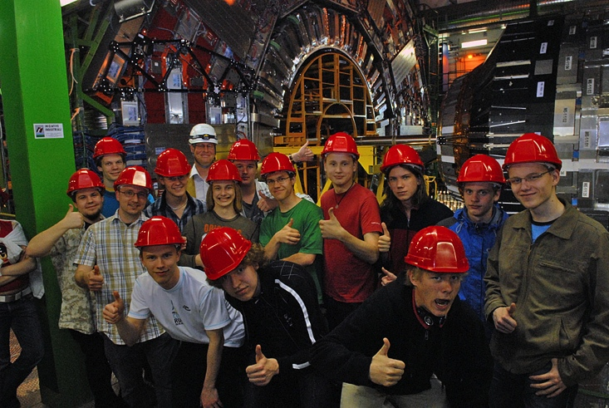
School visits
2015: 18 school groups (366 pupils+57 teachers)
2015 teachers’ courses: 1 long course (1 week, 15 teachers), 1 short course (1-2 days, 10 teachers)
pupils
teachers
School visits, participants in 2000-2015
Participants in the 1 week teachers’ courses 2001-2015

Slide 39
”HIP” extracts…

Slide 40
