Slide 1
Beam distribution at the TDE for different scenarios including re-triggering
C. Wiesner, W. Bartmann, C. Bracco, M. Fraser
WP14 Meeting
March 28, 2017

Slide 2
Outline
C. Wiesner: MKB Failures and TDE Patterns
1) Introduction: LBDS Failure Scenarios
2) Loss of MKBH/MKBV
3) MKB Erratics and Retriggering Strategy
4) Outlook: Upgrade Possibilities
5) Summary
M. Frankl: Energy-Deposition Studies
T. Polzin: Thermo-Mechanical Effects

Slide 3
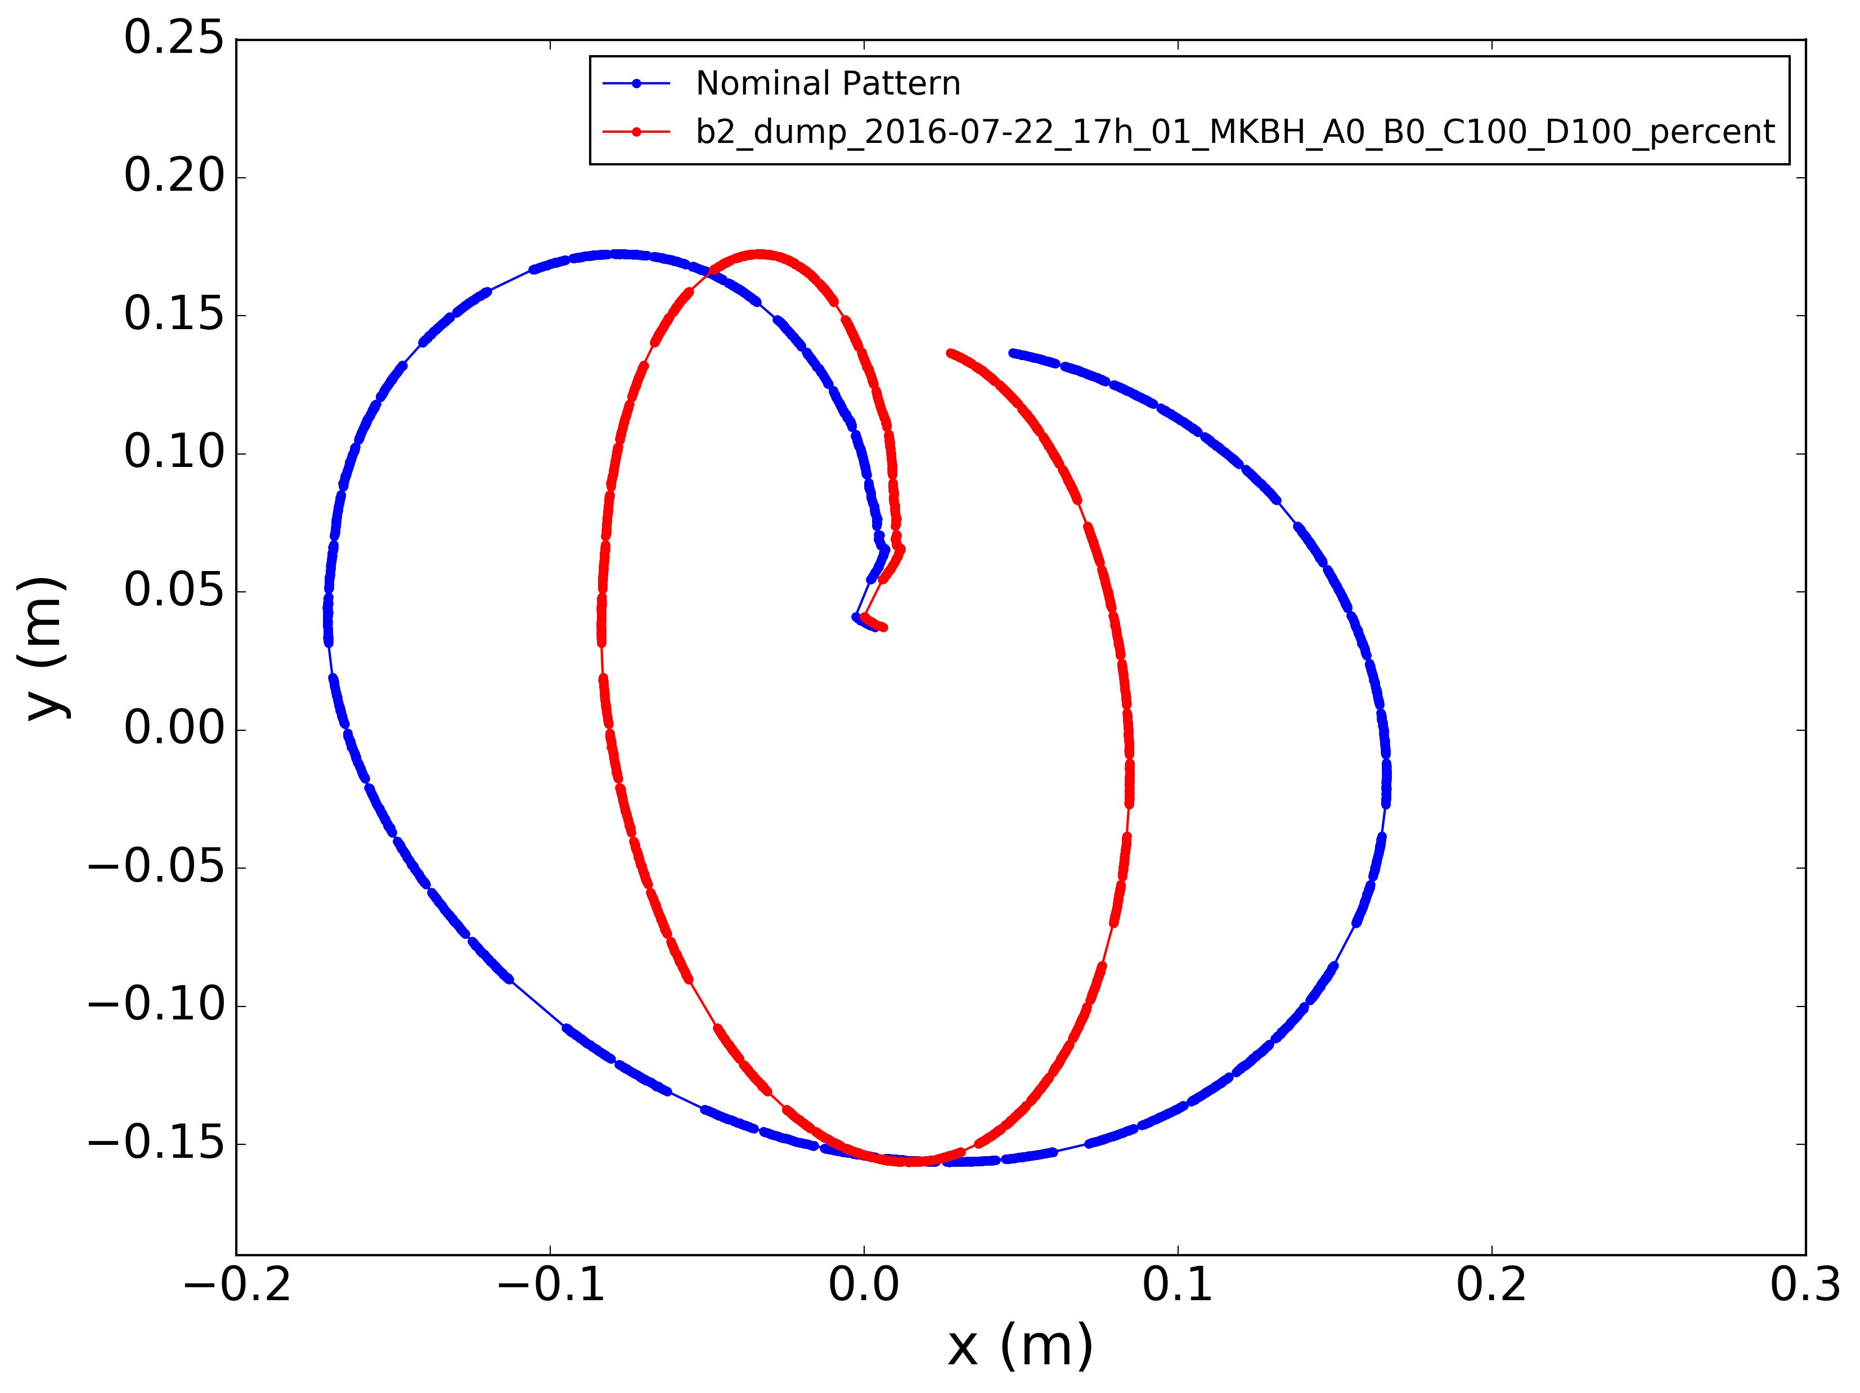
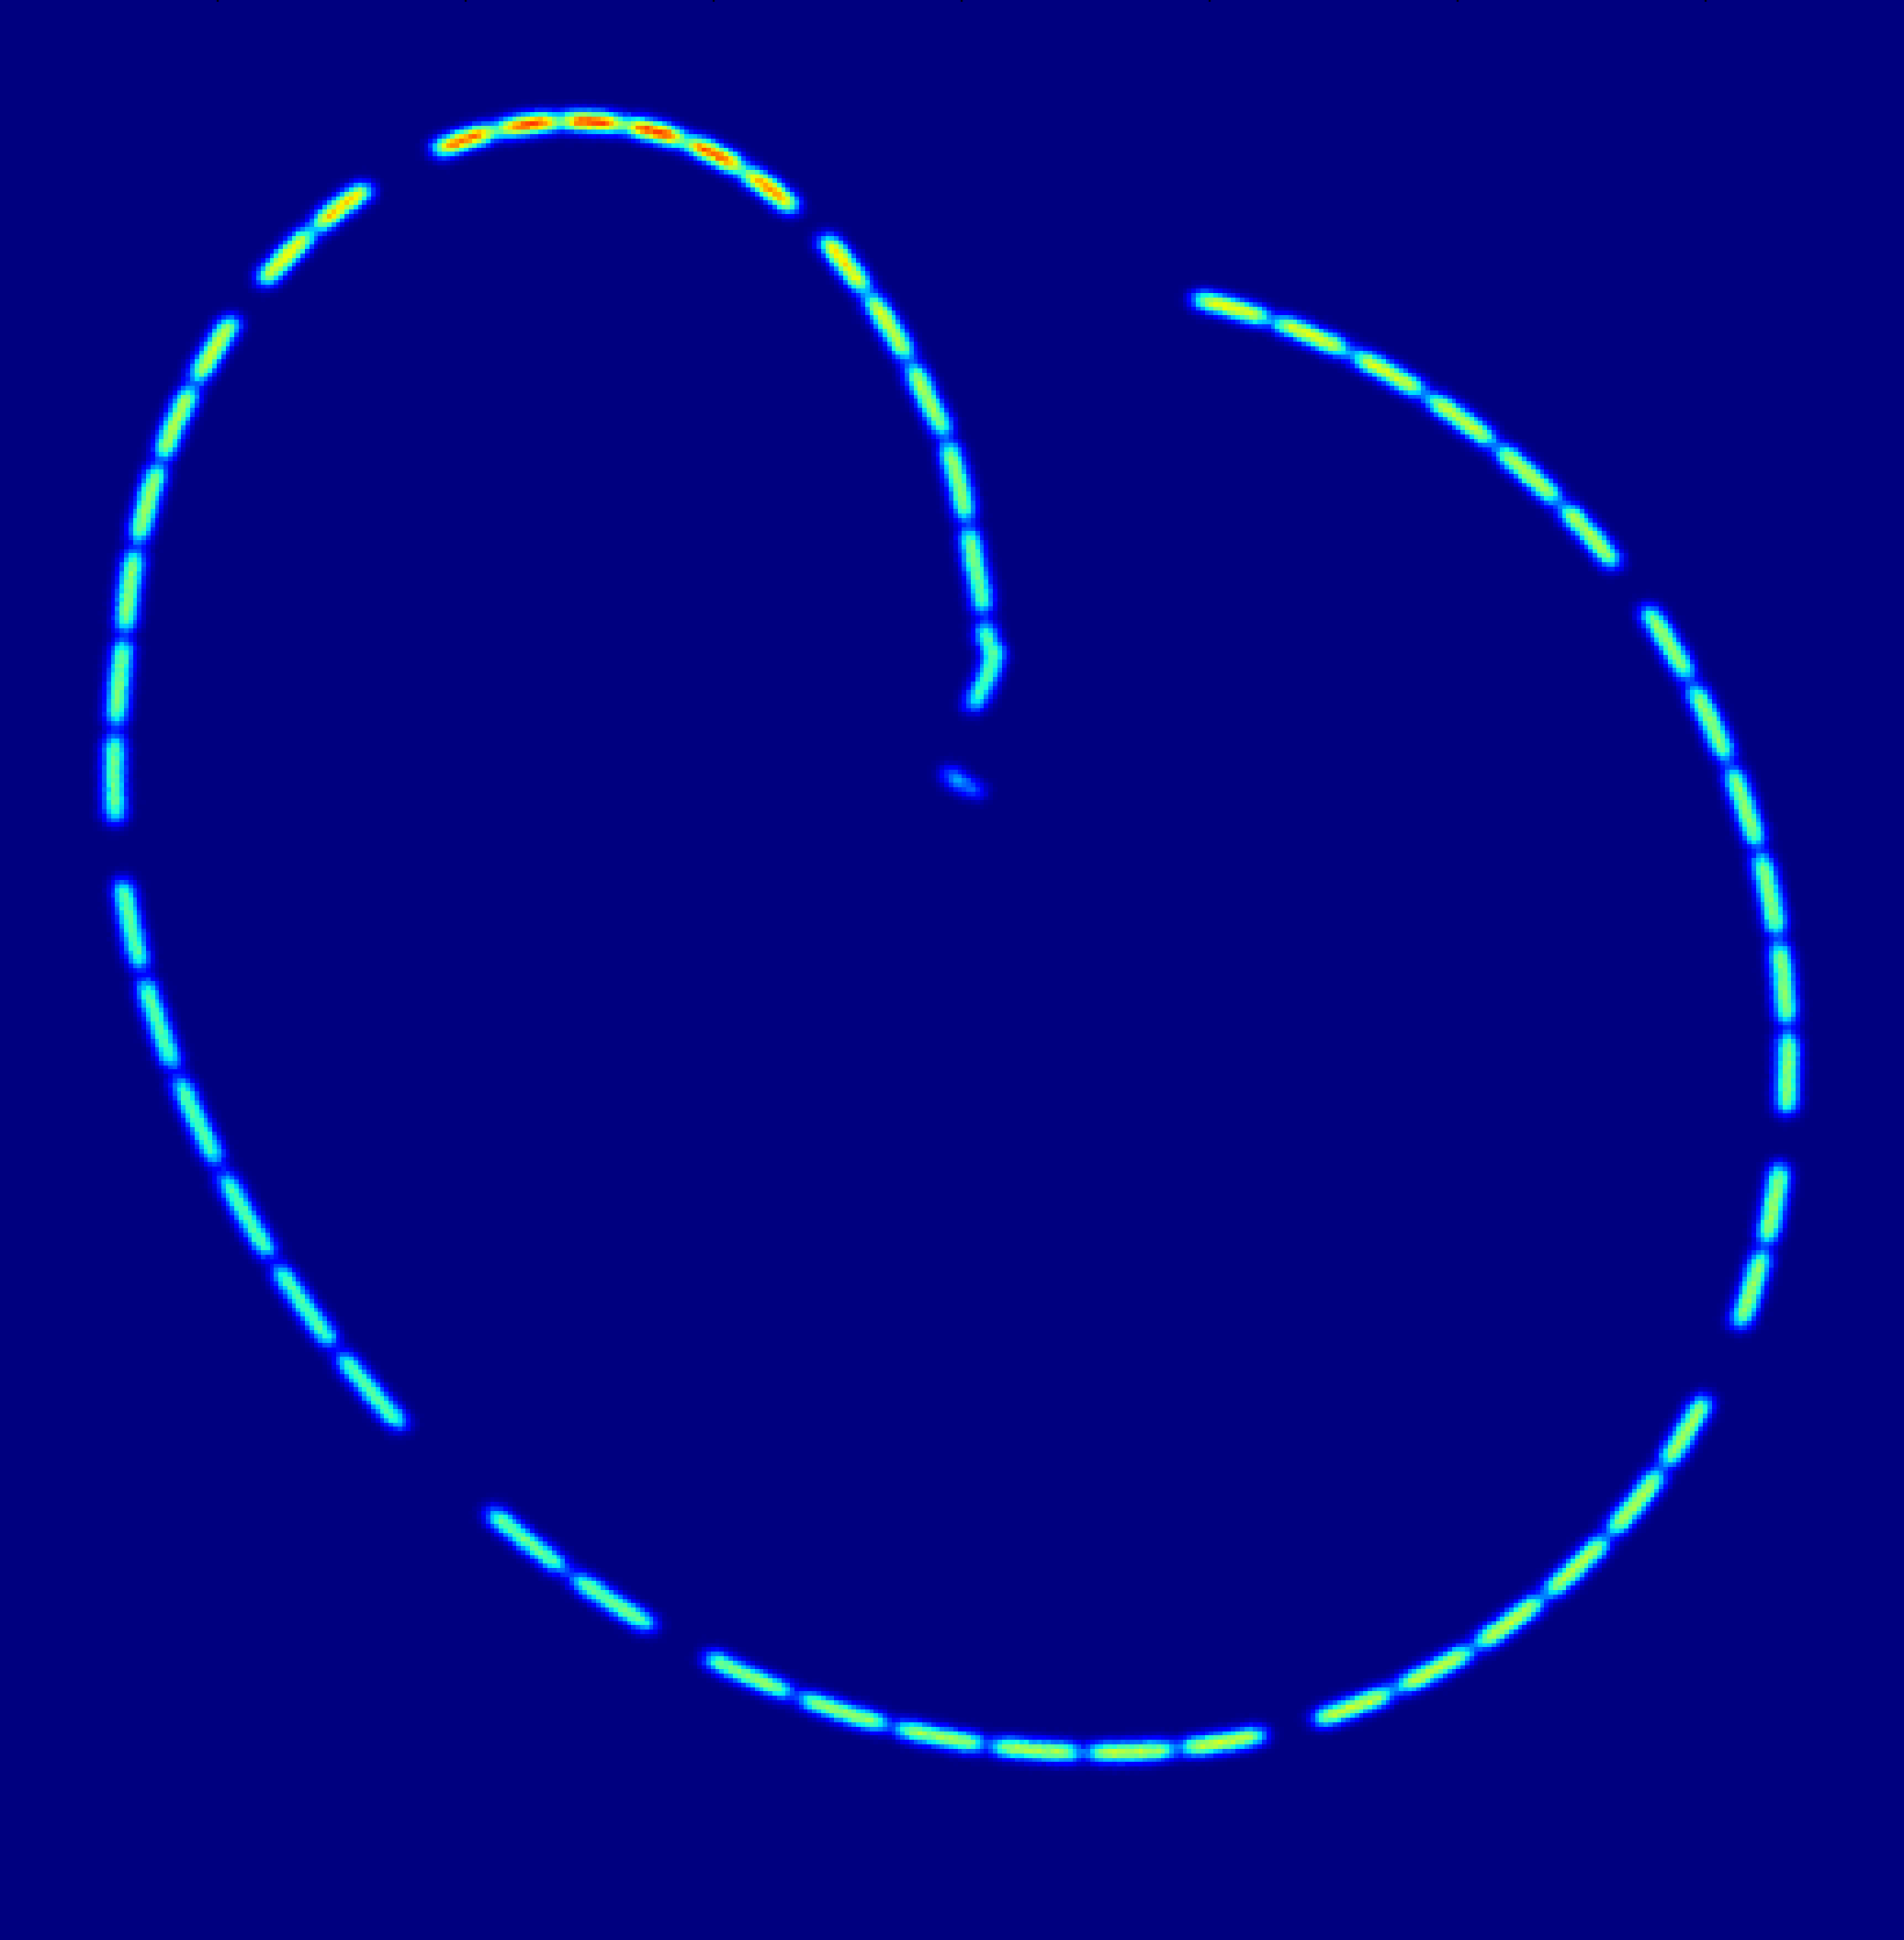
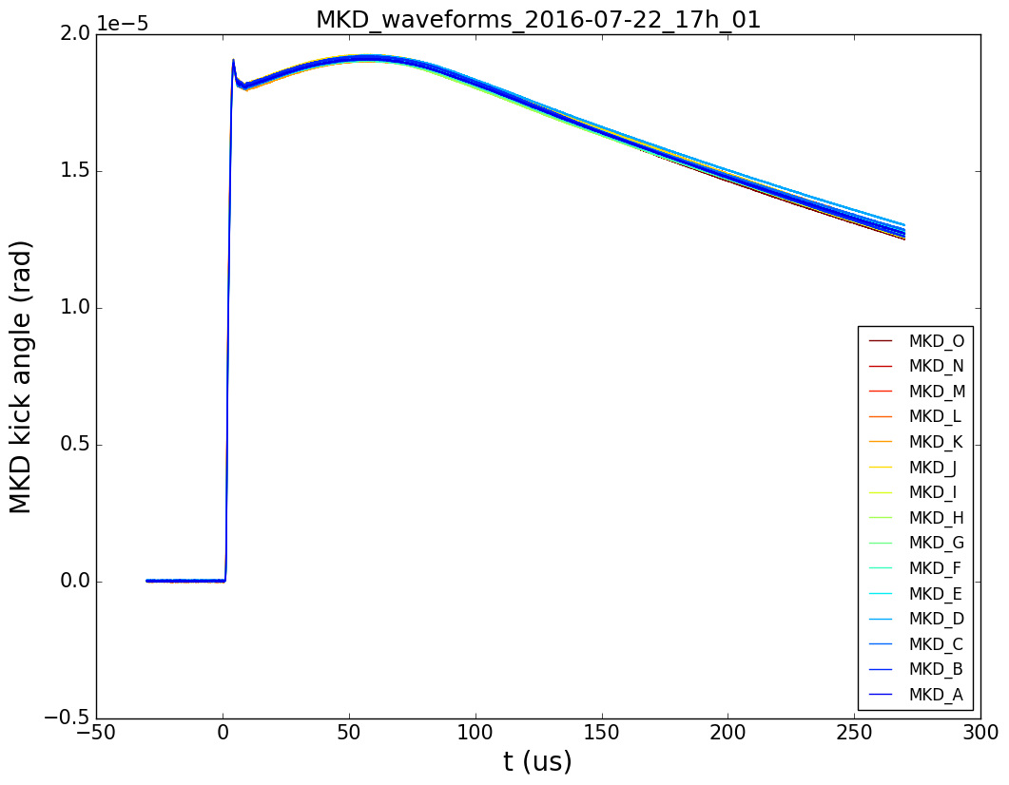
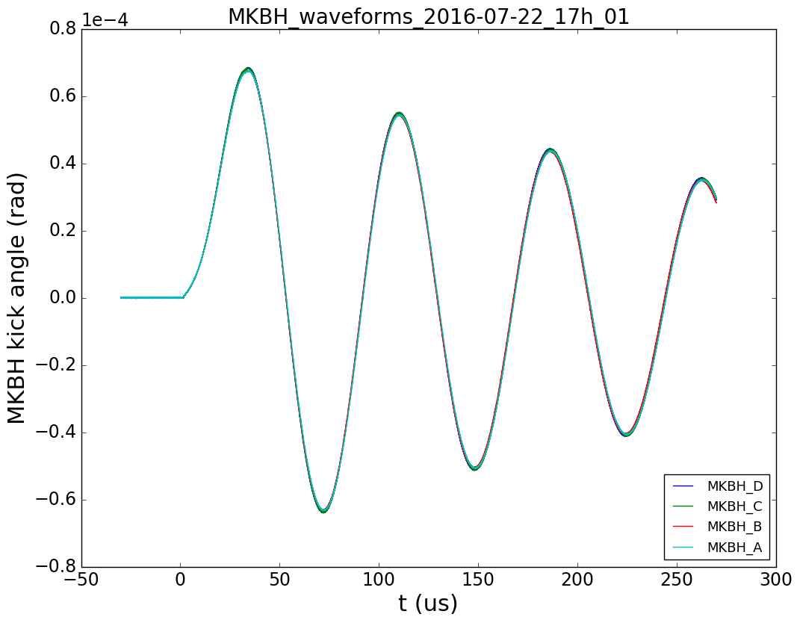
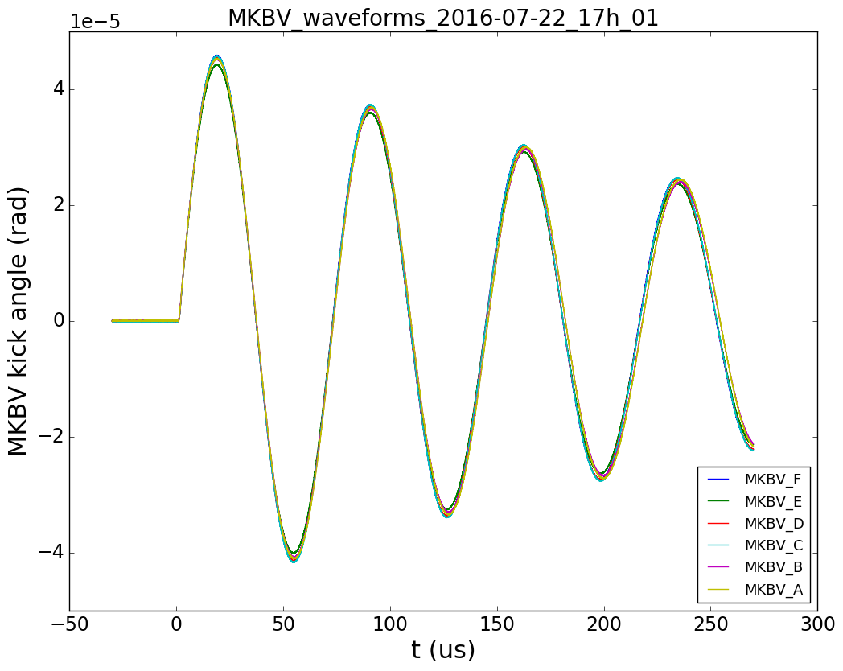
LBDS – Failure Scenarios
Erratic firing of MKB
→ Synchronous dump
Simulated beam pattern at TDE:
nominal and with 2 MKBH failing.
Time delay between MKBs
→ Risk of phase opposition
Loss of 1 or 2 MKB due to flash-over during
execution of dump.
New failure case (2016):
Parasitic coupling of MKBs → Possibility of multi-erratics…
Erratic firing of MKD
→ Asynch. dump
4 MKBH and 6 MKBV
T. Kramer et al, PAC’09, TU6RFP031
MKD
MKBH
MKBV

Slide 4
Dilution Kicker (MKB)
Same maximum kick angle in both planes
(~ 0.28 mrad)
4 MKBH operated at 27 kV
6 MKBV operated at 16 kV
→ MKBH operated at higher voltage than MKBV → Failure of MKBH is more likely
In addition: for the given TDE pattern, loss of horizontal deflection is more critical

Slide 5
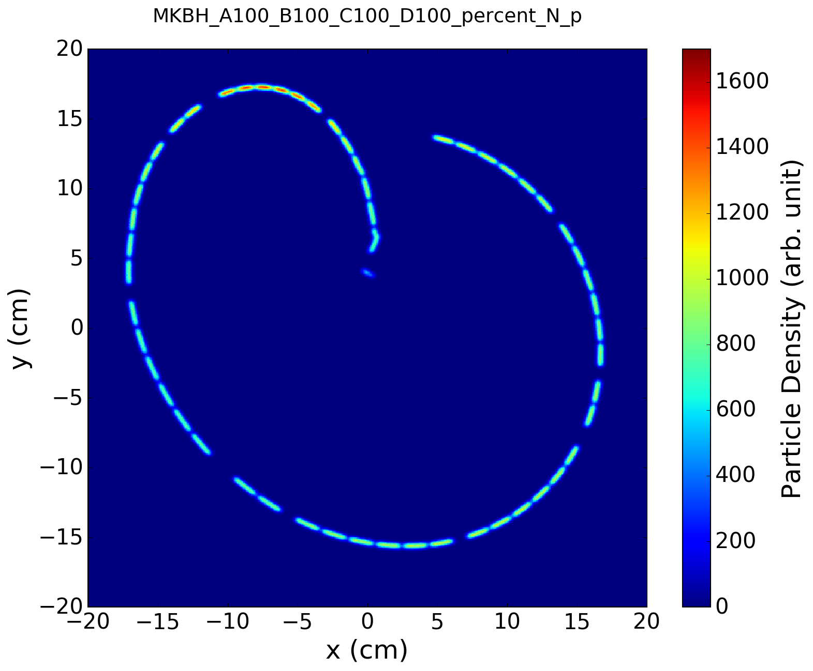
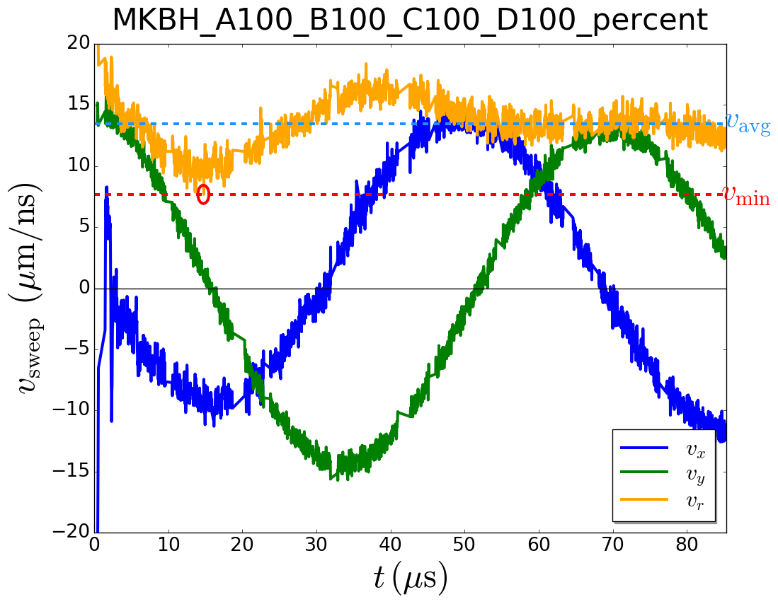
Missing MKBH
All 4 MKBH
Proton Density at TDE
v_{min} = 7.7 μm/ns
Sweep Velocity at TDE
ρ_{peak}(p+) = 100%
Nominal TDE Pattern
Strong dependence on horizontal sweep velocity.
3.9e6 macro particles
Nominal waveform data taken from <2016-07-22, 17:01h> dump, Beam 2, ε = 3.75 μm.
Sweep velocity is averaged over 7 adjacent bunches to reduce effects from waveform noise.
Filling scheme HL-LHC: filling_scheme_bcms_25ns_2604b_2592_2288_2396_288bpi12inj

Slide 6
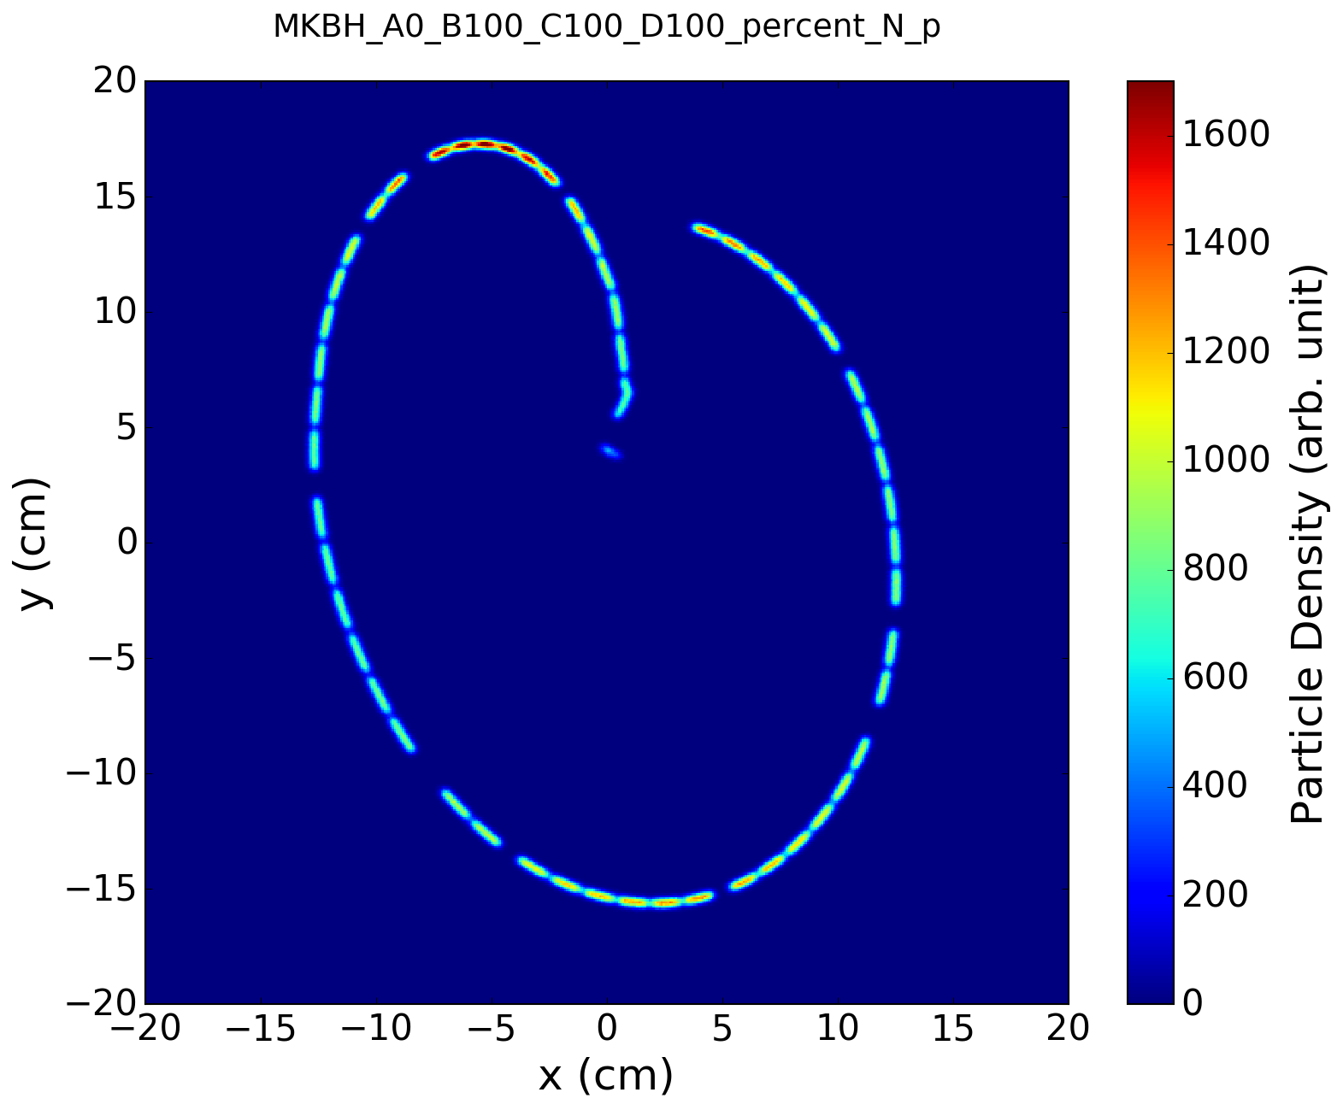
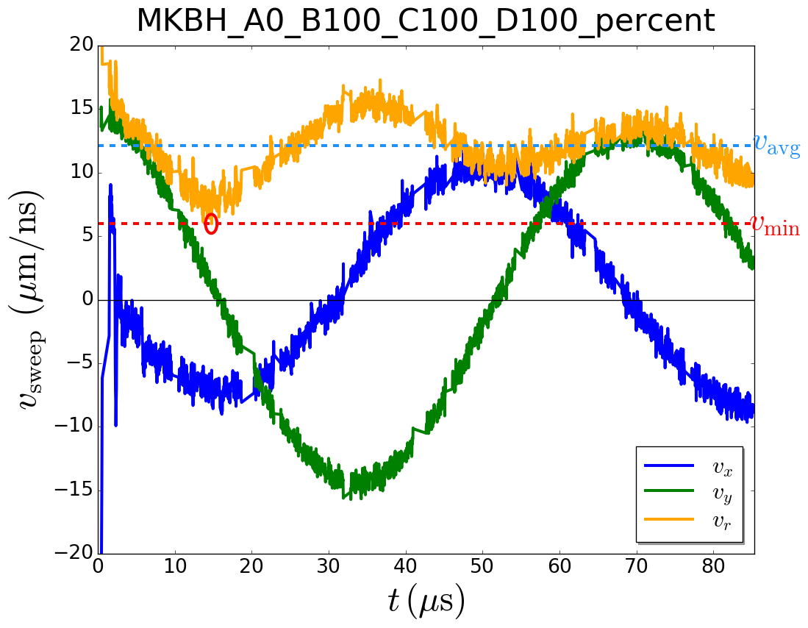
Missing MKBH
1/4 MKBH missing
Proton Density at TDE
v_{min} = 6.0 μm/ns
Sweep Velocity at TDE
ρ_{peak}(p+) = 130%
1 MKBH Missing
Strong dependence on horizontal sweep velocity.
3.9e6 macro particles
Nominal waveform data taken from <2016-07-22, 17:01h> dump, Beam 2, ε = 3.75 μm.
Sweep velocity is averaged over 7 adjacent bunches to reduce effects from waveform noise.
Filling scheme HL-LHC: filling_scheme_bcms_25ns_2604b_2592_2288_2396_288bpi12inj

Slide 7
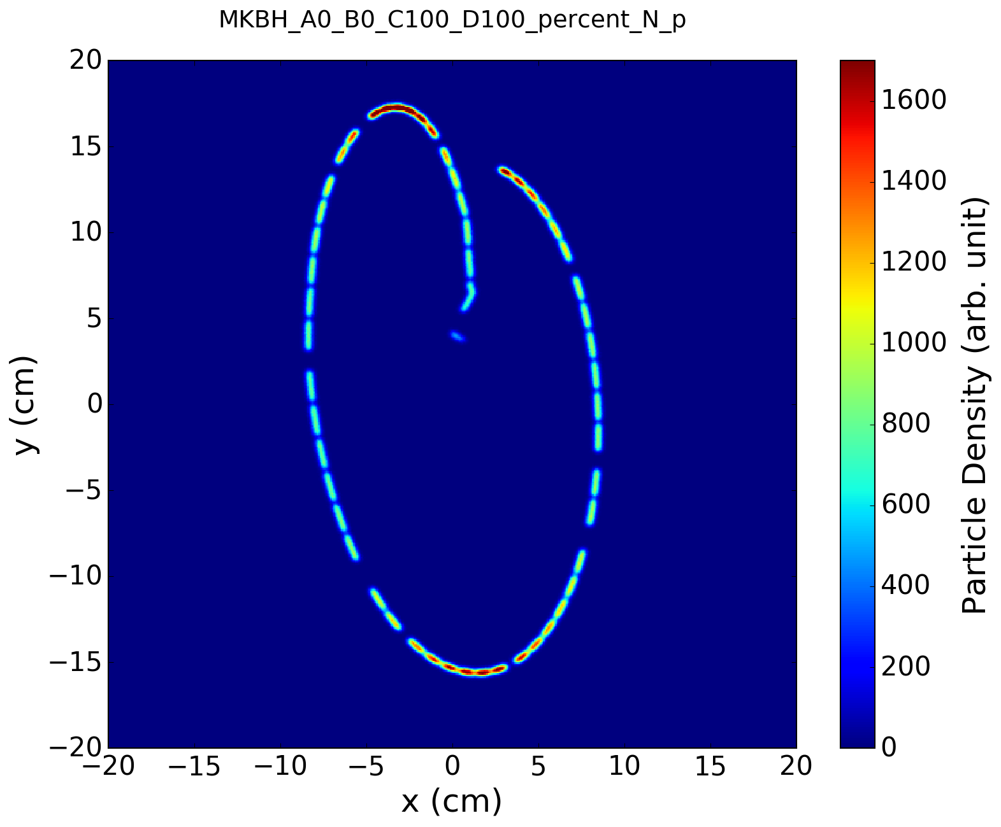
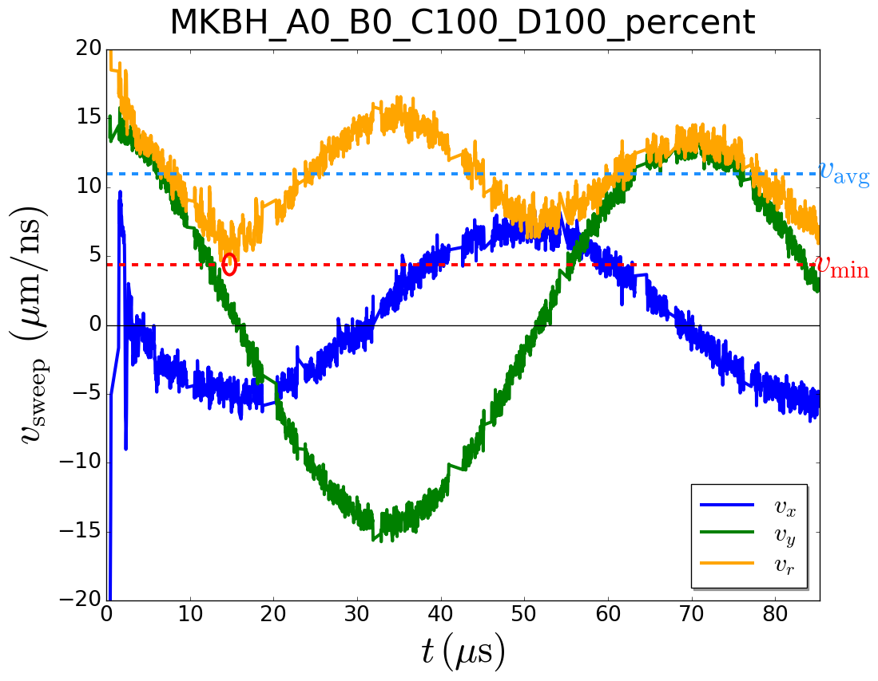
Missing MKBH
2/4 MKBH missing
Proton Density at TDE
v_{min} = 4.4 μm/ns
Sweep Velocity at TDE
ρ_{peak}(p+) = 157%
2 MKBH Missing
Strong dependence on horizontal sweep velocity.
3.9e6 macro particles
Nominal waveform data taken from <2016-07-22, 17:01h> dump, Beam 2, ε = 3.75 μm.
Sweep velocity is averaged over 7 adjacent bunches to reduce effects from waveform noise.
Filling scheme HL-LHC: filling_scheme_bcms_25ns_2604b_2592_2288_2396_288bpi12inj

Slide 8
Missing MKBV
All 6 MKBV
Proton Density at TDE
v_{min} = 7.7 μm/ns
Sweep Velocity at TDE
ρ_{peak}(p+) = 100%
Nominal TDE Pattern
3.9e6 macro particles
Nominal waveform data taken from <2016-07-22, 17:01h> dump, Beam 2, ε = 3.75 μm.
Sweep velocity is averaged over 7 adjacent bunches to reduce effects from waveform noise.
Filling scheme HL-LHC: filling_scheme_bcms_25ns_2604b_2592_2288_2396_288bpi12inj

Slide 9
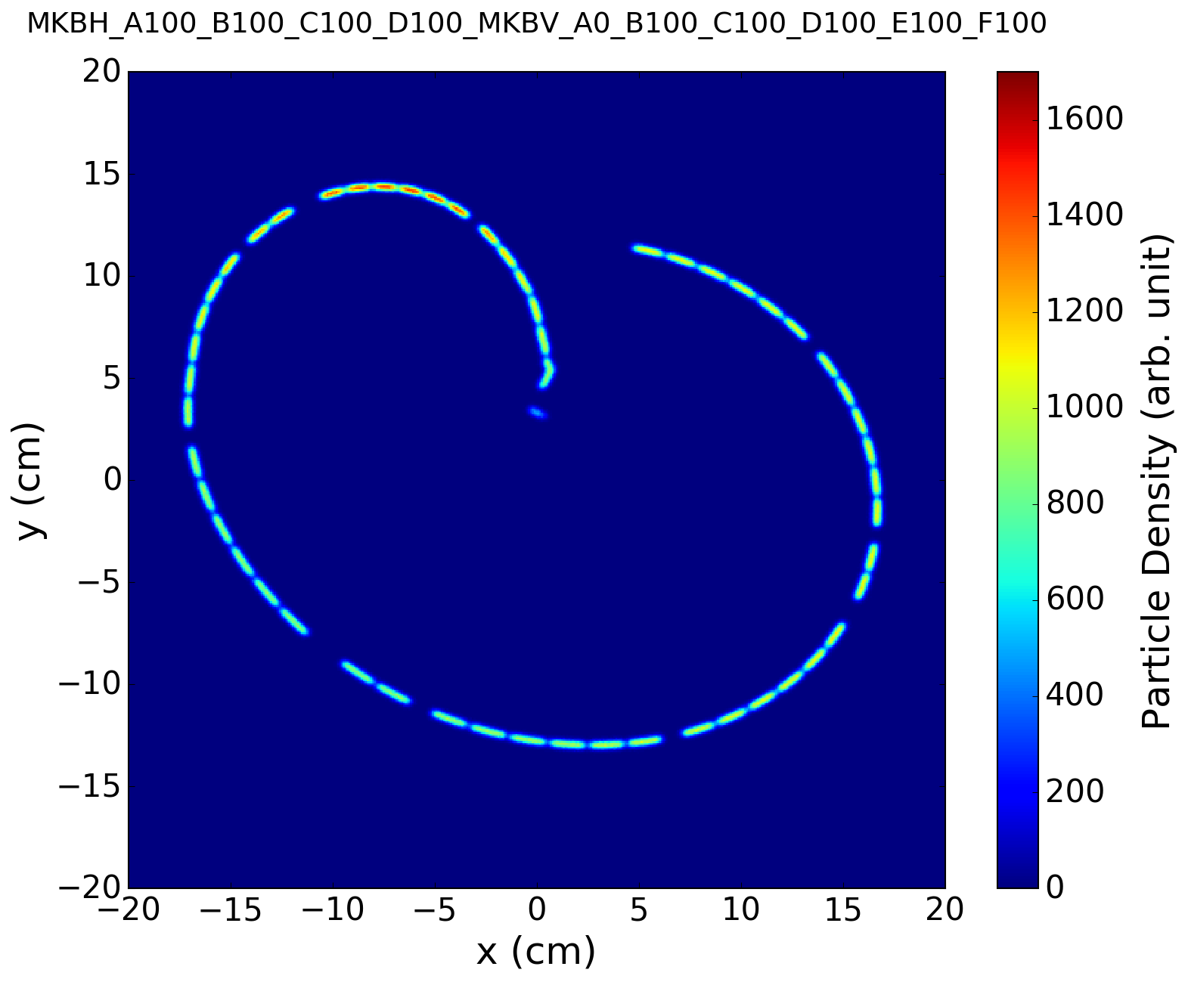
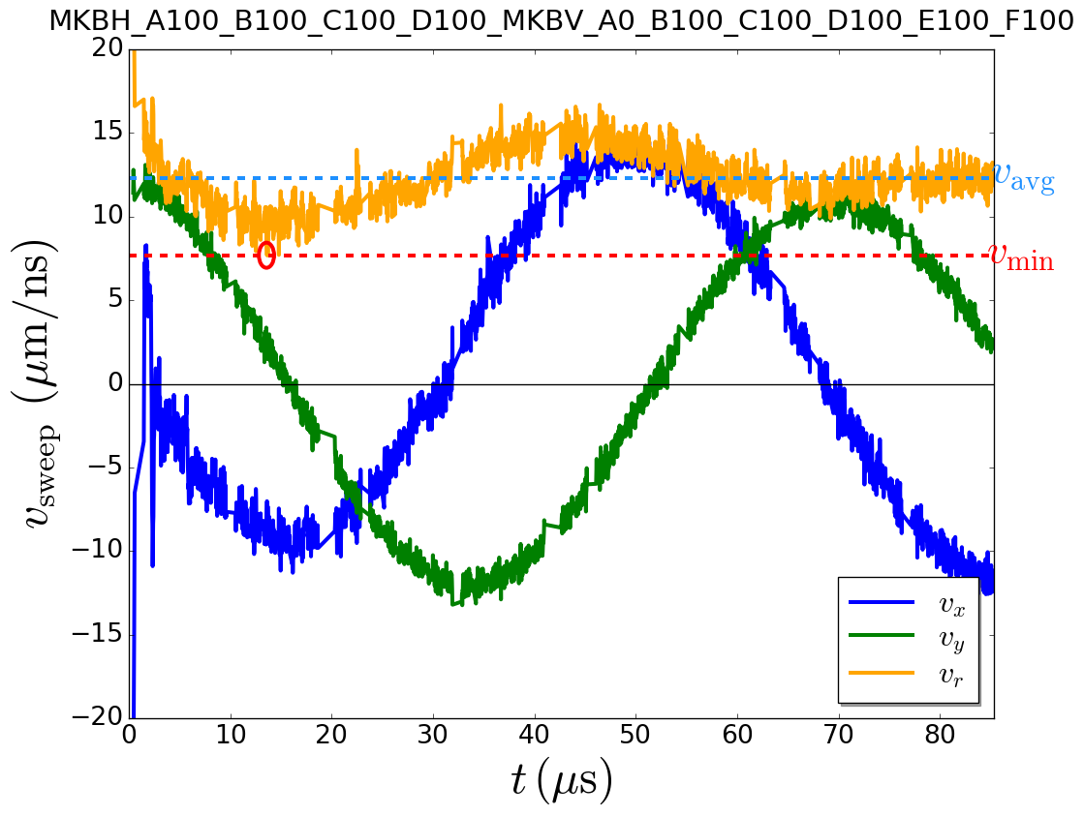
Missing MKBV
1/6 MKBV missing
Proton Density at TDE
v_{min} = 7.7 μm/ns
Sweep Velocity at TDE
ρ_{peak}(p+) = 104%
1 MKBV missing
3.9e6 macro particles
Nominal waveform data taken from <2016-07-22, 17:01h> dump, Beam 2, ε = 3.75 μm.
Sweep velocity is averaged over 7 adjacent bunches to reduce effects from waveform noise.
Filling scheme HL-LHC: filling_scheme_bcms_25ns_2604b_2592_2288_2396_288bpi12inj

Slide 10
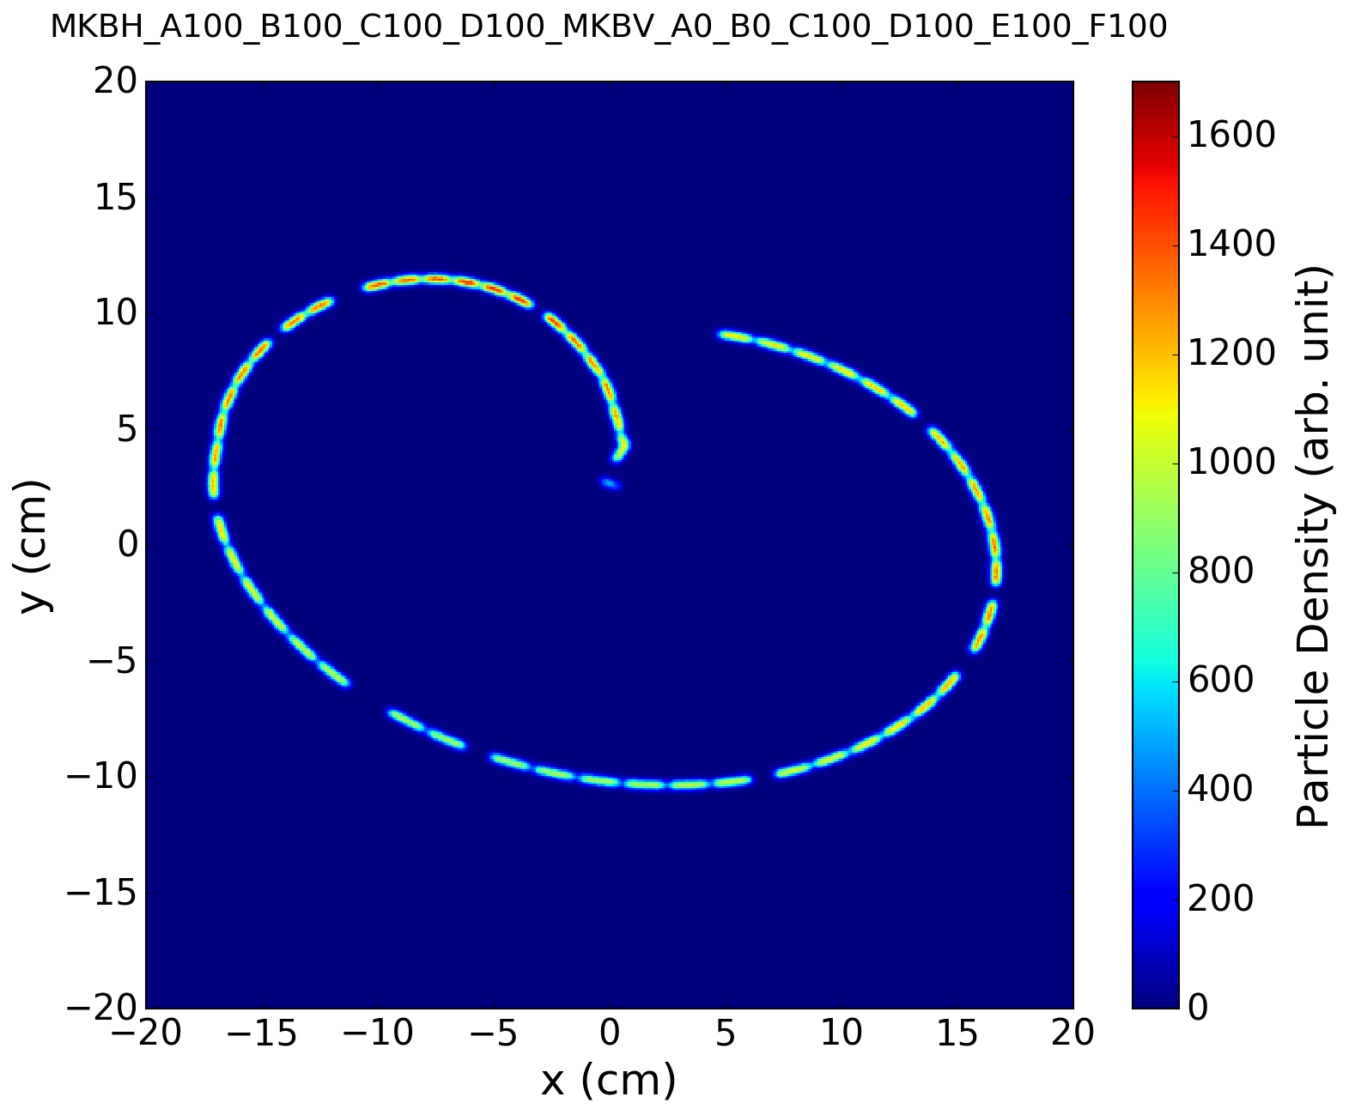
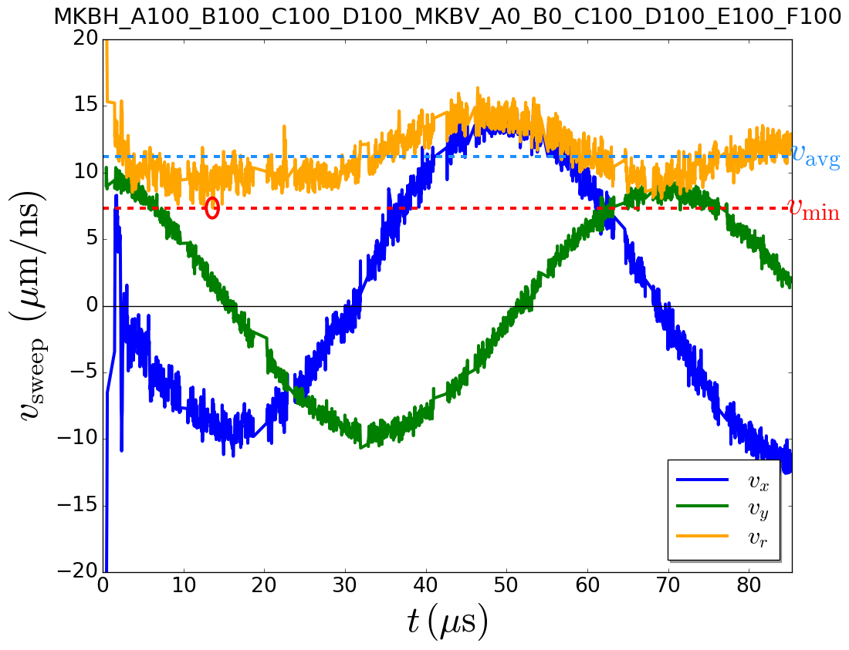
Missing MKBV
2/6 MKBV missing
Proton Density at TDE
v_{min} = 7.3 μm/ns
Sweep Velocity at TDE
ρ_{peak}(p+) = 106%
2 MKBV missing
3.9e6 macro particles
Nominal waveform data taken from <2016-07-22, 17:01h> dump, Beam 2, ε = 3.75 μm.
Sweep velocity is averaged over 7 adjacent bunches to reduce effects from waveform noise.
Filling scheme HL-LHC: filling_scheme_bcms_25ns_2604b_2592_2288_2396_288bpi12inj

Slide 11
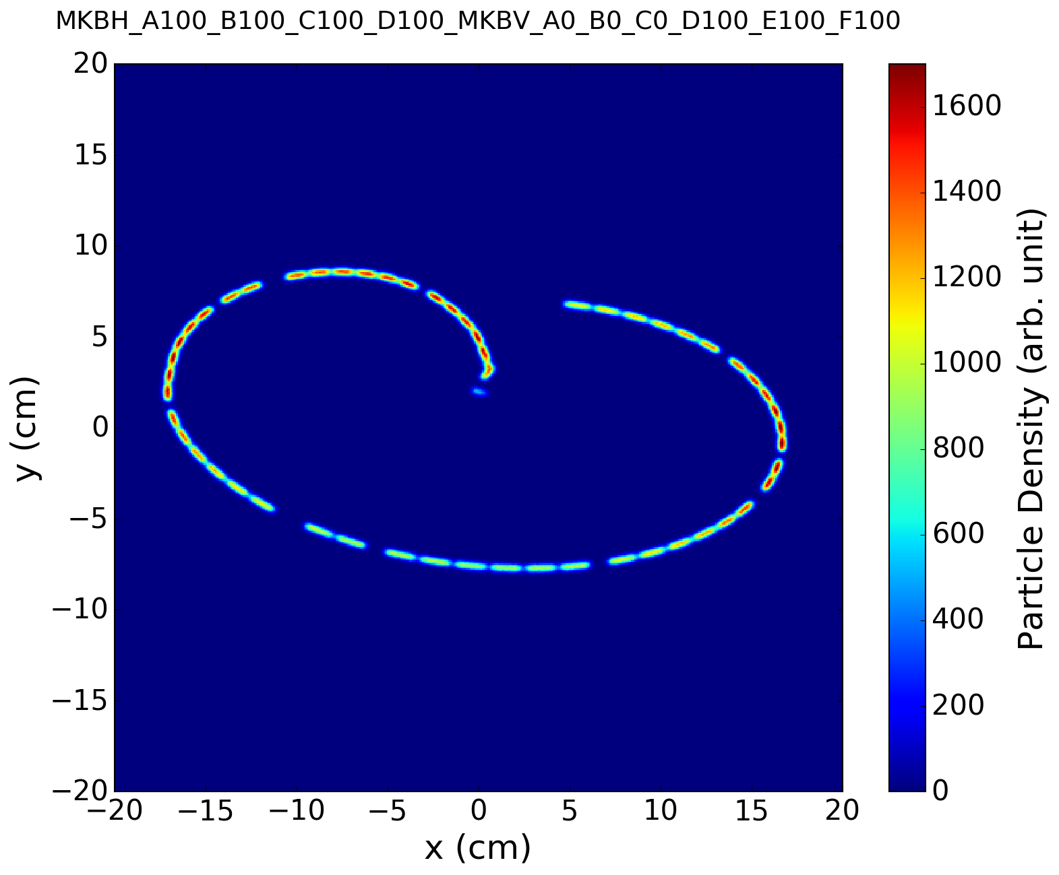
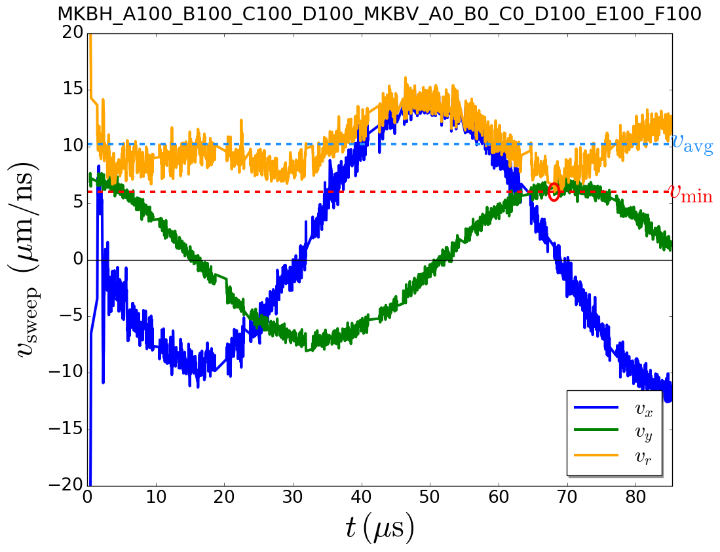
Missing MKBV
3/6 MKBV missing
Proton Density at TDE
v_{min} = 6.0 μm/ns
Sweep Velocity at TDE
ρ_{peak}(p+) = 120%
3 MKBV missing
3.9e6 macro particles
Compared to ρ_{peak}(p+) = 160% for 2/4 MKBH missing.
Nominal waveform data taken from <2016-07-22, 17:01h> dump, Beam 2, ε = 3.75 μm.
Sweep velocity is averaged over 7 adjacent bunches to reduce effects from waveform noise.
Filling scheme HL-LHC: filling_scheme_bcms_25ns_2604b_2592_2288_2396_288bpi12inj

Slide 12
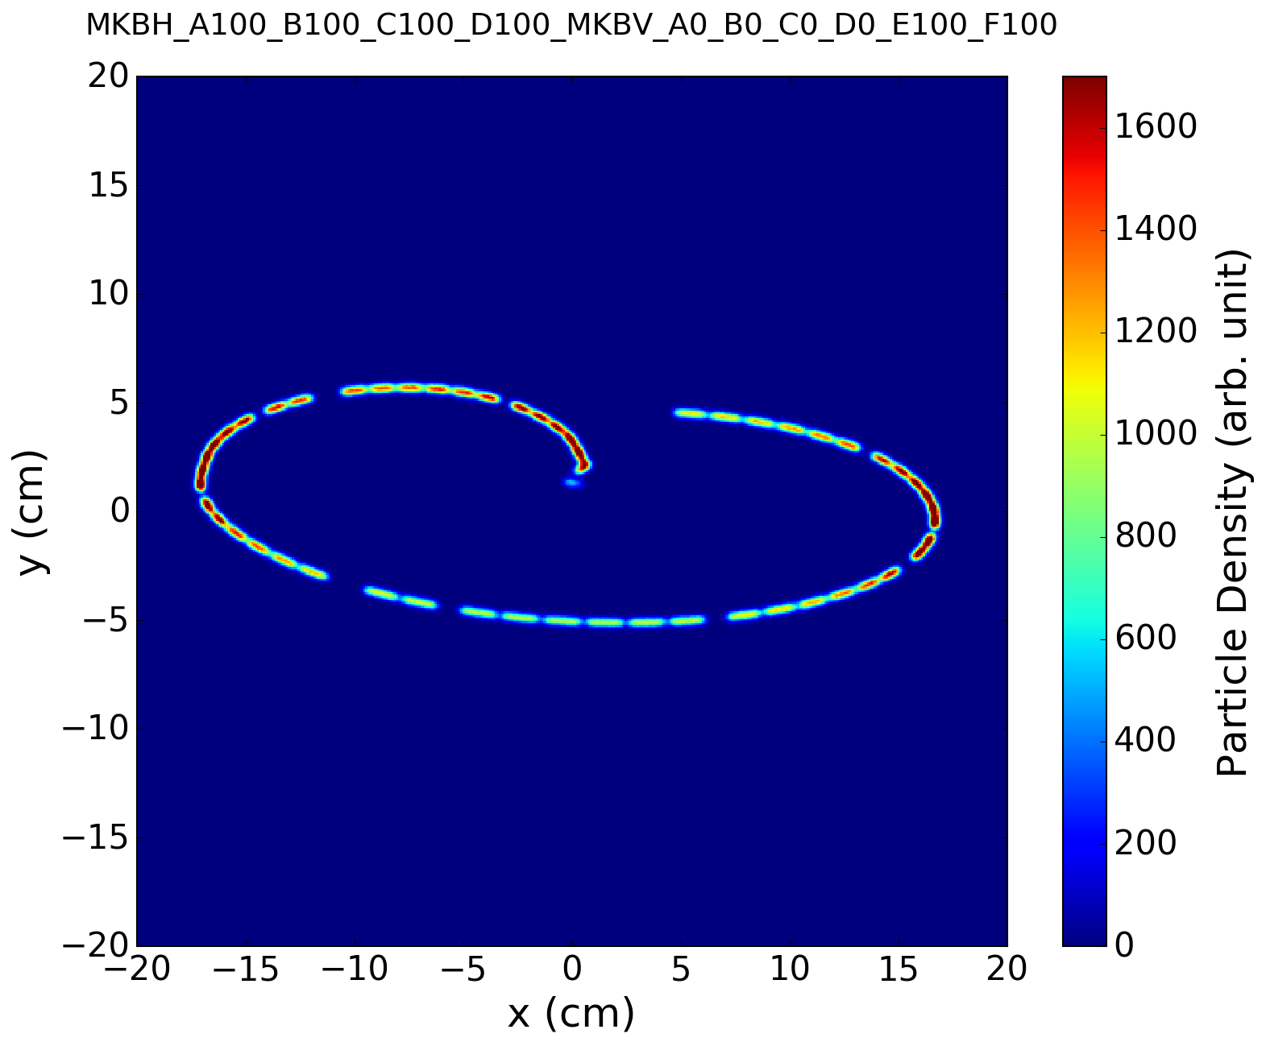
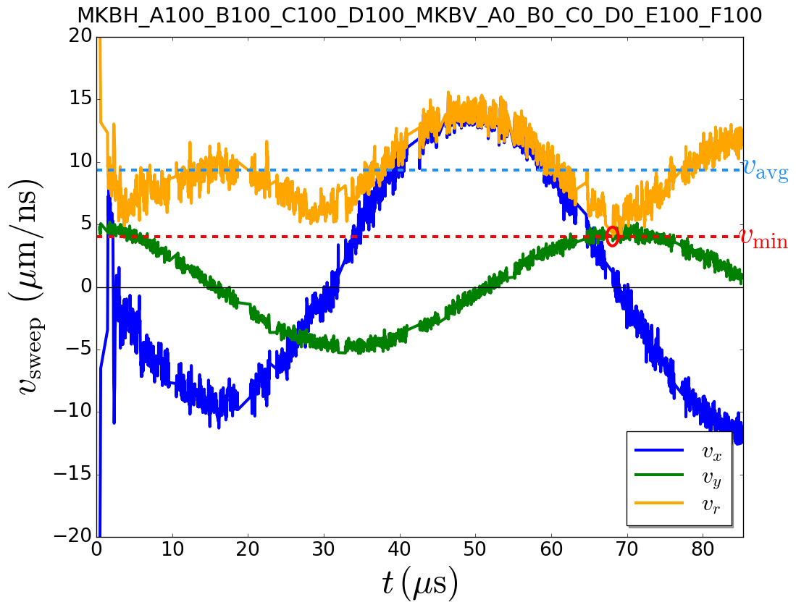
Missing MKBV
4/6 MKBV missing
Proton Density at TDE
v_{min} = 4.0 μm/ns
Sweep Velocity at TDE
ρ_{peak}(p+) = 159%
4 MKBV missing
3.9e6 macro particles
Nominal waveform data taken from <2016-07-22, 17:01h> dump, Beam 2, ε = 3.75 μm.
Sweep velocity is averaged over 7 adjacent bunches to reduce effects from waveform noise.
Filling scheme HL-LHC: filling_scheme_bcms_25ns_2604b_2592_2288_2396_288bpi12inj

Slide 13
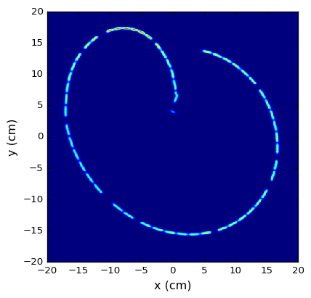
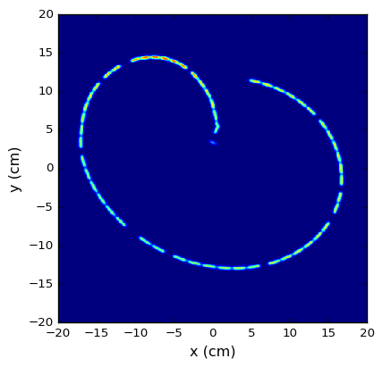
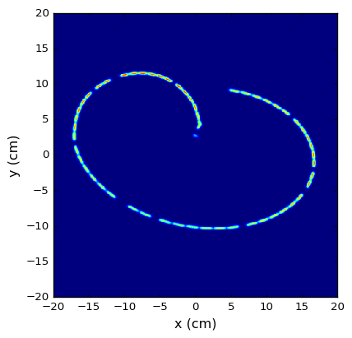
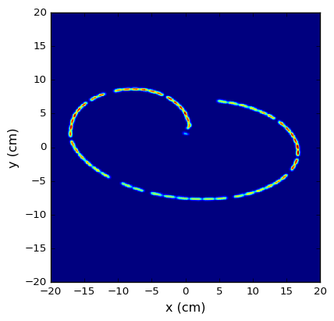
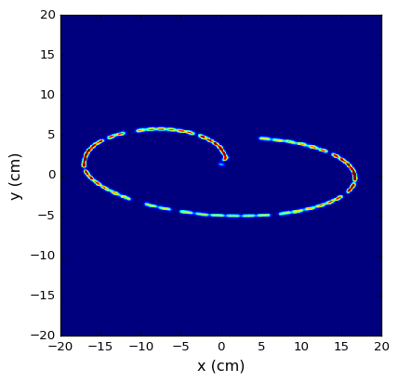
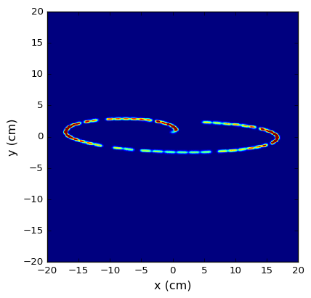
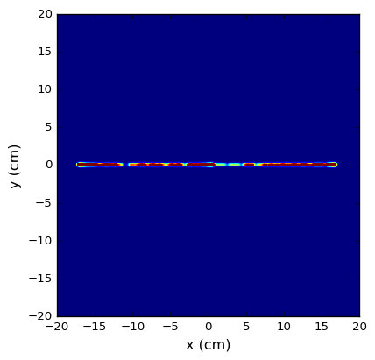
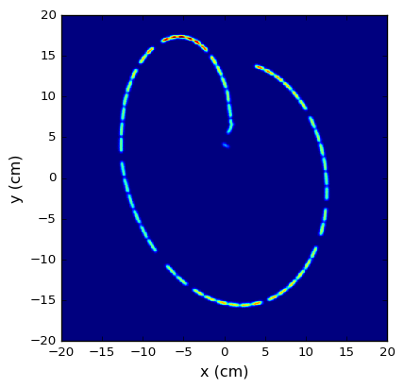
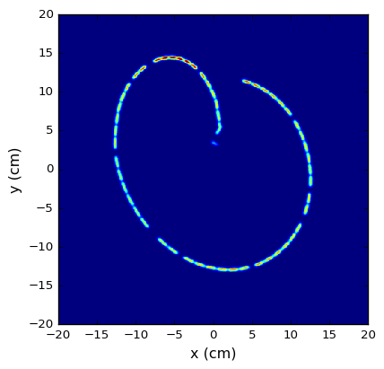
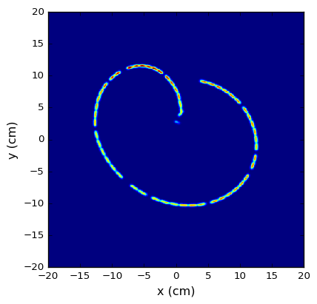
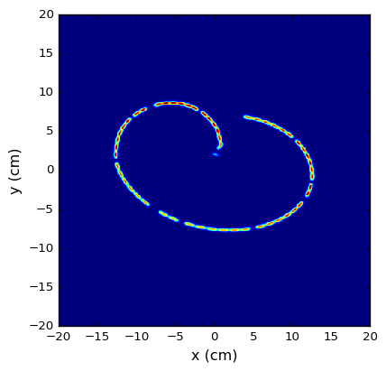
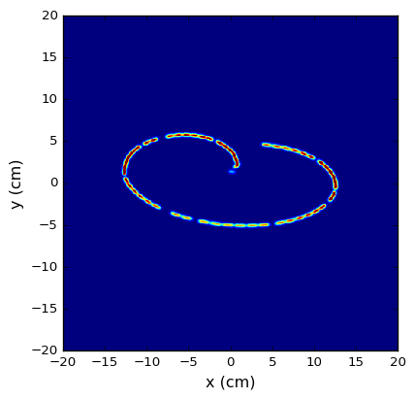


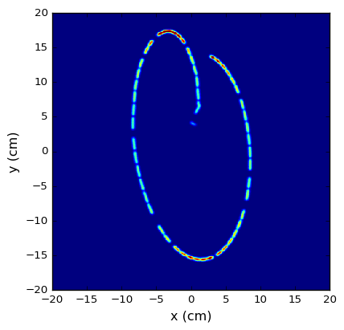
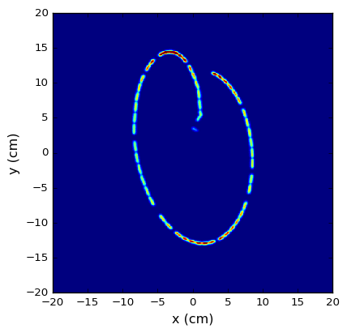
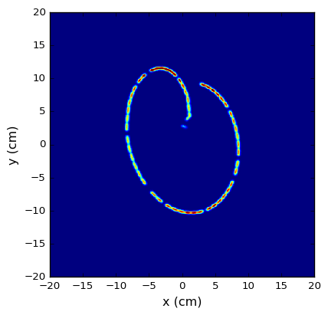




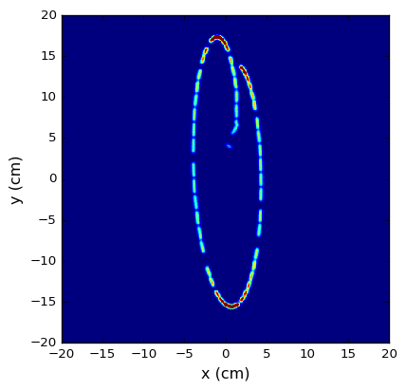
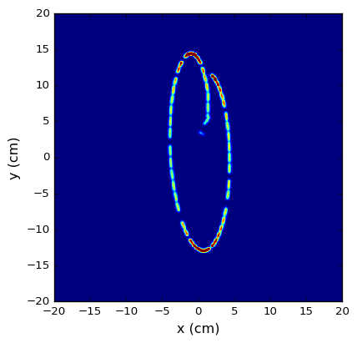
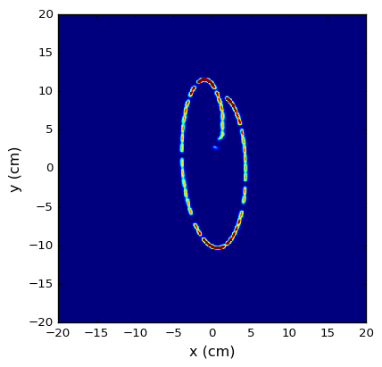
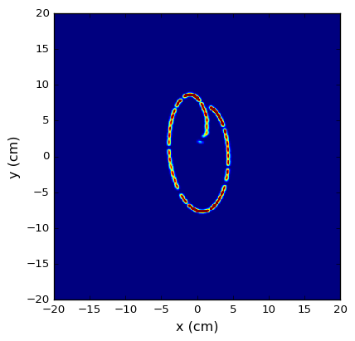

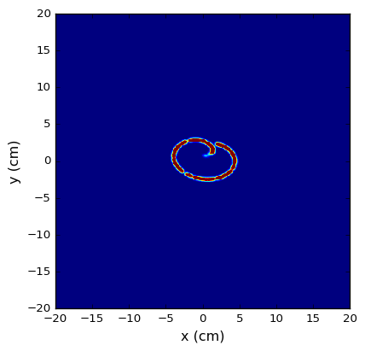

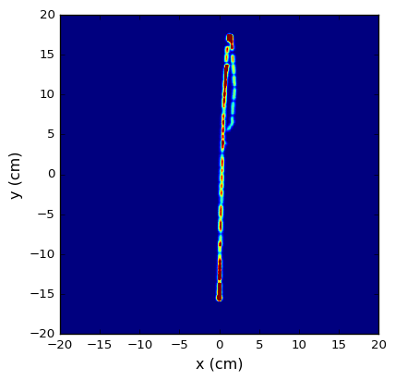
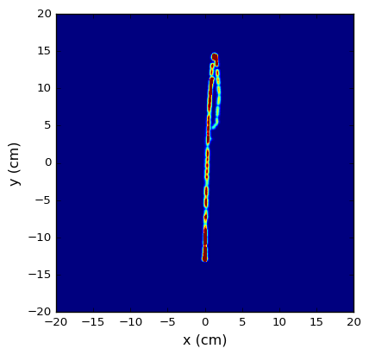
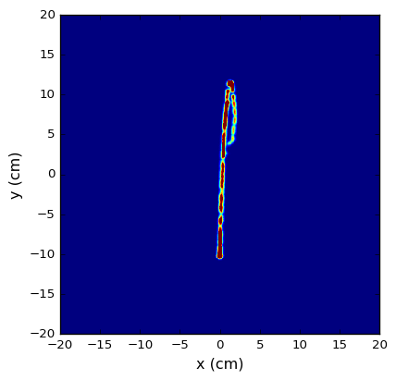

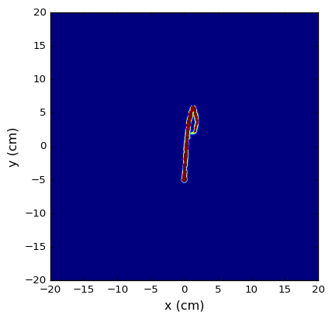
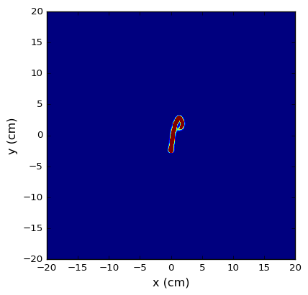

Missing MKB
HL-LHC BCMS Filling Pattern
Single
Failure
 |  | Number of active MKBV
 |  | 6 | 5 | 4 | 3 | 2 | 1 | 0
Number of active MKBH | 4
 | 3
 | 2
 | 1
 | 0
Nominal
Single Failure

Slide 14
Missing MKB
HL-LHC Standard Filling Pattern
Next steps: Energy-deposition and thermo-mechanical studies (BCMS/standard) for HL-LHC parameters
Peak
ρ(p+)
 |  | Number of active MKBV
 |  | 6 | 5 | 4 | 3 | 2 | 1 | 0
Number of active MKBH | 4 | 100% | 100% | 105% | 120% | 165% | 263% | 636%
 | 3 | 115% | 123% | 121% | 126% | 166% | 270% | 740%
 | 2 | 164% | 164% | 164% | 167% | 172% | 284% | 917%
 | 1 | 251% | 246% | 252% | 255% | 262% | 299% | 1328%
 | 0 | 604% | 660% | 736% | 790% | 959% | 1387% | 4559%
Nominal

Slide 15
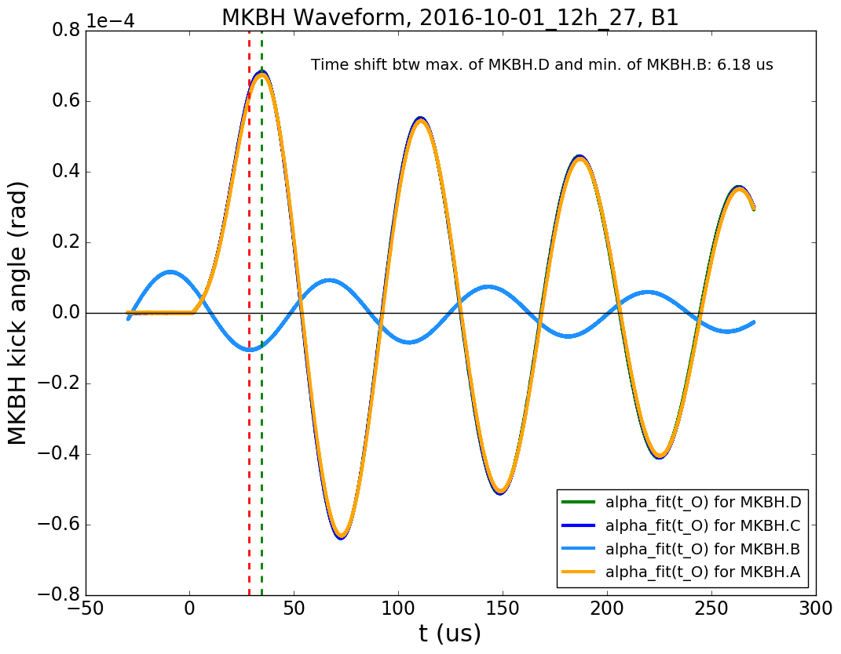
Erratic 2016-10-01: Waveforms
Measured
waveforms
Beam 1
For a single erratic, the worst case is loss of (less than) 2 MKB
MKBH.B in antiphase

Slide 16
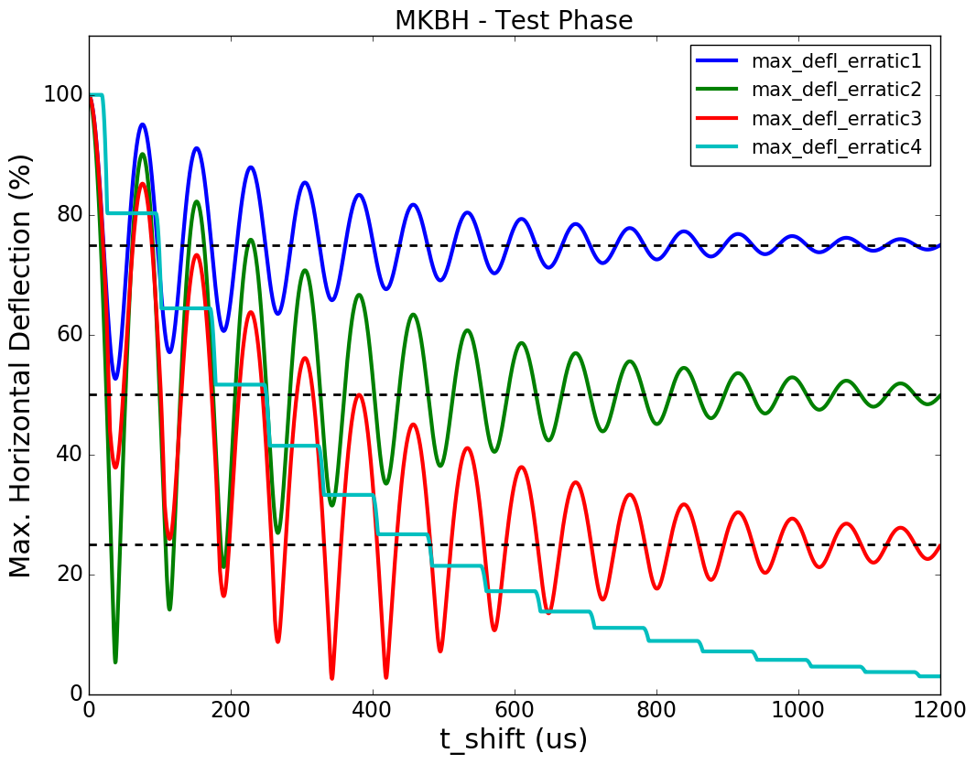
Problem: MKB Coupling
Hardware mitigation (common mode filtering and insulation of retrigger boxes) successfully implemented.
However, immunity margin with respect to HL-LHC parameters to be further validated.
Spontaneous trigger → time delay between MKBHs → Risk of Antiphase
For t→∞
α_{max} → 75%
(loss of 1 MKBH)
For t→∞
α_{max} → 50%
(loss of 2 MKBH)
For t→∞
α_{max} → 25%
(loss of 3 MKBH)
For delay < 150us:
double erratic is worst case
For t→∞
α_{max} → 0%
(loss of 4 MKBH)
For shift 200us..600us:
triple erratic is worst case
Minimum BETS delay (?)
Delay for MKBH erratic 2016-10-01

Slide 17
Options MKB Retrigger Strategy
 | Max. horizontal deflection, single erratic | Max. horizontal deflection, double erratic | Required Changes
Current situation: BETS reacts with delay time < 1ms | 63%...87% (for BETS delay > 220 us) | 27%...77% (for BETS delay > 220 us) | None
Directly request synch. dump (do no retrigger MKBs) | 53%...95% | 5%...90% | Reduce delay time? …
Directly request synch. dump and retrigger all MKBs (within <1us) | 80% (Change of phase relation between MKD&MKB → significant change of TDE pattern). | 80% (Change of phase relation between MKD&MKB → significant change of TDE pattern). | Install dedicated MKB retrigger line Fast detection of erratic required
Directly request asynch. dump | Close to nominal for TDE. But losses in IP6. | Close to nominal for TDE. But losses in IP6. | Trigger signal MKB to MKD (?)
Increase delay time, e.g. >1.5ms | ~75% | ~50% (Remark: will get worse for erratic of 3, 4) | Introduce additional time delay (~1ms ?)…
Increase damping factor | → 75% ? (small change of TDE pattern) | → 50% ? (small change of TDE pattern) | Hardware changes, resistor? ...
Remove “fast path” (to reduce risk of multiple triggering) | No change for synch. dump; TDE pattern (slightly?) changed for asynch. dump. | No change for synch. dump; TDE pattern (slightly?) changed for asynch. dump. | Remove “fast path”
Idea: Eliminate the risk of antiphase by direct retriggering of all MKB

Slide 18
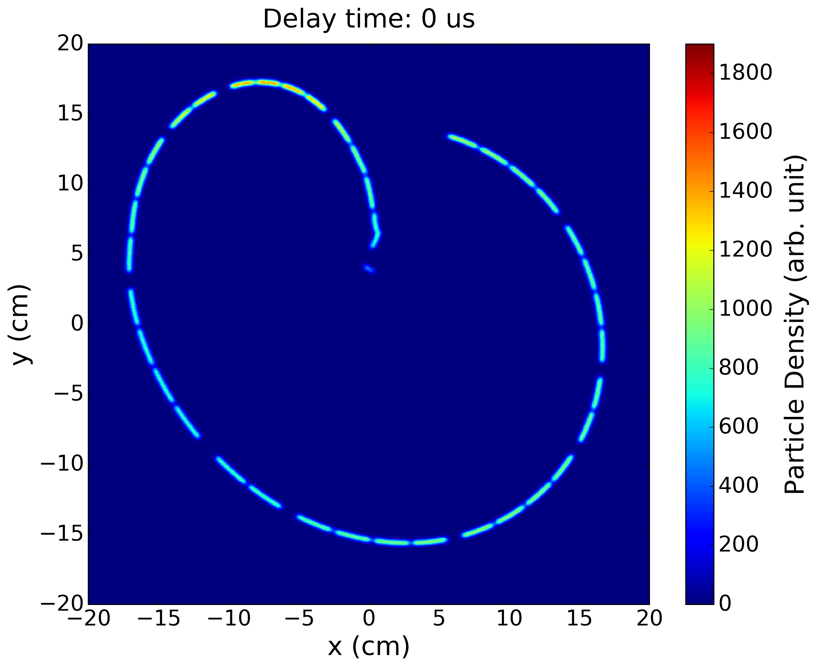
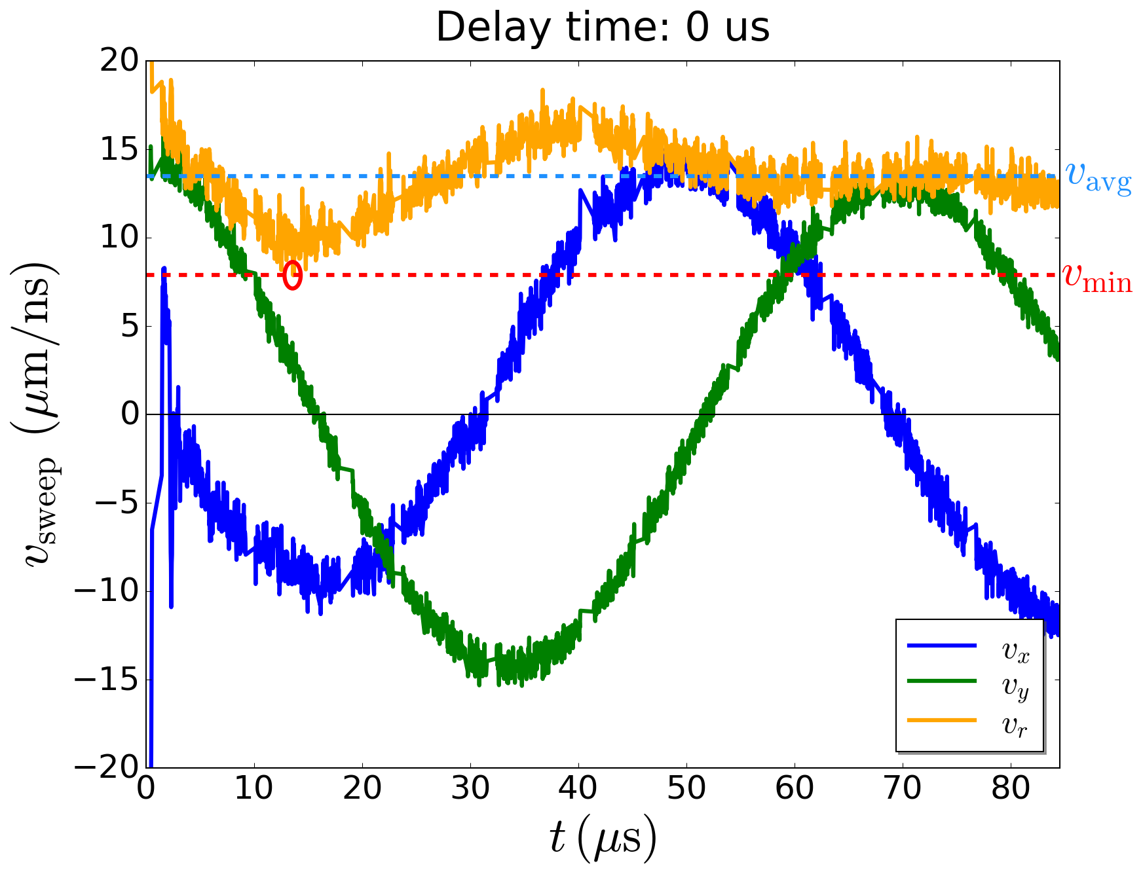
Possible Solution: MKB Retriggering?
Time delay between MKBs and MKDs changes the TDE pattern.
Proton Density at TDE
Sweep Velocity at TDE
v_{min} = 7.9 μm/ns
Nominal TDE Pattern
3.9e6 macro particles
Nominal waveform data taken from <2016-07-22, 17:01h> dump, Beam 2.
Sweep velocity is averaged over 7 adjacent bunches to reduce effects from waveform noise.
Filling scheme HL-LHC: standard_25ns_2748b_2736_2452_2524_288bpi12inj

Slide 19
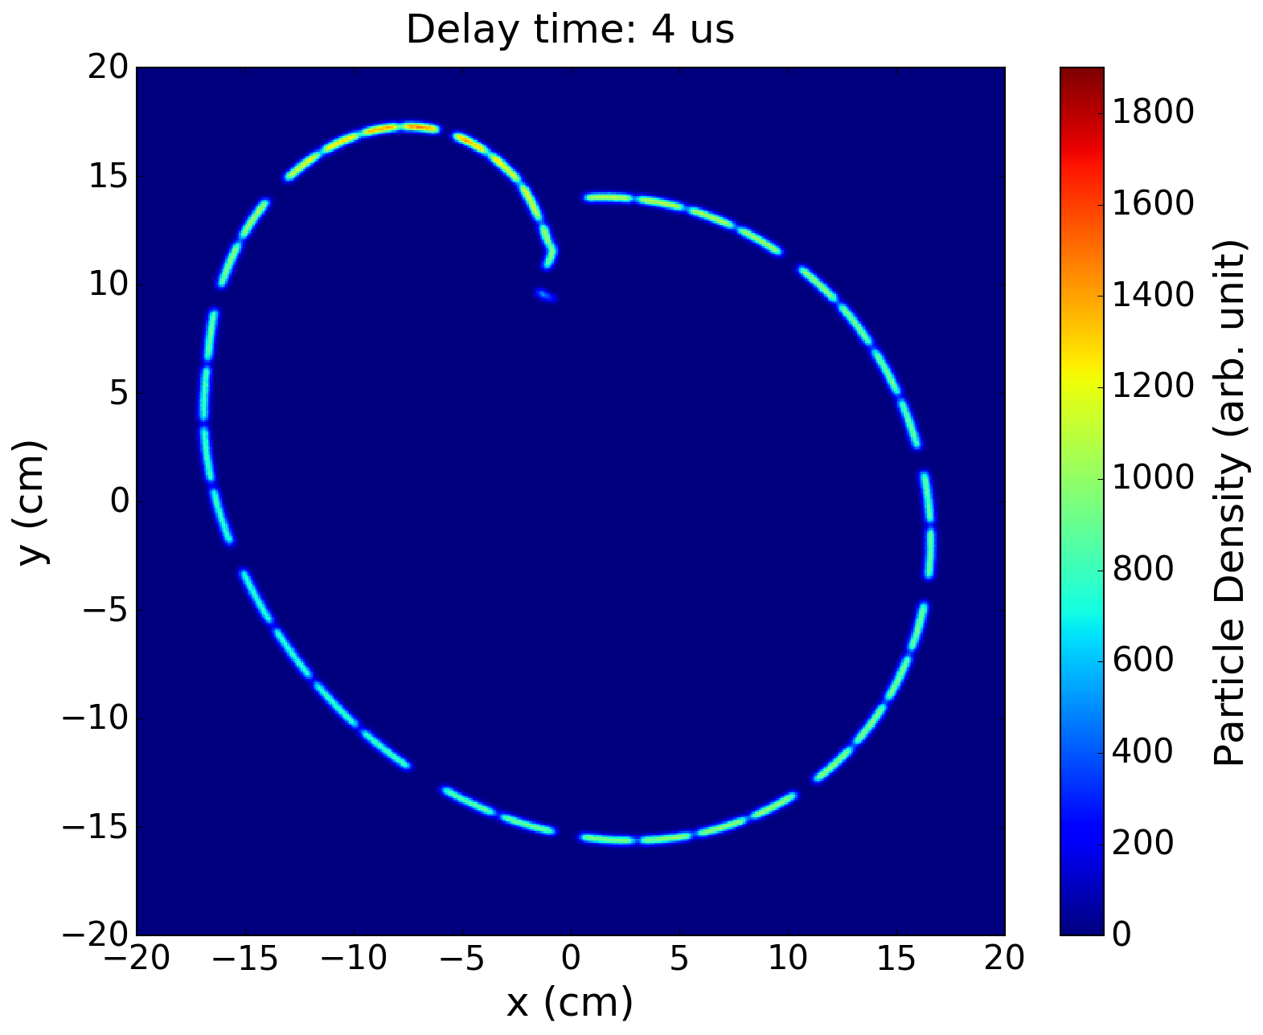
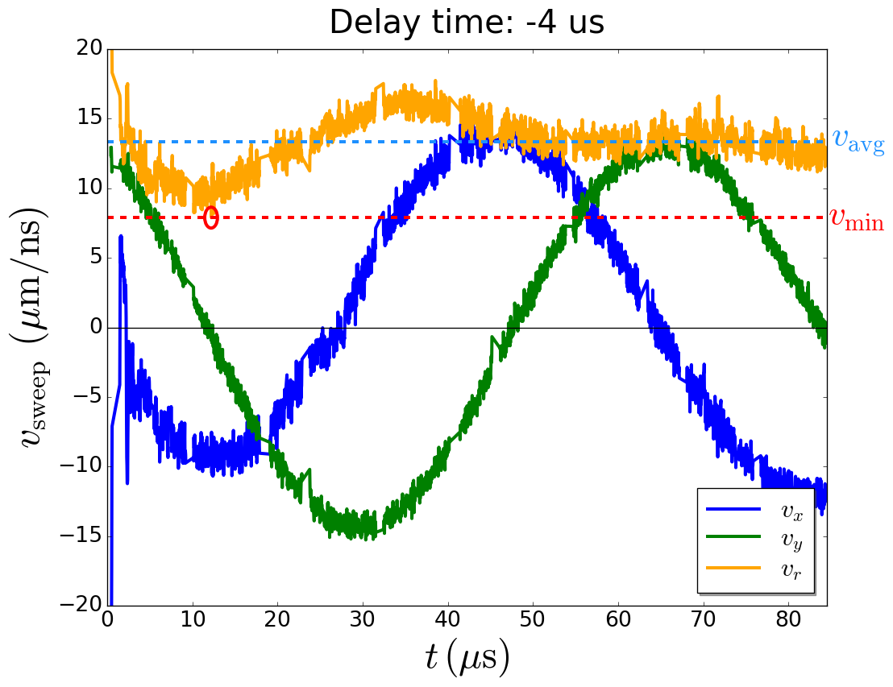
MKB Retriggering
Proton Density at TDE
Sweep Velocity at TDE
Nominal waveform data taken from <2016-07-22, 17:01h> dump, Beam 2.
Sweep velocity is averaged over 7 adjacent bunches to reduce effects from waveform noise.
Filling scheme HL-LHC: standard_25ns_2748b_2736_2452_2524_288bpi12inj

Slide 20


MKB Retriggering
Proton Density at TDE
Sweep Velocity at TDE
Nominal waveform data taken from <2016-07-22, 17:01h> dump, Beam 2.
Sweep velocity is averaged over 7 adjacent bunches to reduce effects from waveform noise.
Filling scheme HL-LHC: standard_25ns_2748b_2736_2452_2524_288bpi12inj

Slide 21


MKB Retriggering
Proton Density at TDE
Sweep Velocity at TDE
Nominal waveform data taken from <2016-07-22, 17:01h> dump, Beam 2.
Sweep velocity is averaged over 7 adjacent bunches to reduce effects from waveform noise.
Filling scheme HL-LHC: standard_25ns_2748b_2736_2452_2524_288bpi12inj

Slide 22


MKB Retriggering
Proton Density at TDE
Sweep Velocity at TDE
Highest p+ density, but very localized.
Nominal waveform data taken from <2016-07-22, 17:01h> dump, Beam 2.
Sweep velocity is averaged over 7 adjacent bunches to reduce effects from waveform noise.
Filling scheme HL-LHC: standard_25ns_2748b_2736_2452_2524_288bpi12inj

Slide 23


MKB Retriggering
Proton Density at TDE
Sweep Velocity at TDE
Nominal waveform data taken from <2016-07-22, 17:01h> dump, Beam 2.
Sweep velocity is averaged over 7 adjacent bunches to reduce effects from waveform noise.
Filling scheme HL-LHC: standard_25ns_2748b_2736_2452_2524_288bpi12inj

Slide 24


MKB Retriggering
Proton Density at TDE
Sweep Velocity at TDE
Nominal waveform data taken from <2016-07-22, 17:01h> dump, Beam 2.
Sweep velocity is averaged over 7 adjacent bunches to reduce effects from waveform noise.
Filling scheme HL-LHC: standard_25ns_2748b_2736_2452_2524_288bpi12inj

Slide 25


MKB Retriggering
Proton Density at TDE
Sweep Velocity at TDE
Nominal waveform data taken from <2016-07-22, 17:01h> dump, Beam 2.
Sweep velocity is averaged over 7 adjacent bunches to reduce effects from waveform noise.
Filling scheme HL-LHC: standard_25ns_2748b_2736_2452_2524_288bpi12inj

Slide 26


MKB Retriggering
Proton Density at TDE
Sweep Velocity at TDE
Nominal waveform data taken from <2016-07-22, 17:01h> dump, Beam 2.
Sweep velocity is averaged over 7 adjacent bunches to reduce effects from waveform noise.
Filling scheme HL-LHC: standard_25ns_2748b_2736_2452_2524_288bpi12inj

Slide 27


MKB Retriggering
Proton Density at TDE
Sweep Velocity at TDE
Nominal waveform data taken from <2016-07-22, 17:01h> dump, Beam 2.
Sweep velocity is averaged over 7 adjacent bunches to reduce effects from waveform noise.
Filling scheme HL-LHC: standard_25ns_2748b_2736_2452_2524_288bpi12inj

Slide 28


MKB Retriggering
Proton Density at TDE
Sweep Velocity at TDE
Nominal waveform data taken from <2016-07-22, 17:01h> dump, Beam 2.
Sweep velocity is averaged over 7 adjacent bunches to reduce effects from waveform noise.
Filling scheme HL-LHC: standard_25ns_2748b_2736_2452_2524_288bpi12inj

Slide 29


MKB Retriggering
Proton Density at TDE
Sweep Velocity at TDE
Nominal waveform data taken from <2016-07-22, 17:01h> dump, Beam 2.
Sweep velocity is averaged over 7 adjacent bunches to reduce effects from waveform noise.
Filling scheme HL-LHC: standard_25ns_2748b_2736_2452_2524_288bpi12inj

Slide 30


MKB Retriggering
Proton Density at TDE
Sweep Velocity at TDE
Nominal waveform data taken from <2016-07-22, 17:01h> dump, Beam 2.
Sweep velocity is averaged over 7 adjacent bunches to reduce effects from waveform noise.
Filling scheme HL-LHC: standard_25ns_2748b_2736_2452_2524_288bpi12inj

Slide 31


MKB Retriggering
Proton Density at TDE
Sweep Velocity at TDE
Nominal waveform data taken from <2016-07-22, 17:01h> dump, Beam 2.
Sweep velocity is averaged over 7 adjacent bunches to reduce effects from waveform noise.
Filling scheme HL-LHC: standard_25ns_2748b_2736_2452_2524_288bpi12inj

Slide 32


MKB Retriggering
Proton Density at TDE
Sweep Velocity at TDE
Nominal waveform data taken from <2016-07-22, 17:01h> dump, Beam 2.
Sweep velocity is averaged over 7 adjacent bunches to reduce effects from waveform noise.
Filling scheme HL-LHC: standard_25ns_2748b_2736_2452_2524_288bpi12inj

Slide 33


MKB Retriggering
Proton Density at TDE
Sweep Velocity at TDE
Nominal waveform data taken from <2016-07-22, 17:01h> dump, Beam 2.
Sweep velocity is averaged over 7 adjacent bunches to reduce effects from waveform noise.
Filling scheme HL-LHC: standard_25ns_2748b_2736_2452_2524_288bpi12inj

Slide 34


MKB Retriggering
Proton Density at TDE
Sweep Velocity at TDE
Nominal waveform data taken from <2016-07-22, 17:01h> dump, Beam 2.
Sweep velocity is averaged over 7 adjacent bunches to reduce effects from waveform noise.
Filling scheme HL-LHC: standard_25ns_2748b_2736_2452_2524_288bpi12inj

Slide 35


MKB Retriggering
Proton Density at TDE
Sweep Velocity at TDE
Nominal waveform data taken from <2016-07-22, 17:01h> dump, Beam 2.
Sweep velocity is averaged over 7 adjacent bunches to reduce effects from waveform noise.
Filling scheme HL-LHC: standard_25ns_2748b_2736_2452_2524_288bpi12inj

Slide 36


MKB Retriggering
Proton Density at TDE
Sweep Velocity at TDE
Nominal waveform data taken from <2016-07-22, 17:01h> dump, Beam 2.
Sweep velocity is averaged over 7 adjacent bunches to reduce effects from waveform noise.
Filling scheme HL-LHC: standard_25ns_2748b_2736_2452_2524_288bpi12inj

Slide 37


MKB Retriggering
Proton Density at TDE
Sweep Velocity at TDE
Nominal waveform data taken from <2016-07-22, 17:01h> dump, Beam 2.
Sweep velocity is averaged over 7 adjacent bunches to reduce effects from waveform noise.
Filling scheme HL-LHC: standard_25ns_2748b_2736_2452_2524_288bpi12inj

Slide 38


MKB Retriggering
Proton Density at TDE
Sweep Velocity at TDE
Nominal waveform data taken from <2016-07-22, 17:01h> dump, Beam 2.
Sweep velocity is averaged over 7 adjacent bunches to reduce effects from waveform noise.
Filling scheme HL-LHC: standard_25ns_2748b_2736_2452_2524_288bpi12inj

Slide 39


MKB Retriggering
Proton Density at TDE
Sweep Velocity at TDE
Nominal waveform data taken from <2016-07-22, 17:01h> dump, Beam 2.
Sweep velocity is averaged over 7 adjacent bunches to reduce effects from waveform noise.
Filling scheme HL-LHC: standard_25ns_2748b_2736_2452_2524_288bpi12inj

Slide 40

Retriggering: Density Comparison
Overlap
Localized hotspot due to low v_{sweep}.
1 MKBH period
reduced v_{sweep}
1 LHC turn
bin size: 200 um x 200 um
Sweep velocity is averaged over 11 adjacent bunches to reduce effects from waveform noise.

Slide 41
Retriggering: Summary
Findings:
Retriggering of all MKBs eliminates risk of antiphase.
It can lead to increased p+ density at TDE:
  overlap at (30 us… 45 us) and
  (~6us, ~110 us), but at relatively high v_{sweep}. Therefore, not prohibitive.
  localized hotspots due to reduced v_{sweep}
  damping effect for t_{shift} > 100us
Certain time delays lead to reduced p+ density.
Strategy:
Concentrate on immediate retriggering:
t_{shift} < 110 us to avoid damping effect
Tailor MKD/MKB waveforms? (Overshoot? Larger damping factor?)
Continue studies of energy deposition and thermo-mechanical stresses.
Evaluate implication for hardware, controls and machine protection (!)

Slide 42
Possible Upgrades
Approach 1: Reduce MKB(H) voltage to reduce failure probability
Approach 2: Reduce sensitivity to failures

Slide 43



Reduce MKBH Operational Voltage
Idea: Reduce MKBH operational voltage (and thus kick strength) to e.g. 90%.
Advantage: Straightforward to implement
Disadvantage: Reduced TDE pattern → Increased TDE density
Simulated TDE patterns with MKBH voltage at 90%
4/4 MKBH
3/4 MKBH
2/4 MKBH
See talk by M. Frankl for FLUKA results.

Slide 44
Adding 2 MKBH
Approach: Keeping total deflection angle
→ reduced voltage for each MKBH generator to ≈ 67%·V₀ ≈ 18 kV
→ (significantly) reduced risk of erratic firing
More modules → reduced failure sensitivity
MKBH.A/B
MKBH.C/D
MKBV.A/B
MKBV.C/D
MKBV.E/F
Thanks to L. Ducimetiere
4.762 m
4.256 m
Apertures
MKBH
MKBV
To be studied: apertures, integration of magnets and generators, costs…
In addition, nominal MKBH voltage could be reduced.
32 mm
36 mm
58 mm
66 mm
Downstream shift of 4.8 m increases Δx by ± 1.3 mm

Slide 45

Adding 2 MKBH
LHC 4R6
MKBV -- BPMD.683451.B1 -- BTVD.683458.B1 -- TCDQ

Slide 46
Increasing Generator Capacitance
MKBH
Increase C₀ by 30%
→ Decrease voltage by 14%
Adjust (decrease) L₀
Results in
larger damping
Thanks to V. Senaj
To be studied: change in TDE pattern (due to change in waveform, larger damping)

Slide 47
Add Optics Elements in Dump Line
  Add quadrupole in dump line to increase kick strength?
    To be studied: integration, apertures, costs, sensitivity for orbit excursions.
  Increase Q4 gradient?
    To be studied: Implications for optics, failure cases.
Example: possible FCC dump line
D. Barna/T. Kramer, FCC-hh Dump Pattern Studies

Slide 48
Approach 2: Reduce sensitivity to failures
  Retrigger all MKBs in case of erratic firing?
    To be studied: change of TDE pattern, implications for hardware, controls and machine protection
  Change MKD/MKB waveforms (overshoot, damping) to avoid overlap for retrigger case?
    To be studied: change of TDE pattern
    Combine with increased generator capacitance
  Change nominal timing between MKBs and/or between MKBs and MKDs to be less sensitive to horizontal failure?
    To be studied: change of TDE pattern, implications for hardware, controls and machine protection
  …

Slide 49
Summary
Loss of MKB
  Failure of MKBH is more likely and more critical
  p+ density increase <170% for 2/4 MKBH and 4/6 MKBV missing
MKB coupling issue might be solved by fast retriggering of all MKBs
  However, this leads to a significant change in the TDE pattern (in case of erratic firing) and significant implications for controls and machine protection
  TDE patterns studied and main effects identified (overlap, local density hotspots) so that possible mitigation measures can be evaluated
Upgrade strategy to reduce MKB failure probability and failure sensitivity to be defined

Slide 50
Thank you for your attention!

Slide 51


Modified Timing
All 4 MKBH
Proton Density at TDE
v_{min} = 9.8 μm/ns
Sweep Velocity at TDE
ρ_{peak}(p+) = 83%
All 4 MKBH
Less dependence on horizontal sweep velocity.
3.9e6 macro particles
Nominal waveform data taken from <2016-07-22, 17:01h> dump, Beam 2, ε = 3.75 μm.
Sweep velocity is averaged over 7 adjacent bunches to reduce effects from waveform noise.
Filling scheme HL-LHC: filling_scheme_bcms_25ns_2604b_2592_2288_2396_288bpi12inj
MKD delayed by 22 μs w.r.t MKB.

Slide 52


Modified Timing
1 MKBH missing
Proton Density at TDE
v_{min} = 8.3 μm/ns
Sweep Velocity at TDE
ρ_{peak}(p+) = 104%
1 MKBH missing
Less dependence on horizontal sweep velocity.
3.9e6 macro particles
Nominal waveform data taken from <2016-07-22, 17:01h> dump, Beam 2, ε = 3.75 μm.
Sweep velocity is averaged over 7 adjacent bunches to reduce effects from waveform noise.
Filling scheme HL-LHC: filling_scheme_bcms_25ns_2604b_2592_2288_2396_288bpi12inj
MKD delayed by 22 μs w.r.t MKB.

Slide 53


Modified Timing
2 MKBH missing
Proton Density at TDE
v_{min} = 5.4 μm/ns
Sweep Velocity at TDE
ρ_{peak}(p+) = 141%
2 MKBH missing
Less dependence on horizontal sweep velocity.
3.9e6 macro particles
Nominal waveform data taken from <2016-07-22, 17:01h> dump, Beam 2, ε = 3.75 μm.
Sweep velocity is averaged over 7 adjacent bunches to reduce effects from waveform noise.
Filling scheme HL-LHC: filling_scheme_bcms_25ns_2604b_2592_2288_2396_288bpi12inj
MKD delayed by 22 μs w.r.t MKB.

Slide 54

Modified Timing: Comparison

Slide 55
Missing MKB
HL-LHC BCMS Filling Pattern
Next steps: Energy-deposition and thermo-mechanical studies (BCMS/standard) for HL-LHC parameters
Peak
ρ(p+)
 |  | Number of active MKBV
 |  | 6 | 5 | 4 | 3 | 2 | 1 | 0
Number of active MKBH | 4 | 100% | 104% | 106% | 120% | 159% | 269% | 621%
 | 3 | 130% | 129% | 131% | 130% | 164% | 273% | 746%
 | 2 | 157% | 160% | 162% | 162% | 170% | 272% | 906%
 | 1 | 247% | 251% | 246% | 253% | 265% | 294% | 1279%
 | 0 | 594% | 684% | 757% | 805% | 987% | 1383% | 4315%
Nominal

Slide 56

Retriggering: Density Comparison
Energy density on upstream windows seems to follow the
p+ density.
For discussion of absolute values and thermo-mechanical stresses see talks by
M. Frankl and T. Polzin.
reduced v_{sweep}
FLUKA values courtesy of M. Frankl.
bin size: 200 um x 200 um
Sweep velocity is averaged over 11 adjacent bunches to reduce effects from waveform noise.

Slide 57

Retriggering: Density Comparison
Energy density in dump core and downstream window might be less sensitive to localized hotspots in the p+ density.
For discussion of absolute values and thermo-mechanical stresses see talks by M. Frankl and
T. Polzin.
reduced v_{sweep}
FLUKA values courtesy of M. Frankl.
bin size: 200 um x 200 um
Sweep velocity is averaged over 11 adjacent bunches to reduce effects from waveform noise.

