Slide 1

Outlook on the Thermo-mechanical Studies of the TDE, the TCDQ / TCDS and the TCDD
Tobias Polzin
EN-TCD-STI
WP14 Meeting – 28th March 2017

Slide 2
Agenda
TDE
TCDQ / TCDS
TCDD

Slide 3
TDE

Slide 4
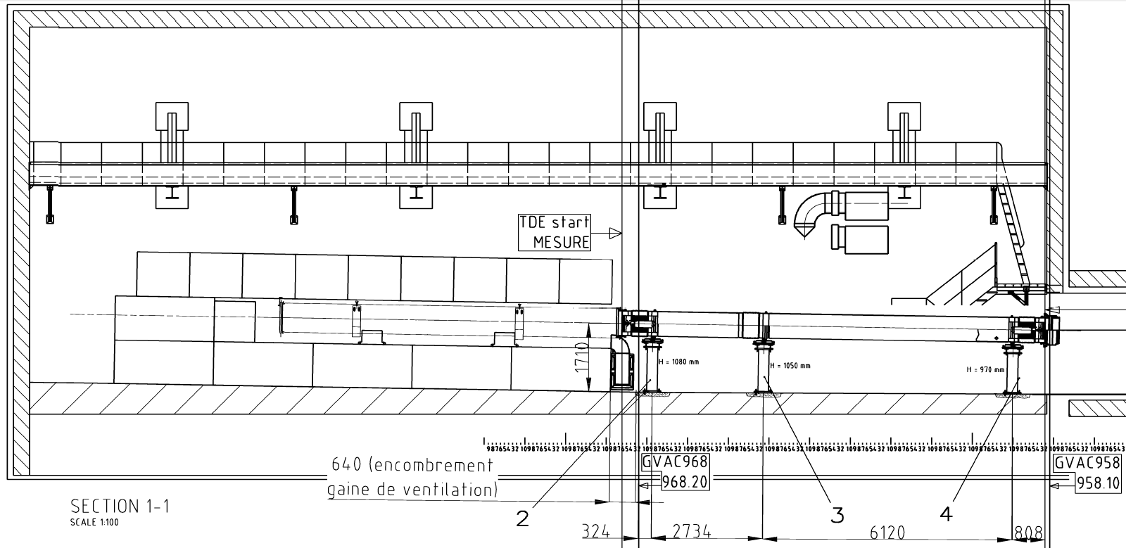
TDE
- Overview -

Slide 5
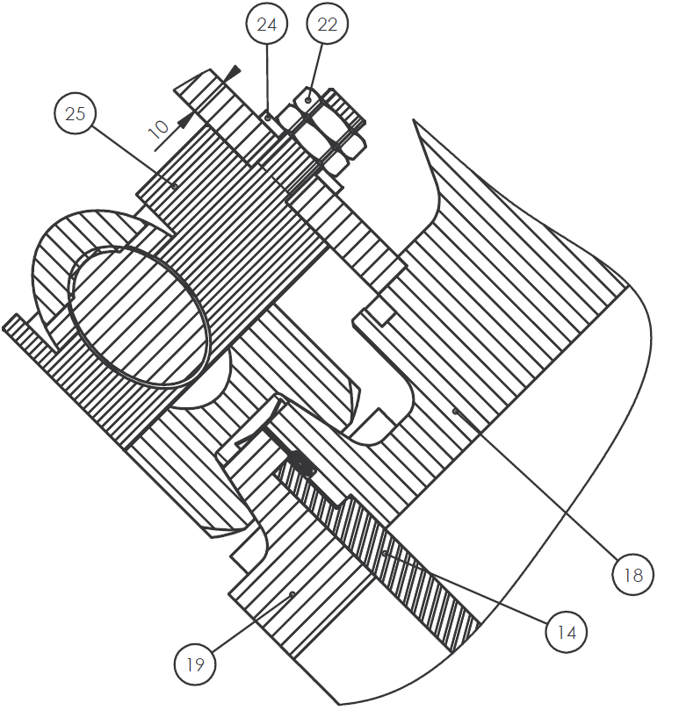
TDE
- Windows -
Upstream Window
Downstream Window
Combination of SIGRABOND and a stainless steel foil
Titanium (Grade 2) window with 10 mm thickness
N₂
Vacuum
Air
N₂

Slide 6
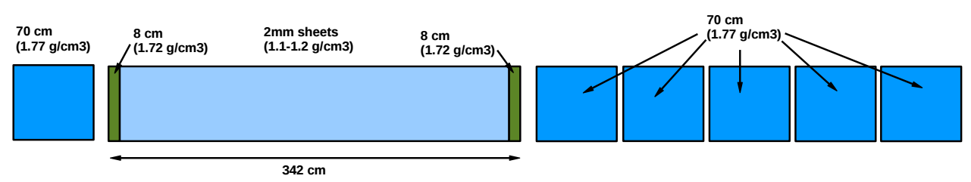
TDE
- Graphite Core -
high- and low-density graphite blocks (SIGRAFINE, SIGRATHERM, SIGRAFLEX)
Diameter of 70 cm and a length of 7.6 m
SIGRAFLEX is mounted in stainless steel jacket

Slide 7
TDE
- Previous Studies -
Standard 25 ns filling
2748 bunches
Bunch intensity = 2.3e11
Beam intensity: 2748 x 2.3e11 = 6.3204e14
Beam emittance = 2.08 µm
Structural Simulations were static!

Slide 8
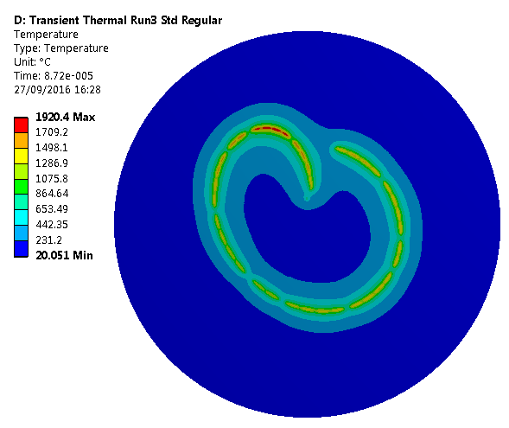
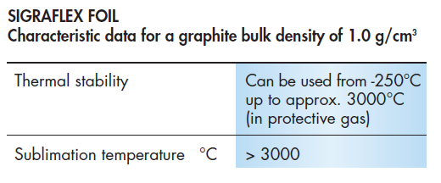
TDE
- Previous Studies of Graphite -
Regular Sweep
Max Temp = 1920°C

Slide 9
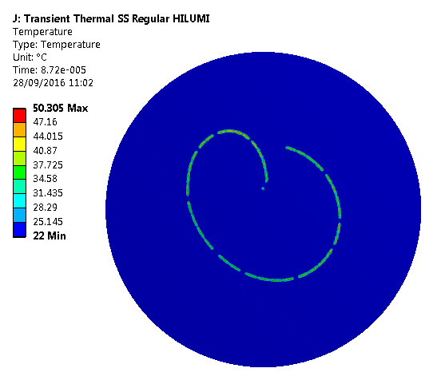
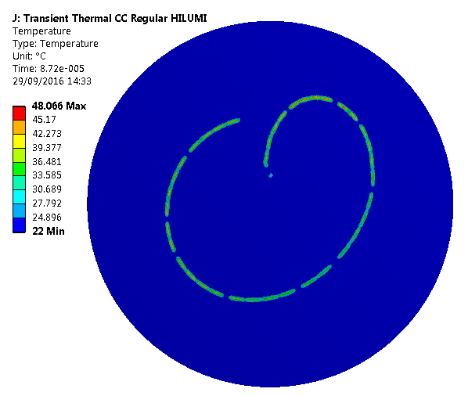
TDE
- Previous Studies of the Windows -
Upstream Window
Stainless Steel Foil
Upstream Window
SIGRABOND window
Regular Sweep
Max Temp = 50°C
Regular Sweep
Max Temp = 48°C

Slide 10
TDE
- Previous Studies -
Static structural simulations were already performed for the core and the windows
The material characterization of the core material is still ongoing and not complete (CTE, specific heat and thermal conductivity till 2000°C)

Slide 11
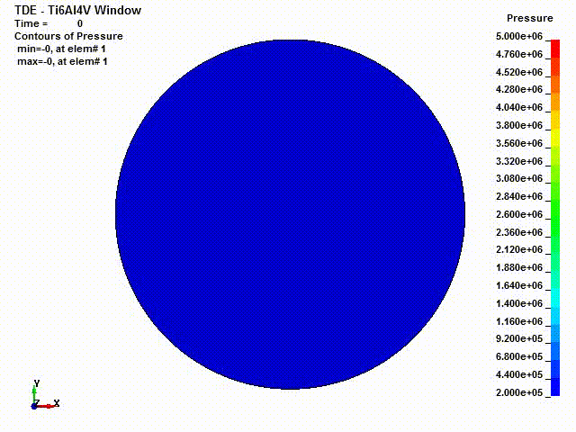
TDE
- Artificial Test Case-
Artificial beam with 26GeV on the titanium window

Slide 12
TDE
- Next Steps -
Dynamic structural simulations for predefined failure scenarios of the MKBs for the core and the windows
Modelling of nonlinear and anisotropic material behavior for the core
Additional simulations for previously defined retriggering scenarios

Slide 13
TCDQ / TCDS

Slide 14
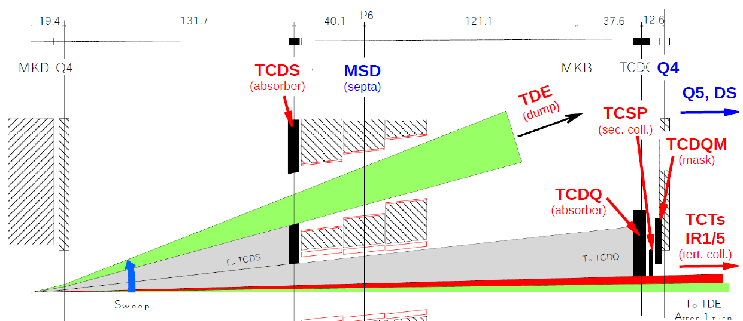
TCDQ / TCDS
- Overview -

Slide 15
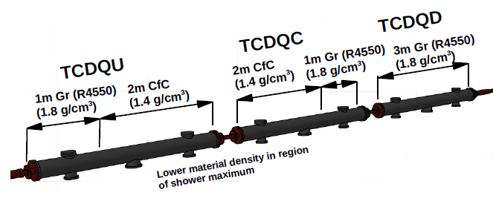
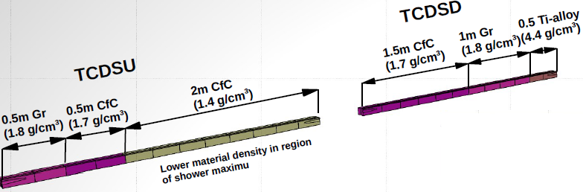
TCDQ / TCDS
- Overview -
TCDQ
Upgraded in LS1
Three modules with 3 m length each
TCDS
2 modules with 3 m length each

Slide 16
TCDQ / TCDS
- Previous Results -
Standard 25 ns filling
50 bunches
Bunch intensity = 2.3e11
Beam intensity: 50 x 2.3e11 = 1.15e13
Beam emittance = 2.1 µm
3D simulation of the block with the highest energy deposition

Slide 17

TCDQ / TCDS
- Previous Results -
TCDQ
Material | C-C 1.75 | C-C 1.4 | Graphite R4550
Max. Temp. [°C] | 1138 | 1280 | 28
Min. Princ. [MPa] | -30 | -31 | -3
Compr. Strength | 69.6 | 69.6 | 130
Max. Princ. [MPa] | 43 | 42 | 2
Tensile Strength | 61 | 61 | 40
TCDS (low Z)
Material | C-C 1.75 | C-C 1.4 | Graphite
Max. Temp. [°C] | 798 | 1141 | 396
Min. Princ. [MPa] | -23 | -27 | -20
Compr. Strength | 69.6 | 69.6 | 35
Max. Princ. [MPa] | 18 | 51 | 27
Tensile Strength | 61 | 84 (y) | 35
TCDS (Ti6Al4V)
 | Area at Max T | Area at Max stress | Area at at Max plastic strain
Temp. [°C] | 568 | 164 | 255
Eq. Stress [MPa] | 308 | 711 | 601
Yield Strength | 248 | 628 | 529
Tensile Strength | 358 | 734 | 645

Slide 18
TCDQ / TCDS
- Next Steps -
Cross check for material parameters, especially the strength of Ti6Al4V at elevated temperatures
Review of simulation method to verify the results

Slide 19
TCDD

Slide 20
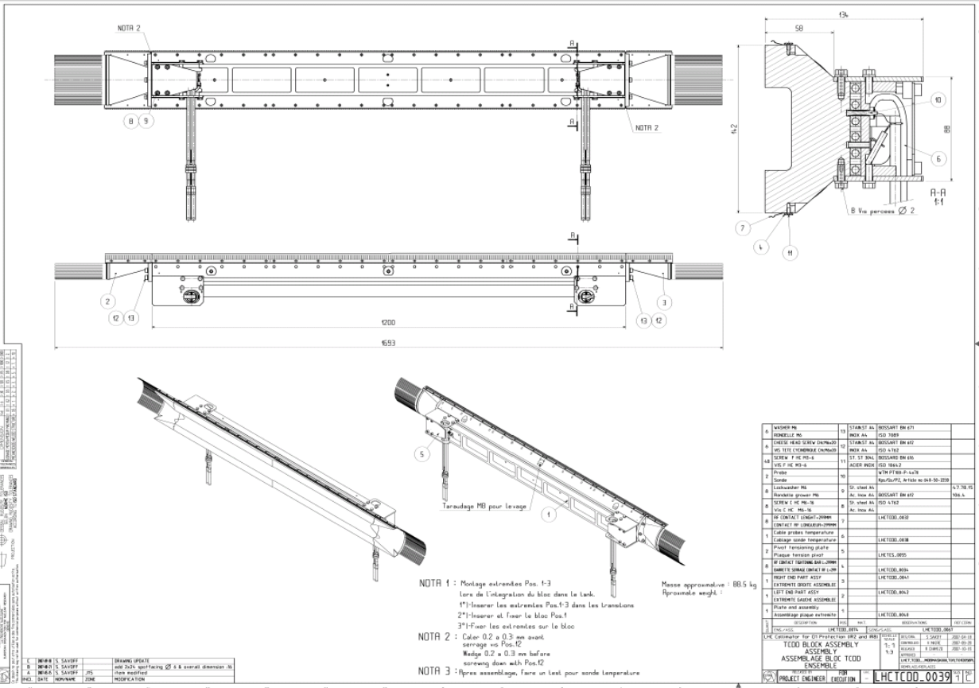
TCDD
- Overview -

Slide 21
TCDD
- Overview -
Protection of D1 against damage
Baseline is to keep current device, but put also a smaller device directly around the beam pipe
Studies ongoing for a material and geometry selection

Slide 22
TCDD
- Next steps -
Thermomechanical simulation of the new smaller “insert”, when a first choice of the material was done in FLUKA
Material data at cryogenic temperatures necessary

Slide 23
Thanks to Matthias Frankl and Anton Lechner for the used pictures
and to Edmundo Lopez Sola and Chiara Di Paolo for the previous work on the TDE, the
TCDQ and the TCDS!

