Slide 1
Run 7469 Emittance Paper
01/42
CM 48 Update
V. Blackmore

Slide 2
contents
02/42
  Run information
  Beam selection
    Validating the new diffuser aperture cut
  Monte Carlo resolutions
  Uncertainties
  Updated emittance plots

Slide 3
Introduction
03/42
What was run 7469?
What detectors were available?
What do we want to do?

Slide 4
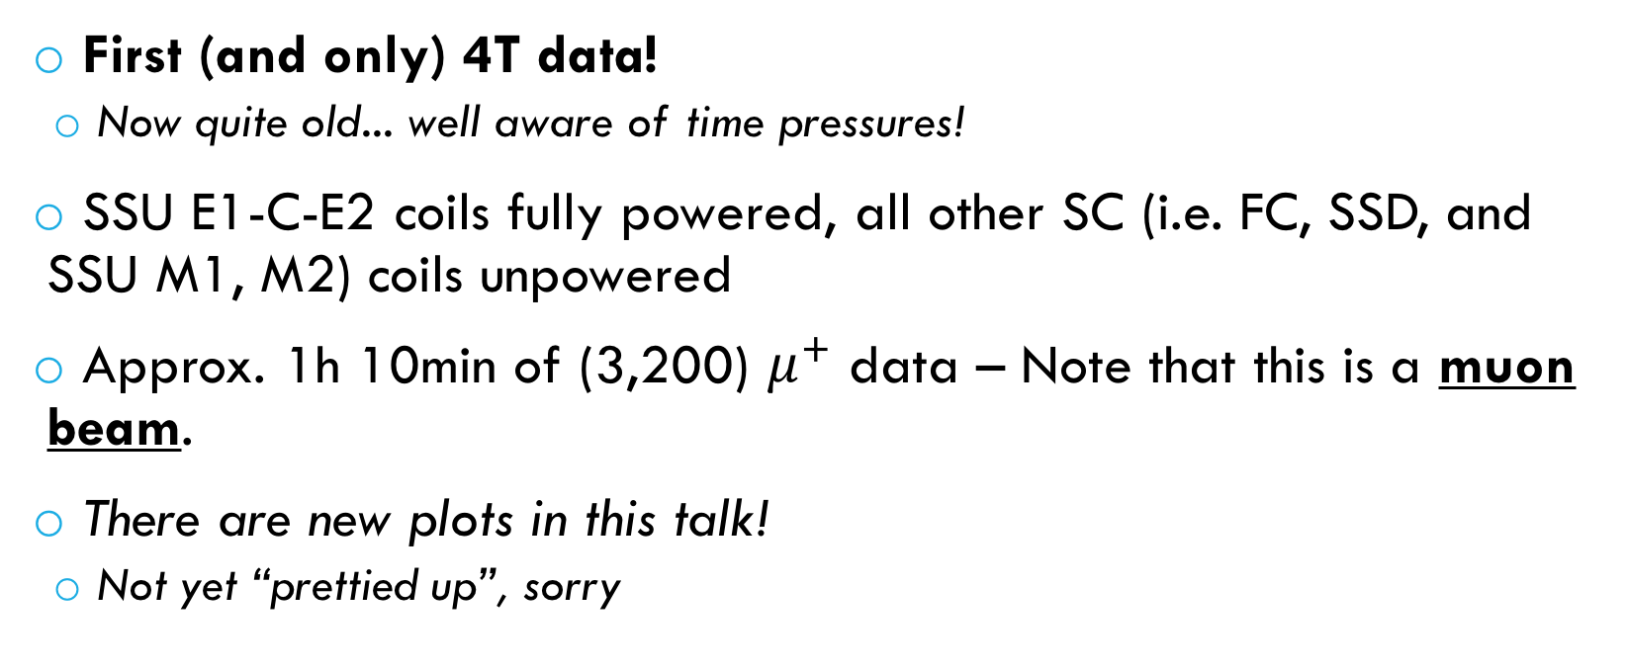
What was run 7469?
04/42
First (and only) 4T data!
  Now quite old... well aware of time pressures!
SSU E1-C-E2 coils fully powered, all other SC (i.e. FC, SSD, and SSU M1, M2) coils unpowered
Approx. 1h 10min of (3,200) $μ^{+}$ data – Note that this is a muon beam.
There are new plots in this talk!
  Not yet “prettied up”, sorry

Slide 5
What detectors?
05/42
Only the upstream detectors are used
  TOF0, TOF1, TKU
No field beyond TKU, just a nice big collimator (FC/SSD)
  TKD was not functioning when this data was taken (scrambled calibration file)
  Not looking at TKD, TOF2 and EMR (without field the transmission is small by TOF2 & EMR, data sample is already small enough)

Slide 6
What do we want to do with this data?
06/42
Sample phase space
  Dispersion
  Sample with respect to Pz
Check Monte Carlo description of our beam
  How well does it do?
  How do we need to tune it to match the data?
Gain confidence
  7469 is our only* data at 4T, data that follows is at lower fields
  Can compare same input beam as measured in TKU with 4T and 3T
Beam behaviour
  Any smoking guns?
* Well.. all the data from that day is at, or on its way to, 4T...

Slide 7
Raw Data and Monte Carlo
07/42

Slide 8
Raw data and MC
Data
08/42
Reconstructed MC
Same z-axis colour scale (from 0 to 300)
Horizontal axis: Total momentum measured at station 1 (most downstream) of TKU
Vertical axis: Time of flight between TOF0 and TOF1
Left: Raw (uncut) data
Right: Raw (uncut) reconstructed MC
Similar features indicated on plots
What are we dealing with?
1. Pions lie in this region
2. Muons that scrape the diffuser aperture
Number here includes all the particles from D2 that didn’t make it to TKU
1.
2.

Slide 9
Reconstructed MC
09/42
MC: Compare Virtual Hits to Reconstructed Hits
Same z-axis colour, same plots
Reconstructed values plotted (no cuts/selection)
Plot a particle ended up in depends on its true PID
  Left: Everything
  Middle-Left: Muons only
  Middle-Right: Pions only
  Right: Electrons only
Particle Species
50/50 mu/pi in this region
50/50 mu/pi in this region
Just muons
No pions

Slide 10
Reconstructed MC
10/42
Hypothesis: The ‘junk’ are muons that scrape the outer aperture of the diffuser
  Diffuser has 4 irises that open/close
  All irises were open
  Iris material stored at a radius > 100mm
Look at the total momentum lost between TOF1 and;
  A virtual plane positioned near the most downstream point of the diffuser
  The most upstream tracker station
NB: Diffuser “ends” with aluminium plate
  Acts as a helium window
  Extra energy loss crossing this before getting to TKU
MC: Compare Virtual Hits to Reconstructed Hits
What is that ‘junk’?
All these particles lose momentum in the
material stored around the outside of
the diffuser
To be accepted
Extra loss from Al plate

Slide 11
Reconstructed MC
11/42
Look at the (t, p) plot w.r.t. the total momentum lost between TOF1 and the most upstream tracker station
  Left: All particles
  Middle: Particles that lost less than 5MeV/c between TOF1 and TKU
  Right: Particles that lost more than 5 MeV/c
MC: Compare Virtual Hits to Reconstructed Hits
Where do these particles go?

Slide 12
12/42
What can be done?
MC is a useful tool, but the data doesn’t have ‘virtual planes’
Use Chris Rogers particle tracking tool to take measurements at TKU and backtrack to the diffuser
  Tracking done for data and MC
  Will look at residuals for this later in the talk.
Removing the ‘junk’ particles means imposing an aperture around the diffuser to eliminate particles that scrape on it but still end up in the tracker.

Slide 13
Beam Selection
13/42

Slide 14
What are the Cuts?
14/42
Have previously spent a lot of time validating cuts 1—10 individually. See CM45 talk for these.
‘Cut number’ | Cut
1 | Good M. Rayner TOF0 slab calibration
2 | Good M. Rayner TOF1 slab calibration
3 | Good M. Rayner TOF reconstruction
4 | Hit 5 stations of TKU
5 | Time of flight between 27 and 40ns
6 | Hit TOF0, TOF1 and 5 stations of TKU
7 | One, and only one, hit at TOF0
8 | One, and only one, hit at TOF1
9 | One, and only one, track in TKU
10 | TKU P-value > 0.01
11 | C. Rogers tracked radius at diffuser < 80mm
Have good TOF reconstruction,
only muons selected
Good TKU reconstruction
“Basic”
Cuts
Minimise track confusion
New!
NB: Tracked value at most downstream point (closest to TKU to minimise tracking error)

Slide 15
How good is the backtracking?
Reconstructed MC
15/42
Residual plots (tracked radius – true radius) at three points across the diffuser
“True radius” = radius at virtual plane
Compare after all other ‘basic’ selection carried out (only task left is removing scraped muons)
Well centered, use most downstream tracked value for better accuracy
Most upstream
Furthest from TKU
Most downstream
Furthest from TKU

Slide 16
Diffuser aperture cut effect:
Recon MC
Reconstructed MC
16/42
NB: This and next slide’s plots all use the same colour-scale (z)
NB2: Downwards ‘shift’ in TOF between data and MC very visible between these two slides – momentum distributions don’t match
Particles that have (tracked) r < 80mm at diffuser
Particles that have (tracked) r > 80mm at diffuser
Particles that pass all cuts
No cuts

Slide 17
Diffuser aperture cut effect:
Data
Data
17/42
NB: Uses same colour-scale (z) as previous slide
NB2: Downwards ‘shift’ in TOF between data and MC very visible between these two slides – momentum distributions don’t match
Particles that have (tracked) r < 80mm at diffuser
Particles that have (tracked) r > 80mm at diffuser
Particles that pass all cuts
No cuts

Slide 18
Diffuser aperture cut effect:
Recon MC
Reconstructed MC
18/42
NB: This and next slide’s plots all use the same colour-scale (z)
NB2: Downwards ‘shift’ in TOF between data and MC very visible between these two slides – momentum distributions don’t match
Particles that have (tracked) r < 80mm at diffuser
Particles that have (tracked) r > 80mm at diffuser
Particles that pass all cuts
No cuts

Slide 19
Diffuser aperture cut effect:
Data
Data
19/42
NB: Uses same colour-scale (z) as previous slide
NB2: Downwards ‘shift’ in TOF between data and MC very visible between these two slides – momentum distributions don’t match
Particles that have (tracked) r < 80mm at diffuser
Particles that have (tracked) r > 80mm at diffuser
Particles that pass all cuts
No cuts

Slide 20
How many fail cuts?
20/42
‘Cut number’ | Cut | Particles that fail this cut
1 | Good M. Rayner TOF0 slab calibration | 14793
2 | Good M. Rayner TOF1 slab calibration | 6644
3 | Good M. Rayner TOF reconstruction | 15996
4 | Hit 5 stations of TKU | 11603
5 | Time of flight between 27 and 40ns | 15996
6 | Hit TOF0, TOF1 and 5 stations of TKU | 20903
7 | One, and only one, hit at TOF0 | 15463
8 | One, and only one, hit at TOF1 | 6886
9 | One, and only one, track in TKU | 14749
10 | TKU P-value > 0.01 | 1144
11 | C. Rogers tracked radius at diffuser < 80mm | 25817
Total PASSING all cuts (passed/total events): |  | 18,772 / 53,452
“Basic”
Cuts
New!

Slide 21
Monte Carlo residuals
21/42

Slide 22
Diffuser Tracking residuals
Reconstructed MC
22/42
All cuts applied
Match up reconstructed values with those at virtual planes
Residual: Reconstructed value – true value
Bias in total momentum tracked back to diffuser
Doesn’t show in radius residual
  Does show in x residuals, less so in y residual

Slide 23
Diffuser Tracking residuals
Reconstructed MC
23/42
All cuts applied
Match up reconstructed values with those at virtual planes
Residual: Reconstructed value – true value
Bias in total momentum tracked back to diffuser
Doesn’t show in radius residual
  Does show in x residuals, less so in y residual

Slide 24
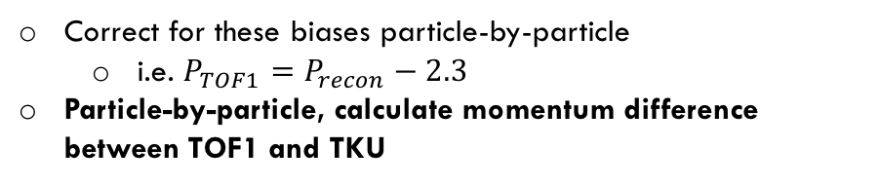
Total Momentum at TOF1 and TKU
Reconstructed MC
24/42
Use M. Rayner method to reconstruct |P| at u/s side of TOF1
TOF1 overestimates P by ~ 2.3 MeV/c
TKU underestimates P by ~ 0.8 MeV/c
Correct for these biases particle-by-particle
  i.e. $P_{TOF1}=P_{recon}−2.3$
Particle-by-particle, calculate momentum difference between TOF1 and TKU

Slide 25
Total Momentum at TOF1 and TKU
Data
25/42
Reconstructed MC
Particle-by-particle, calculate momentum difference
  TOF P – TKU P
  MC contains our best estimate of materials
Data – Recon MC difference: ~ 1.3 MeV/c
NB: Momentum distributions differ a little between data and MC
Data
Mean: 15.4
Recon MC
Mean: 16.7
True MC
Mean: 16.0

Slide 26
Total Momentum at TOF1 and TKU
Data
26/42
Reconstructed MC
Biases have been corrected for in these distributions: Top row: TOF1, Bottom row: TKU
TOF1 P, Data
Mean: 216.4
TOF1 P, Recon MC
Mean: 211.7
TOF1 P, True MC
Mean: 207.4
TKU P, Data
Mean: 197.7
TKU P, Recon MC
Mean: 191.2
TKU P, True MC
Mean: 191.9

Slide 27
Uncertainties
27/42
”Efficiency”, fields, beam purity, binning

Slide 28
TKU “Efficiency”
28/42
Admittedly not “efficiency” in the way Adam might mean it!
Analysis samples a distribution
How much of that might we miss?
Check if we have a hit at TOF1
Look for corresponding 5-point SciFi track in TKU
Check across different momenta (i.e. time-of-flight)
Are there any (x, y, px, py)-related inefficiencies? → Still to do
At a simple level, ‘efficiency’ > 80% across momentum range of interest

Slide 29
TKU “Efficiency”
Data
Horizontal error bars indicate bin width of 0.2ns
A 5-point track?
A 4-point track?
|P| > 200
If I have a hit in TOF1, do I see...
Admittedly not “efficiency” in the way Adam might mean it!
Multiple tracks?
No track, despite TKU being hit in at least one station?
29/42

Slide 30
TKU “Efficiency”
Data
Horizontal error bars indicate bin width of 0.2ns
A 5-point track?
A 4-point track?
|P| > 200
If I have a hit in TOF1, do I see...
Admittedly not “efficiency” in the way Adam might mean it!
Multiple tracks in TKU and multiple hits at TOF1?
No track, despite TKU being hit in at least one station?
30/42

Slide 31
Fields: TKU Assumptions vs Hall Probes
Data
31/42
(* Assume that SciFi track uses a negative field due to SSU/TKU being a mirror image of SSD/TKD, have asked the experts to confirm)
Probe # | Average|B| measured (T) | Standard deviation (T) | SciFi Track Fit Uses (T)*
65 | 4.05 | 36.1e-6 | Mean field: -3.998 Max field deviation: 0.276 Variance: 3.9e-9 Standard deviation: 0.62e-6
67 | 3.80 | 34.6e-6
77 | 4.08 | 38.3e-6
79 | 4.05 | 38.8e-6
Average | 3.995 | 36.95e-6
<0.1% difference
Does this make sense with TKU residual on P?
  P = qBr, so if r is fixed and we overestimate B, we should overestimate P
  But TKU residual is an underestimate → needs more thought → Look at MC

Slide 32
Fields: TKU Assumptions vs Hall Probes
Reconstructed MC
32/42
(* Assume that SciFi track uses a negative field due to SSU/TKU being a mirror image of SSD/TKD, have asked the experts to confirm)
TKU station | |B| at virtual plane measured (T) | SciFi Track Fit Uses (T)
1 | 3.817 | Mean field: 3.998 Max field deviation: 0.276 Variance: 3.9e-9 Standard deviation: 0.62e-6
2 | 3.951
3 | 4.006
4 | 4.035
5 | 4.066
Average | 3.975
~0.6% difference
Does this make sense with TKU residual on P?
  P = qBr, so if r is fixed and we overestimate B, we should overestimate P
  But TKU residual is an underestimate → needs more thought
  → Field is (in reality and MC) non-uniform, guesstimating effect with an oversimplification

Slide 33
Momentum scale
33/42
7469 vs 8590
7469: 4T in SSU, ECE only, non-uniform
8590: 3T in SSU, all coils
Same (3, 200) mu+ input muon beam
Should have comparable total tracker momentum
Caveats:
  Different proportions go through diffuser annulus (different fringe fields)
  Want to remove these particles from this comparison
Cuts for comparison:
  For some reason, 8590 has many multi-track events in the tracker
  Don’t have tracking-to-diffuser for 8590
  Only using cuts 1—8 & 10.

Slide 34
Momentum scale: Time of Flight
Data
34/42
7469 vs 8590
Run 7469
Run 8590
Mean: 28.36
‘RMS’: 0.668
Mean: 28.29
‘RMS’: 0.6434

Slide 35
Momentum scale: Total Momentum
Data
35/42
7469 vs 8590
Run 7469
Run 8590
Mean: 192.8
‘RMS’: 31.29
Mean: 192.2
‘RMS’: 30.18

Slide 36
Momentum scale: Pz
Data
36/42
7469 vs 8590
Run 7469
Run 8590
Mean: 192.8
‘RMS’: 31.37
Mean: 192.2
‘RMS’: 30.13

Slide 37
MC Recon and True Emittance difference
Reconstructed MC
37/42
Emittance from reconstructed values
Emittance of same particles using true values from virtual plane at TKU station 1
Transverse normalised emittance (mm)
Minor change in calculated emittance between sample with pions and without
(Watch this point)
Horizontal error bar = Pz bin width (8 MeV/c)
Vertical error bar = statistical errors (1/sqrt(2N))
<Pz> (MeV/c)

Slide 38
MC Recon and True Emittance difference (Pure Muon Sample)
Reconstructed MC
38/42
Emittance from reconstructed values
Emittance of same particles using true values from virtual plane at TKU station 1
Transverse normalised emittance (mm)
Minor change in calculated emittance between sample with pions and without
(Watch this point)
Horizontal error bar = Pz bin width (8 MeV/c)
Vertical error bar = statistical errors (1/sqrt(2N))
Largest % change in emittance = 0.1%
<Pz> (MeV/c)

Slide 39
Pz Binning
39/42
Calculating emittance in Pz-bins
  Calculation depends on which particles end up in which bins
  Depends on both where bins start/end and how wide they are
This is in progress
  Need to think of best way to present it
  (Delayed by OSX terminal deciding that if a number begins with a minus sign, it doesn’t need that handy tab space printing in front of it – was also printing variation of covariance matrix elements)

Slide 40
Updated Emittance plot
40/42

Slide 41
Emittance
Data
41/42
Reconstructed MC
(Statistical errors)
Transverse normalised emittance (mm)
Data
Reconstructed MC
<Pz> (MeV/c)

Slide 42
Task List
42/42
Uncertainty sources need finalising
  All small compared to statistical error
  Need to think more about field assumption (overestimate vs underestimate of P)
  Systematic’s introduced by cuts?
  Better presentation of Pz-binning and Pz bin-size effects
  Write, write, write!
  NB: Anyone who would like to drown in phase space plots should just ask!

