Slide 1
Main results of radiation of CMOS 65 nm technology and the impact on the design of RD53A, a large scale pixel chip prototype for HL-LHC
Mohsine MENOUNI
On behalf of the RD53 collaboration
CPPM - Aix-Marseille Université, France
26th International Workshop on Vertex Detectors - VERTEX 2017
Las Caldas, Asturias 10-15 September 2017

Slide 2
Outline
Introduction
TID effects in CMOS
Irradiation tests of the 65 nm devices
Radiation effects modeling for SPICE simulation
DRAD : Digital RADiation test chip
Prototypes test and qualification
Summary and conclusion

Slide 3
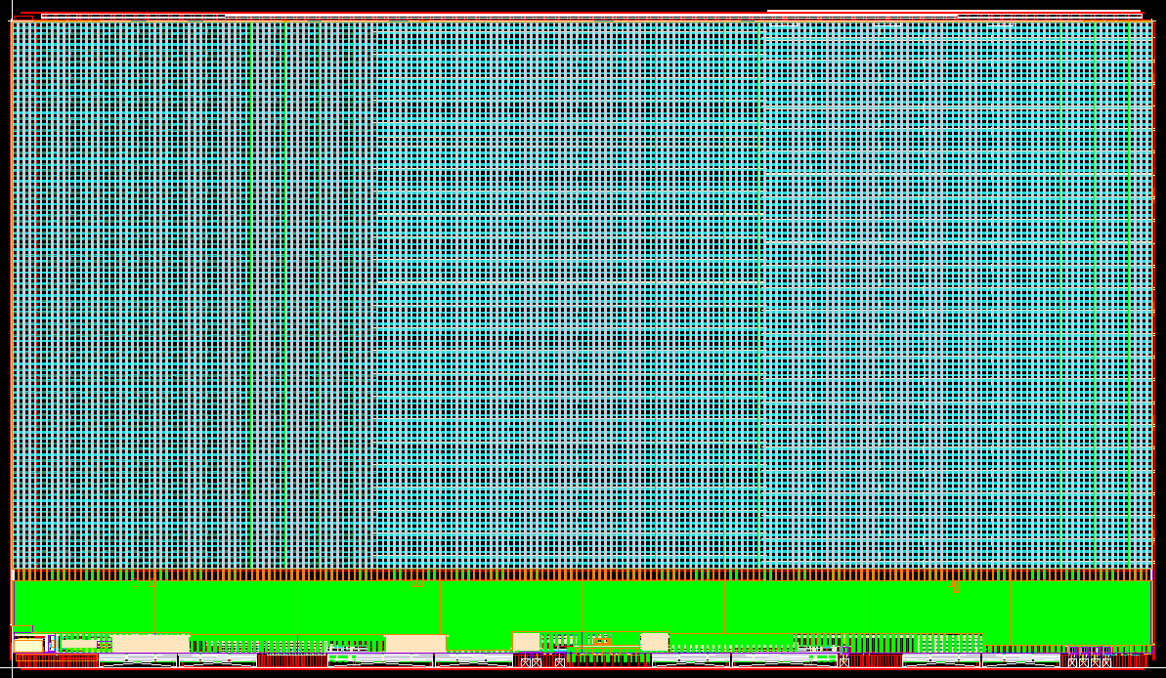
Introduction
See Roberto Beccherle presentation
The purpose of RD53 collaboration is the design of pixel chips for ATLAS/CMS phase 2 upgrades
18 collaborating institutes organized on different working groups
Very challenging requirements:
  High hit rate: 3 GHz/cm² (200 MHz/cm² in the current system)
  Small pixels: 50 x 50 µm²
  Large chips : ~2cm x 2cm
  Trigger rate of 1 MHz with up to 12.8 µs Latency
  Low power - Low mass
  Radiation : 1 Grad (SiO₂) - 2 10¹⁶ neq/cm² over 10 years
    1 Grad seems to be very challenging
    Target of 500 Mrad. Inner layer to be changed after 5 years
Baseline technology : 65nm CMOS
RD53A : Large scale demonstrator pixel chip submitted the 31 of August 2017
  2 cm x 1.18 cm – 400 x 192 pixels of 50 x 50 µm²
20 mm
Synchronous
Front end
Linear
Front end
Differential
Front end
11.8 mm
Periphery

Slide 4
  Radiation effects in CMOS
Baseline technology for the RD53 project
  65 nm CMOS
  gate thickness tox = 2.6 nm
The TID-induced charge in this thin oxide is low
  ΔVt α tox2 + tunnel annealing
The 65 nm is intrinsically very radiation hard
Thick oxide exists everywhere around the device
Shallow Trench Isolation Oxide (STI) for devices isolation
  Radiation Induced Edge Leakage Current
  Radiation Induced Narrow Channel Effect (RINCE)
Oxide or Nitride Spacer
  Radiation Induced Short Channel Effect (RISCE)
STI
STI
D
D
G
G
S
S
F. Faccio and G.Cervelli, IEEE Trans. Nucl. Science, Vol.52, N.6 (2005) pp.2413-2420
F. Faccio et al., IEEE Trans. Nucl. Science, Vol.62 , N.6 (2015)

Slide 5
Radiation effects in CMOS
The TID qualification is performed at a High Dose Rate (HDR) several orders of magnitude higher than the HL-LHC dose rate
MOS structures have a complex time-dependent response to TID since the effect depends on several parameters:
  Temperature
  Bias
  Annealing
  Dose rate
How to determine if a complex integrated circuit is functional in a certain environment
  Device irradiation testing → Design rules
  Modeling for circuit simulation
  Prototypes irradiation
  Appropriate Method to be used for the qualification (Worst case)

Slide 6
  Device Irradiation

Slide 7
Radiation Induced Edge Leakage
STI
IDS
Drain N+
Main NMOS
Thin gate
Source N+
Parasitic NMOS
VT2
VT1
VTpre
VGS
Increasing TID
Radiation-induced positive charges in the STI
Negative shift in the threshold voltage for the edge transistor → opens inversion channel (Only NMOS transistors)
Increase in off-state leakage and inter devices leakage
  Higher effect for narrow transistors
Effects on IC design : increase power, overheating and failure

Slide 8
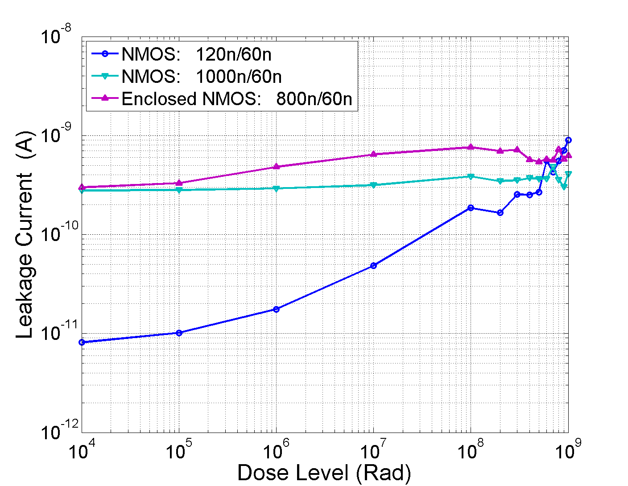
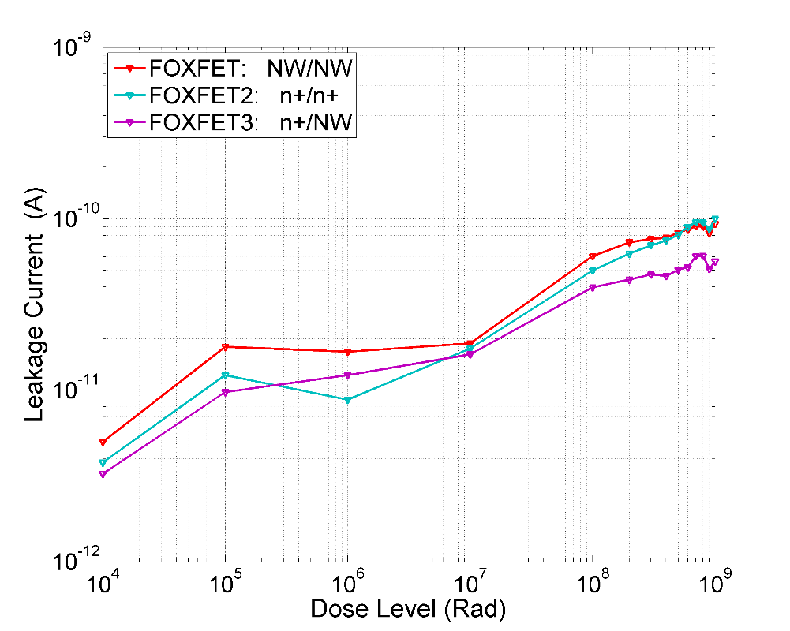
Leakage current Measurements
Supplier A - room temperature -Leakage current
Device with 120nm/60nm (the narrower one) shows the highest increase in leakage :
  Parasitic device more influent
  ~ 2 orders of magnitude for the level of 1000 Mrad
  The leakage value is below 1 nA
Different FOXFET structures have been tested (NW/NW, n+/n+ and n+/NW)
  The current increase is limited
  The increase of the Inter-device leakage is also limited
For the 65nm process :
  the increase of the leakage current is not an issue
  The enclosed layout is not needed
Vds=1.2V
FOXFET current for Vds=1.2 V vesus the TID level
FOXFET devices

Slide 9
Size effects
Narrow
Short
PMOS
Short
NMOS
Narrow
Current Drive Variation (%)
Narrow and Short
Current Drive Variation (%)
Narrow and Short
Irradiation bias
Vds=Vgs=1.2V
Irradiation bias :
Vds=Vgs=0V
TID (rad)
TID (rad)
For narrow transistors (RINCE), NMOS less affected by TID because oxide charge effect is compensated by the interface charge effect
For short devices (RISCE), PMOS and NMOS devices are degraded in the same proportion
For narrow and short devices, PMOS degrades much more since it suffers from the two effects
  Completely OFF for 1 Grad (transconductance decrease)
An issue for the speed in digital design
F.Faccio et al., TWEPP 2015, TID effects in 65nm transistors: summary of a long irradiation study at the CERN X-rays facility

Slide 10
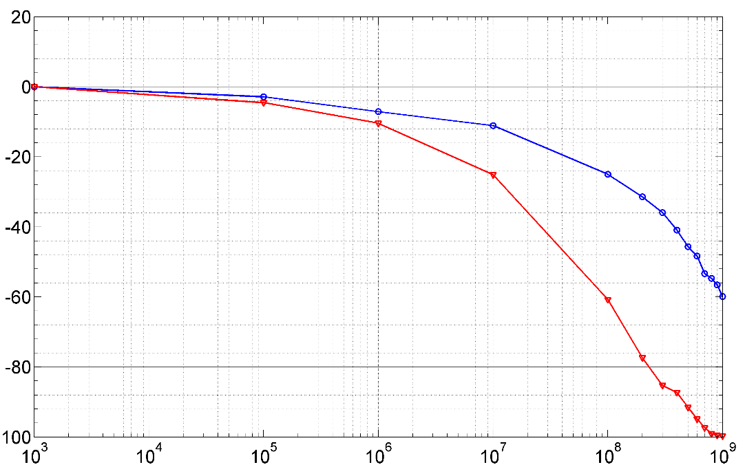
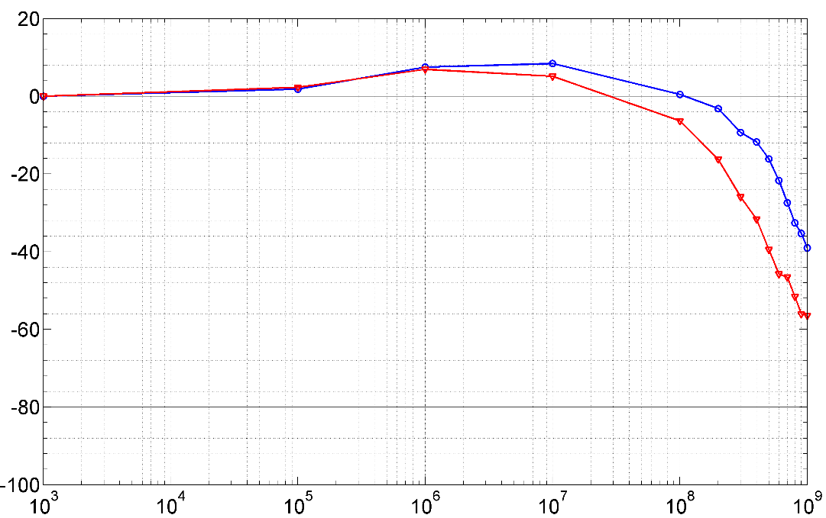
Temperature and Bias effects
Irradiation at low temperature
  Less degradation at -15°C than at room temperature
Explored in the range of -30°C to 60°C
  Damage increases for NMOS and PMOS with temperature in this explored range
TID effects depends on the bias for small size transistors
  Worst case is Vds=Vgs=1.2 V
  Applied bias is relevant at room and high temperature but it is negligible at cold temperature
T = -15°C
Current Drive Variation (%)
T = 25°C
PMOS : 120n/60n
|Vds|=|Vgs|=1.2V
TID (rad)
T = -15°C
NMOS : 120n/60n
T = 25°C
Current Drive Variation (%)
Vds=Vgs=1.2V
TID (rad)

Slide 11
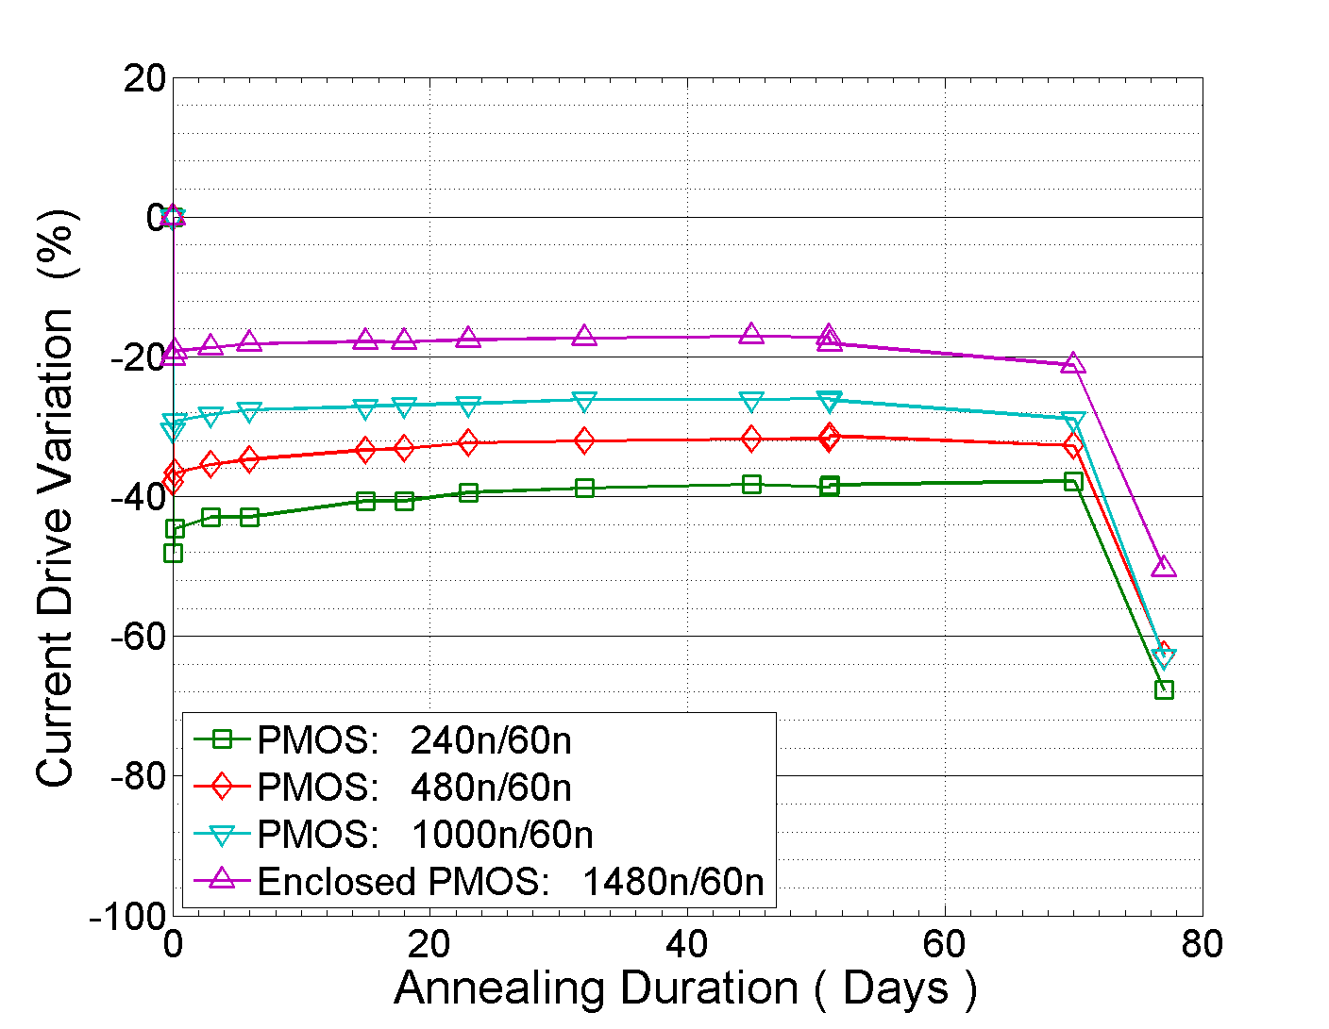
  Annealing Effect
The TID qualification is performed at a High Dose Rate (HDR) of 9 Mrad/hour
The qualification for LDR consists in performing HDR testing followed by the high temperature annealing under bias
A slight recovery is observed at low and room temperature annealing for small size devices
For pmos devices, high temperature annealing (100 °C for 7 days) degrades strongly the DC parameters
  This degradation comes from the increase of the threshold voltage
Supplier A
PMOS devices : ON state current for Vds=50mV
1 Grad at -15°C
Annealing
-25°C
25°C
100°C

Slide 12
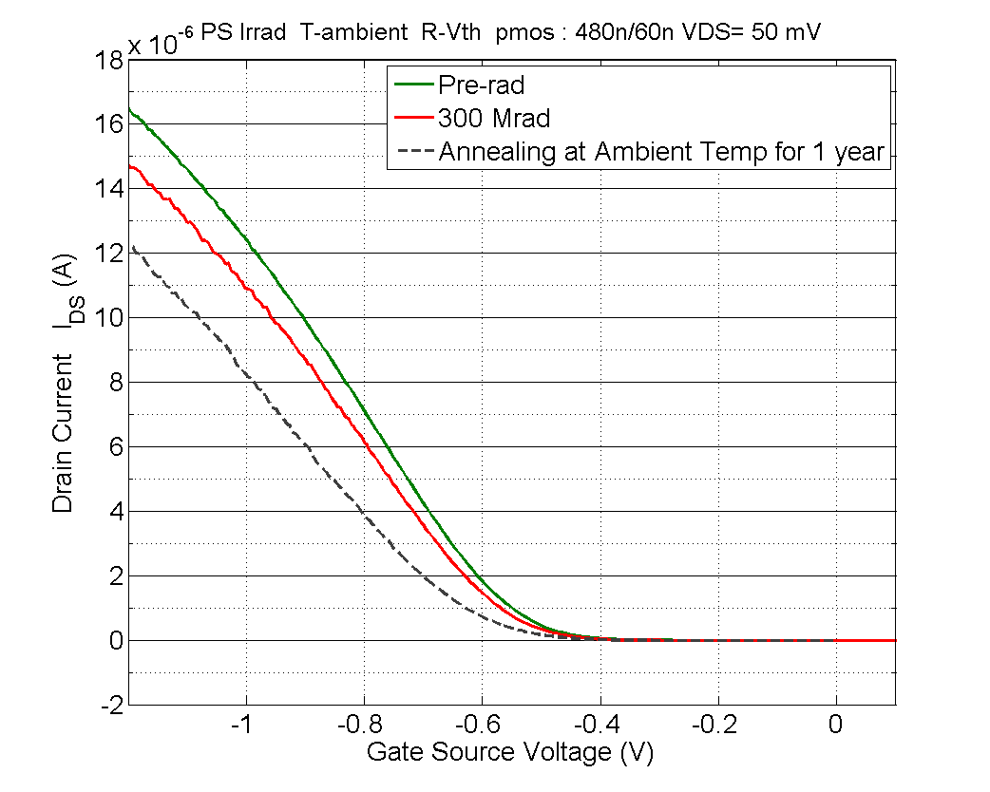
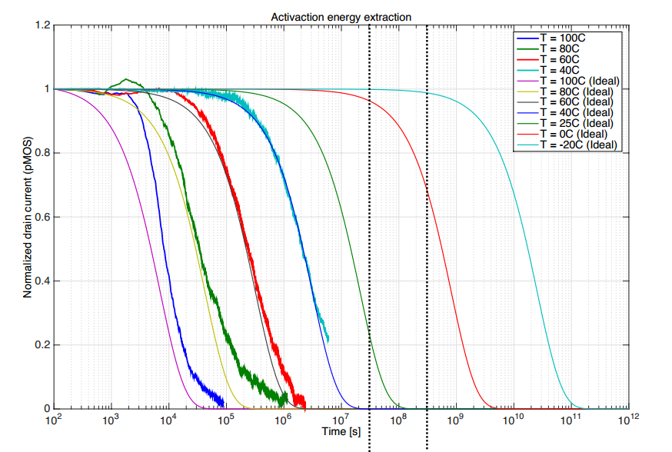
  Long Term Annealing Under Bias
A long term annealing at room temperature under bias was done for ~1 year
  more degradation after annealing
Qualification and annealing for different temperature were done at CERN
  The Vth shift of the PMOS device is a thermally activated process
Extrapolation for lower temperatures :
  No effect after 10 years for T=-20°C
For the RD53 Front end chip, this temperature effect can be avoided by keeping the system :
  In cold environment : -20°C for 5 years
  Unbiased when it is not cooled (at room temp)
300 Mrad
PS-CERN 24 GeV protons
Bias during irradiation and annealing
|VDS|=|VGS|=1.2V
Irrad
Annealing for 10 months at Troom
1 year
10 year
T=25°C
T= -20°C
Time (sec)

Slide 13
  Low Dose Rate Effect
Recent tests done by CERN team with X-rays and ⁶⁰Co
Irradiation at 35 krad/hour produces more damage than irradiation at 2-9 Mrad/hour (room temperature)
Time-dependent effects are excluded
  “LDR” effect compared to the “HDR + annealing” effect at room T
More damage for LDR
Additional tests should be done including tests at low temperature
Current Drive Variation (%)

Slide 14
  Irradiation effects Modeling

Slide 15
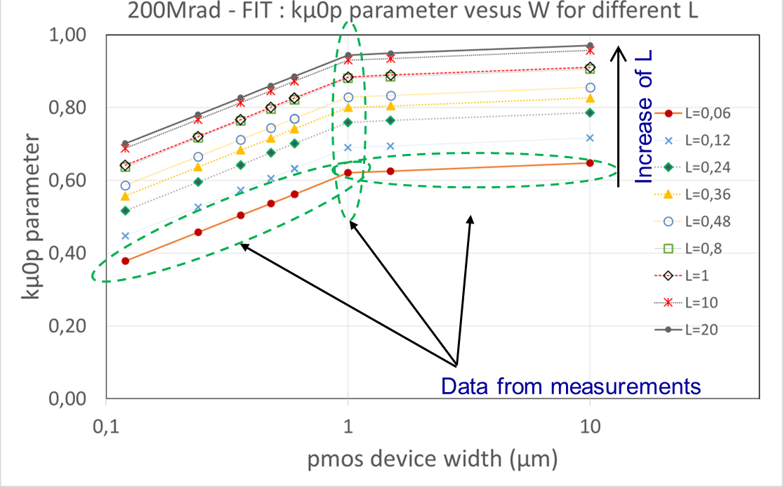
Pmos fitting parameters
Spectre Model Corners were developed based on the irradiation tests done up to 200 Mrad and 500 Mrad
A large part of data used in the fit were provided by CERN (X-ray irradiation)
The mobility factor kµ0p is defined as the ratio µ0_rad/µ0_prerad and depends on W and L
The variation of kµ0p versus L measured only for W = 1 µm.
  This variation is assumed valid regardless the value of W
kµ0p relation to W and L is implemented inside the initial spectre model file

Slide 16
Irradiation effects Modeling
The model is including :
  Transconductance degradation - Threshold voltage increase for NMOS and PMOS
  Short channel effect and subthreshold swing for short channel devices (60nm<L<240nm)
  Leakage current for NMOS
Assumptions : room temperature irradiation, worst case biasing and no annealing
HVT and LVT models were extrapolated from NVT devices measurements
Largely used for RD53A chip simulation, optimization
Analog designs : Directly done under Spectre virtuoso (Analog simulator)
  Avoid excessively narrow and short transistors
  Keep the same bias for branches of the differential structures
Digital Designs : 200 Mrad, 500 Mrad Liberty files based on the analog model developed for synthesis and simulation
  A digital prototype chip designed to study the effect of radiation on digital standard cells

Slide 17
  DRAD : Test chip for digital design

Slide 18
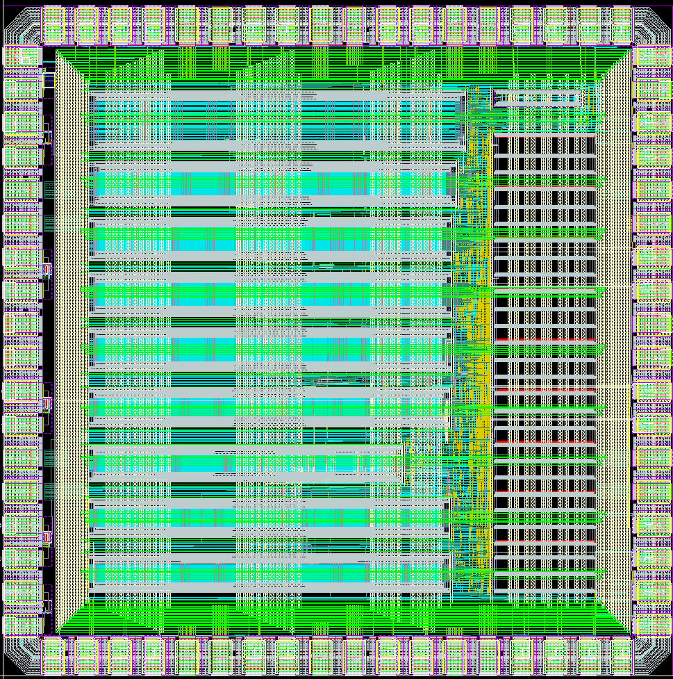
DRAD Chip : Test chip for digital design
DRAD chip is designed to study the effect of radiation on digital standard cells for the 65nm technology
Library characterization
  Cadence Liberate based on the spectre model for 200 Mrad and 500 Mrad
Timing
  Combinatory
    Delay
    Transition time
  Sequential
    Delay & Transition time
    Hold & Setup
    Recovery and Removal
Power
    Leakage : Static power
    Internal Power
2 mm
9
8
7
2 mm
6
5
4
3
2
1
L.M. Jara Casas et al. : Characterization of radiation effects in 65 nm digital circuits with the DRAD digital radiation test chip, Journal of Instrumentation, Volume 12, February 2017

Slide 19
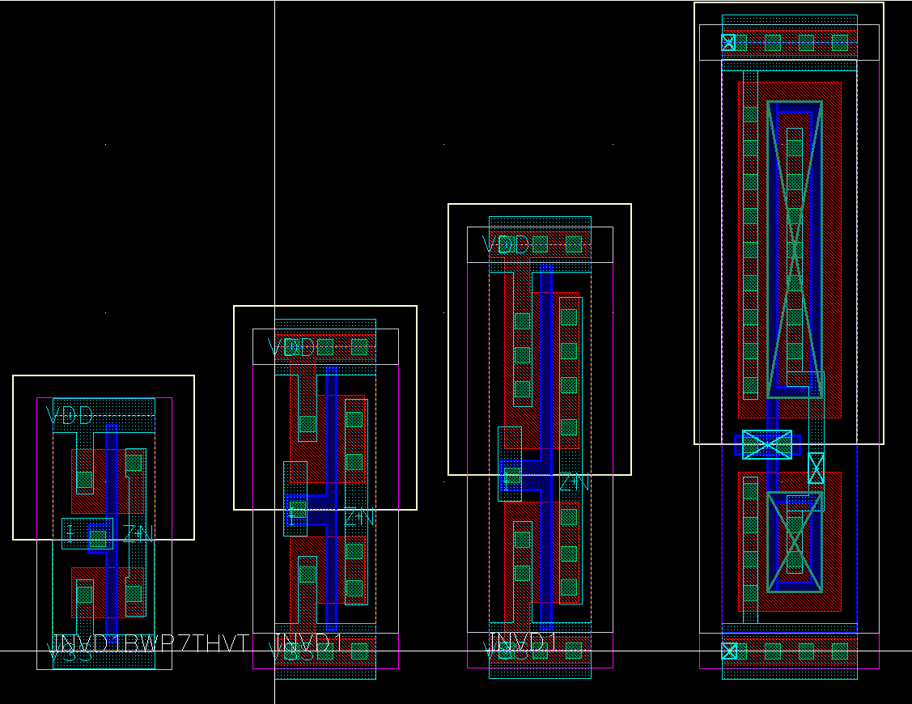
Various Digital Libraries
7 Track (7T) (1 Track = 200 nm)
  High Vt (HVT)
9 Track (9T)
  Regular Vt, High Vt
  Regular Vt with increased width
12 Track (12T) (Modified)
  Regular Vt, Low Vt , High Vt
  Regular Vt with L=130 nm
18 Track (18T) (Custom)
  Enclosed layout transistors for LPGBT
Standard Cells : INV, NAND, NOR, XOR, Clock buffers, DFF and latchs
The chip irradiated at CERN facility with 10 keV X-rays
TID of 200 Mrad and 500 Mrad
Dose Rate of 9 Mrad/hour
FOUNDRY
7T
9T
12T
18T
CELL HEIGHT
7 Track: 1.4 µm
9 Track: 1.8 µm
12 Track: 2.4 µm
18 Track: 3.6 µm

Slide 20
Results for 500 Mrad room T
The relationship of the behavior between libraries is as expected :
  Libraries with smaller size behave worse than large ones
  Libraries with High Vt behave worse than libraries with Low Vt.
Recovery after annealing at room temperature
7T_HVT more sensitive but recovers better (in %) respect the rest of the libraries.

Slide 21
Results for 500 Mrad
9T_NVT
Delay degradation (%)
Delay degradation (%)
Irradiation at Room T
Time (days)
Time (days)
The reference is the delay at -20°C
Library 9T_NVT delay degradation for irradiation up to 500 Mrad
  160% delay degradation reached for room temperature irradiation
  Only 20% when irradiation is done at low temperature (-20°C)
Recovering for room temperature annealing
High temperature annealing creates more damage

Slide 22
Results for 500 Mrad
Annealing under bias
Annealing without bias
Delay degradation (%)
Delay degradation (%)
Time (days)
Time (days)
2 chips irradiated up to 500 Mrad with cooling
No damage observed for high temperature annealing if the chip is unbiased during annealing

Slide 23
Main Results
Digital libraries
  High density digital cells have significant radiation degradation at 500Mrad dominated by PMOS degradation
  Less damage for irradiation at low temperature if the chip is unbiased during annealing
9T_NVT standard library used for the RD53A chip
  The high density pixel array
  The logic in the periphery (Digital Chip Bottom)
  High speed designs (Serializers) are based on modified standard cells (resized for better radiation hardness)
  200 Mrad, 500 Mrad Liberty files for synthesis, timing verification and digital simulation

Slide 24
  Prototypes Irradiation

Slide 25
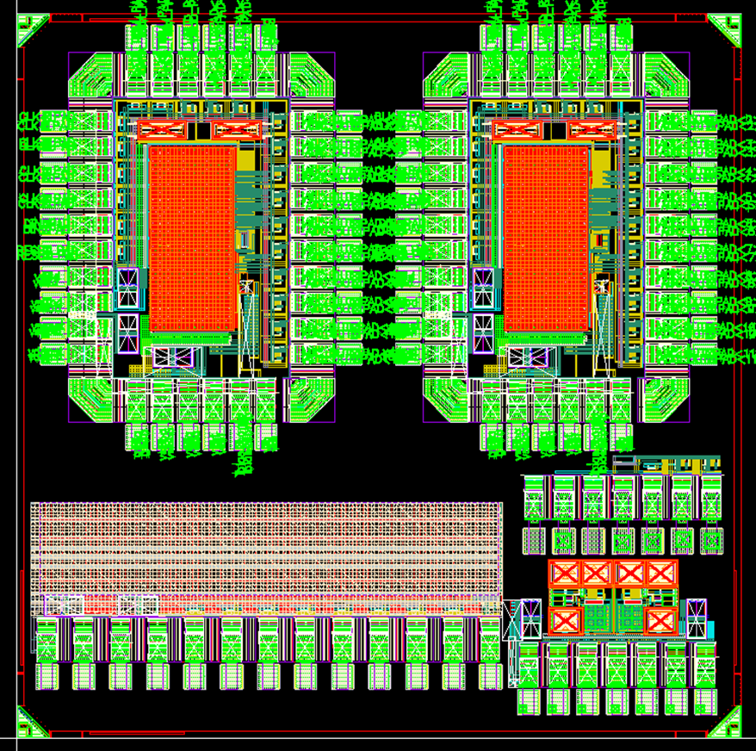
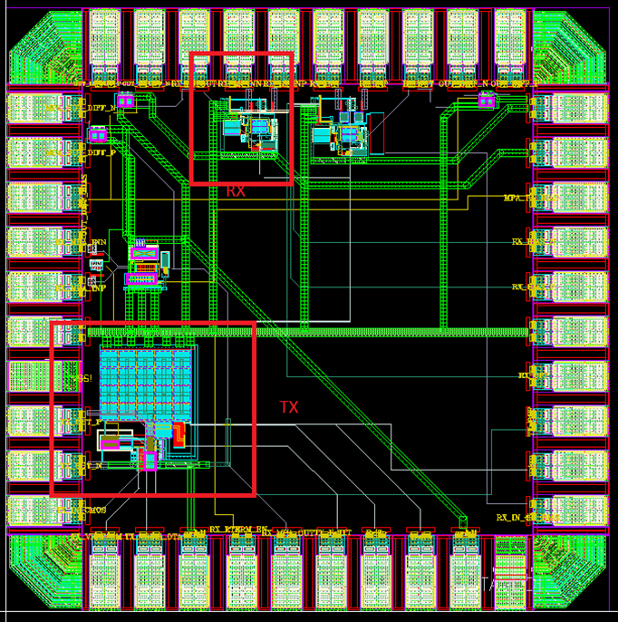
Analog IPs
Building blocks developed for the RD53A pixel chip
ADCs, DACs, sensors, Bandgap references, analog buffer, PLL, serializers, SLVS driver and receiver, shunt-LDO, Power on reset
Narrow - short transistors were avoided in the design
Simulated with 200 Mrad and 500 Mrad corners
Prototyped, tested and irradiated up to 500 Mrad
CDR, SER and CML driver
12 bit ADC
10 bit DAC
SLVS TX/RX

Slide 26
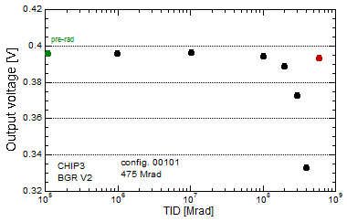
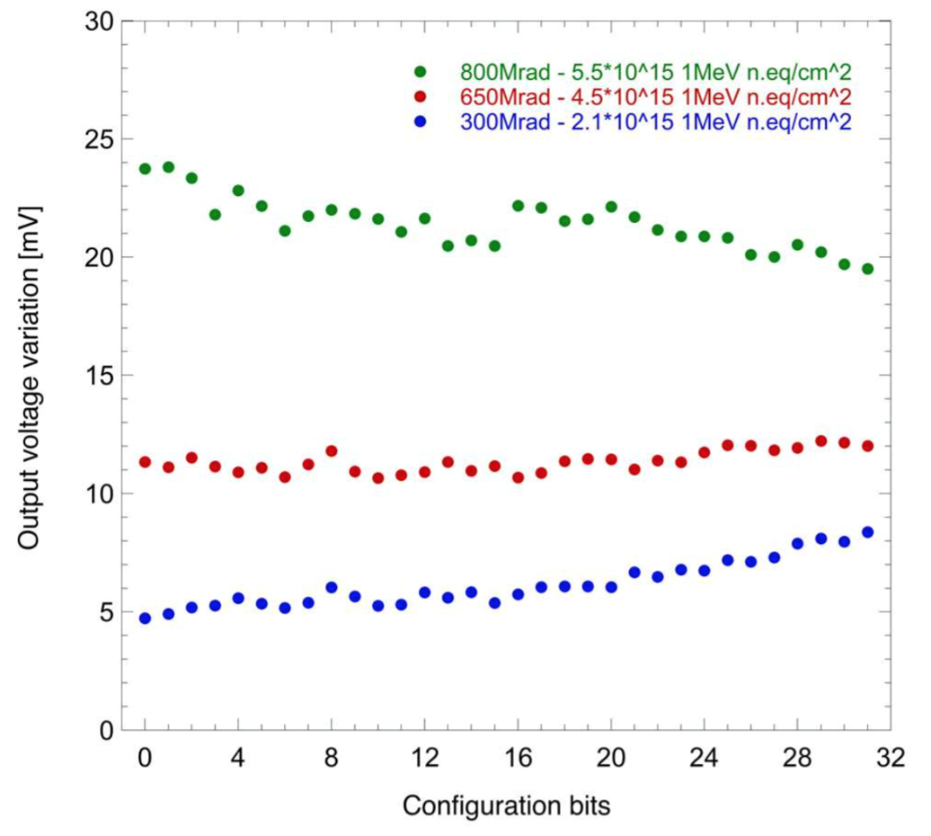
  Band Gap IP block
CERN facility -10 keV X-rays :
  TID of 500 Mrad and Dose Rate of 9.5 Mrad/h
  Chip biased during the irradiation and ΔV=-63mV but recovery after stopping
TANDEM accelerator - 3 MeV protons :
  Total fluence absorbed of 5.5 10¹⁵ (1MeV)neq/cm² (TID of 800 Mrad)
  For 500 Mrad Maximum voltage shift is close to 10 mV
Ljubljana : Neutrons
  Total fluence absorbed of 2.0 10¹⁵ (1MeV)neq/cm²
  Irradiated at room temperature and unbiased
  ΔV = -2.5mV

Slide 27
  FE65P2
64 × 64 pixel array
pixel size : 50 × 50µm²
8 columns with different analog ‘flavors’
2x2 pixel share digital region
4bit ToT counter, 7 memory locations
9bit BCId memory (2x9bit gray counter distributed)
Peripheral Logic
End-of-Column logic with token based trigger system
Serial programming interface to access global and pixel register
Up to 320 Mb/s 8b10b encoded readout

Slide 28
  FE65P2
Very good performance in terms of noise and threshold dispersion
  ENC ≈ 35 e- RMS for CD=50fF
  Threshold dispersion after tuning ≈ 40 e- RMS
Chip irradiated with 800 MeV protons up to 350 Mrad
Chips were powered and clocked, but default configuration disables clock gate to pixel matrix
No cooling during irradiation, put in freezer after they have been taken out of the beam
The AFE prototype in FE65P2 shows significant degradation of its threshold tuning capabilities
limited degradation of its noise performance
Used in RD53A chip
Dario Gnani: RD53A Analog Front-end Design Review CERN -March 28, 2017

Slide 29
  CHIPIX65
64×64 pixel array - pixel size of 50×50µm²
  Synchronous Front-End
  Asynchronous Front-End
Replicated currents for column bias cells
End of column
  Readout and configuration digital blocks + high speed serializer
Global DACs, BGR and ADC
SLVS transmitters/receivers and I/O cells

Slide 30
Irradiation
CERN - 10 keV Xray irradiation :
  Low temperature (-20 °C)
  TID up to 600 Mrad
  Dose rate of 3.7 Mrad/h for 0-200 Mrad and 4.7 Mrad/h for 200-600 Mrad
  Chip maintained under bias and working conditions during irradiation
  Continuous testing during irradiation
Chip fully functional during / after irradiation
  Digital logic works fine at 40 MHz
  I/O at 320 MHz works fine
The threshold mean value increases slightly with radiation
  In the region of interest below 1 ke- the increase is limited to around 10%
The ENC : 10% increase at 600 Mrad
Ennio Monteil : RD53A Analog Front-end Design Review CERN -March 28, 2017

Slide 31
Summary
The 65 nm process tested up to 1 Grad
Corner Models developed : 200 Mrad and 500 Mrad
DRAD chip designed to study the effect of radiation on digital standard cells and to choose the appropriate digital library
Prototypes with small pixel array show good tolerance to TID up to 500 Mrad
Less damage if the detector is kept at cold temperature (-20°C ) and the readout chips kept unbiased when the detector is at room temperature
The RD53A prototype just submitted and will be intensively used for irradiation effects study
An appropriate methodology to be used in the RD53A design to guaranty a good functionality up to 500 Mrad
Radiation tolerance can variate for the same process between different Fabs, and can change over time. Qualify and use one Fab - qualify each ASIC during the prototyping and production phases

Slide 32
  Thank you for your attention
  Thank you for your attention

Slide 33
Radiation effects in CMOS
VG>0
VG>0
  SiO₂ : µ_{e} ~ 10⁶ × µ_{hole}
  (µe ~ 20 cm²/V.s at room temp)
1st step: Ionizing Radiation → electron/hole pairs creation in oxide. Depending on biasing, electrons swept out in ~ps. A fraction of e- / holes recombine
2nd step: Hopping hole transport to Si/SiO2 interface
3rd step: Holes at interface → long-lived trap states → Qot →ΔVot : <0 for nmos and >0 for pmos
4th step: Interface traps build-up : → Qit → ΔVit (>0 for nmos and pmos)
gate
gate
Oxide
Oxide
Silicon
Silicon
VG>0
VG>0
gate
gate
Oxide
Oxide
Silicon
Silicon

Slide 34
Radiation Induced Narrow Channel Effect
Minimum width device
Pre-rad
Pre-rad
RINCE is caused by the charge trapped in the STI
This charge affects the electric field in the channel and modify the transistor characteristics
More relevant for narrow transistors
STI
STI
D
D
G
G
S
S
100 Mrad
100 Mrad
STI
STI
D
D
G
G
S
S
Regions influenced by the trapped charges in the STI

Slide 35
Radiation Induced Short Channel Effect
RISCE is not related to the STI
May be attributed to the charge induced in the spacer’s oxide
This charge affects the electric field and then the surface potential in the LDD (Lightly Doped Drain)
More damage for short channel device

Slide 36
Large size transistors
NMOS : W/L= 1µ/1µ
TID effect on large and long devices (NMOS and PMOS) is limited
The 65 nm is intrinsically very radiation hard
Analog Design : Avoid the use of narrow or short transistors
  Analog designs following these rules showed a good radiation tolerance up to 1 Grad
  Irradiation damage depends on the bias. The matching can become worse with irradiation
Digital design : Available standard cells are designed with minimum L and narrow devices
  Are subject to RINCE and RISCE effects
  Irradiation qualification procedure is needed
PMOS : W/L= 1µ/1µ
W/L= 1µ/1µ

Slide 37
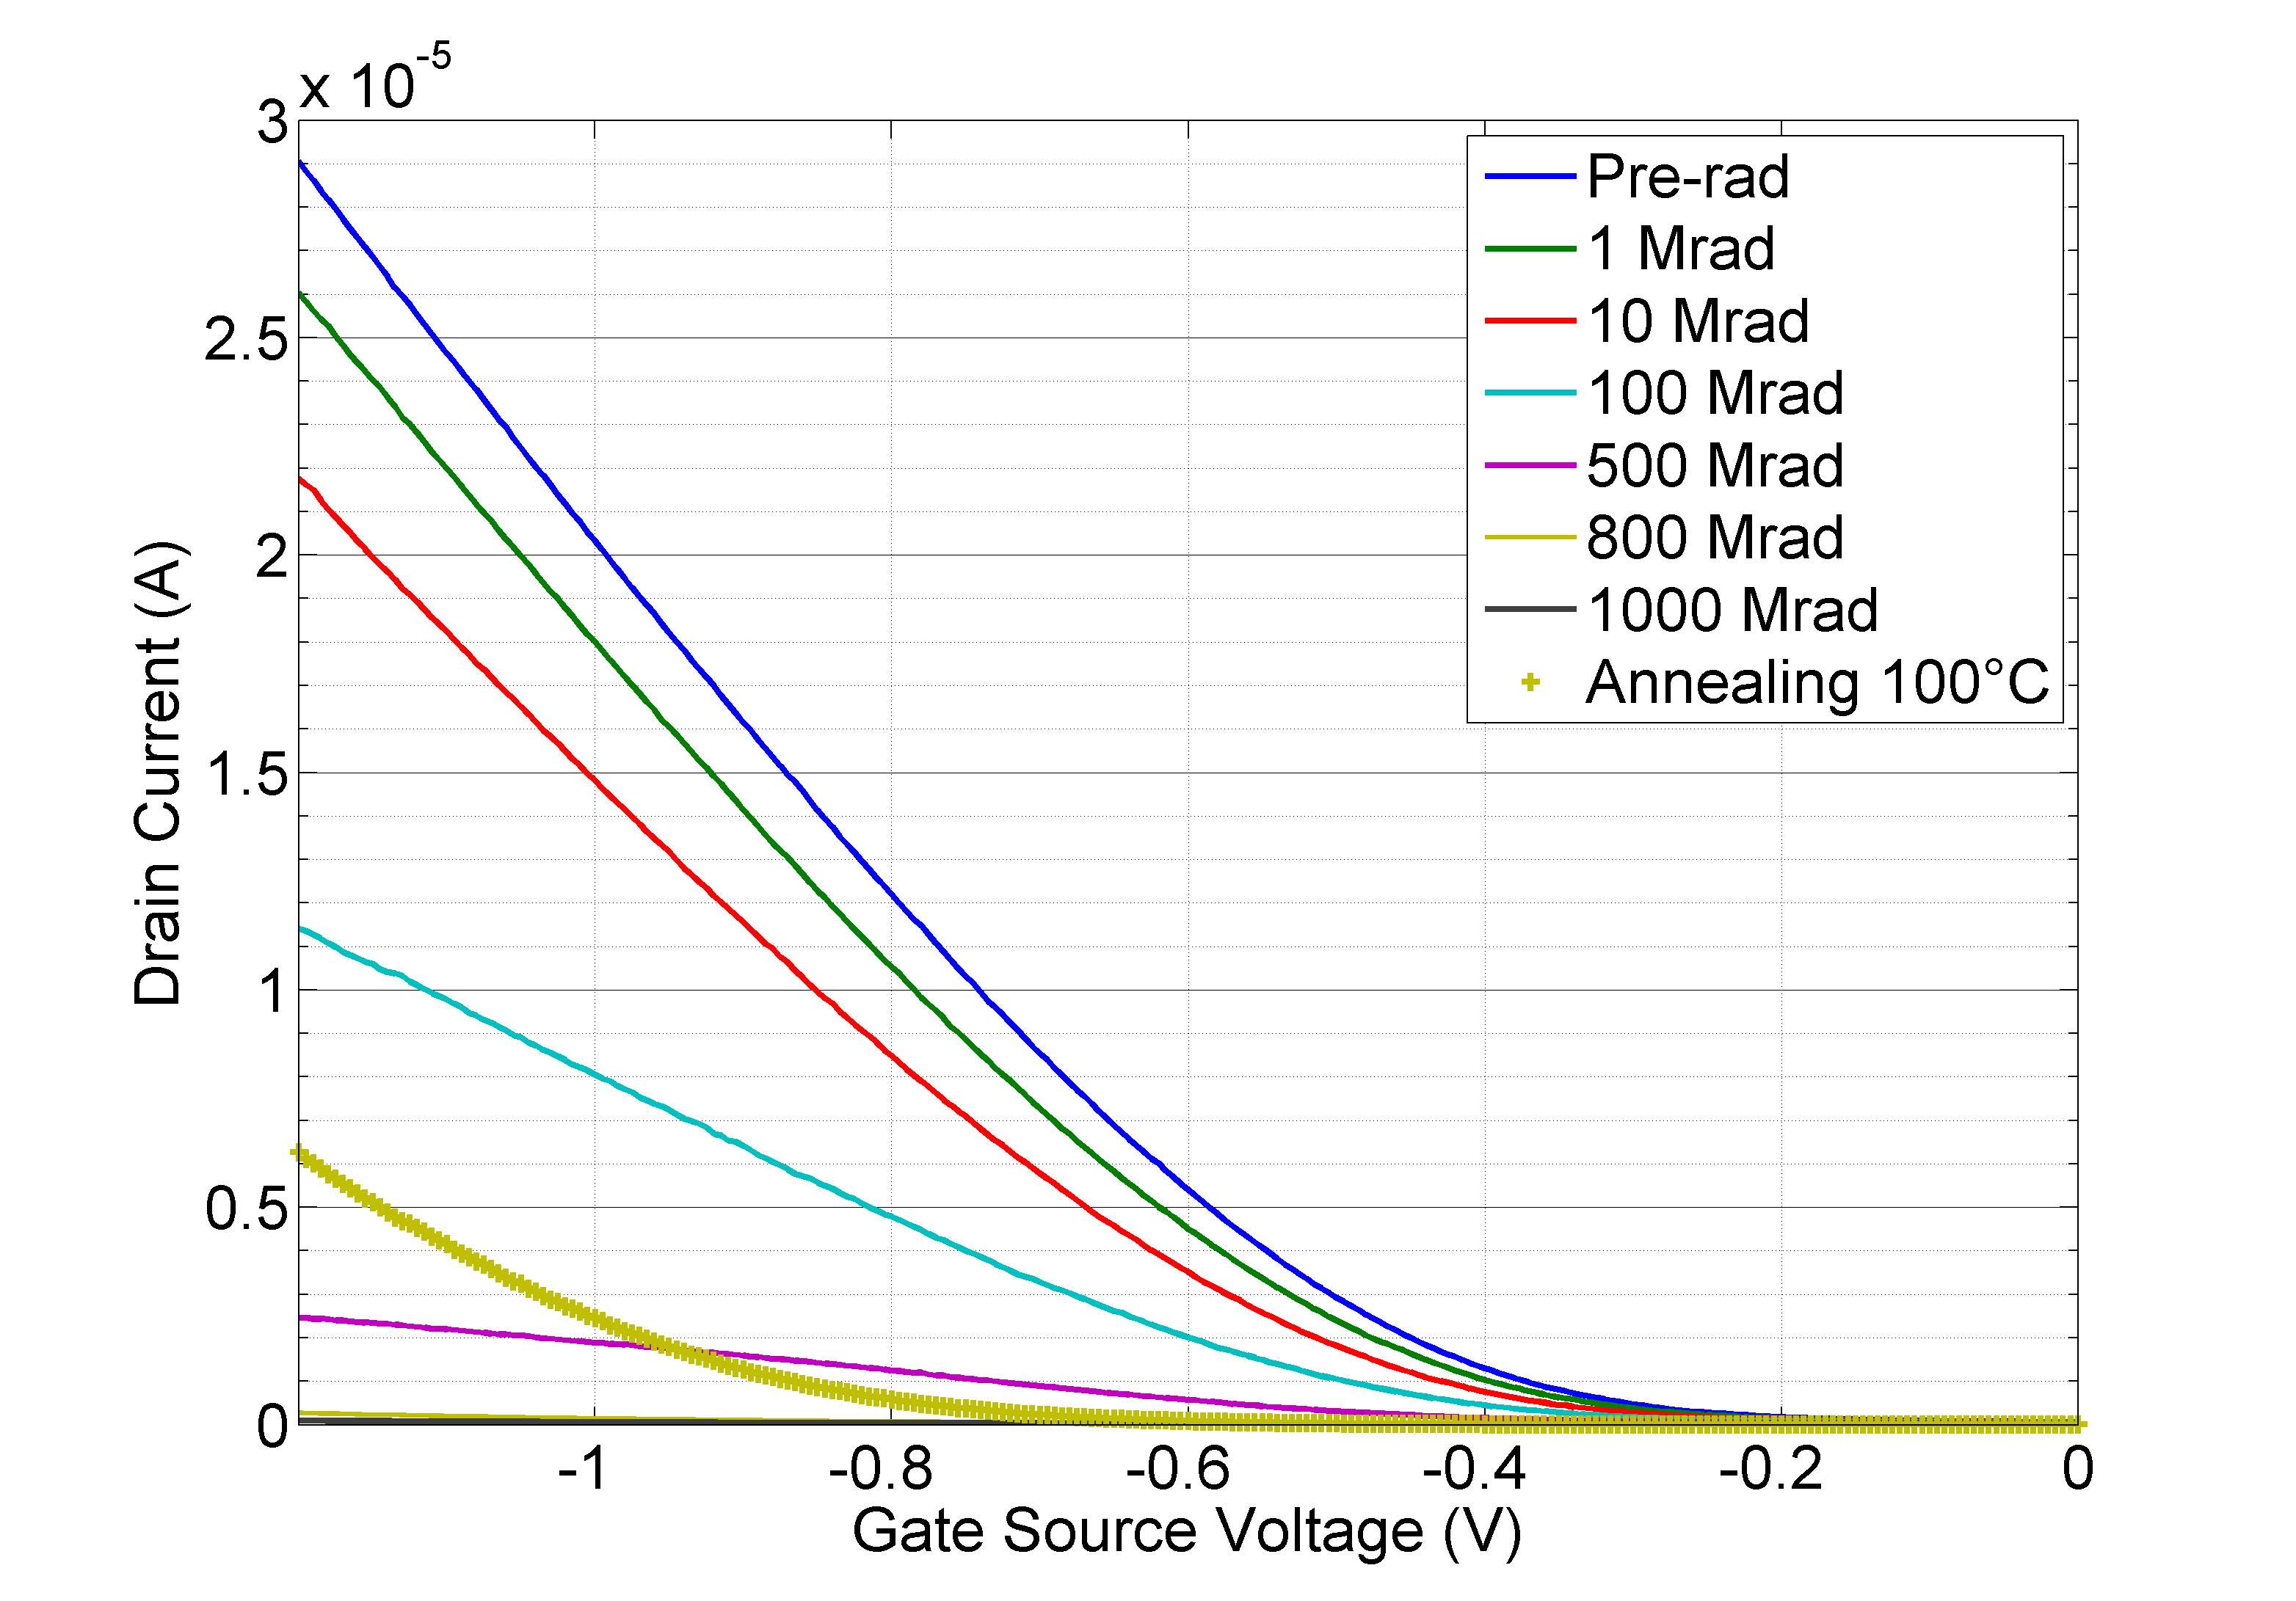
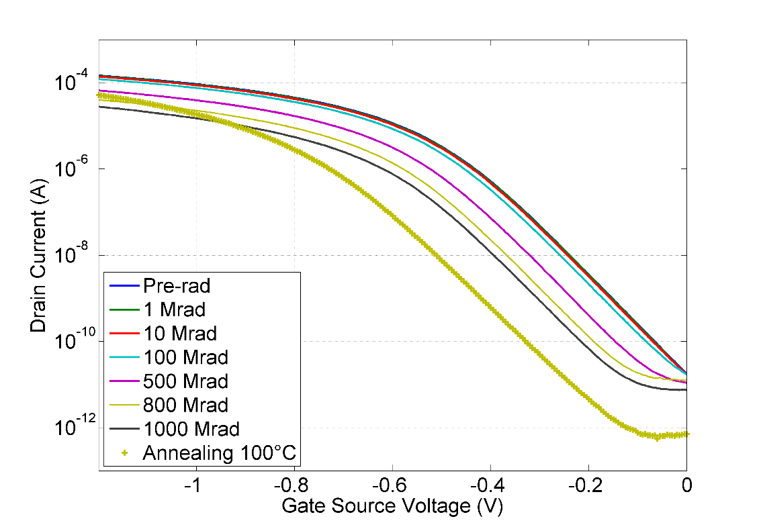
Ids(Vgs) variation for small pmos device
Supplier A - Temp=20°C
Id(Vg) for the narrower device (120nm/60nm)
At the high level of dose, The device becomes completely “OFF”
The transconductance factor G_{M} (mobility) is more affected than the threshold voltage
With high temperature annealing G_{M} recovers well but Vth increases
The Vth shift is ΔVth ~ 0.45 V for the small size devices
pmos:120n/60n
Vds=50mV
1 Grad
100°C Anneal
ΔVth
pmos:480n/60n
Vds=50mV
1 Grad
100°C Anneal

Slide 38
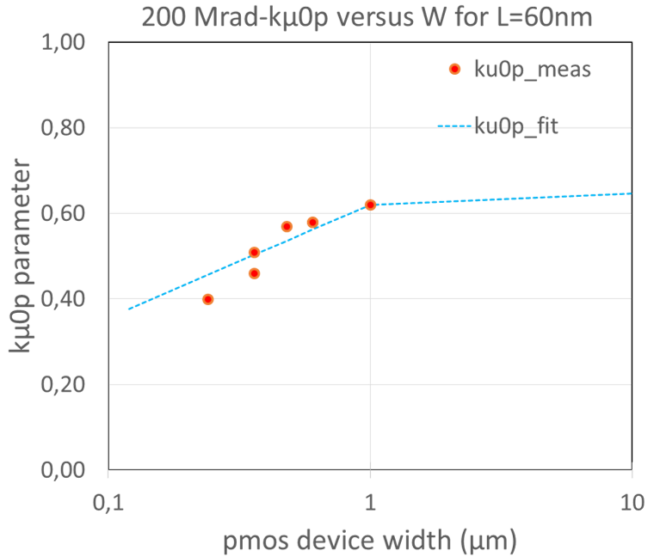
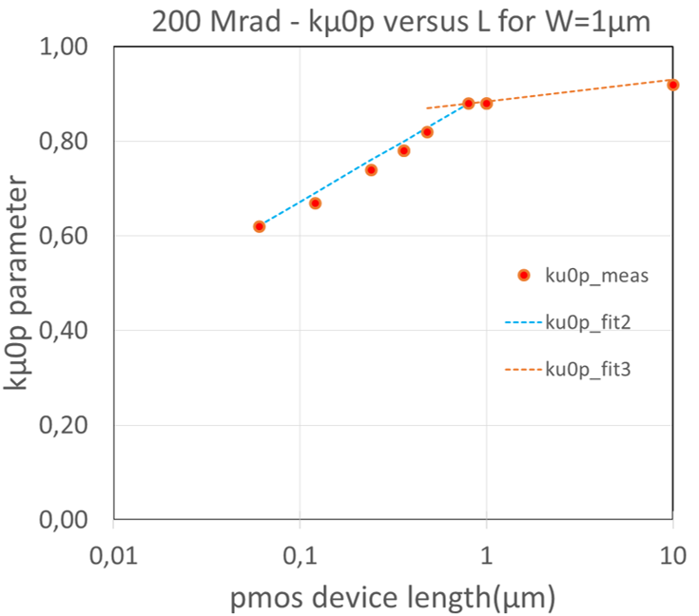
PMOS fitting parameters
The current drive loss depends strongly on the device width W and on length L
Only the transconductance degradation is considered (Annealing is not included)
The mobility factor kµ0p is defined as the ratio µ0_rad/µ0_prerad and depends on W and L

Slide 39
Results for 500 Mrad T=-20°C
Less damage for irradiation at low temperature (-20°C)
High temperature annealing creates more damage

Slide 40
Comparison of results with simulations
ANNEALING NOT INCLUDED IN THE MODELS
Simulation results goes in the same direction than irradiation tests but the model overestimates the TID damage level
  Models were done for worst case of biasing

Slide 41
Results for 500 Mrad

Slide 42
Results for 500 Mrad
-20°C

