Slide 1
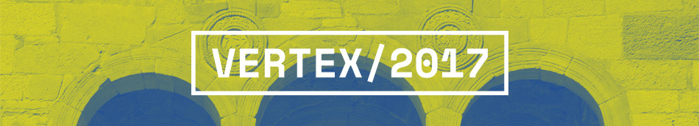
Modelling radiation damage in TCAD
D. Passeri^{(1,2)}, F. Moscatelli⁽²⁾, A. Morozzi^{(1,2)}
(1) Dipartimento di Ingegneria - Università di Perugia, Italy
(2) Istituto Nazionale Fisica Nucleare - Sezione di Perugia, Italy

Slide 2
Outline
Motivations and background.
TCAD radiation damage modelling: discussion.
Simulation results and comparison with experimental data:
  - DC (steady-state) -> Diodes / Gate Controlled Diodes.
  - AC (small-signals) -> MOS Capacitors.
  - Time (transient) -> Multi-strip structures.
Conclusions.

Slide 3
Outline
Motivations and background.
TCAD radiation damage modelling: discussion.
Simulation results and comparison with experimental data:
  - DC (steady-state) -> Diodes / Gate Controlled Diodes.
  - AC (small-signals) -> MOS Capacitors.
  - Time (transient) -> Multi-strip structures.
Conclusions.

Slide 4

Motivations
Modern TCAD tools⁽¹⁾ offer a wide variety of approaches,
characterized by different combinations among physical accuracy and comprehensiveness, application versatility and computational demand -> mixed-mode approaches can be efficiently followed.
A number of different physical damage mechanisms actually may interact in a non-trivial way. Deep understanding of physical device behavior therefore has the utmost importance, and device analysis tools may help to this purpose.
Bulk and surface radiation damage have been taken into account by means of the introduction of deep level radiation induced traps whose parameters are physically meaningful and whose experimental characterization is feasible.
Within a hierarchical approach, increasingly complex models have been considered, aiming at balancing complexity and comprehensiveness.
(1) Sentaurus Device

Slide 5
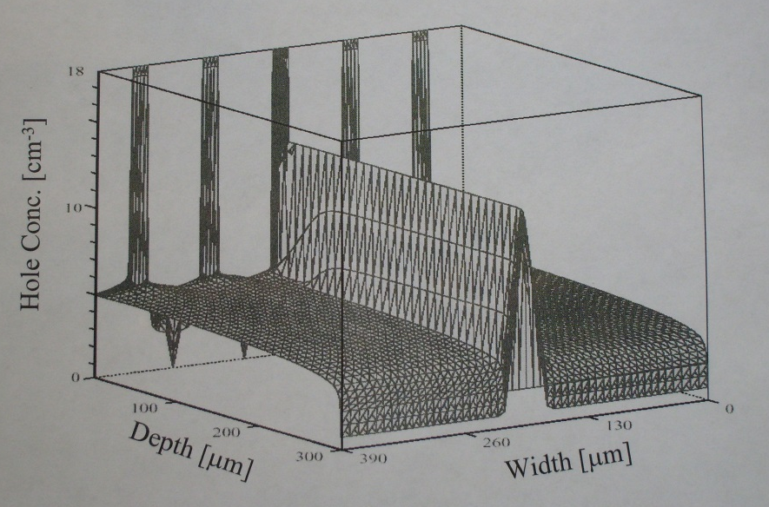
Once upon a time... (1996)
Numerical analysis and physical modelling of semiconductor devices
-> application in High Energy Physics domain…
Modelling of the interaction between ionizing particle / silicon substrate compatible with Box Integration Method simulation scheme.
TCAD applications
in HEP in 1996…
G^{rad} can be distributed in time and space according to the numerical spatial and time discretization algorithms.

Slide 6
Radiation damage modelling
Numerical modelling of radiation damage effects in semiconductor devices.
Deep-level recombination centres / traps radiation induced.
Explicit contribution of the trapped charges to the charge density (modified Poisson equation):
Continuity equation for both free and trapped carriers:

Slide 7
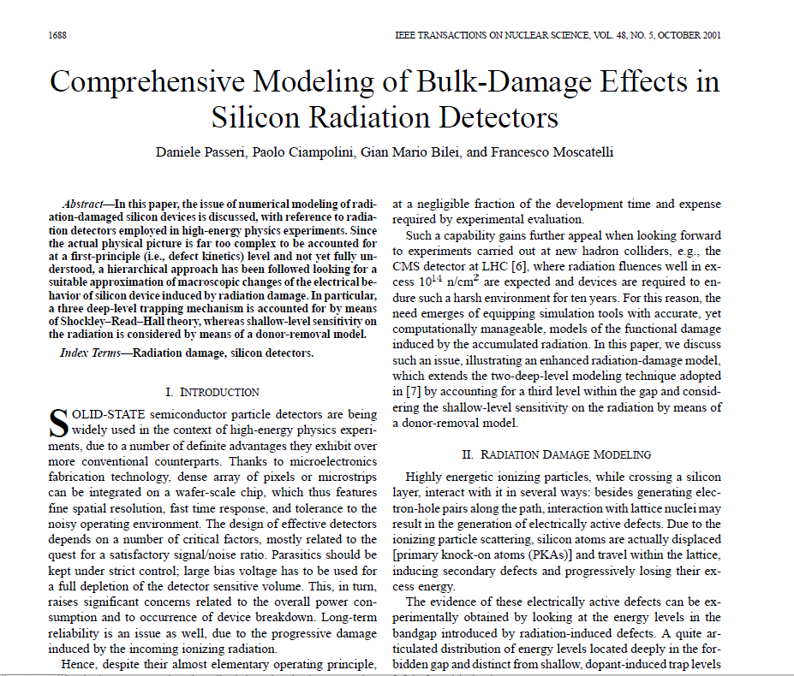
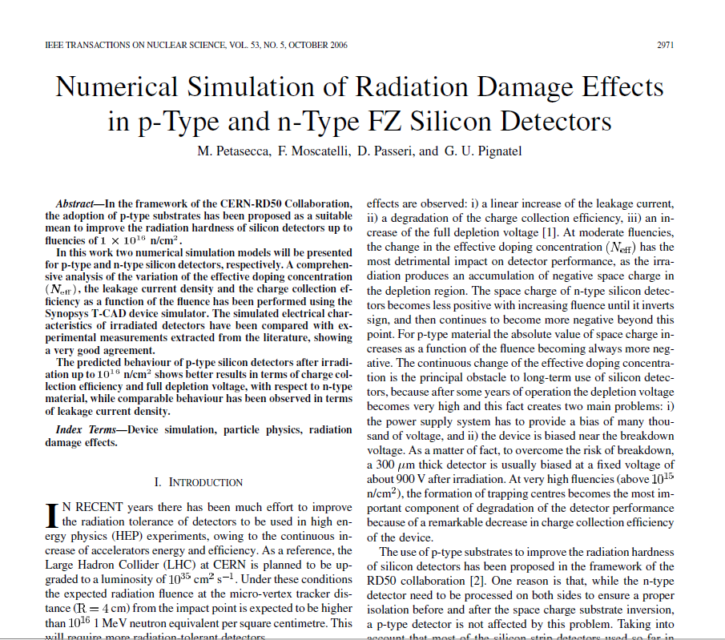
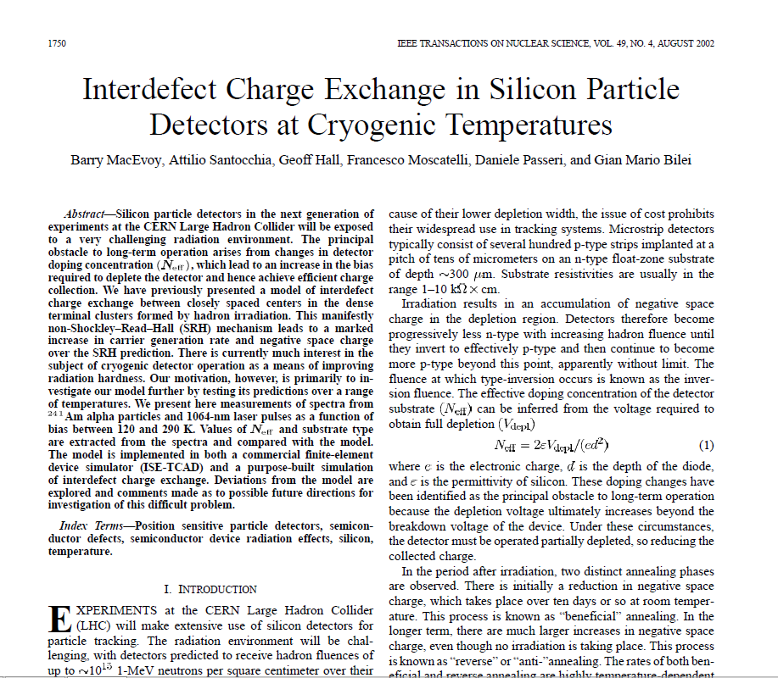
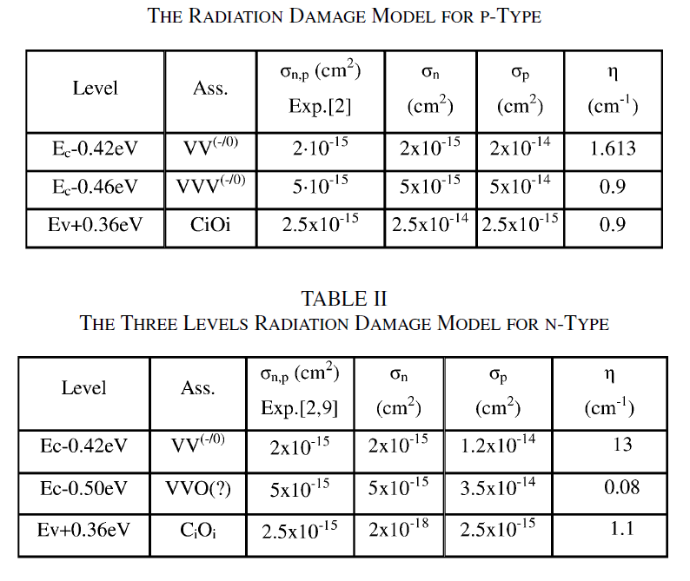
“University of Perugia” model
More than 20 specific journal papers
on TCAD radiation damage modelling
…
[1] D. Passeri, P. Ciampolini, G.M. Bilei, and F. Moscatelli, Comprehensive Modeling of Bulk-Damage Effects in Silicon Radiation Detectors, IEEE Trans. on Nuclear Science, vol. 48, no. 5, October 2001.
[2] M. Petasecca, F. Moscatelli, D. Passeri, and G. U. Pignatel, Numerical Simulation of Radiation Damage Effects in p- Type and n-Type FZ Silicon Detectors, IEEE Trans. on Nuclear Science, vol. 53, no. 5, October 2006.

Slide 8
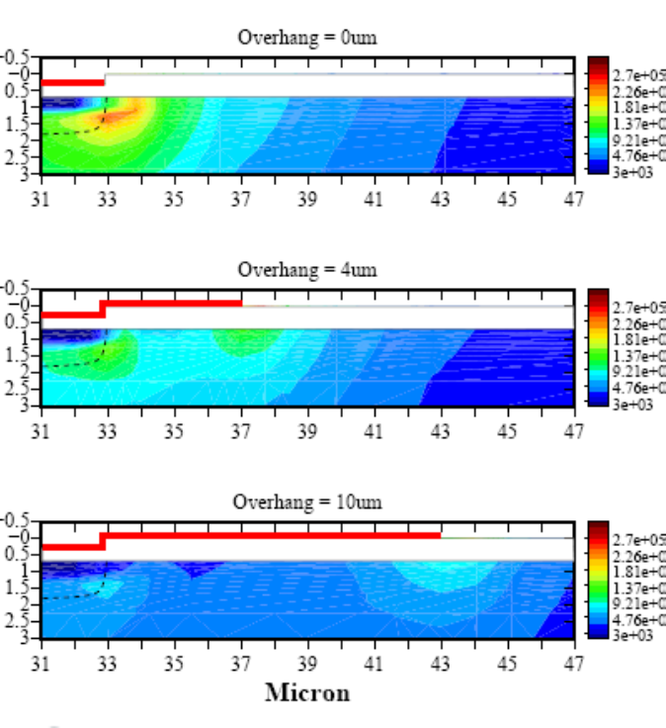
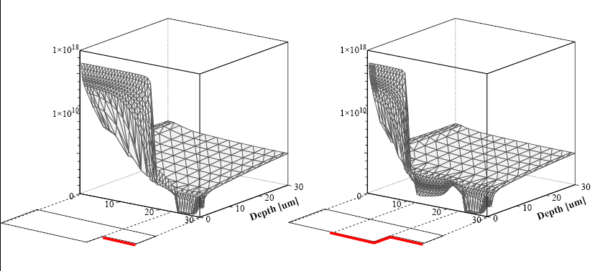
LHC CMS Si Tracker design
Choice of the Si-Strip detector substrate resistivity.
Strip geometry optimization (w/p, metal overhang).
Critical Electric Fields (within Si) reduction
Electron concentration at the surface

Slide 9
Outline
Motivations and background.
TCAD radiation damage modelling: discussion.
Simulation results and comparison with experimental data:
  - DC (steady-state) -> Diodes / Gate Controlled Diodes.
  - AC (small-signals) -> MOS Capacitors.
  - Time (transient) -> Multi-strip structures.
Conclusions.

Slide 10
TCAD radiation damage models
Pennicard et al., Simulations of radiation-damaged 3D detectors for the Super-LHC, NIM A 592 (2008) 16–25 .
- 3 levels, increased capture cross-sections σ_{n}, σ_{p}.
E. Verbitskaya et al., Operational voltage of silicon heavily irradiated strip detectors utilizing avalanche multiplication effect, JINST 7 C02061, 2012.
- 2 levels, avalanche multiplication, 1D “analytical” approach.
Delhi University (R. Dalal et al., Vertex - 2014, 23rd RD50 CERN, Nov. 2013)
- 5 levels + Q_{F} / 2 levels + Q_{F} + Q_{it.}
RD50 Collaboration (T. Peltola PSD2014 / RESMDD2014)
  - defect models tuned by R. Eber from V. Eremin et al., Avalanche effect in Si heavily irradiated detectors: Physical model and perspectives for application, NIM A 658 (2011) for Φ_{eq}=1.0×10¹⁴ - 1.5×10¹⁵ cm⁻² at fixed T=253 K;
  - 3-level model within 2 μm of device surface + proton model in bulk.
Hamburg model J. Schwandt, R. Klanner – Global parameter optimization (27th RD50 Workshop, December 2-4, 2015).

Slide 11
New “University of Perugia” model
Extend the predictive capabilities to HL-LHC radiation damage levels (e.g. fluences > 2.0×10¹⁶ cm⁻² 1 MeV neutrons).
Keep low the number of traps (e.g. fitting parameters).
New effects (e.g. charge multiplication <- avalanche effects).
Physically grounded approach.
No over-specific modelling (one model fits all…).
Predictive capabilities @Φ, @T, @V_{bias}, …

Slide 12
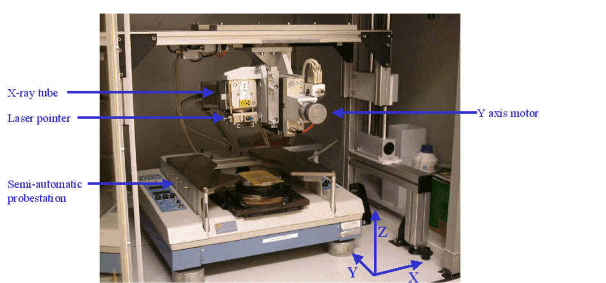
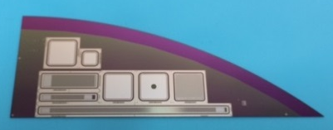
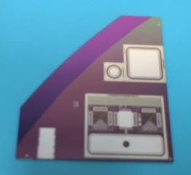
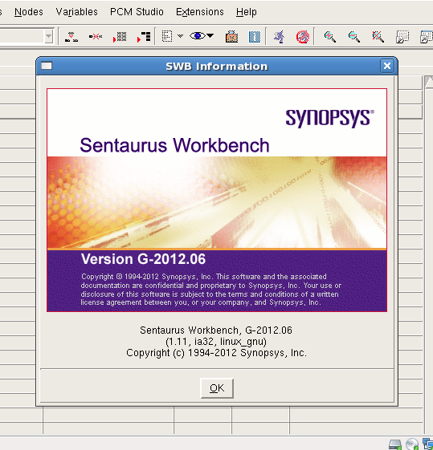
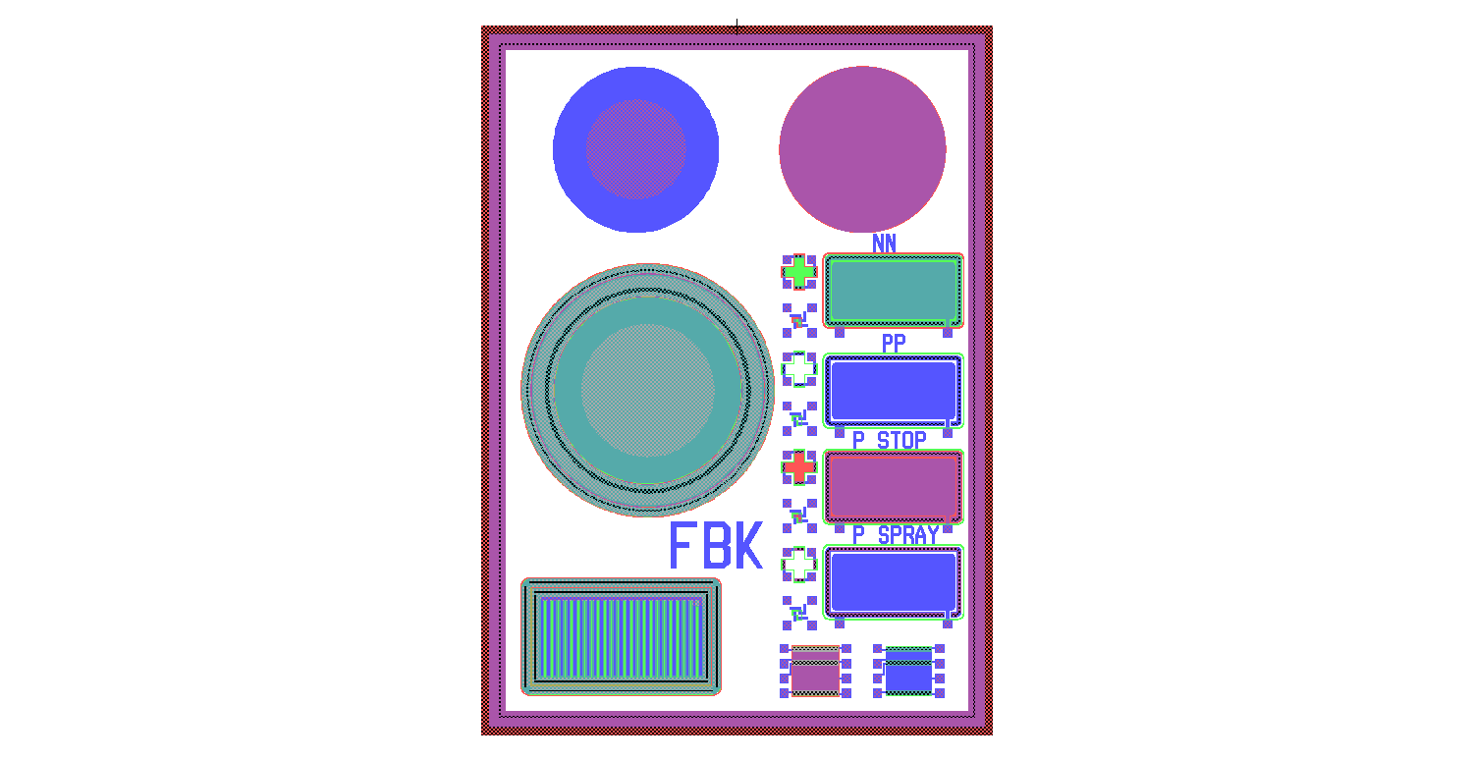
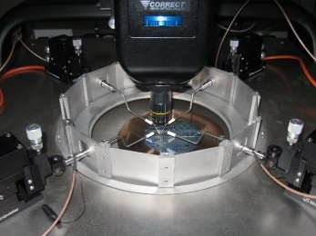
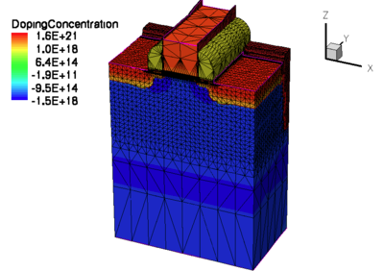
New “University of Perugia” model
MODEL
PARAMETERS EXTRACTION
TEST STRUCTURE
MEASUREMENTS
MODEL VALIDATION
Modelling the effects of the radiation damage.
Predictive insight of the behaviour of detectors, aiming at their performance optimization.
DETECTOR OPTIMIZATION
CHARGE COLLECTION

Slide 13
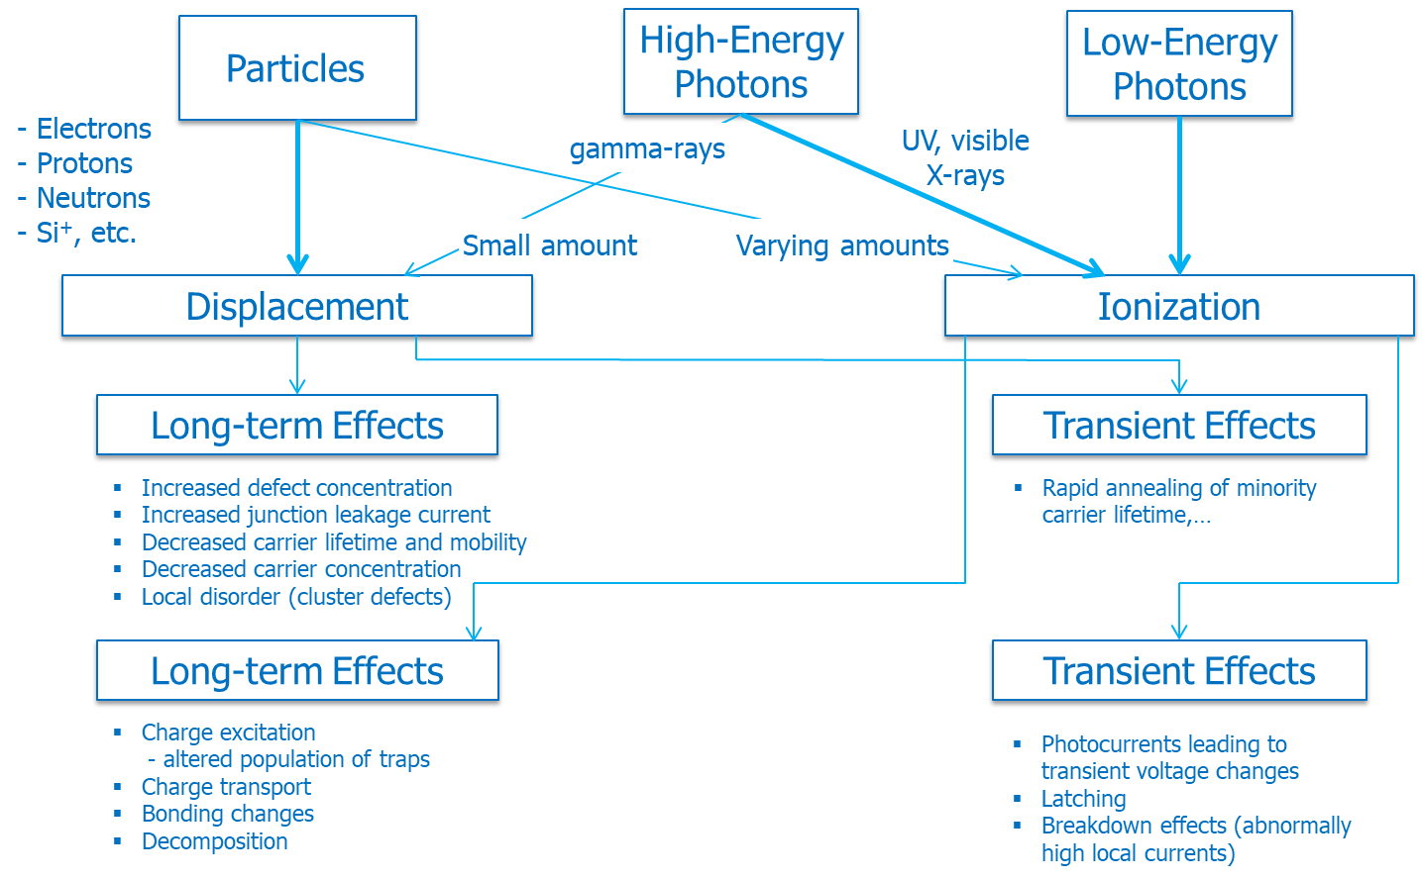
Radiation damage effects

Slide 14
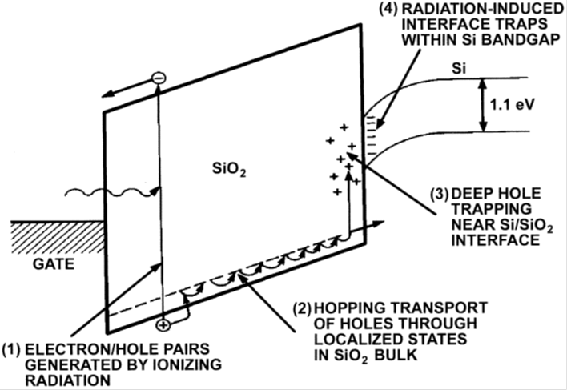
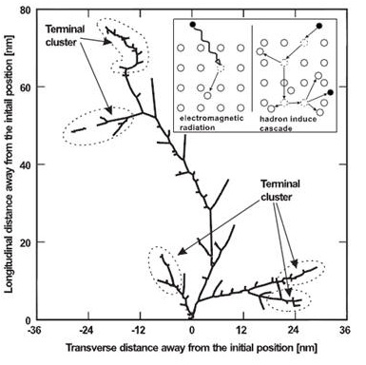
Radiation damage effects (2)
Ionization -> SURFACE damage
  - build-up of trapped charge in the oxide;
  - increase in the number of bulk oxide traps.
  - increase in the number of interface traps;
  - Q_{OX}, N_{IT}
Atomic Displacement -> BULK damage
  - silicon lattice defect generations;
  - point and cluster defects;
  - increase of deep-level trap states;
  - N_{T}
T. R. Oldham, F. B. McLean, Total Ionizing Dose
Effects in MOS Oxides and Devices, IEEE Trans.
on Nuclear Science, vol. 50, no. 3, June 2003

Slide 15
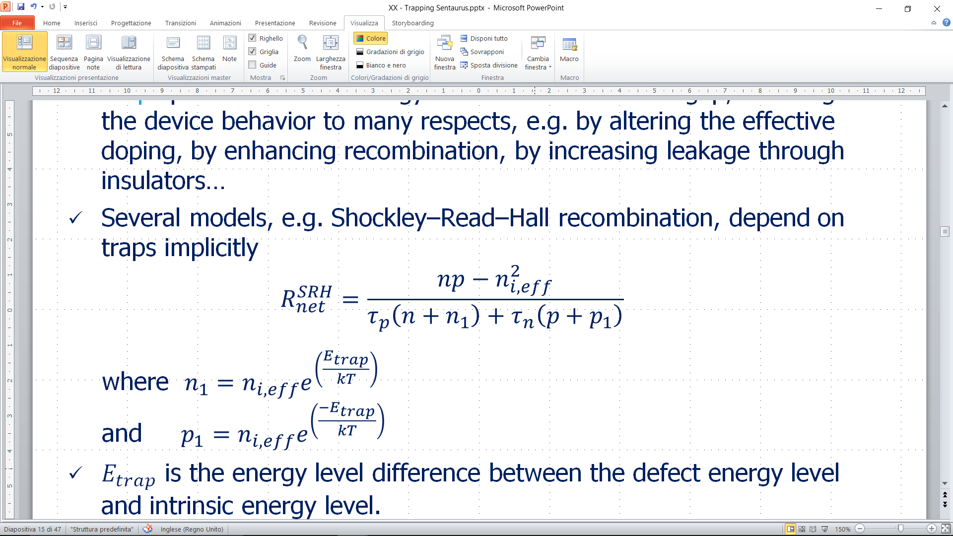
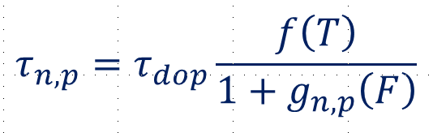
Traps characteristics
Traps provide allowed energy states within the band-gap, affecting the device behavior to many respects, e.g. by altering the effective doping, by enhancing recombination, by increasing leakage…
Several models, e.g. Shockley–Read–Hall recombination, depend on traps implicitly
Traps can be specified in terms of:
  Type (Acceptor, Donor)
  Energy Distribution (Level, Gaussian, Uniform, …)
  Capture cross-sections (electrons, holes)
  Concentration / Spatial distributions

Slide 16
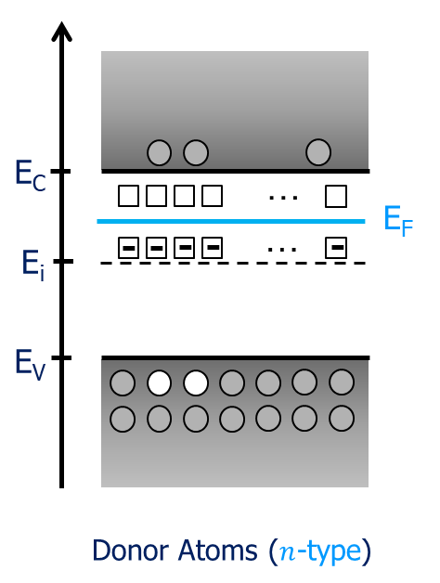
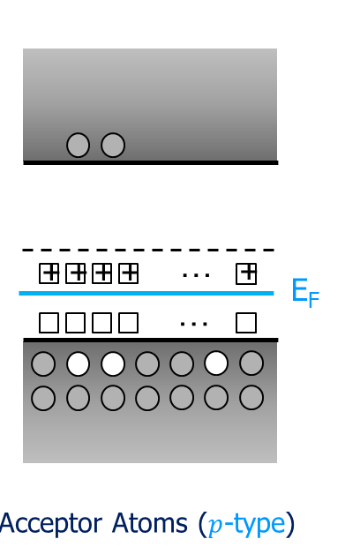
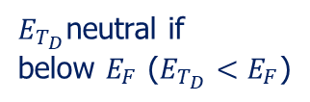
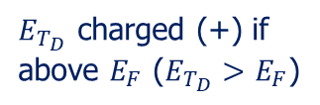
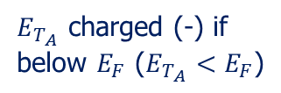
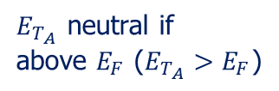
Traps type
Acceptor traps are uncharged when unoccupied (empty) / negatively charged when occupied (they carry the charge of one electron when fully occupied).
Donor traps are uncharged when unoccupied (empty) /positively charged when occupied (they carry the charge of one hole when fully occupied).
Acceptor
Donor
$E_{T_{A}}$ neutral if
above $E_{F}$ ($E_{T_{A}}>E_{F}$)
$E_{T_{D}}$ charged (+) if
above $E_{F}$ ($E_{T_{D}}>E_{F}$)
$E_{T_{A}}$ charged (-) if
below $E_{F}$ ($E_{T_{A}}<E_{F}$)
$E_{T_{D}}$neutral if
below $E_{F}$ ($E_{T_{D}}<E_{F}$)

Slide 17



Traps energy distribution
Traps energetic parametrization.
$$N_{max}e^{−}\frac{{\left(E−E_{0}\right)}^{2}}{2E_{s}^{2}}$$
$$E_{S}$$
$$N_{max}e^{−\left|\frac{E−E_{0}}{E_{s}}\right|}$$
FromMidBandGap
EnergyMid=0

Slide 18
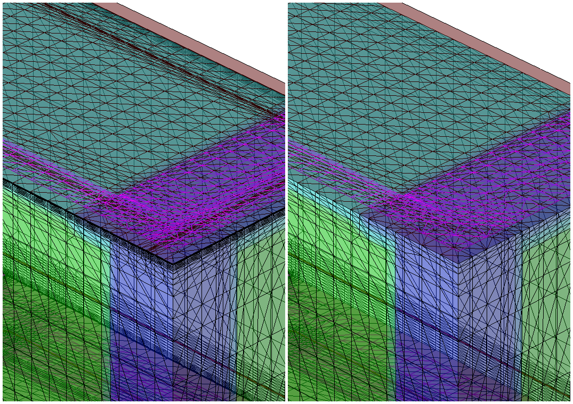
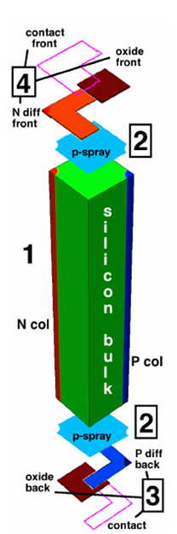
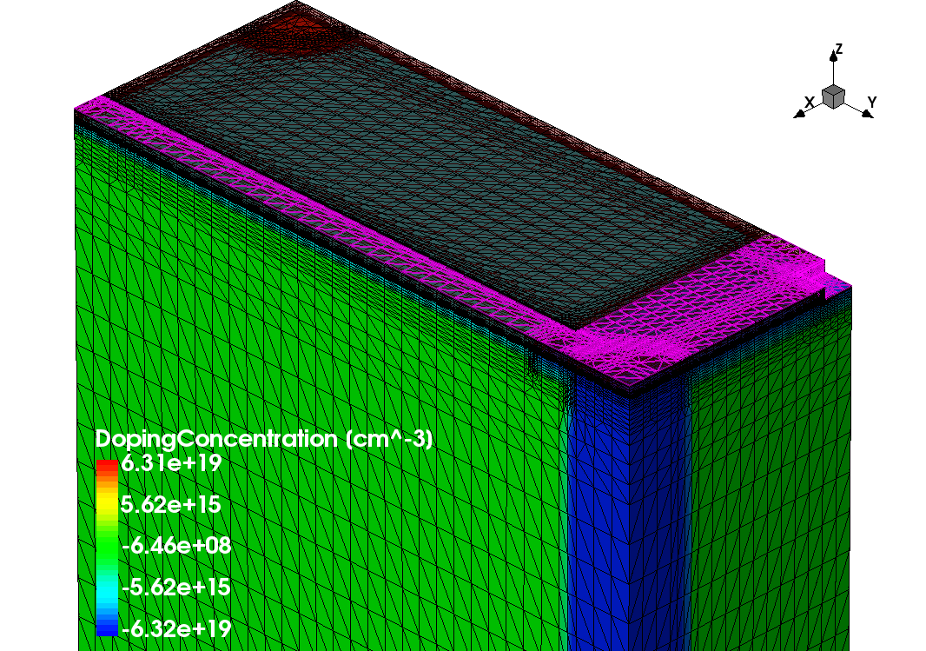
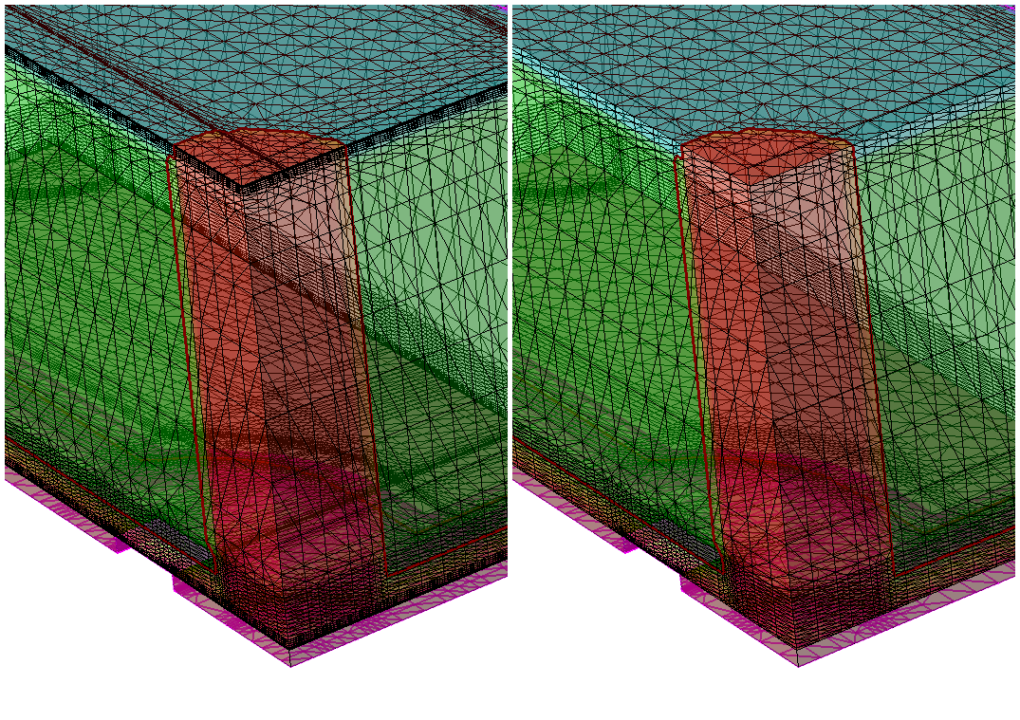


The space discretization issue
Mesh (grid) definition is crucial for simulation accuracy.
Global Refinement
& Interface
$$0.01μm$$
$$0.5μm$$

Slide 19
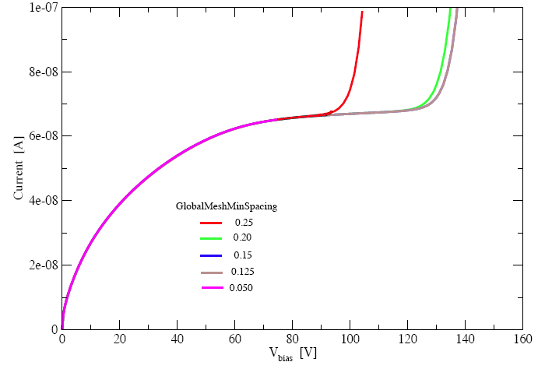
The space discretization issue (2)
Mesh (grid) definition is a crucial for simulation accuracy /
simulation convergence.
G. Giugliarelli et al., “TCAD simulations of breakdown voltage and isolation properties of 3D sensors”, 12th “Trento” Workshop on Advanced Silicon Radiation Detectors.

Slide 20
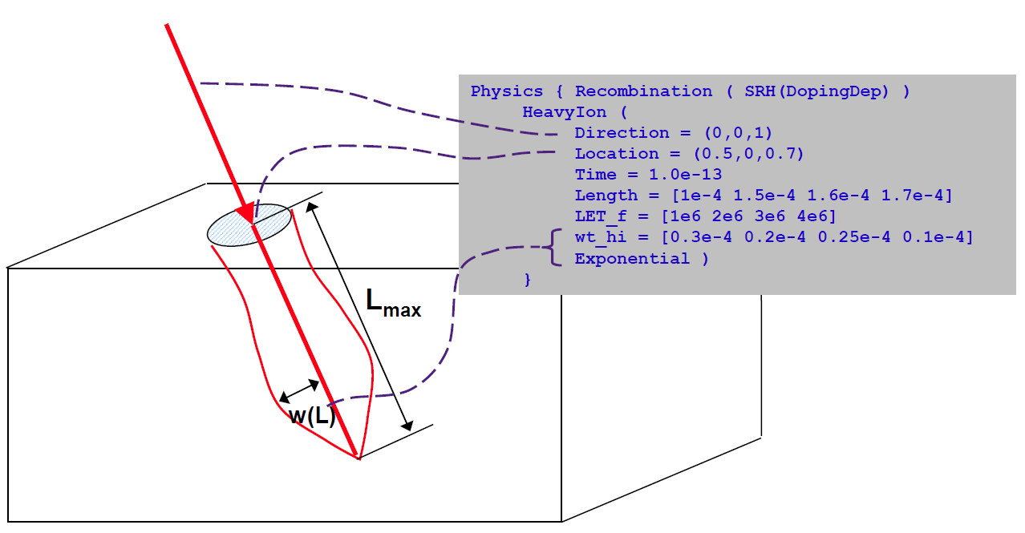
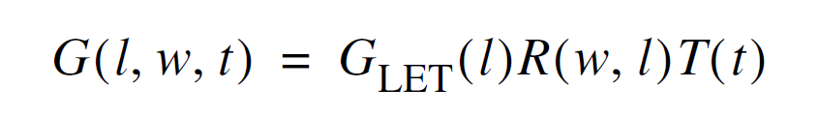
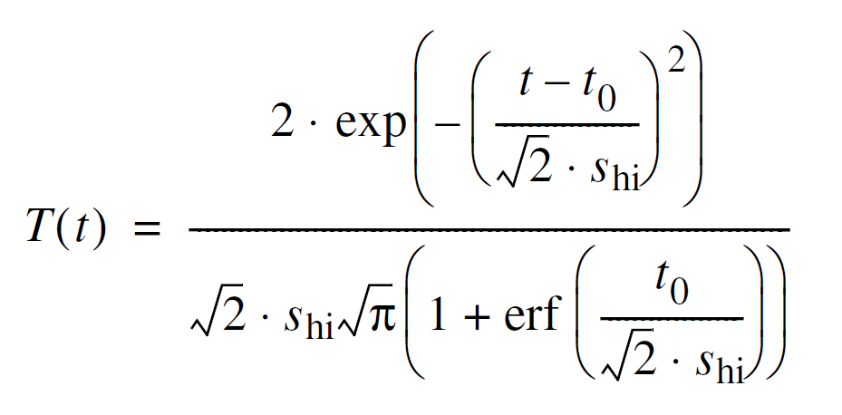
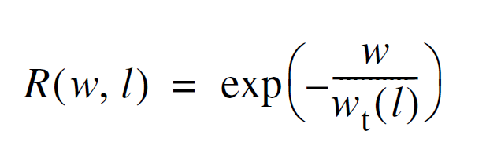
The time discretization issue
MIP DISCRETIZATION

Slide 21
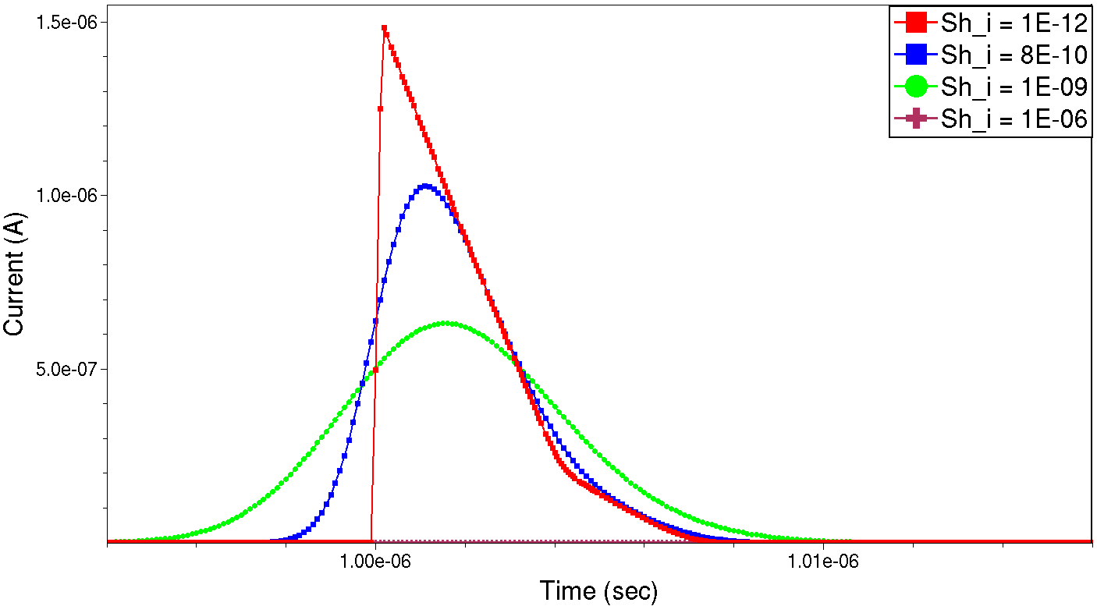
The time discretization issue (2)
Time discretization of the charge generation…
Numerical issues in charge generation -> charge collection evaluation.
Poor time discretization
Proper time discretization
Good Landau shape
“Extra” time discretization
Pure Gaussian shape

Slide 22
Outline
Motivations and background.
TCAD radiation damage modelling: discussion.
Simulation results and comparison with experimental data:
  - DC (steady-state) -> Diodes / Gate Controlled Diodes.
  - AC (small-signals) -> MOS Capacitors.
  - Time (transient) -> Multi-strip structures.
Conclusions.

Slide 23
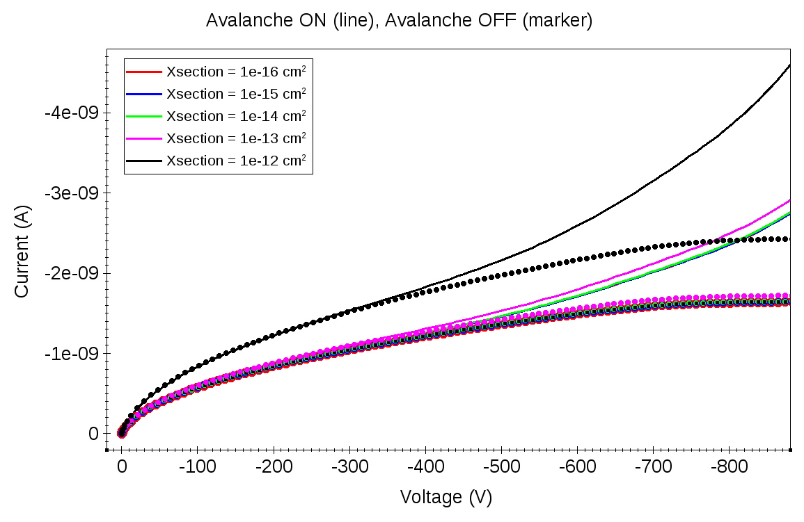
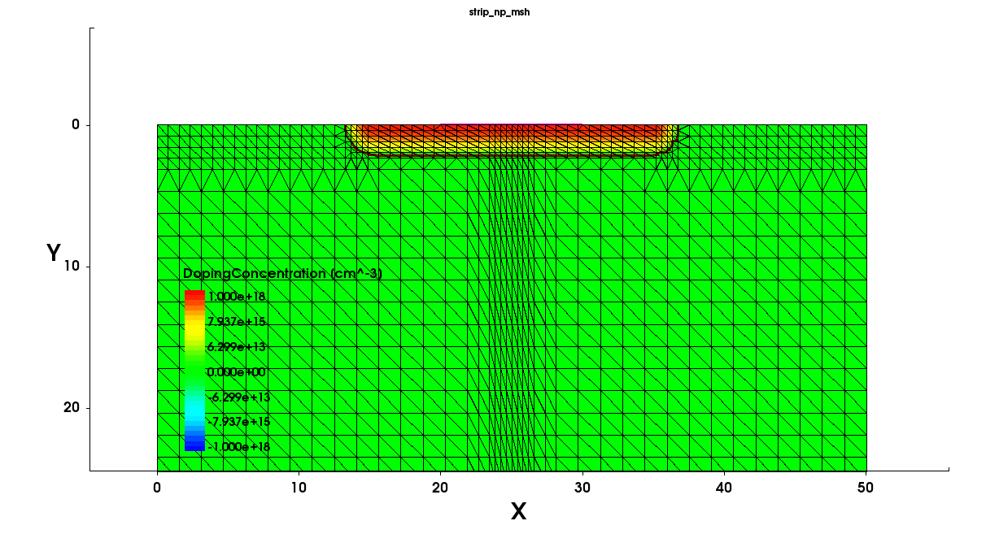
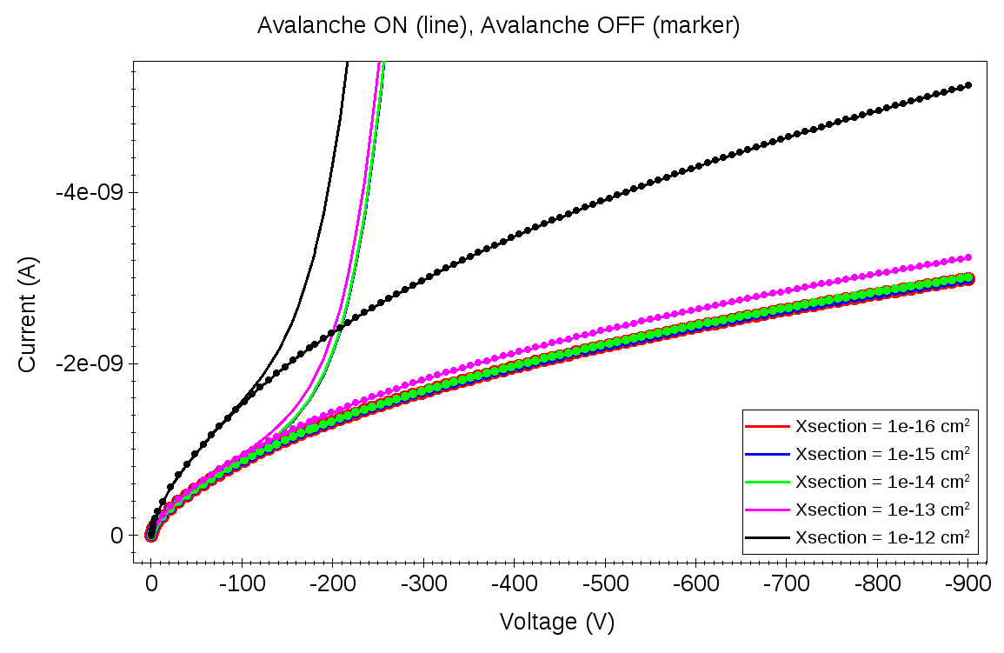
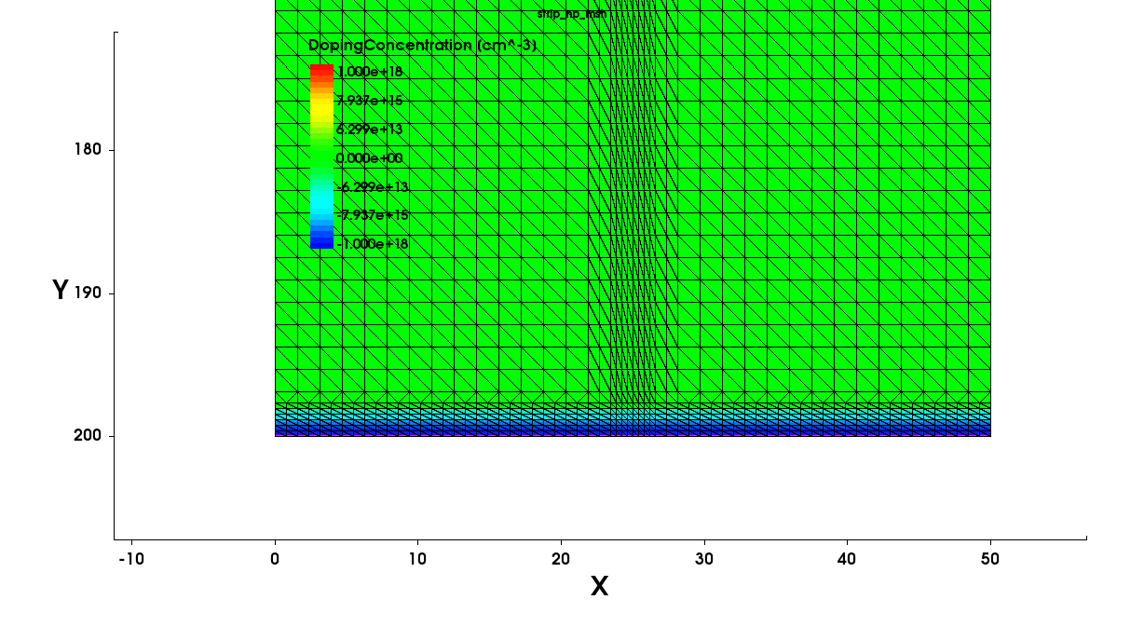
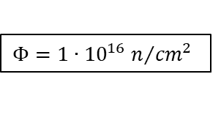
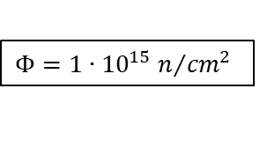
Diode simulation: leakage current
Effect of the capture cross-sections variation combined
with impact ionization
(simplified n-on-p single
strip structure).
$$Φ=1{∙10}^{15}n/{{cm}^{2}}$$
Relatively low effect
Significant effect of the impact
ionization at high fluences
$$Φ=1{∙10}^{16}n/{{cm}^{2}}$$

Slide 24
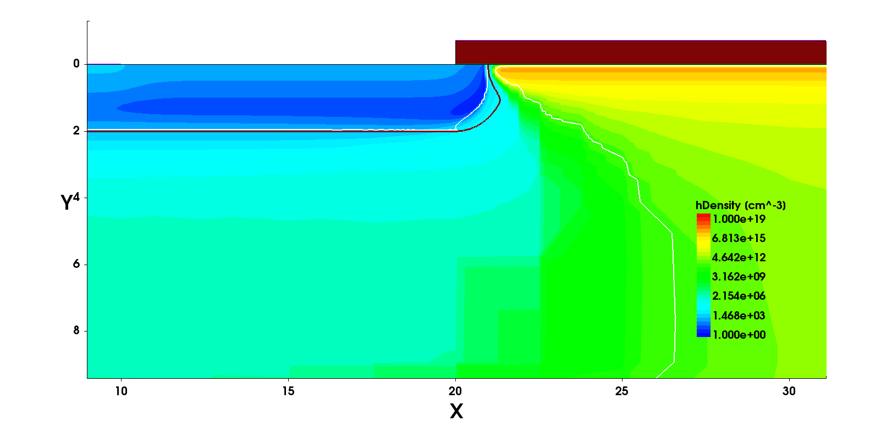
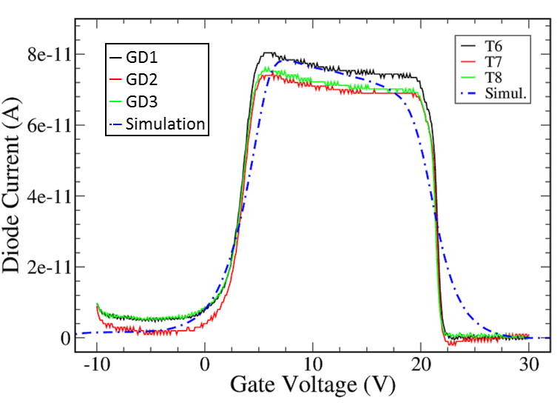
Gate Controlled Diode
Non-irradiated structures.
L_{d}/2 = 20 µm
L_{g}/2 = 20 µm
SiO₂
n⁺
  100 µm active depth
  n⁺ = 1×10¹⁹ cm⁻³
  p_{sub} = 3×10¹² cm⁻³
p_{sub}

Slide 25
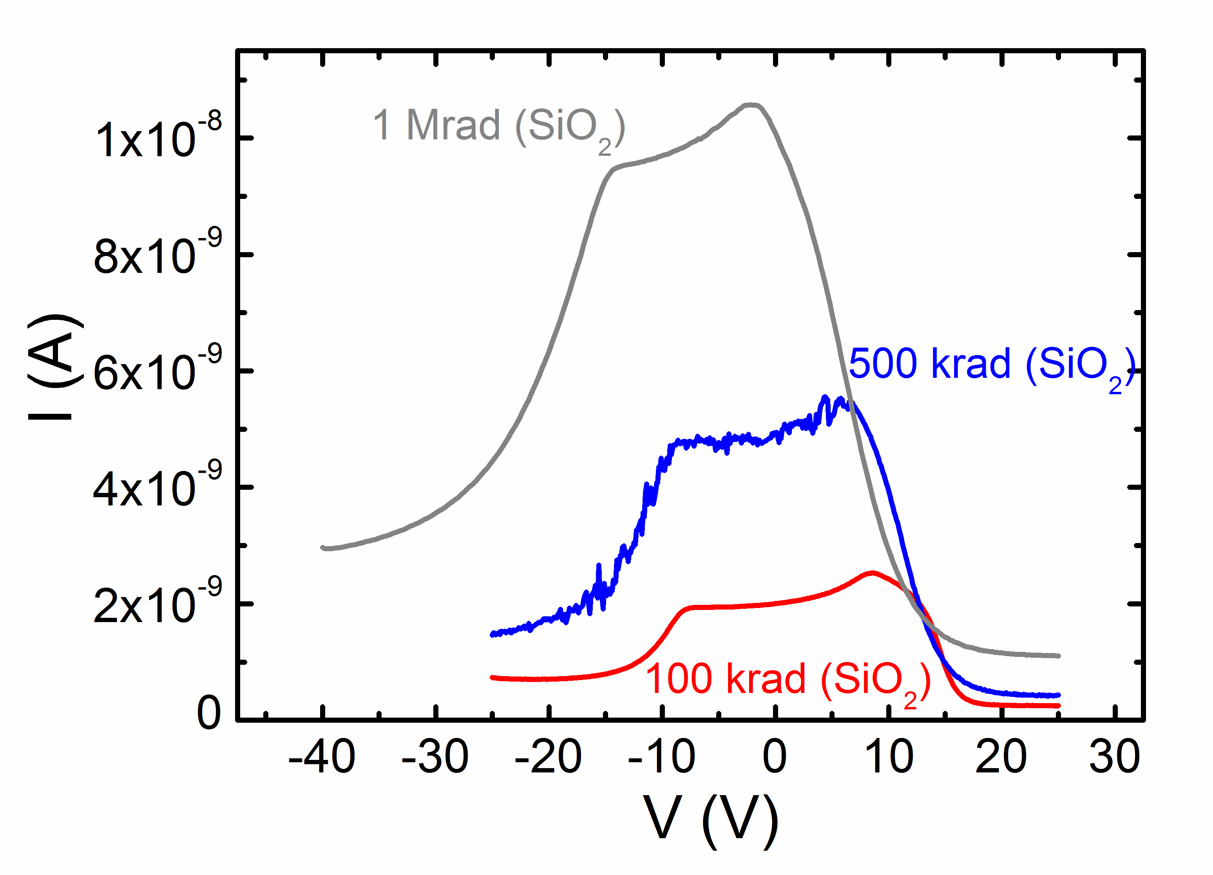
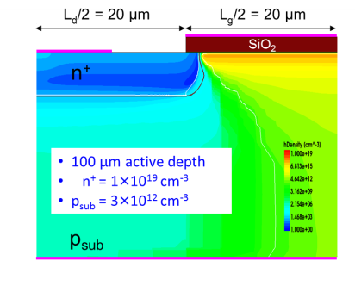
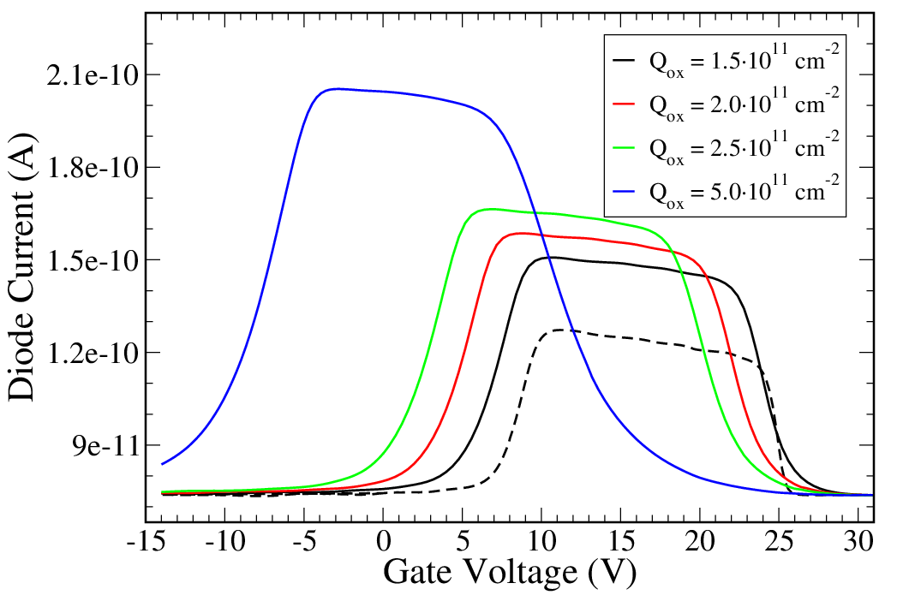
Sensitivity analysis: Q_{OX} + N_{IT}
Combined effect of fixed charge (Q_{OX}) and interface trap states/trapped charge (N_{IT}) increase.

Slide 26
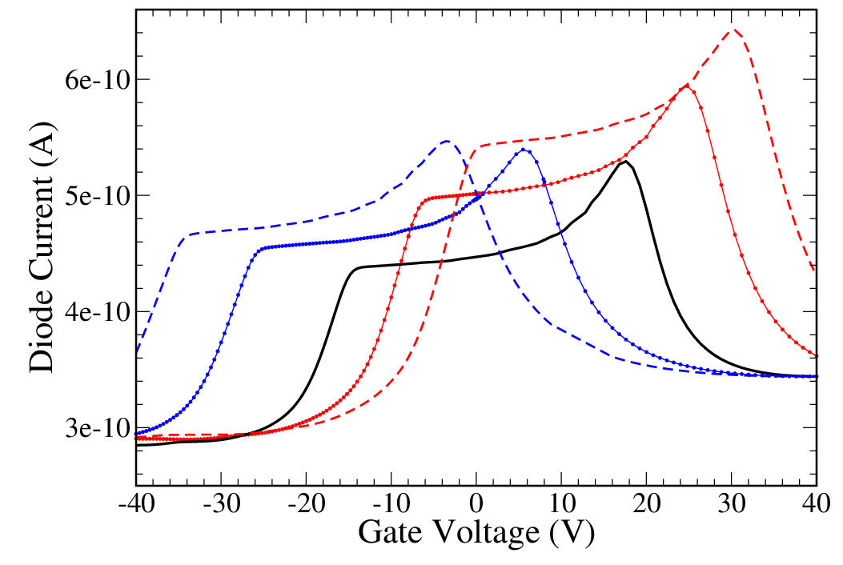
Effect of Interface Trap type
N_{ITA} acceptor type traps, N_{ITD} donor type traps.
N_{itA} >> N_{itD}
N_{itA} << N_{itD}
N_{itA} > N_{itD}
N_{itA} = N_{itD}
N_{itA} < N_{itD}

Slide 27
Outline
Motivations and background.
TCAD radiation damage modelling: discussion.
Simulation results and comparison with experimental data:
  - DC (steady-state) -> Diodes / Gate Controlled Diodes.
  - AC (small-signals) -> MOS Capacitors.
  - Time (transient) -> Multi-strip structures.
Conclusions.

Slide 28
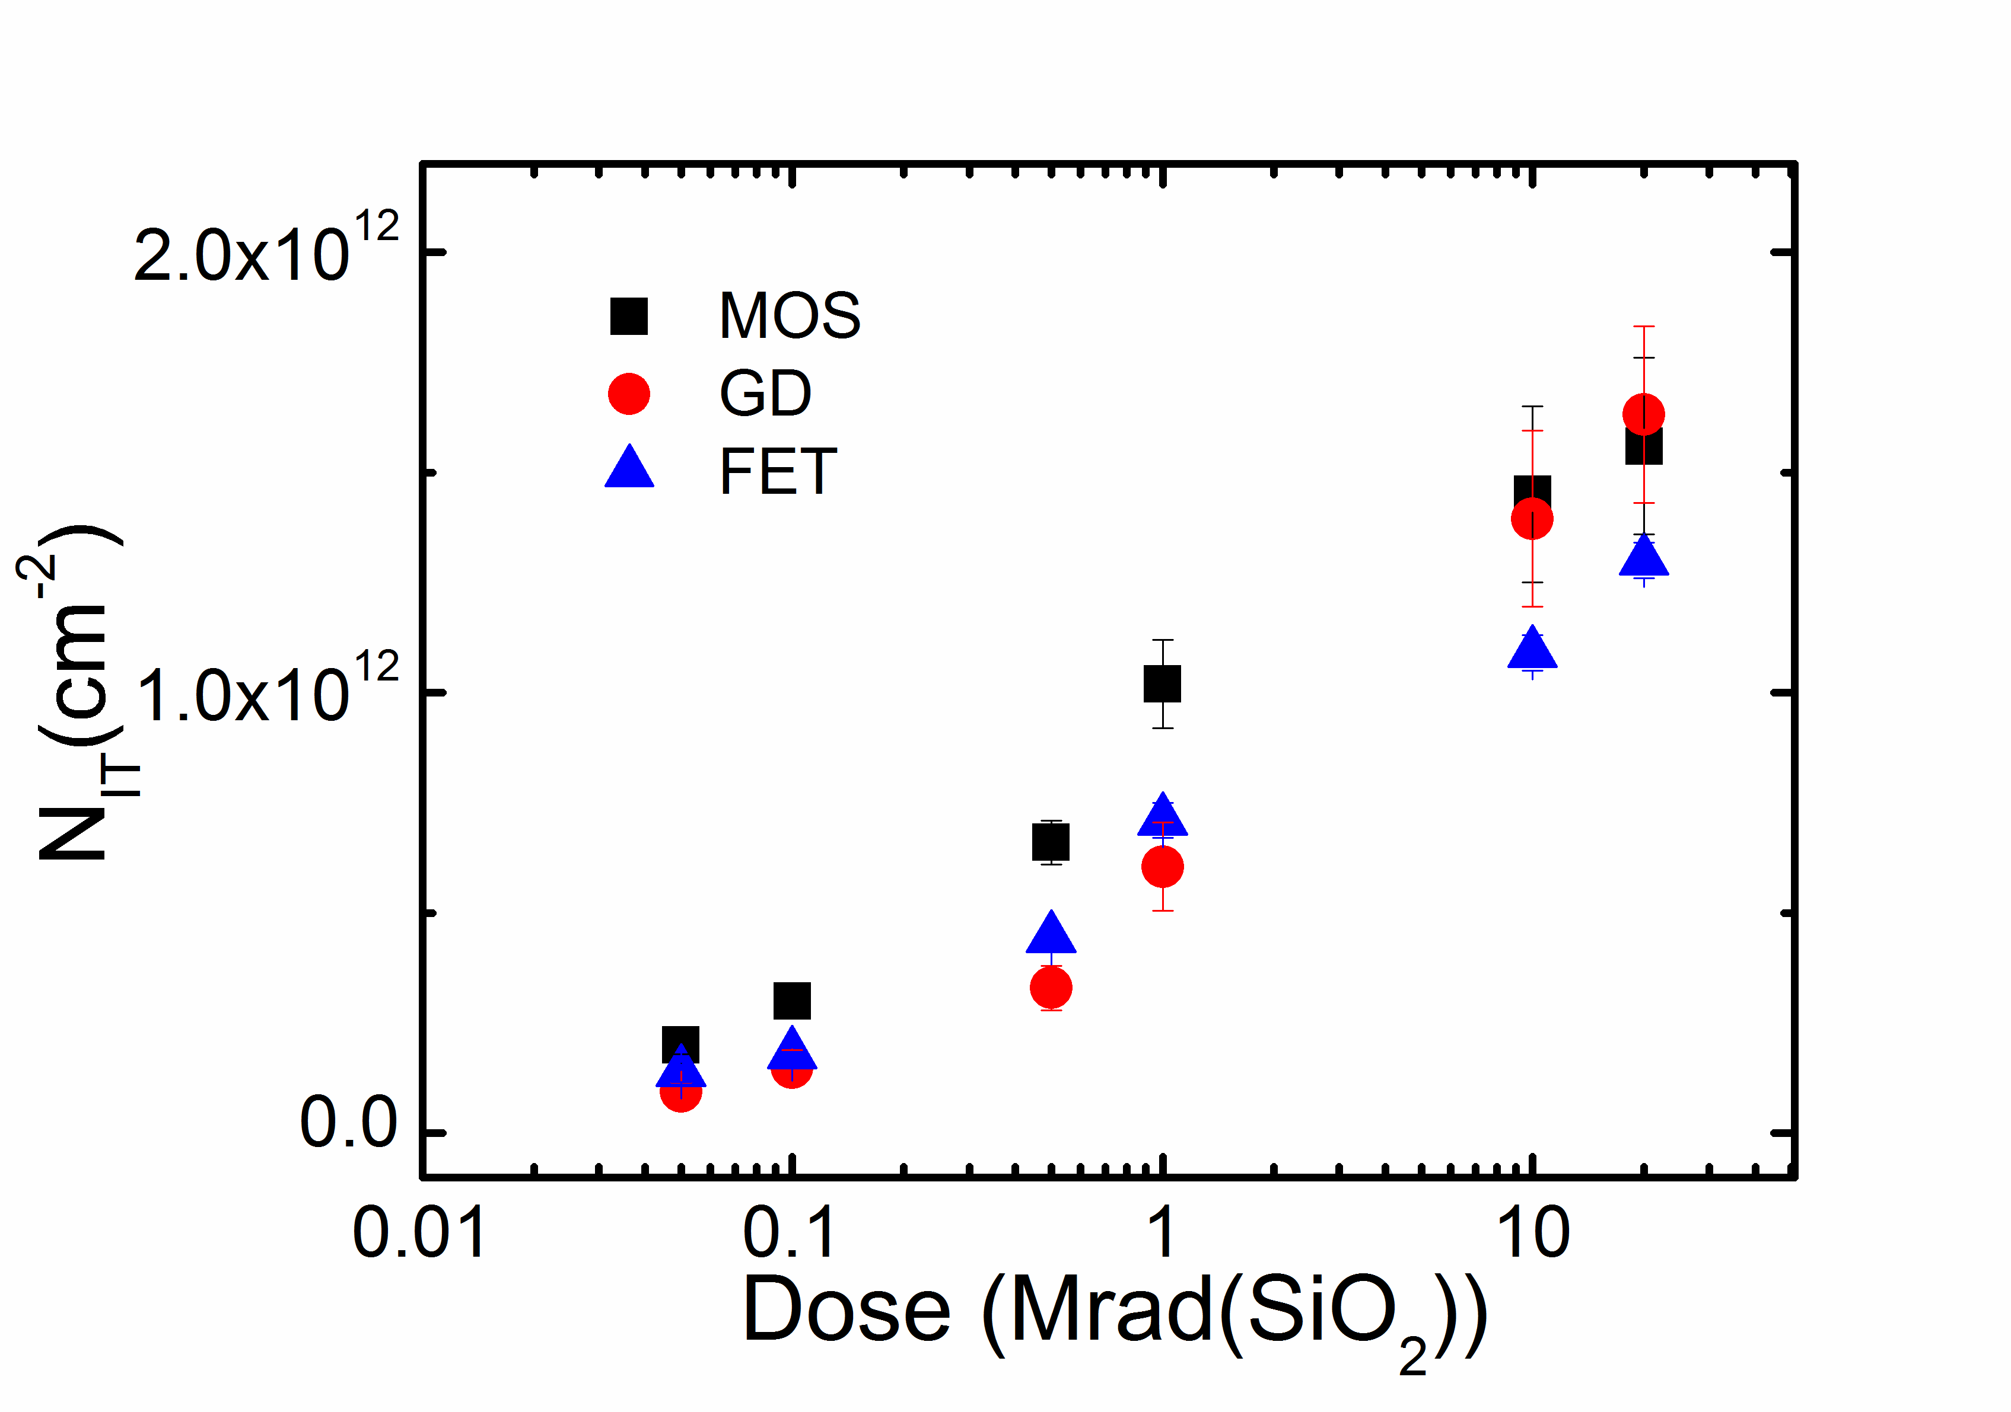

MOS Capacitor measurements
Q_{OX} and N_{IT} evaluation (from C_{HF} - C_{QS} measurements).
N_{IT} evaluation from p-type substrate (MOS C, GD) and pMOSFET.
Following the method proposed in P. J. McWhorter and P. S. Winokur
in Applied Physics Letters 48, 133 (1986), it is possible to separate the
two contributions of Q_{OX} and N_{IT}.
Q

Slide 29




Interface Trap density measurements
N_{IT}/D_{IT} evaluation (from C_{HF} - C_{QS} measurements).
Donor interface trap states
from $p$-type substrates
Acceptor interface trap states
from $n$-type substrates
Relatively low interface
trap state density region
Non negligible interface
trap state density

Slide 30



MOS Capacitor simulations
Non-Irradiated structures.
C_{QS}
Measurements
Simulations
C_{HF}

Slide 31





MOS Capacitor simulations
Sensitivity analysis: effect of Q_{OX} and D_{IT}.
Increase
of D_{ITA}
Increase
of Q_{OX}
$$Q_{OX}=1.0×{10}^{12}{cm}^{−2}$$
$$Q_{OX}=4.3×{10}^{11}{cm}^{−2}$$
$$D_{ITA}=9.0×{10}^{11}{cm}^{−2}{eV}^{−1}$$
$$D_{ITA}=2.5×{10}^{12}{cm}^{−2}{eV}^{−1}$$

Slide 32

MOS Capacitor simulations
Irradiated structures.
Measurements
Simulations

Slide 33
Outline
Motivations and background.
TCAD radiation damage modelling: discussion.
Simulation results and comparison with experimental data:
  - DC (steady-state) -> Diodes / Gate Controlled Diodes.
  - AC (small-signals) -> MOS Capacitors.
  - Time (transient) -> Multi-strip structures.
Conclusions.

Slide 34







MultiStrips simulation: MIP response
Current responses to different impact locations.
MIP
MIP
$$V_{BIAS}=900 V$$
$Φ=1∙{10}^{15}n/{{cm}^{2}}$
$$V_{BIAS}=900 V$$
$$Φ=1∙{10}^{15}n/{{cm}^{2}}$$

Slide 35

Transient analysis: Charge Collection
Charge collection: simulations vs. measurements at different
biasing voltages (T = 248 K)
Measurements from Affolder et al., “Collected charge of planar silicon detectors …” NIM A, Vol. 623 (2010), pp. 177-179.

Slide 36
Outline
Motivations and background.
TCAD radiation damage modelling: discussion.
Simulation results and comparison with experimental data:
  - DC (steady-state) -> Diodes / Gate Controlled Diodes.
  - AC (small-signals) -> MOS Capacitors.
  - Time (transient) -> Multi-strip structures.
Conclusions.

Slide 37
The model
F. Moscatelli; D. Passeri; A. Morozzi; S. Mattiazzo; G. -F. Dalla Betta; M. Dragicevic; G. M. Bilei,
Effects of Interface Donor Trap States on Isolation Properties of Detectors Operating at High-Luminosity LHC, IEEE Transactions on Nuclear Science, 2017, Vol. 64, Issue: 8, 2259 - 2267
Surface damage (+ Q_{OX})
From D_{IT}
measurements
Bulk damage
(up to 7.0×10¹⁵ n/cm²)
E_{C}
D_{ITA}
D_{ITD}
(7.0×10¹⁵ ÷ 1.5×10¹⁶ n/cm²)
E_{V}
(1.6×10¹⁶ ÷ 2.2×10¹⁶ n/cm²)

Slide 38
Conclusions
Modelling radiation damage effects is a hard task!
Radiation damage modelling scheme (bulk + surface),
suitable for commercial TCAD tools (e.g. Synopsys Sentaurus).
Predictive capabilities extended to HL-LHC radiation damage levels (e.g. fluences > 2.0×10¹⁶ cm⁻² 1 MeV neutrons).
Further validation with experimental data comparisons
-> model refinement.
Application to the optimization of (pixel) detectors
(3D detectors, 2D planar detectors, …).

