Slide 1
Challenges in Neutrino Simulation: Geometry and Digitization
Xin Qian (BNL)
Laura Fields and Tingjun Yang (FNAL)

Slide 2
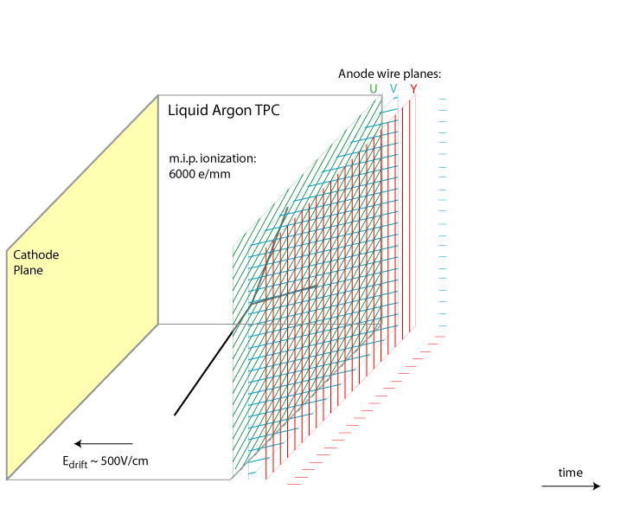
Liquid Argon Time Projection Chamber
Position sensitive detector at anode to obtain 2D positions
Drift time → drift distance
Scintillation light → time information
Ionization Charge → energy information
Excellent technology for accelerator neutrino experiments
time
Drift velocity 1.6 km/s → several ms drift time

Slide 3
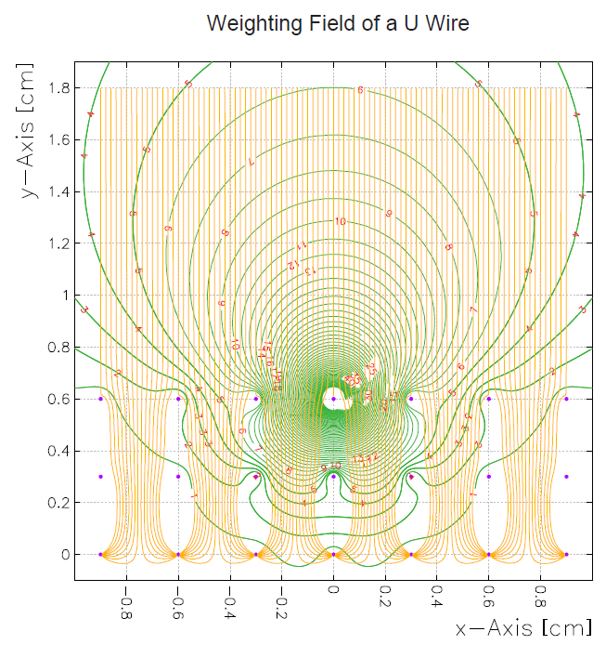
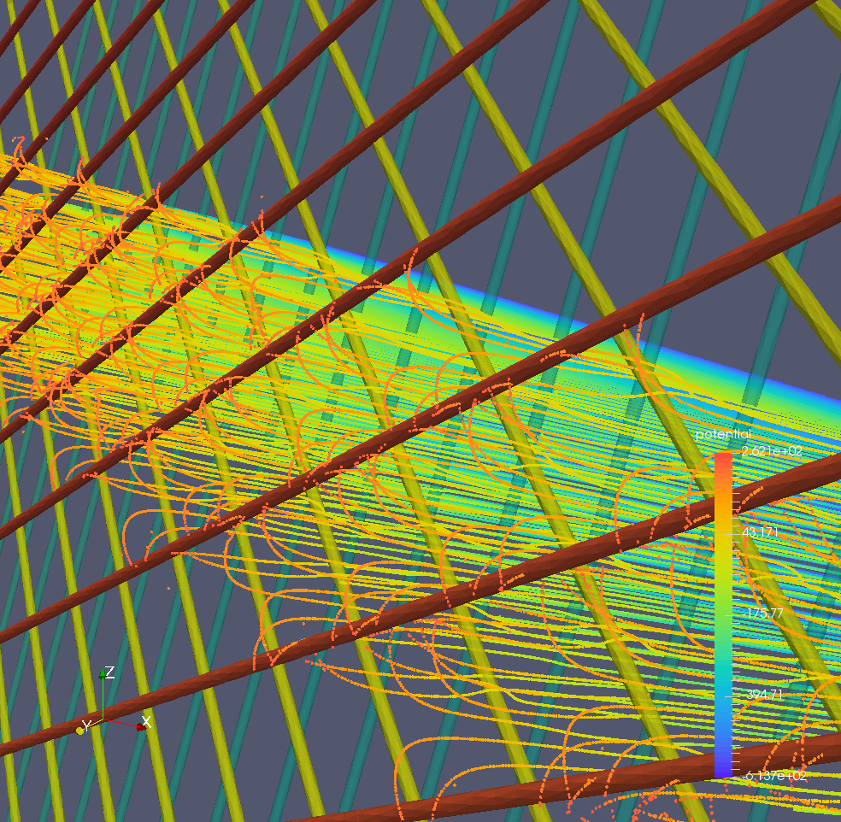
TPC Signal Formation
Weighting Potential of a U wire
Example
Shockley–Ramo theorem
v_{q}: velocity
E_{w}: weighting field
q: charge
Induced current (field response) depends on the external electric field (velocity) and the geometry (weighting field)

Slide 4
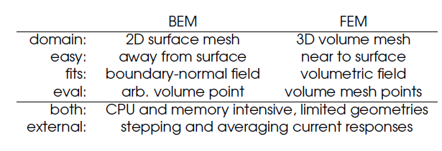
Challenge I: Realistic Simulation of Field Response Function
Problem is intrinsically 3D
  The volume is at the order of O(1000) cm³
  The pixel size is determined as fractions of the wire diameter ~150 μm
3D calculation of field response is ongoing
  Two approaches: BEM (Brett Viren) and FEM (Leon Rochester)
2D Garfield calculation is currently the nominal, well characterized method

Slide 5
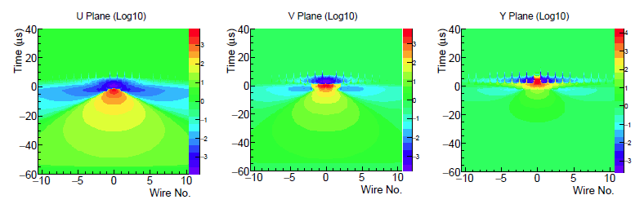
Simulation of the Detector Response
2D Garfield Simulation
Induced signal is long-range and position dependent
Smaller distance between charge and wire, bigger the signal is
Currently taking into account +-O(10) wires and O(10) positions within a single wire region in 2D (Brett Viren, WCT)
Do we need to simulate the detector response in 3D?

Slide 6
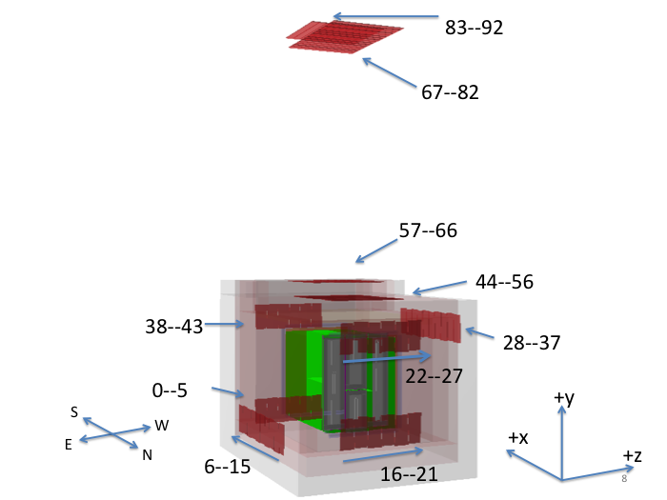
Challenge II: Geometry
The DUNE detector geometry consists of many components
  Multiple TPCs (~200 in the 10 kton module)
  3 wire planes in each TPC
  Many wires on each wire plane
  Multiple photon detectors
  Multiple scintillator counters
Challenges in detector alignment
Also detector geometry optimization for physics
  Wire pitch, angle
  Detector orientation
  Number of wire planes
Scintillator counters
TPC and
photon detectors
DUNE 35-ton prototype geometry

Slide 7
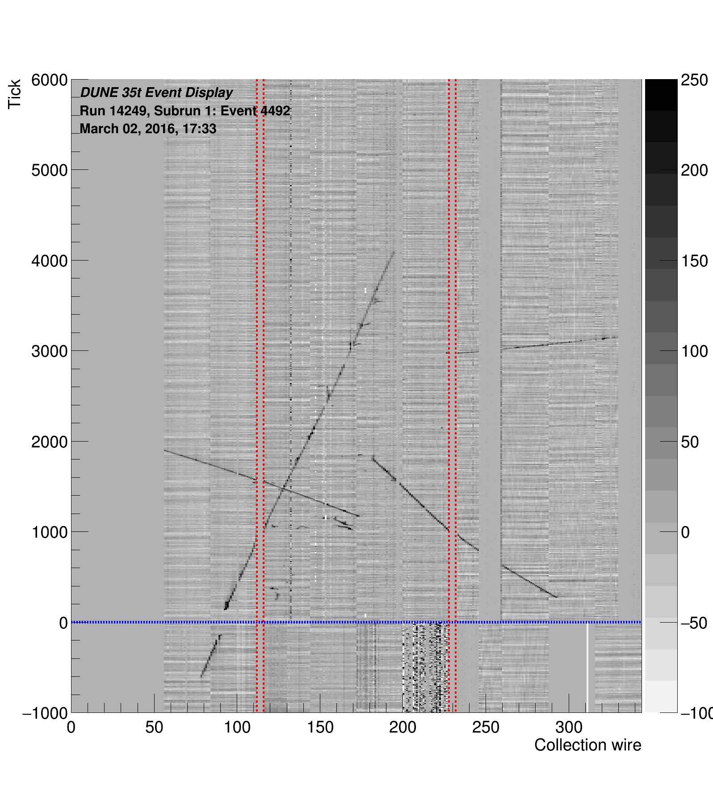
Detector Alignment
TPC boundaries
Need to correct for TPC misalignment in order to reconstruct/stitch objects in multiple TPCs.
Need to correct for scintillator counter locations to get the correct trigger information.
Both alignments can be done using cosmic ray muons.
Use gaps to align TPCs
Anode Plane Assemble

Slide 8
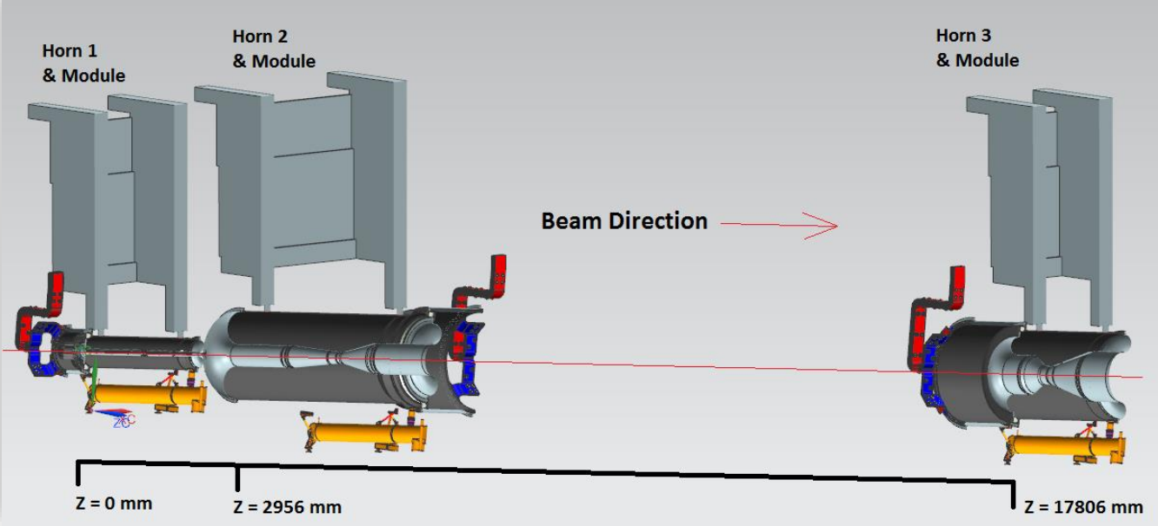
Neutrino Beam Simulations
All accelerator-based neutrino experiments depend on detailed simulations of neutrino beamlines to predict neutrino fluxes and uncertainties
LBNF Optimized Beam
Flux predictions are very sensitive to modeling of material and magnetic fields.
Geometry problems in beam simulations have a much larger impact than in most detector simulations.

Slide 9
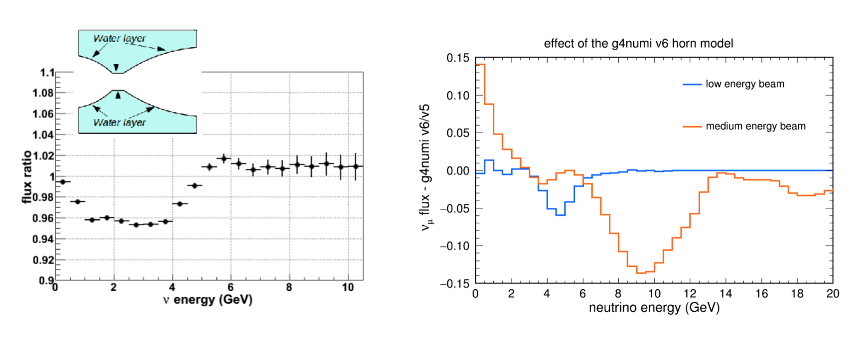
Neutrino Beam Simulations
Impact of two recent NuMI modeling problems
  Such problems are hard to identify
  Here they were found when a separate Geant4 implementation of horns was made for LBNF
These are both significantly larger than the systematics budget previously assumed for such effects
Such uncertainties will be more important as accelerator-based oscillation experiments become systematics dominated
Effect of a 1 mm cooling water later on horn inner conductors
Effect of small change to the shape of the inner conductor neck

Slide 10
Summary
Digitization:
  Challenges in LArTPC detector response simulation
Geometry:
  Large LArTPC, impacts in simulation and optimization
  Neutrino beam, impacts in systematics
Did not cover technologies of water Cerenkov, liquid scintillator, …

Slide 12
Challenge II: Detector Response in 3D?
Once the 3D calculation of the field response is achieved, the next challenge is the simulation of detector response in 3D
Non-trivial problem
  We need to consider both long-range induction effect as well as position dependence (2D transverse plane)
  Required calculation and memory significantly increase
  Also boundary of the detector

Slide 13
Detector Geometry Optimization
Detector geometry needs to be optimized to maximize physics sensitivity
  Wire pitch
  Wire angle
  Detector orientation
e/γ separation

