Slide 1



for fast prototyping WITH cogevito lib
CWP-Simulation meeting - 24th of April 2017
“Geometry and Digitisation”
3D Detector interactive display
Event data animation

Slide 2
Scope and Requirements
Scope
  Provide a suitable tool that may be used in HEP to display complex geometries and also particle and event data with animation based on the time information generated by MC simulation software (eg GeantV) or experimental data.
Initial requirements
  Web based application (to facilitate exchange of information)
  Use of public domain 3D graphics library “ThreeJS”

Slide 3

Status of developments
Root
“plugin”
Web
“tools”
Starting point
0
1
2
The Root “plugin” will create an output file with the definition of the Geometry in JSON format
Geometry definition in TGEO
(Root, Geant4 etc)
C++ code using root Clang interpreter
Web home page: Default.htm
Import all JavaScript libraries for Three.Js and Cogevitolib.js and Creates the interface
OutputFile.js
Calls to GoGeviTo library for the creation of logical and physical volumes
Cogevitolib.js
contains all functions to create Three.Js volumes and functionalities
ParticleData.js
Data related to events and particles in time
Particle and events data are generated by MC software or experiments
The files will be imported using the interface on the web home page of the application
Other applications
(eg GeantV)

Slide 4
Cogevitolib.js
It is a collection of functions in JavaScript
Most of the functions are related to creation of the geometry of volumes using native three.js graphic functions
  Box, sphere, trapezoids etc
The geometry is represented internally in tree structure
  Logical volumes are created first
  Physical volumes are clones (copies) of the Logical volumes
Clones are copies including all the sub-tree of volumes. Those clones are sharing information on Geometry and Material in order to save space in memory.

Slide 5
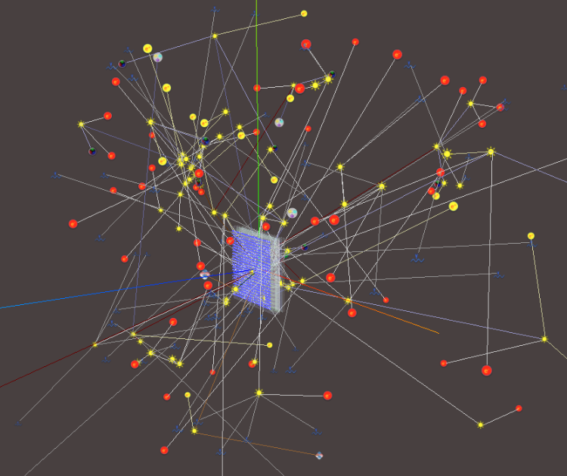
Dynamic particles
& tracks
Dynamic event animation in time

Slide 6
TimeSlot:
10*10⁻⁹
seconds
T,E,
x0,y0,z0
T,E,
x0,y0,z0
T,E,
x0,y0,z0
TimeSlot:
20*10⁻⁹
seconds
T,E
,x1,y1,z1
T,E,
x1,y1,z1
T,E,
x1,y1,z1
n steps…
TimeSlot:
n*20*10⁻⁹
seconds
T,E,
xn,yn,zn
T,E,
xn,yn,zn
T,E,
xn,yn,zn
T,E,
xn,yn,zn
T,E,
xn,yn,zn
m=n+j steps…
TimeSlot:
m*20*10⁻⁹
seconds
T,E,
xm,ym,zm
T,E,
xm,ym,zm
T,E,
xm,ym,zm
T,E,
xm,ym,zm
T,E,
xm,ym,zm
TimeSlot:
k*20*10⁻⁹
seconds
T,E,
xk,yk,zk
T,E,
xk,yk,zk
T,E,
xk,yk,zk
T,E,
xk,yk,zk
T,E,
xk,yk,zk
T,E,
xk,yk,zk
T,E,
xk,yk,zk
T,E,
xk,yk,zk

Slide 7

Roadmap
What is next

Slide 8


Discuss with potential users in the experiments, HSF etc
The roadmap of developments
Please suggest …
Optimize / consolidate the functionality.
Interact with Geant/GeantV
Create simple geometries and watch
Particles animation on line.

Slide 9

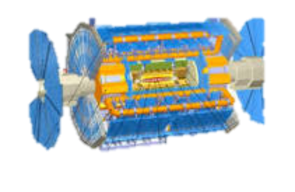
Going Live
The Atlas detector

