Slide 1
Machine Learning for (fast) simulation
Sofia Vallecorsa for the GeantV team
CERN, April 2017

Slide 2
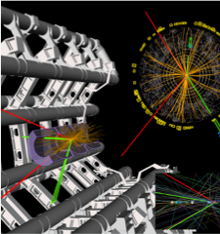
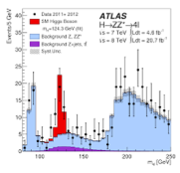
Monte Carlo Simulation: Why
Detailed simulation of subatomic particles is essential for data analysis, detector design
      Understand how detector design affect measurements and physics
      Use simulation to correct for inefficiencies, inaccuracies, unknowns.
      The theory models to compare data against.
A good simulation demonstrates that we understand the detectors and the physics we are studying

Slide 3
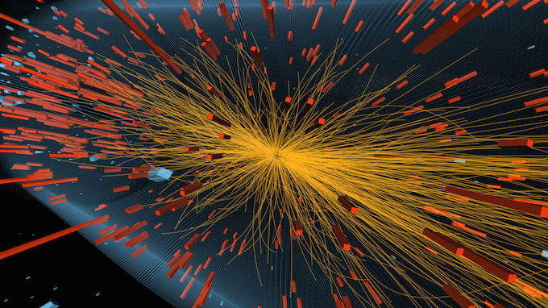
The problem
  Complex physics and geometry modeling
    Some physics process are extremely rare!
  Heavy computation requirements, massively CPU-bound
  Already now more than 50% of WLCG power is used for simulations
  @HL LHC we will need to simulate
  More data
  More complex events
  Faster!

Slide 4
GeantV: Adapting simulation to modern hardware
GeantV simulation
needs to profit at best from all processing pipelines
Classical simulation
hard to approach the full machine potential
Single event scalar transport
Embarrassing parallelism
Cache coherence – low
Vectorization – low (scalar auto-vectorization)
Multi-event vector transport
Fine grain parallelism
Cache coherence – high
Vectorization – high (explicit multi-particle interfaces)
Notes:
Compared to the classical approach, GeantV transports vectors of tracks grouped by geometry/physics to get access to fine grain parallelism features like ILP/SIMD, with much better cache coherence.

Slide 5
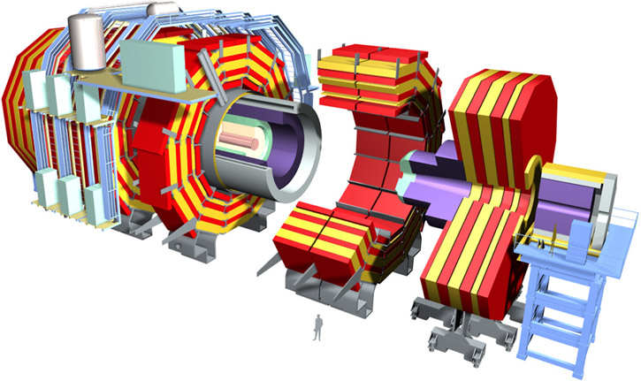
Some benchmarks on Intel Xeon Phi
GeantV delivers already a part of the expected performance
Testing new geometry navigation performance wrt ROOT (classical)
CMS detector simulation (tabulated physics)
Single thread: T_{GV}/T_{classical} ≈ 4.7
Intel Xeon Phi 7210 @1.30 Hz – 64 cores

Slide 6
Going beyond x10: fast simulation
In the best case scenario GeantV will give O(10) speedup
  It likely won’t be enough to cope with HL-LHC expected needs
Improved, efficient and accurate fast simulation
  Currently available solutions are detector dependent
  Looking for a generic approach + user API
A general fast simulation tool based on Machine Learning techniques
  ML techniques are more and more performant in different HEP fields
  Optimizing training time becomes crucial
http://hilumilhc.web.cern.ch

Slide 7
Going beyond x10: fast simulation

Slide 8
GeantV fast simulation
A project in two steps:
  Phase1: Proof of concept and generic fastsim interface in GeantV
  Phase2: Networks design and training optimisation on HPC

Slide 9
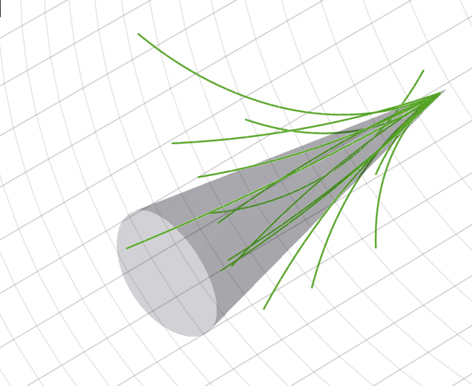
ML engine for fast simulation
Untrained Model
Training
GeantV
Trained Model
Detector
Physics (e⁺, e⁻,γ,π..)
Kinematics…
http://www.physics.umd.edu/rgroups/hep/LegoCMS/
http://www.quantumdiaries.org/wp-content/uploads/2011/06/JetConeWithTracksAndECAL.png

Slide 10
ML engine for fast simulation
Untrained Model
Training
GeantV
Trained Model
Detector
Physics (e⁺, e⁻,γ,π..)
Kinematics…
http://www.physics.umd.edu/rgroups/hep/LegoCMS/
http://www.quantumdiaries.org/wp-content/uploads/2011/06/JetConeWithTracksAndECAL.png

Slide 11
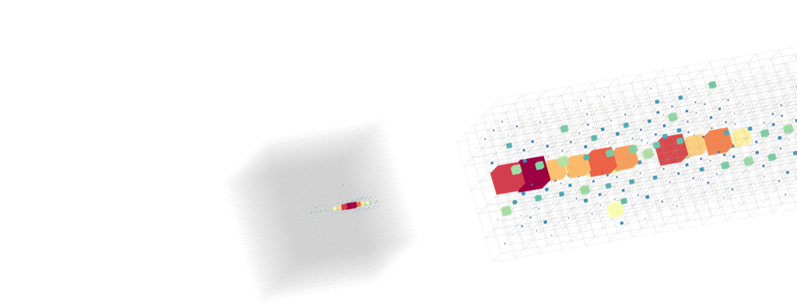
Phase 1: Proof of concept and interface in GeantV
Identify significant variables (PCA analysis, variable reduction)
Test different ML and DL techniques
  Generative adversarial networks
  PCT and MP for MO regression
Focus on most time consuming detectors
  Initially reproduce calorimeter showers
Train networks on full simulation
  Eventually test possibility of training on real data
Integrate a generic interface in GeantV
Automatic tool for training
Single particle energy deposits in the Linear Collider Detector calorimeters generated by a GAN

Slide 12
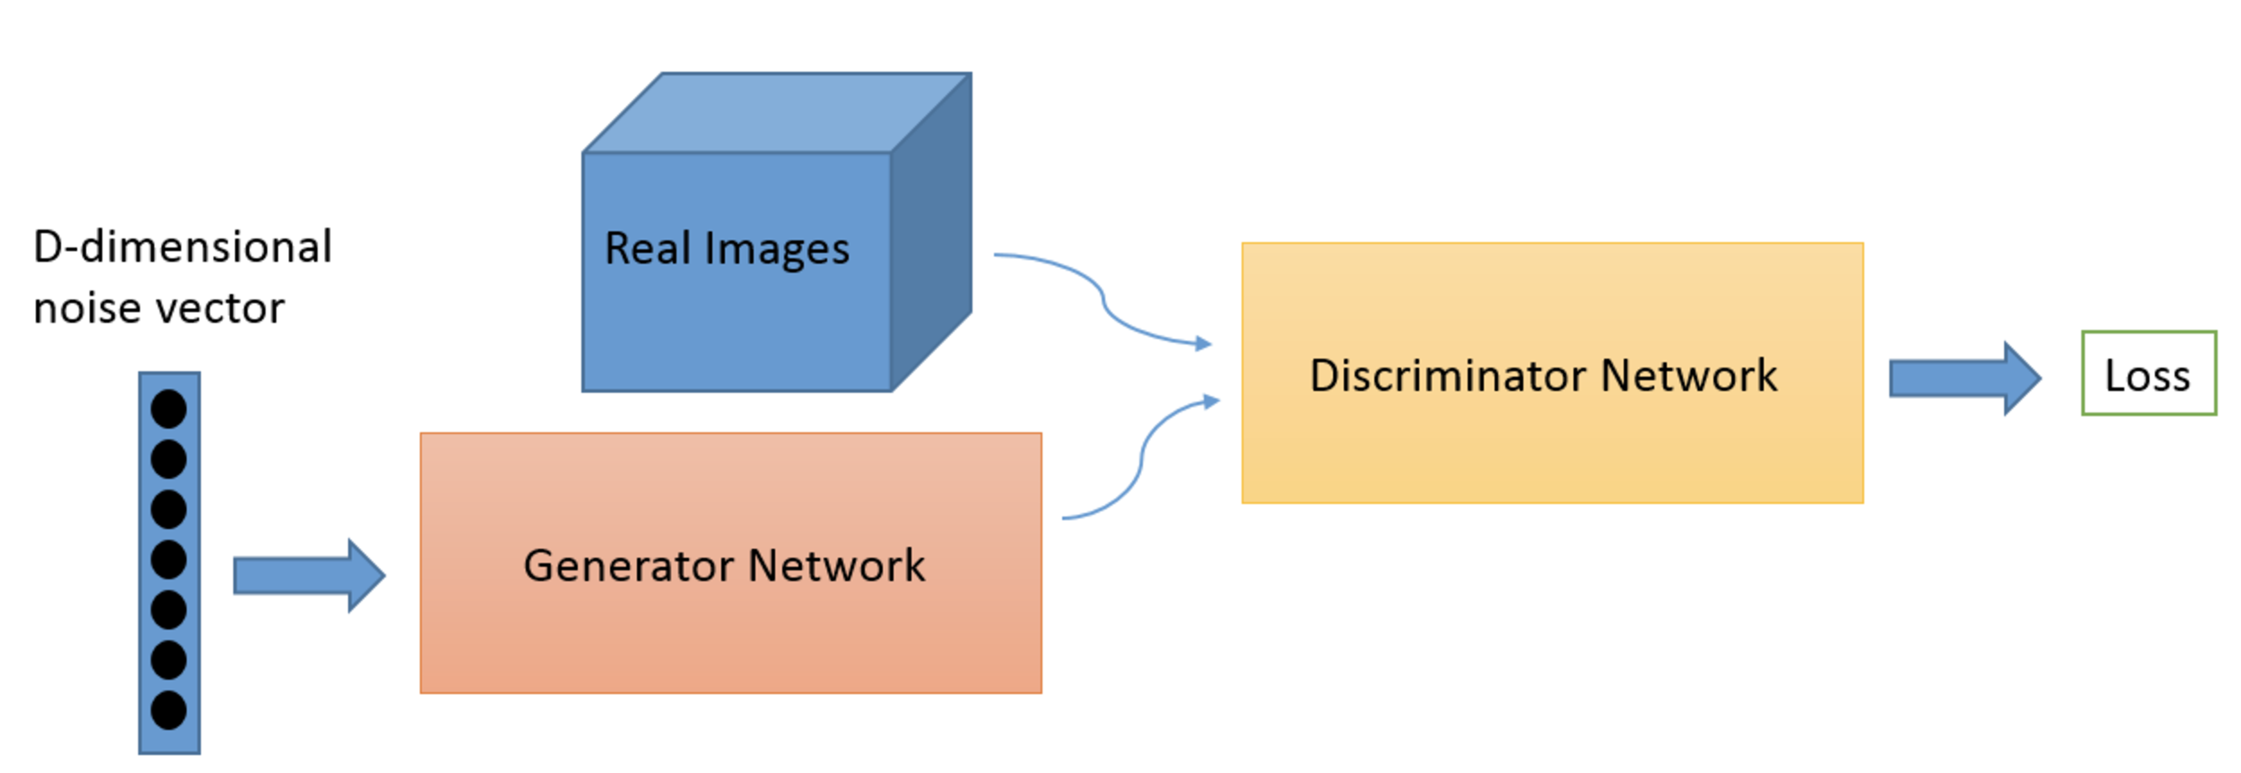
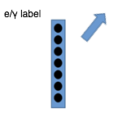
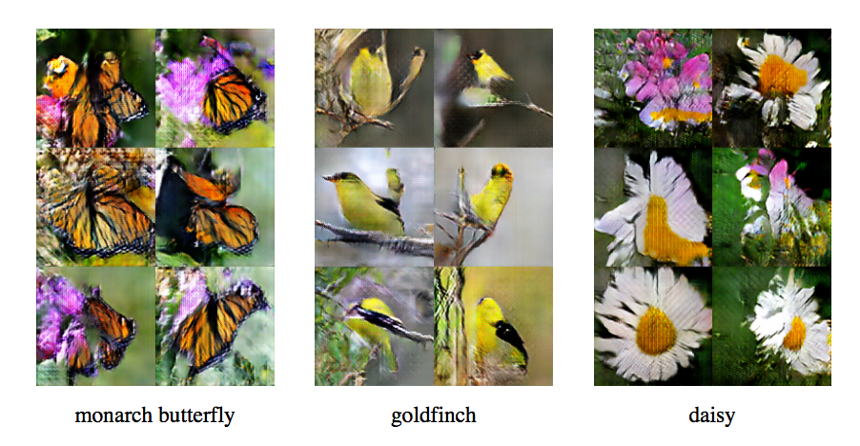
Ex: testing GANs for calorimeter showers
arXiv:1406.2661v1
Simultaneously train two models:
Generative model G to capture the data distribution
Discriminative model D to estimate the probability that a sample came from training data rather than G
The training procedure for G is to maximize the probability of D making a mistake
Particle label
Conditional: arXiv:1610.09585v3

Slide 13
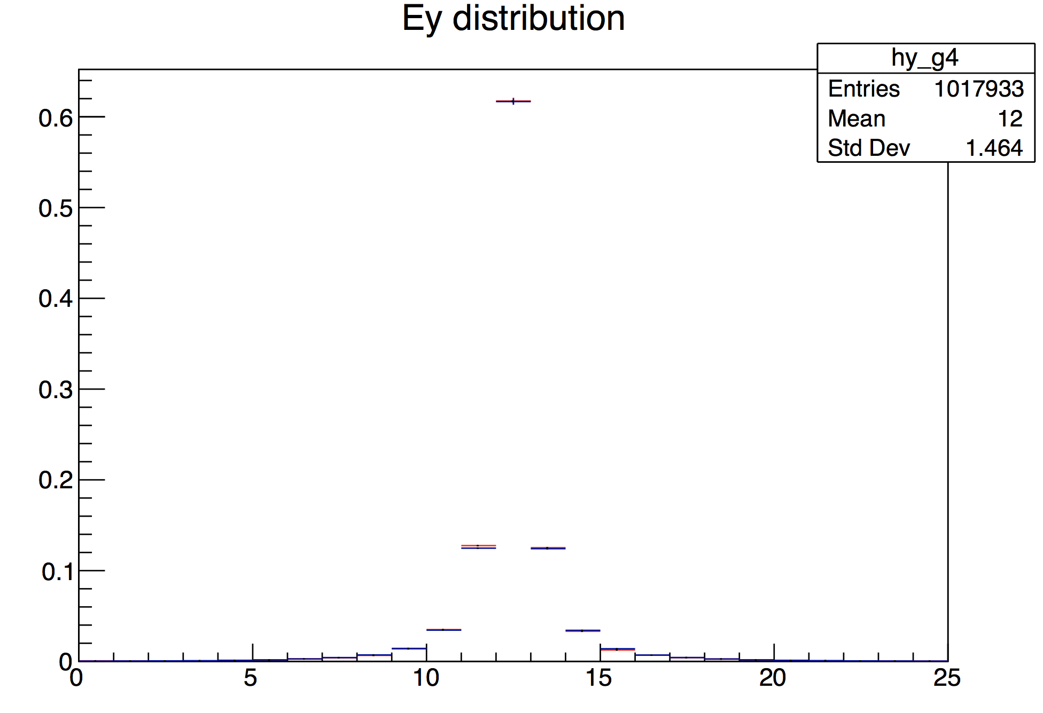

Ex: testing GANs for calorimeter showers
Geant4 π shower in LCD calorimeter
High granularity LCD calorimeter single particle benchmark datasets simulated with Geant4⁽¹⁾
3D convolutional models implemented using Keras + Tensorflow
Batch training
Test different optimisers (SGD, Adam, RMSprop)
Working on model optimisation to improve physics description
Geant4
GAN generated
a.u.
Geant4
GAN generated
preliminary
Shower longitudinal section
a.u.
Shower transverse section
GAN generated electron shower
(1) https://indico.cern.ch/event/575212/contributions/2361407/attachments/1386217/2109575/MLchallengesForHEP_OpenLabDec2016.pdf
Y

Slide 14
Optimising training time
Using DL techniques for fast simulation is profitable if training time is not a bottleneck
  Currently adversarial training of the generative models takes a few hours on NVIDIA GTX1080 (Pascal)
  Study and optimise algorithm
Test different hardware
  Test on a single KNL node and measure multi-threading speedup, memory footprint …
Test multi-node scaling
  Thanks to a collaboration with CINECA and Intel, we have access to a cluster of KNL
www.cineca.it

Slide 15
Phase 2: Optimization and training on clusters
We want to provide a generic, fully configurable tool
  Optimal network design depends on the problem to solve
    Need embedded algorithms to perform hyper-parameters tuning and meta-optimization
    Scan large hyper-parameter space
  Need to improve training time by parallelization on large clusters
    Evaluate existing libraries and improve scaling of training process on distributed systems
    Optimize training strategy by reducing communication overheads

Slide 16
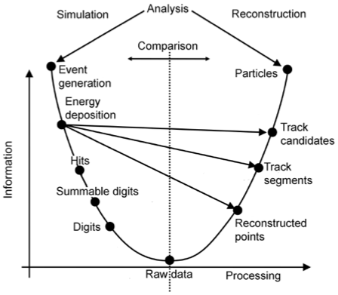
Summary
Ambition: to have the first ML prototype engine for fast simulation ready and fully integrated in GeantV by the end of 2018 (GeantV beta)
    We are testing different models and techniques in order to achieve the best possible physics results
    We also keep in mind computing efficiency and insure optimal performance on modern hardware
    Test inference step on dedicated hardware
  Even larger speedup gained by replacing digitization and reconstruction steps

Slide 17
Thank you

Slide 19
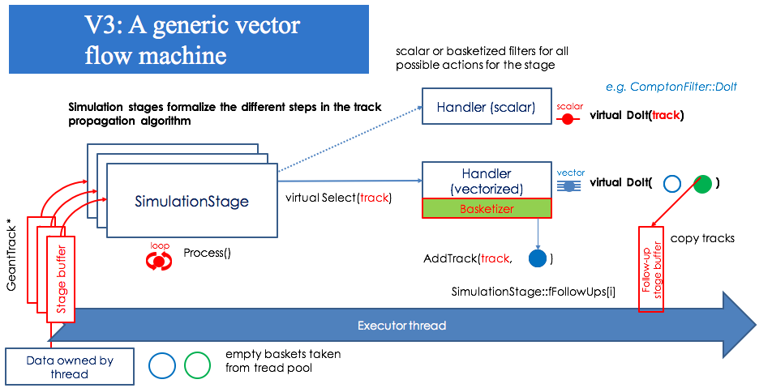
GeantV framework
(Vectorized) Inference handler
FastSim Stage
Virtual Select (track)
Basketizer
StopTrack

Slide 20
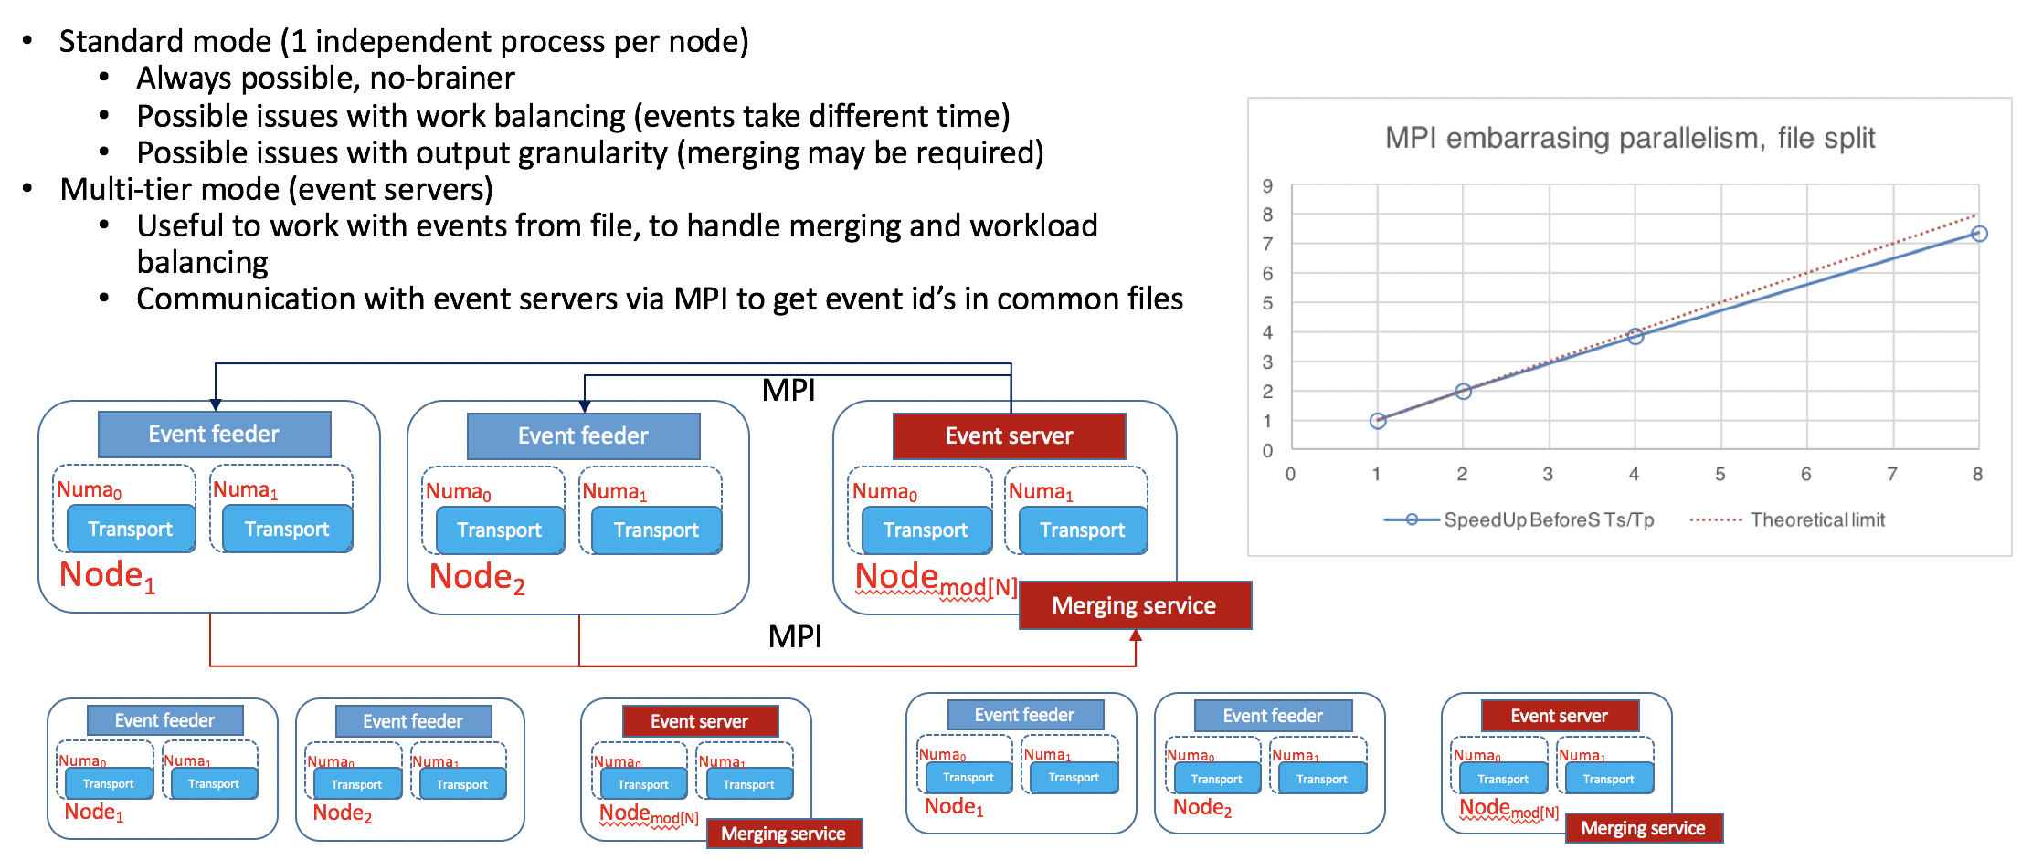
GeantV for HPC environments
GeantV can run in many-nodes and multi-sockets modes
NUMA aware
Standard 1 process per node or multi-event server mode for better work balancing available (MPI based)

