Slide 1

Update on Linac4 Status, Reliability Run and Modelling
J. Uythoven, O. Rey Orozco, A. Apollonio and R. Schmidt
CERN
Acknowledgements:
colleagues from Empresarios Agrupados
and the LINAC4 team @ CERN
MYRTE 4th WP2 Meeting, 27-28/03/2017, Madrid

Slide 2
Outline
Introduction and Linac4 Status
Plans for Linac4 Reliability Run
Linac4 Fault Tracking
Linac4 Failure Catalogue
Availability Modelling
  Common Input Format
  Linac4 Model
Milestones

Slide 3
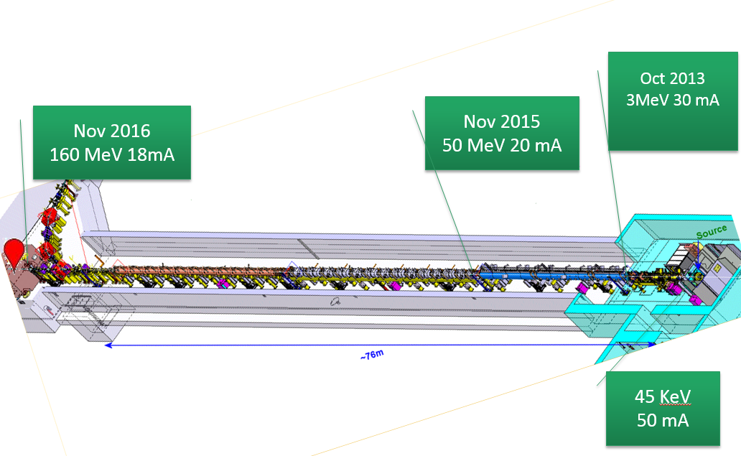
LINAC4 made it to the final energy !

Slide 4
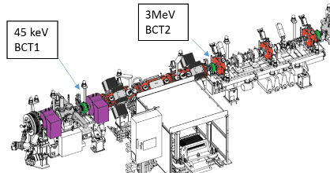
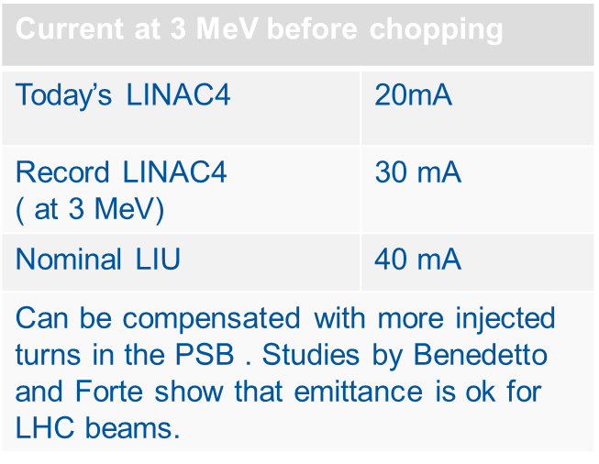
A word on the Source
Many improvement since march 2015
Intensity
Stability
Auto-Pilot (automatic regulation of critical source parameters for increased stability)
Ceasiation with autopilot , time needed went from half day w/o beam to few hours in degraded beam conditions
Still needs attention
Control of the emittance
Optimised electrode shape
Matching into the LEBT
Mastering neutralisation?
Current at 3 MeV before chopping
Studies show that the reduced current can be compensated by more injection from the LINAC into the PSB.

Slide 5
LINAC4 Status
Operational without major problems for over 10 weeks since November 2016
  About 10 days of total down time due to 3 water leaks (DTL)
  Re-alignment not fully successful, impacting the chopping efficiency
Half Sector Test first phase successful = test stand of injection system with stripping foil into the next accelerator (PSB)
  Beam delivered over the last four weeks
The Linac4 can be run from the CERN Control Centre CCC in preparation of the Reliability Run

Slide 6
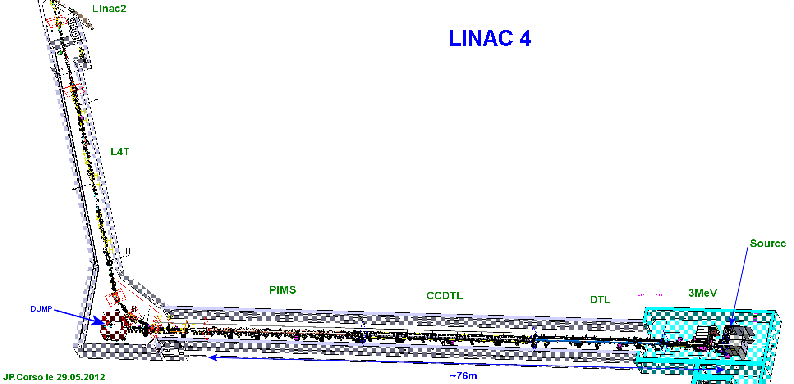
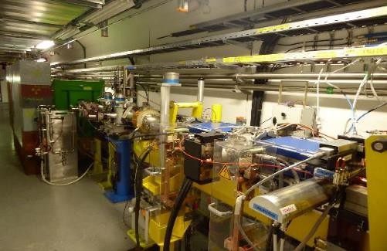
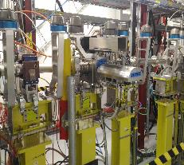
The LINAC4 Half Sector Test
HST
Installed in Linac4
during summer 2016
Temporary
dump
Chicane
magnets +
H⁰/H⁻ dump
Stripping foil
system
Stripping Foil
Test Stand
+ diagnostics, vacuum eq. …
Linac4

Slide 7
LINAC4 Reliability Run
RR Foreseen to start summer 2017, most likely continue in 2018
  Smooth transition from commissioning to operation: train operators, software development, finish tweaking the machine
  Find the weak points and improve on them in time
  Achieve beam availability above 90 % (spec. is 95 %)
  Verify the LINAC4 availability modelling
  Short runs followed by repairs & optimisation → longer runs towards the end
  Regular measurement of Beam Quality (Current, emittance, T-o-F)
Routine operation from the CCC by operators
Registration of the faults with standard tool which left its marks at the LHC: Accelerator Fault Tracking

Slide 8
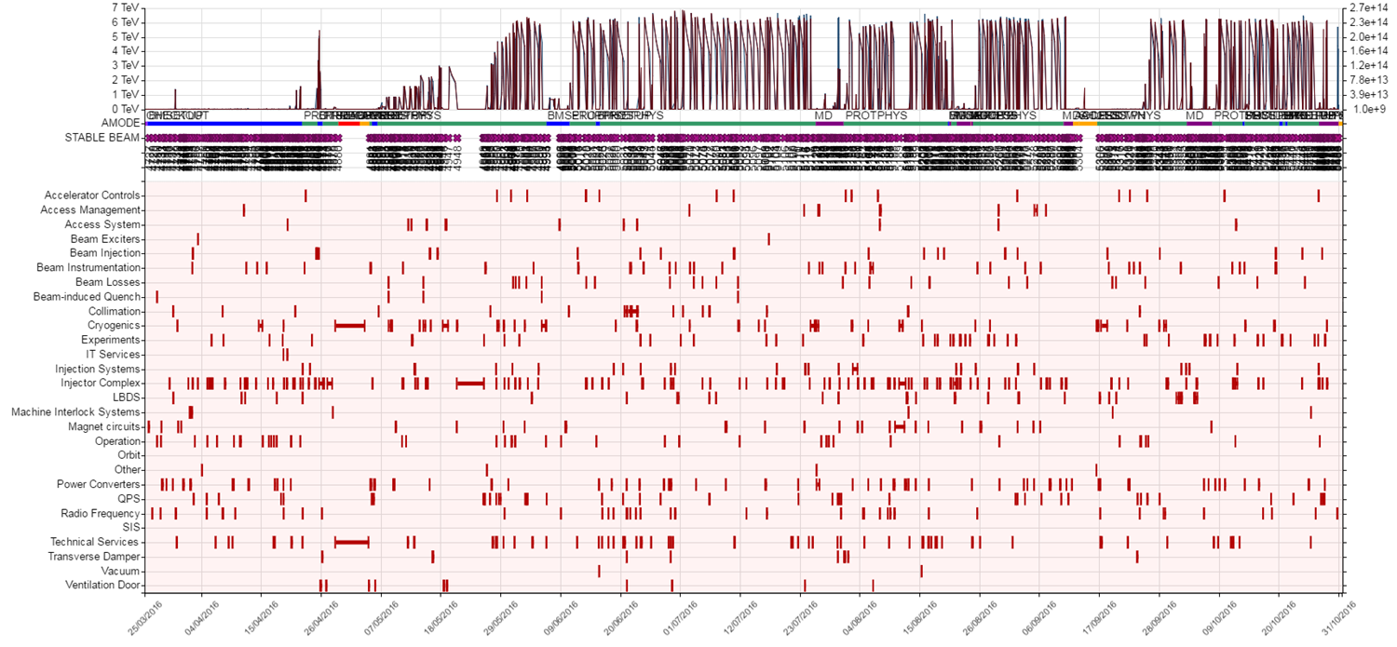
Accelerator Fault Tracker
LHC Accelerator Fault Tracker (AFT) in operation from beginning of 2015 – excellent experience
“Cardiogram of LHC Operation”

Slide 9
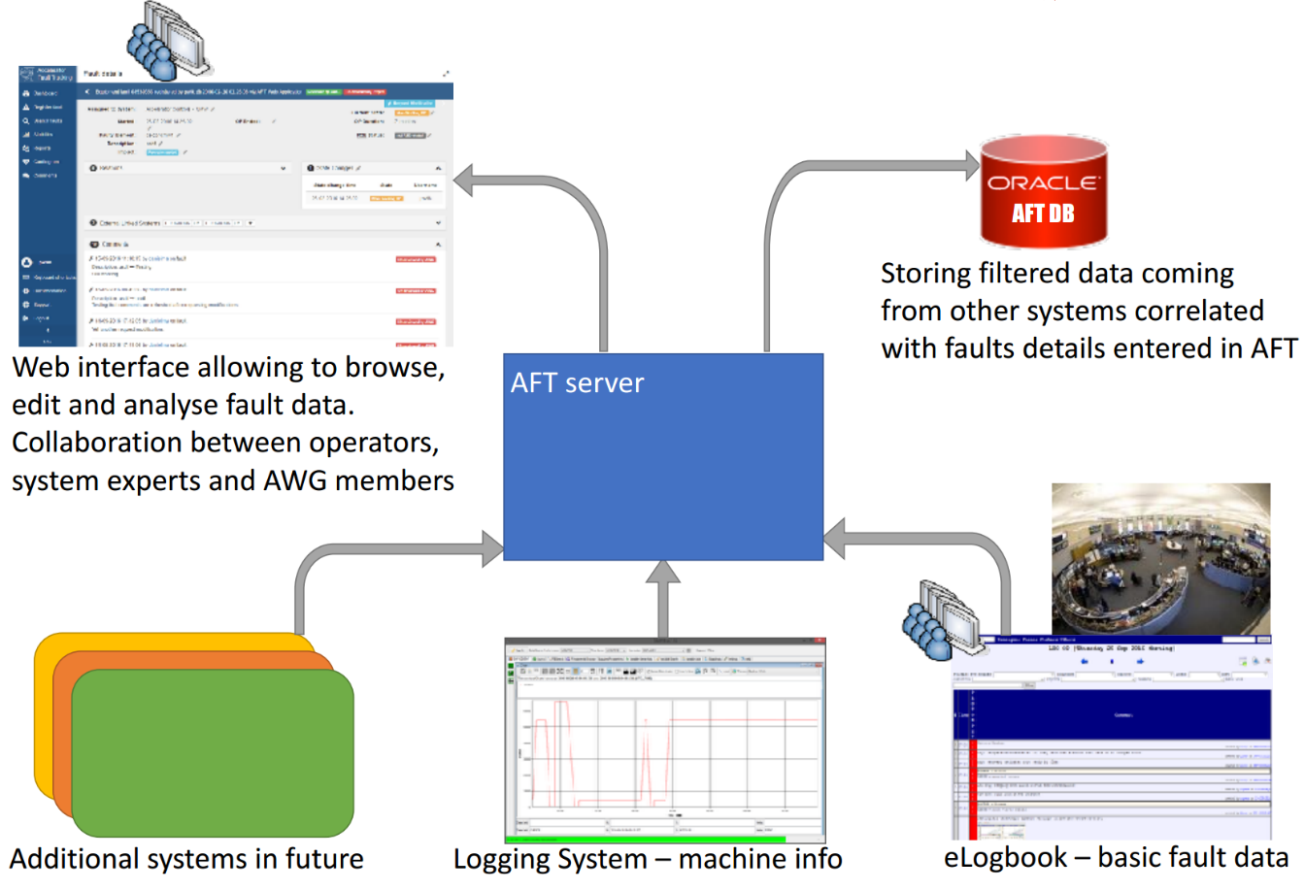
AFT implementation
Web interface allowing to browse, edit and analyse fault data. Collaboration between operators, system experts and availability experts.

Slide 10
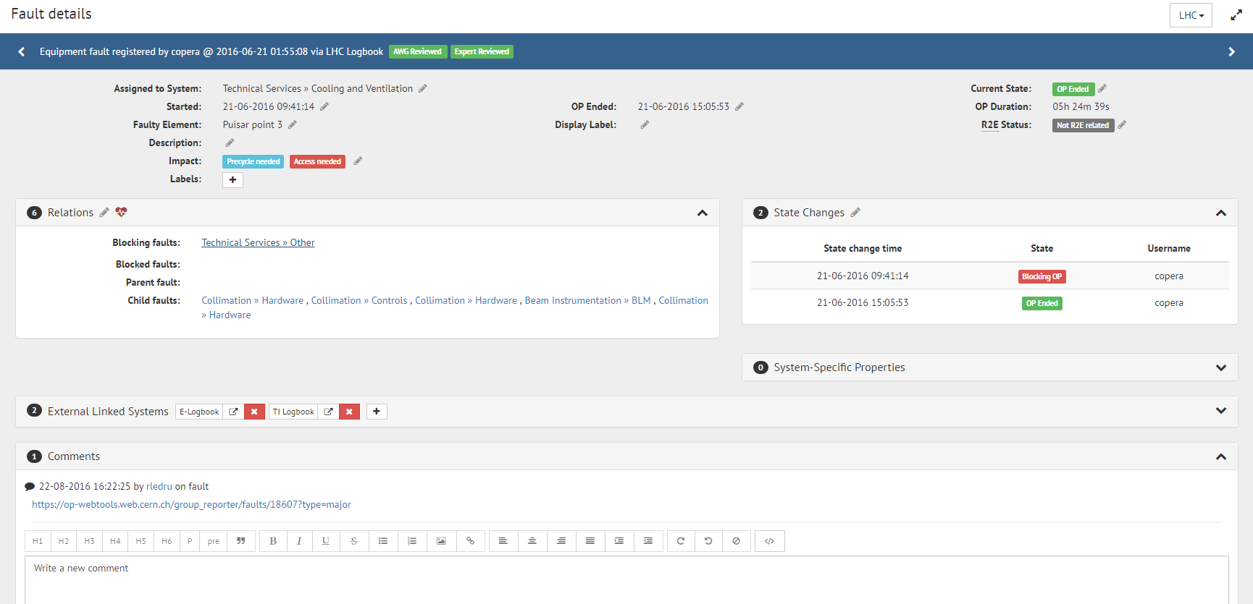
Fault editing in AFT
Fault Duration
Detailed Description
Fault Relations
Fault State
Additional Information
Recording potential fault overheads (access, RP, transport)
Link faults to their root cause (‘parent’), …

Slide 11
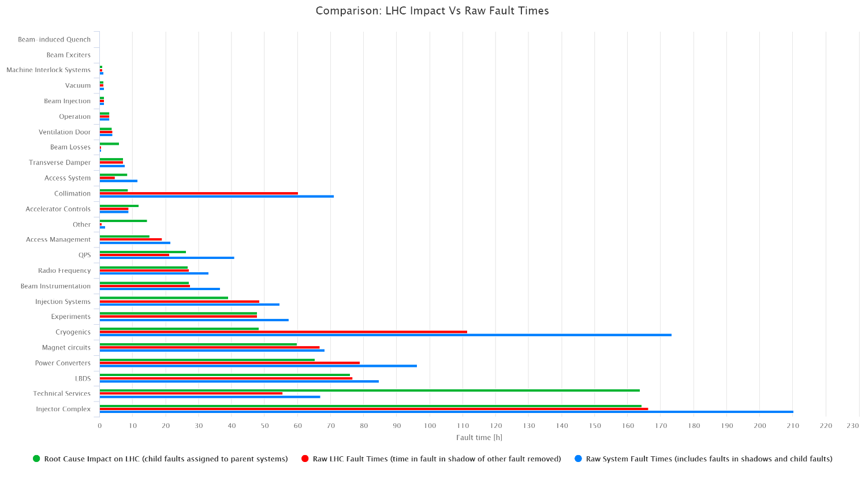
Failure Analysis
Fault vs. Fault Duration

Slide 12
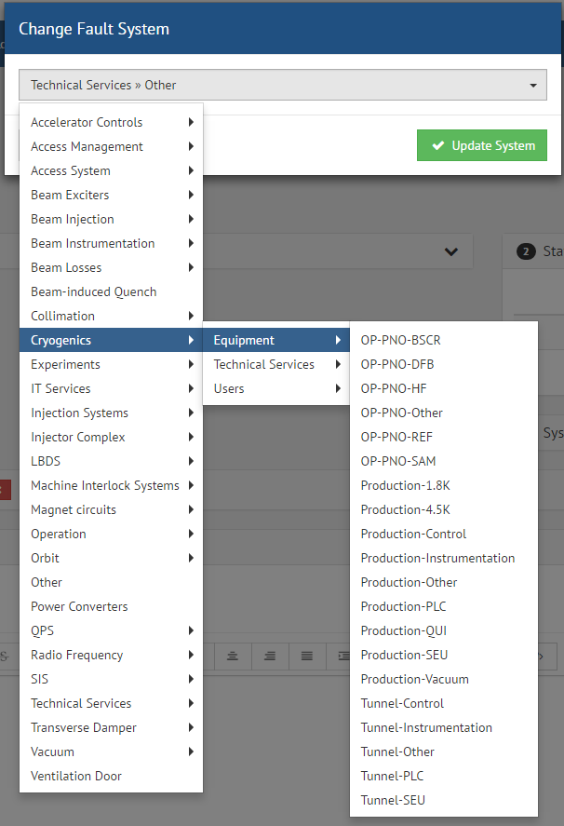
Fault Classification
Predefined Fault Tree used to classify faults
Several Layers, with increasing level of detail
Possibility to make visible to OP only some layers of the Fault Tree to facilitate data-capture
System experts can then refine fault classification
LINAC4:
Fault Classification = Faults in the LINAC4 availability study

Slide 13
Goal of the Linac4 Availability Study
Predict the expected availability / future operation
Refine and validate models with the Reliability Run data
Provide guidelines for Linac4 performance improvement
Contribute to better understanding of MYRRHA availability

Slide 14
Gathering data for the Availability Model
  Linac4 availability model
Hardware description
Failure modes
Failure mode analysis
Failure data
Repair / Maintenance assumptions
Assumptions and simulation parameters
Simulation parameters

Slide 15
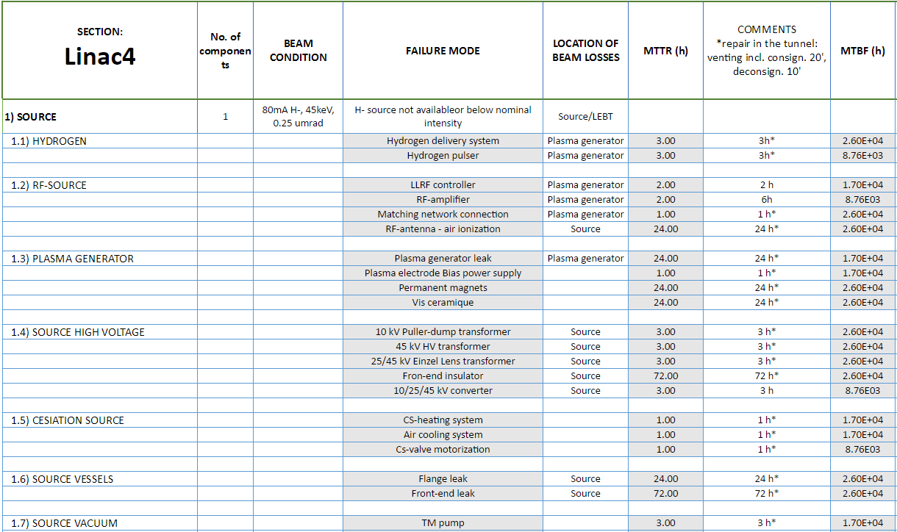
Gathering Data for Availability Models
FAILURE MODE ANALYSIS
Failure catalogue based on
  Outcome of meetings with
  system experts
  Failure data from Linac2
Identification of system failure modes
Quantification of failure effects (mainly in terms of downtime)
Continuously updated (Started in 2012 and followed-up in the commissioning)
Link information with SNS Failure Catalogue (Empresarios Agrupados)
Development of a common database for MYRRHA (CERN + EA)

Slide 16
Gathering data for the Availability Model
  ASSUMPTIONS AND SIMULATION PARAMETERS
  Simulation period: 1 year (operation 24/7)
  Components failure behaviour follow an exponential distribution
  Maintenance/repairs:
    Only repairs when the system is down due to components failures
    Repairs of different systems can be done simultaneously
    All repairs must finished before restarting the Linac
  The system is down after failure -> No components failure during repair

Slide 17
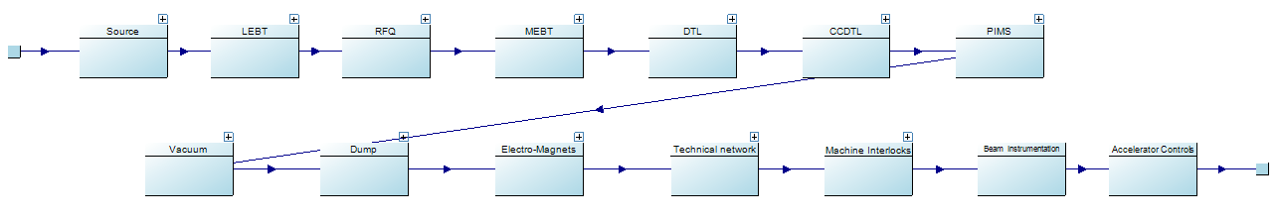
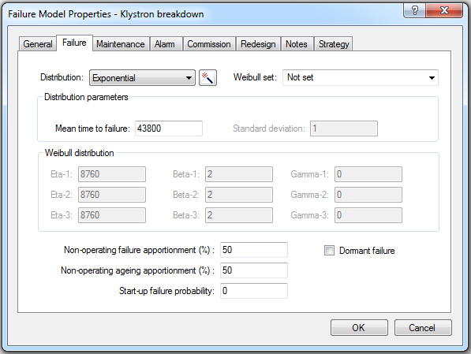
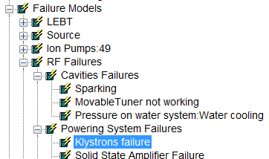
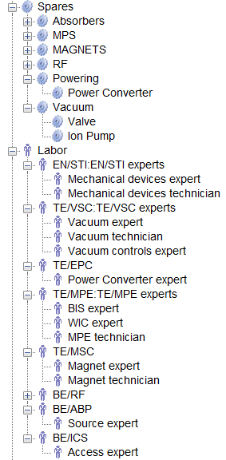
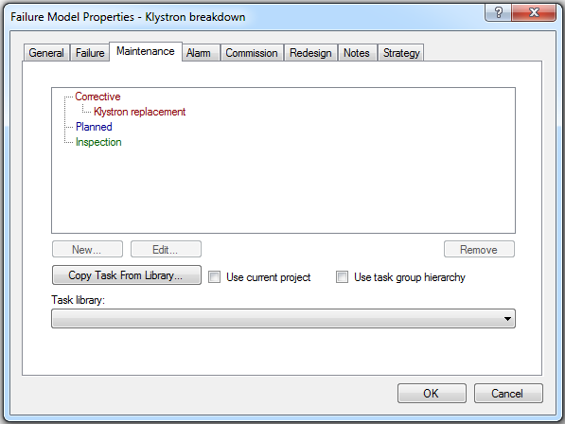
Availability Model Implementation in Isograph®
Linac4 failure behaviour modelled by Reliability Block diagrams in Isograph®
Each block can be assigned a failure mode…
  Failure distribution
  MTTF
  Consequences
…and a maintenance strategy

Slide 18
Linac4 Availability model results
Availability | Mean down time | Failures | Mean time to repair (MTTR) | Mean Time to Fail (MTTF)
96% | 14 d 18.5 h / 1 year | 97 | 3.64h | 3 d 18 h
Up
Down
Operation
Failure / Downtime

Slide 19
Focus: Top Contributors to Downtime/Failures
Which system failure caused the Linac4 to fail?
Failure Root Causes
t
Failure Downtime
Which system failure contributed more to Linac4 downtime?

Slide 20
Simulation results: Contributors to Linac Downtime
TOTAL DOWNTIME: 14 days 18.5 h / 1 year
Which component contributed more to repair time (DT) after system failure?
  H- Source 44%
  RF System 37%
  Dump 6%
  MEBT 5%
Notes:
Important: stress that this is from the simulations … hopefully in one year we have a graph with data
Mention DUMP , why contributes to downtime?

Slide 21
Simulation results: Contributors to Linac Failures
NO. OF FAILURES: 97
Which component caused the system to go down?
  RF System 47%
  Source 18%
  Electro Magnets 10%
  MEBT 7%
  Technical Services 7%
  Accelerator Controls 7%

Slide 22
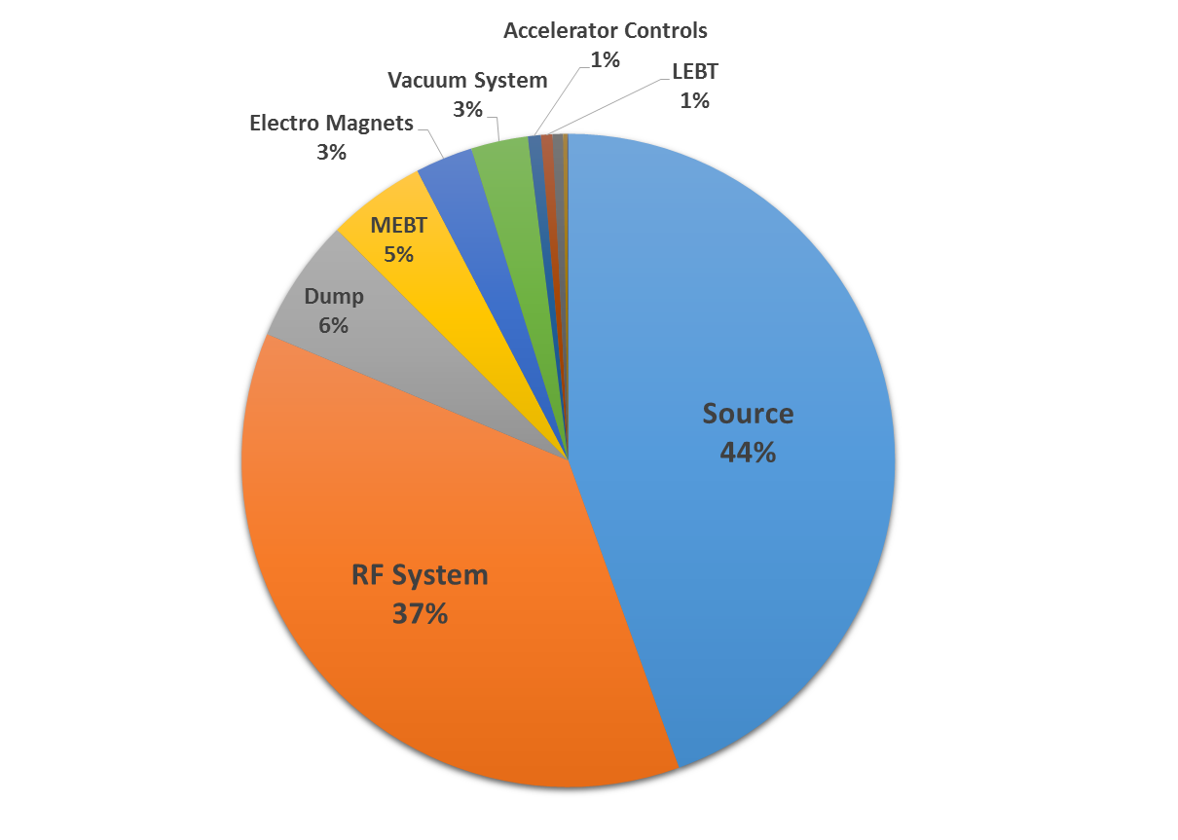
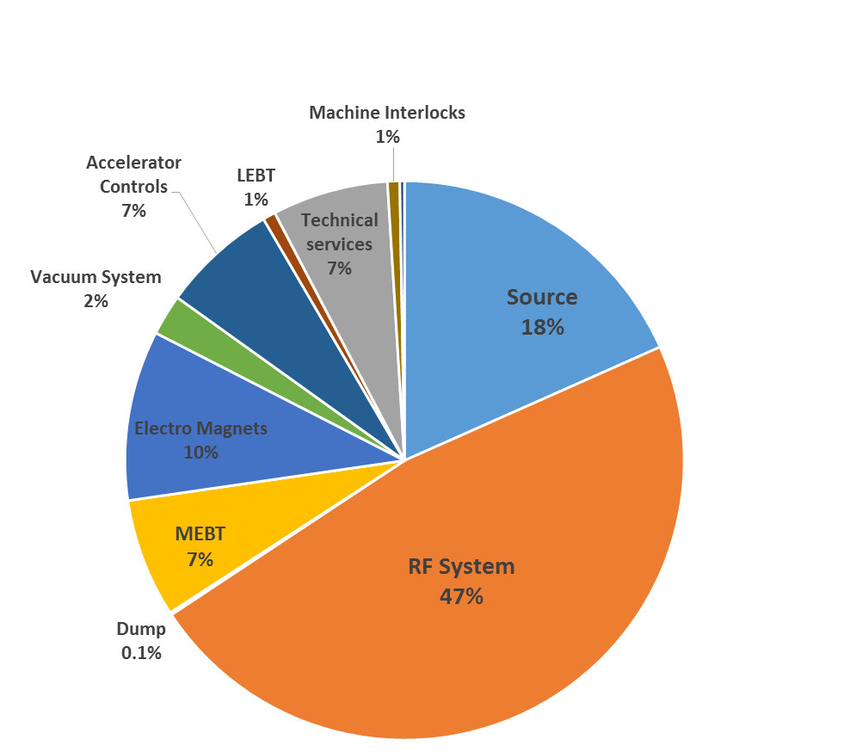
Linac4 Availability model results
Linac4 availability estimations
Availability | 96 %
No. of failures | 97
Mean Down time | 14 d 18.5 h / 1 year
MTTR | 3.64h
Mean Available time | 3 d 18 h
Important for MYRRHA
Downtime | Failures
H- Source ( 44%) | RF System ( 21%)
RF System ( 37%) | H-Source ( 20%)
Dump ( 6%) | Electro Magnets ( 13%)
MEBT ( 5%) | MEBT ( 7%)
Electro Magnets ( 3%) | Technical Services ( 7%)
Vacuum System ( 3%) | Accelerator Controls ( 7%)
Accelerator Controls( 1%) | Vacuum System ( 2%)
LEBT ( 1%) | Machine Interlocks ( 1%)
Important for Linac4

Slide 23
Gathering data for Availability Models
  Linac4 availability model
Hardware description
  Set of tables that fully define the availability model
Failure modes
Common
input format
Common
input format
Common
input format
Common
input format
Failure data
Repair / Maintenance assumptions
Simulation parameters

Slide 24
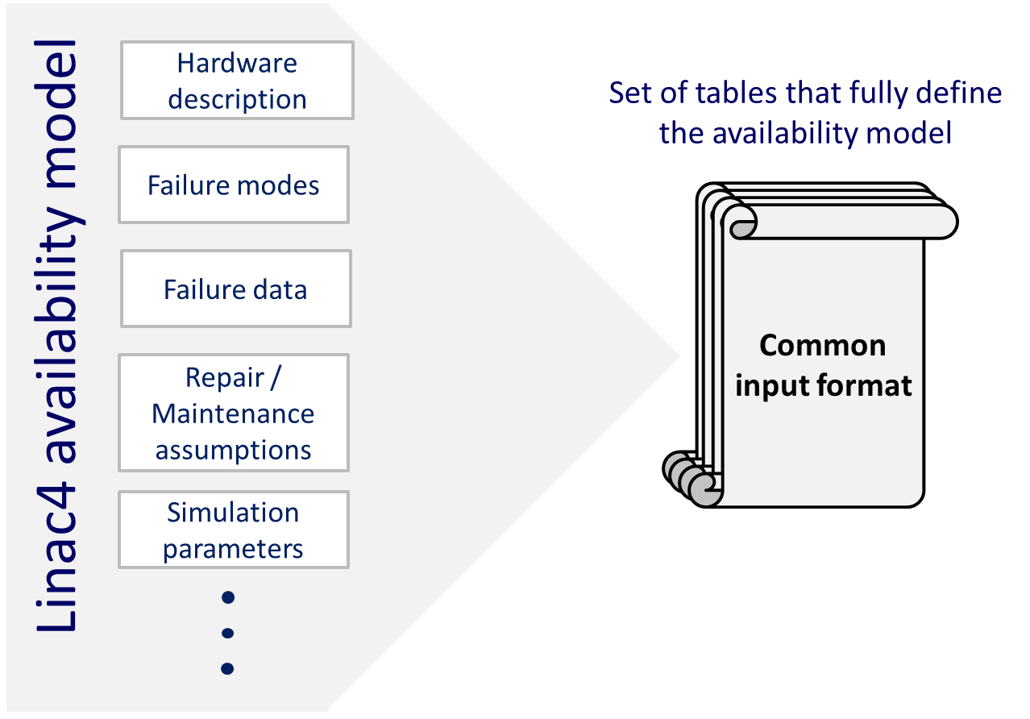
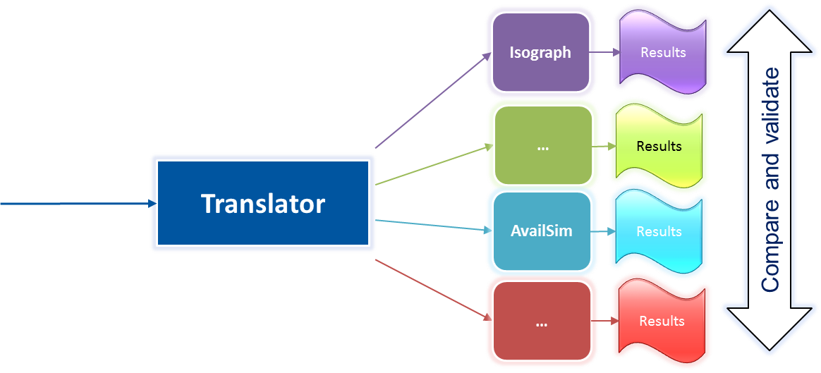
Gathering data for Availability Models
CONCEPT OF THE COMMON INPUT FORMAT
Merge all the relevant information to define the MYRRHA Availability Model (CERN + EA)

Slide 25
Gathering data for Availability Models
  FEEDBACK FROM EA ON THE COMMON INPUT FORMAT
  Well elaborated, provides complete information about the Linac4 system reliability/maintainability.
  Some misleading terminology: Some concepts need to be reviewed.
  Some of the attributes will not be relevant for MYRRHA
  Overall, good format to define the MYRRHA model and inputs

Slide 26
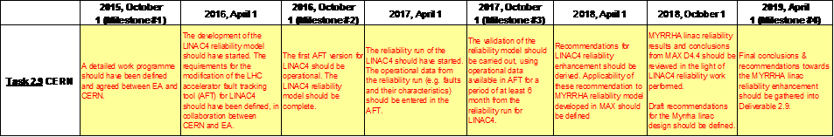
Next steps CERN + EA
Under study…
Application and extension of Linac4 data in the common failures database (Failure Catalogue) and the common input format to MYRRHA
For 2017…
Refine and validate the Linac4 availability model with the Reliability Run data
Provide guidelines for Linac4 performance improvement
For 2018…
Evaluate applicability of Linac4 enhancement conclusion to MYRRHA in consideration of the previous recommendation of D4.4 (MAX) reliability report.

Slide 27
Summary
LINAC4 reached nominal energy, tests of PSB injection system
Reliability Run to start summer 2017
Fault Tracking ready to be deployed
Detailed availability modelling LINAC4 done
  Simulations seem to show a realistic prediction, to be proven with the RR
  Synchronisation of failure catalogue and Fault Tracking
Collaboration between CERN and EA on modelling
  Development of common input format to compare tools
  LINAC4 Reliability Run results to be folded into Myrrha model

Slide 28
THANKS A LOT FOR YOUR ATTENTION!

