Slide 1
CM and Cryo meeting #2
S. Feher
4/3/2017

Slide 2
Agenda
1. CM FRS S. Feher
2. Electrical circuit Review summary H. Prin/D. Ramos Duarte
3. AOB

Slide 3
Schedule
Couple of Reviews:
  CD1 director’s Review in June 13th
  CD1 DOE Review August 1st
Prototype Cryo-assembly (Full magnet) ready for testing: June 16, 2019
Prototype Cryo assembly Fabrication start date: October 23, 2018
Important Milestones for CM prototype:
  Interface specifications need to be completed ~ January, 2018
  Parts need to be received by Fermilab: some of them June, 2018
Important Milestones for Cryostat prototype:
  Tooling design – to prepare the tables and floor space: September, 2018
  Start of the Cryostat work at FNAL: April 16th, 2019
    Means the Cryostat Kit should be shipped from CERN to FNAL around December, 2018
Important Milestones for Stand for Test facility:
  Interface specifications – to be able to make the relevant shuffling unit: January, 2018

Slide 4
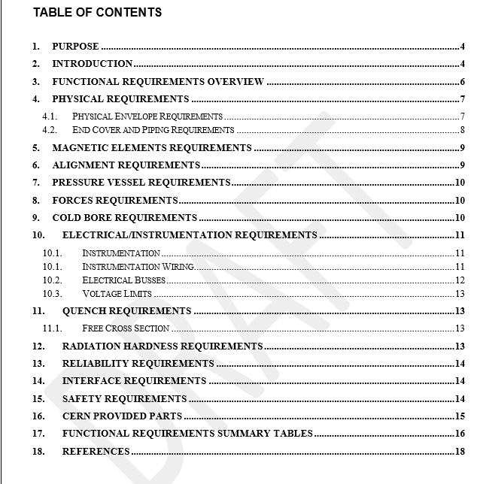
Cold Mass Functional Requirement Specifications
New version is available
  Attached to indico
Needs to be signed of by CERN and FNAL at NAPA
Alignment has been worked on:
  Clarity – more description
  Distinguish between:
    Measurement
    Actual alignment
Proposed electrical reqs.
Part-list to be provided by CERN is proposed

