Slide 1
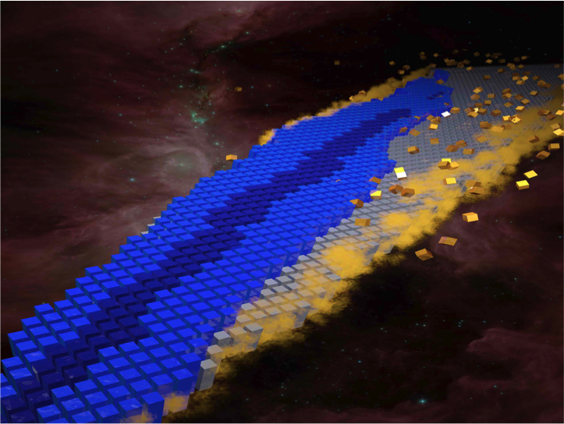
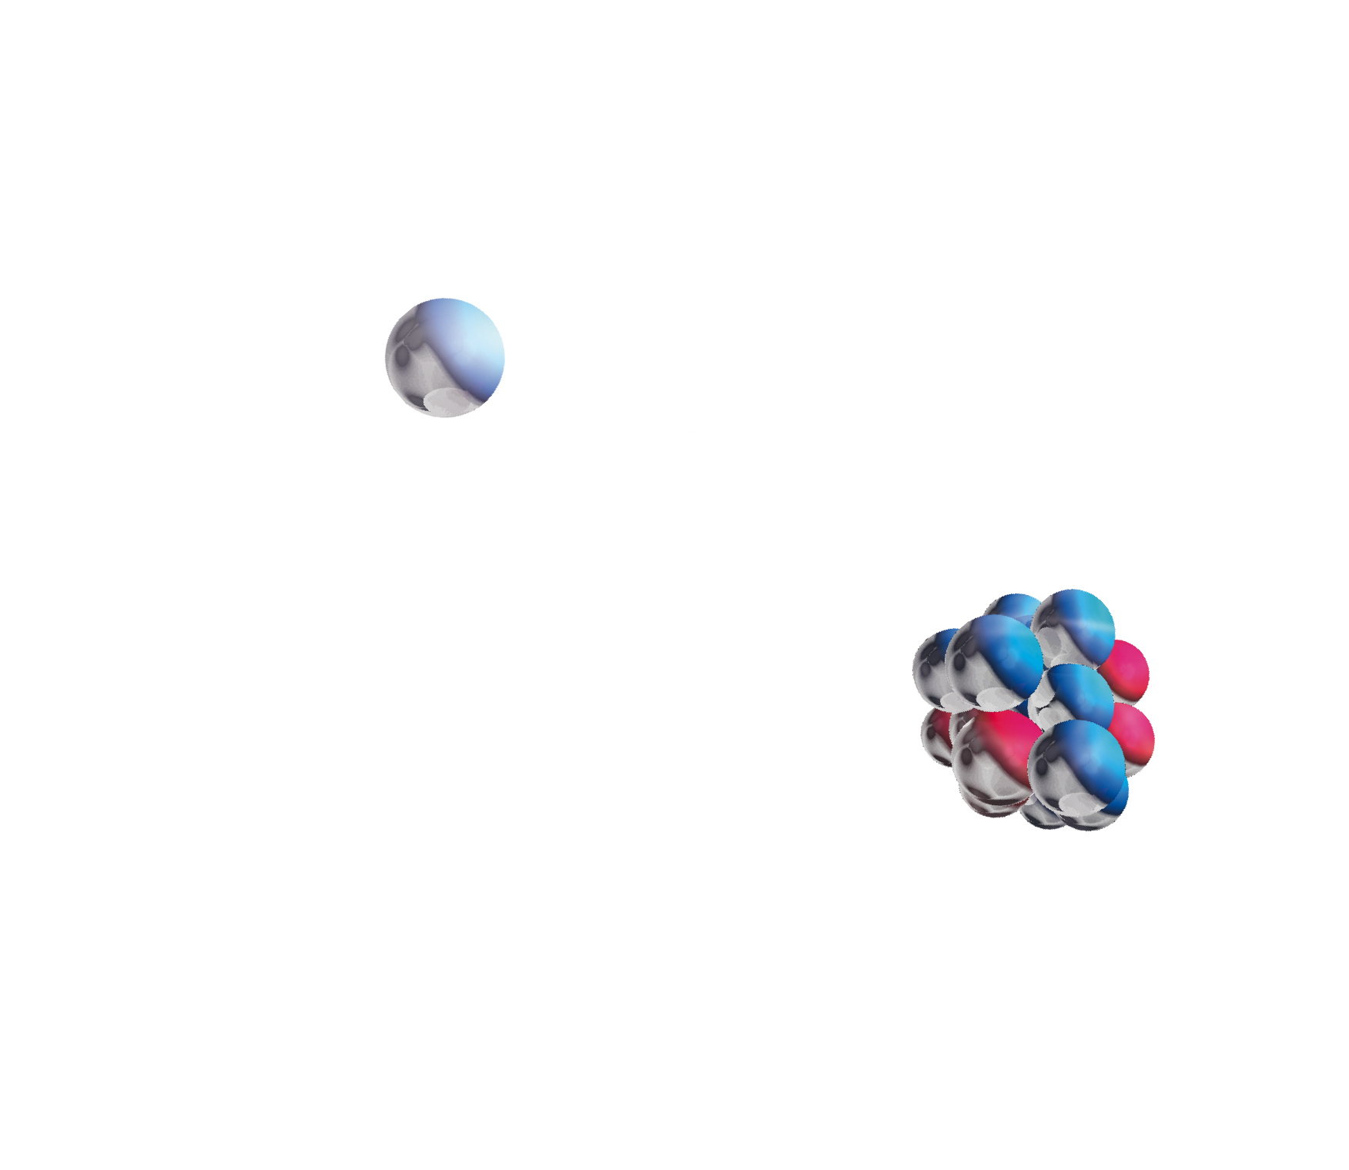
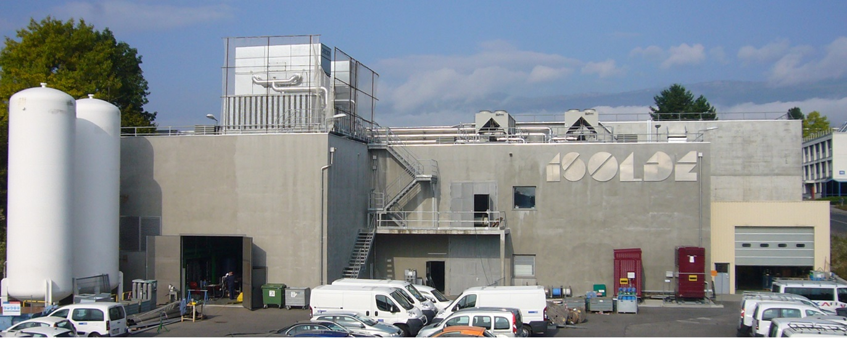
ISOLDE:
Focus on Exotic Beams
ISOLDE
1992
n_ToF Physics
Maria J. G. Borge
ISOLDE-PH, CERN
(Isotope Separator On-Line)
Maria J. G. Borge , CERN, PH-Dept

Slide 2
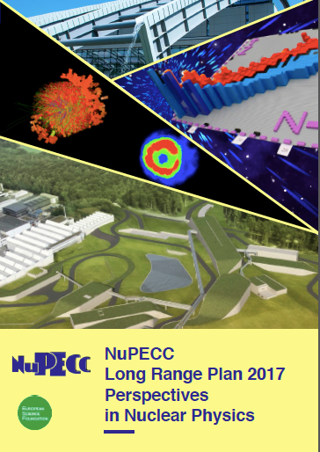
Open Questions
What are the limits of nuclear stability?
¿ How does the complexity of nuclear structure arise from the interaction between nucleons?
How and where in the Universe are the
chemical elements produced?
Observables:
Basic ground state properties: mass, radius, moments J, μ, Q
Half-life y decay process
Transition probabilities
Theoretical Models:
Shell Model (magic numbers)
Mean field Calculations (collective properties)
Ab Initio Calculations (light nuclei)
Notes:
¿Cómo se forma un núcleo a partir de sus contituyentes? Fuerza fuerete dentro del nucleo
• ¿Cómo explicar las propiedades colectivas a partir del comportamiento individual?
Prop. colectivas versus individuales
• ¿Por qué aparecen regularidades en sistemas tan complejos?
Identificación de simetrías
This single-particle versus collective quatum behaviour is a key feature of atomic nuclei.

Slide 3
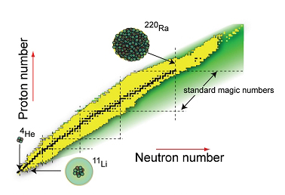
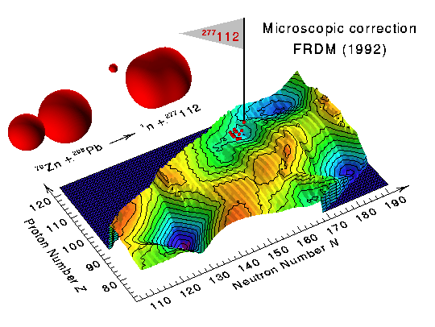
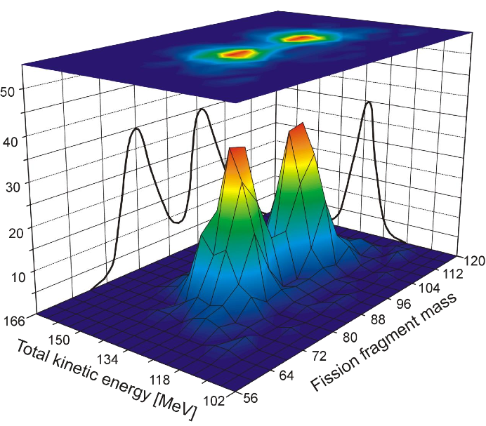
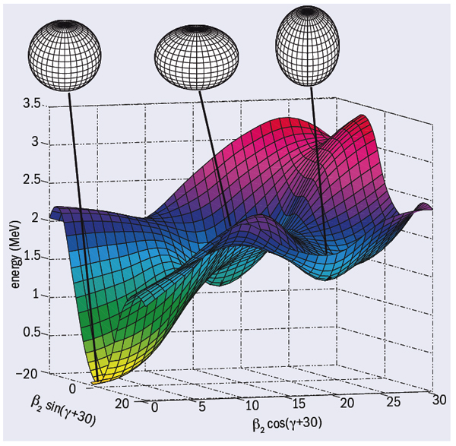
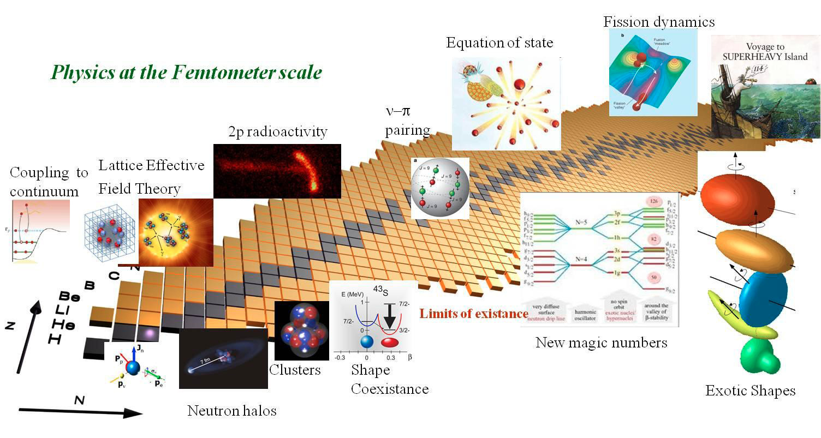
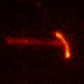
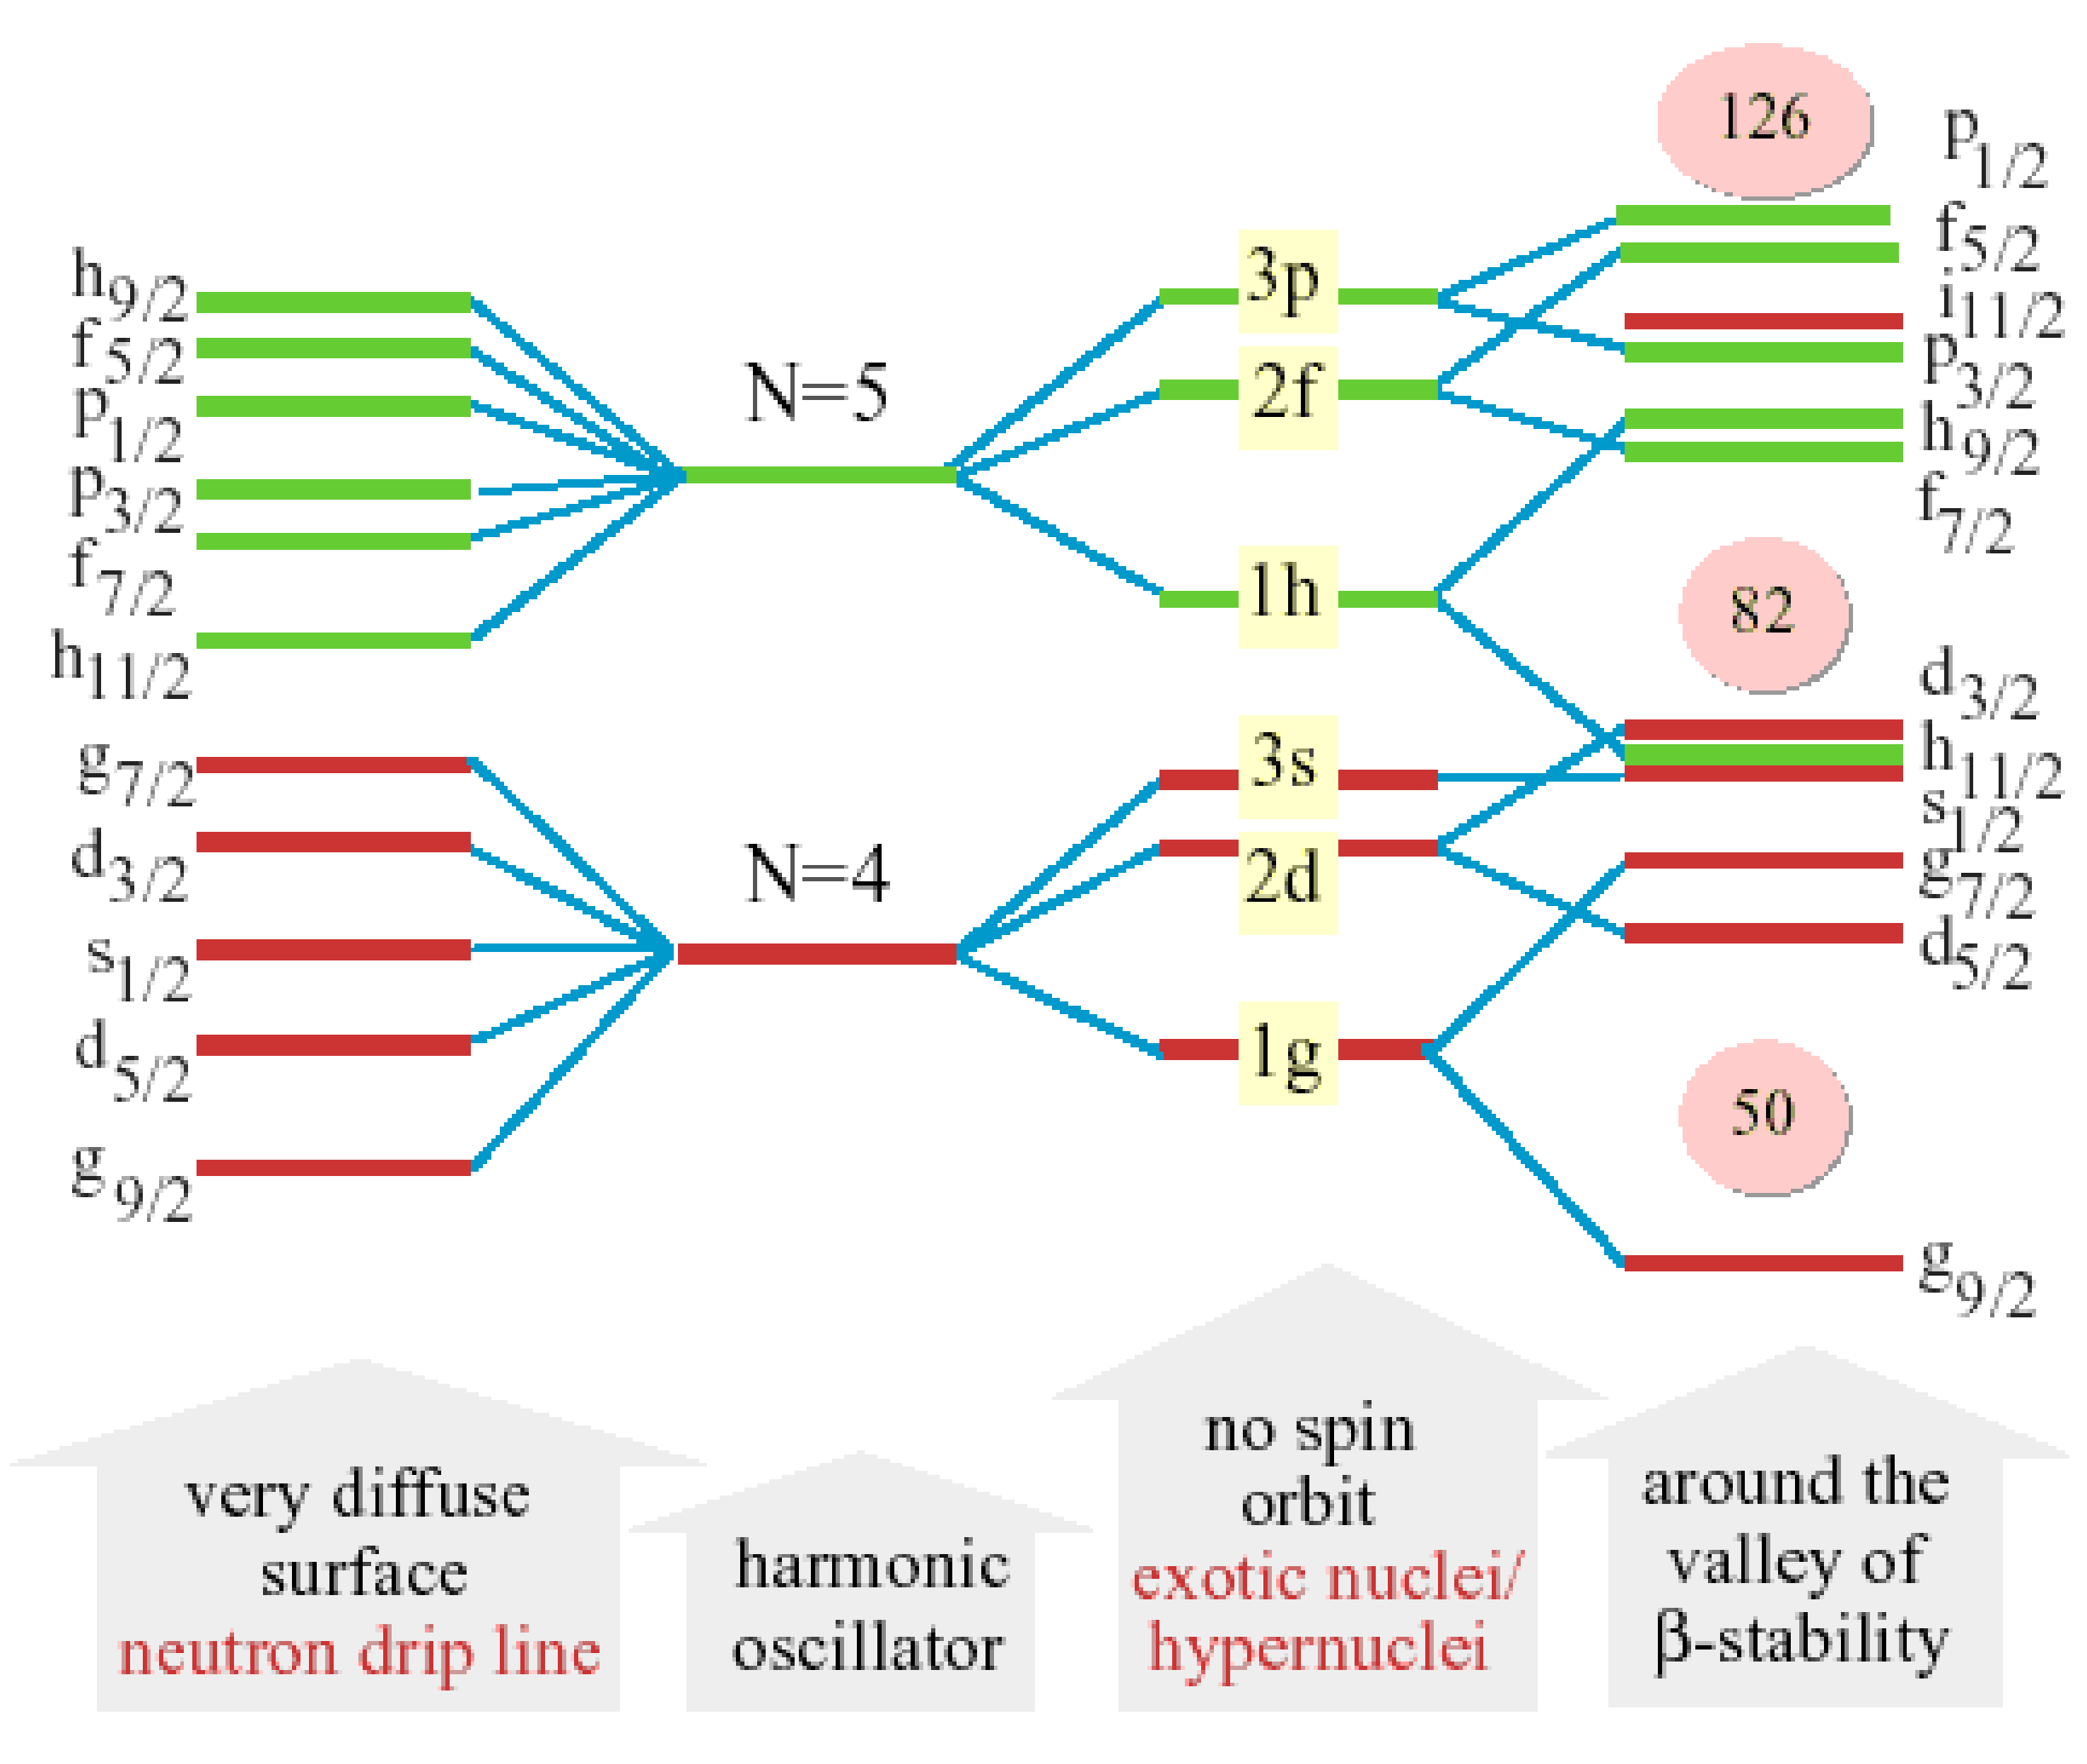
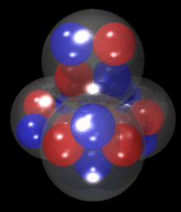
Hot subjects in Nuclear Physics
Nuclear Physics
Magnificent Complexity
Fission Dynamics
Super-
heavies
Exotic Decay Modes
Shape Coexistence
clusters
Exotic Shapes
Neutron
Halo
New Magic Numbers
Notes:
The forces binding nucleons interact to produce an extraordinary range of structures.
Protons and neutron arrange in shells such that nuclei with a fully filled outer shell are specially stable, and we call them magic.
In lightweight nuclei cluster of simpler nuclear species appear while heavier nuclei display collective behaviour.
This single-particle versus collective quatum behaviour is a key feature of atomic nuclei.
In the extreme regions of the nuclear landscape
More exotic structures appear : unusual shapes, shape coexistence, different magic numbers .
Those with a extreme ratio of neutron to protons or viceversa, may halo structure , loosely bound nucleons around an inert core.
This structure was first proposed by Bjoen Jonson hear in the audience.
The quest for superheavies hunting for the heaviest Z atom has take us to Z=118 discovered in Dubna.
The most exotic nuclei can also decay in unusual ways, in the picture 45Fe that decay mainly by emitting 2 proton as shown in the picture, photo taken will optical Time projection chamber.

Slide 4
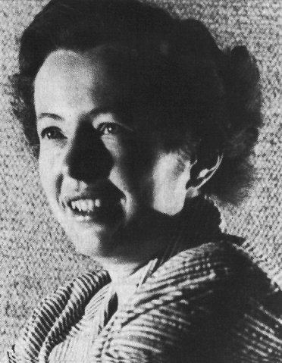
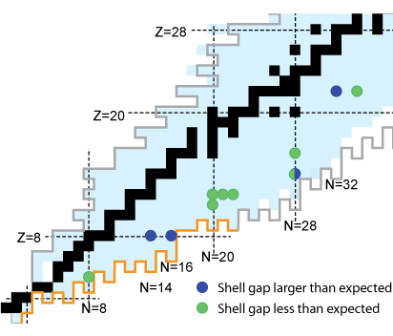
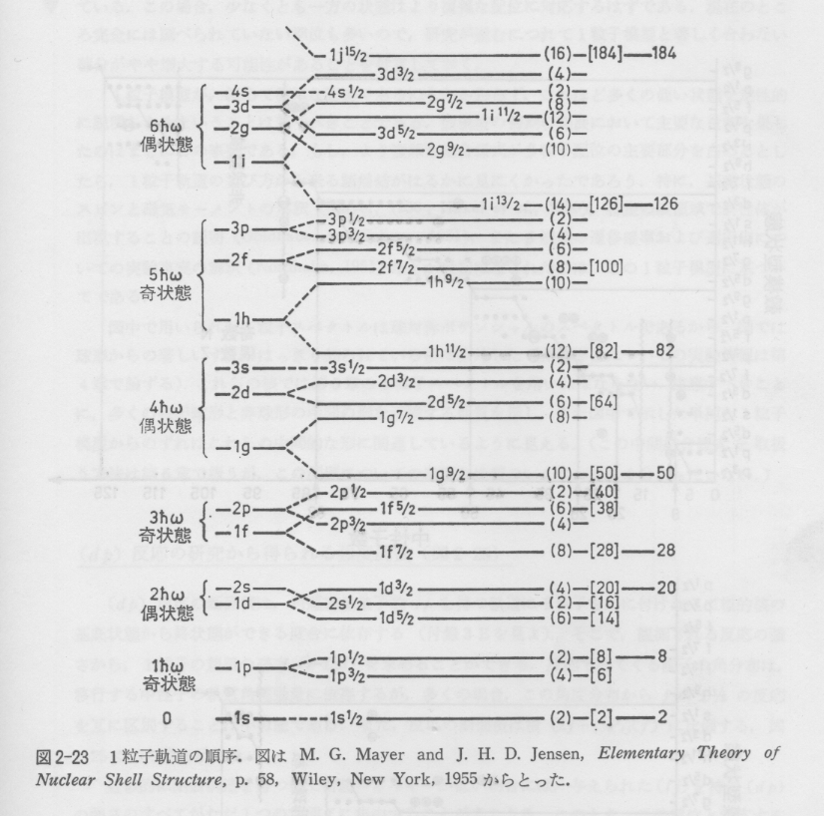
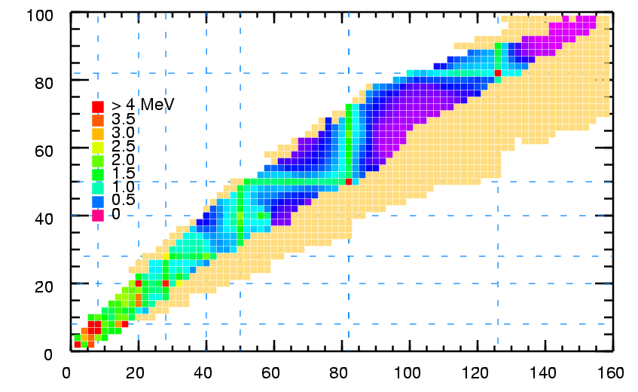

The Nuclear Shell Model: Universal Magic Numbers ?
Mayer & Jensen (1949)
Goeppert-Mayer
Nuclei exhibit shell structure
  Filled orbitals = « magic nuclei »
  Valence nucleons are crucial
  We rely on the Shell Model, with magic nuclei as the building blocks, to predict the structure of exotic nuclei
184
6ħω
126
2⁺ energies
5ħω
82
4ħω
Z
In « exotic nuclei » (extreme N/Z ratio)
  Shell structure evolves
  Shell gaps disappear, new ones emerge
  New structures and new types of radioactive decay have been observed
50
3ħω
28
2ħω
20
1ħω
8
N
Double magic Nuclei: ⁴He, ¹⁶O, ⁴⁰Ca, ⁴⁸Ca, ⁵⁶Ni, ¹³²Sn, ²⁰⁸Pb
2
Notes:
Robust structure based on
1. constant density (saturation)
2. short-range central force
→ Harmonic Oscillator Potential
3. (one-body) spin-orbit force

Slide 5
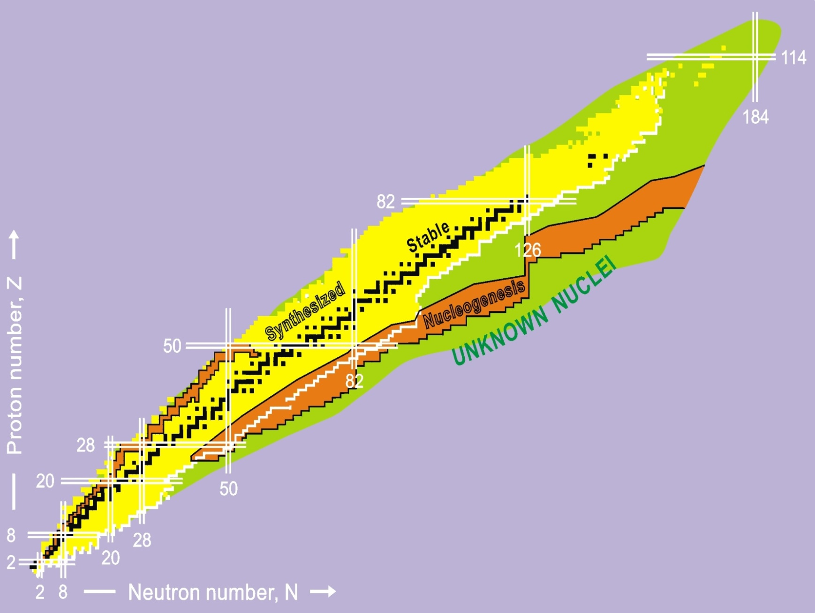
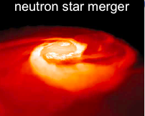
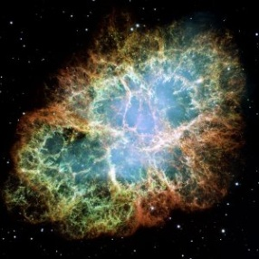
Nucleo-synthesis: Stellar scenario
Protons & Neutrons are produced 10⁻⁶ s – 1s after the Big Bang (13.7 x 10⁹ years ago)
H, D, He, Li, Be, B were formed 3 - 20 min after the Big Bang
Heavier nuclei are formed along the life of the star
rp-, p-process:
masses at & beyond the proton drip-line
(p,γ), (γ,p) rates
r - process
r-process:
masses, half-lives
β-delayed neutron emission
(γ,n), (n,γ) rates
shell structure
rp- process
➔ Combine accurate nuclear physics with precision astronomy to constrain astrophysical scenarios
Notes:
One of the most intriguing question in Science is what is the origin of the 92 natural elements that make up our world and all living organims.
While light elements: H, He, Li and Be were produced in primordial processes just after the bing-bang.
The heavier elements are continously produced during the life of the star.
Nuclear physicist try to untangle the complex reaction paths.ocurring in their lives. And match their findings with the abundances observed in Earth.
Process:
Fusing H into helium: pp-cycle dominated for Sun-type stars . Massive stars catalysed by Carbon: CNO cycle.
When Hidrogen is burnt the He undergoes fusion reactions to produce oxigen and by further element processes neon, silicon up to iron.
At the same time the neutron collide and stick to the existing elements building up heavier element. The probability is low and therefore the process very slow. Producing elements beyond iron.
Many stars die quietly continuing making elements as they puff out into read giants and then contract into a white dwarf. However very massif stars end their lives spectacurlarly in a supernova explosion. The sudden collapse to a neutron star or black hole is thought to trigger cascades of ultra rapid reactions involving unstable neutron-rich nuclei, the r-process. This generates elements like uranium.
Neutron stars when part of a binary system may be resurrected to nuclear life by sucking hidrogen and He from the companion. The acreted material can ignite exotic reactions in which protons are captured creating unstable nuclei: rp-process.
The so called r process that is responsible for producing half of the elements heavier than Iron. It requires an environment with extreme neutron densities, permitting neutron captures on nuclei to proceed much faster than beta-decays. „
On October 16 a team of scientists, including members from the LIGO and Virgo collaborations and several astronomical groups, announced the detection of both gravitational and electromagnetic waves, originating from the merger of two neutron stars. These mergers have been speculated as the yet unknown production site of heavy elements including Gold, Platinum and Uranium in the Universe. In 2010 an international collaboration led by Gabriel Martínez-Pinedo (GSI Helmholtzzentrum für Schwerionenforschung and Technische Universität Darmstadt) and Brian Metzger (Columbia University) pointed out that the heavy element synthesis in the merger process leads to a unique electromagnetic wave emission pattern.
The electromagnetic signal observed from the merging neutron stars indeed shows this pattern and confirms that the site for the heavy element production in the Universe is finally found.
Thielemann, Professor at the University of Basel in 1999 performed the first nucleosynthesis study showing that the r-process can operate in material ejected during the coalescence of two merging neutron stars.
Almost simultaneously, it was suggested that the radioactive decay of the freshly synthesized nuclei will trigger an electromagnetic transient. The first realistic modeling of the electromagnetic signal was performed in 2010 by an international team led by Gabriel Martinez-Pinedo and Brian Metzger. They predicted that such an event will be a thousand times brighter than a nova and will reach its maximum on timescales of a day. It was named "kilonova". This picture has been confirmed by the recent observation of an optical/infrared counterpart associated with GW170817.

Slide 6
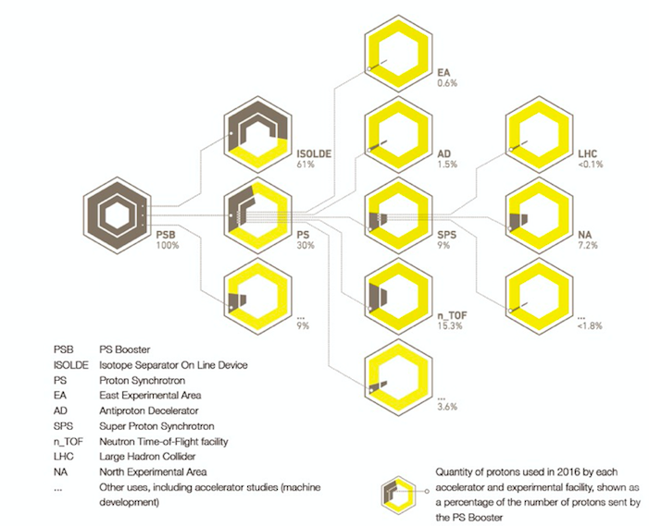
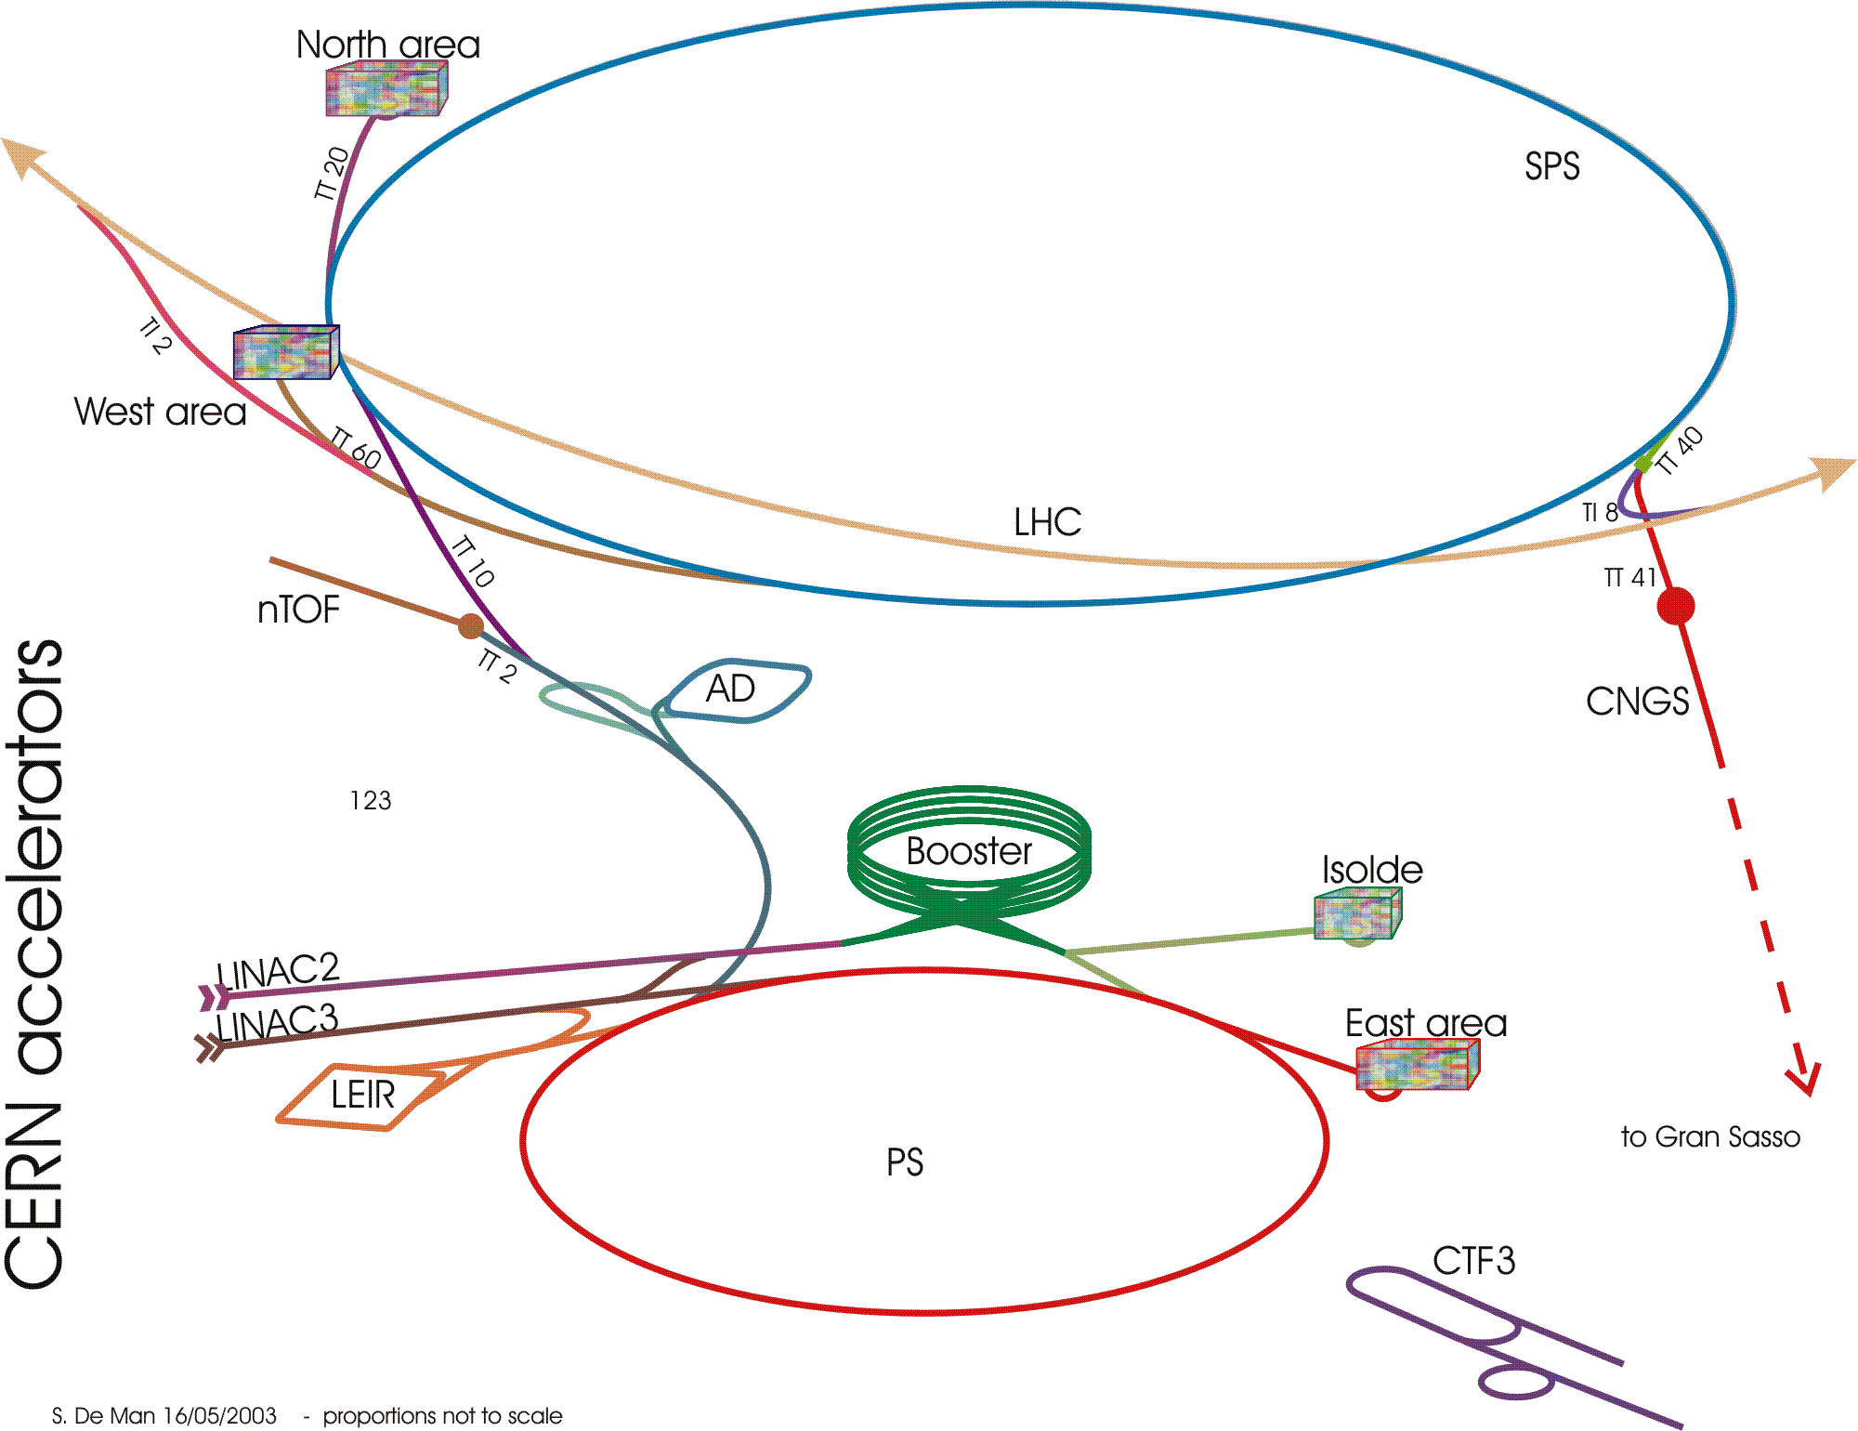
ISOLDE & n_ToF at CERN
CERN Proton Distribution in 2016
LHC
n-ToF
Protons
2μ, 1.4 GeV
40-60% of the CERN produced protons
15 % for n-ToF

Slide 7
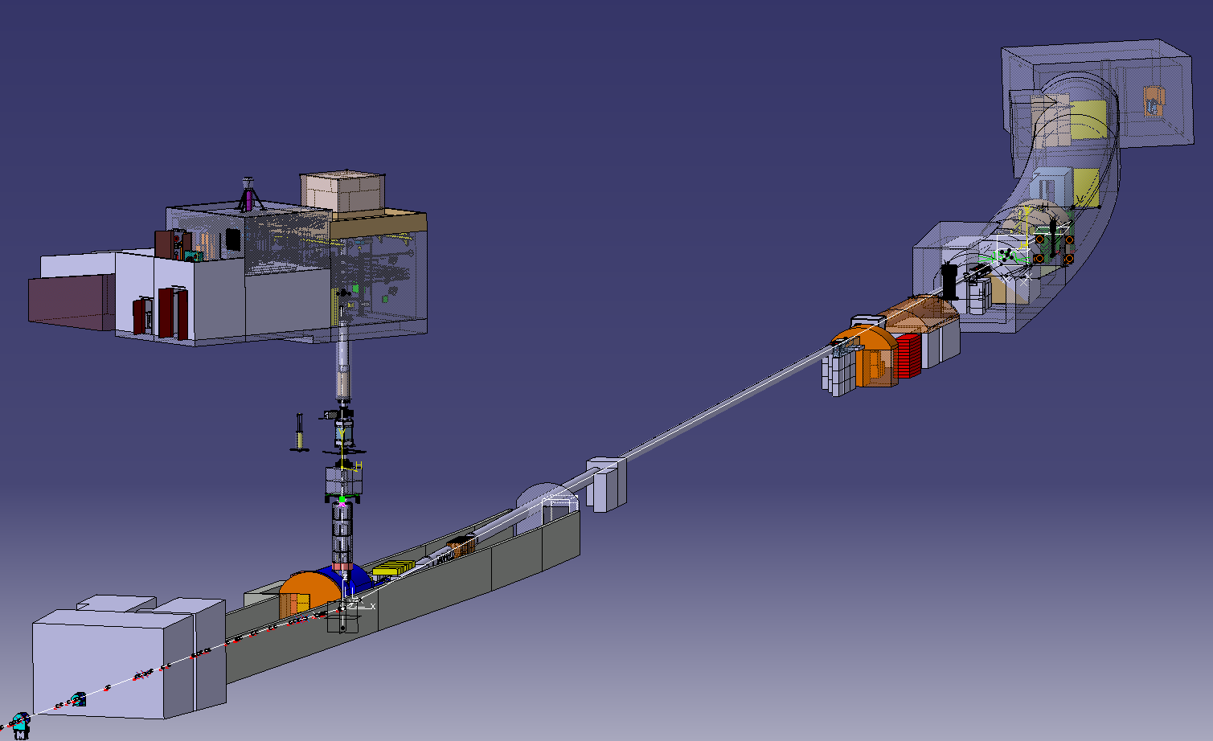
The neutron time of Flight Facility
World Reference for Nuclear data (IAEA and JEFF ) in EAR1
Main feature of n_TOF is the extremely high instantaneous neutron flux (10⁵ n/cm²/pulse)
EAR2 (2014)
20 m
185 m
  High resolution in energy (ΔE/E=10⁻⁴) → study resonances
  Large energy range (25 meV<E_{n}<1 GeV) →
  measure fission up to 1 GeV
Spallation
Target

Slide 8
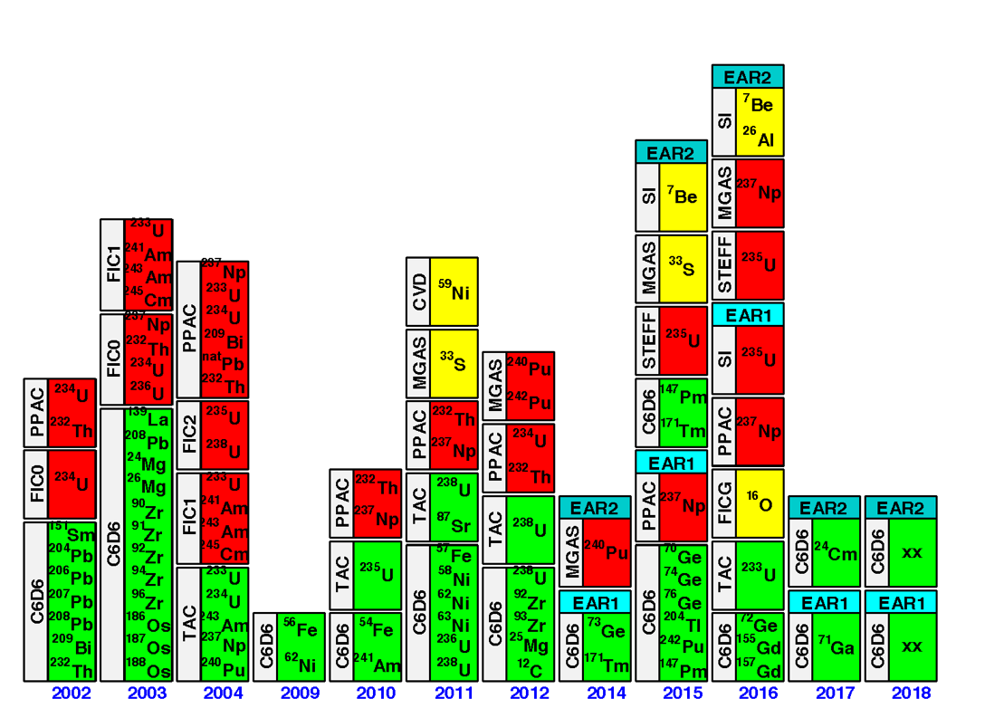
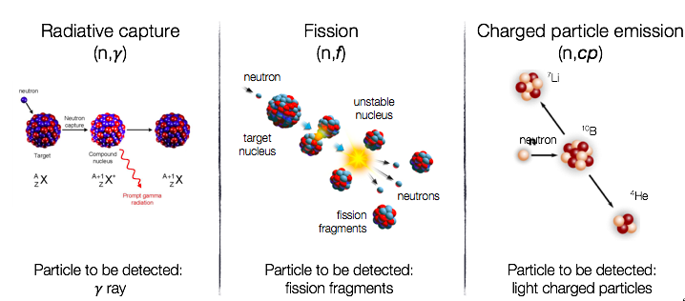
Physics at n-ToF
104 ISOTOPES MEASURED
  Fission (n,f)
  radiative capture (n, γ)
  charged particle (n,cp)
104 ISOTOPES MEASURED
  fission
  radiative capture
  charged particle

Slide 9
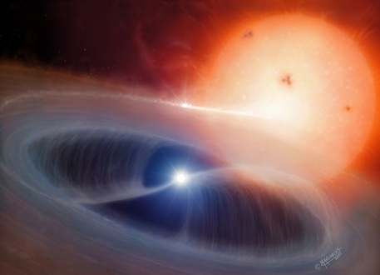

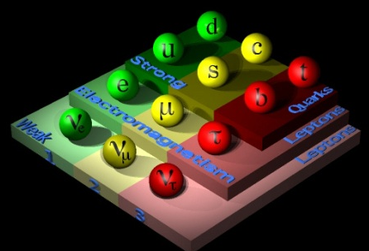
Research with radioactive nuclides @ ISOLDE
Nuclear Phys
ISOLDE today offers the largest range of available nuclei ( >1000 of 74 elements) of any ISOL facility worldwide.
Astrophys
Ion traps
Perturbed Angular Correlations
Atomic Phys
Decay spectro-scopy
Nucleo-synthesis
decay pattern
mass
Laser spectro-scopy
Transition probability
Spin, parity
e-m moments
half-life
radius
Nucleon-transfer reactions
Beta-detected NMR
Fundamental
Symetries
Material Science
Coulomb excitation
Life
Science
Test of SM
Techniques: all available at ISOLDE
Notes:
In the center the observable we measure and the fields of impact.
The intermediate ring describe the techniques used in the measurements

Slide 10
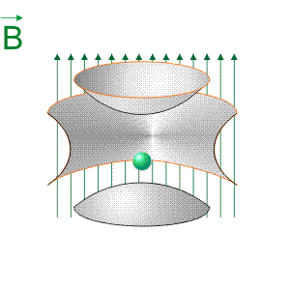
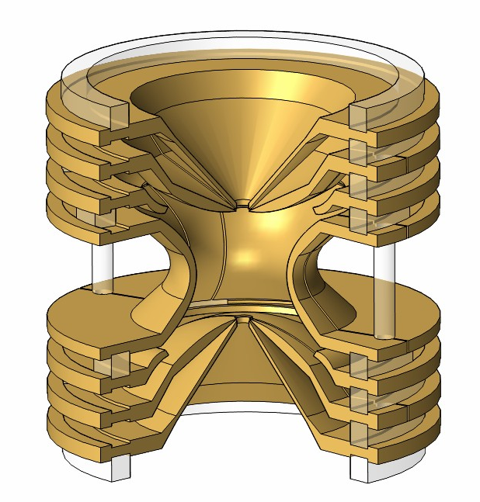
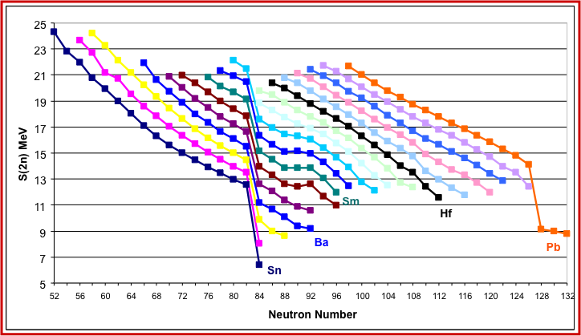
Masas & Números mágicos
M_{Atom} = N•m_{neutron} + Z•m_{proton} + Z•m_{electron} - (B_{atom} + B_{nucleus})/c²
δm/m < 10⁻¹⁰
δm/m = 10⁻⁶ – 10⁻⁸
B
N=82
5 cm
N=126
Change in shape
Notes:
The free cyclotron frequency is inverse proportional to the mass of the ions!

Slide 11
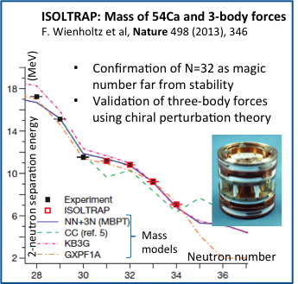
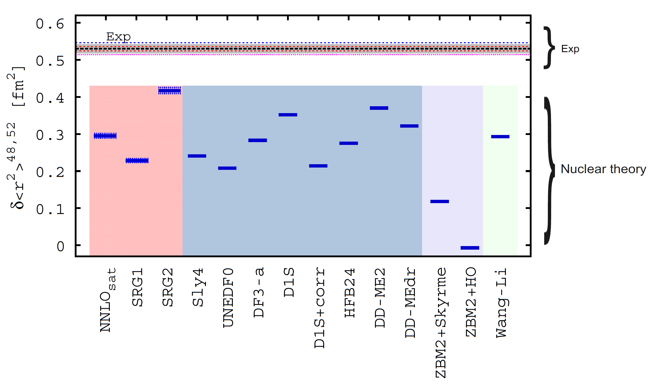
Exploring the nature of N=32
Collinear laser Spectroscopy study of Ca-isotopes: ⁴⁰⁻⁵²Ca
Change in nuclear size produces a shift in the hfs.
R. F Garcia Ruiz et al., Nature Physics 12 (2016) 594
11

Slide 12
The astrophysical r-process
The r-process is a two step process:
  Neutron capture until n-γ equilibrium
  beta-decay
N-rich Cd isotopes important for the r-process:
¹²⁹⁻¹³¹Cd masses @ISOLTRAP
βn with VANDLE @ IDS
Radii and Q-moments @ COLLAPS
http://www.nupecc.org/report97/report97_astrobib/node17.html
r-process abundance
Mass number A
Proton Number
Solar abundance
Pure Cd-beams thanks to
UC-target with neutron converter and cold quartz line, and ionized with RILIS.
Neutron Number

Slide 13
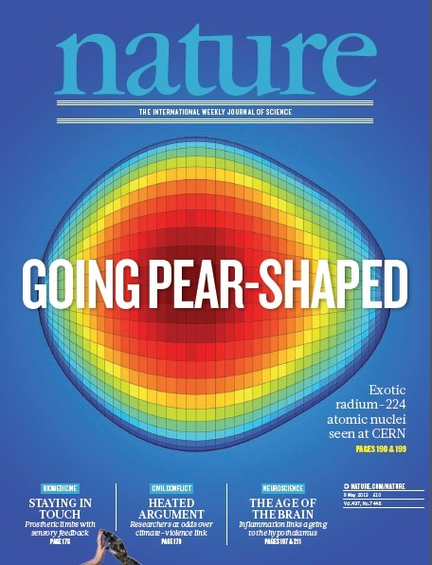
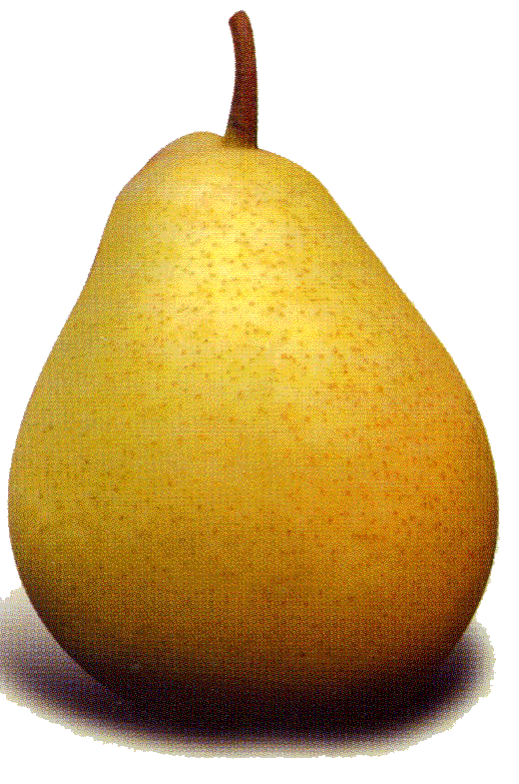
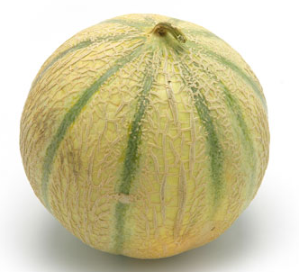
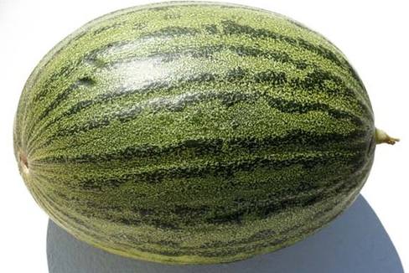
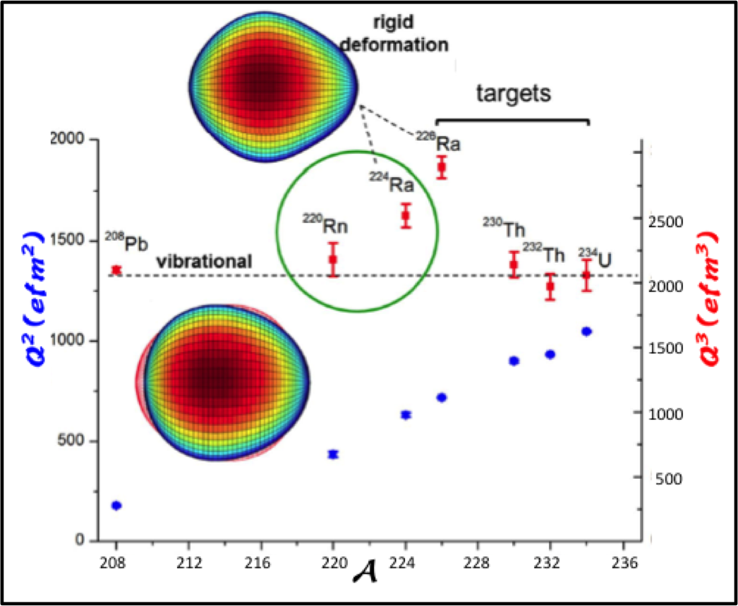
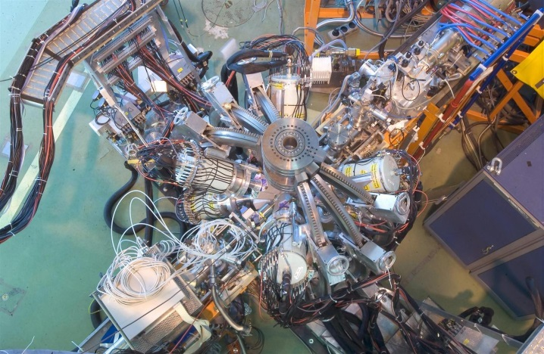
Searching for pear-shaped nuclei @ ISOLDE
λ = 2
λ = 2
Octupole correlations enhanced at numbers: Z or N=34, 56, 88, and
N= 134. → Observed Z≈88 & N≈134
L. P. Gaffney, et al. (2013). Nature, 497(7448), 199–204.
Notes:
1/3 of all nuclei are bound mostly if they are settle away sphericity into deformed elongated quadrupole shape.
Quantum correlations between nucleons are expected occasionally to favour more exotic shapes.
These special nuclei serve to test these specific correlations.
In quadrupole deofrmed experimental observables are the E2 transitions and Q-moments
In case of pear shapè there are additional E1 and E3 moments.
While the first are very small the E3 are collective > 10 single particle units.
So far the E3 moment has only been determined for 226Ra.
Particular correlations arise when particular momentum J are near the Fermi surface.
Excitation of coherent correlated pairs of nucleons between these states drives the whole nucleus into a pear shape.
Strong octupole correlation leading to pear shapes can arise when nucleons near the Fermi surface occupy states of opposite parity with orbital and total momentum differeing in 3h.
In these cercunstances interleave parity bands with enhanced E1 transitions.

Slide 14
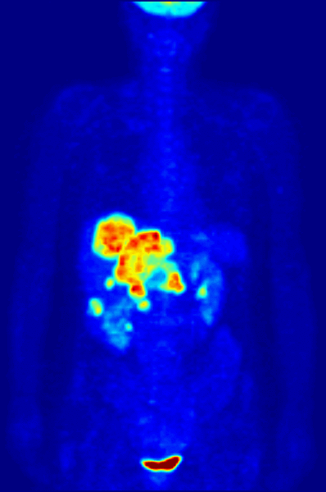

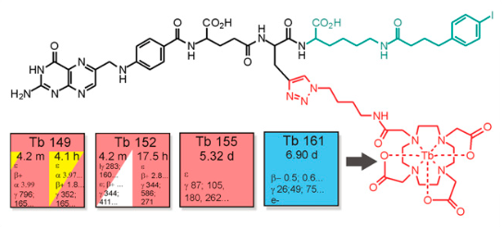
Multidisciplinary Efforts to fight the cancer
Personalised Treatment Different responses to the same drug
Same Chemical elements of Diagnosis and Treatment : Theranostics
Tumor
Receptor
Peptides, antibodies, etc.
Proteín/
ligand
Immunology
Biochemistry
Nuclear Physics & radio-Chemistry
Bombesin is a ligand successfully used with ¹⁵⁵Tb (5 d) and ¹²⁵I (59 d) for prostate, mama and stomach cancers

Slide 15
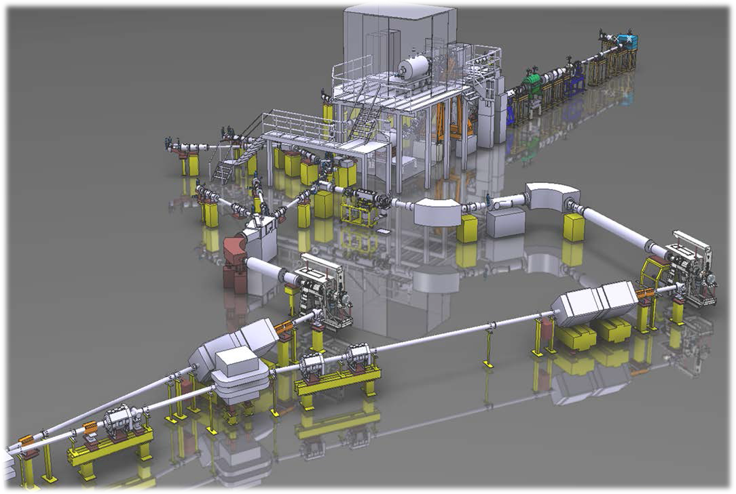
The HIE-ISOLDE project: I , E
Energy: 4.5 – 10 MeV/u
Intensity: x10 in power
Beam Quality
Higher Energy
2015 - 2018
Purity & Beam Quality
Higher Intensity
2021
ISOLDE
mgb@cern.ch
15

Slide 16
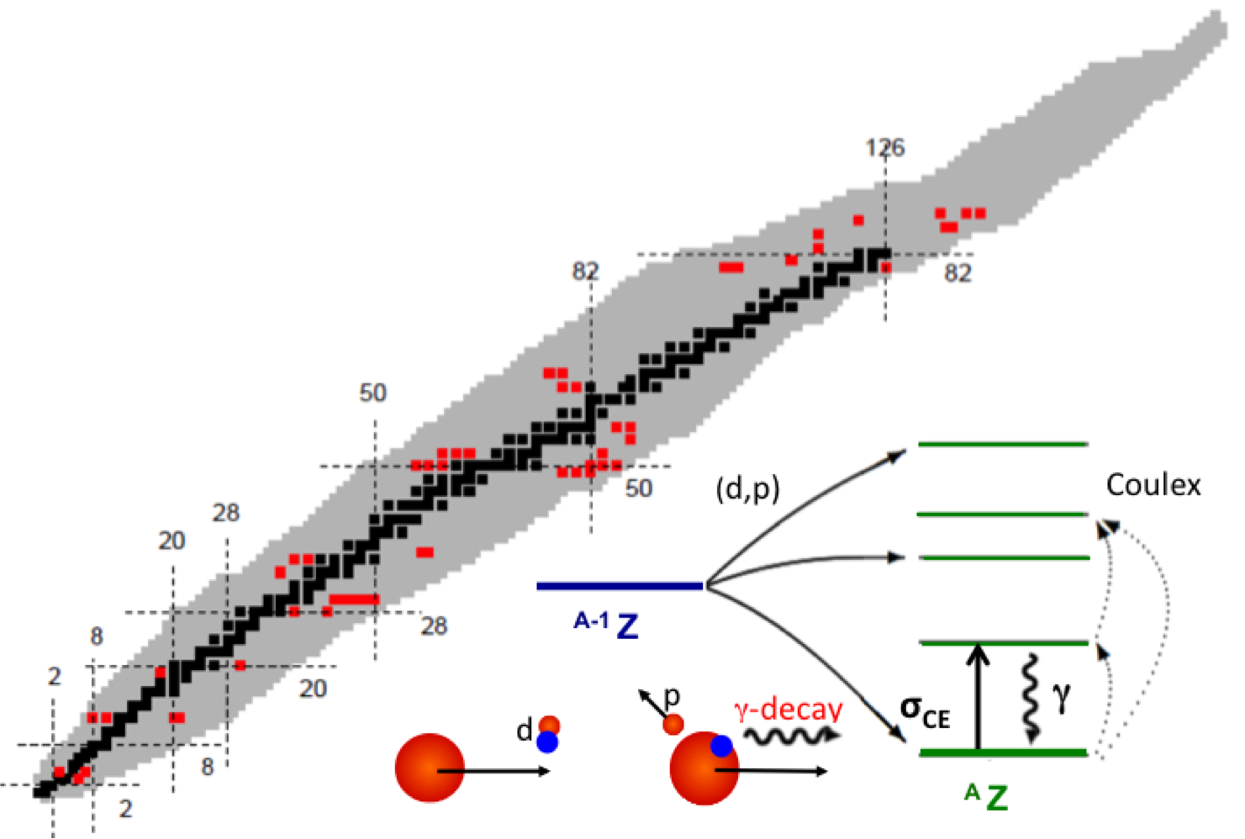
Physics at HIE-ISOLDE
The new energy window gives the opportunity to address new physics questions
35 Experiments approved
> 700 shifts
Isospin symmetry
Magic numbers far from stability
Collectivity versus Single Particle
Shape Coexistence
Quadrupole and Octupole degrees of freedom
Reaction for nucleo-synthesis studies

Slide 17
Summary & Outlook
ISOLDE offers largest variety of radioactive and post-accelerated beams in the World. Plenty of challenging physics
ISOLDE, operative since 50 years (first radioactive beam October 16, 1967), is in continuous transformation to stay at the forefront of nuclear physics research.
The energy upgrade, up 10 MeV/u in 2018. Many new devices and groups have been attracted by the increase of energy of the post-accelerated beams.
Main features of n_TOF is the high instantaneous neutron flux, high resolution in energy and large energy range
Since 2001, n_TOF is contributing to the world efforts aimed at collecting high quality data, mostly on capture and fission
The new EAR2 (since 2014) offers the unique opportunity to perform challenging measurements involving short-lived radioisotopes or sub-mg samples
Notes:
The nuclear physics community is expecting that CERN will provide this facility on time.

Slide 18

¡Thanks for your attention!

Slide 19
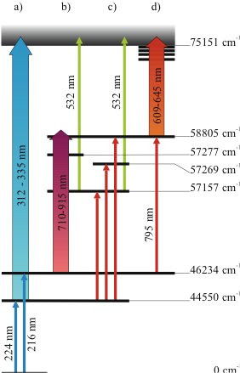
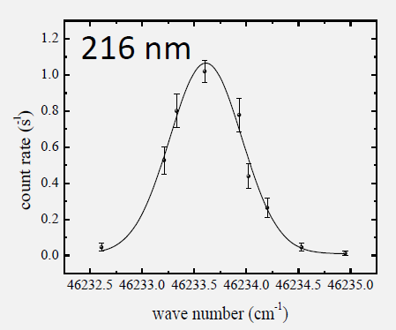
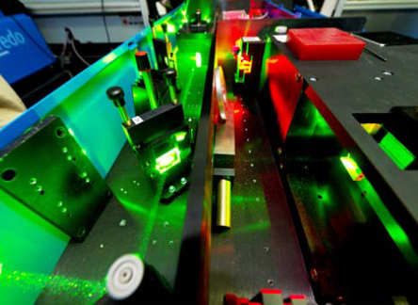
Atomic properties of Astatine
Determination of ionising potential
Identification of new atomic transitions
Comparison with atomic theory
Scan of ionizing laser: converging Rydberg levels allow precise determination of the IP
TRIUMF
IP(At) = 9.31751(8) eV
Nature Com. 14May2013
DOI 10.1038
Notes:
Study done with 211At as the most suitable isotope ideal for short range radiation source for targeted alpha therapy.
The Determination of IP of At is important to test the atomic models at the level of relativisticand coorelation effects.
This tuning of the model will help in the precdition for superheavies in particular for Z = 117 that shoul dhave similar chemical properties.
The identification for the 3 intermediate states was done at TRIUMF-TRILIS
The most precise method to determine the IP is by the analisis of the converging levels of the rydberg states.
Excitation scheme:
(a): verification of the lowest 2 transition from ground state.
(b)Ionization threshold.
(c) Develop 3 colour scheme.Verfication of levels found with transition 224 nm
(d)Scann over the rydberg states
Ion detection from the alpha-decay of 119At measured in the wind-mill system.

Slide 20
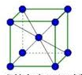
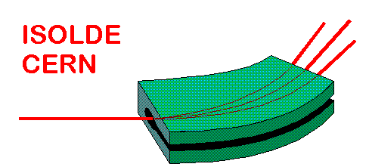
Emission channeling at ISOLDE
30-60 keV

Slide 21
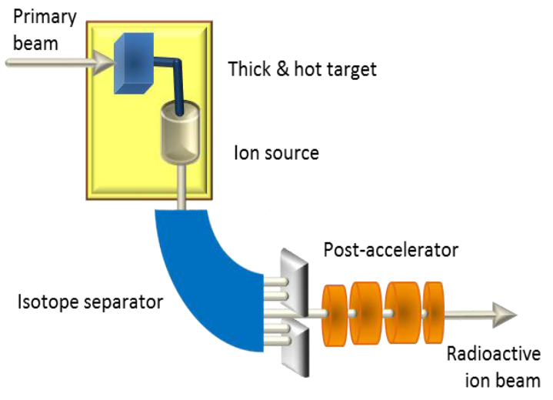


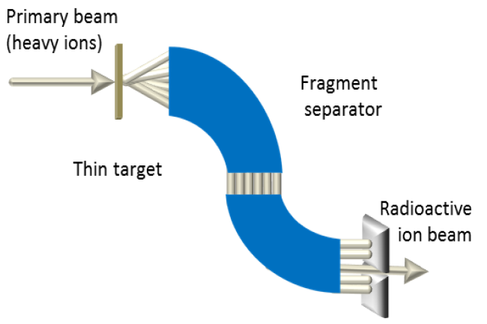

Production of Radioactive Beams
Radioactive Ion Beams are produced using two complementary ways
  Isotope Separator On Line method (ISOL):
    low/medium energy, high quality beams (phase space)
  In-flight method:
    high energy, short lived (μs)
ISOL
In-flight
Tailored made nuclei
Extraction time: ms – s
Well defined beam optics
Fast production
Many nuclei at the same time
Mapping region

Slide 22
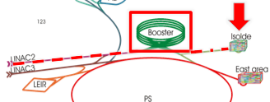
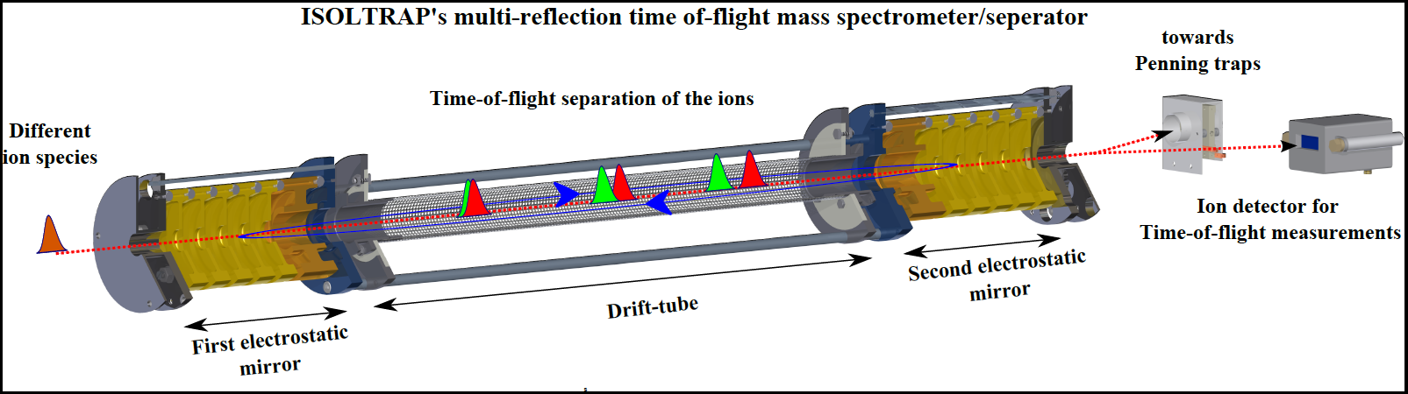
HIE-ISOLDE (2010-)
  Energy (2015-)
  Intensity from Injectors
    Linac 4 (5x10¹³ – 1x10¹⁴)
    Production increases linearly with injector intensity
    PSBooster to 2 GeV
      Increase x 2 – x 5 in fragmentation cross reactions
      Increase x 6 - x 10 for spallation cross section
  Beam Purity:
    New Target Materials & LIST
    ISCOOL: DS of new RFQ Cooler and Buncher
    HRS: DS for higher mass resolving power
    EBIS: DS for EBIS upgrade
    General purpose MR-ToF
Notes:
The HIE-ISOLDE (High
Intensity and Energy) project will provide major improvements in energy
range, beam intensity and beam quality. A major element of the project will
be an increase of the nal energy of the post-accelerated beams to 10 MeV/u
throughout the periodic table. The rst stage will boost the energy of the
current REX LINAC to 5.5 MeV/u where the multistep Coulomb excitation
cross sections are strongly increased with respect to the previous 3 MeV/u
and many transfer reaction channels will be opened. The construction of
the Linac is underway and the full physics program with post accelerated
beams up to 5.5 MeV/u will start in 2016.
TSR
The TSR storage ring. Recently a low-energy storage ring got proposed
to be installed at HIE-ISOLDE using the
Reaction and decay studies can benet from the "recycling" of the
rare exotic nuclei stored in the ring and from low background conditions.
In addition to experiments performed using
beams recirculating within the ring, cooled beams can be extracted and
exploited by external spectrometers for high-precision measurements.

Slide 23




What keep protons and neutrons together?
Strength
Strong force(“Nuclear force")
Short range (1 x10⁻¹⁵m)
Interation of one nucleon with 10
protons, neutrons...
1
Coulomb Force (em)
  Long range
  Keeps nucleons and electrons
  Feel by all charged particles
< 10⁻²
Weak Force
Responsible of the decay of nuclei
e
< 10⁻⁵
n
p
ν
Gravitation Force
Mass
-
< 10⁻³⁸

Slide 24








Production Mechanism
10⁻³ – 10⁻⁸
5 – 90 %
Target
HRS
Target
FE 7
GPS
beam lines

Slide 25






ISOLDE: brief History
The 1963 Conference on High Energy Physics and Nuclear Structure
Conclusions: Call for proposals in nuclear physics at CERN
February 1964 first proposal to study short-lived isotopes
Approved 19th Dec 1964
V. Weiskopf (DG 1961-65)
First beam October 1967 @ SC
Upgrade 1974
ISOLDE-II
Control room 1967
ISOLDE-III 1987 (HRS)
New Facility June 1992 @ PSB
C. Rubbia
(DG 1989-93)

Slide 26


Advantages of HIE-ISOLDE
Intensity & Selectivity & Beam quality & Efficiency
Energy upgrade to 5.5 MeV /A 10 MeV /A
³²Mg(d,p)³³Mg
Access to a wealth of spectroscopic information
From the absolutes intensities of 4⁺/2⁺ ⁽multistep coulex)
⇒Access to the sign of deformation
θ_{cm}
Single particle information through the spectroscopic factors
High energy needed to learn about the “l” transfer
26

