Slide 1
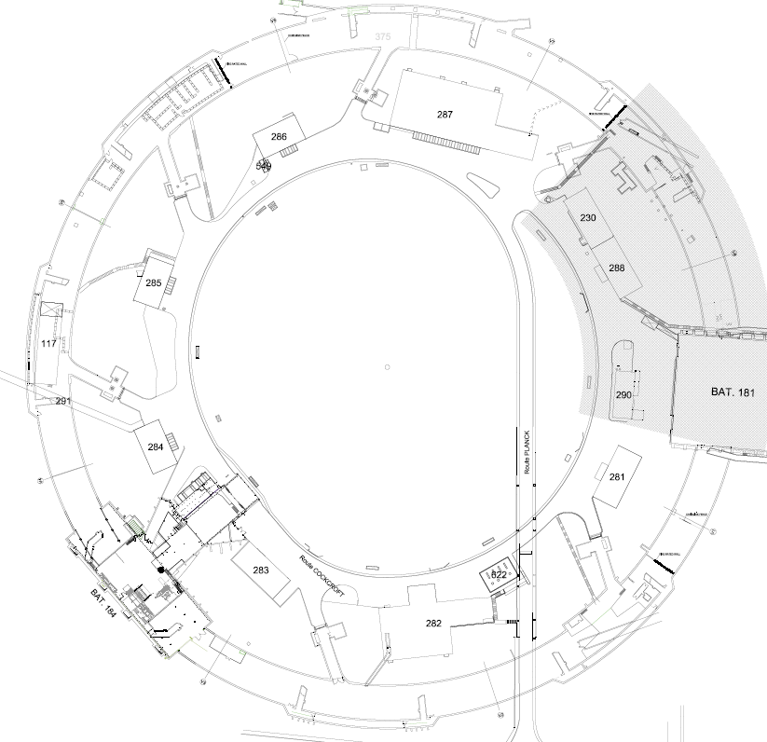
Technical work packages
STATUS & UPDATES
Organisation,
Planning & Budget vs. Baseline
C. Colloca
RWTCS Steering Commitee
6th of April 2017

Slide 2
INFRASTRUCTURE WORK
WORK PACKAGES | WORK PACKAGE OWNER | WORK PACKAGE TEAM
Civil engineering & building work | C. Colloca SMB/SE | A. Dodard, R. Ortega SMB/SE
Electricity | J. Gomez SMB/SE | F. Vincent SMB/SE
HVAC | G. Rouge SMB/SE
Cranes & handling/lifting equipment | H. Lourenco EN/HE | S. Fumey EN/HE
IT networks | L. Borakiewicz IT/CS
Access control | R. Nunes BE/ICS | N. Rama BE/ICS
Fire detection | D. Raffourt BE/ICS

Slide 3
- Crane support extension
- Fire doors (bldg. 184, ISR2-3-5-6-7)
- Underground galleries waterproofing (ISR2-3-5-6-7-8)
- Ceiling painting (ISR5-6)
- Electricity (ISR4-5-6)
- Fire detection (ISR5-6)
JAN 17- APR 17 WORK

Slide 4
CONDITIONAL PERIODS OF AVAILABILITY
o n - g o i n g
S2 2018
S1 2021
S2 2022
S1 2022
S1 2017
S2 2016
S1 2020
S2 2015
S2 2015
ISR 2
ISR 3L
ISR 3R
ISR 5L
ISR 5R
ISR 6L
ISR 6R
ISR 7L
ISR 7R
Storage of LS2 rad. Waste.
Move of
- tritiated water to B.573
- Magnets >8t to ISR 5.
- Comb. RW to B.225
Treatment by cont.enclosure by S1 2019.
Elimination of cables and combustible RW.
Move of residual combustible RW to B.225
No floor access
(shielded areas for highly rad. waste).
Storage of not-stackable RW (pallets).
Dismantling of old shielded area.
Floor available in ¼ octant
Elimination of LEP RF Cavities, Pb vacuum chambers and asbestos RW.
HSE-RP
B.573 refurb. by S2 2017
Containment enclosure by S2 2018
B.225 refurb. by S1 2018
Evaporation in B.573 by end of S2 2017
B.225 refurb. with sprinkler by S1 2018 (to be discussed).
Floor waterpr. compatible with the existing sh. area.
Keep storage racks in place.
Floor waterproofing before sh. area extension
Asbestos facility avail. By S1 2018
Civil eng. work and HVAC possible before S2 2022. Partial waterprof. in S1 2018.
Elec., fire det., access ctrl, waterproof. & painting in S1 & S2 2022 (per ½ sector)
Waterpr. partially possible after ISR6 sh. extension. Elec., IT & painting ongoing. HVAC in 2018
All other work in 2017
Civil eng. work and HVAC possible before S2 2018.
Elec., fire det., access ctrl, waterproof. & painting in S2 2018
Floor waterpr. and all remaining work possible in 2017
HVAC in 2018
Civil eng. work possible in 2017. HVAC 2018.
Elec., fire det., access ctrl, waterpr.& painting ? POSSIBILITY WITH RACKS IN PLACE TO BE VERIFIED
Civil eng. work possible in 2017. HVAC 2018.
Elec., fire det., access ctrl, waterproof. & painting in S1 2020.
INFRASTR.

Slide 5
PLANNING 1/2

Slide 6
PLANNING 2/2

Slide 7
SPENDING PROFILE
EXPENDITURES (FOR TUNNEL WORK ONLY – NO SECURITY) | 2017 | 2018 | 2019 | 2020 | 2021 | 2022
GLOBAL BUDGET* (kCHF) | 1’950 | 900 | 1650 | 60 | 65 | 350
TOTAL* (kCHF) | ~5’000
COMMITTED : 847kCHF
SPENT : 164kCHF
* Without ‘Access control’

Slide 8
CONCLUSIONS OF WORKSHOP*
The baseline for the RWTC has to foresee
construction of an access building - FORESEEN, START DATE TO BE DEFINED
installation of containment enclosure in Q3 2018 – NEED OF INFORMATION
access control and safety
consequences of the risk analysis: complementation and adaptation of safety systems, civil engineering – PARTIALLY AGREED (DEPENDING ALSO B. 573 AND 225)
detailed noise study (by outside company)
In addition, a list of all processing tools has to be provided by RP to SMB
* Memo of 19th of december 2016

Slide 9
CONCLUSIONS OF WORKSHOP*
Baseline RW Storage
Besides the already known activities like installation of HVAC system, retention basins, installation of fire walls and water proofing of the floor, the following new activities need to be integrated:
modifications of Bat 225 to be integrated into the baseline as combustible waste will be stored there – IPP?
modifications of Bat 573 to be integrated into the baseline as water containers will be moved there and water evaporated - IPP?
* Memo of 19th of December 2016

Slide 10
CONCLUSIONS OF WORKSHOP*
Baseline RW Storage
RP has to finalise the technical specification for the HVAC latest until March 2017. In particular, RP has to assess with SMB if modifications to the present baseline are required following the comments of the Host State Authorities on the proposed fire protection scheme. In addition, the protection of RP’s neighbours (CMS, TE) in the ISR, i.e. against fire and smoke has highest priority as damage to their equipment will put LHC operation and exploitation at stake
RP has to provide a map of radiation risks (= radiological area classification to SMB)
Security Concept: the security concept (as proposed by D. Constant (SMB) and R. Nunes (BE)) of three embedded areas with increasing security barriers had been accepted by HSE. Negotiations are ongoing with the other users of the ISR complex. At one point the HSE Unit Head will present the scheme and its consequences to the ED for approval. The present baseline of the RWTCS project does not yet include the budget for the first security barrier
* Memo of 19th of December 2016

Slide 11
CONCLUSIONS OF WORKSHOP*
RWTC – items to be completed:
  Complete the electrical installations (INF) – ON GOING (80% WORKS COMPLETED)
  Implement the actions following the fire risk analysis (INF) – ON GOING (STUDY)
  Access building (INF, ELM) – ON HOLD
  Infrastructure needed for the installation of the new process equipment (ELM, INF) – DONE FOR EXISTING, NEED OF INFO FOR FUTURE
  Noise reduction infrastructure following noise-reduction study (ELM, INF) - ON GOING (WITH FIRE WALL)
RWTC – new items to be studied for potential inclusion in the baseline:
  Renovation/adaptation of building 573 (ISB) – IPP?
  Renovation/adaptation of building 225 (ISB) - IPP?
INF- Infrastructure, ELM-Elimination, ISB-Infrastructure Steering Board
* Memo of 19th of December 2016

Slide 12
CONCLUSIONS OF WORKSHOP*
Storage – items to be completed:
  Identified work packages (INF) – ON GOING & PLANNED
  Review HVAC design with the comments form the authorities (ELM, INF) – TECHNICAL PART DONE AND DISPATCHED
ISR security – items to be completed:
  Phase 2-3 that includes the access control, safety and security for the access to the RWTCS (ELM, INF)
ISR security – new items to be studied for potential inclusion in the baseline:
  Phase 1, perimetral access and security protection (ISB)
* Memo of 19th of December 2016

Slide 13
HSE/RP CONTROL BUILDING
Duration : 2 years from the start of design
Budget : 800 kCHF
Constraints : one of ISR4 access condemned +
parking reduction

Slide 14

THANK YOU
FOR THE ATTENTION!

