Slide 2
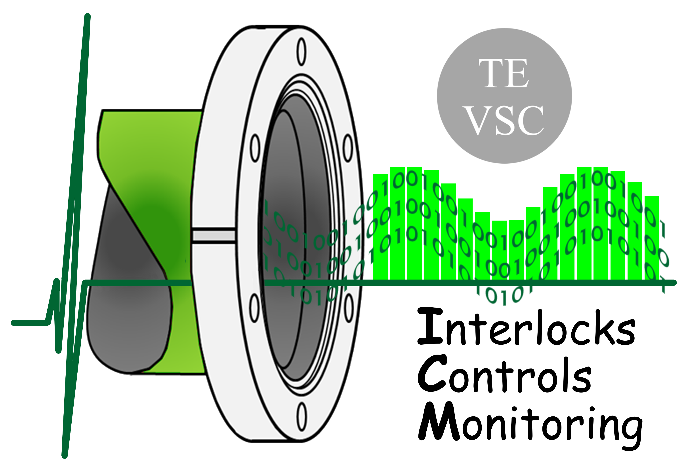
FCT and CERN
Portuguese Trainee Programme Report
Claudia Dias
CERN, Technology Department
Vacuum, Surfaces and Coatings Group
Interlocks Controls Monitoring
FCT and CERN Portuguese Trainee Programme Report
| 31st March, 2017

Slide 3

Resume
Vacuum at CERN – Overview
Vacuum Control SCADA System – Developments
Vacuum Equipment Labelling – Campaign
Vacuum Monitoring Application – Development
Training Competences
| 31st March, 2017

Slide 4
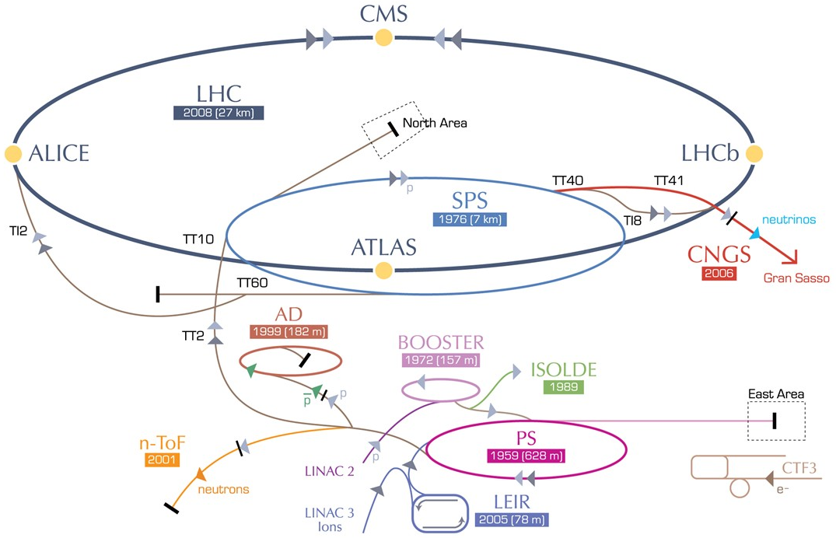
Vacuum at CERN – Overview
Beam and Insulation vacuum systems
> 128km of vacuum chambers across all accelerators
Pressure range from 10⁻⁴ to 10⁻¹¹ mbar achieved by:
  ~3000 vacuum pumps
  ~3000 vacuum gauges
  ~500 sector valves
How to supervise and control such a large system?
  7 SCADA servers
  ~300 PLCs
  Backboned by vacuum-specific software frameworks
Supervision
Control
Field
| 31st March, 2017

Slide 5
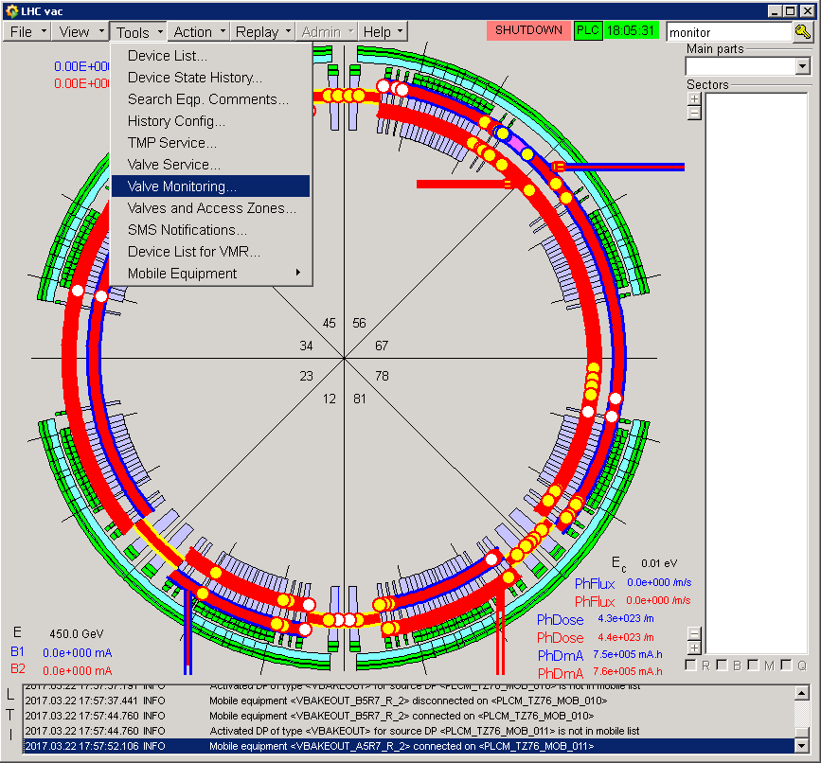

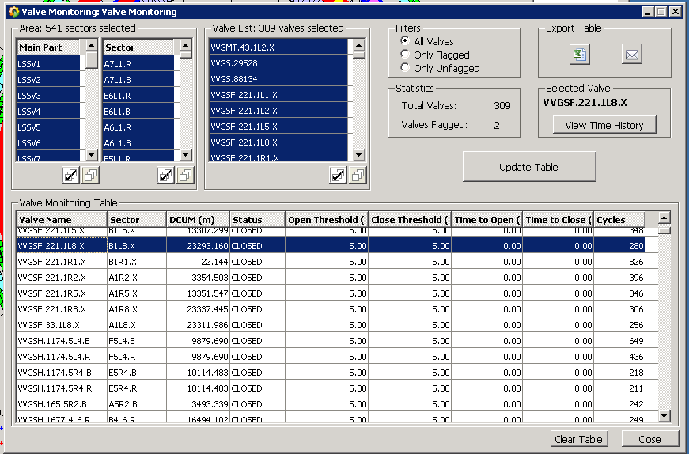
Vacuum Control SCADA System – Developments
Valve Monitoring panel
  Real-time and continued valve fatigue follow-up
  Archiving of valve behaviour main parameters
  User notification features (system warnings, errors)
| 31st March, 2017

Slide 6
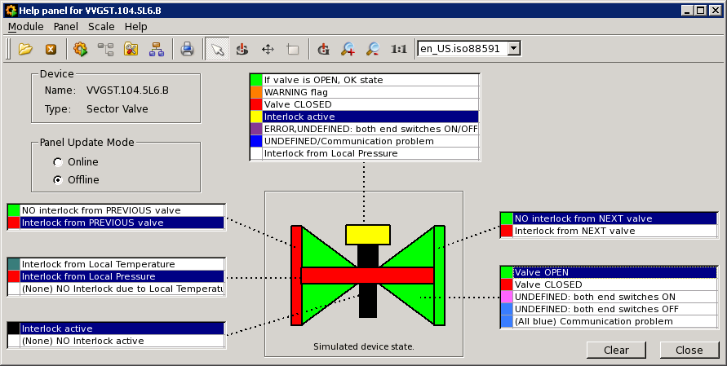
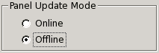
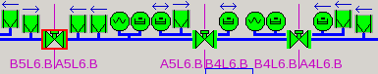
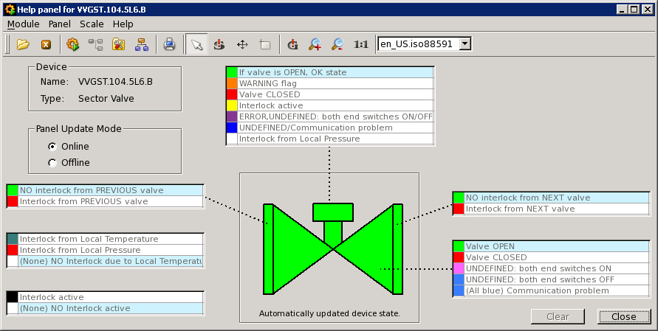
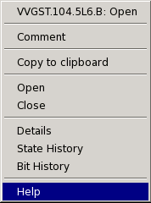
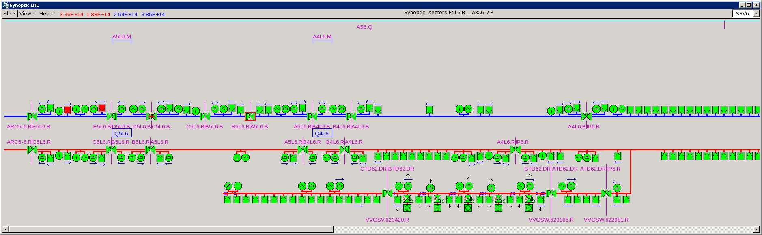

Vacuum Control SCADA System – Developments
Valve Monitoring panel
  Real-time and continued valve fatigue follow-up
  Archiving of valve behaviour main parameters
  User notification features (system warnings, errors)
Vacuum devices Help panels
  Real-time device state description
  Emulation of any device state, and description
LHC Sector Valves
Pirani Gauges
Penning Gauges
Ion Pumps
| 31st March, 2017

Slide 7
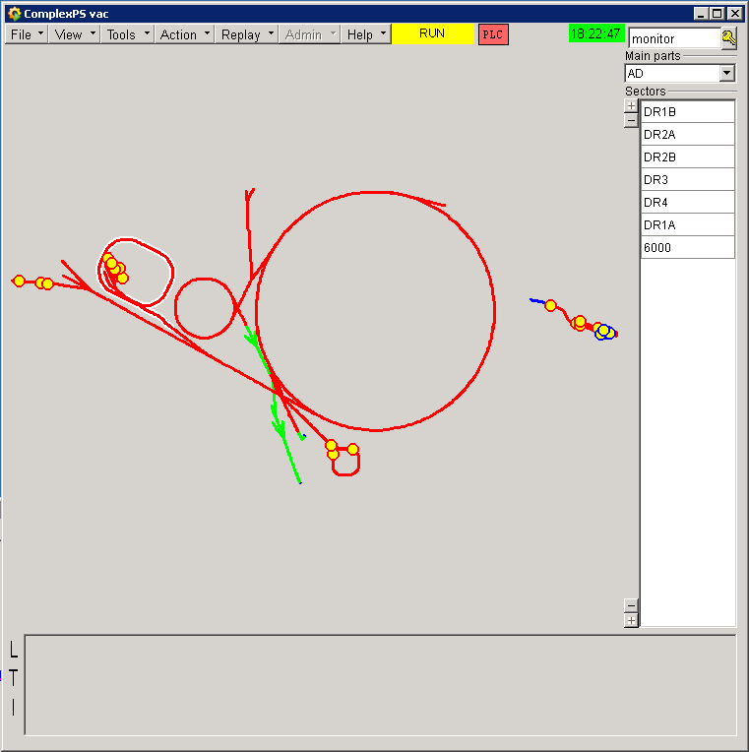
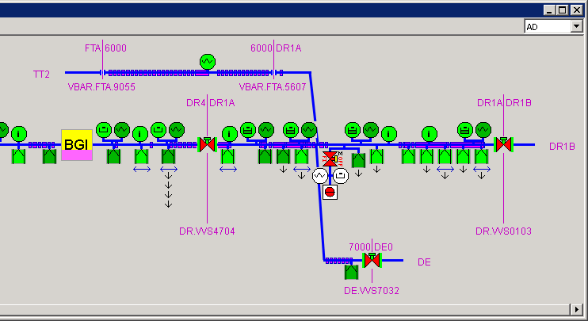
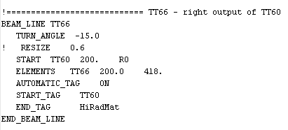
Vacuum Control SCADA System – Developments
Valve Monitoring panel
  Real-time and continued valve fatigue follow-up
  Archiving of valve behaviour main parameters
  User notification features (system warnings, errors)
Vacuum devices Help panels
  Real-time device state description
  Emulation of any device state, and description
Beam Line name tags
  Automatic and user-defined beam line identification on synoptic
| 31st March, 2017

Slide 8
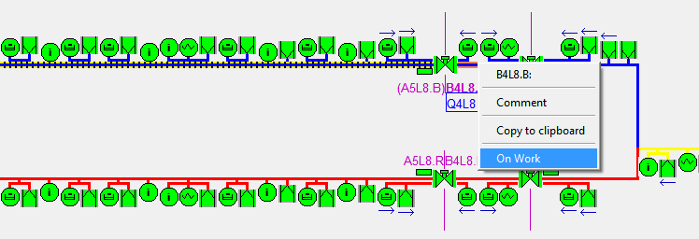
Vacuum Control SCADA System – Developments
Valve Monitoring panel
  Real-time and continued valve fatigue follow-up
  Archiving of valve behaviour main parameters
  User notification features (system warnings, errors)
Vacuum devices Help panels
  Real-time device state description
  Emulation of any device state, and description
Beam Line name tags
  Automatic and user-defined beam line identification on synoptic
Vacuum Sector selectable by user (on work)
  Sector lines can be right-clicked
  Sector status can be set, affecting its synoptic representation
  Integration with assets management
| 31st March, 2017

Slide 9
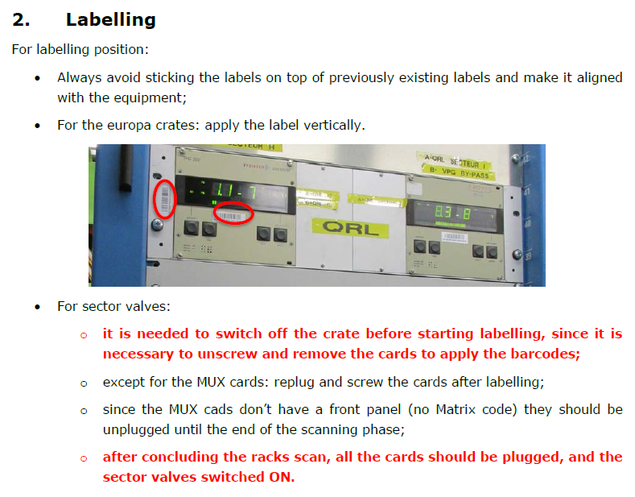
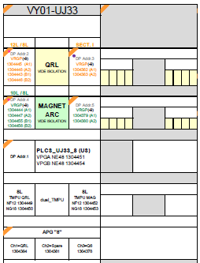
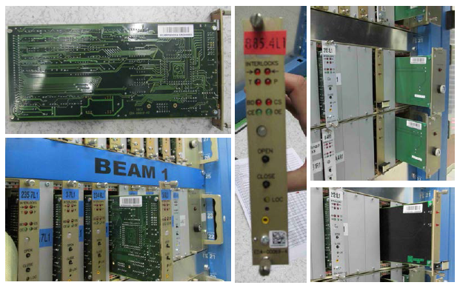
Vacuum Equipment Labelling – Campaign
Quality developments on assets management
  Vacuum equipment name standardization
  Integration with global asset management tools
Applying to all the vacuum devices and monitoring hardware
The complete VSC-ICM team involved
>2000 labels printed and scanned
| 31st March, 2017

Slide 10
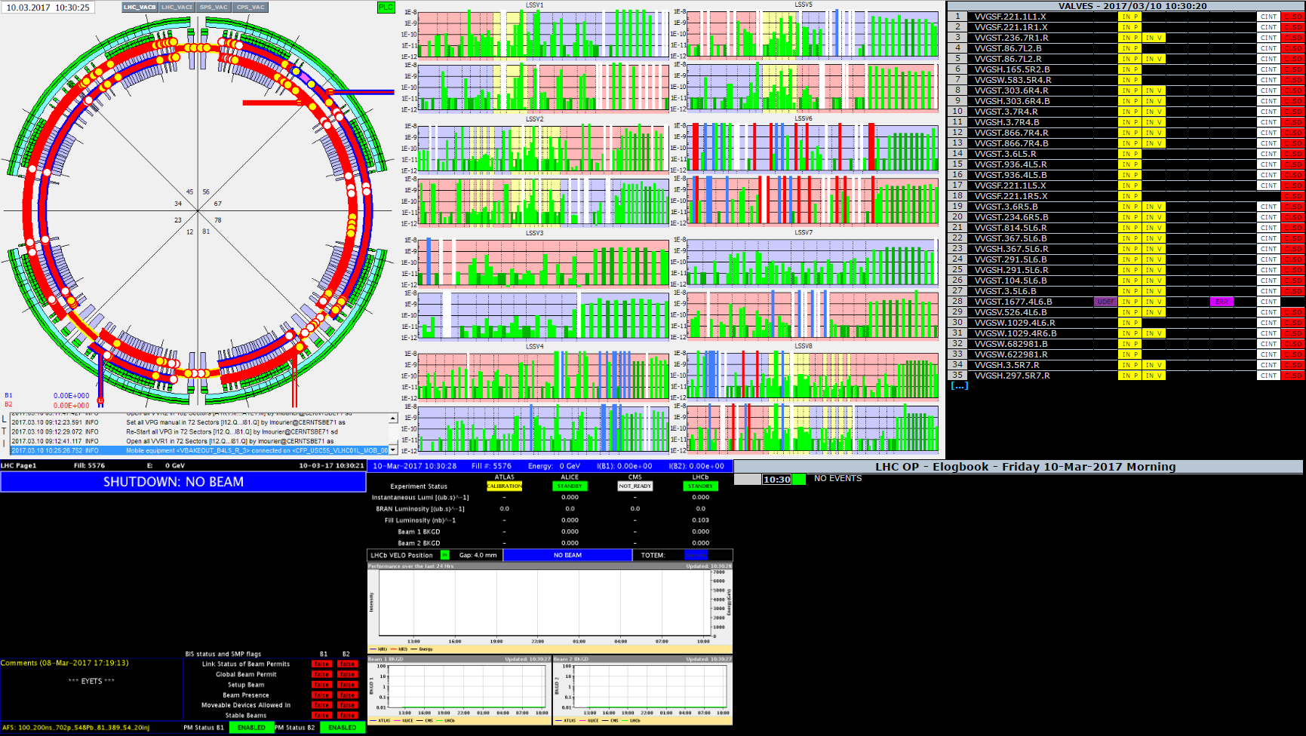
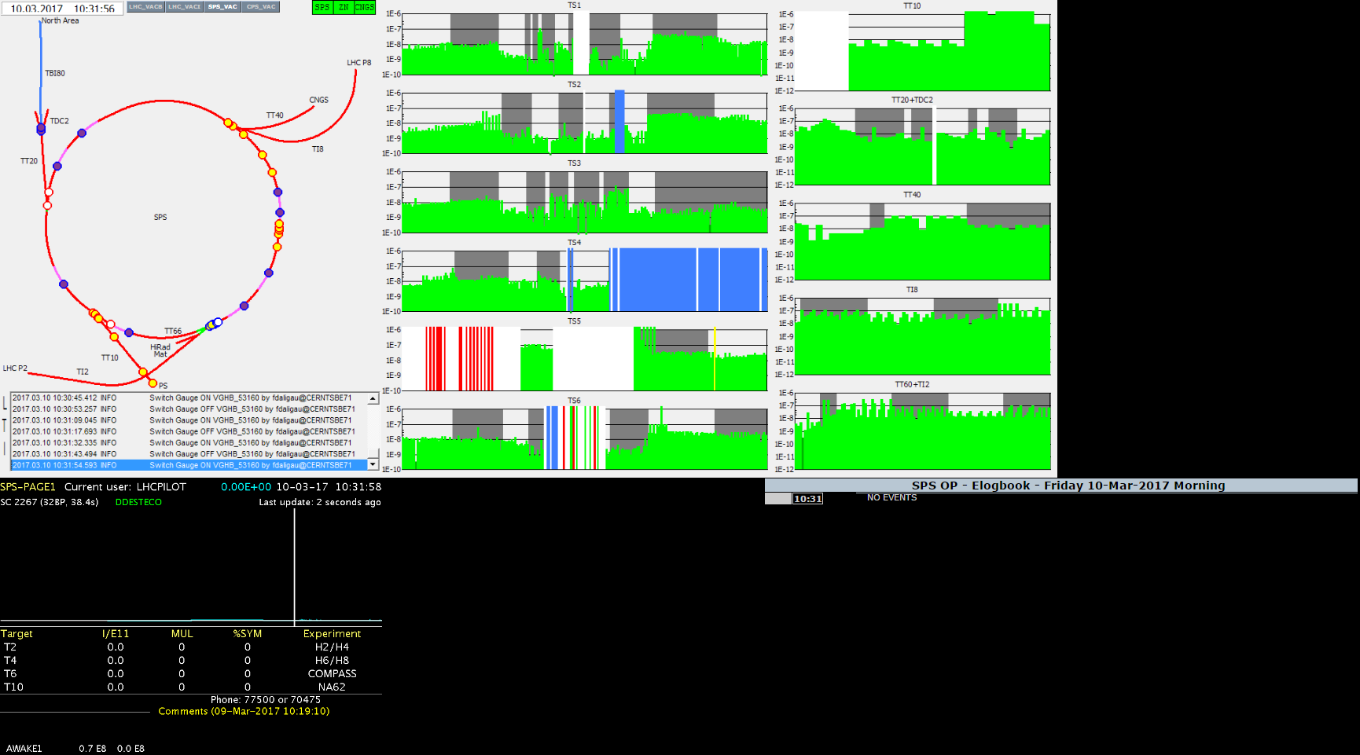
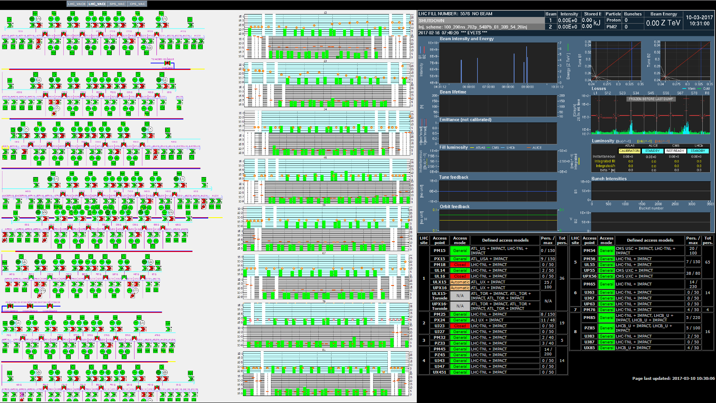
Vacuum Monitoring Application – Development
Monitoring webpage
  SCADA synoptic for the main accelerators
  Beam status
  Vacuum devices status
  External operational panels
  Main user: Vacuum Monitoring Operator
  Displayed in the CERN Control Center (CCC) and around the Vacuum building
  http://vacmon.web.cern.ch
Improvements:
  Interactivity with user
  New web development technologies
  Enhance maintenance
  Boost the development of new features
  Integration with SCADA system to provide more detailed information to the user
  Integration CERN groups databases
| 31st March, 2017

Slide 11
Training Competences
Competences being acquired:
  SCADA (WinCC-OA, PVSS) development
  General programming (Java, C++, QT, VBS)
  Web Development (Java Spring)
  Databases (SQL, architecture)
  Quality assurance and management
Overall purpose:
  Vacuum Controls features extension
  Vacuum control system user-support
| 31st March, 2017

Slide 12
Questions?
FCT and CERN Portuguese Trainee Programme Report
| 31st March, 2017

