Slide 1


Fiber Optics Sensors for Humidity Monitoring Applications in High Radiation Experiments @ CERN
Tiago Neves – Trainee Engineer
May 2015 – April 2017
tiago.neves@cern.ch
Supervisors : Gaia Maria Berruti and Paolo Petagna

Slide 2
Outline
Needs at CERN for relative humidity (RH) monitoring
Fiber Bragg Grating (FBG) Technology
RH-sensors based on FBG
Long Period Grating (LPG) Technology
RH-sensors based on LPG
My work at CERN
PhD objectives

Slide 3
Needs at CERN for RH monitoring
High luminosity applications
High radiation levels
Possible damages, leakage current and heat generation
Cooling and RH measurements
No radiation resistant RH sensors available in the market
Development in EP-DT group of FOS sensor for RH measurements to be applied in high radiations experiments @ CERN
From 2011, in collaboration with:
  University of Sannio (IT-Benevento)
  IPCB-Institute for Polymers Composite and Biomaterials (CNR-IT-Naples)

Slide 4
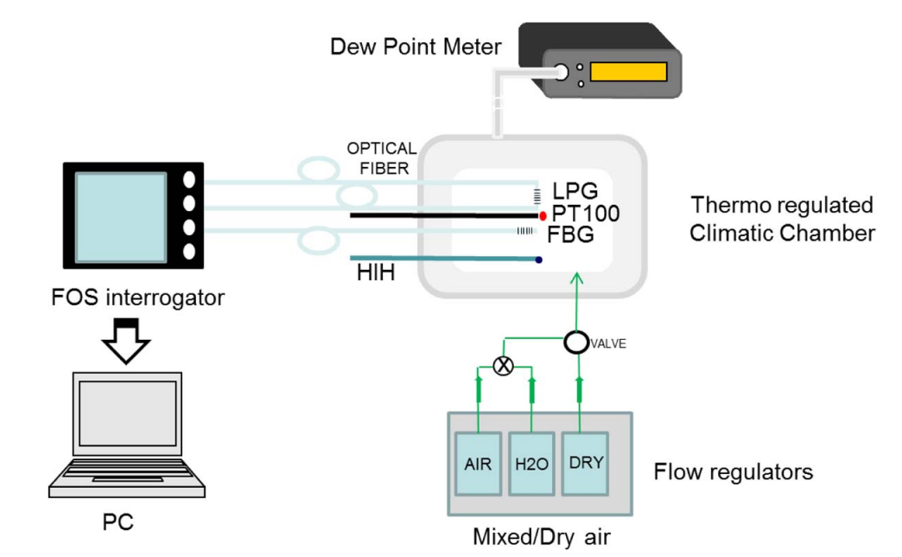
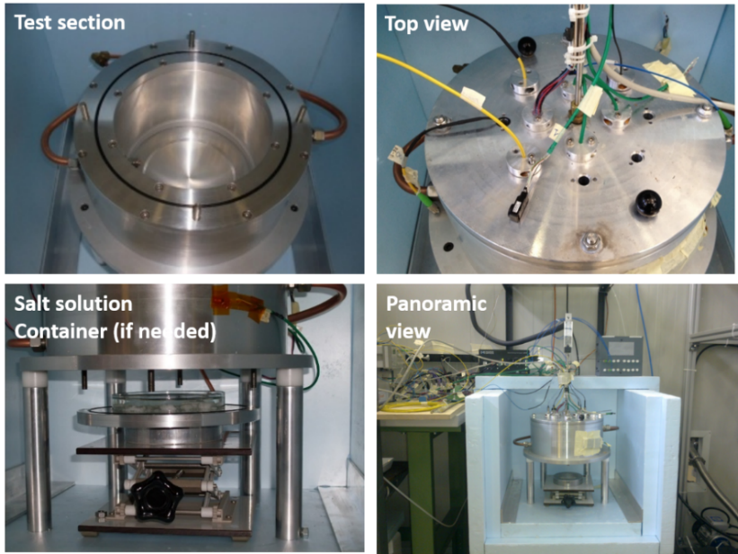
Climatic chamber for experimental investigations at CERN
Temperature ranges [-20,30]°C
Stability of T measurements: ± 0.1°C
RH ranges [0,100]%RH
Stability of RH measurements: ± 0.1 %RH

Slide 5
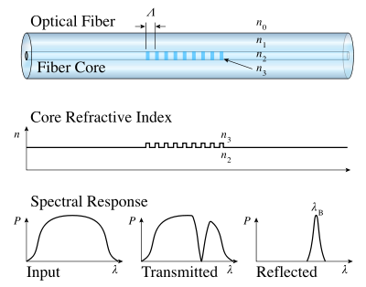



Fibre Bragg Grating Technology
  Periodic perturbation of the effective index in the fiber’s core
  Reflects particular wavelength, called Bragg wavelength
$$λ_{Bragg}=2n_{eff}ᴧ$$
Where $n_{eff}$ is the refractive index and $ᴧ$ the grating period
$$n_{eff},ᴧ=f(ε,T)$$
Where $ε$is the strain and T the temperature
Strain free packaging -> Thermometer

Slide 6
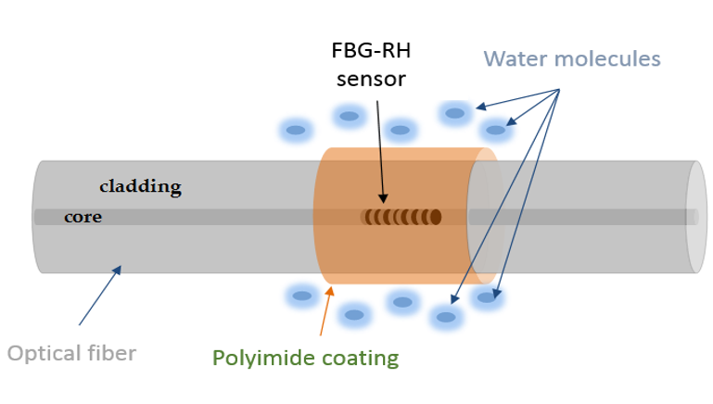
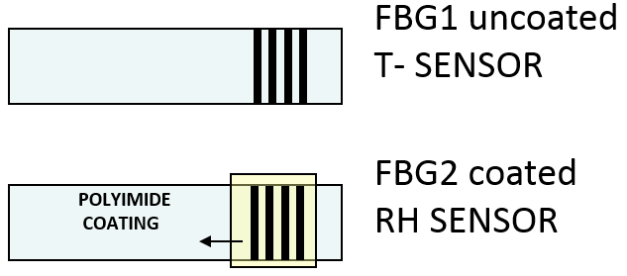


FBGs for RH measurements
Development of RH sensors by coating the FBG with an hygroscopic material ^{[1] [2]}
Polymeric coating
Temperature compensation needed
$$Δλ_{RH= }Δλ_{Total}−Δλ_{T }$$
  Decouple the cross-sensitivity to temperature to avoid errors in the RH measurements
Moisture Adsorption
Coating “swelling”
Strain onto the FBG
$$Δλ_{Bragg}$$
[1] P. Kronenberg et al., Opt. Lett. 27(2002) 1385-1387
[2] T.L. Yeo et al., Sensors and Actuators B Chemical, 110 (2005) 148-155
FBG1 uncoated
T- SENSOR
FBG2 coated
RH SENSOR
POLYIMIDE
COATING

Slide 7
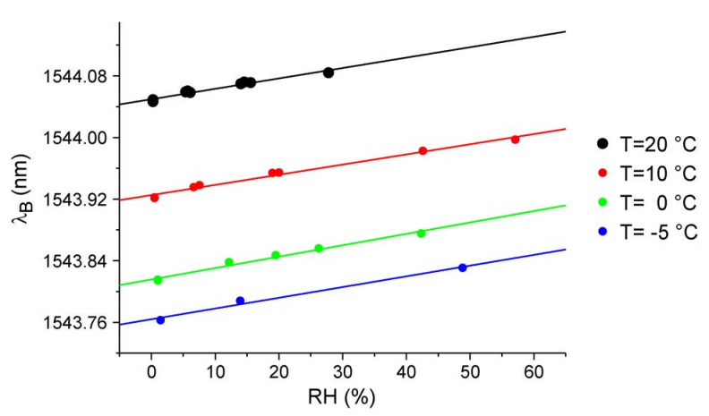
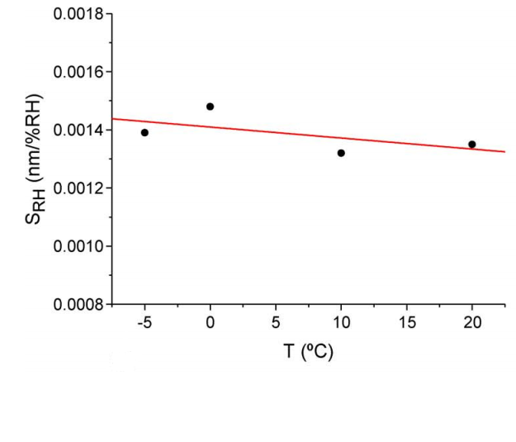

RH-FBG sensors studies at CERN from 2011^{[3]}
Grating and Coating
Photomask fabrication technique
Dip-coating procedure - Thickness of 10μm
Calibration at different temperatures
Relative Humidity Sensitivity
$$S_{RH}=1.41±0.07pm/\%RH$$
[3] G. Berruti et al., IEEE Photon. J., vol. 6, no. 6, Dec. 2014, Art. no. 0601015
Notes:
Low temperatures working – checked

Slide 8
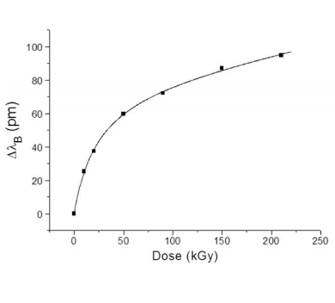
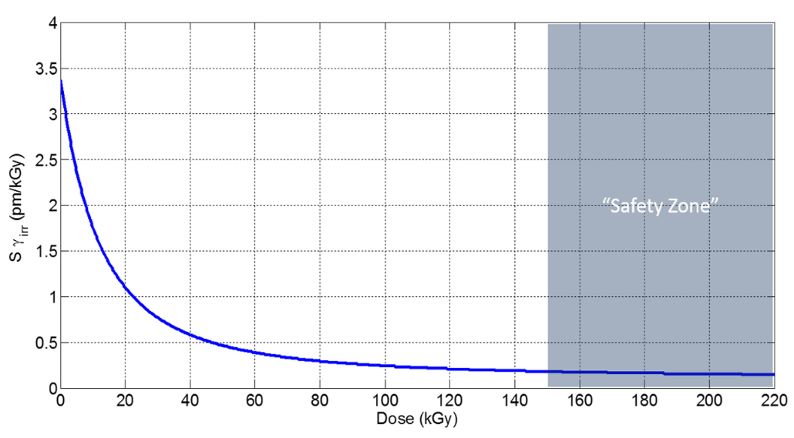
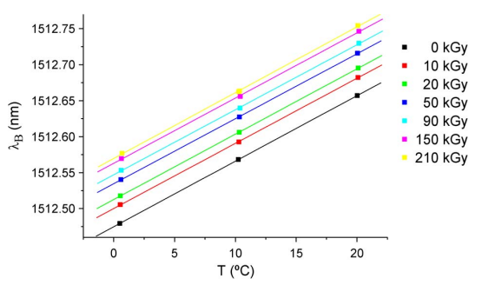
Are FBG-based sensors radiation resistant? ^{[3]}
FBG- based sensors are radiation resistant
Radiation does not change significantly the FBG sensitivity
Only a induced wavelength shift registered
After 150 kGy (“Safety zone”) the sensitivity of the sensor to further irradiation drops down (~0.1pm/kGy)
PRE-IRRADIATION STEP NEEDED BEFORE INSTALLATION IN HIGH RADIATION ENVIRONMENT!
[3] G. Berruti et al., IEEE Photon. J., vol. 6, no. 6, Dec. 2014, Art. no. 0601015
Notes:
Radiation resistant - check

Slide 9
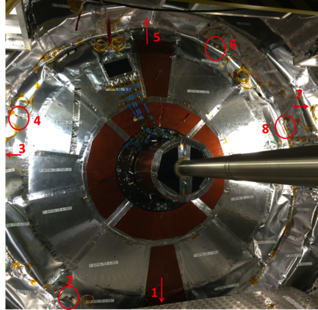
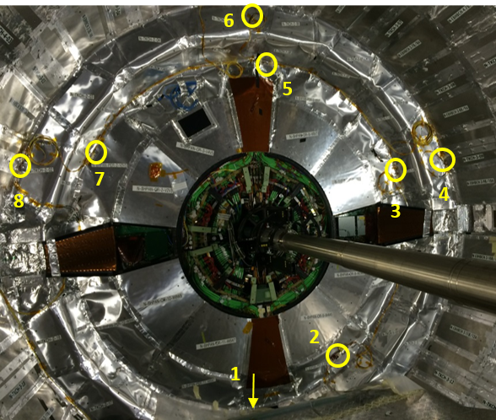
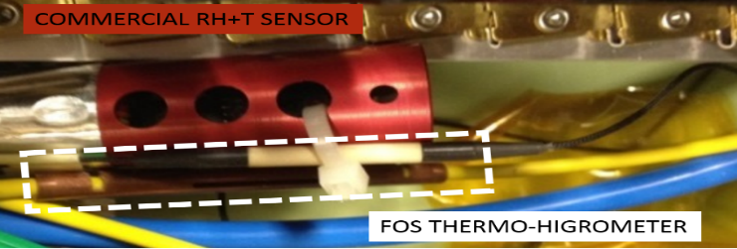
FGB-based thermo-hygrometers in CMS
72 FBG-based thermo-hygrometers correctly working in CMS experiments from December 2014 ^{[4]}
FBG-based thermo-hygrometer installed in CMS
Network of FBG-based sensors installed on the outer part of the TK bulkhead on the Positive and Negative side of the detector, respectively
[4] G. Berruti et al., Journal of Instrumentation, vol. 11, Mar 2016

Slide 10
Issues related to coated FBGs
Requested a high precision temperature compensation (T Sensitivity 10 times bigger then RH Sensitivity) ^{[3]}
  Decouple the cross-sensitivity to temperature to avoid errors in the RH measurements
Accuracy levels near the commercial sensor available in the market (±2% RH)
Trade-off between thickness and response time
Expected life time of the polymer unknown
[3] G. Berruti et al., IEEE Photon. J., vol. 6, no. 6, Dec. 2014, Art. no. 0601015

Slide 11

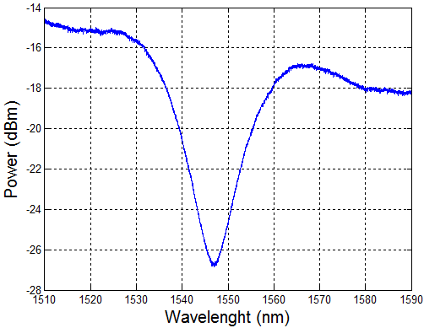
Long Period Grating
[4]
Photonic Devices
  Produced by inducing periodic refractive index (RI) modulations
  Allowing the power transfer from the fundamental guide core to a discreet number of forward propagating cladding modes
  The LPG transmission spectrum shows attenuation bands
  100 μm to 1mm grating period
[4] T. Eftimov, Optical Waveguide Sensing and Imaging, 2008, 1-23

Slide 12
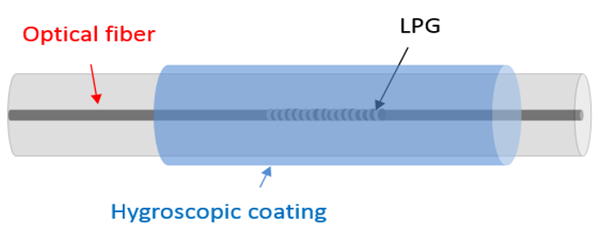
LPGs for RH measurements
Coated LPG can be used for RH sensing ^{[5]}
Moisture Adsorption
RI Changes
Spectral Variation
Several kinds of materials have been studied (Polymers, Hydrogels, Gelatine, Cobalt Chloride)
No evidence in literature of characterization of coated LPGs at low RH values (Below 20%RH) and in presence of radiation
IN EP-DT group, under investigation from 2014^{[6]}
Metal oxides as coating
  TiO₂ selected
    Good hygroscopic features
    High refractive index (1.96)
[5] T. Venugopalan et al., IEEE Sensors J., vol. 8, no. 7, pp. 1093–1098, Jul. 2008
[6] M. Consales, et al., Opt. Lett. 39(14), 4128–4131 (2014)

Slide 13
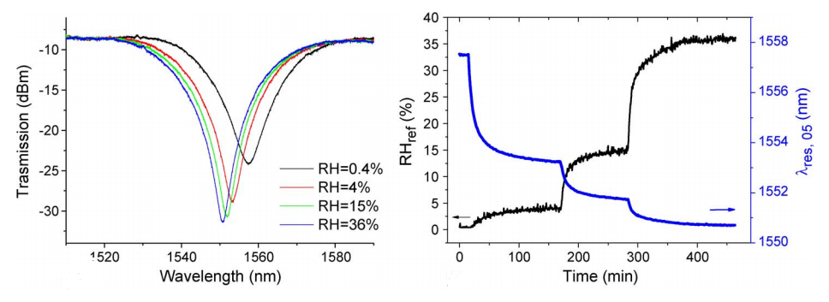
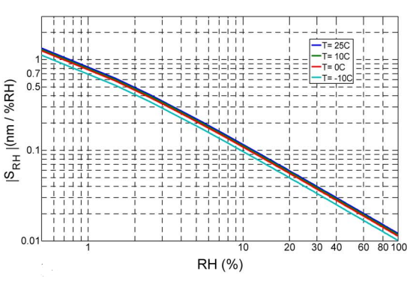
TiO₂ coated LPGs studies at CERN
  Coating thickness of 100 nm
  Dip-coating procedure
Relative Humidity Sensitivity of LPGs up to 3 orders of magnitude higher than FBGs
S_{RH} from 1.4 to 0.11 nm/%RH in the range of [0-10] %RH
HIGH PRECISION RELATIVE HUMIDITY MEASUREMENTS!

Slide 14
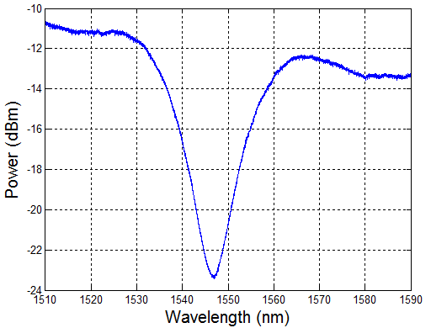
TiO₂ coated LPGs studies at CERN
Wavelength analysis
Methods
Minimum
Centroid
Threshold

Slide 15
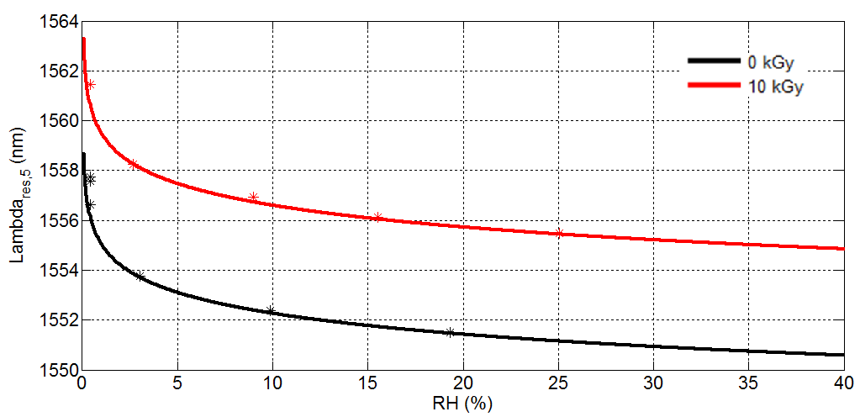
Preliminary investigations about LPGs under radiation
Sensitivity is not very affected by radiation
Radiation-induced shift to be taken in account
Incremental ϒ-ionizing radiation campaigns in progress for a better understanding of the behaviour of coated/uncoated-LPGs under radiations

Slide 16
What did I do at CERN?
1.1 – LabVIEW interface development to monitor the thermo-regulated chamber (temperature and humidity)
3 – Tests and Data Analysis
3.1 – Temperature and RH tests
4 – On going
4.1 – Preliminary study about the behaviour of LPG sensors under γ-ionizing radiation dose
1.2 – Setup improvements and automatization (mass flow controllers installation and integration) + interfaces to control
1 – Setup
3.2 – Sensitivity to humidity and temperature, accuracy, repeatability and hysteresis analysis
3.3 – MATLAB scripts development to analyse the data collected from the FBG and LPG
2 – Theory
2.1 – Study of the state of the art of FBG
2.2 – Study of the state of the art of LPG

Slide 17
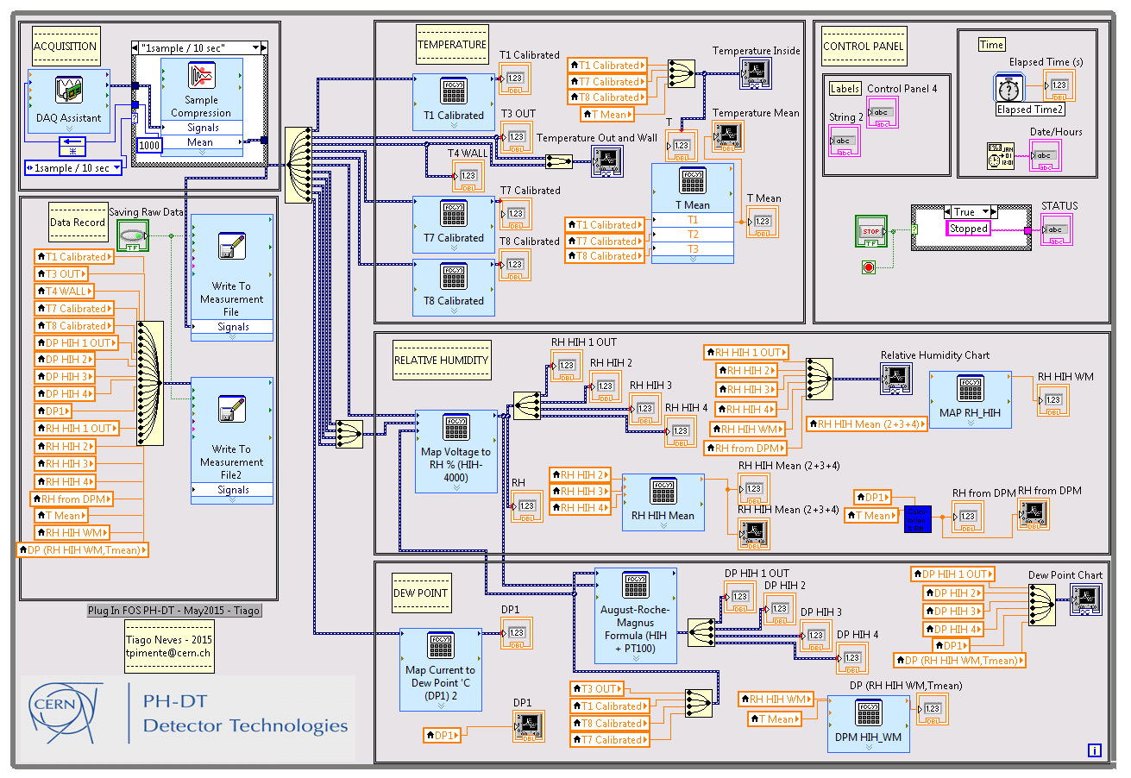
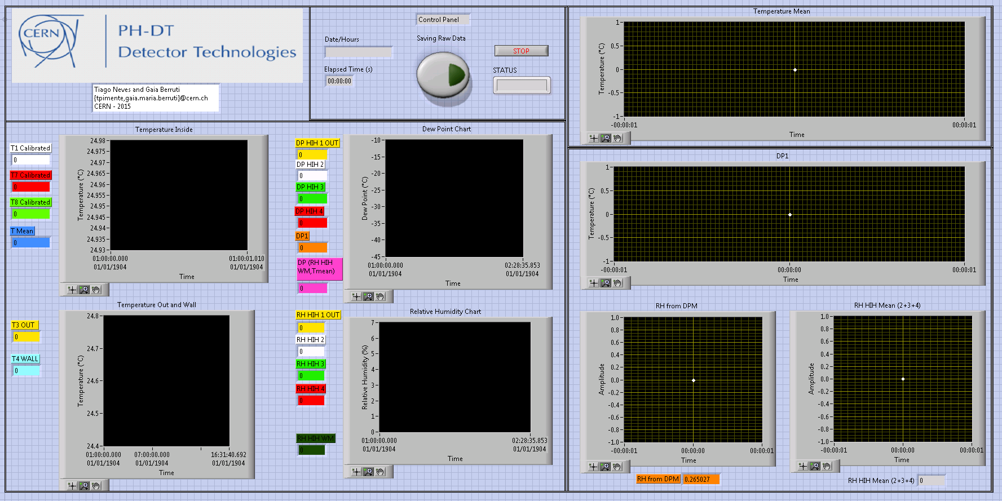
1.1 Labview Interface
Block Diagram
Visual Interface
Report : Plug-In FOS LabVIEW VI.pdf

Slide 18
1.2 – Setup Improvements
Clean and re-organization of the experimental setup
  Removal of the unconnected wires
  Reduction of the length of the wires
  Removal of the unnecessary wires joints
  Reconnection of all sensors
  Connection of all the ground planes
  Reduction of the length of the tubes
  Fix some air leaks
  Before:
  After:
Report : Oscillations Problem.pdf

Slide 19
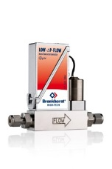
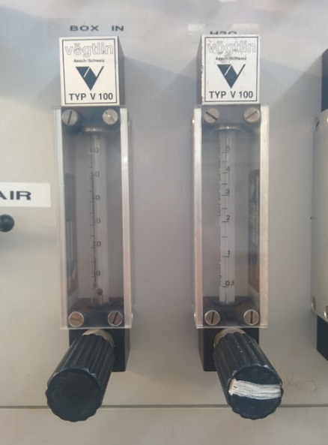
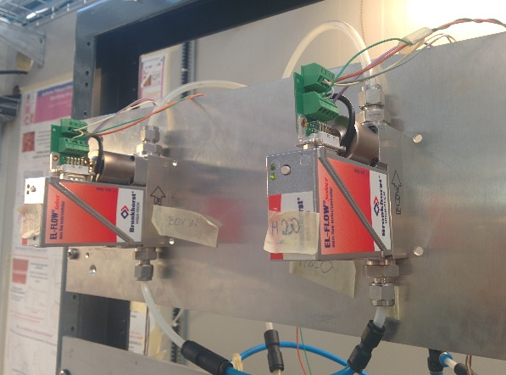
1.2 – System Automatization
Switch from the manual to automatic Valves
  2 x Mass Flow Controllers (MFCs) Implemented
    Dry Air – BOX IN (80ln/h)
    Wet Air – H2O (25ln/h)
  Bronckhorst El-Flow F-201CV
  Before:
  After:
Low precision
  Set point hard to define
Requires the presence of a test user
Remotely controlled
High precision
  Stable
Easily configured
Report : Valves Comparison.pdf

Slide 20
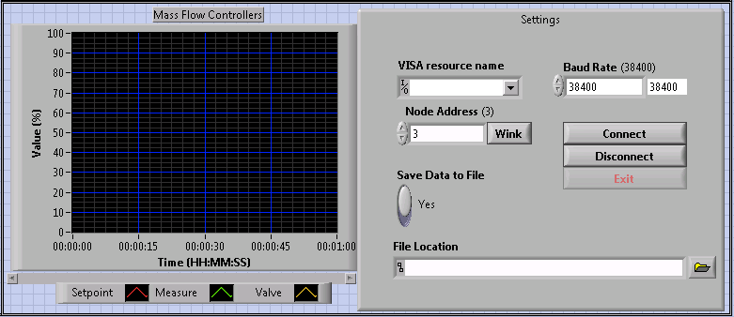
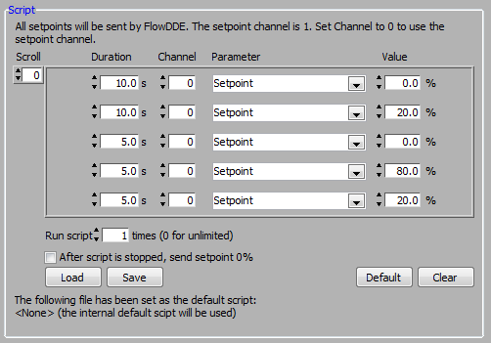
1.2 – System Automatization
  Easily programmed
  LabVIEW Interface
Programmable script to define the aperture of the valves
LabVIEW VI to control the MFCs added to the main VI

Slide 21
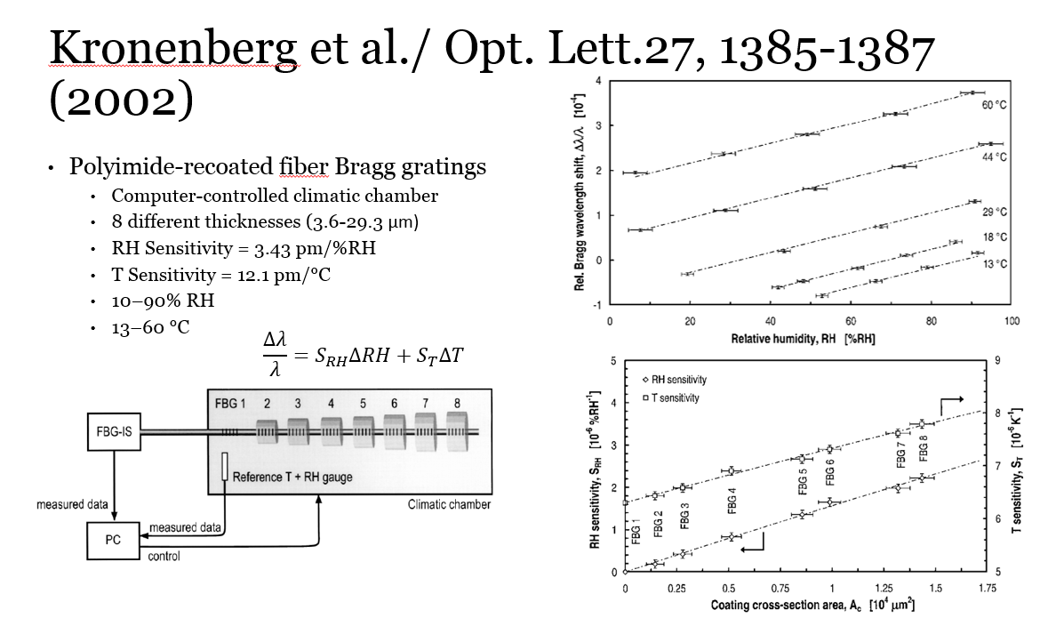
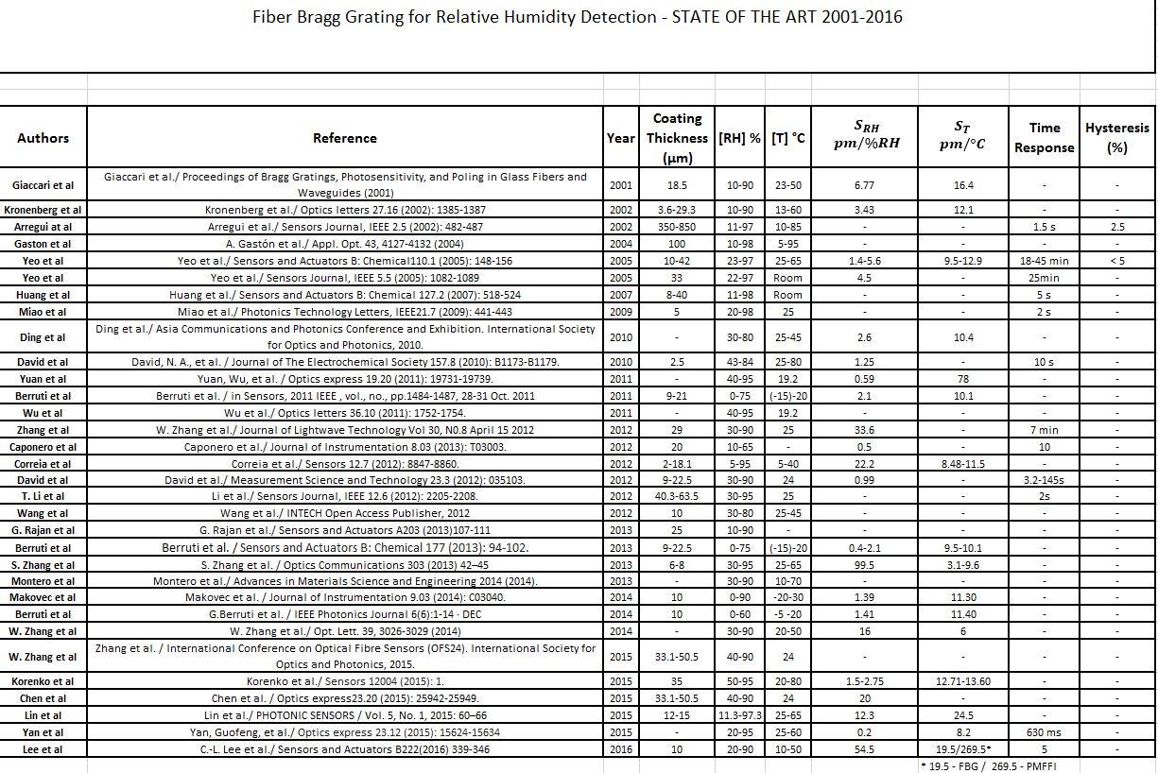
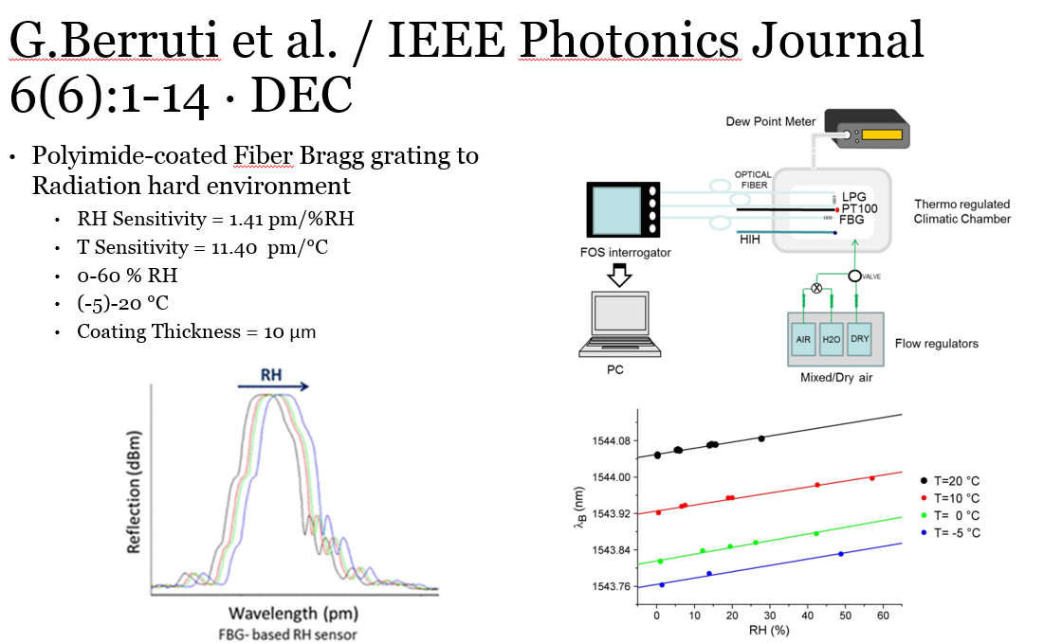
2 – State of the Art Study (FBG and LPG)
Resume and presentation about the most important studies in the area

Slide 22
3.1 – Tests and data analysis
Example of a tests with a LPG

Slide 23
3.2 – Characteristics analysis
FBG
LPG
Example of the tests with FBG and LPG to study the sensitivity

Slide 24
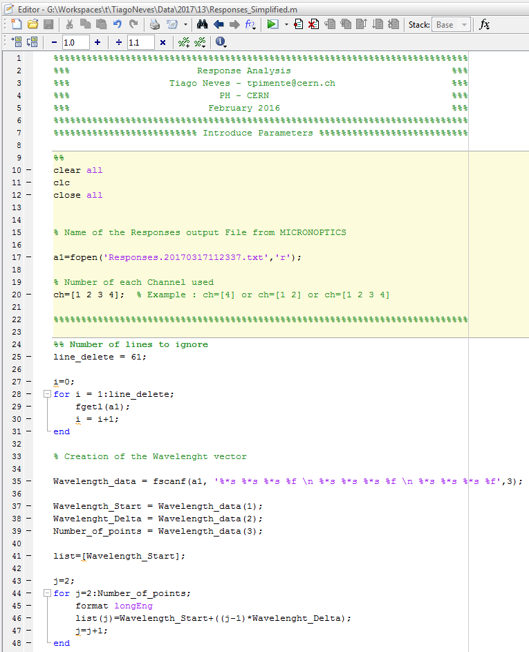
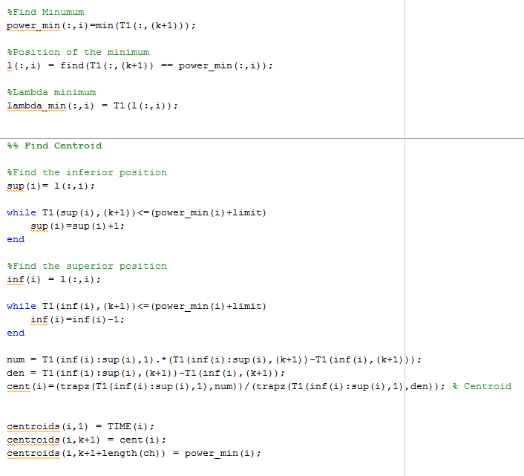
3.3 – MATLAB codes

Slide 25
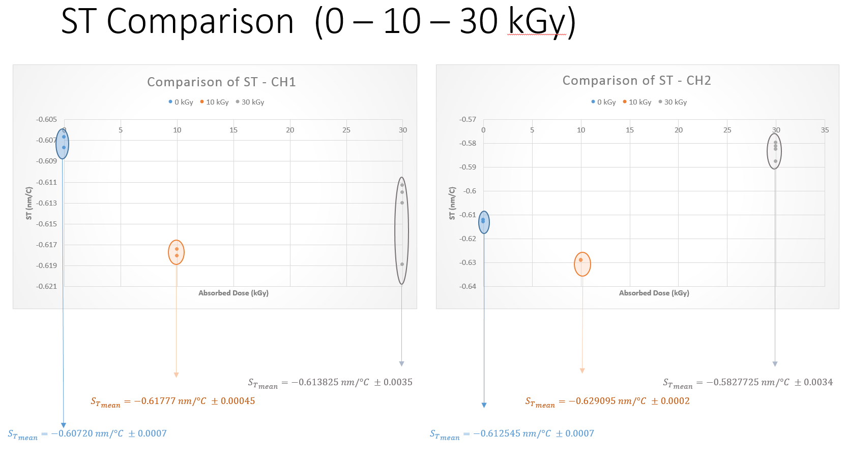
4 – Preliminary study about the behaviour of LPG sensors under γ-ionizing radiation dose

Slide 26
Future works – PhD Objectives
Production of final version of a RH sensor based on LPG
(1) Identify the best grating’s fabrication technique
  In collaboration with University of Sannio
  Different inscription techniques may affect the response of the sensor
  Well controlled process of fabrication are high-performing in terms of repeatability and stability of measurements compared to production in batch
(2) Identify the best coating’s technique
  In collaboration with CNR-ICMB
  Good quality, smoothness and homogeneity of the metal oxide deposited onto the grating

Slide 27
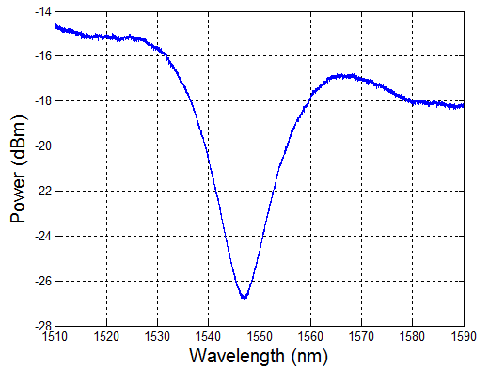
Future works – PhD Objectives
Production of final version of a RH sensor based on LPG
Wavelength range : 1510 – 1590 nm
Good Shape
  Thin
  Deep
  Symmetric

Slide 28
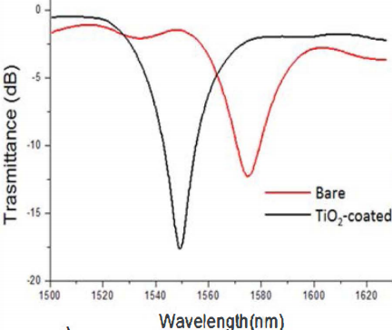
Future works – PhD Objectives
Production of final version of a RH sensor based on LPG
Minimum’s Position
  Coating Effects
  Radiation

Slide 29
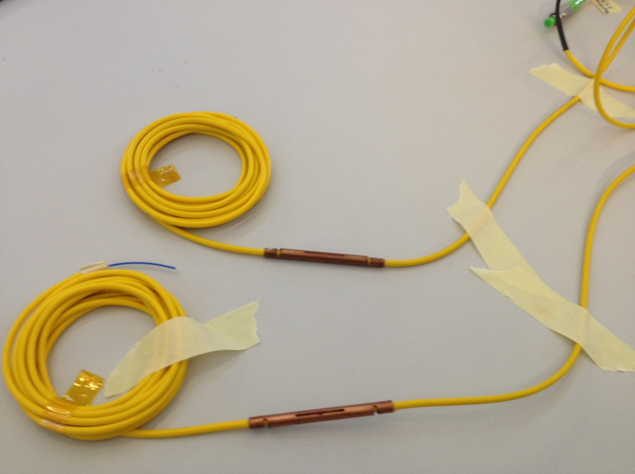
Future works – PhD Objectives
Production of final version of a RH sensor based on LPG
(3) Prototyping and production of a strain-free Package
  Similar design developed for the first generation of humidity sensors based on FBG technology
  New design of ceramic packaging (fabrication through 3D printing technology)
    First prototype under production
or

Slide 30
Future works – PhD Objectives
Production of final version of a RH sensor based on LPG
(4) Complete sensor’s behaviour characterization under radiation
ϒ-ionizing radiations
  On-going collaboration with ATOMKI (Debrecen-HU) and CERN irradiation facility
  Incremental irradiation campaigns to study the saturation properties of the radiation-induced shift
  On-line monitoring during the irradiation
  Off-line characterization (study of how the radiation affects the performance of the LPG based sensors)
Interest in the study of the behaviour of LPGs in presence of non ionizing radiations

Slide 31
Future works – PhD Objectives
Production of final version of a RH sensor based on LPG
(5) Design of the final thermo-hygrometer based on LPG technology
  Include a temperature sensor. Possibilities:
    Uncoated FBGs written in the same fiber than the coated LPGs
    Uncoated FBGs in a different fiber
    Use a distributed temperature sensor
Multiplexing
  Implement several sensors in the same fiber
  Restricted to the wavelengths ranges that we have in our devices (1510-1590nm)

Slide 32
Future works – PhD Objectives
Production of final version of a RH sensor based on LPG
(7) Sensor installation and integration in the CERN detectors
  Control and monitoring

Slide 33
Thank you for your attention!
Questions ?
tiago.neves@cern.ch

