Slide 1

Development of aluminium vacuum components
Q. Deliege, C. Garion. and J. Hansen
TE-VSC Seminar
Tuesday, 31st October 2017
CERN

Slide 2
Why aluminium in vacuum ?
Low nuclear activation
Low magnetic permeability
Low density
Thermal properties
Machinability
Good mechanical properties for some alloys
Low outgassing rate

Slide 3
Outline
Aluminium ConFlat flanges
  Principle and materials
  Welding tests
  Finite element studies
  Results
Aluminium vacuum windows

Slide 4
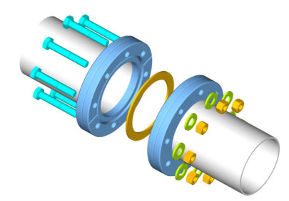
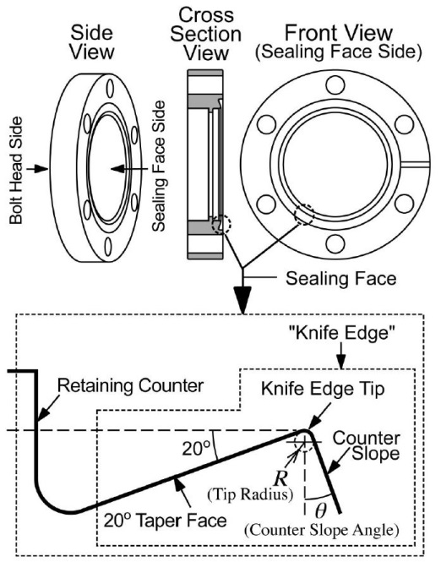
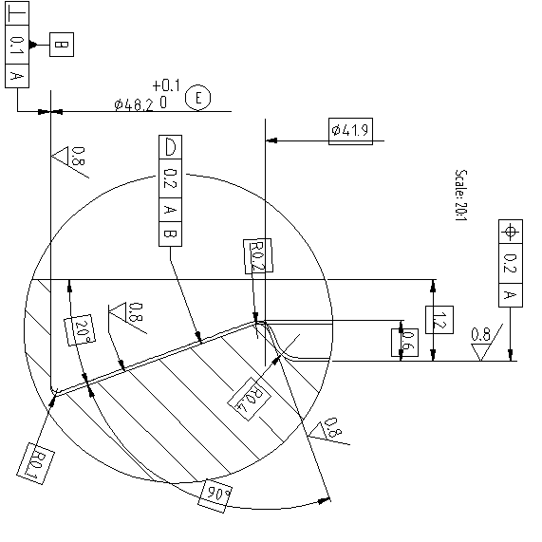
Principle of ConFlat (CF) sealing
Metal to metal seal used to connect vacuum components with a high leak-tightness
Dependence of the seal property of ConFlat-type flanges on the fine dimensions of the knife edge.
S. Kurokouchi, S. Shinoda, and S. Morita, 2003
DN35/40 Conflat flange drawing, STDVFUHV0005

Slide 5
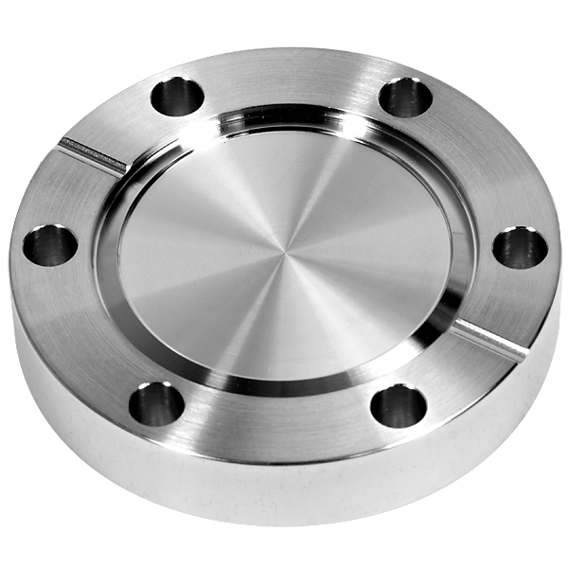
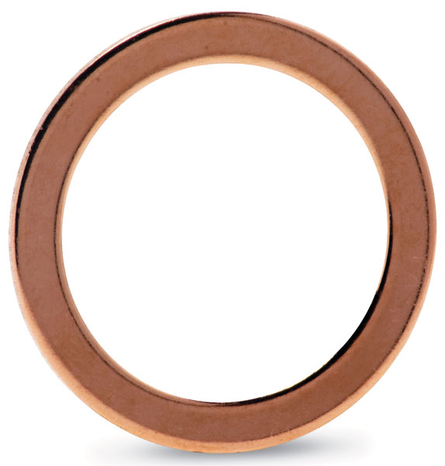
Goals
Replace:
Austenitic stainless steel CF flange & OFS copper CF gasket
Aluminium CF flange & aluminium CF gasket
Low activation on components to handle in aluminium vacuum chambers
Q. Deliege

Slide 6
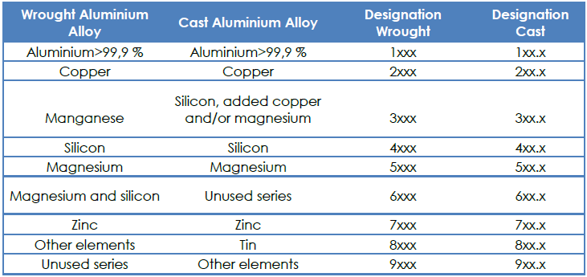
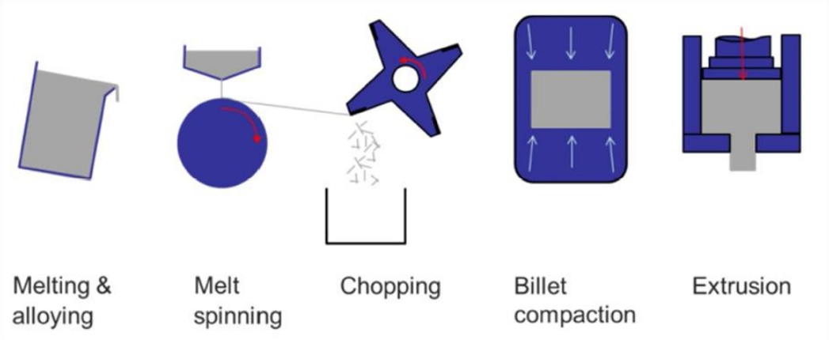
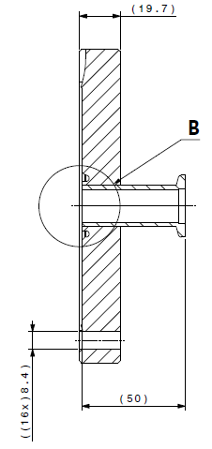
Materials
CF Flange
  Al-Cu-Li alloy 2050 T8411 & 2195 T8511
  Rapid solidification aluminium RSA-501 & RSA-905
CF Gasket
  Aluminium alloy 1100 H14
  Aluminium alloy EN AW 5083 H111
KF Connection
  Aluminium alloy EN AW 2219 T6
  Aluminium alloy EN AW 5083
EDMS 1415859, Floriane Leaux
LCHVFC__0016

Slide 7
Aluminium material properties
Flange material
Material | E-modulus [GPa] | Yield strength [MPa] | UTS [MPa] | Elongation at break | Hardness [HB]
RSA 501 | 70 | 500 | 540 | 12 | 150
2050 T8511 | 77 | 609 | 624 | 11 | 163
316LN annealed
RP0.2 | 300 MPa
Hardness | 150-190 HB
Gasket material
Material | E-modulus [GPa] | Yield strength [MPa] | UTS [MPa] | Elongation at break | Hardness [HB]
1100 H14 | 68.9 | 95 | 124 | 10 | 32
5083 H111 | 71.5 | 145 | 290 | 16 | 77

Slide 8
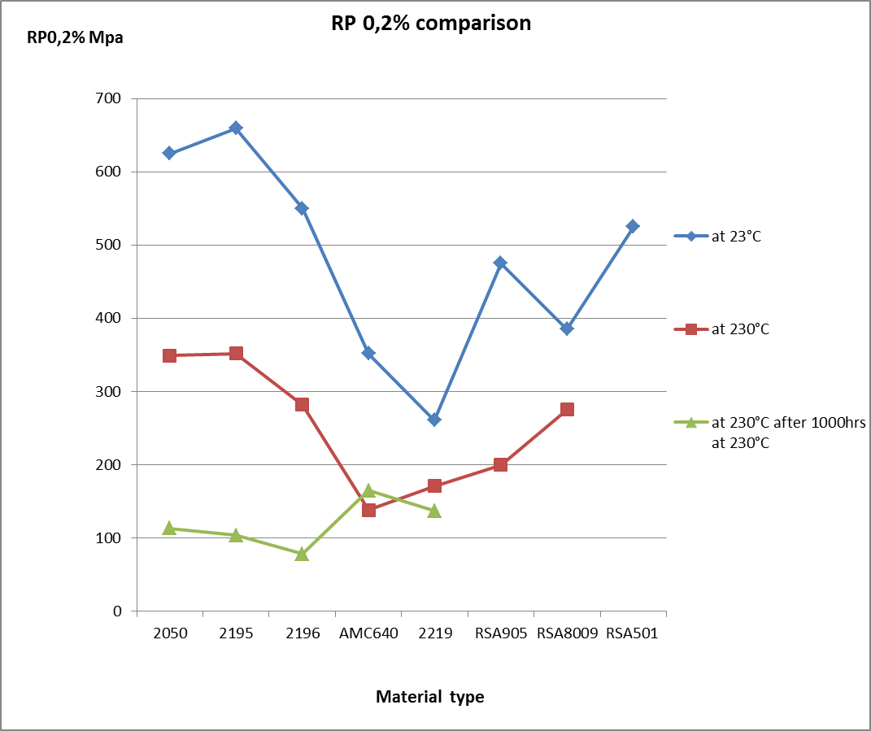
Aluminium material properties
Why do we use these two alloys for the CF flanges ?
Pre-qualification of new aluminum alloys for CERN UHV, P. Lepeule, 03/09/2013

Slide 9
Outline
Aluminium Conflat flanges
  Principle and materials
  Welding tests
  Finite element studies
  Results
Aluminium vacuum windows

Slide 10
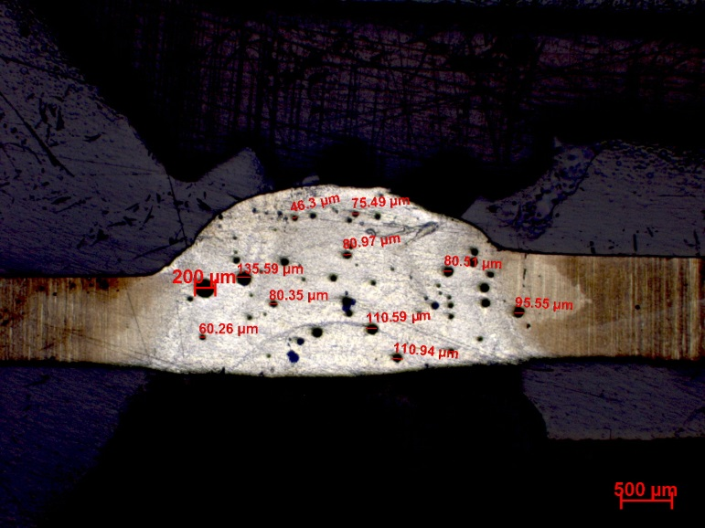
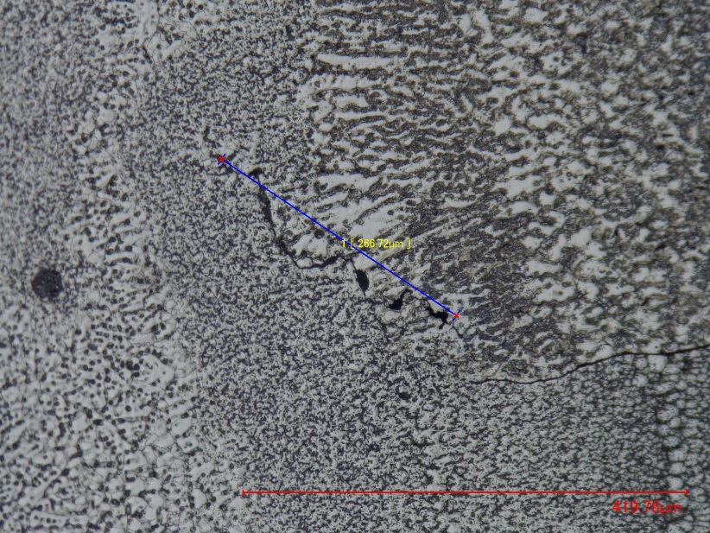
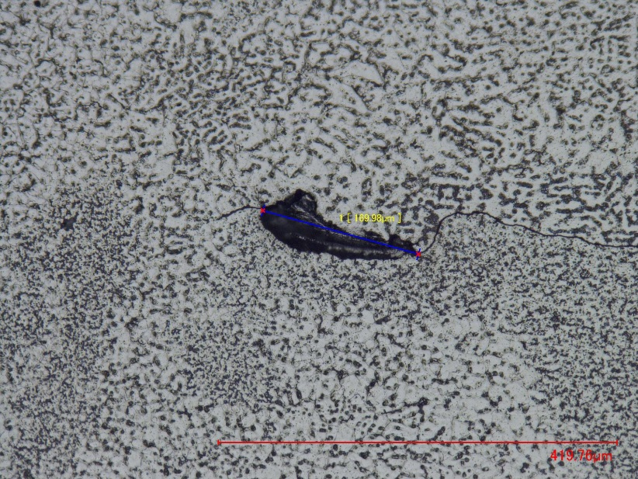
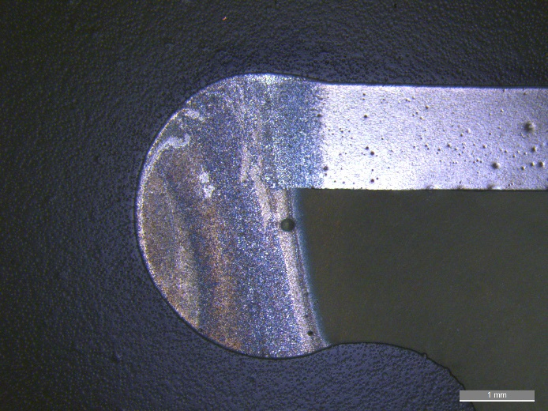
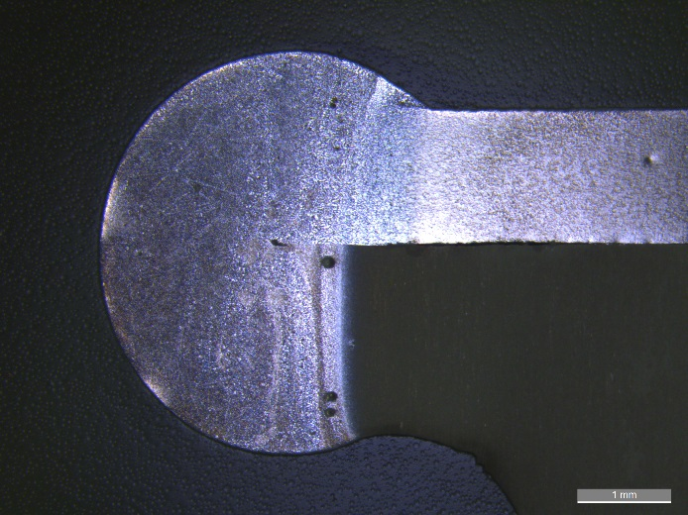
Welding tests with RSA 501
Metallurgical inspections of TIG welded RSA 501 with itself
RSA 501
Linear porosities
Not permitted
EDMS 1388355, Weldability of aluminium alloys produced by rapid solidification, N. Valverde, F. Leaux, 02/2015
12.5 x, current 23 A
Metallurgical inspections of TIG welded RSA 501 on EN AW-5083
ALMG 4.5
Porosity area ratio: 0.0055
Permitted
Imperfection height: 267 μm
Not permitted
Porosity area ratio: 0.0045
Permitted
Imperfection height: 170 μm
Not permitted
ALMG 5
12.5 x
12.5 x
EDMS 1457946, Metallurgy report, R. Hirt, A. Gerardin, 12/2014

Slide 11
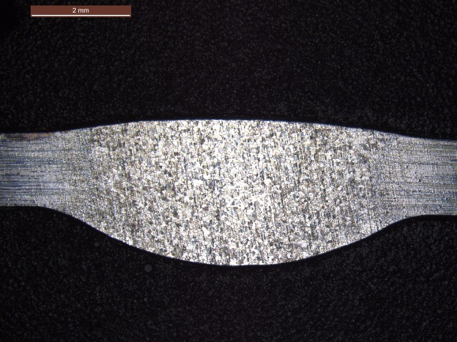
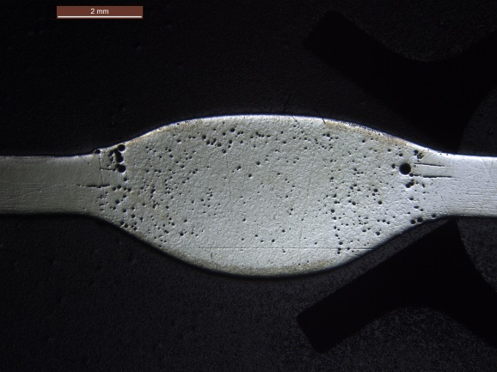
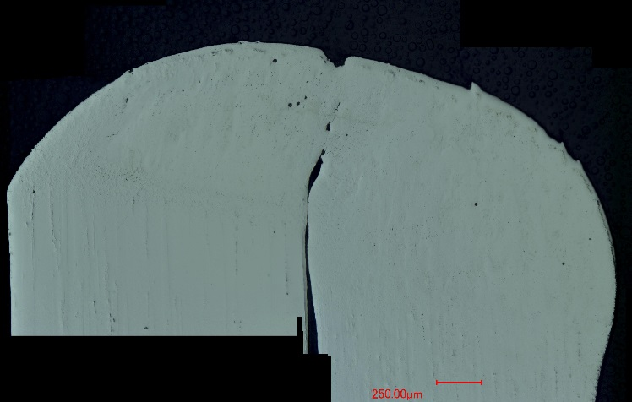
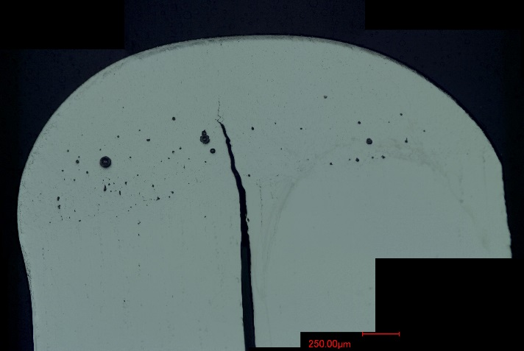
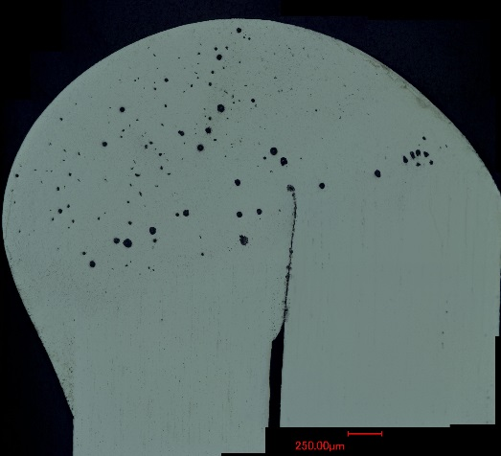
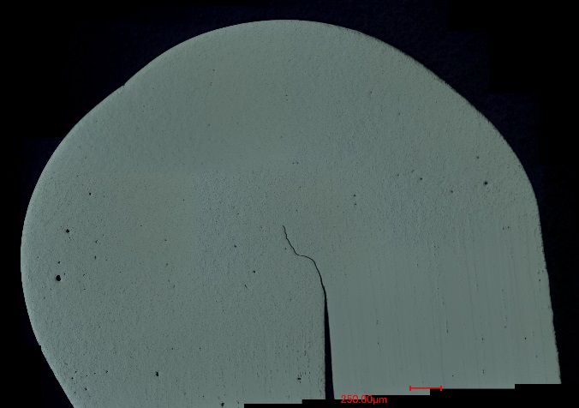
Welding tests with EN AW-2050
Metallurgical inspections of TIG welded EN AW-2050 on itself with filler material EN AW-2319 (thickness of samples: 1.6 mm).
EN AW 2050 Ø 64 mm
EN AW 2050 Ø 74 mm
Clustered porosity
Not permitted
EDMS 1301285, Metallurgy report, M. Hiltbrand, A. Gerardin, S. Sgobba, 07/2013
10 x
Permitted
10 x
Metallurgical inspections of TIG welded EN AW-2050 on EN AW-5083 and EN AW-2219 with or without filler material EN AW-2319.
2050 / 5083
2050 / 2219
2050 / 5083 (filler)
2050 / 2219 (filler)
Micro-cracks
Lack of fusion
Not permitted
Micro-cracks
Not permitted
Uniformly distributed porosity
Not permitted
Micro-cracks
Not permitted
200 x
200 x
200 x
200 x
EDMS 1561349, Metallurgy report, M. Crouvizier, GA. Izquierdo, S. Sgobba, 02/2016
Micro-cracks can only be permitted in case on non-sensitivity of the parent material to crack propagation.

Slide 12
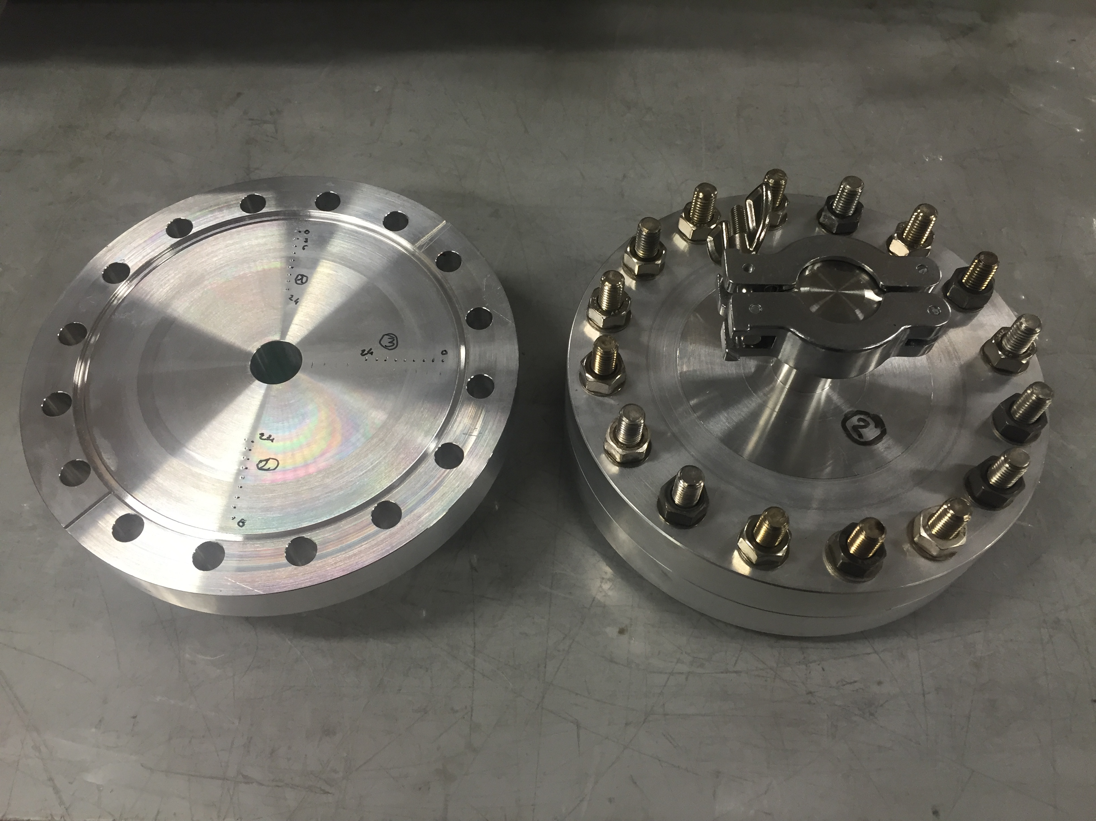
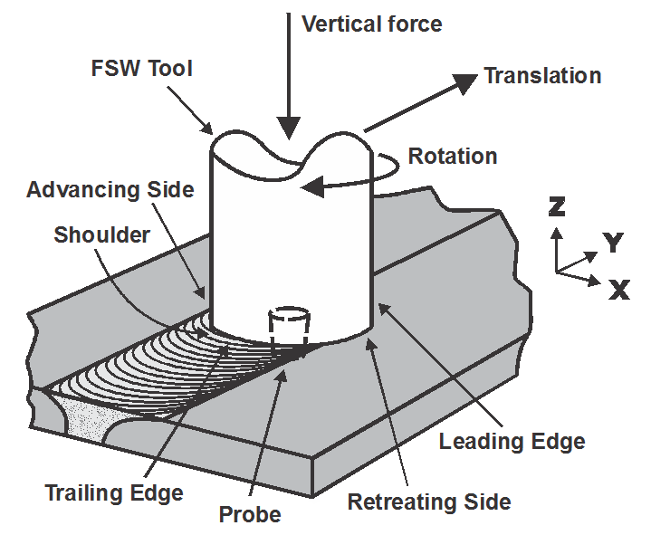
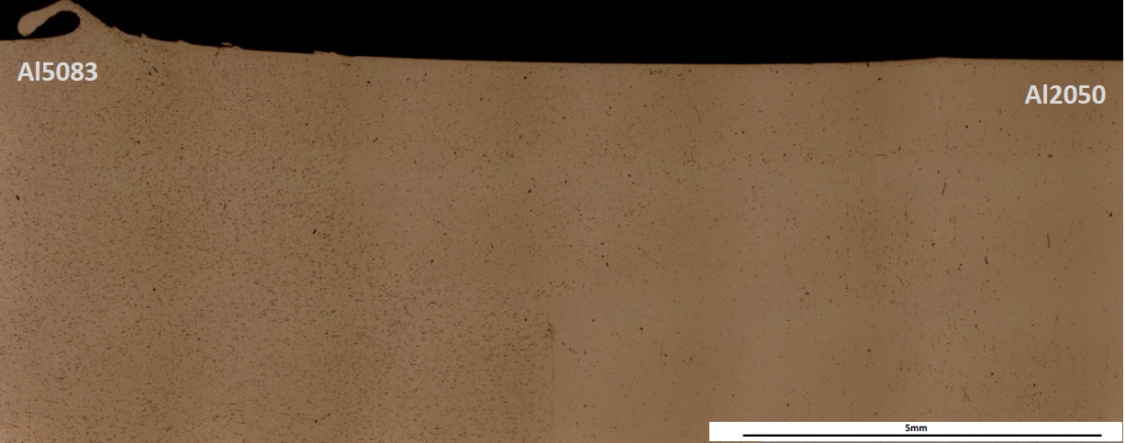
Friction stir welding (FSW)
Alternative to TIG welding process
2 DN100 flanges have been manufactured by Sominex doing FSW between EN AW-2050 (flange) and EN AW-5083 (KF connection)
FSW process
The hardness of the heat affected zone is between the 2 parent materials
The ultimate stress is not degraded after welding
Good microstructure in the interface
Courtesy Sominex, M. Polidor

Slide 13
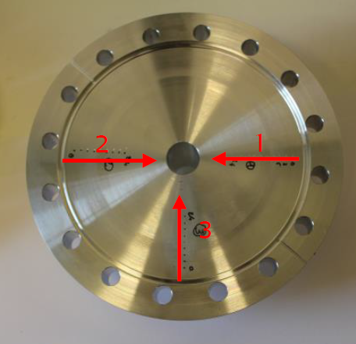
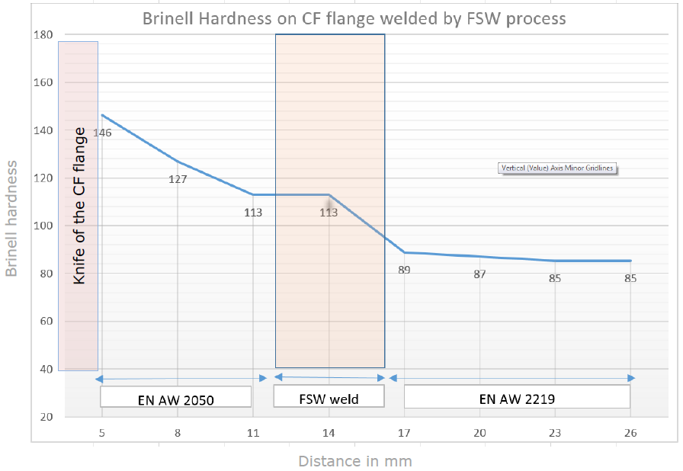
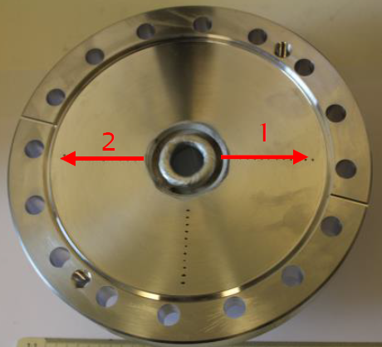
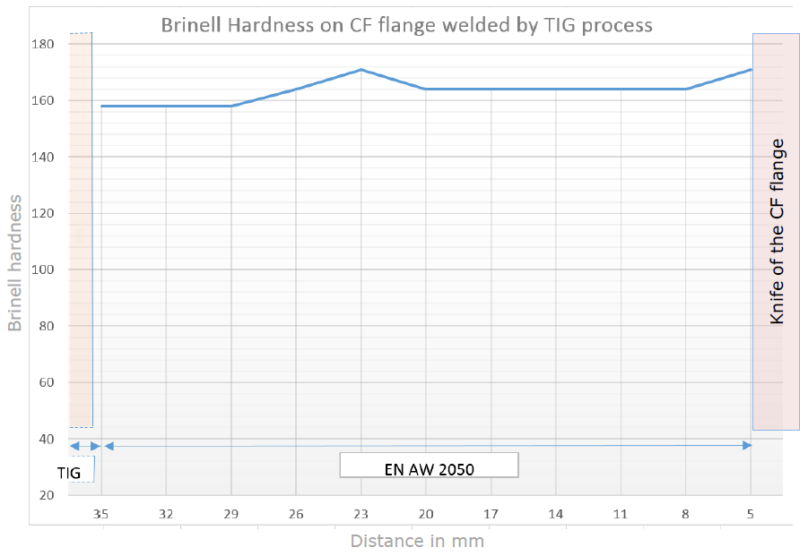

Hardness after welding
Brinell Hardness of Al 2050 welded by FSW process
Hardness at the weld between Al 2050 hardness and Al 5083 hardness.
Slight decrease of the Al 2050 hardness close to the weld which can be due to a partial dissolution of the hardening precipitates.
No effect on the 5083 hardness.
EN AW 5083
Brinell Hardness of Al 2050 welded by TIG process
No effect at least 9 mm away from the welding bead
EDMS 1687628, metallurgy report, M. Meyer, 05/2016

Slide 14
Outline
Aluminium Conflat flanges
  Principle and materials
  Welding tests
  Finite element studies
  Results
Aluminium vacuum windows

Slide 15
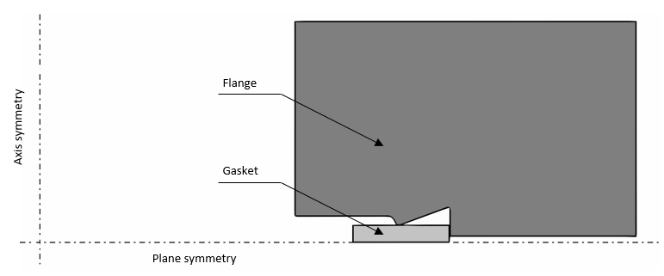
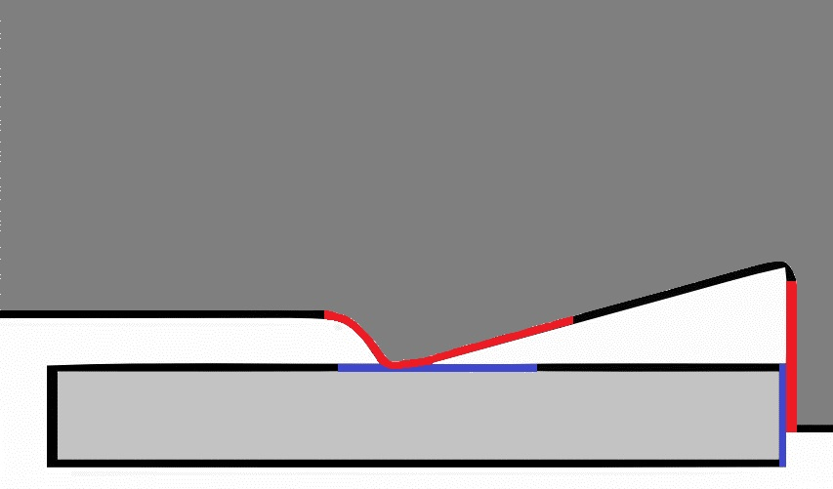
Finite element calculations
2D axisymmetric model with DN40 and DN100 standard geometries
Materials
  Elastic-plastic with bilinear kinematic hardening
  Gaskets: aluminium alloy 1100-H14 & 5083-H111
  Flanges: aluminium alloy RSA-501 & Al-2050
Fix seal / moving flange up to 0.35 mm penetration
Frictional contact between the knife and the gasket → sliding friction coefficient of 0.34 for dry surface Al 6061-T6 (Friction surface and technology, Peter J. Blau, 2008)
Frictionless contact at the retaining counter region
In collaboration with Rafal Wawrowski

Slide 16
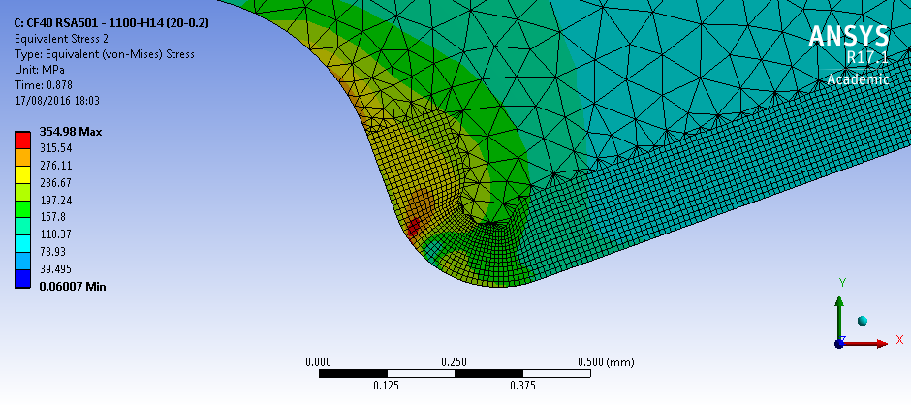
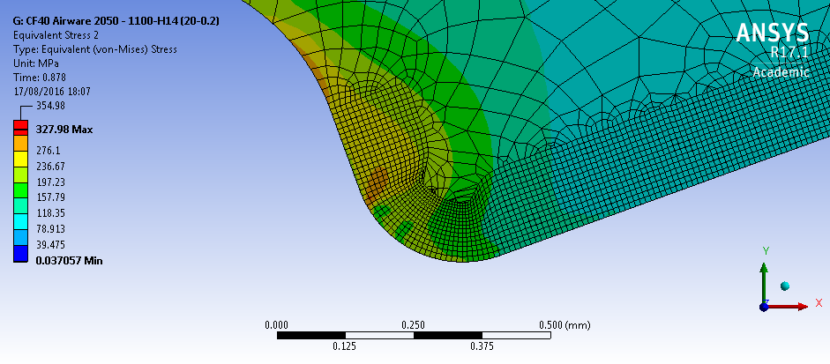
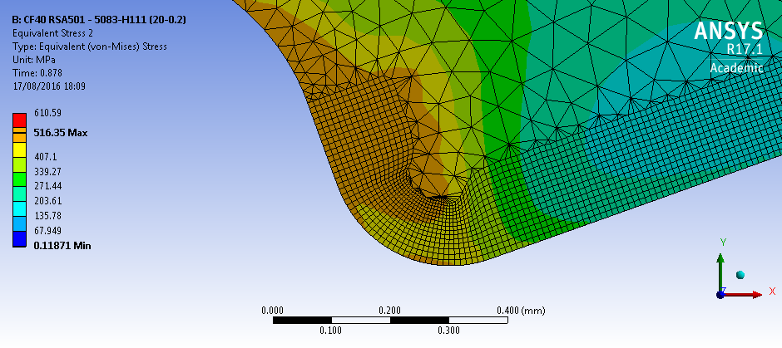
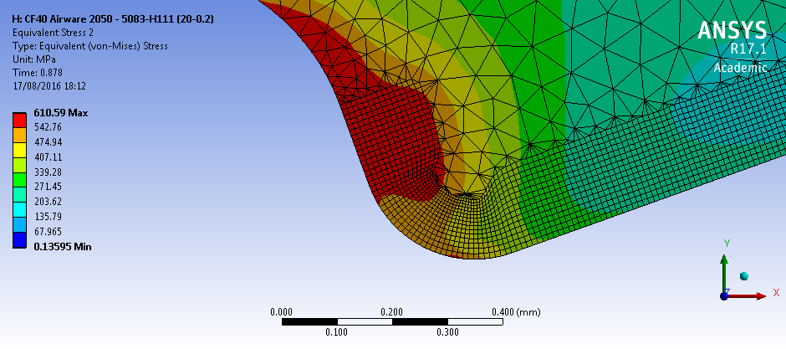
Finite element calculations
Material | Yield strength [MPa]
1100 H14 | 95
5083 H111 | 145
Material | Yield strength [MPa]
RSA 501 | 500
2050 T8511 | 609
RSA 501 – 1100-H14
Max stress 355 MPa
Al 2050 – 1100-H14
Max stress 328 MPa
RSA 501 – 5083-H111
Max stress 516 MPa
Al 2050 – 5083-H111
Max stress 610 MPa
In collaboration with Rafal Wawrowski

Slide 17
Outline
Aluminium Conflat flanges
  Principle and materials
  Welding tests
  Finite element studies
  Results
Aluminium vacuum windows

Slide 18
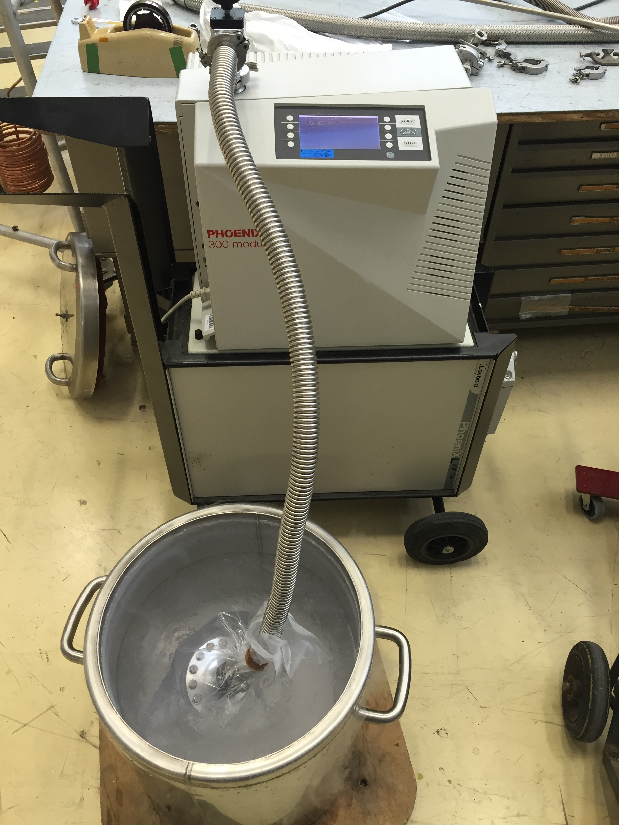
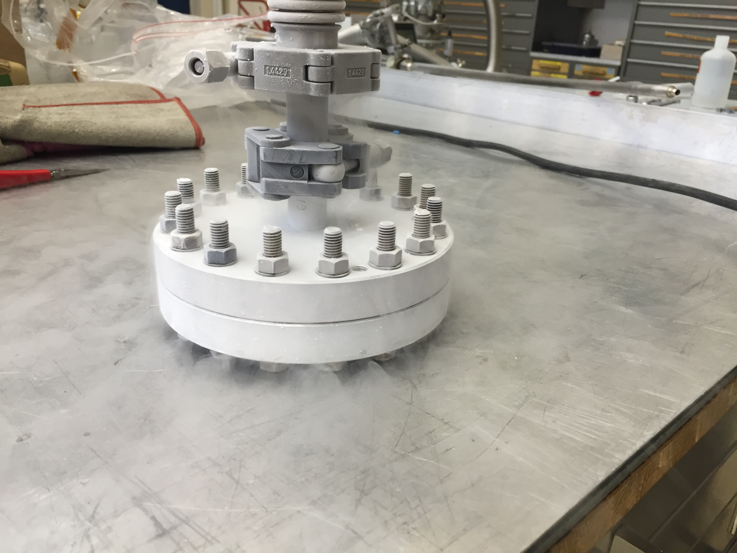
Leak tests results
 |  | RSA 501 | Al 2050
Bake out (200˚C) | DN 35-40 | 4 tests passed | 4 tests passed
 | DN 100 | - | 2 tests passed
Room temperature | DN 35-40 | 8 tests passed | 8 tests passed
 | DN 100 | - | 4 tests passed
Cryogenic 77 K | DN 100 | - | 2 tests passed
+ With 2 different gaskets 1100 and 5083
+ With stainless steel screws
Note: Some complementary tests were done with an aluminium CF flange and a stainless steel CF flange using aluminium gasket at RT and at 200˚C.

Slide 19
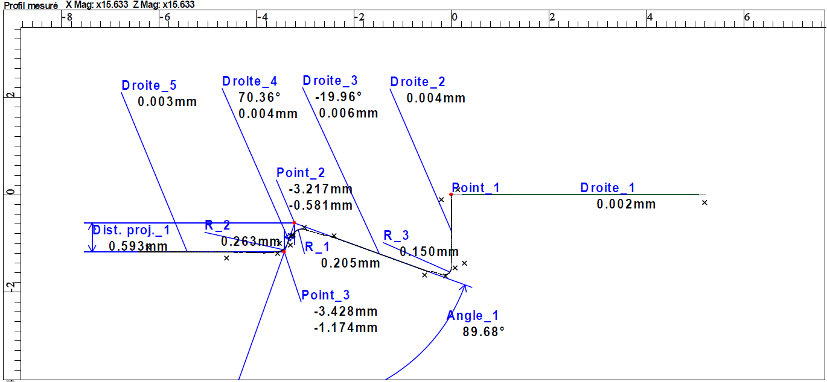
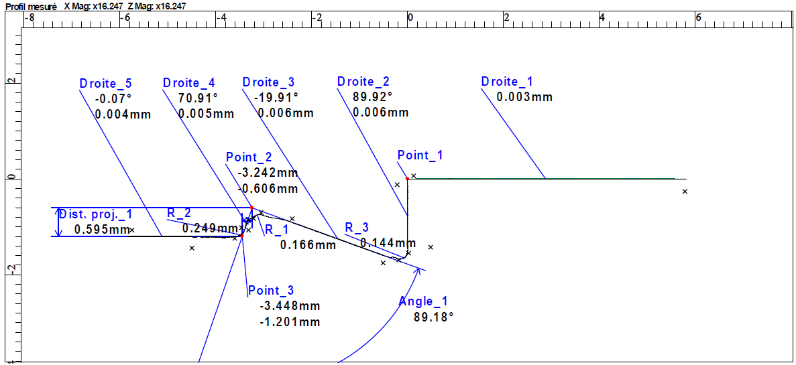
Metrology – knife deformation – RSA 501
After 8 tests at room temperature
After 4 bake out tests (200 °C)
EDMS 1511348 v.1, metrology report, J.P. Rigaud, 06/2015

Slide 20
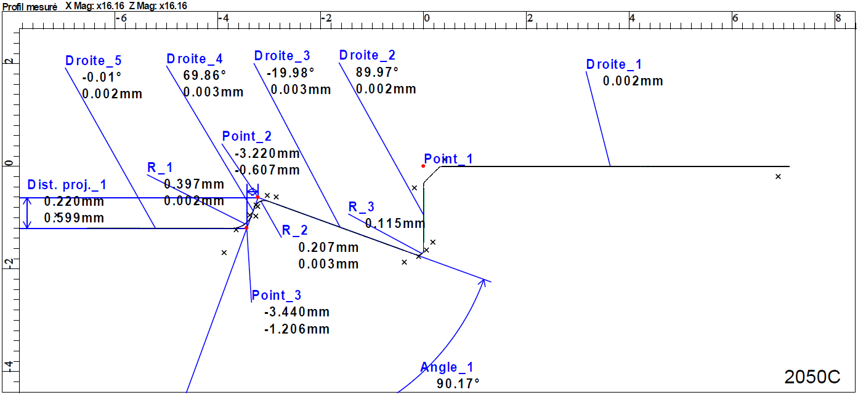
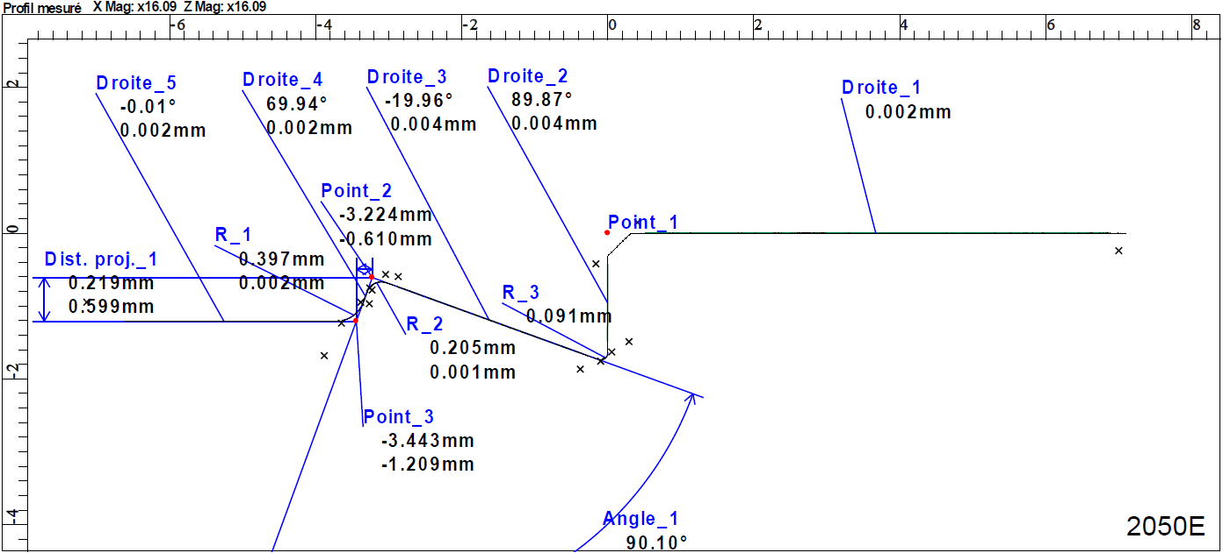
Metrology – knife deformation – Al 2050
After 8 tests at room temperature
After 4 bake out tests (200 °C)
EDMS 1586657, metrology report, J.P. Rigaud, 03/2016

Slide 21
Conclusions
 | RSA 501 | Al-Cu-Li 2050
Mechanical properties | + + | + + +
Behaviour at bake out temperature | + | + +
Hardness after welding | + + + | + + +
Outgassing (H2O) mbar/l/cm2/s | + 3.31e-9 | - 3.95e-8
Outgassing BO (H2) mbar/l/cm2/s | + 3.19e-12 | + + + 2.47e-14
Welding ability | - | -
Leak tightness | + + + | + + +
Knife resistance | - - | + + +
Procurement | - - | + +
Price | - | - (164 € / kg)

Slide 22
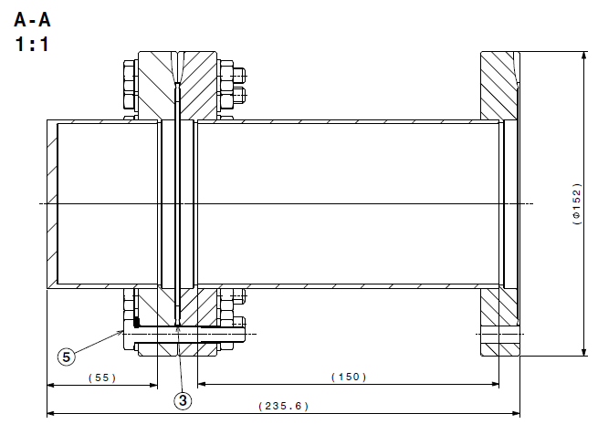
Further studies
Have more data on materials with the temperature in order to predict the knife deformation more accurately.
Eventual creep after many bake out cycles. Test bench in 113, done by C. Di Paolo, J. Chaure)
LCHVFC__0020

Slide 23
Outline
Aluminium Conflat flanges
  Principle and materials
  Welding tests
  Finite element studies
  Results
Aluminium vacuum windows

Slide 24
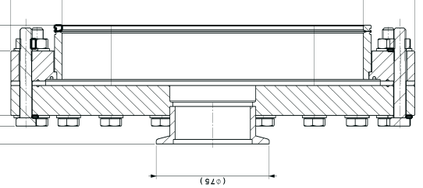
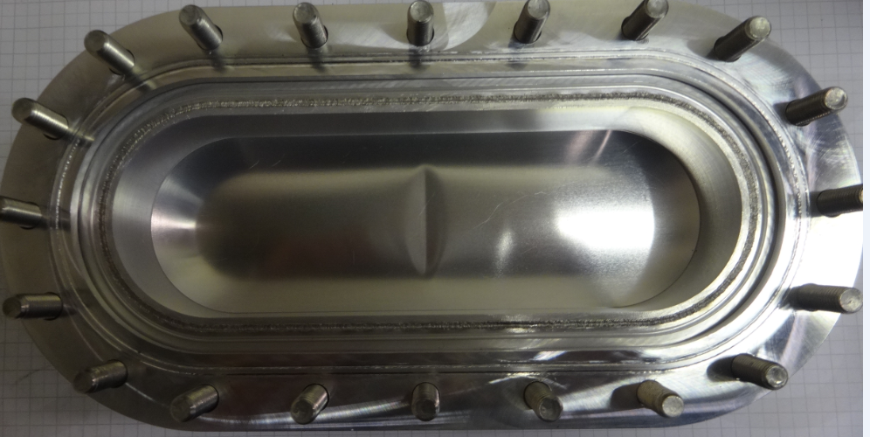
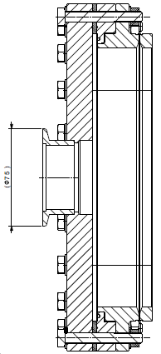
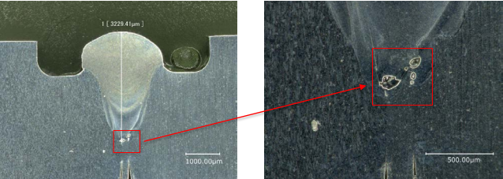
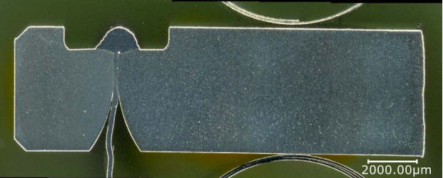
Prototypes of awake spectrometer window
99.5% Al window
5083 H116 frame
6082 T6 flange
5083 H116 weld neck
Assembly of the prototype window, CDD SPSVXW__0011
Spectrometer prototype after pumping and venting to atmospheric pressure, J. Hansen, EDMS 1558694
Assembly of the prototype window, CDD SPSVXW__0018
Metallurgical observations (EB), L. Gomez Pereira, EDMS 1698905

Slide 25
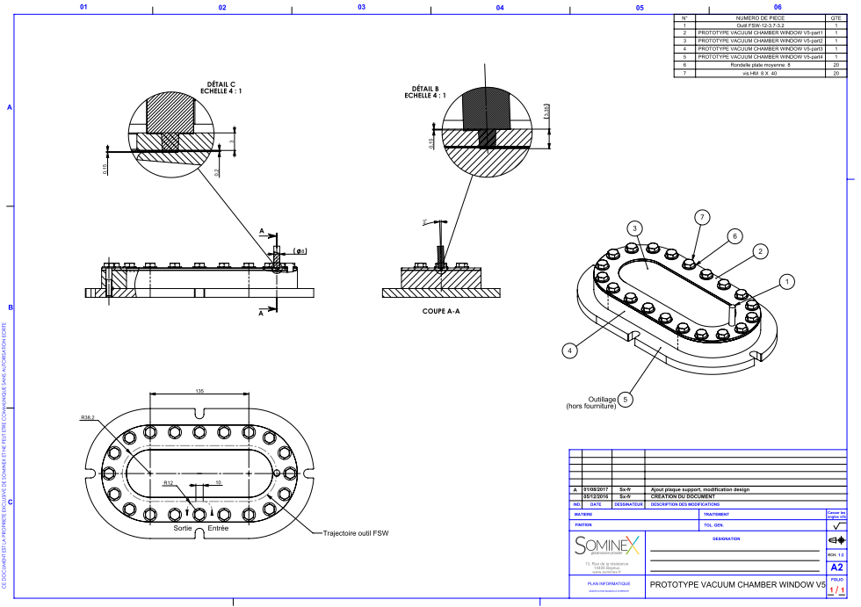
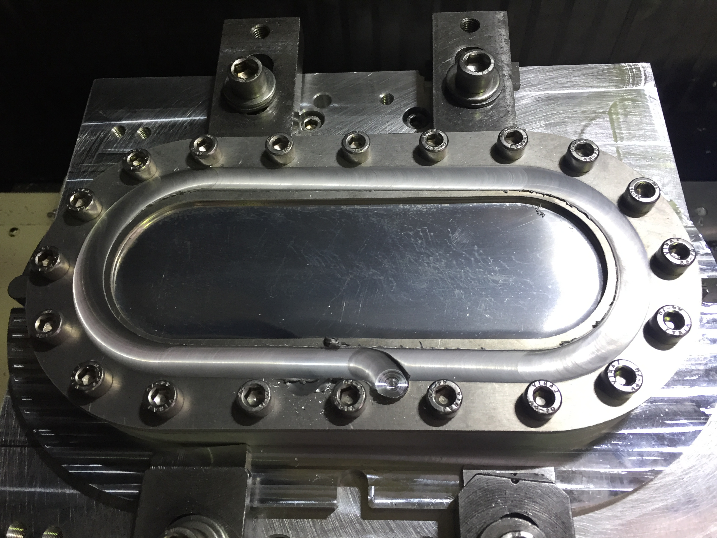
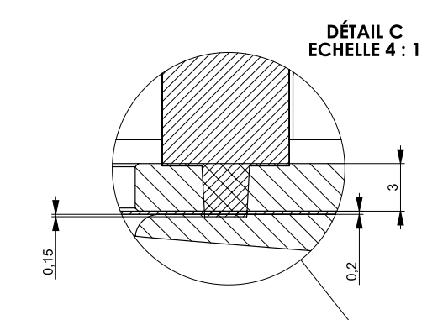
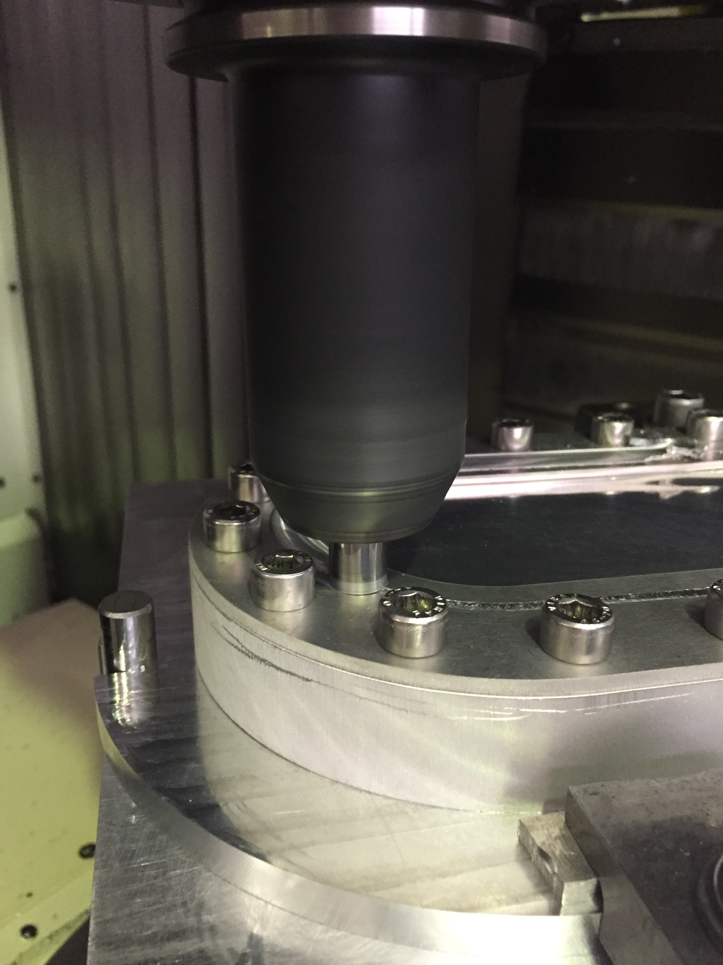
Prototypes with FSW
Courtesy Sominex

Slide 26
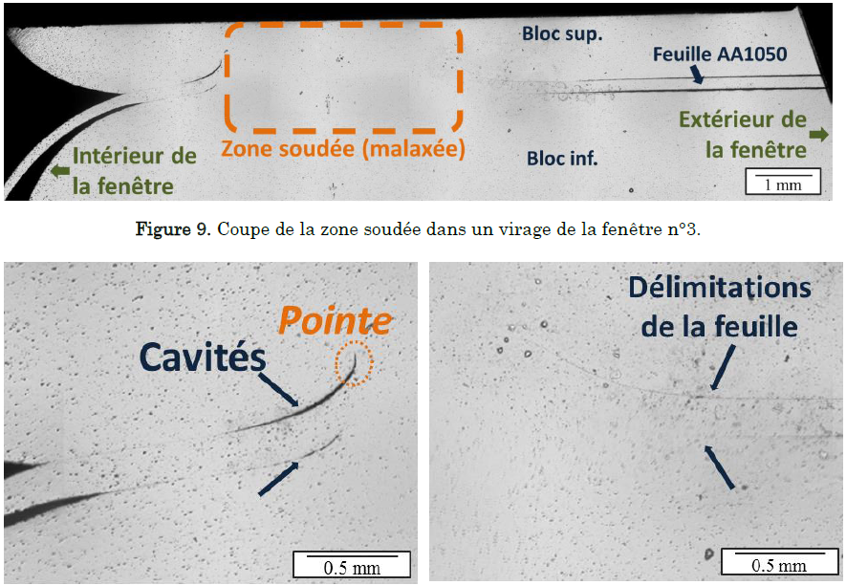




Conclusions…
Courtesy Sominex
- Good behaviour of the window under vacuum and at atmospheric pressure
- He leak tightness $Q<2.{10}^{−10}mbar.l.s^{−1}$
- Possible virtual leaks to be investigated

Slide 27





…Other FSW applications
St. steel / Al CF flange
St. Steel / Al Pressure tubes
Titanium / Aluminium
500 µm
Courtesy Sominex

Slide 28
Thank you for your participation !

Slide 29
Outgassing
Material | H2O Outgassing rate After 10h pumping [mbar/L/cm2/s] | H2 Outgassing rate After 10h pumping [mbar/L/cm2/s]
2050 | 3.95e-8 (average on 2) | 2.47e-14
2195 | No data | 2.99E-13
2196 | 3.49e-8 (average on 2) | 1.53E-13
RSA 501 | 3.31e-9 | 3.19E-12
RSA 905 | 1.93e-9 | 1.56E-12
2219 | 9.52e-9 | 4.28E-14
5083 | 5.55e-9 | 6.62E-13
Cousrtesy P. Lepeule and M. Morrone measurements, 02/2016
St. steel | 3e-10 | 3e-12

Slide 30

Comparison with SS / Cu couple

Slide 31
Metrology
Goals:
  Compare the deformation of the knife profile for RSA 501 and Al-Cu-Li 2050 alloy
  Compare the deformation of the knife profile after bake out (BO) or room temperature (RT) tests

Slide 32




Metrology – knife deformation – RSA 501
8 RT tests
4 bake out tests
EDMS 1511348 v.1, metrology report, J.P. Rigaud, 06/2015

Slide 33


Gasket choice
5083 H111 with RSA 501 knife print
Higher elastic spring back
1100 H14 with RSA 501 knife print
Higher plastification

Slide 34






Leak rate calculations
Conductance for annular seal:
$$C=34\frac{2π}{\ln\left({r_{o}}/{r_{i}}\right)}A^{2} e^{\frac{−3P}{R}}$$
Where:
$C [l.s^{−1}]$ Conductance
$r_{o}$ and $r_{i} [cm]$ Inner and outer radiuses
$A \left[cm\right]$ Double value of surface roughness
$P \left[MPa\right]$ Contact pressure
$R \left[MPa\right]$ Sealing ability factor
Sealing ability for different materials
$$Q=C∗∆P$$
Leak rate $Q [mbar.l.s^{−1}]$
Where $∆P$ stands for the pressure difference of the leaking gas i.e. the pressure difference between the atmospheric pressure and the vacuum pressure

Slide 35

Leak rate calculations
Comparison between theoretical and experimental results:
DN40
DN100

Slide 36

Leak rate calculations
Fixed compression plate
Intermediate parts
Flexible pipe connected to the pumping group and the leak detector
CF flanges
Force sensor
Mobile compression plate

Slide 37

Friction stir welding (FSW)
Hardness at the Al2050 / Al5083 interface
Hardness 2050
Hardness 5083

Slide 38
Materials
Samples | Experimental conditions
RSA 501 | 24 h at 250 °C 4 h at 500 °C
RSA 905 | 24 h at 250 °C 4 h at 500 °C
RSA 8009 | 24 h at 250 °C 4 h at 500 °C
Alloy | E-Modulus (GPa) | Hardness (HB) | Ultimate Tensile Strength (MPa) | Yield Strength (MPa) | Elongation (%)
RSA 501 | 70 | 159 | 550 | 510 | 16
RSA 905 | 90 | 180 | 600 | 475 | 7
RSA 8009 | 90 | 138 | 460 | 385 | 15
RSA 501 composition: Al-Mg5-Mn1-Sc0.8-Zr0.4
RSA 905 composition: Al-Fe2.5-Ni5-Cu2.5-Mn1-Mo0.8-Zr0.8
RSA 8009 composition: Al-Fe8.7-Si1.8-V1.3

