Slide 1
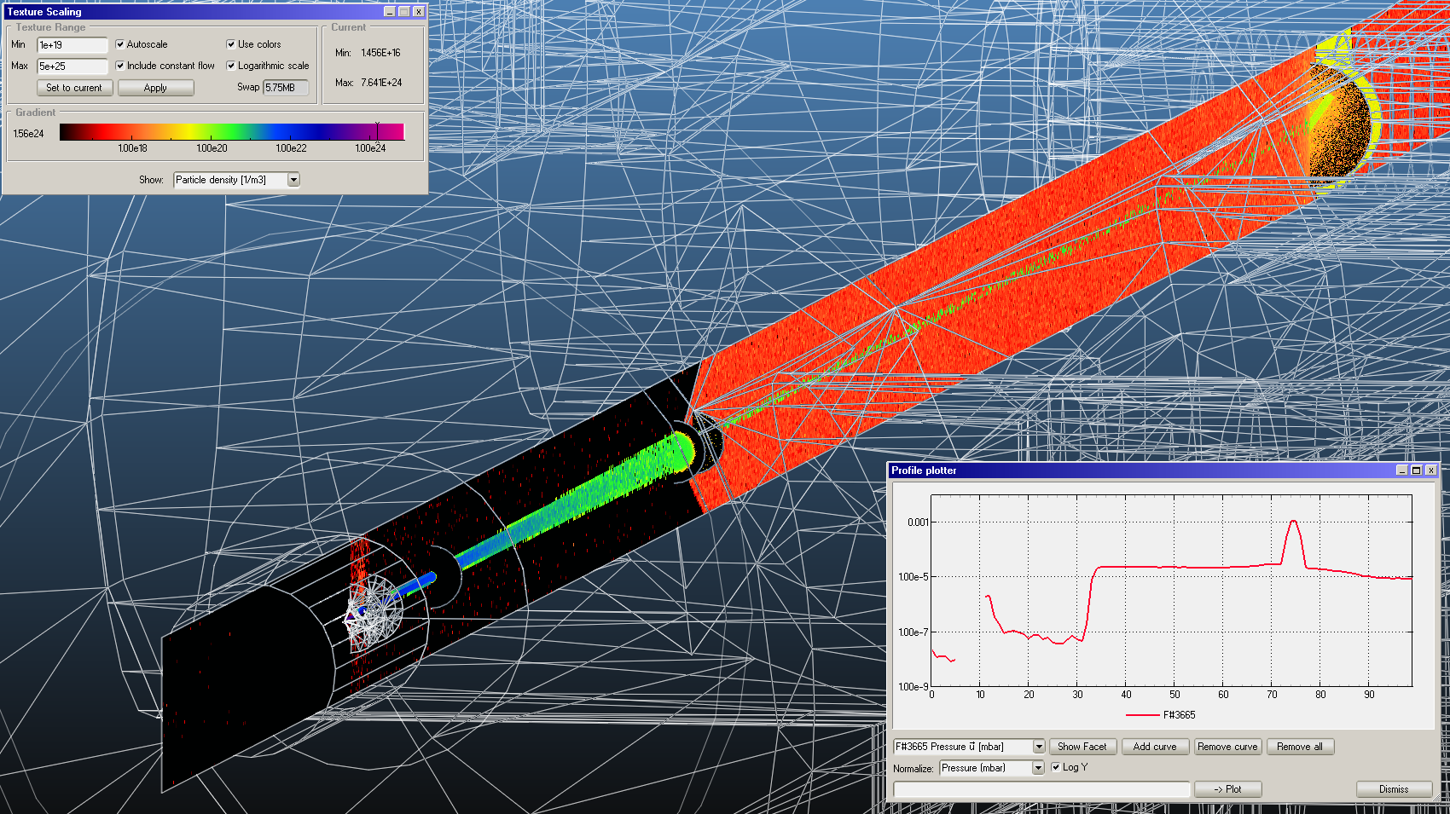
Progress on Monte Carlo simulation of the low-density region
Marton ADY, Roberto KERSEVAN
BGC meeting 28/04/2017

Slide 2
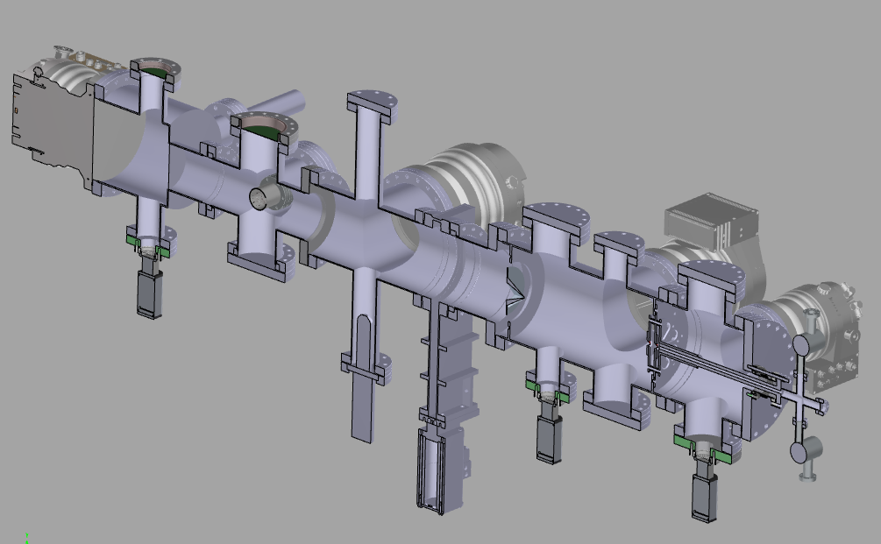
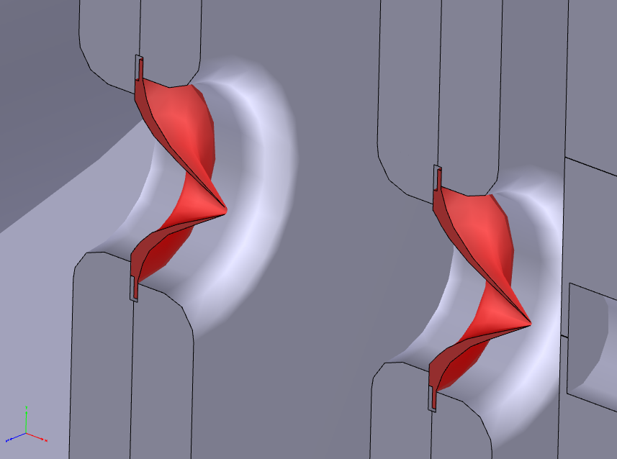
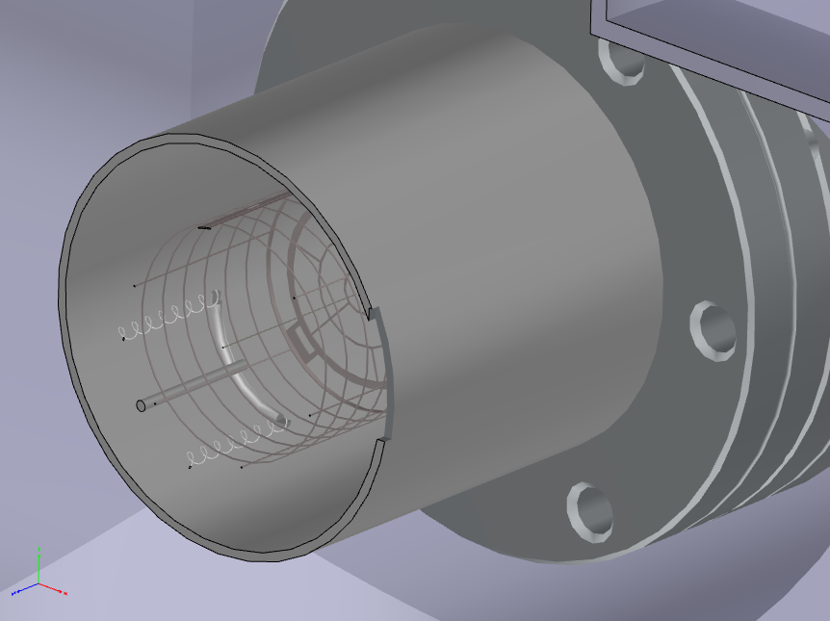
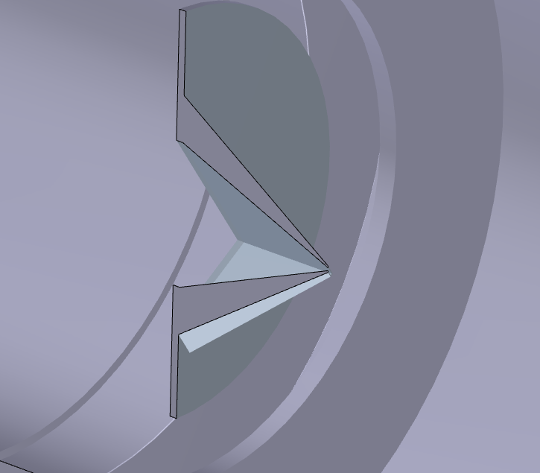
CAD model received from Elena
Skimmers 1 & 2
Interaction chamber
Skimmer 3

Slide 3
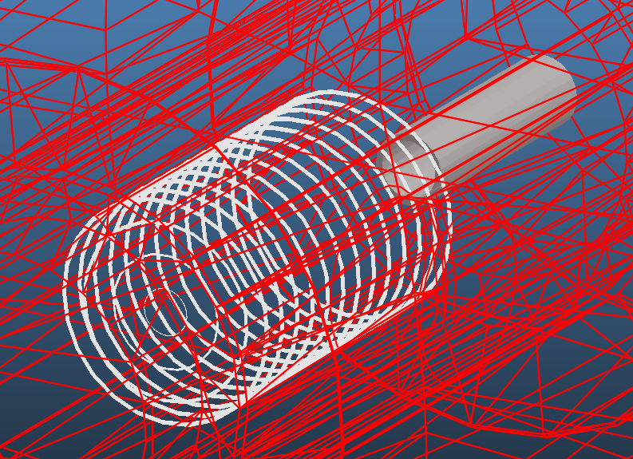
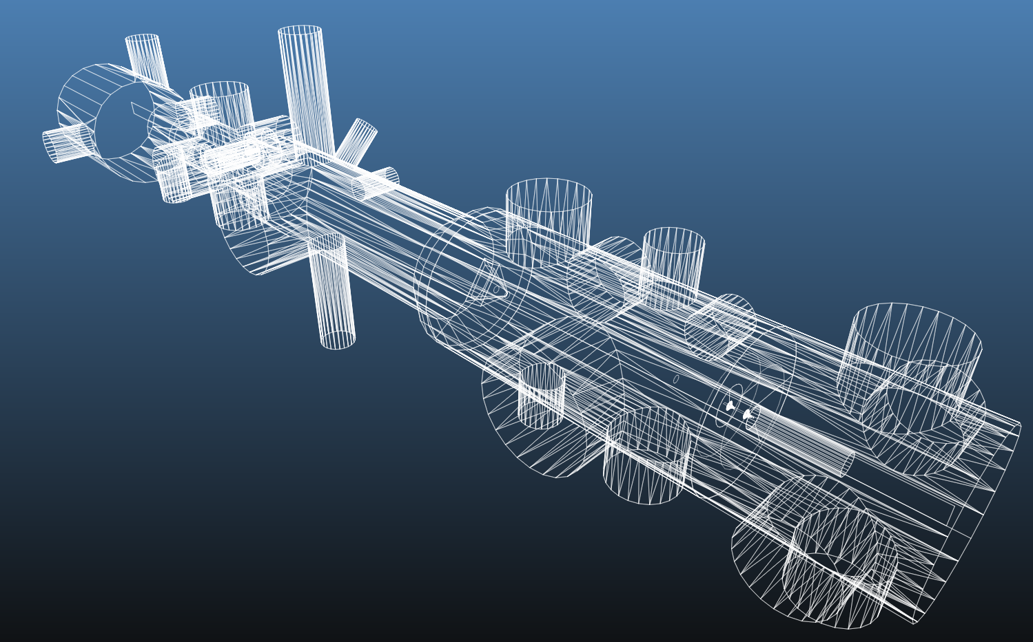
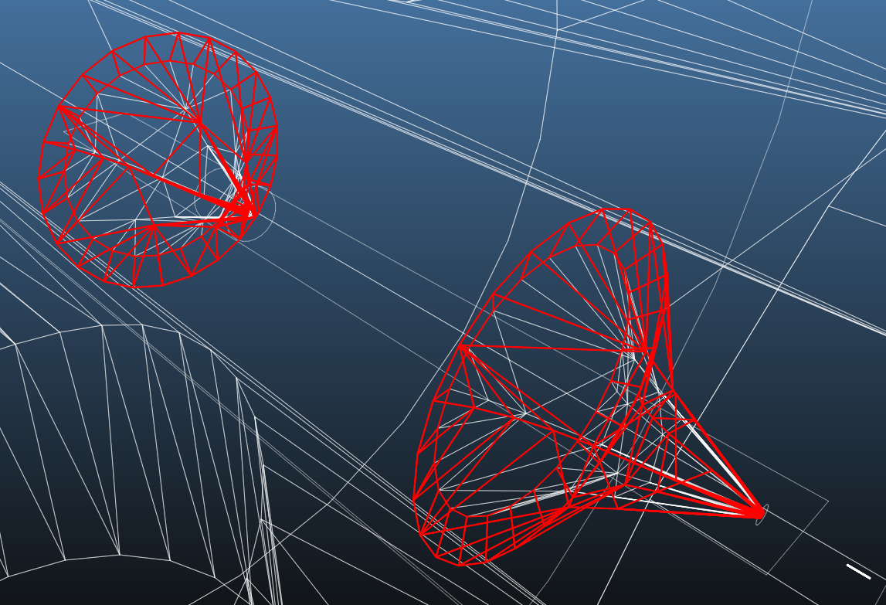
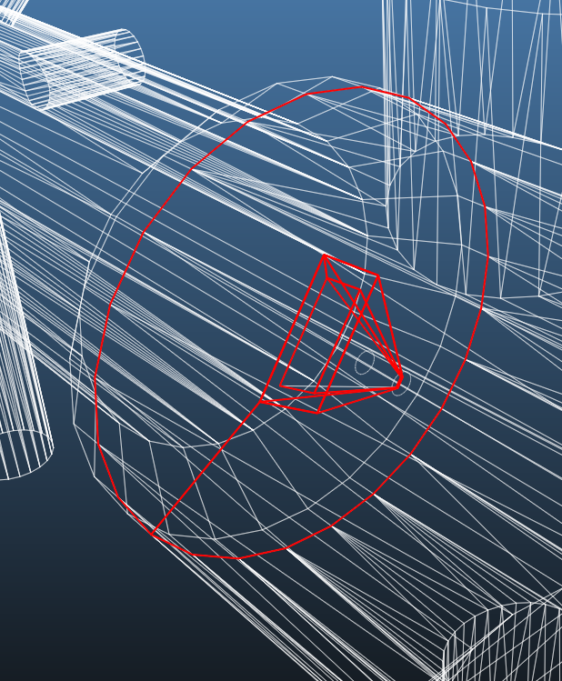
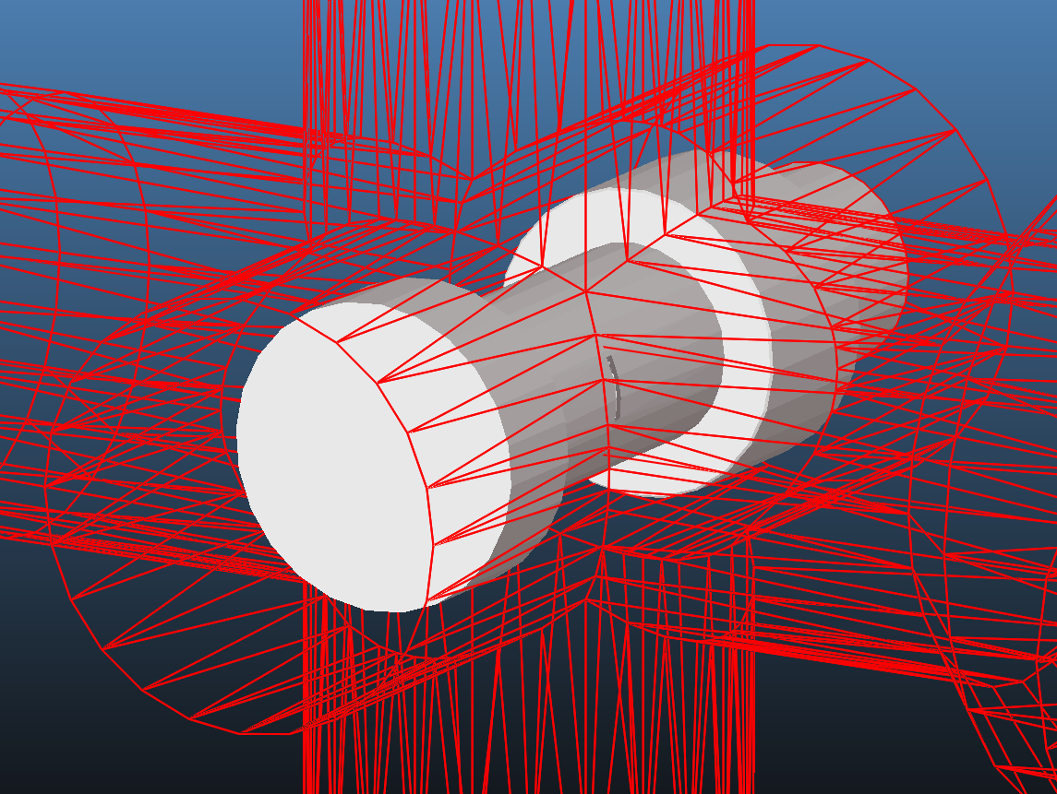
Interaction chamber
Skimmers 1 & 2
Molflow model “inside out”
Screws, supports, outer shell removed
4300 polygons
Skimmer 3

Slide 4
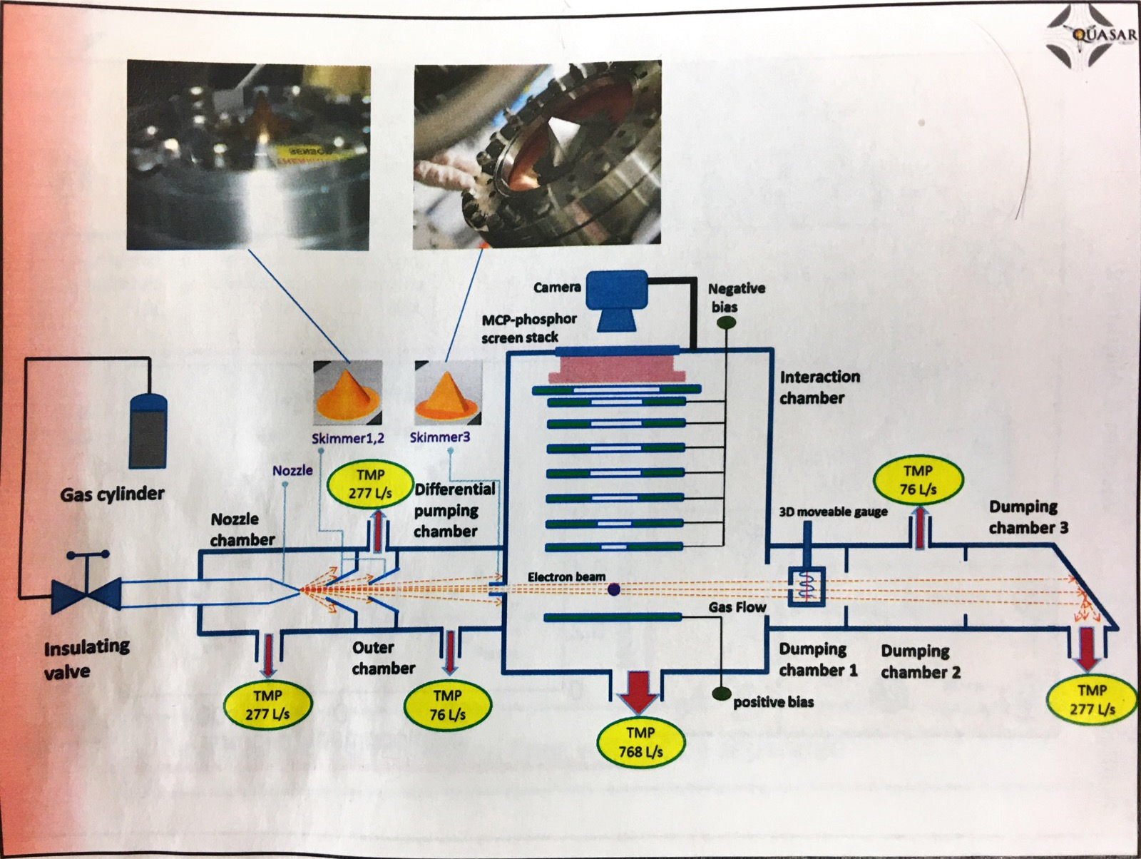
Pumping

Slide 5
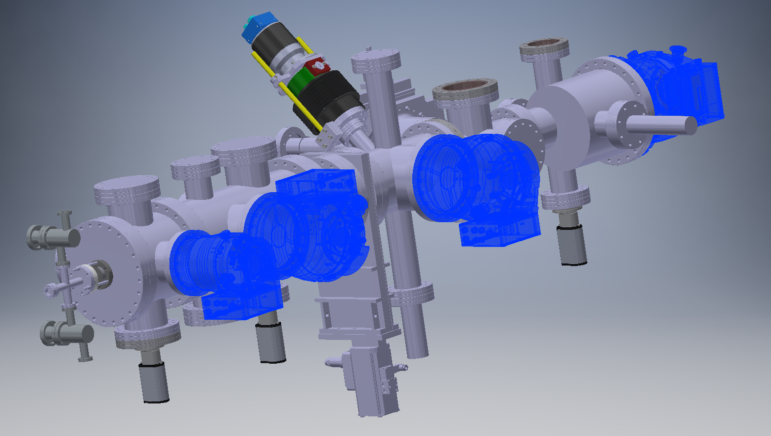
DN200
DN160
DN160
DN100

Slide 6
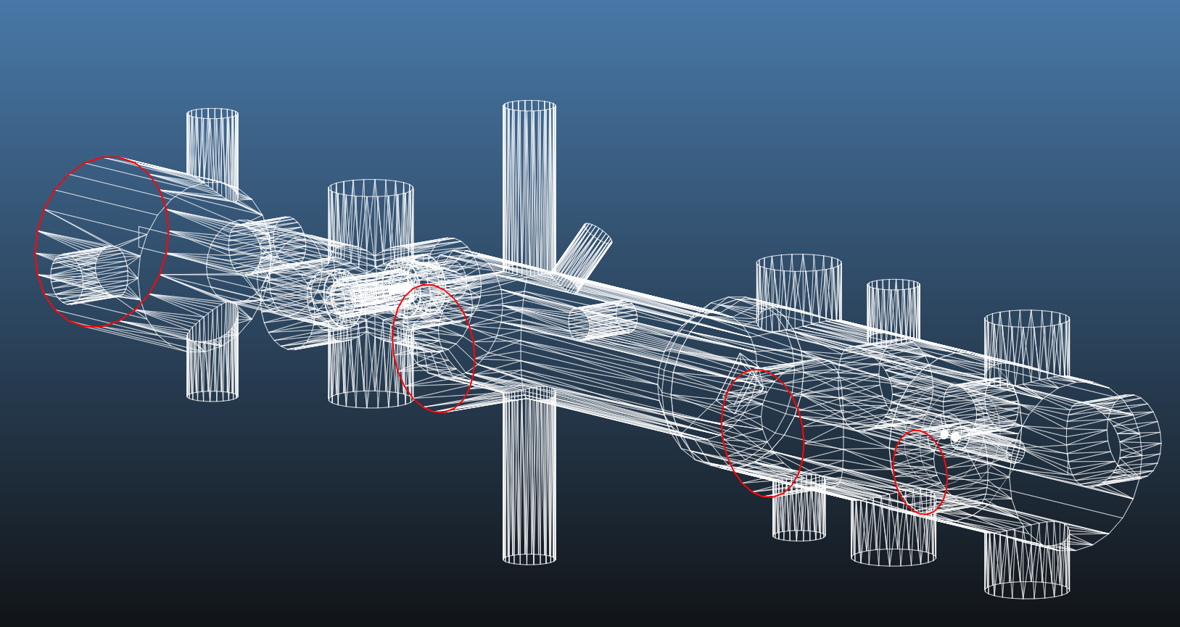
470 l/s
270 l/s
270 l/s
250 l/s

Slide 7
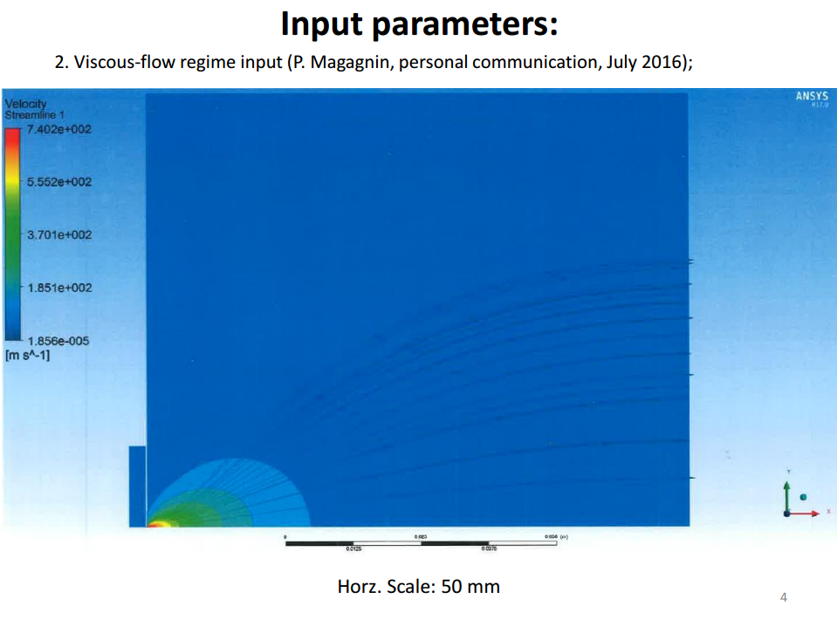
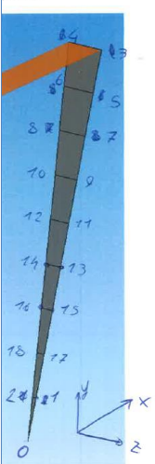
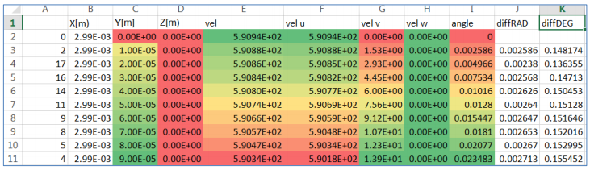
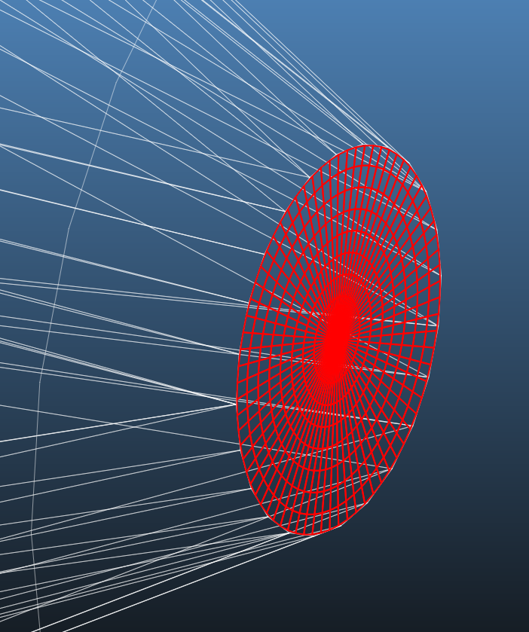
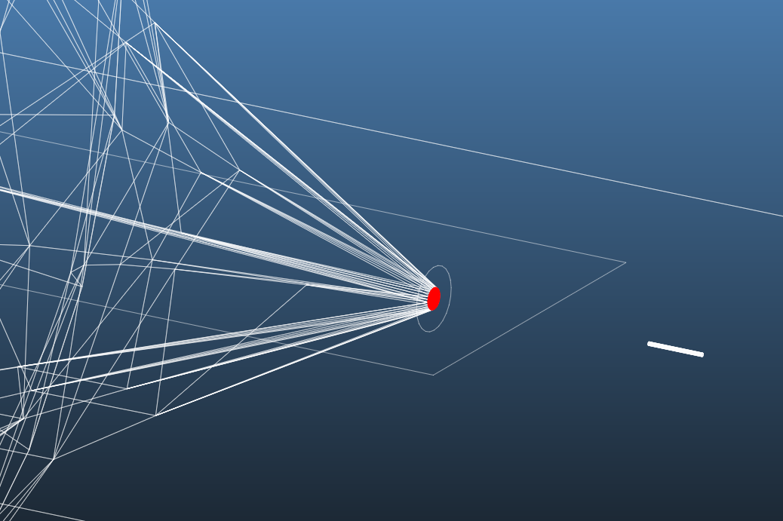

Slide 8
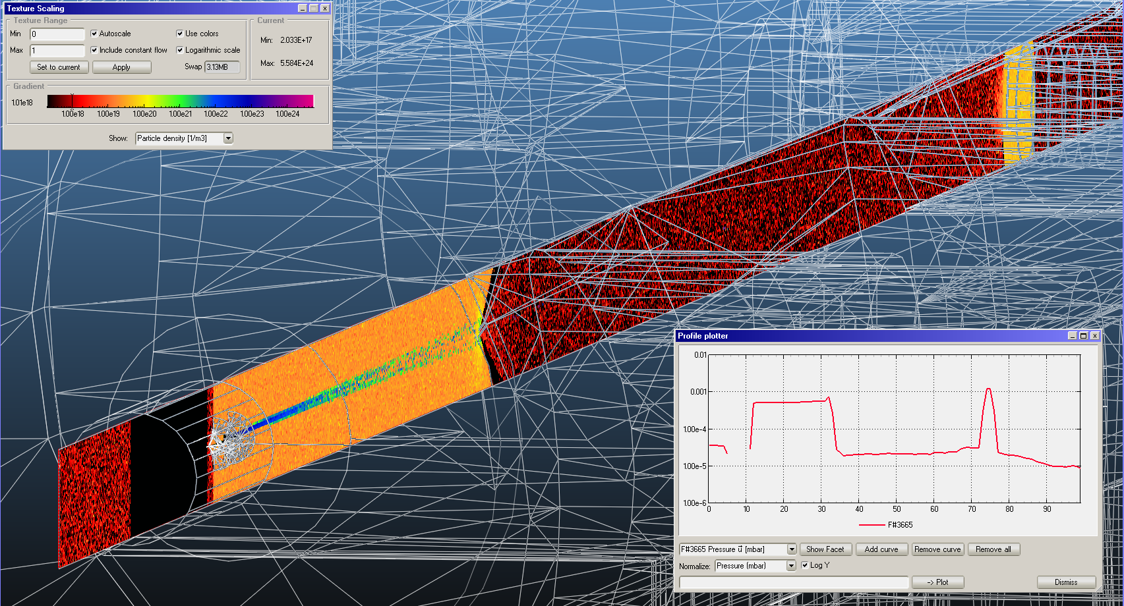
Interaction chamber
Skimmer 3
Skimmers 1 & 2

Slide 9
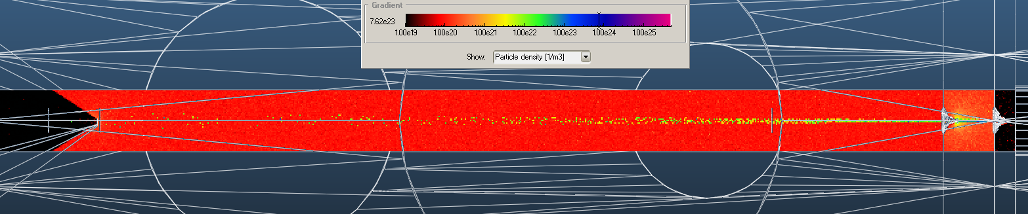
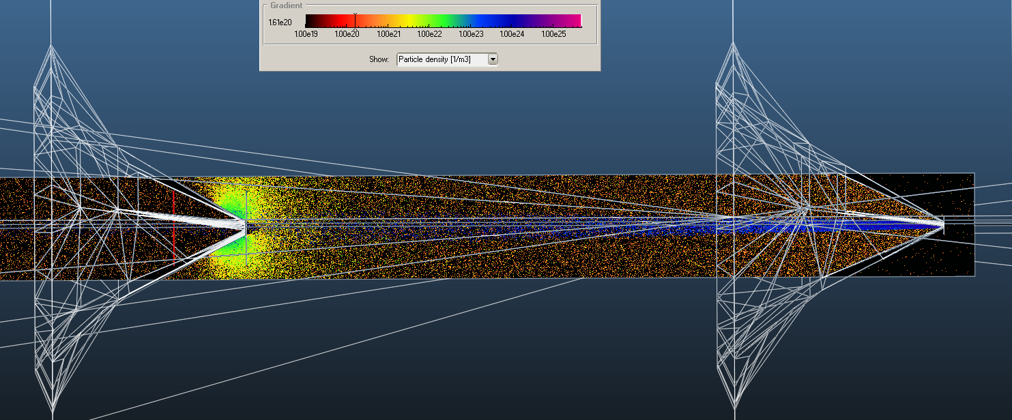
Skimmer 3
Skimmers 1 & 2
Skimmer 2
Skimmer 1

Slide 10
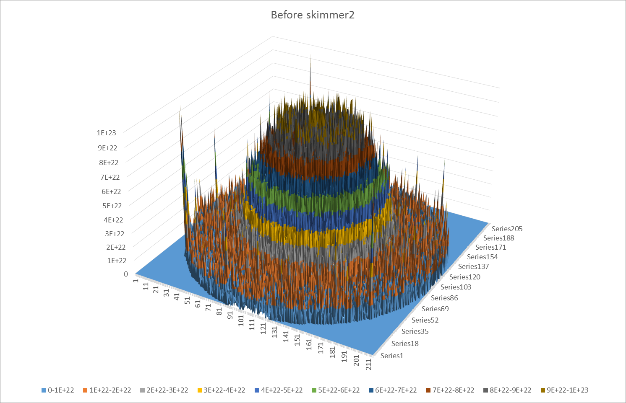
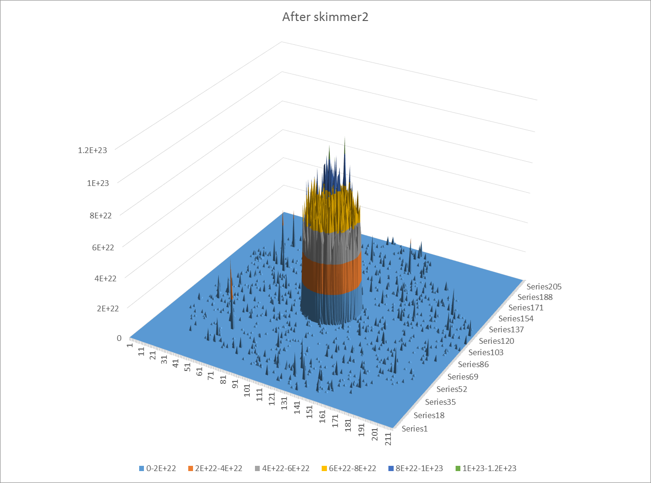
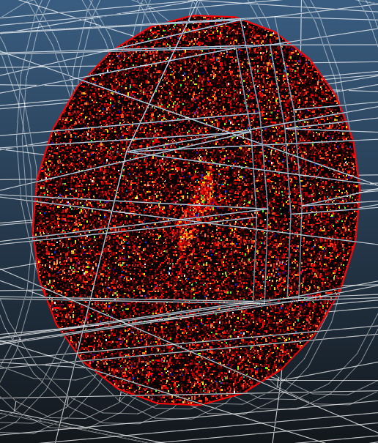
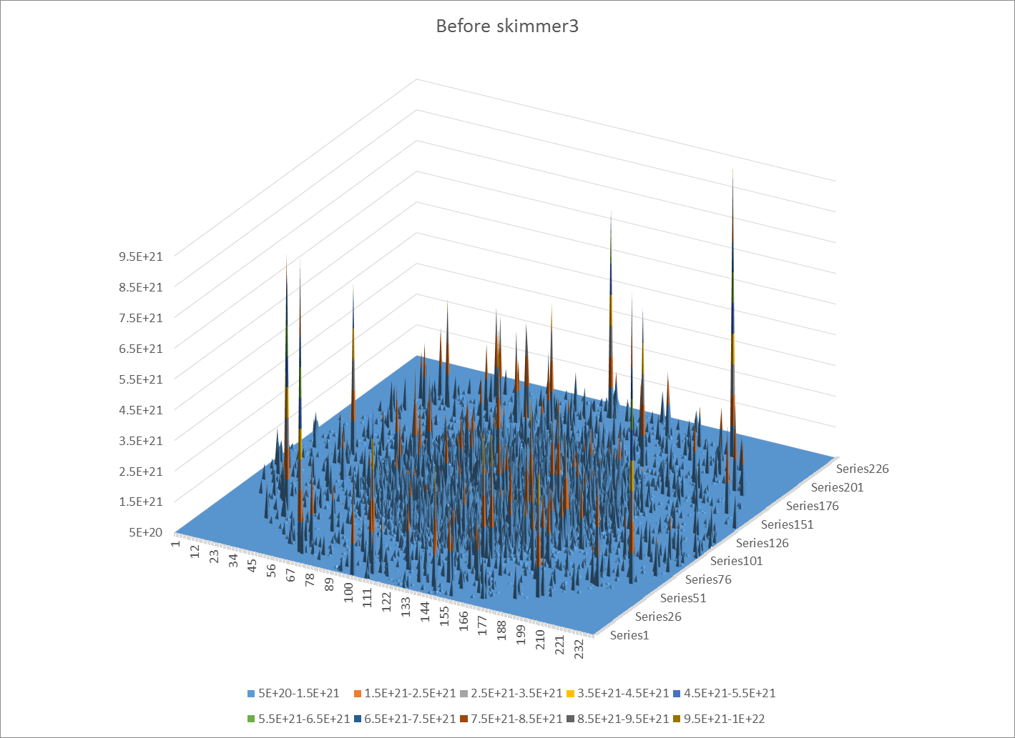
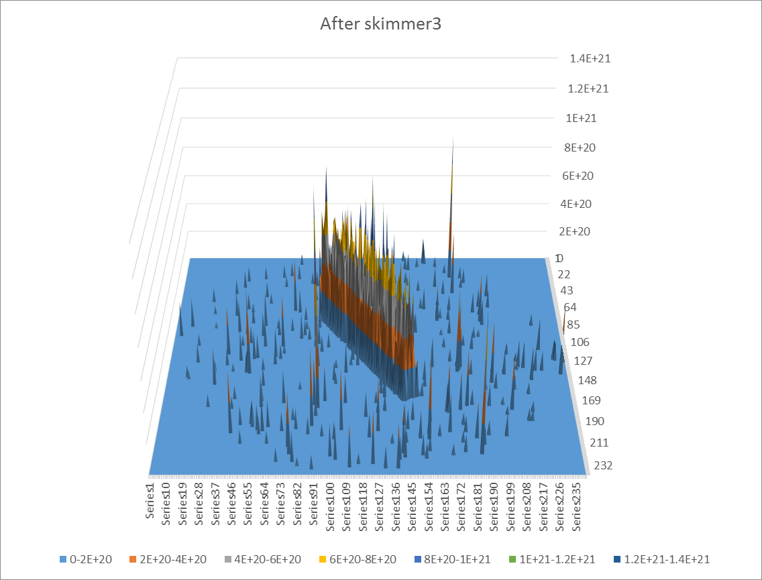
Interaction chamber

Slide 11
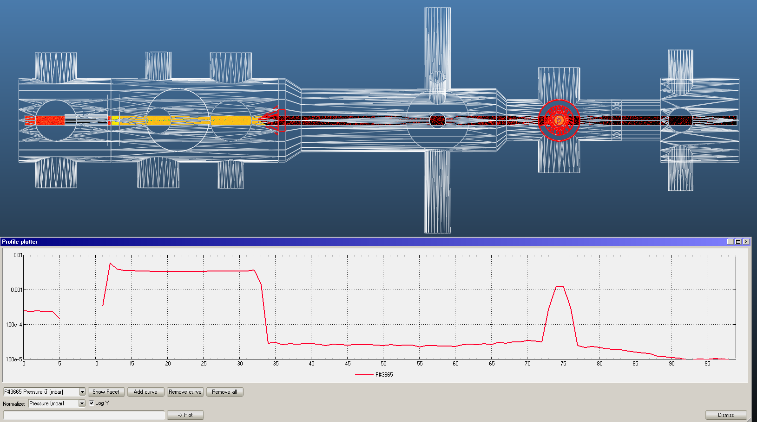
The problem with large density differences

Slide 12
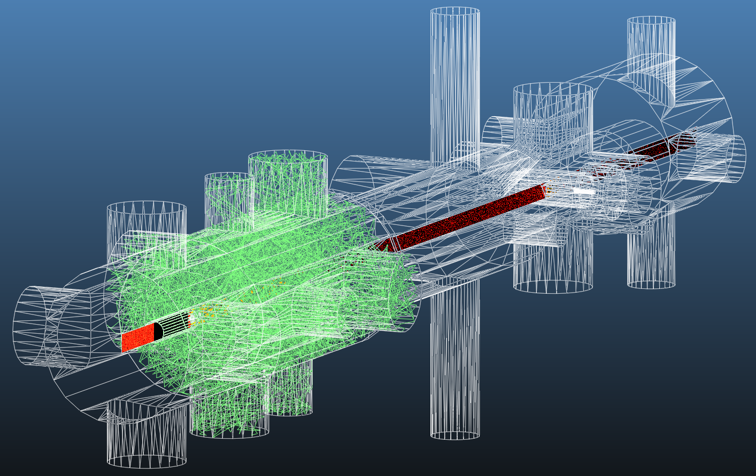
The problem with large density differences

Slide 13
Linear system: Iterative simulation
RECORD
RECORD
RECORD
Nozzle
Skimmer1
Skimmer2
Skimmer3
Interaction
chamber

Slide 14
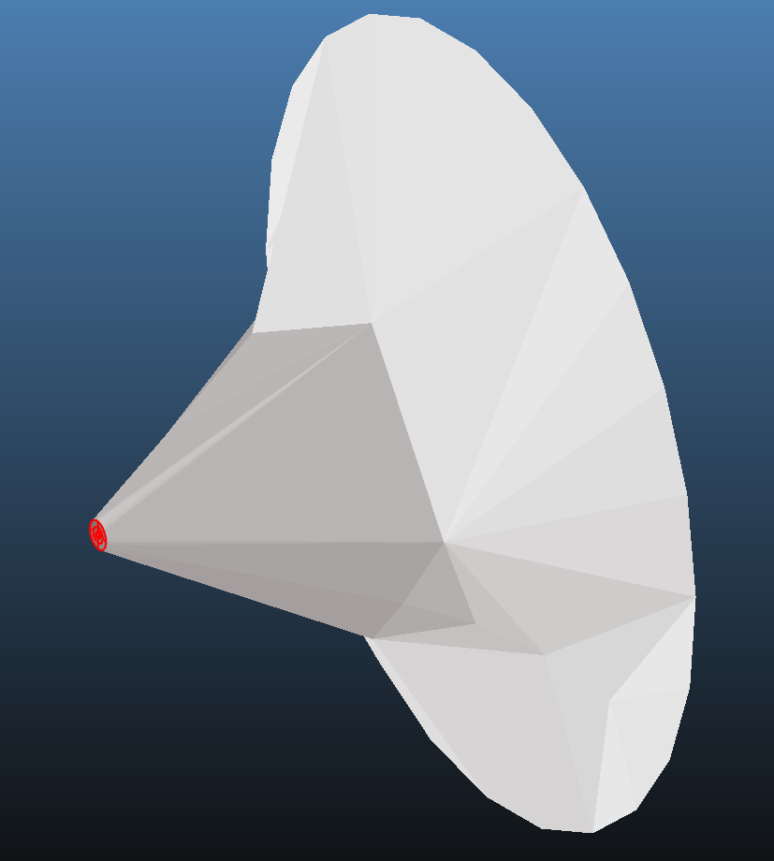
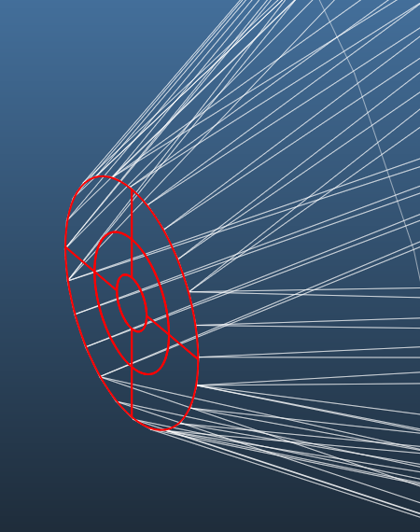

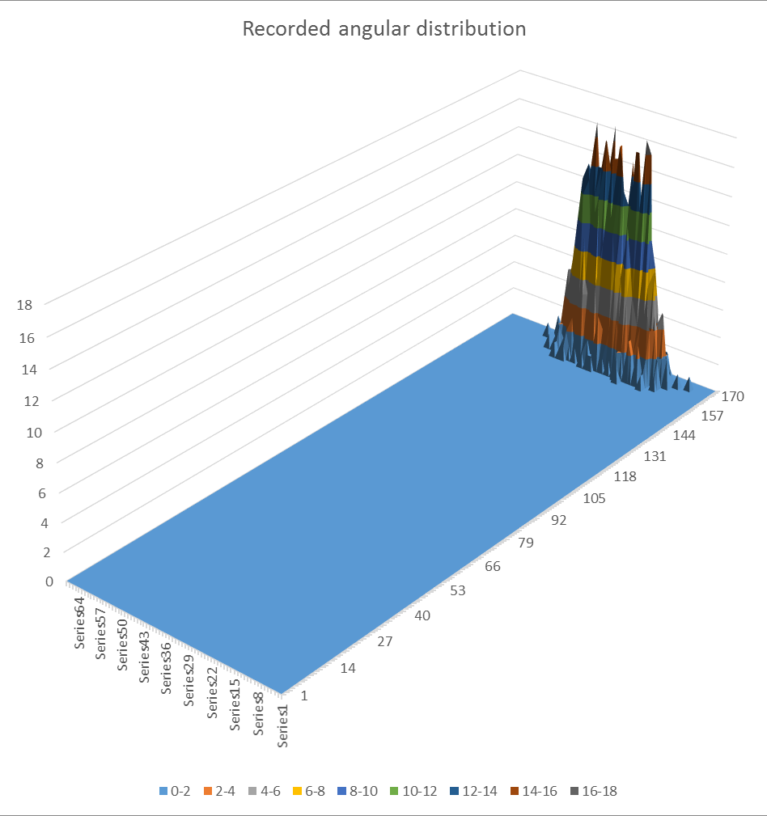
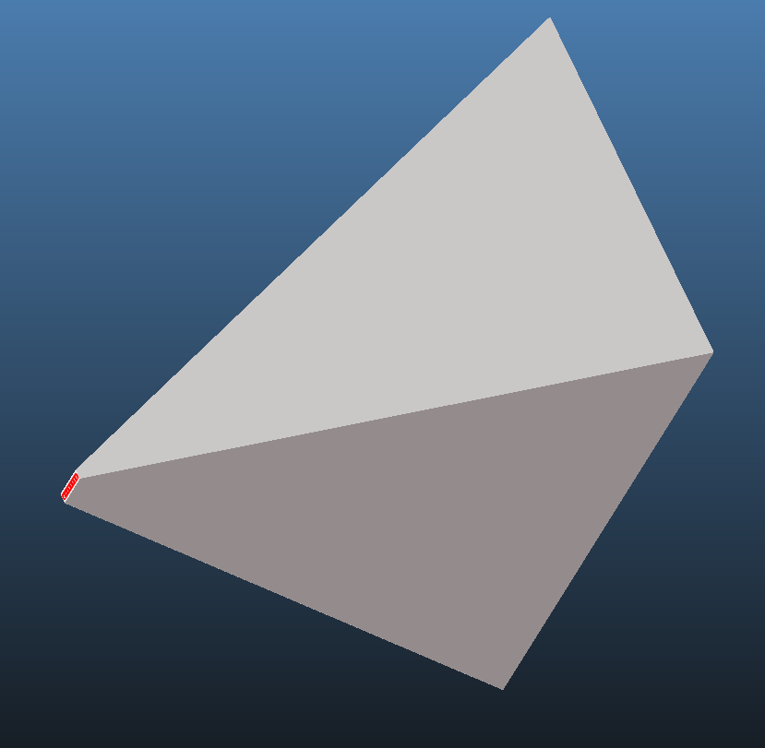
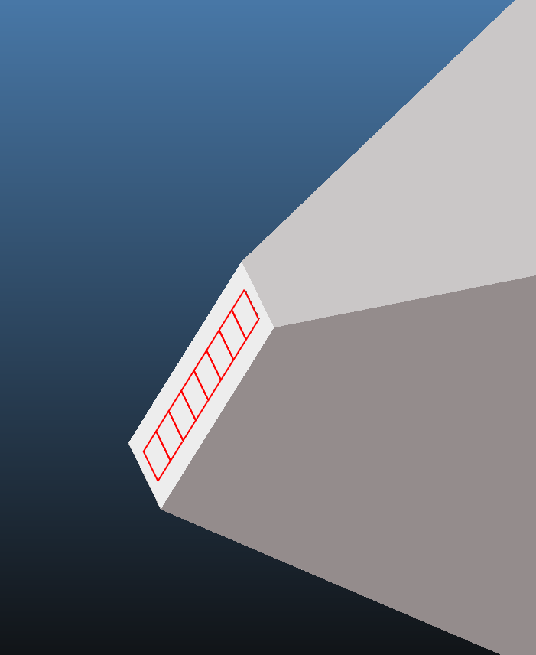
Skimmer 2
Elevation
Azimuth
Skimmer 3

Slide 15
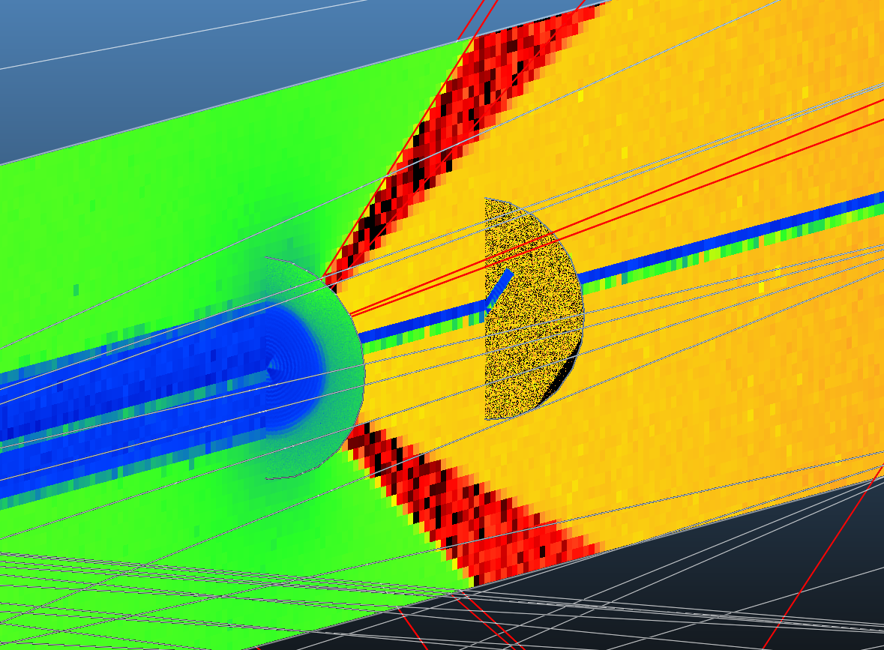
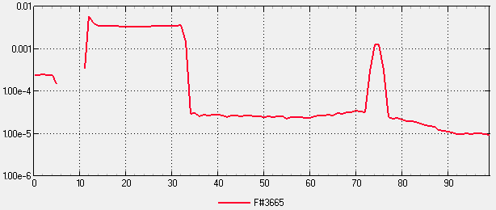
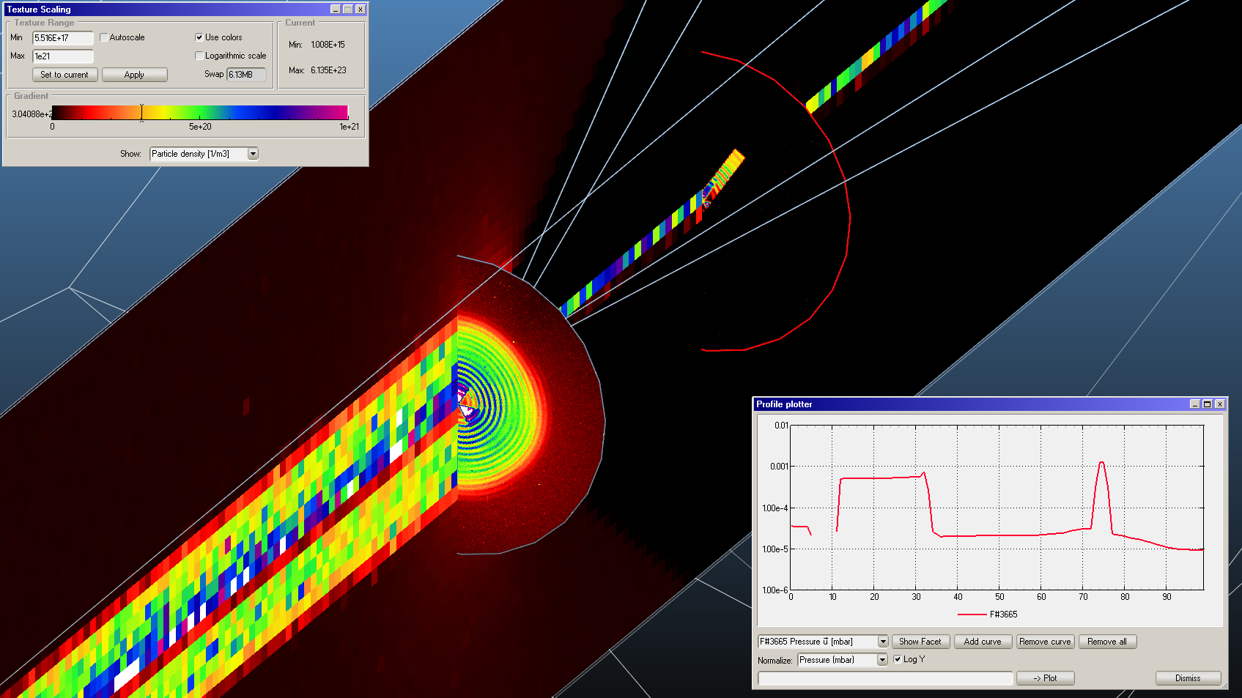
Skimmer1
Skimmer3
Interaction
chamber
Skimmer2

Slide 17
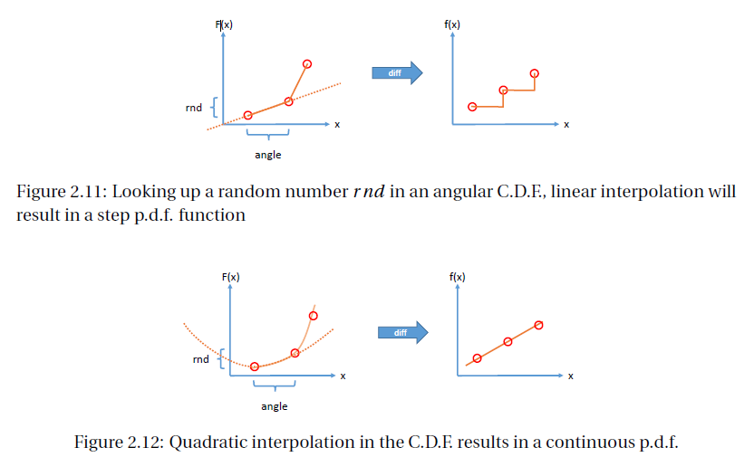
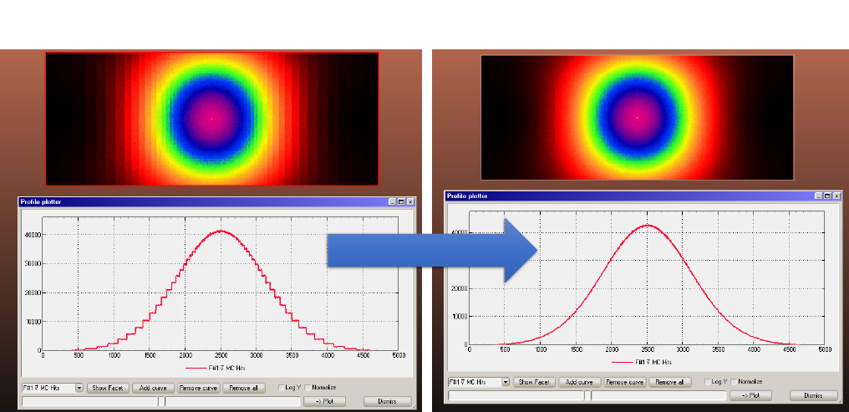
Cumulative
distribution
Derived
distribution
Cumulative
distribution
Derived
distribution

Slide 18
Original pumping

Slide 19
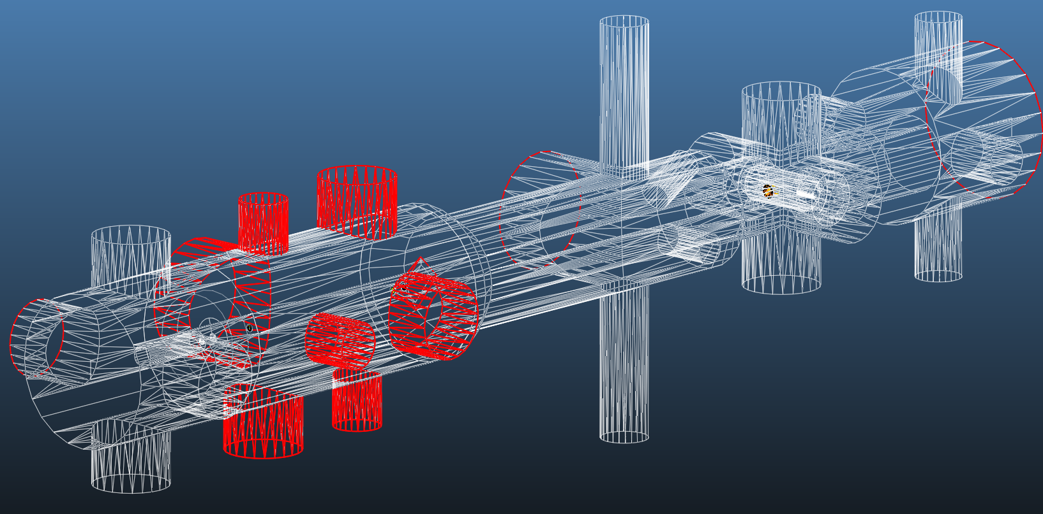
Collecting rebounding particles at skimmer 3

Slide 20
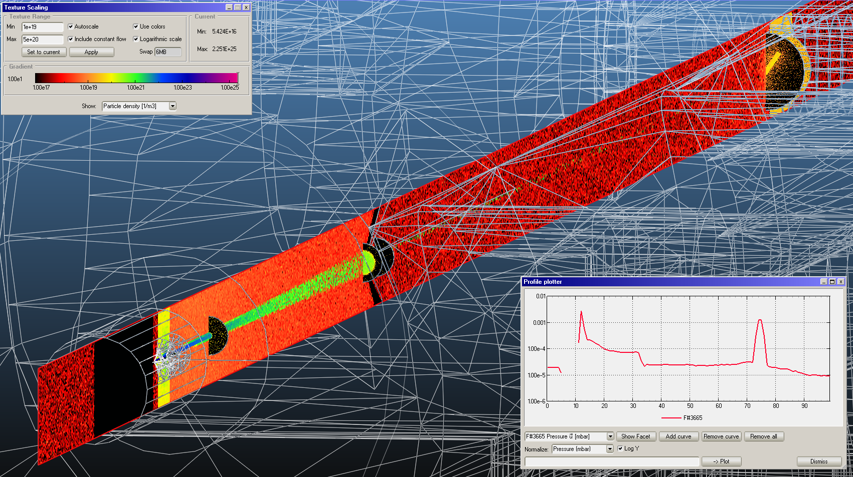
Collecting rebounding particles at skimmer 3

Slide 21
Collecting rebounding particles at skimmer 2

Slide 22
Skimmer1
Interaction
chamber
Skimmer2
Skimmer3

Slide 23
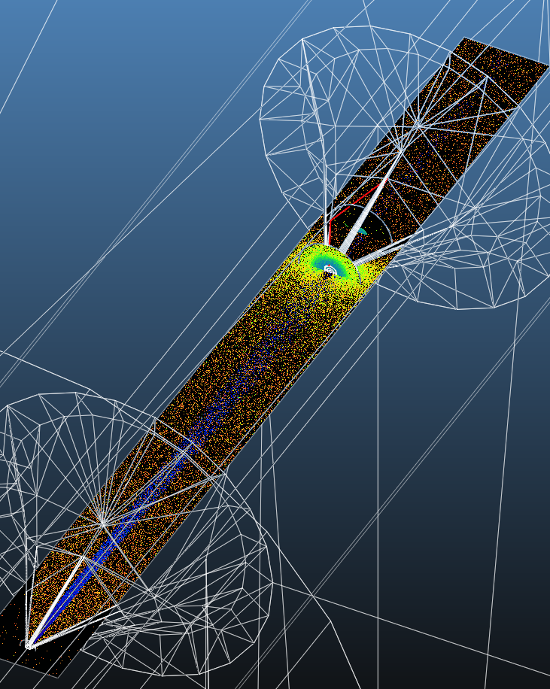
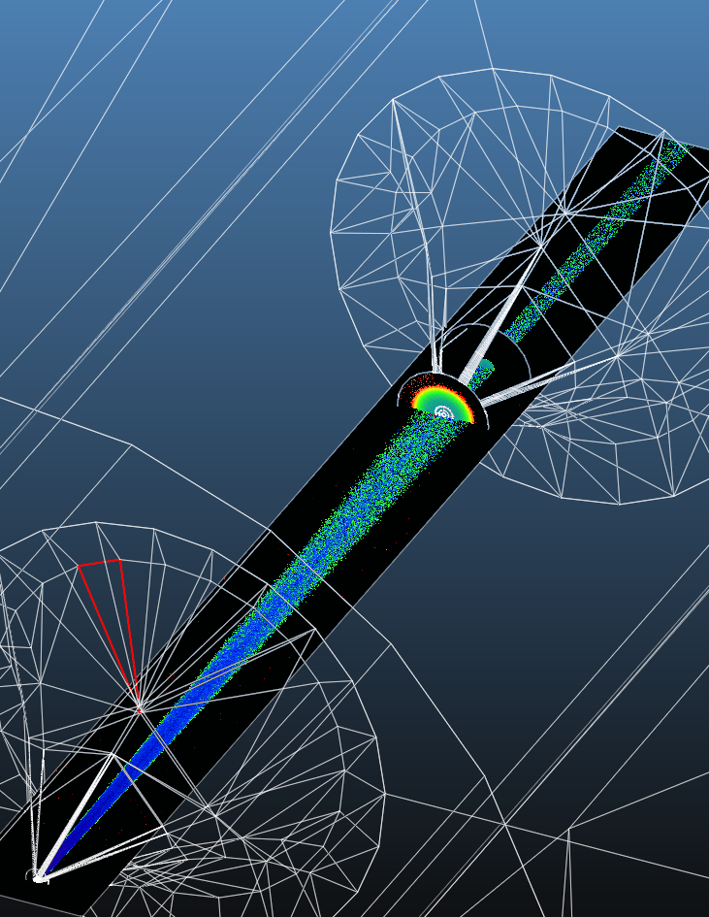
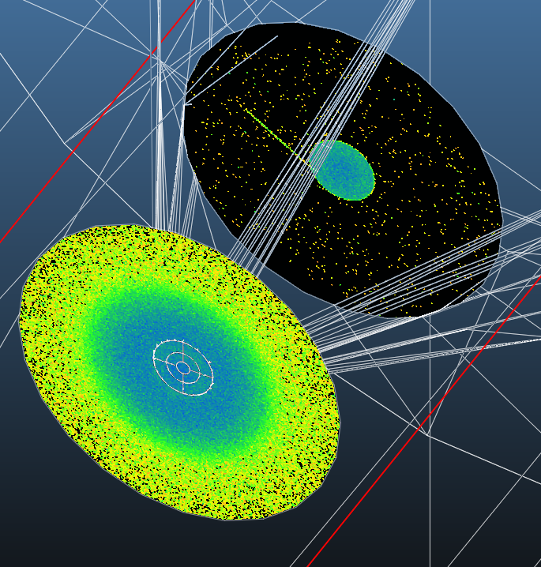
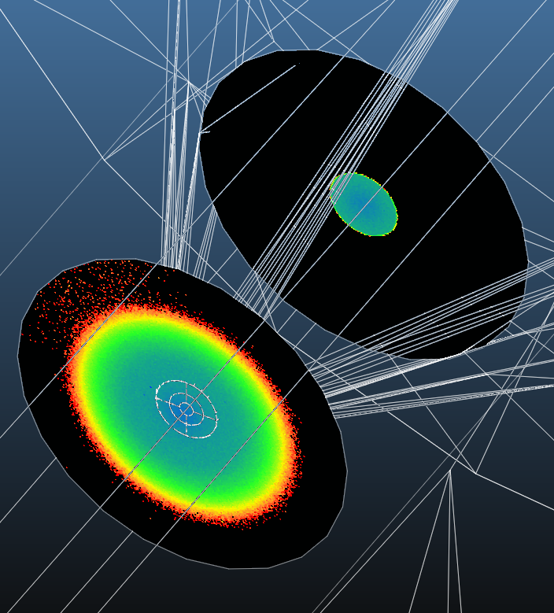
Original pumping
Eliminating skimmer 2 rebounds
After skimmer 2
After skimmer 2
Before skimmer 2
Before skimmer 2

Slide 24
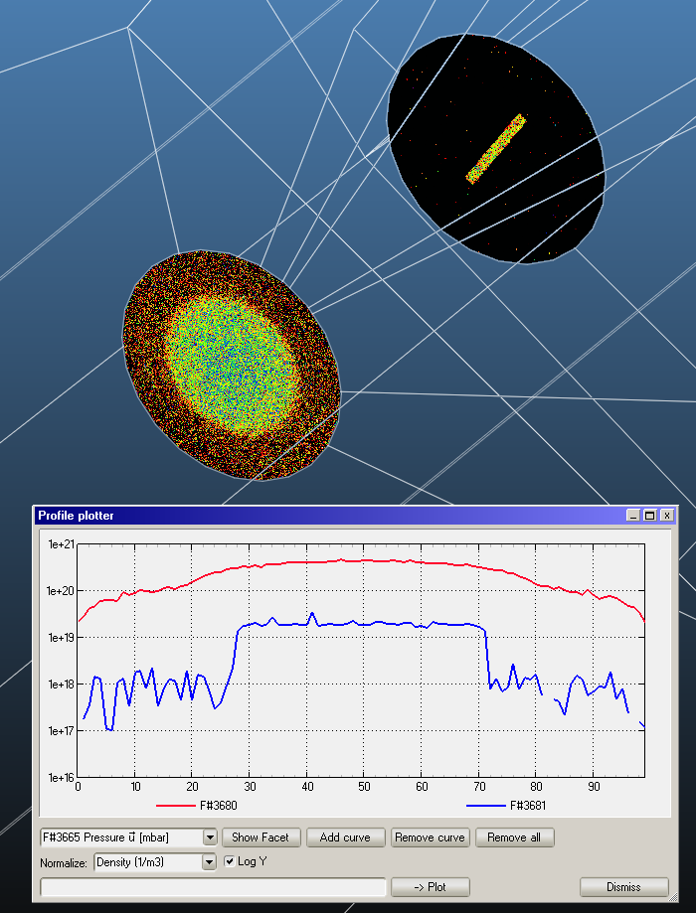
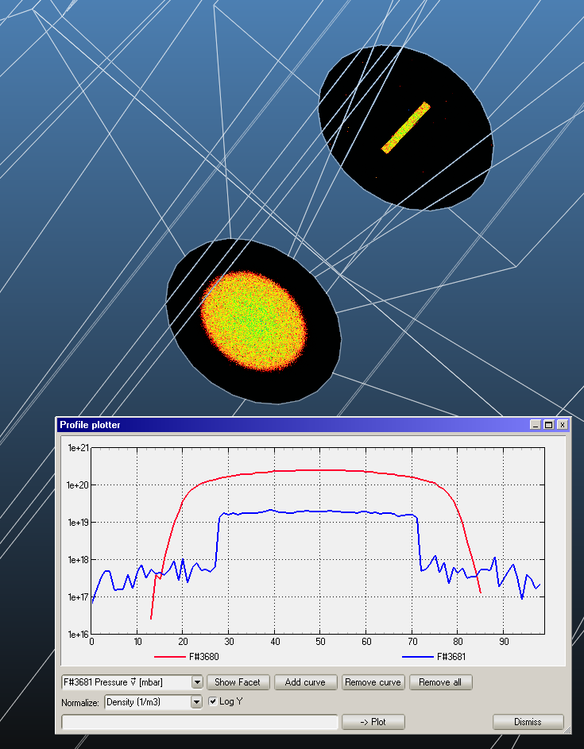
Original pumping
Eliminating skimmer 2 rebounds

Slide 25
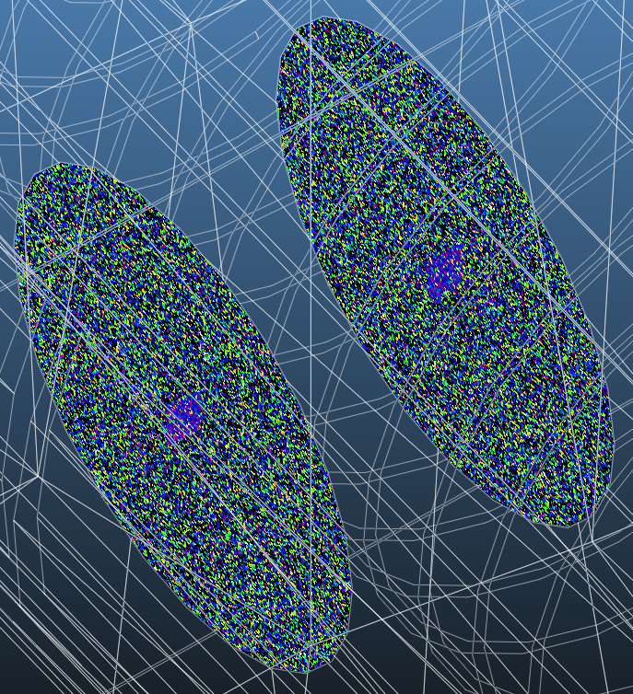
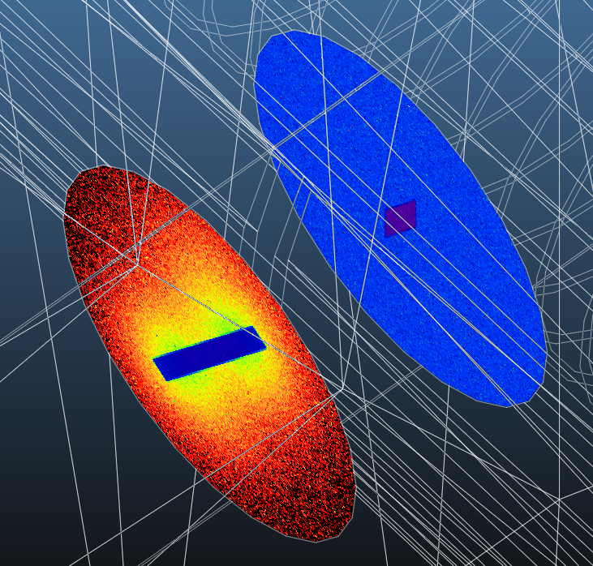
Original pumping
Eliminating skimmer 2 rebounds

Slide 26
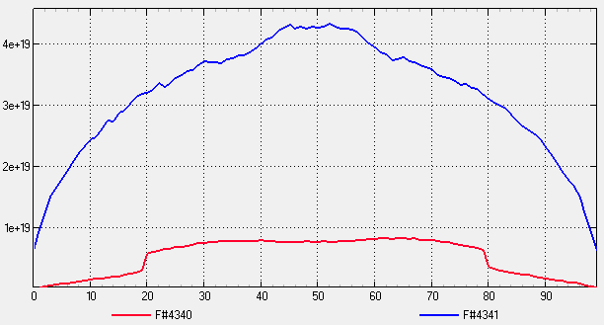
Insufficient signal
Profile
Profile
Profile

Slide 27
Conclusion
This was just a qualitative analysis
The result that it is possible to simulate the gas jet, despite the large density differences
At its current stage the background is too high in the interaction chamber (will there be a pump I don’t know about?)
For real, quantitative analysis I need to check the parameters (pumping speeds)
Then it will be possible to deliver meaningful gas jet shapes, playing with misalignments, etc.

