Slide 1
Optical system
BGC

Slide 2


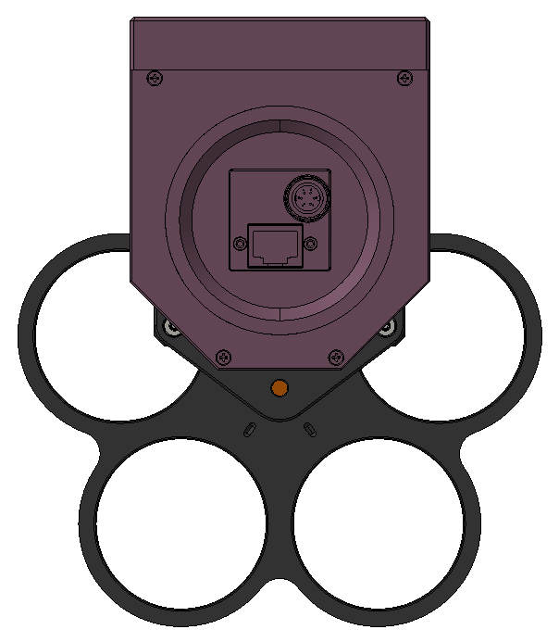

Slide 3
