Slide 1



3D Graphics & tools for HEP
HSF meeting - 7th of April 2017
3D Detector interactive display
Event data animation

Slide 2
Scope and Requirements
Scope
  Provide a suitable tool that may be used in HEP to display complex geometries and also particle and event data with animation based on the time information generated by MC simulation software (eg GeantV) or experimental data.
Initial requirements
  Web based application
  Use of public domain 3D graphics library “ThreeJS”
In SFT there are being developed powerful tools that can display 3D geometries and much more. They are part of the ROOT functionalities.
Latest developments also use Three.js for web developments. Swan is the latest web-oriented development.
So far there are not yet published developments related to particle and event animations in SFT
Follows the web development philosophy
Friendly User interface
Light files
Standard formats (JSON)

Slide 3
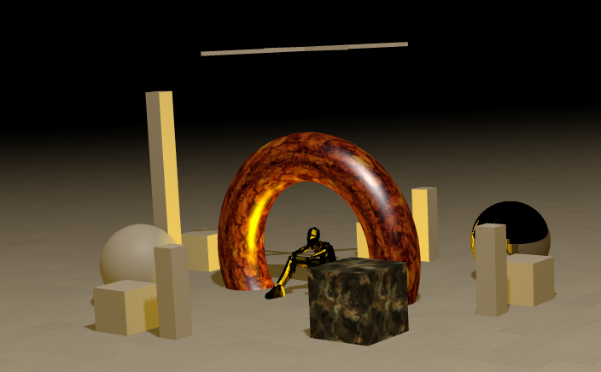
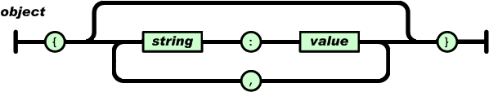
Web tools and terminology
three.js
JSON
Three.JS
Json format

Slide 4
JSON Format for non experts
http://www.json.org/
JSON (JavaScript Object Notation)
  Is a lightweight data-interchange format.
  It is easy for humans to read and write.
  It is easy for machines to parse and generate.
Why use JSON
  kind of standard like XML
  Everyone can read and interpret its contents with no additional efforts …
  In JavaScript, with just one command you get the full definition of objects defined in your JSON file.
    loadJSON(filename, function(content) {
      var JsonGeom = JSON.parse(content)});
    JsonGeom will contain all objects defined in the file
In the case of Atlas Geometry
I read a file of 100.500 lines and create the related object structure in memory with just one line of code
{
"metadata": { "version": 1.0,"type": "Object", "generator": "CogevitoExporter","File":"Atlas-all.json"},
"Geometry":[
{"fn":"START"},
{"fn":"csg","gid":2,"dz":345,"rmin1":3.5,"rmin2":3.5,"rmax1":115,"rmax2":115,"phs":0,"phl":6.28319},
{"fn":"mesh","gid":2,"cdf":0,"nv":5730051,"lv":1,"m":"root","cl":"#6666ff","cn":"kBlue-7","vs":0,"n":"INNE","v":[]},
{"fn":"csg","gid":172,"dz":100,"rmin1":25,"rmin2":25,"rmax1":61.5,"rmax2":61.5,"phs":0,"phl":6.28319},
{"fn":"mesh","gid":172,"cdf":0,"nv":5087,"lv":2,"m":"INNE","cl":"#6666ff","cn":"kBlue-7","vs":1,"n":"ZEND","v":[1,0,0,0,0,1,0,0,0,0,1,181,0,0,0,1]},
…
{"fn":"trd","gid":175,"dx1":2,"dx2":3.85,"dy1":0.1272,"dy2":0.1272,"dz":1.75},
{"fn":"mesh","gid":175,"cdf":0,"nv":1,"lv":6,"m":"ZMOD","cl":"#ff6600","cn":"kOrange+7","vs":1,"n":"ZELE","v":[0,0,1,41.5815,1,0,0,0,0,1,0,0,0,0,0,1]},
{"fn":"clone","cdf":0,"nv":5,"lv":5,"m":"ZRII","ovn":"ZMOD","gid":6709,"cn":2,"v":[0.935016,-0.354605,0,0,0.354605,0.935016,0,0,0,0,1,0,0,0,0,1]},
{"fn":"clone","cdf":0,"nv":5,"lv":5,"m":"ZRII","ovn":"ZMOD","gid":6709,"cn":3,"v":[0.822984,-0.568065,0,0,0.568065,0.822984,0,0,0,0,1,0,0,0,0,1]},
…
{"fn":"csg","gid":27,"dz":211.7,"rmin1":0,"rmin2":0,"rmax1":6,"rmax2":6,"phs":0,"phl":6.28319},
{"fn":"mesh","gid":27,"cdf":0,"nv":1,"lv":2,"m":"PIPE","cl":"#cccccc","cn":"kGray","vs":1,"n":"POUk","v":[1,0,0,0,0,1,0,0,0,0,1,1653.3,0,0,0,1]},
{"fn":"clone","cdf":0,"nv":1,"lv":2,"m":"PIPE","ovn":"POUk","gid":27,"cn":44,"v":[1,0,0,0,0,1,0,0,0,0,-1,-1653.3,0,0,0,1]},
{"fn":"END"}
]}
A few lines of the JSON file
defining the Atlas Geometry

Slide 5
About three.js
https://threejs.org
Three.js is a cross-browser JavaScript library used to create and display animated 3D computer graphics in a web browser.
Three.js uses WebGL.
The source code is hosted in a repository on GitHub
Three.js allows the creation of GPU-accelerated 3D animations using the JavaScript language as part of a website without relying on proprietary browser plugins. This is possible thanks to the advent of WebGL
Using Three.js it is possible to author complex 3D computer animations in a browser with minimal efforts

Slide 6

Status of developments
Root
“plugin”
Web
“tools”
Starting point
0
1
2
The Root “plugin” will create an output file with the definition of the Geometry in JSON format
Geometry definition in TGEO
(Root, Geant4 etc)
C++ code using root Clang interpreter
Web home page: Default.htm
Import all JavaScript libraries for Three.Js and Cogevitolib.js and Creates the interface
OutputFile.js
Calls to GoGeviTo library for the creation of logical and physical volumes
Cogevitolib.js
contains all functions to create Three.Js volumes and functionalities
ParticleData.js
Data related to events and particles in time
Particle and events data are generated by MC software or experiments
The files will be imported using the interface on the web home page of the application
Other applications
(eg GeantV)

Slide 7
Some Technical details
OutputFile.js
Calls to GoGeviTo library for the creation of logical and physical volumes
Web home page: Default.htm
Import all JavaScript libraries for Three.Js and Cogevitolib.js and Creates the interface
Cogevitolib.js
contains all functions to create Three.Js volumes and functionalities
ParticleData.js
Data related to events and particles in time
Contents of the file with calls to Cogevito.js library
Contents of the file related to events and particles
Home Web Page
Cogevito library
+Live demo

Slide 8
Contents of the file with calls to Cogevito.js library
(plugin output)
TGEO function
Plugin function creates →
JSON function def in Cogevitolib
TGeoShapeAssembly
TGeoBBox
TGeoParaboloid
TGeoSphere
TGeoConeSeg
TGeoCone
TGeoTubeSeg
TGeoTube
TGeoPcon
TGeoTorus
TGeoPgon
TGeoHype
TGeoScaledShape
TGeoArb8
TGeoPara
TGeoTrap
TGeoGtra
TGeoTrd1
TGeoTrd2
TGeoCtub
TGeoXtru
ExportGeomAssembly →fn= grp
ExportGeomBBox →fn= box
ExportGeomParabloid →fn= prb
ExportGeomSphere →fn= sph
ExportGeomConeSeg →fn= csg
ExportGeomConeSeg →fn= csg
ExportGeomConeSeg →fn= csg
ExportGeomTub →fn= tub
ExportGeomConeSeg1 →fn= lth
ExportGeomTorus →fn= tor
ExportGeomConeSeg2 →fn= pgn
ExportGeomHype →fn= hpb
ExportGeomQuad →fn= tra
ExportGeomPara →fn= par
ExportGeomTrap →fn= trp
ExportGeomGTra →fn= gtr
ExportGeomTrd →fn= trd
ExportGeomTrd →fn= trd
ExportGeomTub →fn= csg
ExportGeomEltub →fn= elc
ExportGeomExtrude →fn= exr
The output file is a collection of those functions defined in cogevitolib.js that define the geometry of each volume.
An additional function “mesh” will define the relative position, material and matrix

Slide 9
Each volume is defined in JSON format as follows (example)
Function
Geometry ID
Parameters
{"fn":"csg", "gid":2, "dz":345,"rmin1":3.5,"rmin2":3.5,"rmax1":115,"rmax2":115,"phs":0,"phl":6.28319},
Flag (clones)
Number of Volumes
Mother
Level
{ "fn":"mesh", "gid":2, "cdf":0, ”nv":5730051, "lv":1, "m":"root",
"cl":"#6666ff","cn":"kBlue-7”, "vs":0, "n":"INNE", "v":[] },
Visible
Name
Matrix
Color
Particular cases for Composite volumes not shown here.
Clones are defined as follows:
Original Vol. Name
{ "fn":"clone", "cdf":0, "nv":5, "lv":5, "m":"ZRII", "ovn":"ZMOD",
"gid":6709, "cn":2, "v":[0.935016,-0.354605,0,0,0.354605,0.935016,0,0,0,0,1,0,0,0,0,1]},

Slide 10
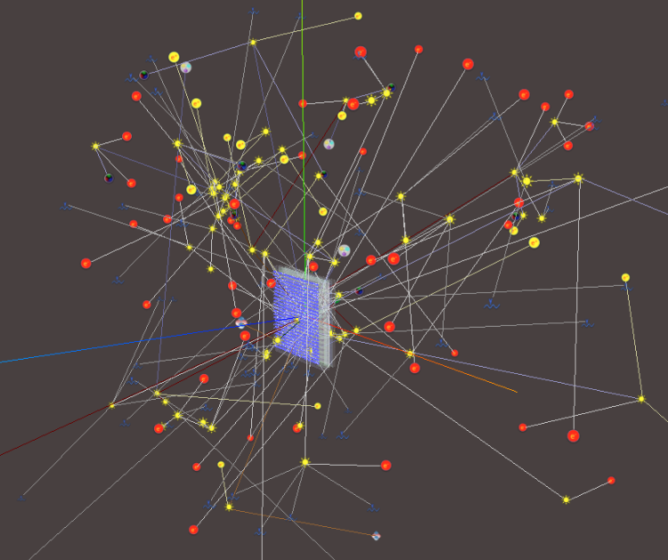
Dynamic particles
& tracks
Dynamic event animation in time

Slide 11
Contents of the file related to events and particles
Syntax of JSON file:
Each event is an Array of the structure:
“time stamp” and the Array of particles &their position at “time stamp”
{ "Event":[
{"time":0, "pset":[
{"id":0,"kind":4,"type":"a","pos":[0,0,0],"e":0.028},
{"id":1,"kind":4,"type":"a","pos":[0,0,0],"e":0.129},
….
{"id":19,"kind":9,"type":"a","pos":[0.000,0.000,0.000],"e":0.170}
]
},
…
{"time":17160, "pset":[ … ]
},
]
}

Slide 12
TimeSlot:
10*10⁻⁹
seconds
T,E,
x0,y0,z0
T,E,
x0,y0,z0
T,E,
x0,y0,z0
TimeSlot:
20*10⁻⁹
seconds
T,E
,x1,y1,z1
T,E,
x1,y1,z1
T,E,
x1,y1,z1
n steps…
TimeSlot:
n*20*10⁻⁹
seconds
T,E,
xn,yn,zn
T,E,
xn,yn,zn
T,E,
xn,yn,zn
T,E,
xn,yn,zn
T,E,
xn,yn,zn
m=n+j steps…
TimeSlot:
m*20*10⁻⁹
seconds
T,E,
xm,ym,zm
T,E,
xm,ym,zm
T,E,
xm,ym,zm
T,E,
xm,ym,zm
T,E,
xm,ym,zm
TimeSlot:
k*20*10⁻⁹
seconds
T,E,
xk,yk,zk
T,E,
xk,yk,zk
T,E,
xk,yk,zk
T,E,
xk,yk,zk
T,E,
xk,yk,zk
T,E,
xk,yk,zk
T,E,
xk,yk,zk
T,E,
xk,yk,zk

Slide 13
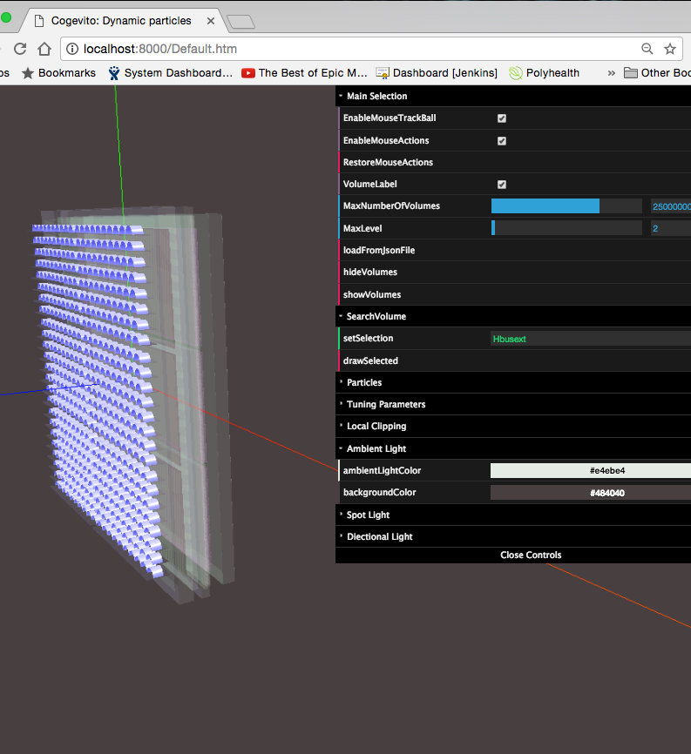
Home Web Page
Written in JavaScript
Load Three.js, Cogevitolib.js and other libraries.
Defines the main menu
Load Geometry files and creates the internal Three.js structure
Defines the user interface and all functionalities

Slide 14
Cogevitolib.js
It is a collection of functions in JavaScript
Most of the functions are related to creation of the geometry of each volume using native three.js graphic functions
Geometries are associated to meshes (physical volumes) created in memory.
Composite volumes are obtained using external Constructive Solid Geometry (CSG) package. It is a kind of problematic because creates a big number of additional vertices and faces. For this reason we use CSG package only for Intersections while for Union we merge the geometries using native Three.js functionality.
Clones are copies of physical volumes including all the sub-tree of volumes. There are available three implementations of cloned volumes
  The sub-tree is copied as it is (mesh+Geometries+materials)
  The geometries of cloned volumes are merged in a single mesh
  Geometry and Material are shared between the clones

Slide 15
Just a note …
A mesh in three.js allocates space for:
  Matrixes (local and global transformations)
  Other information (name, children, parent etc)
  Geometry
    Vertexes (eg a cube is defined with 8 vertexes)
    Faces which are triangles composing the surface of the volume by interconnecting the vertices (eg a cube is defined with 12 faces, 2 for each face)
    face and vertex normals and colors
    Array of face UV layers
    Other information
  Material
    All parameters of the material (name, transparency, color etc)
A lot of space is allocated for
Geometry and Material

Slide 16
Two Clones implementation
Clones Implementation 1
Clones Implementation 2
A
A
A copy-3
A copy-1
A
A
Using the native clone function in three.js
“A” geometry merged 3 times
A copy-2
A
Four different objects
4 meshes
4 geometries
4 materials
Only one object
1 mesh
1 geometry
1 material

Slide 17
THIRD Clones implementation
Clones Implementation 3
A
The mesh is cloned (together with the full sub-tree of volumes) but the Geometry and the Material are shared between the cloned volumes in order to save memory
G+M
Using the modified clone function in three.js
A copy-3
A copy-1
G+M
G+M
Four different objects
4 meshes
1 geometries
1 materials
G+M
A copy-2

Slide 18

Roadmap
What is next

Slide 19


Discuss with potential users in the experiments, HSF etc
The roadmap of developments
Please suggest …
Optimize / consolidate the functionality.
Interact with Geant/GeantV
Create simple geometries and watch
Particles animation on line.

Slide 20

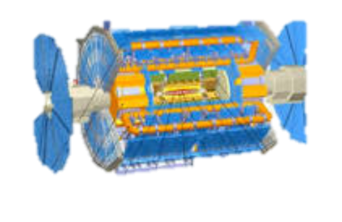
Going Live
The Atlas detector

