Slide 1
MyCERN scoping sub-WG
Meeting #2 – 10th April 2017

Slide 2
Mandate
Establish the boundaries of the work to be done for the detailed study stage of the MyCERN project with a view on reducing the scope presented by the conceptual design report while preserving the essence of the project.
The MyCERN scoping working group will list and define the various modules that could be part of MyCERN, and if needed will complete their specifications. For each of them, it will evaluate its relevance taking into account various factors: expected short term and long term benefits, potential overlap with other computing services, needed resources. It will then propose which modules should be part of the detailed study stage and confirm the needed resources and timeline.

Slide 3





MyCERN Modules
Personal Assets Aggregator
Communication Hub
Information Hub
Procedures Engine
Convenience Tools

Slide 4

Personal Assets Aggregator
Goal: Create one central place where CERN users can view all their personal data and assets stored in various CERN departments
Benefits: Easy access and transparency of assets and information linked to a person, data sanitization, guidance to final service through simple redirection, seamless experience accessing data which otherwise would be accessible in very different contexts.
Duplication: data exists outside but is scattered; no other gathering project
Challenges: asynchronous connections to multiple data sources, multiple concurrent calls

Slide 5
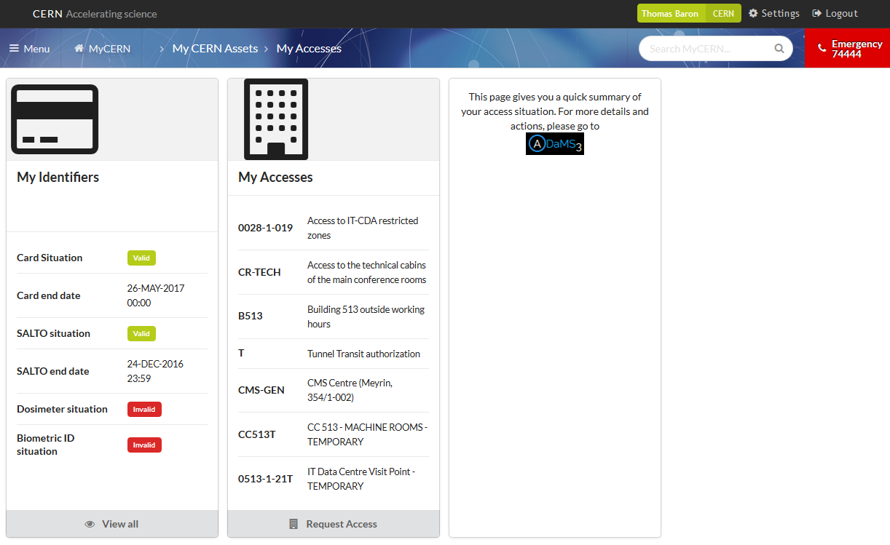
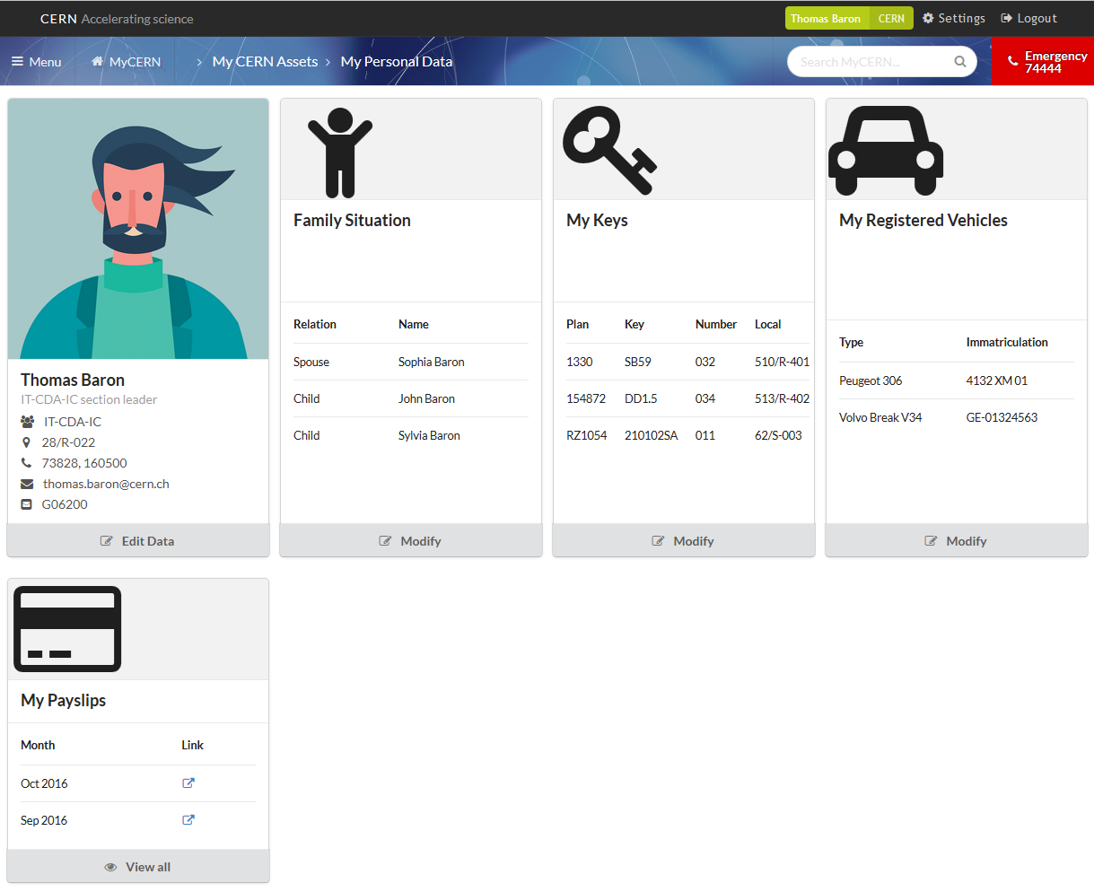
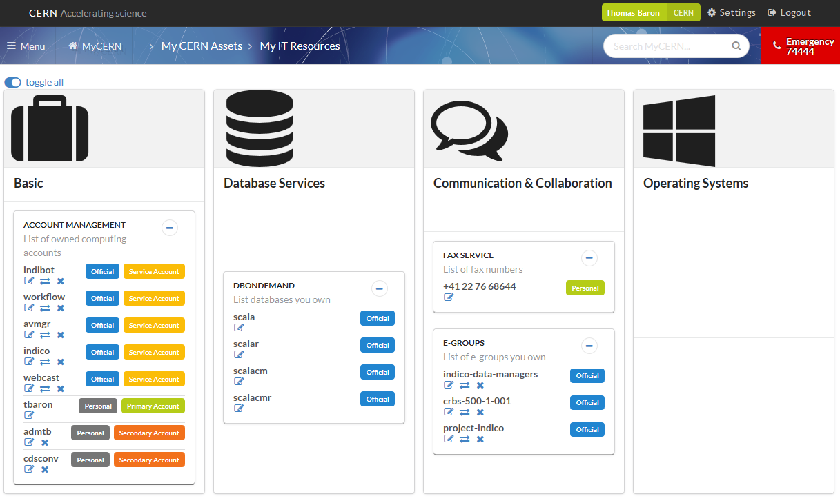
Personal Assets Aggregator

Slide 6
Personal Assets Aggregator: Scope
Resources for detailed design: 5m
Contact all owners of data considered (see backup slides)
  Detail with them what data should be shown
Evaluate the cost of implementation of all connectors + OAuth compliance
Prototype with at least two data sources:
  One AIS (some targetted information), one IT
  Stress tests

Slide 7
Communication Hub
Goal: Centralising all CERN official and services communications through one interface with a possibility to redirect messages to other channels
See more detailed specifications in backup slide
  Service specs are still work in progress
Benefit: Better reach of CERN users, lower email usage, simplify access to notifications for users
Duplication: None
Challenges: Create new service from scratch

Slide 8
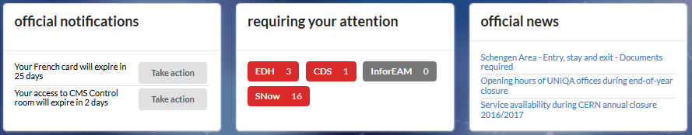
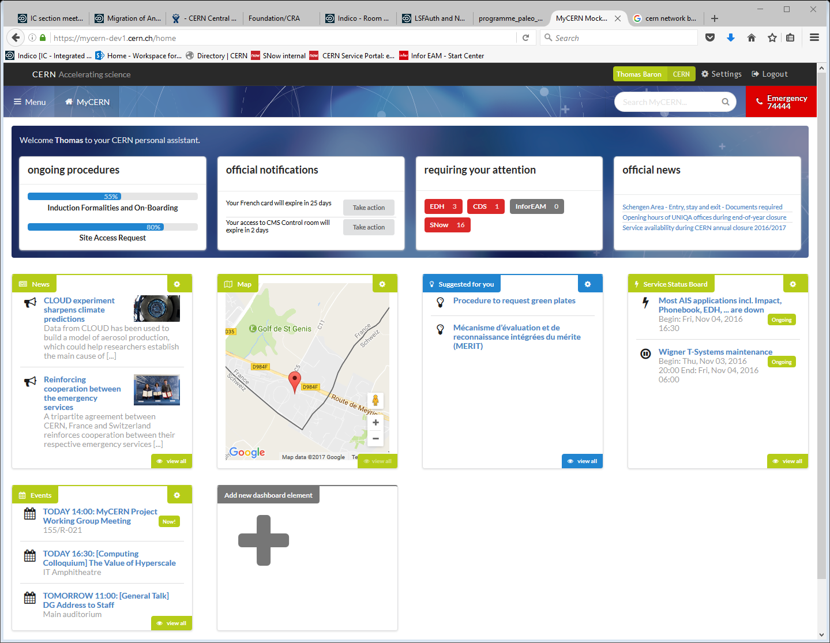
Communication hub

Slide 9
Communication Hub: Scope
Resources for detailed design: 2m
Liaise with the Push Notifications Project management team
Establish detailed specs and mockups for
  Push Notification Service configuration page
  Notifications listing page and widgets
Evaluate the cost of implementation

Slide 10
Information Hub
Goal: Group administrative and practical information from various sources (newcomers guide, admin e-guide, welcome brochure, regional information, Help at CERN…) and provide easy access through a powerful semantic search engine
Benefit: Ease retrieval of practical information for CERN users
Duplication: None (the new portfolio should become the master and not just a copy of existing sites)
Challenges: Setup the semantic search engine, build up and maintain the CERN Ontology

Slide 11
Information Hub: Scope
Resources for detailed design: 3m
Information sources
  List all sources of information to be centralised in MyCERN
  Select a common way to handle version management, cooperative editing and automated deployment for this information
    Drupal, Sharepoint, Gitbooks etc.
Semantic Search
  Study the requirements for the semantic search
    Initial corpus: Above information sources
    Possible extensions: Snow KBs, other CERN pages
  Market survey and selection of product
Evaluate the cost of implementation
Re-scope: Ranking of search results according to personal preferences and personal data

Slide 12
Procedures Engine
Goal: Turn procedures currently existing on paper into computing workflows automatically adapting to the user’s situation, and tracking progress
Benefit: Simplify processes by tailoring them to users, better guidance of users
Duplication: Other services (EDH) already handle these kinds of processes, through workflow engines and expert systems
Challenges: process complexity, reliance on external sources

Slide 13
Procedures Engine: Scope
Resources for detailed design: ???
De-scope: Hand over handling of new procedures to AIS in their standard work plan.
Ensure that feedback from ongoing procedures can be given to MyCERN (ongoing procedures widget)

Slide 14
Convenience Tools
Goal: Provide centralized, light-weight interfaces to existing practical tools, through interfaces suitable for mobiles and desktops
Benefit: Mobile usage
Duplication: Low (m.cern.ch will be replace by MyCERN)
Challenges: None

Slide 15
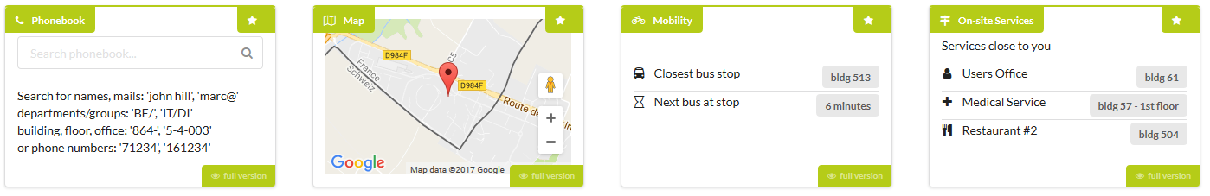
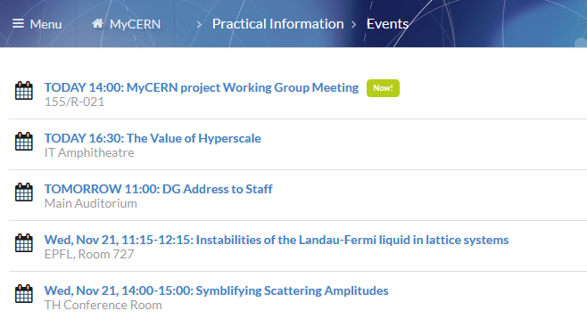
Convenience Tools

Slide 16
Convenience Tools: Scope
For each tool, establish the precise specifications based on existing features from m.cern.ch
Evaluate cost of implementation
Resources for detailed design: 0.5m

Slide 17
MyCERN: Scope
Resources for detailed design: 1m
Establish the detailed specs for the web interface
  Customization of pages and widgets
Establish the detailed architecture
Select best suited technology stack

Slide 18
Backup Slides

Slide 19
List of Personal Data to Consider (1/2)
Personal photos (official and social) (ADAMS and IT)
Firstname, Lastname (AIS)
Address at CERN (AIS)
Stored email address (AIS or IT)
Contract date, end date, type (category of MP) (AIS)
Supervisor name (Team Leader and DTLs for Users) (AIS)
Official documents (Swiss card, French card): start date, validation end date; if applicable date when a new card was requested and pending) (AIS)
My local address (residence) (AIS)
Family member names (names, registration date, birth date) and their legitimation cards as above (AIS)
Registered vehicles: number, start date (AIS)
Green number plates, start date (AIS)
Rented radioactive source, details as available (HSE)
Stored emergency contacts (or link to that) (AIS)
Rented books (if the list is too long then a link instead of a list) (Library/CDS)
Rented gas bottles (AIS)
Rented electronic pool items (if the list is too long then a link instead of a list) (AIS)
List of CERN club memberships
Generic links which leads to specific entries when logged in:
  Link to my entry in HRT,
  Link to print EDH CERN contract certificate
  Link to personal pay info (if ‘paid’) and tax certificate
  Link to my leave

Slide 20
List of Personal Data to Consider (2/2)
My Accesses (ADAMS)
  Overview list provided by BE plus link to ADaMS
My IT Resources (IT-CDA)
  Provided by IT; link to IT resources portal for actions
My IT Services (IT-CDA)
  Provided by IT; link to IT Services portal for actions
My Documents (CDS, EDMS, Indico, INSPIRE)
  Summary of documents owned by the user in CDS, EDMS, Indico, INSPIRE
My Snow tickets (IT)
  List of recent tickets and link to Snow for action
My CERN Social (IT)
  Citations in Facebook Workplace, Mattermost and social.cern.ch

Slide 21
Push Notifications Service Specs
Notification channels
  Restricted to specific posters
  Subscribable by users
Notifications targets
  Individualized
  Group
    Mapped to existing E-group
    Dynamic egroups for other criteria
  Location
    Geolocalisation
Notification carriers
  Desktop applications (Win, Mac, Linux)
  Mobile Apps (iOS, Android)
  SMS
  Email
  Web Portal
Notification sources in MyCERN (channels)
  Internal Communication – News
  Internal Communication – Official news
  Official notifications
    Mandatory channel (everybody is subscribed) open to specific services
    Card service
    Account service
    ADAMS
  CERN SSB
  Any other service
    Indico-developers
    IT-CDA
    Etc.
Notification history
  Supported
Acknowledgement (dissmissal)
  For individual messages only

Slide 22
List of Convenience Tools
List of events of interest
Map of CERN points of interest
Lightweight phonebook
List of on-site services
List of emergency contacts
Mobility information
Weather
My Links
  Set up by the person; MyCERN can propose an initial list

