Slide 1
SNS Ring TiN Coating Experience
CERN Anti E-Cloud Coating Workshop
Oct 12-13, 2009
by
M. Plum,
Ring Area Manager

Slide 2
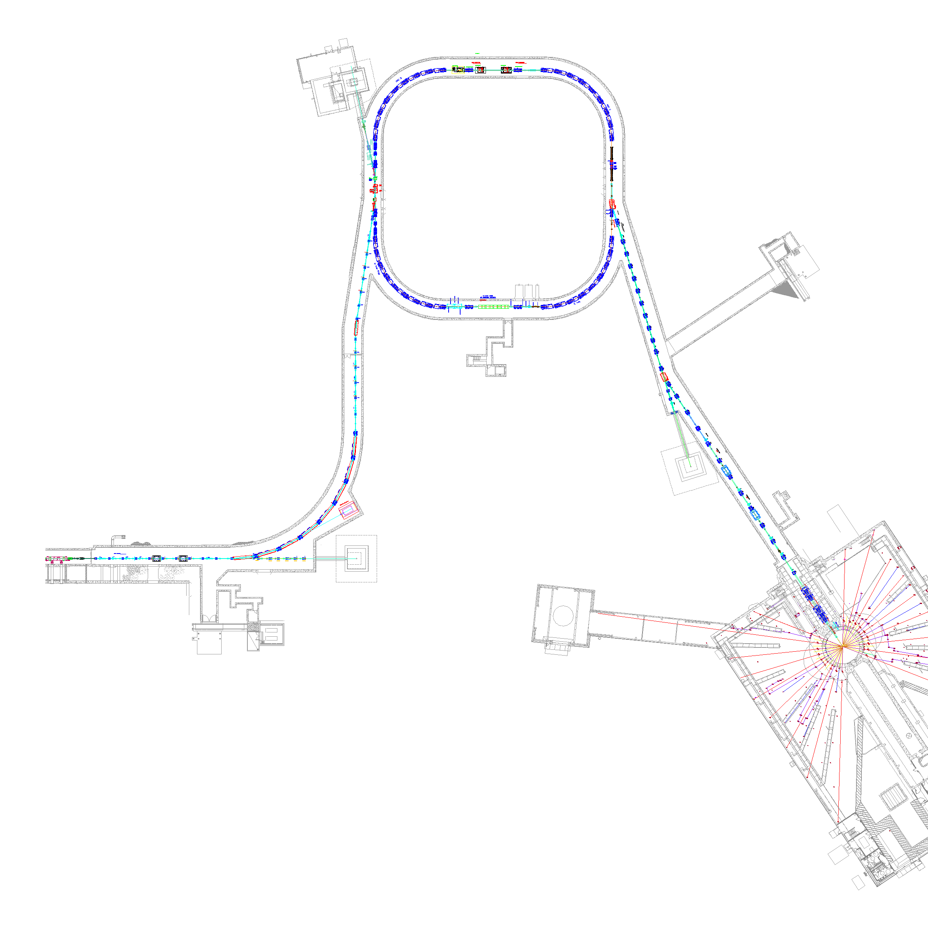


SNS Accelerator Complex
Accumulator Ring
1 GeV LINAC
Accumulator Ring: Compress 1 msec long pulse to 700 nsec
Collimators
Front-End:
Produce a 1-msec long, chopped,
H⁻ beam
Extraction
Injection
RF
1000 MeV
RTBT
2.5 MeV
HEBT
Front-End
LINAC
Liquid Hg Target
Chopper system makes gaps
945 ns
mini-pulse
Current
Current
1 ms macropulse
1ms

Slide 3
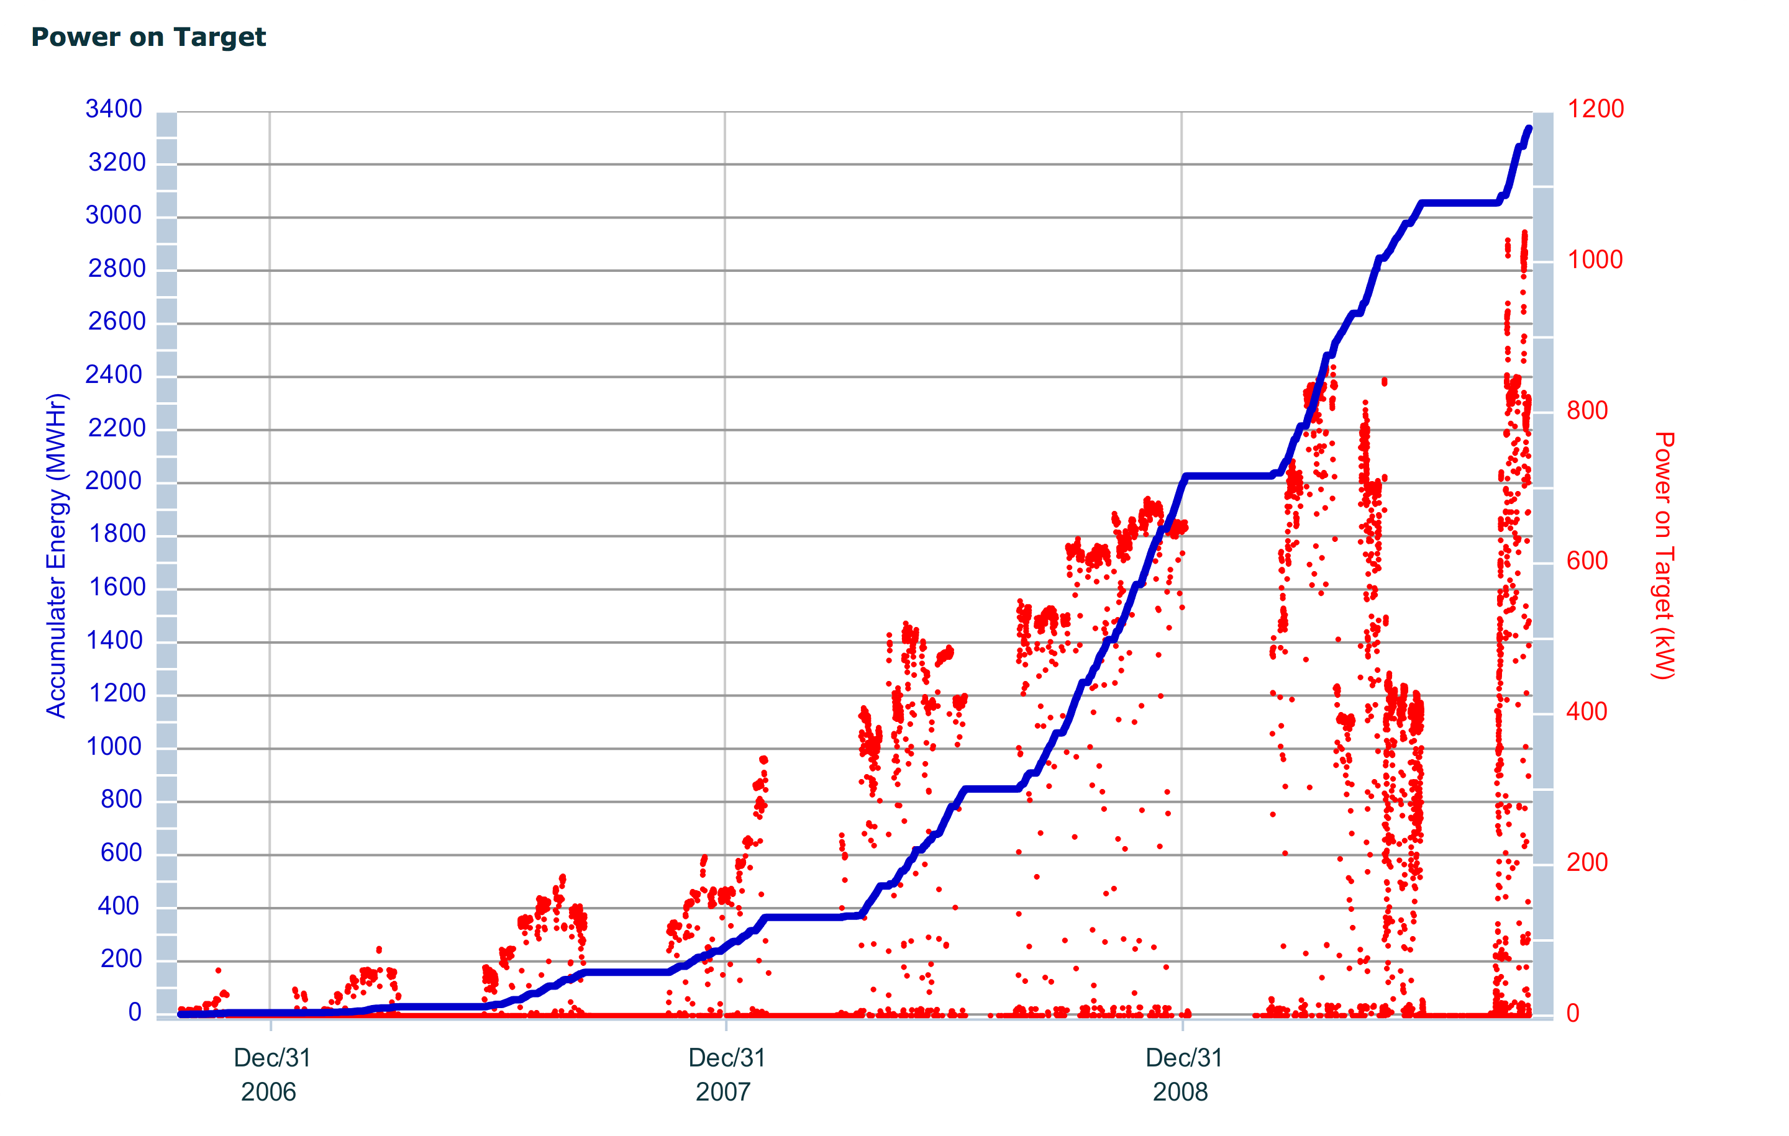
Beam power ramp up
Status:
    Production beam with up to ~1.1e14 ppp (18 uC).
    Full design intensity demonstrated at 1 Hz.
October 1, 2006 to October 5, 2009

Slide 4
The SNS Accumulator Ring
Design ring parameters:
1 GeV beam
Intensity: 1.5×10¹⁴ ppp (24 uC)
Working point (6.23,6.20)
Ring circumference – 248 m
Space charge tune shift – 0.15
e-p mitigating features at SNS:
Vacuum chambers coated with TiN to reduce
secondary electron yield
Solenoids in the collimation region
Clearing electrode near the stripper foil
BPMs can be biased to use as clearing electrodes
Robust dual harmonic RF system which can help keep the gap clean
Beam in gap kicker
Active damping system

Slide 5
Status of electron control and measurement in the SNS Ring
All vacuum chambers TiN coated except:
  ~7.1 m in RF straight for IPM and electron beam profile monitor development
  ~2.2 m in collimation straight for active damping system development
  ~2 m in vicinity of primary stripper foil, due to Al over-coating
Clearing electrode by primary foil
  Powered for first time on Oct. 6, 2009
Solenoid winding in collimation straight
  Not powered

Slide 6
Status of electron control and measurement in the SNS Ring (cont.)
BPM electrodes that can be biased
  Present electronics do not allow biasing
Beam in gap kicker system
  Not installed
Active damping system
  Under development
RFA electron detectors
  Have some very preliminary data

Slide 7
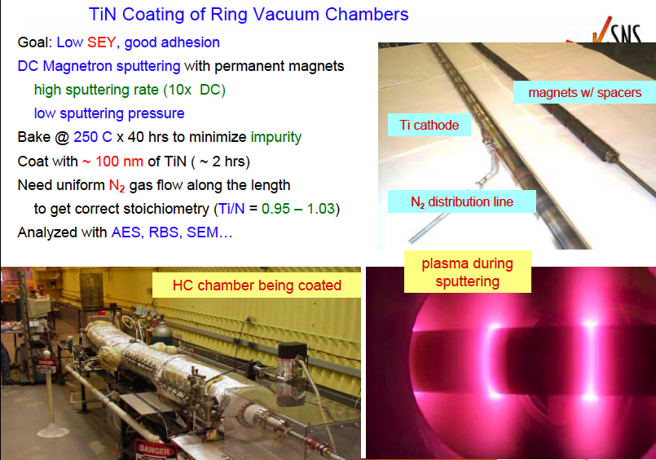
Hseuh et al., Ecloud04 workshop

Slide 8
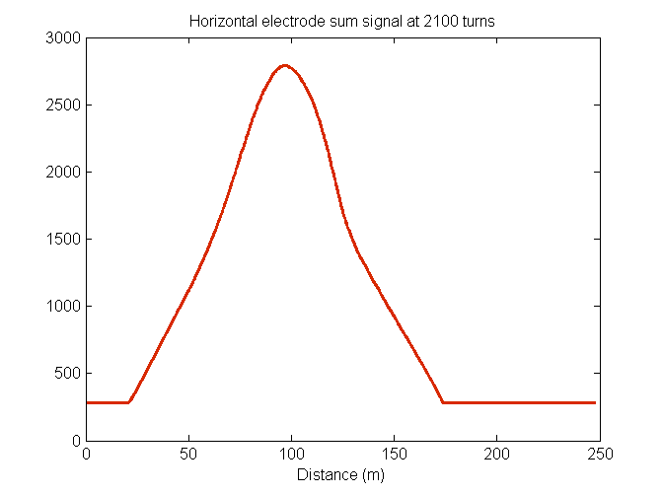
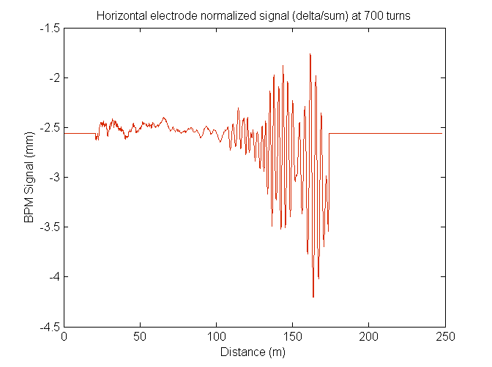
Example of e-p instability data
BPM sum
gap
BPM signal (mm)
700 turns
gap
high freq. oscillation
near tail of bunch
(From S. Cousineau et al., HB2008)

Slide 9
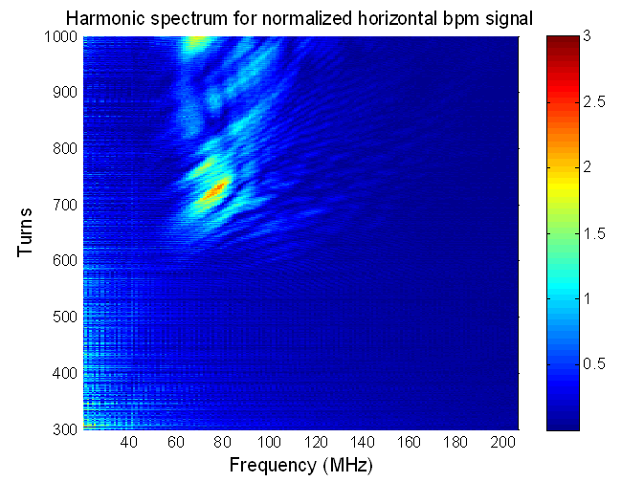
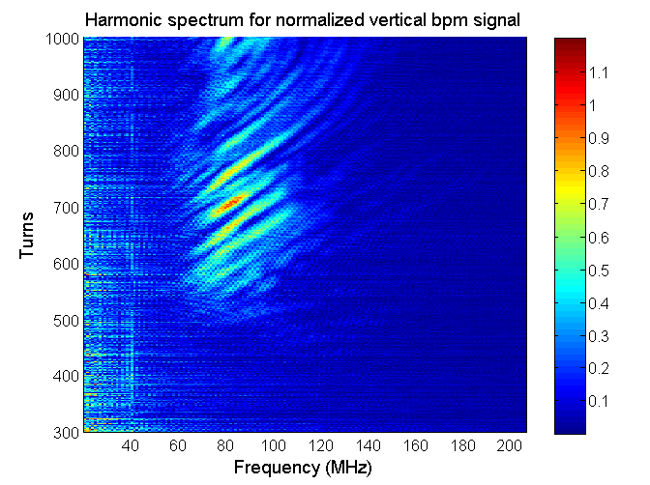
Example of instability frequency
Horizontal
Vertical
Instability frequency: 60 – 100 MHz.
Vertical preceded horizontal by ~200 turns.
(From S. Cousineau et al., HB2008)

Slide 10
Summary of 2008 e-p data
(From S. Cousineau et al., HB2008)

Slide 11
Experiment vs theory
Measurements show that the e-p instability is present at charge intensities as low as 3e13 ppp (one fifth full design intensity,
24 kV of h=1 and 16 kV of h=2 RF)
On one occasion so far at full design intensity (1.5e14 ppp), measurements showed that instability can be controlled with Ring RF. (42 kV of h=1, 20 kV of h=2 RF).
Note that ~4.6% of Ring is uncoated.
Based on analytical and computational studies, and comparisons with LANL’s PSR, with no TiN coating
  Stable up to 2e14 ppp for h=1 RF of 15 kV [Blaskiewicz et al., PRSTAB 2003]
Computational simulation including effects of TiN coating
  Stable up to 2e14 ppp for h=1 RF of 13 kV [Shishlo et al., EPAC06]

Slide 12
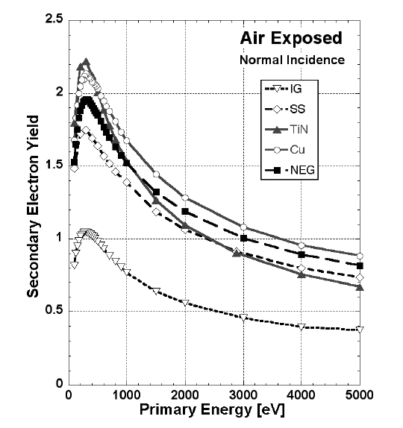
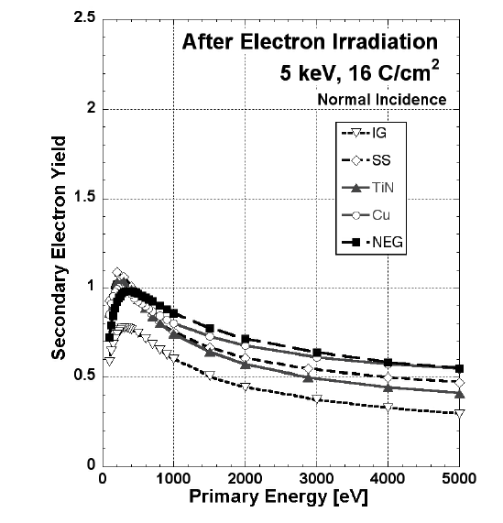
SEY of st. steel and TiN vs. scrubbing
Copied from M. Nishiwaki and S. Kato, ECLOUD’07
SNS Ring beam pipes are 316L or 316LN stainless steel, bellows are Inconel 625
 | SEY_{max} of TiN | SEY_{max} of St. St.
Unscrubbed | 2.2 | 1.8
Scrubbed | 1.05 | 1.1

Slide 13
TiN summary
With ~95.4% of our ring coated with TiN, we have seen the instability at about one fifth of design intensity
Theory predicts no e-p instability up to 30% greater than design intensity
PSR experience: TiN coatings sometimes help, sometimes not until after scrubbing [R. Macek et al., ECLOUD ’04 & PAC03]
SNS vacuum chambers were exposed to air for months prior to installation, so our TiN started out unscrubbed, and may still be unscrubbed
Secondary emission yields of stainless steel and TiN seem to be about the same, before and after scrubbing
Is TiN coated stainless steel really better than just plain stainless steel?

Slide 14
Future plans
Continue to develop active damping system
  400 W, 3 to 300 MHz, each plane
Complete purchase of TiN coating system
  $339k from Kurt J Lesker Co., due ~Jan. 2010
Continue to get all chambers TiN coated
Continue to develop diagnostics and characterize electrons in ring
  RFA electron detectors
  Microwave plasma measurements
Determine effectiveness of TiN coating

Slide 15
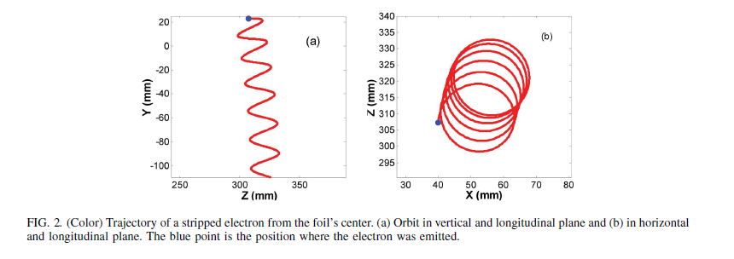
Electrons in vicinity of stripper foil
Convoy electrons from a 1 GeV H⁻ beam have 545 keV energy, gyroradius 12 mm, period 0.29 ns, pitch 16-23 mm. Center of circular motion moves ~14 mm downstream and ~5 mm beam left. Electrons are collected in an “electron catcher”. A 1 MW beam has ~1 kW power in the convoy electrons.

Slide 16
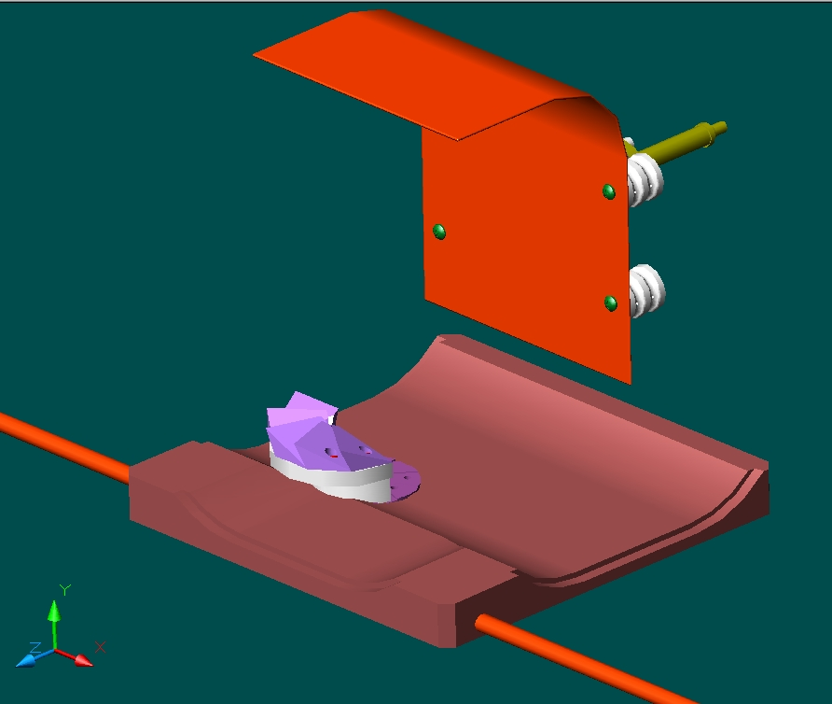
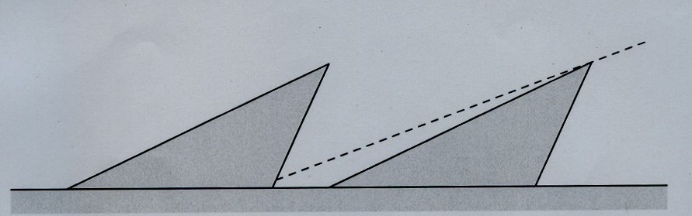
Electron catcher and clearing electrode
Water cooled carbon-carbon wedges
Undercut prevents secondary electrons from escaping
+/-20 kV biasing system
Inlet and outlet water cooling lines have thermocouples, read out by EPICS and archived

Slide 17
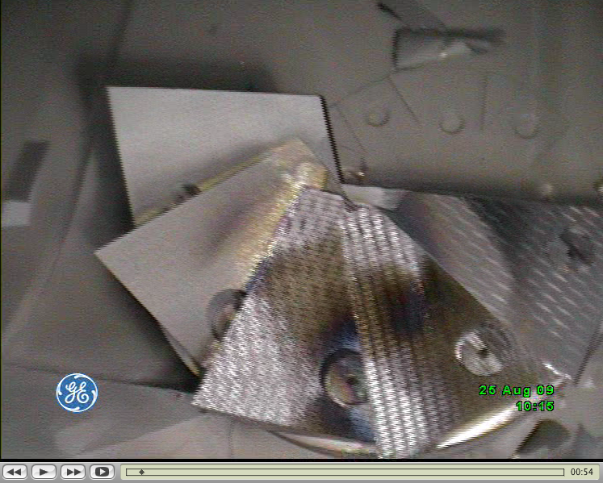
Electron catcher boroscope image
Al coating
Electron impact

Slide 18
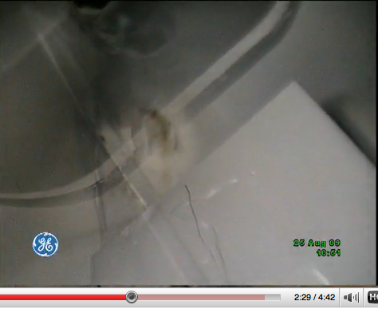
Graphitization at top of vacuum chamber
Could be reflected convoy electrons or trailing-edge multipactoring
~24 mm
152 mm
Clearing electrode

Slide 19
Summary
e-p instablility is present in SNS ring at intensities as low as 3e13 ppp (one-fifth design intensity). Theoretical work prior to commissioning predicted no e-p instability up to 30% greater than the design intensity.
e-p instability can be controlled with ring RF system up to full design intensity of 1.5e14 ppp (one time only)
Results from TiN coating are mixed – is it really better than just stainless steel? Note that ring still has ~11.3 m (4.6%) with no TiN coating.
Attempting to coat everything with TiN has been expensive and has caused installation delays. It will be interesting to determine if it has been worth it.

Slide 20
Thank you for your attention!

Slide 21
Backup slides

Slide 22
SNS injection schematic
Closed orbit bump of about 100 mm
Merge H⁻ and circulating beams with zero relative angle
Place foil in 2.5 kG field and keep chicane #3 peak field <2.4 kG for H⁰ excited states
Field tilt [arctan(By/Bz)] >65 mrad to keep electrons off foil
Funnel stripped electrons down to electron catcher
Direct H⁻ and H⁰ waste beams to IDmp beam line

Slide 23
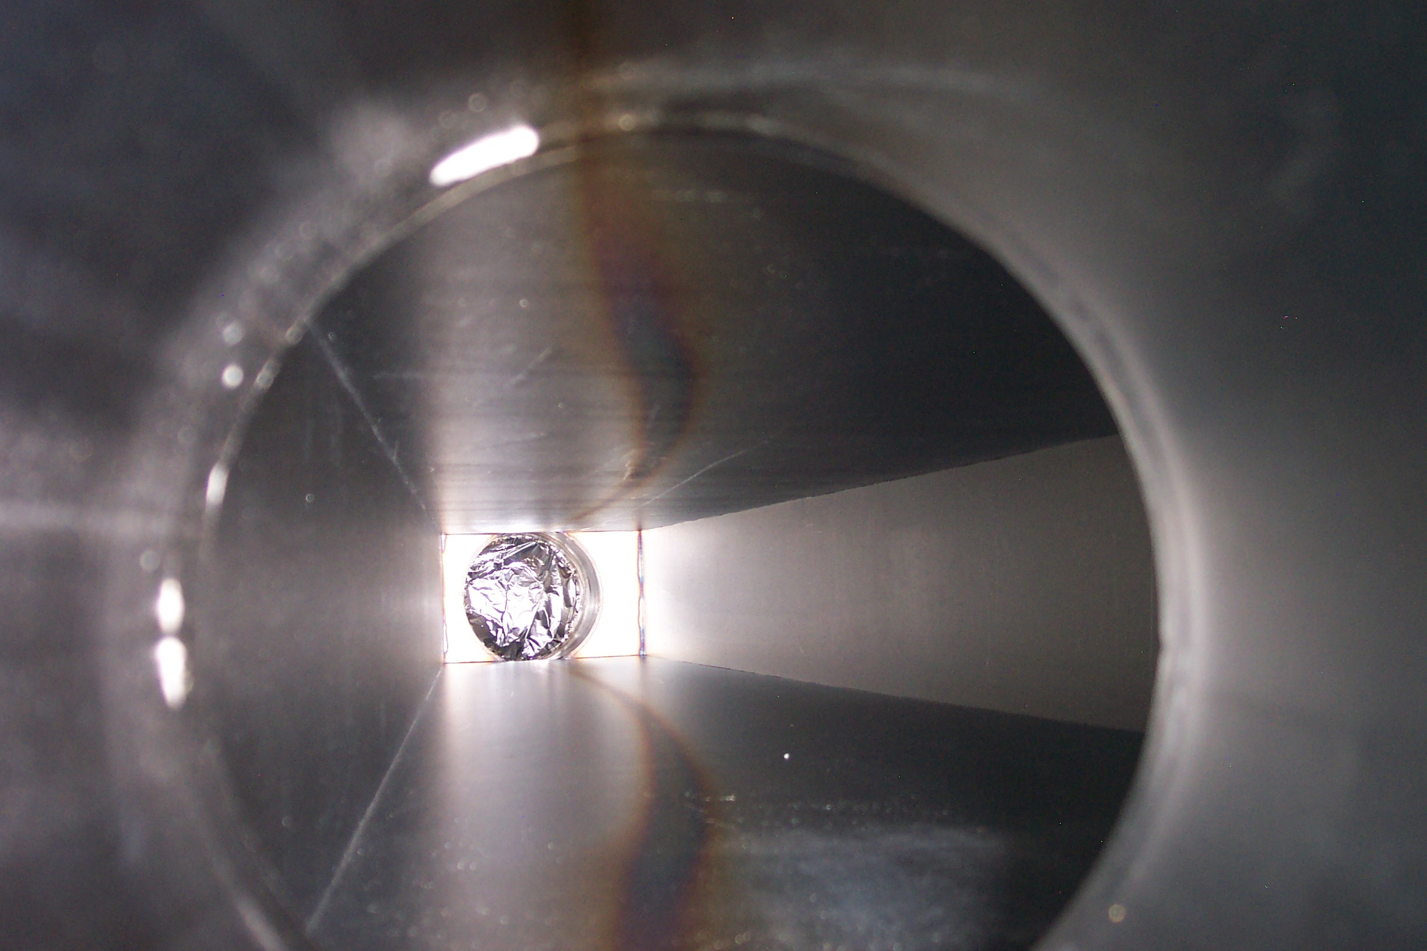
Graphitization
Example of graphitization by multipacting electrons in SRBM11 at PSR. This is not a thermal effect!
(R. Macek, HB2008 & private comm.)

