Slide 1
Coating of the CERN SPS main dipoles vacuum chambers: alternative scenarios, logistics
  J. Bauche – CERN magnet group

Slide 2
Coating of the CERN SPS main dipoles vacuum chambers: alternative scenarios, logistics
Introduction
  SPS machine and magnet system overview
  Goal and restrictive parameters
Strategy 1: coating in the tunnel
  Previous experience
  Implementation of the method in the coating project
  Rythm, bottlenecks
  Pros & cons
Strategy 2: coating in an underground workshop
  Previous experience
  Workshop
  Transport
  Rythm, bottlenecks
  Pros & cons
Strategy 3: coating in a surface workshop
  Previous experience
  Transport
  Rythm, bottlenecks
  Pros & cons
Conclusions and prospects

Slide 3
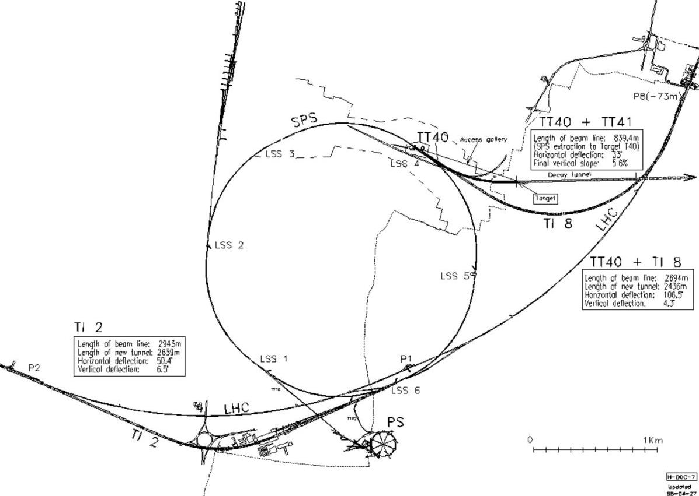
Introduction
  SPS complex:
  14 km of beam lines including the 7 km long synchrotron ring
  About 3100 magnets for the whole complex
  About 1400 magnets in the ring including 744 main dipoles and 216 main quadrupoles
  The main dipoles represent more than 70% of the length of the synchrotron vacuum system, the quadrupoles about 10%

Slide 4
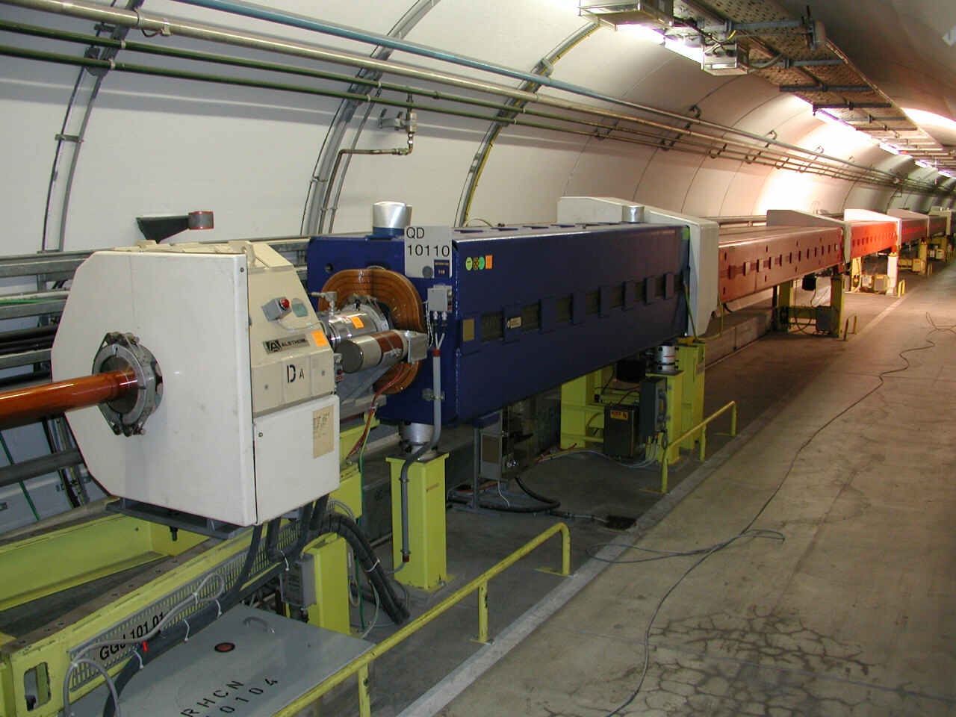
Introduction
SPS typical FODO half-cell

Slide 5
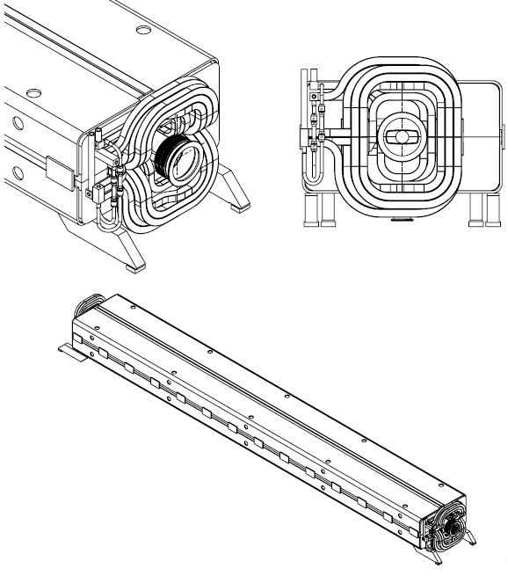
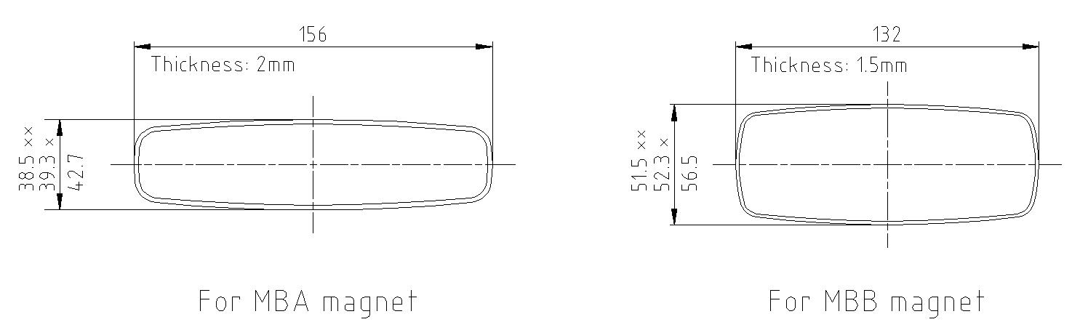
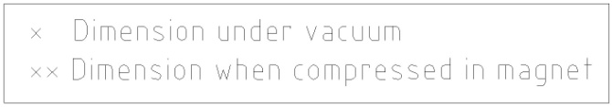
Introduction
General Overview of the SPS main Dipoles
→ MBA and MBB dipole magnets have similar outside dimensions, but different apertures. Each dipole is a H-type magnet about 6 meter long, 18 tons and consists of two identical laminated half-cores, a coil assembly and a captive stainless steel vacuum chamber.
→ The assembly is welded into a rigid self-supporting unit.

Slide 6
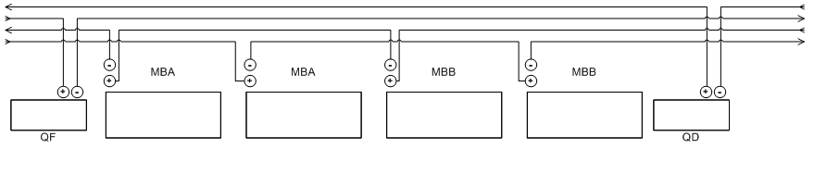
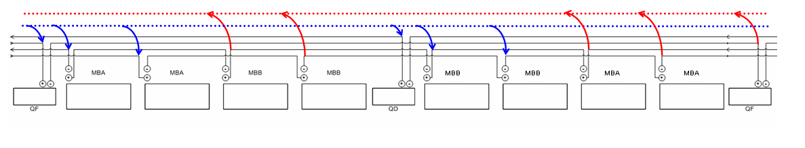
Introduction
SPS Bus-Bar System: Powering and Cooling Principles
Main dipole and quadrupole magnets powered and water-cooled through hollow copper bus-bars
Powering Principle
The cooling system is equipped with valves for each half-sextant
Cooling Principle
Diagrams: courtesy of D. Smekens

Slide 7
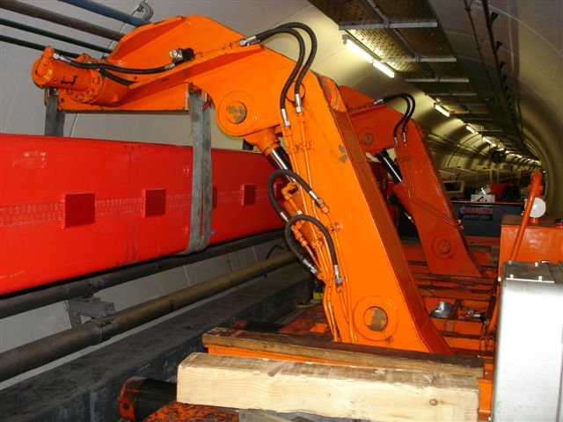
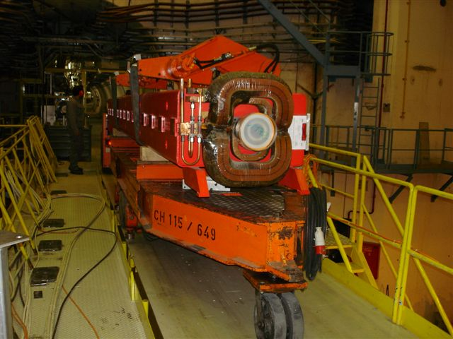
Introduction
Handling and transport of SPS main magnets
➔ done with machines so called the ‘Dumont’s’:
- Trailers designed for the SPS tunnels, equipped with 2 handling manipulators,
- Hydraulic system, not automated
- For long distances, we transfer the magnets on standard trailers in the access galleries to win time
- 2 of these machines are currently available
Installation of main dipole in the SPS
Transport of dipole

Slide 8
Introduction
Goal and restrictive technical Parameters
Goal
  Complete coating of the 744 SPS main dipoles AFAPA and ACARA ➔ optimize logistics
Restrictive parameters to total duration of project
  Cadency of treatment
  If implemented during shutdown periods, duration: standard period is 14 weeks of access in the machine, i.e.10 weeks of effective work (4 weeks are necessary for start-up and end phases of the project)
  Availability of the machine w.r.t. other activities (interferences): TBD by priority of this project
Restrictive parameters to cadency of treatment
  Time of coating process: 4 days, including cleaning (1 day), installation of equipment - vacuum pumping (1/2 day), coating (2 days) and dismantling of equipment (1/2 day)
  Number of equipments available for coating, transport, ancillary: no purchase of additional transport machines
  Space available (number of units being treated in parallel)
  Manpower (number of teams available for work in parallel (and / or shifts ?)
  Working time: 8 hours / day, 5 days / week
  Equipment technical limits (e.g. overheating of PU of transport equipment wheels)

Slide 9
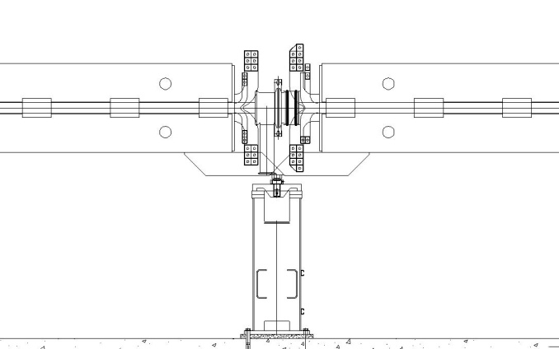
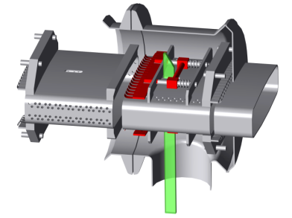
Strategy 1: coating in the tunnel
Previous experience
  Installation of RF shieldings in the pumping port cavities of the magnet vacuum chambers to reduce the machine impedance between 1999 and 2001
  → Method used: 1 over 2 dipoles removed from its position and put in the passageway on the Dumont handling machines to allow accessing interconnections on all the magnets
  → Figures:
    1200 interconnections equipped during 2 long shutdowns
    370 main dipoles and a hundred of auxiliary magnets removed from their position
    Rate of treatment: 3 dipoles / day removed and reinstalled to their position
    Time of process / magnet: a few hours, including handlings
RF shielding model

Slide 10

Strategy 1: coating in the tunnel
Implementation of the method to the coating project
  Idea to take out of its position 1 over 2 magnets to allow access to all vacuum chambers ➔ OK
  BUT with a coating process time ≈ 4 days, doing it in the same way means to let 370 magnets, 4 days each one, on the Dumont in the passageway. This would destroy the polyurethane wheels of the Dumont’s. Also, since only 2 Dumont are available → project would be realized in about 750 days… not realistic!
Alternative: lifting the magnets about 500 mm above their position instead of bringing them in the passageway + stabilizing them with supports in order to free the Dumont + removal of SSS girders
Access for coating equipment Insertion
SPS typical half-cell

Slide 11
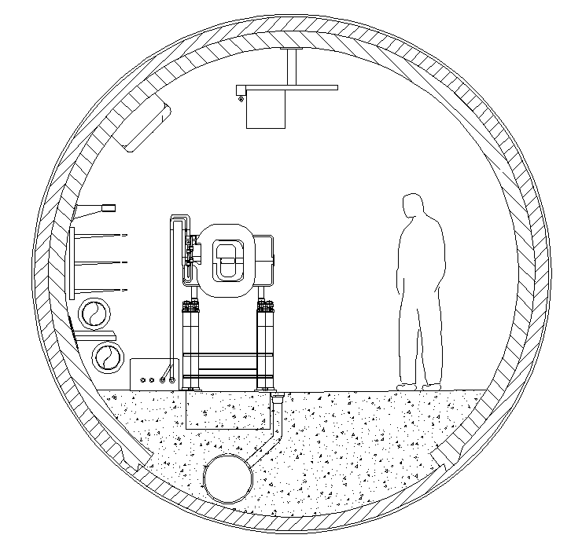
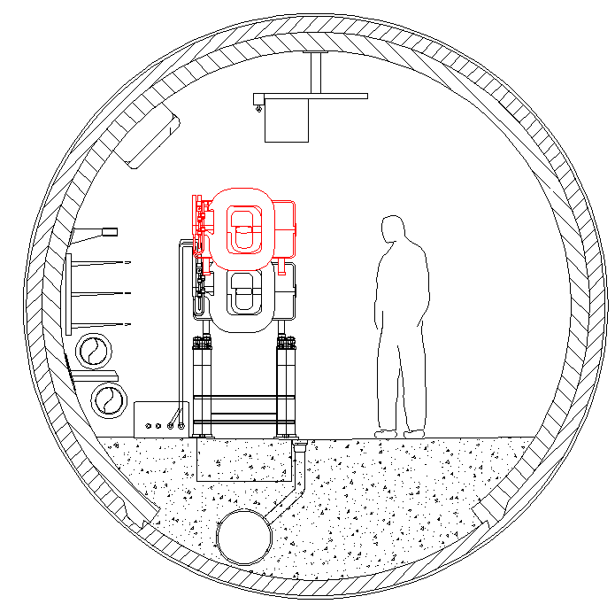
Strategy 1: coating in the tunnel
  BUT space available above the magnet is too small to realize that with the Dumont machines
  ➔ need to purchase or manufacture a lifting device that ‘pushes’ instead of ‘pulling’ (like a lifting table)
SPS tunnel cross-sections @ dipole position

Slide 12
Strategy 1: coating in the tunnel
  Sequence of the operations
Day 1
Day 2
Day 3
Day 4
Cleaning
Installation & puming
Coating
Dismantling
Main quadrupole
Main dipole
Schematic of the work site in 6 half-cells

Slide 13

Strategy 1: coating in the tunnel
Bottlenecks
  Required number of pumping / coating equipments
  Space available for work and for rotation of the equipment
Rhythm
  Assuming realistic cadencies, i.e. in 4 days:
    1 team disconnects-reconnecst 12 dipoles from the busbars;
    1 team lifts and puts back in place 12 dipoles ;
    1 team removes-reinstalls 6 SSS girders with auxiliary magnets;
    1 team cleans 24 dipole vacuum chambers;
    1 team aligns 6 half-cells
  Assuming also:
    15 supporting units are necessary (3 for rotation)
    21 pumping / coating equipments are necessary (realistic ?)
  Rhythm = 6 magnets / day
  Project completed in 120 working days

Slide 14


Strategy 1: coating in the tunnel
Pros
  Minimize handling of magnets to the very minimum (lift and put down)
  No transport
  Reasonable interference with other activities (stays localized in a sector)
  The method gives access to both sides of each quadrupole that could so be treated too (≈10% of SPS ring vacuum length)
  Quadrupoles stay in place → survey reference kept, time won for alignment
Cons
  Radioactive environment, important exposure of the workers
  Space available is small → risks increased + equipment has to be adapted (is it possible ?). Rotation of the equipment would be difficult
  Requires a lot of pumping / coating equipments in parallel
  Access to vacuum chambers not so easy
  Requires numerous specific supporting structures

Slide 15
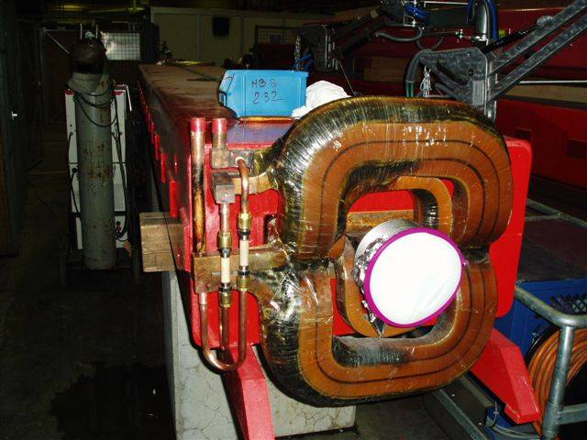
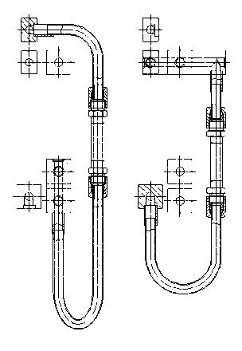
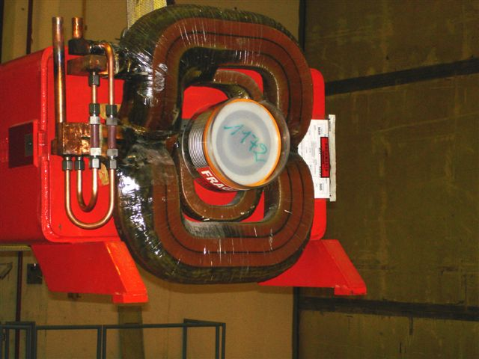
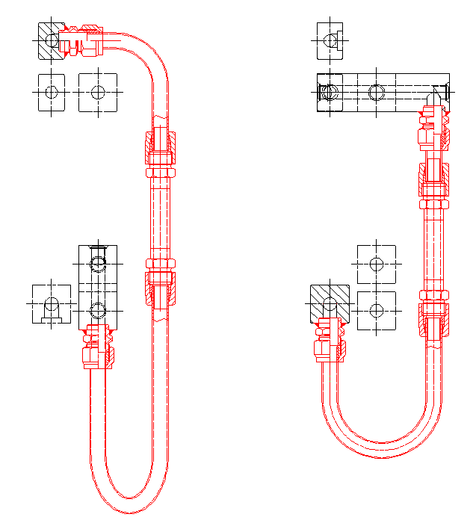
Strategy 2: coating in an underground workshop
Previous (and current) experience
MBB manifold consolidation program 2006 - 2008: complete refurbishment of all the manifolds on the MBB magnets equipped with Lintott coils in operation in the SPS
  → Method used: magnets removed from their positions and transported with the Dumonts and trailers to ECX5 cavern converted in radioactive workshop
  → Figures :
    255 magnets treated over 3 shutdowns (about 70 days of work in the workshop)
    Refurbishment rate: 4 magnets / day
    Time of process / magnet (machining, welding, assembly and tests): ≈ 3 hours
Before
After

Slide 16
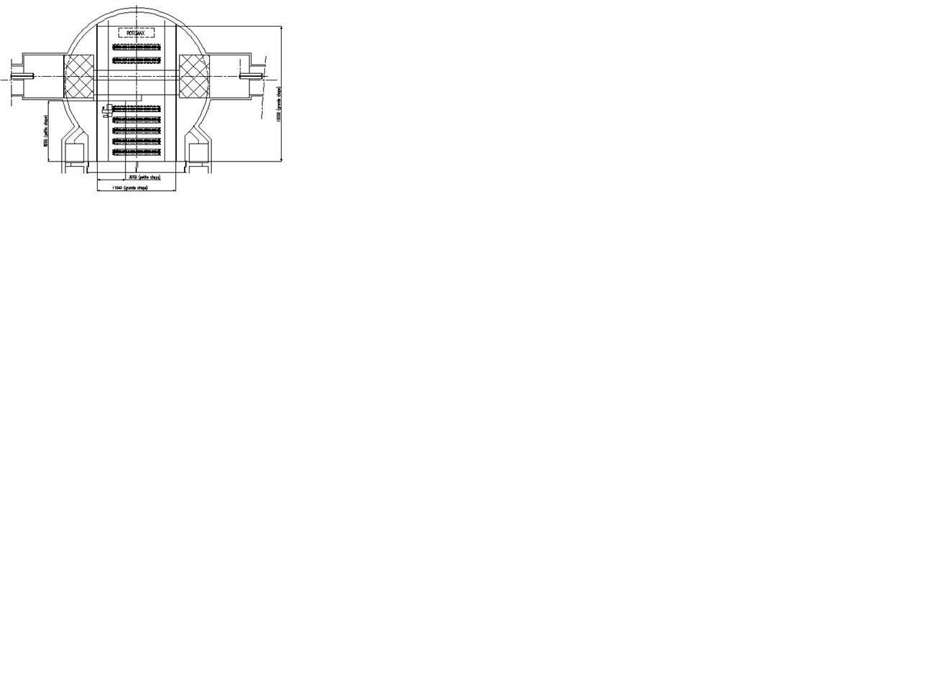
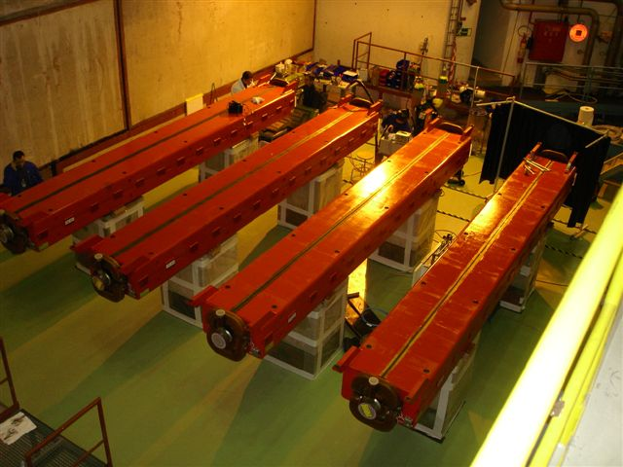
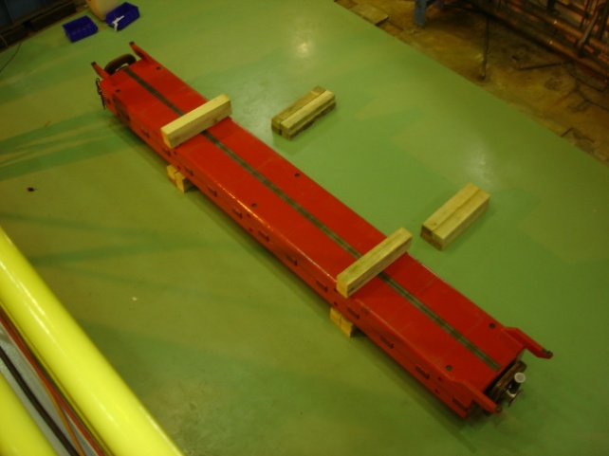
Strategy 2: coating in an underground workshop
Workshop
→ Radioactive workshop in ECX5 cavern
- Underground instead of surface: to limit the risks of transport and handlings and to win time
- In the ECX5 cavern (ex-UA1 experiment):
→ polar 40 tons crane available (refurbished in 2007)
→ enough space to refurbish 4 magnets / day
→ very low radiation level
ECX5 worshop for MBB manifold consolidation (top view)
ECX5, workshop side
ECX5, storage side

Slide 17
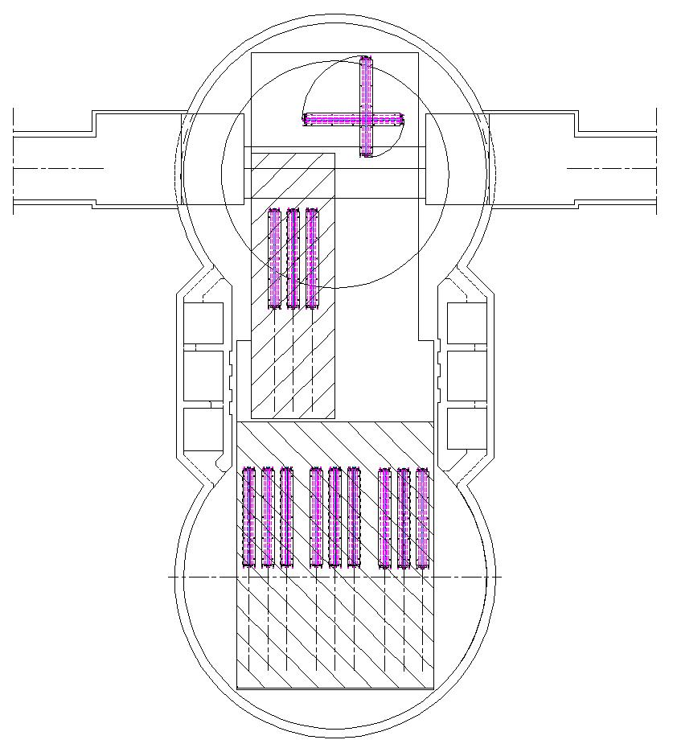
Layouts of Underground Worshop
Underground Workshop ECX5 + 300 m2 concrete screed ECA5
460 m²
Capacity of workshop: 24 magnets

Slide 18
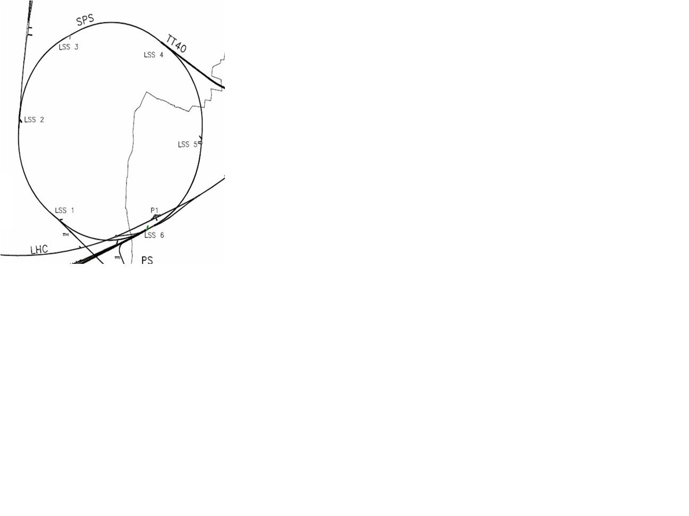

Strategy 2: coating in an underground workshop
Transport
Transfer Dumonts ↔ trailers
- Possible in all access points
- T_{transfer} ≈ 20 min
Journey with Dumont machines
- Average speed ≈ 2 km/h
- T_{1 sextant} = 36 min
Sector type 3
Sector type 4
Journey with trailers
- Average speed ≈ 5 km/h
- T_{1 sextant} = 14 min
Sector type 6
Sectors type 2
Sectors type 1
Sector type 5
‘Equi-time’ positions between 2 sextants :
positions from which transfering Dumonts ↔
trailers in the previous or in the next point
results in the same total time of transport

Slide 19
Strategy 2: coating in an underground workshop
Bottlenecks
  Number of Dumont vehicles available (2)
  Required number of coating equipments
  The space available in ECX5 - ECA5
Rhythm
  Assuming same rhythm for connection to busbars, alignment and vacuum connections than strategy 1
  Assuming 18 equipments of coating are necessary
  Assuming 1 pumping unit could pump 6 magnets in parallel → only 3 pumping units would be necessary
  Assuming 2 transport teams work in parallel with 2 Dumont + trailers (3 magnets / day removed – reinstalled per team → realistic following last consolidation experience)
  Rhythm = 6 magnets / day
  Project completed in 120 working days

Slide 20
Strategy 2: coating in an underground workshop
Pros
  Workshop environment with much lower radiation level than in the tunnel
  Much space available, possibility to pile up magnets
  Equipment regrouped in a dedicated workshop, improved safety and ergonomics
  Possibility to pump more magnets in parallel with less pumping units than in strategy 1
  Same with cleaning units
  No special supporting structure required
Cons
  Interference between transport and other activities in the tunnel
  Risks inherent to crane handling and transport
  Need for transport teams in addition to coating teams → increase costs
  No crane available between ECA5 and ECX5 → we would need for a portico crane or for air cushion motioned supporting structures

Slide 21
Strategy 3: coating in a surface workshop
Previous experiences
None in big projects, only preventive and corrective annual magnet exchanges (5 to 10 / year)
  → Method used: magnet removed from its positions and transported with the Dumont to BA3 equipment lift and pulled by electro tractor to magnet workshop in bdg. 867, replaced by a spare
Transport
BAs equipped with equipement lifts:
BA2, BA3 & BA6
- T_{lift} ≈ 30 min
Transfer ECX5 to ECA5 and lifting to surface with ECA5 crane
- T_{lift} ≈ 10 min
  Workshop in BHA5 → if we open the concrete block wall between ECA5 and ECX5, we can lift the magnets with the BHA5 crane (no more need for lifts)

Slide 22
Strategy 3: coating in a surface workshop
Bottlenecks
  Number of Dumont vehicles available (2)
  Required number of coating equipments
  Required number of lorries and transport teams in addition to the logistic in the tunnel in case we would choose BA2 or BA6 equipment lift
Rhythm
  Assuming same rhythm for connection to busbars, alignment and vacuum connections than strategy 1 and 2
  Assuming same cadencies of transport in the tunnel than strategy 2
  Assuming additional teams and lorries are available in case we would choose to pass by the road (not necessary if we transit by ECA5 to surface)
  Rhythm = 6 magnets / day
  Project completed in 120 working days

Slide 23
Strategy 3: coating in a surface workshop
Pros
  Work in a non radioactive environment (but not so different than in ECX5), and not underground → access more easy to workshop
  We could find a bigger workshop in surface if necessary (e.g. BHA5)
Cons
  Need to implement an important logistic in surface in addition to the one underground → more difficult to manage, time consuming and costly
  Increase of risks inherent to handlings and transport compared to strategy 1 and 2 + transport of radioactive material on the road → not recommended
  If we would use the lifts, they could need to be refurbished
  If we would pass by the ECX5 - ECA5 and use the BHA5 as a workshop, we would have to stock the 30 blocs of 72 ton of the wall that separates ECX5 and ECA5 outside the building → need for a mobile crane (1 week of work for dismounting)

Slide 24
Conclusion
Summary
If we would run the project during shutdown periods, 3 shutdowns would be necessary for any strategy. But since in big projects like this, things are never straight forward, we have to consider 25 % of safety margin → 4 shutdowns would be realistic, moreover for strategies 2 and 3 that interfere with other activities
Strategies | Pros | Cons
1 | No transport, few handlings | - Few space / not safe Requires numerous equipments Equipments difficult (impossible ?) to design
2 | - Space available Dedicated workshop → safety and ergonomics Requires less equipments to reach the same cadencies than strategy 1 | Transport in tunnel → interference with other activities + costs increased
3 | Same as strategy 2 | Same as strategy 2, but with increased cost

Slide 25
Conclusion
So, which strategy ?
This is a first draft ! We first need to fix the following parameters:
  Operating mode, process duration and conditions needed for each operation
  Deadline for the project to be completed
  Resources allocated to the project (budgets, manpower)
  Will this project be implemented during shutdowns ? If yes, what will be the durations of the shutdown periods and the priority of this project w.r.t. other activities ?

Slide 26
Conclusion
Thank you for your attention !

Slide 27
References
Reducing the sps machine impedance, P. Collier, M. Ainoux, R. Guinand, J-M Jimenez, A. Rizzo, A. Spinks, K. Weiss
New Strategy for the Repair of SPS Dipole Water Manifolds, J. Bauche, W. Kalbreier, D. Smekens (EDMS Doc. No.: 783313)
Projet de Consolidation des Dipôles Principaux du SPS. Remplacements des manifolds de refroidissement des bobines dipôles, D. Smekens (EDMS Doc. No.: 782003)

