Slide 1
Results and plans of CESR-TA experiments on low SEY coatings
Anti e-Cloud Coatings - "AEC'09"
Report by S. Calatroni on behalf of
J. Calvey, J. Crittenden, Y. Lin,
J. Livezey, M. Palmer G. Rumolo
Many thanks to the SPS-U WG and the CLIC DR WG

Slide 2
Coating for Cesr-TA
June 2008: First approach by M. Tigner (during LHC MAC, presentation of a-C for the SPS-U by P. Chiggiato)
July 2008: GR & SC take part to ILCDR08, and discussions are started
August (?) 2008: start of formal CLIC-ILC collaboration on damping rings (Yannis Papaphilippou & Mark Palmer)
November: 2008 (ECM’08): definition of program and of test chamber. Design & manufacturing start in Cornell.
May 2009: Shipping of test chamber to CERN
June 2009: Carbon coating, shipping to Cornell, and installation in Cesr-TA
July-August 2009: data taking

Slide 3
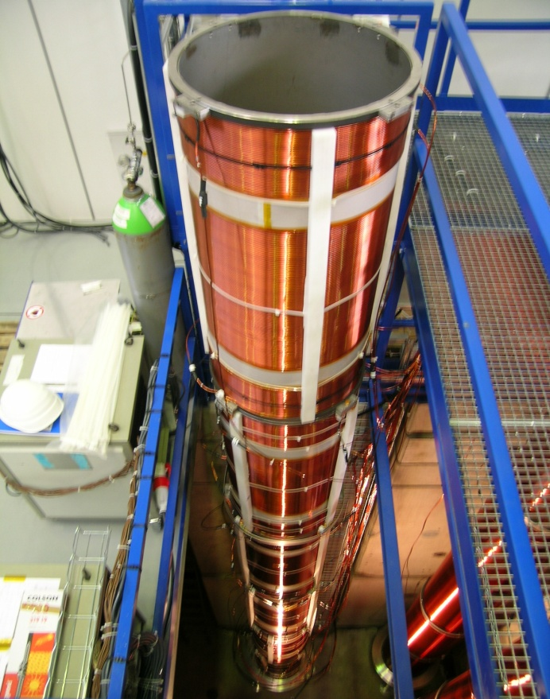
Magnetron sputter coating in “LSS system”
Graphite
rod
+
noble gas ion
Electron
C atom
+
+
+
+
+
+
+
+
Variable parameters
-gas pressure
-power
-700V
B-field
Four tests have been carried out on a dummy chamber, to optimize coating parameters (thickness uniformity, SEY…)
Final coating took place on 8 June 2009

Slide 4
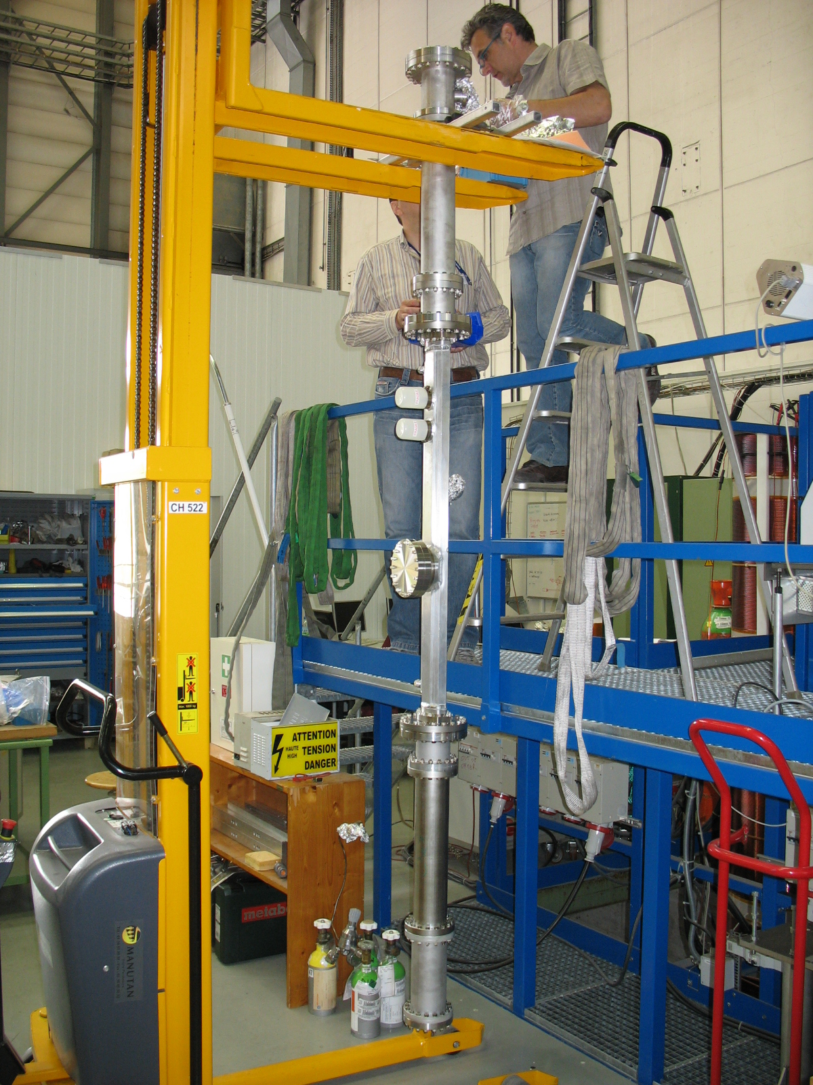
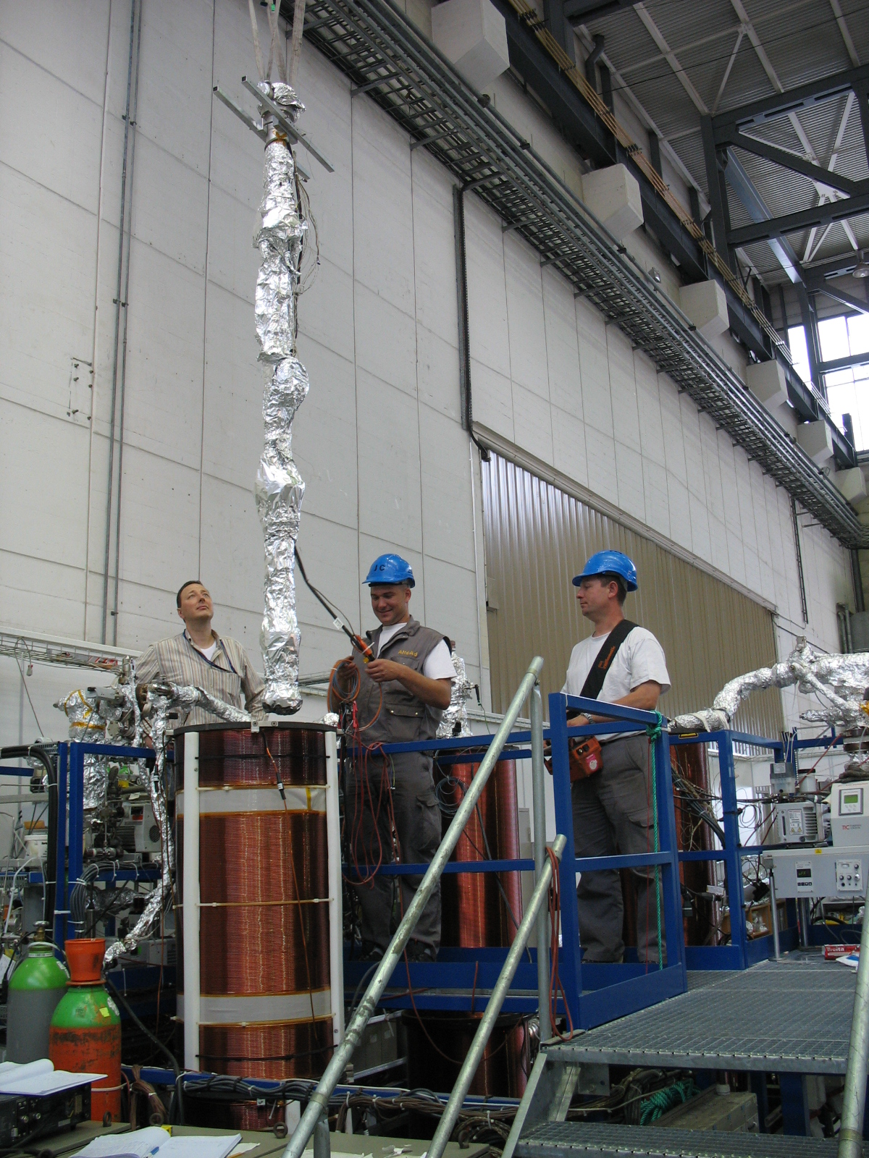
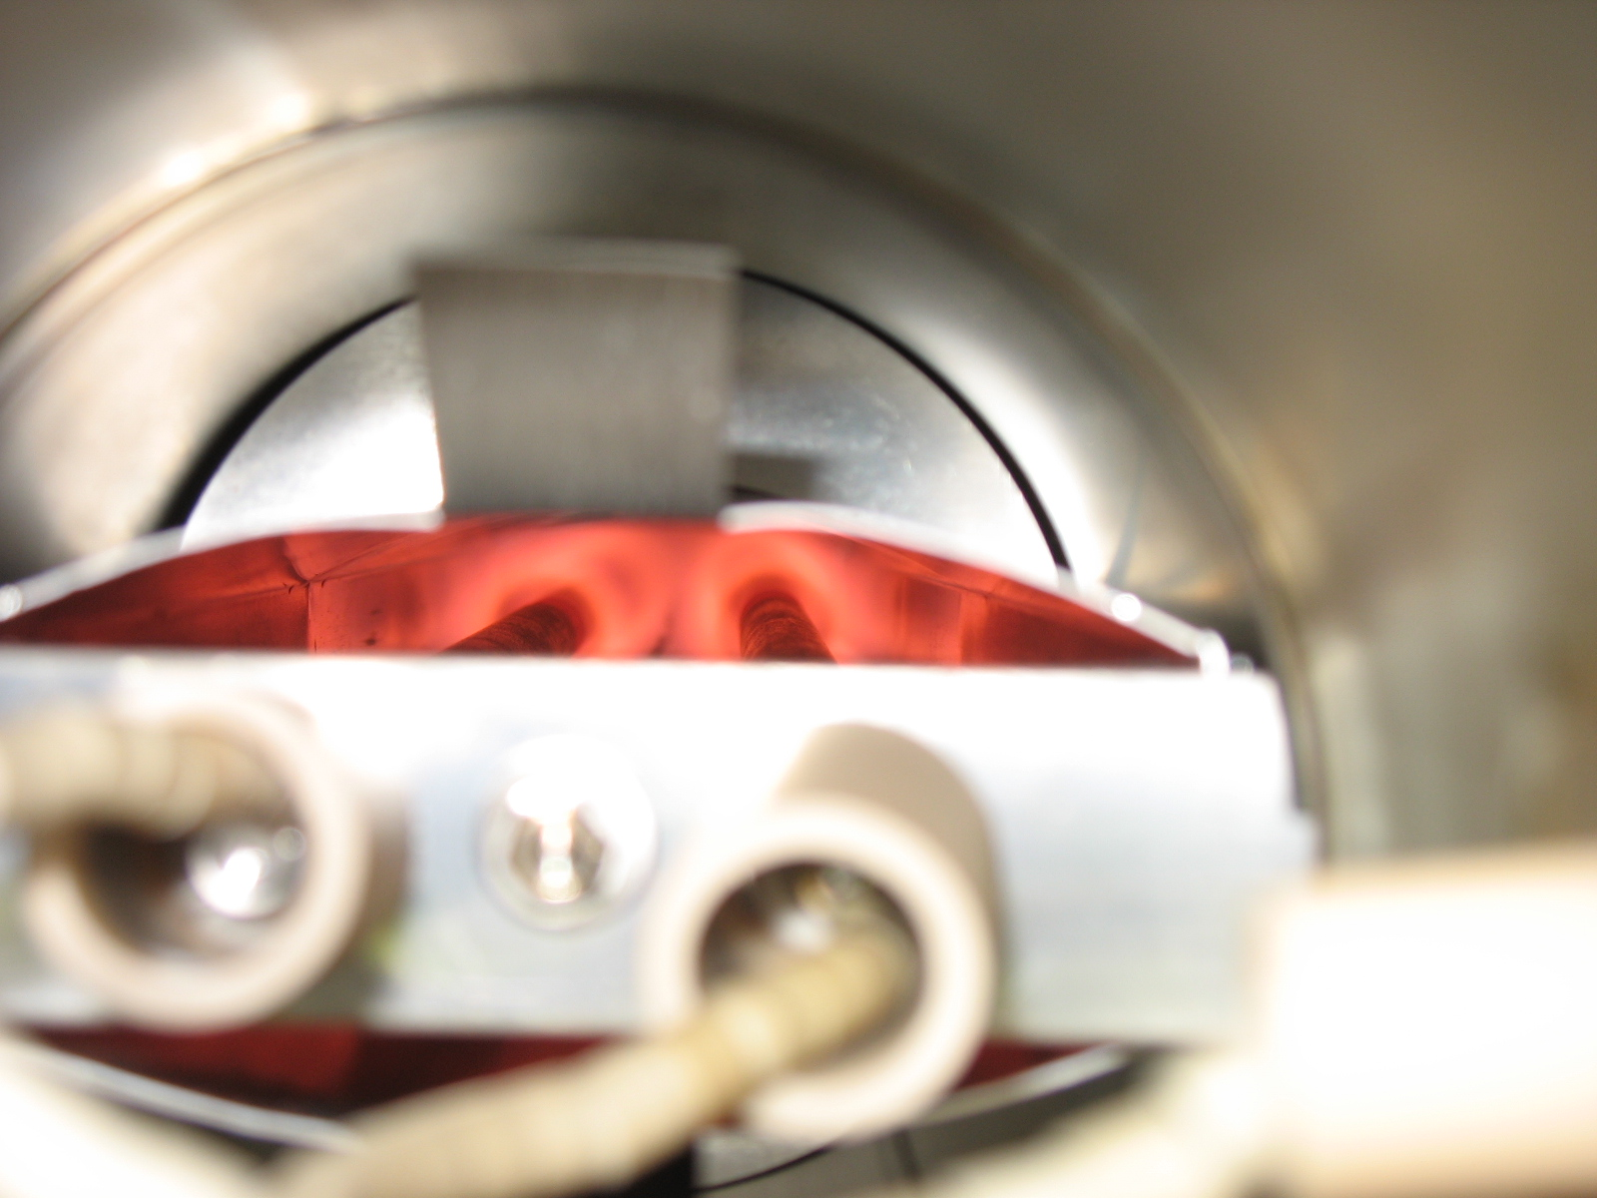
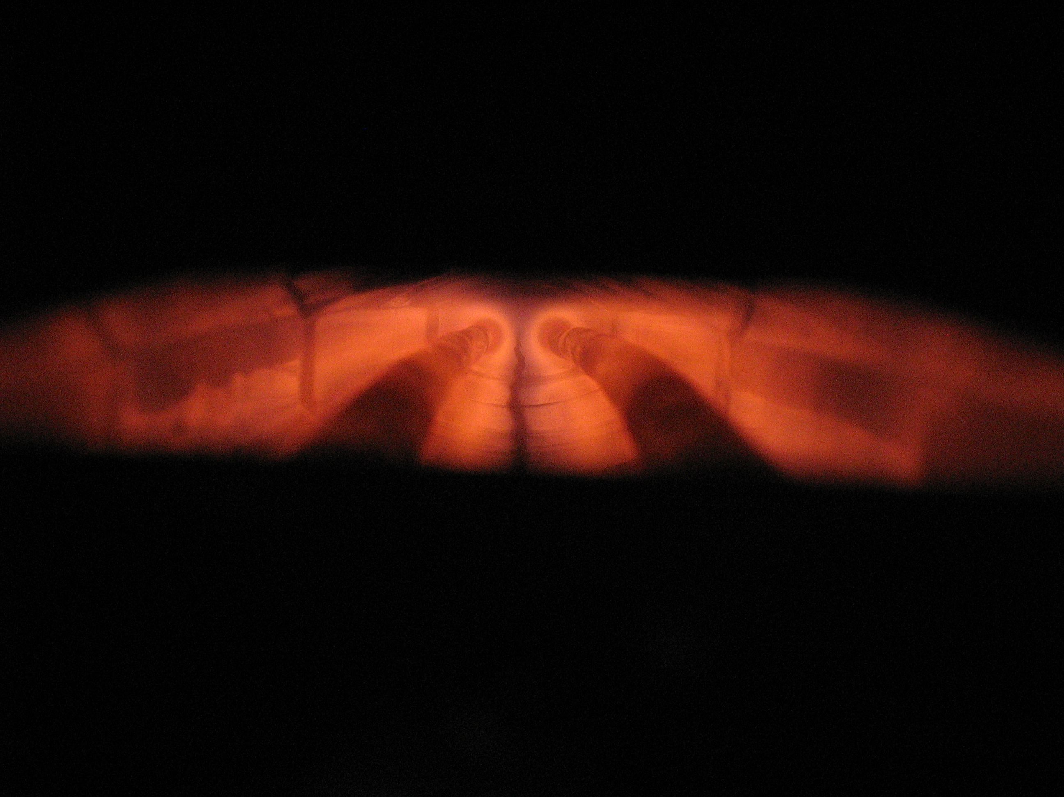
Coating the Cesr-TA chamber
Initial SEY of a-C coating = 0.98 (measured on witness samples)

Slide 5
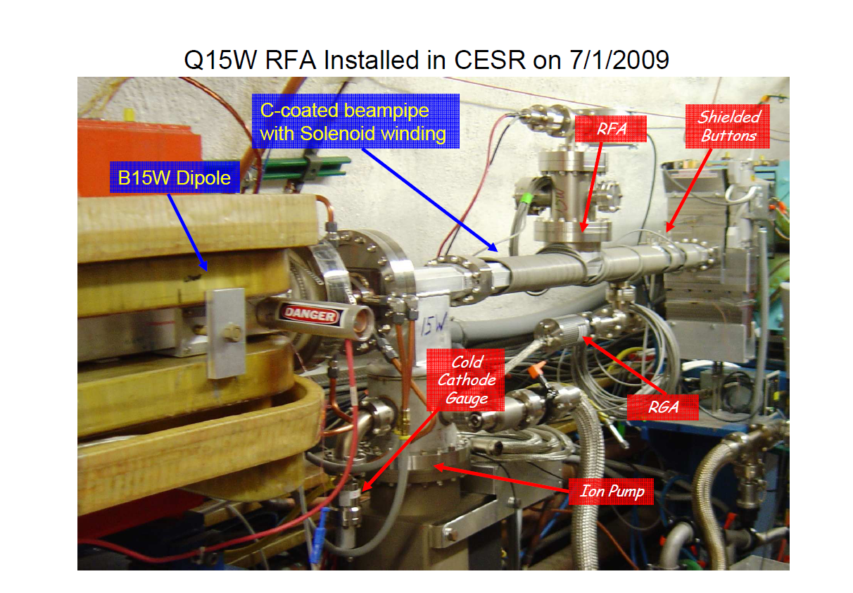

Slide 6
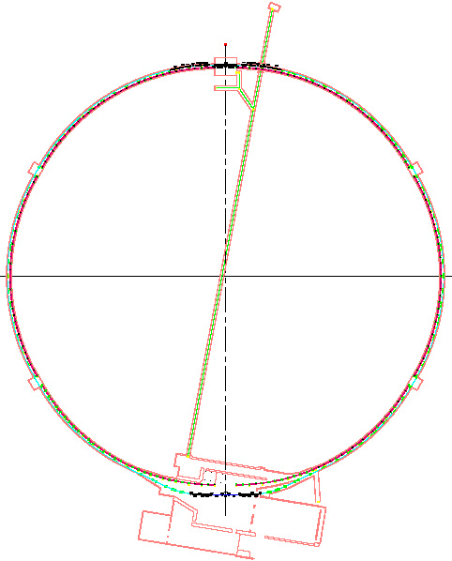
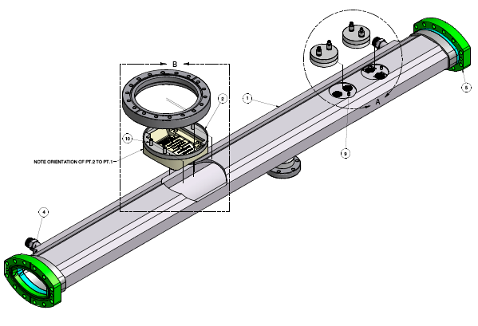
CESR Modifications
North IR
15W: C-coated chamber
15E: Reference Al chamber
wigglers
e+
e-
CLEO
South IR

Slide 7
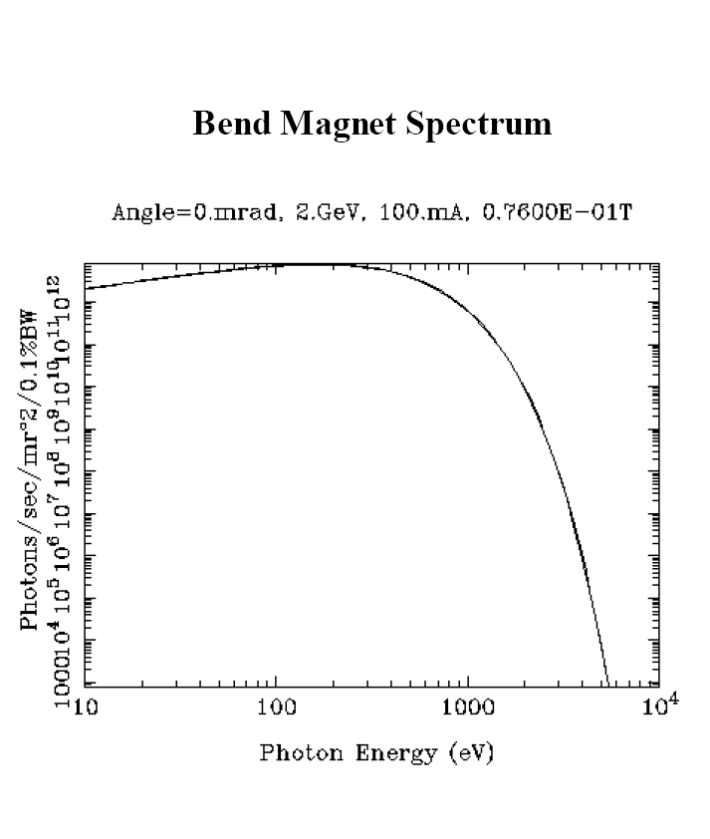
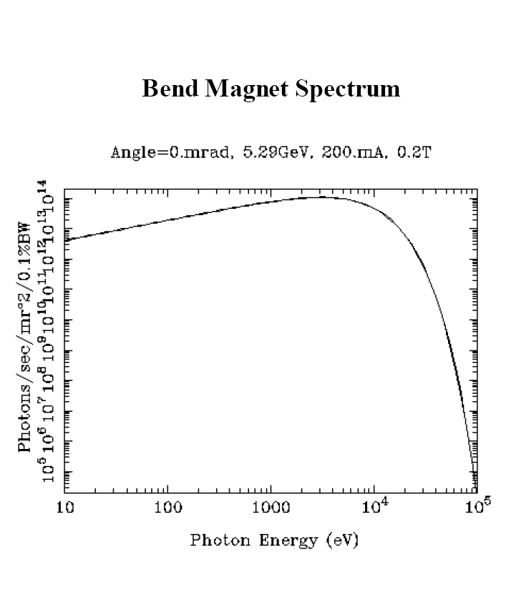
Frequency spectra of the synchrotron radiation

Slide 8
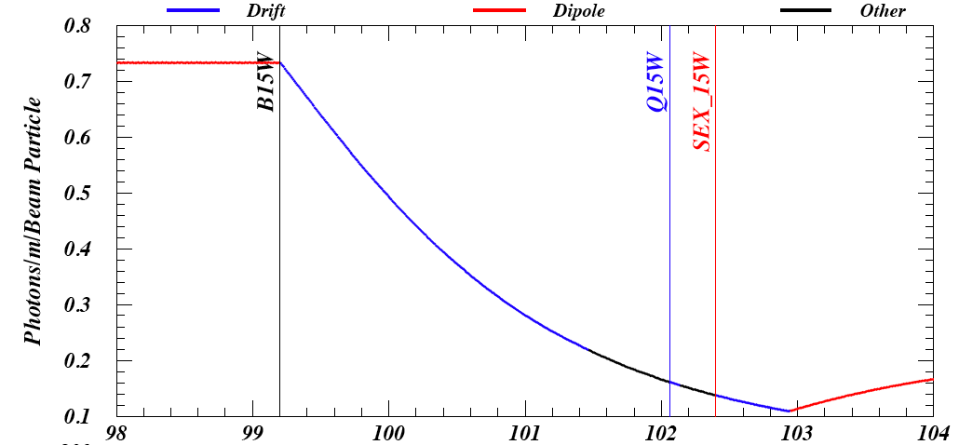
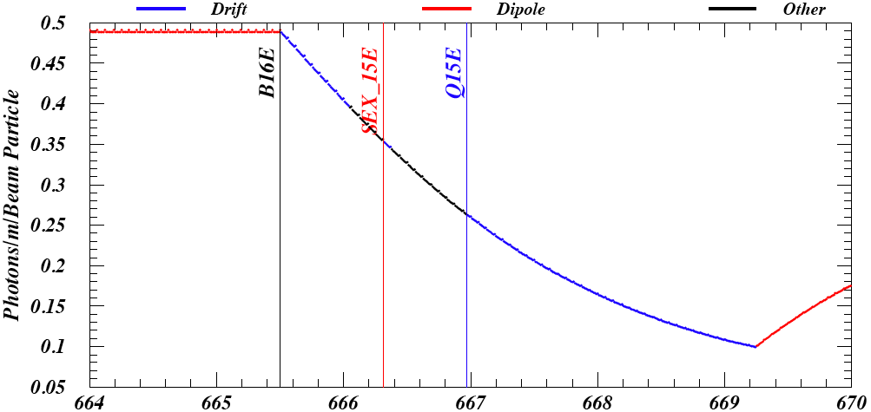
15W, a-C, positrons, 2 GeV
RFA location
0.44
15E, Al , positrons, 2 GeV
RFA location
0.18

Slide 9
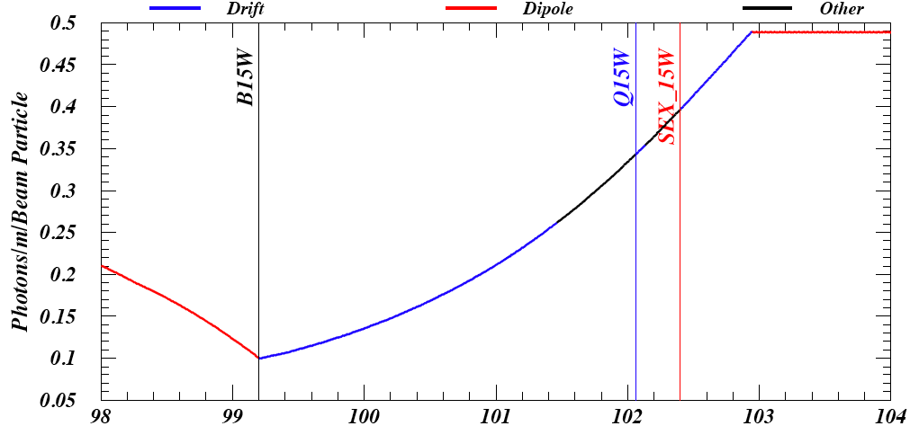
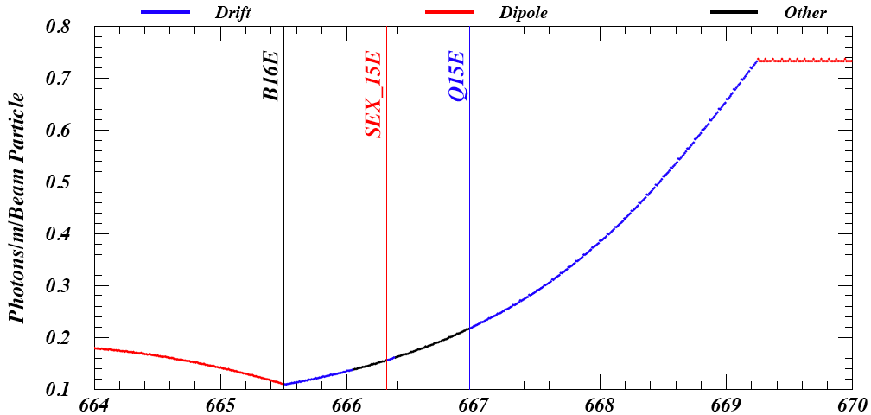
15W, a-C, electrons, 2 GeV
RFA location
0.15
15E, Al, electrons, 2 GeV
RFA location
0.36

Slide 10
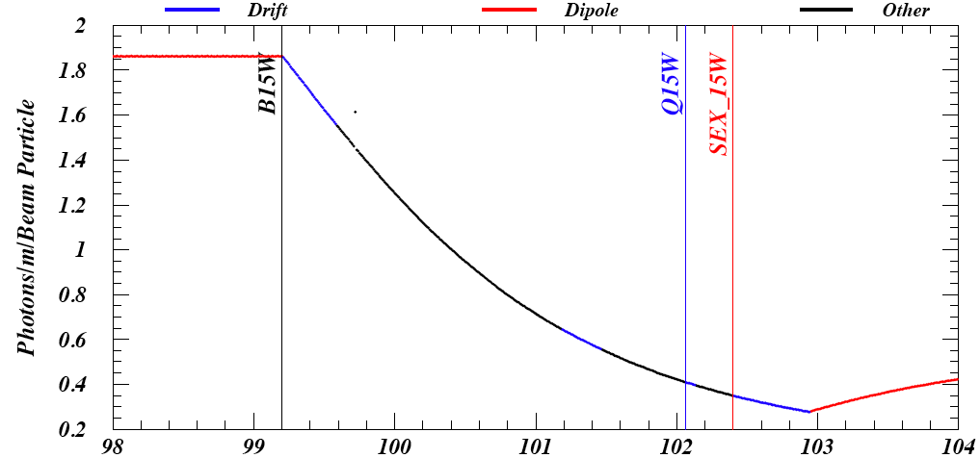
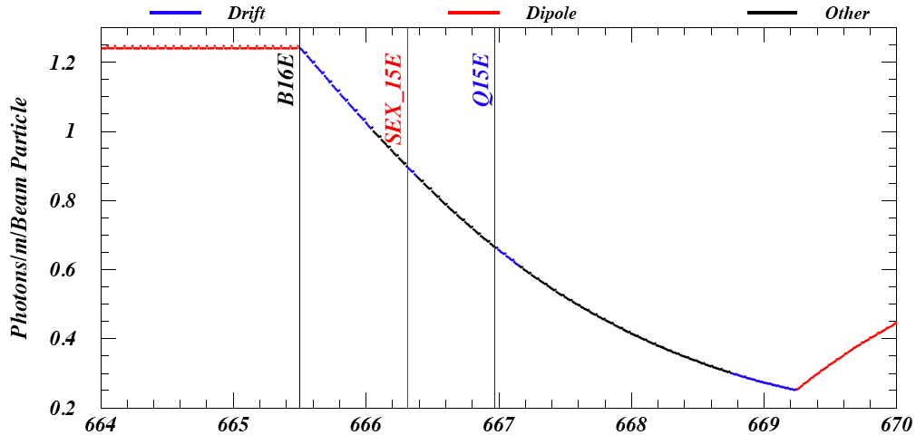
15W, a-C, positrons, 5 GeV (CHESS)
RFA location
1.1
15E, Al, positrons, 5 GeV (CHESS)
RFA location
0.45

Slide 11
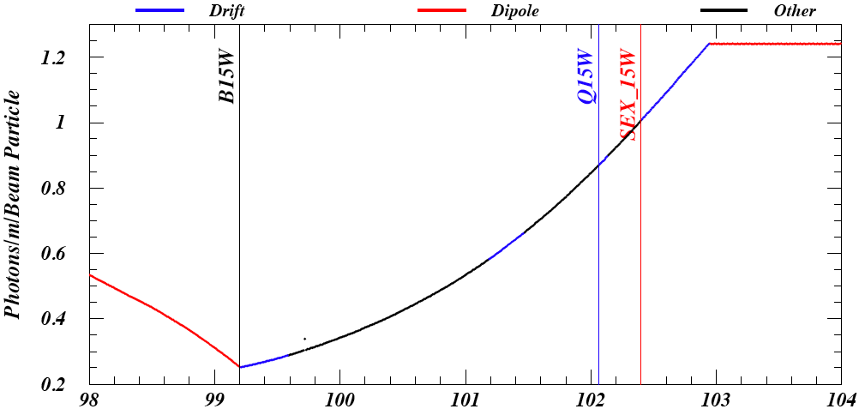
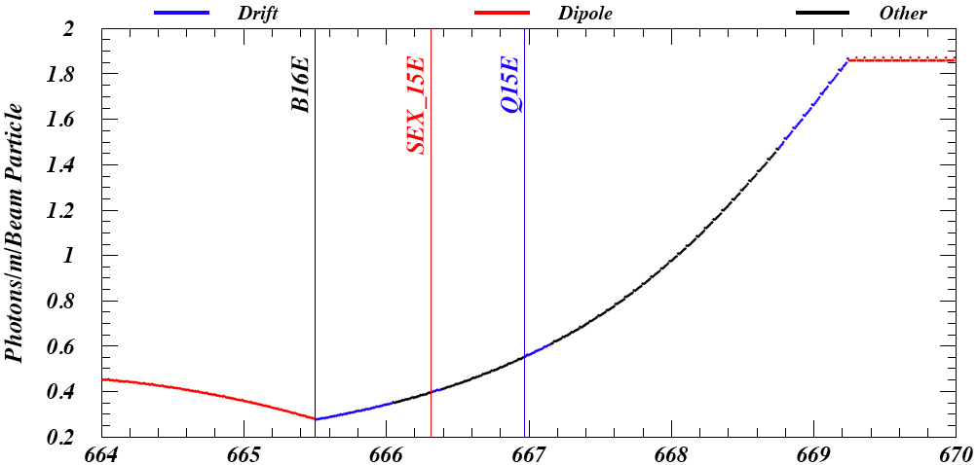
15W, a-C, electrons, 5 GeV (CHESS)
RFA location
0.38
15E, Al, electrons, 5 GeV (CHESS)
RFA location
0.9

Slide 12
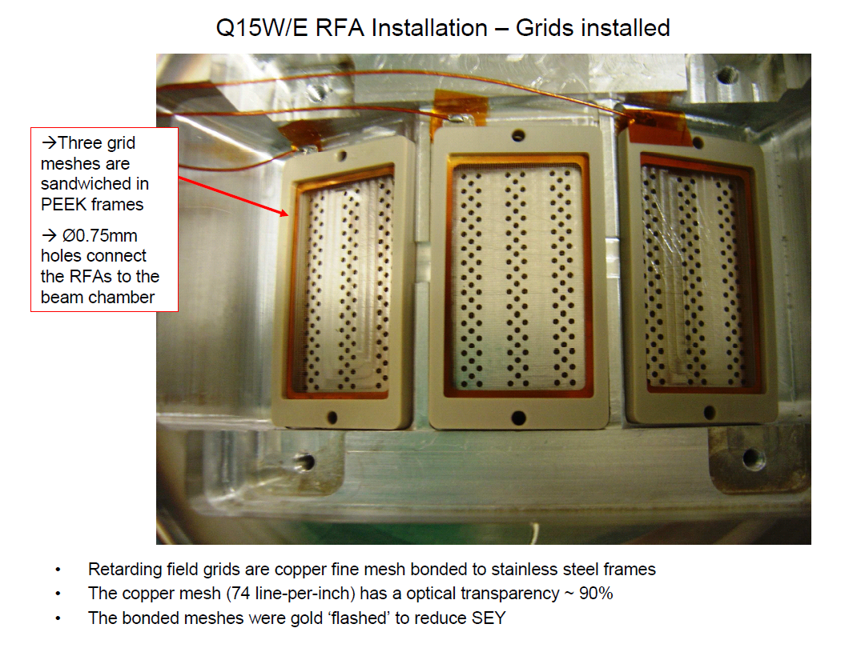
RFA

Slide 13
15W vs 15E: Current Scans
Data with a 45 bunch train of e⁺ and e⁻, 14ns spacing, 2 GeV
Data with a 45 bunch train of e⁺, 14ns spacing, 5 GeV

Slide 14
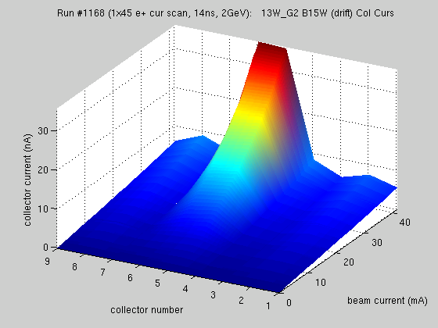
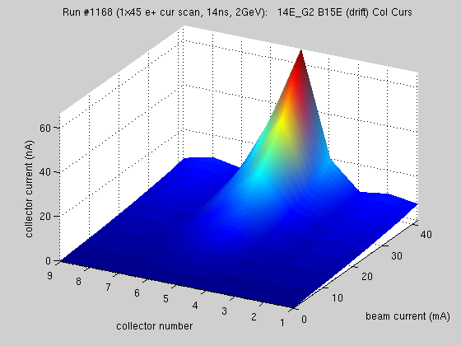
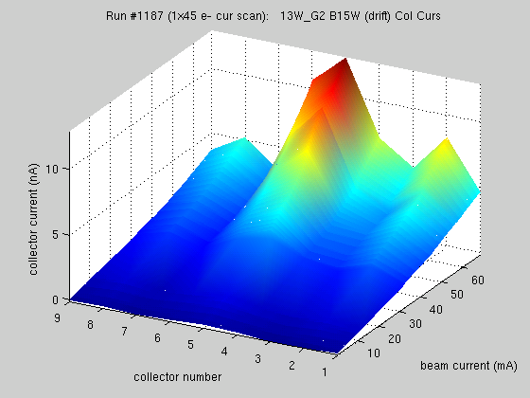
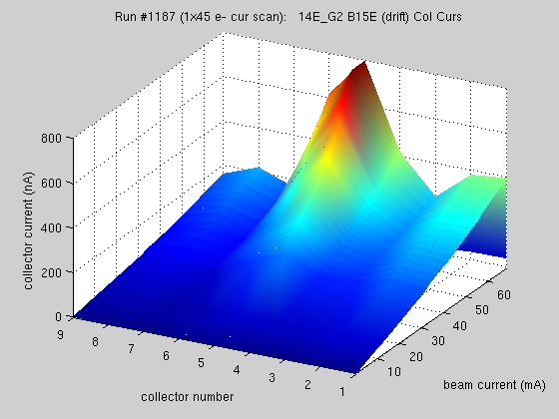
15W, a-C, e+
15E, Al, e+
15W, a-C, e-
15E, Al, e-

Slide 15
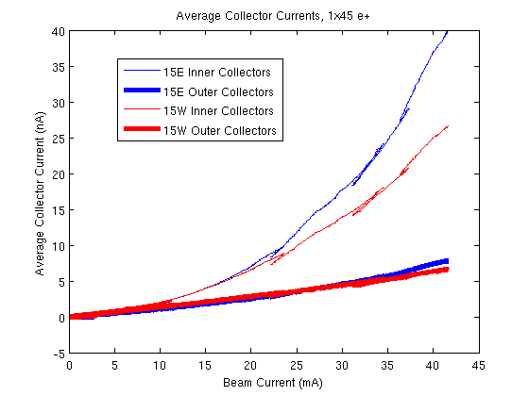
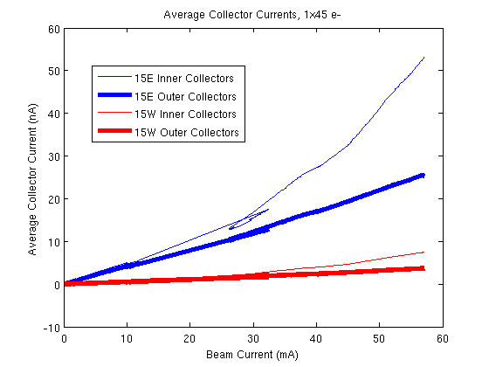
Plots show mean of inner 3 collectors (4,5,6) and outer 6 collectors (1,2,3,7,8,9) for positrons (left) and electrons (right)
  Outer collectors ~ primary photoelectrons
  Inner collectors ~ primaries + secondaries (?)
  15W → a-C 15E → Al
15W, e-

Slide 16
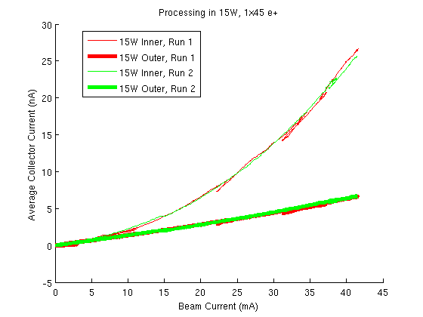
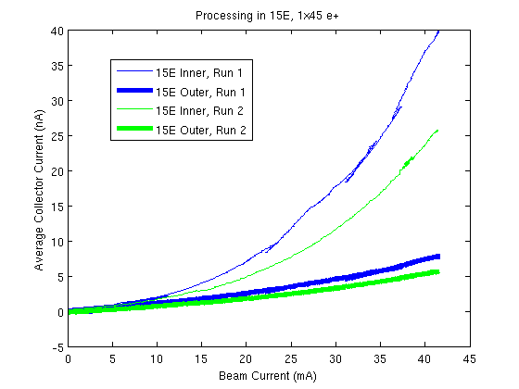
Plots show comparison of positron runs done on Sunday and Tuesday
  15E (left) sees significant conditioning
  15W (right) does not
15W, a-C
15E, Al

Slide 17
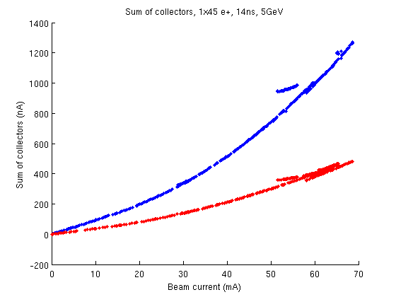
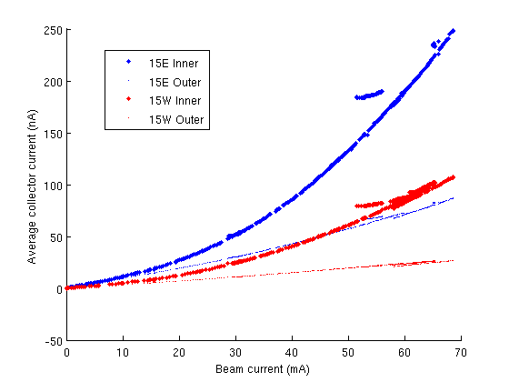
Positrons at 5 GeV, intensity scan
15W → a-C 15E → Al

Slide 18
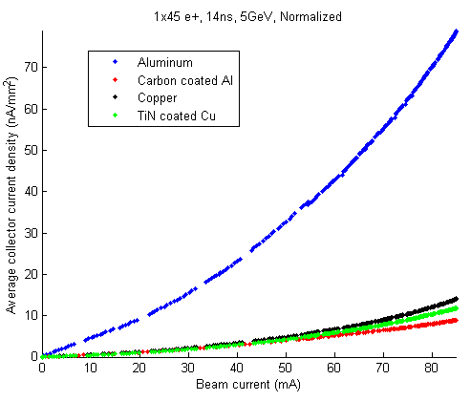
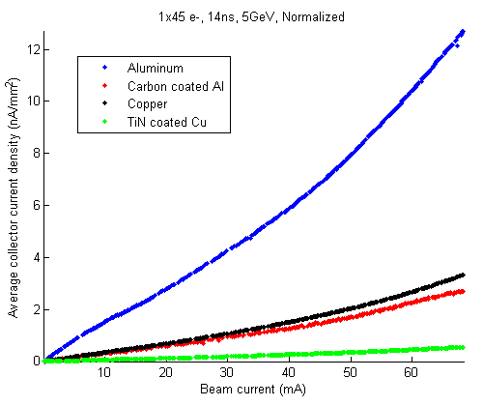
Comparison Al, a-C/Al, Cu, TiN/Cu
e+
e-

Slide 19
          Summary of e+ and e- runs, at 2 and 5 GeV
          Photoyield of a-C is much less than for uncoated Al
          A-C does not show much conditioning, whereas Al does
          Other tests not discussed here:
            Dogleg in 15W on and off. The dogleg is a short dipole with 100G field between the C-coated chamber and the dipole upstream. Its purpose is to avoid contamination from the electrons upstream.
            Solenoid in 15W on and off
            Change bunch spacing from 14 to 28ns and make a train of 75 bunches (instead of 45)
            Monitor the electrons with 9 bunches almost perfectly uniformly distributed around the machine (3 x (280/280/294))

Slide 20
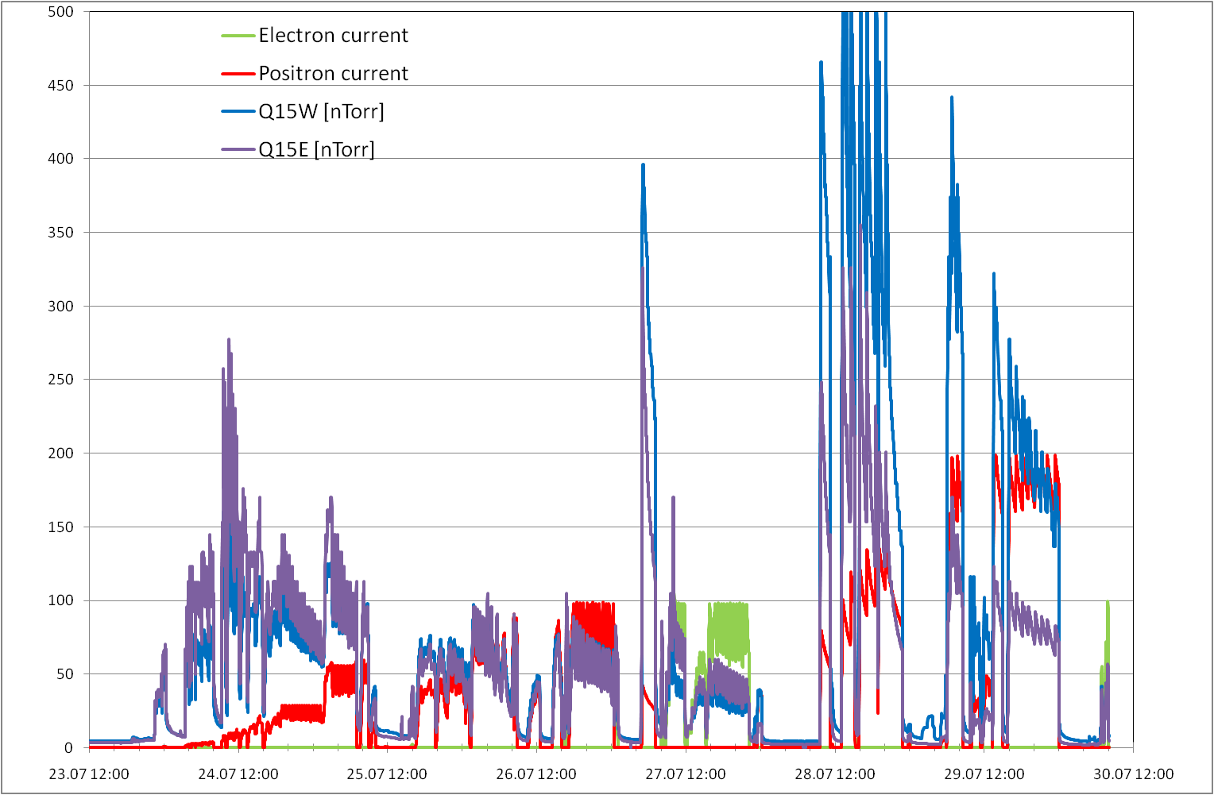
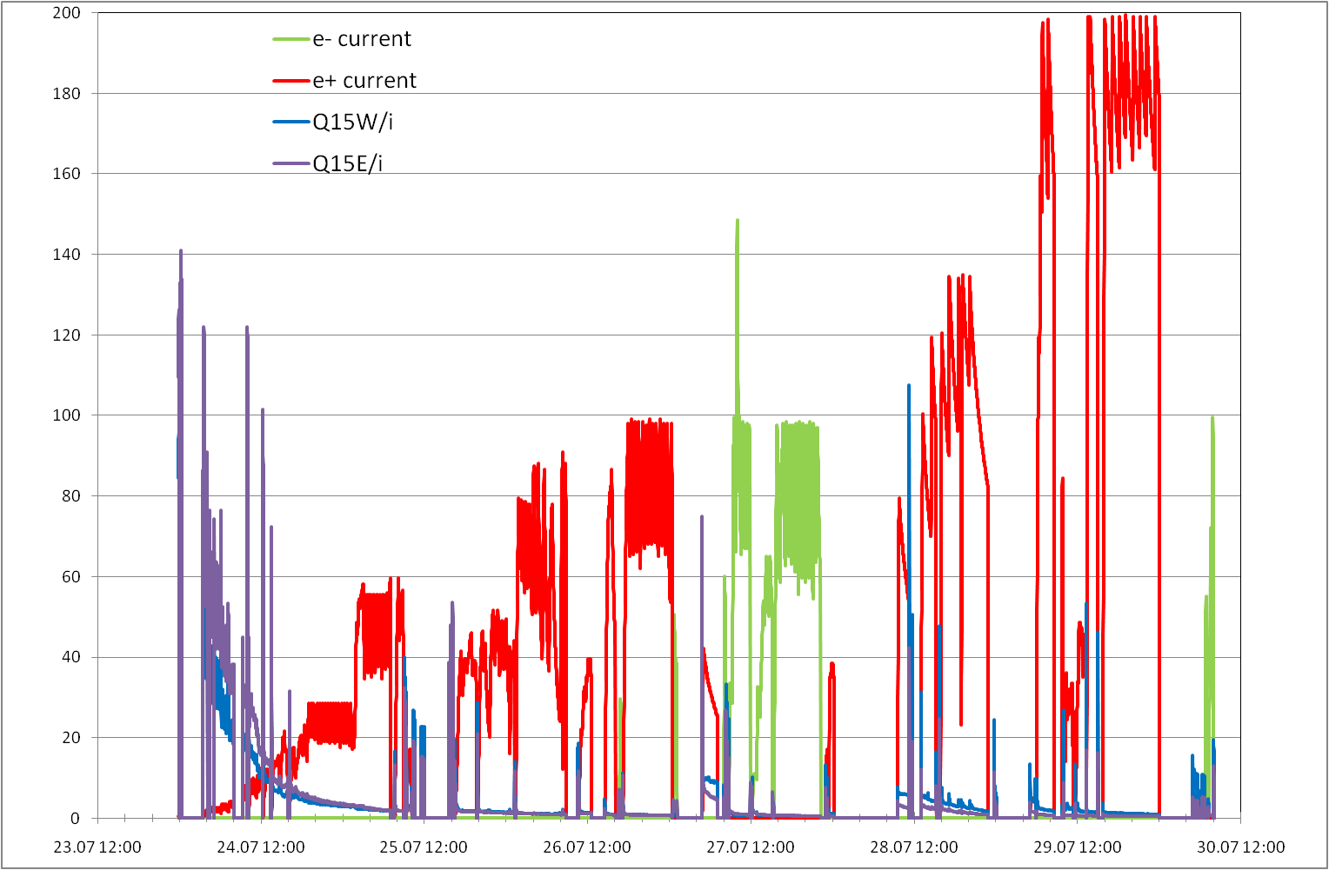
Scrubbing
5.3 GeV

Slide 21
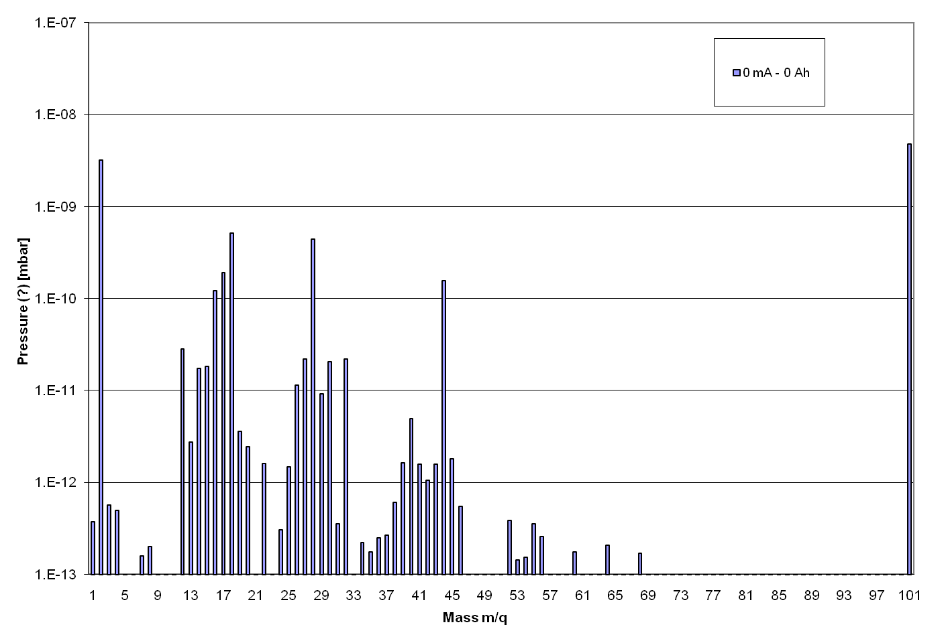
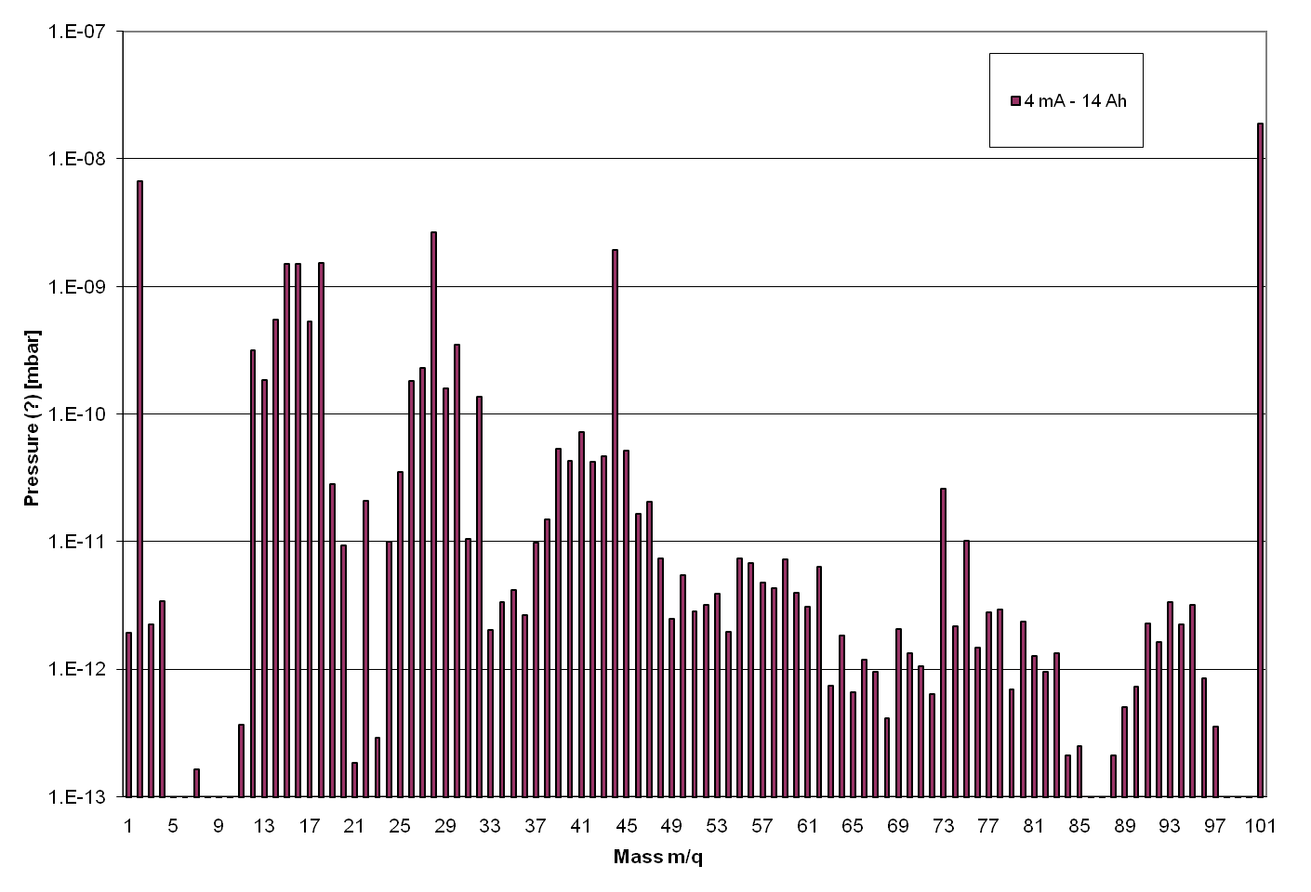
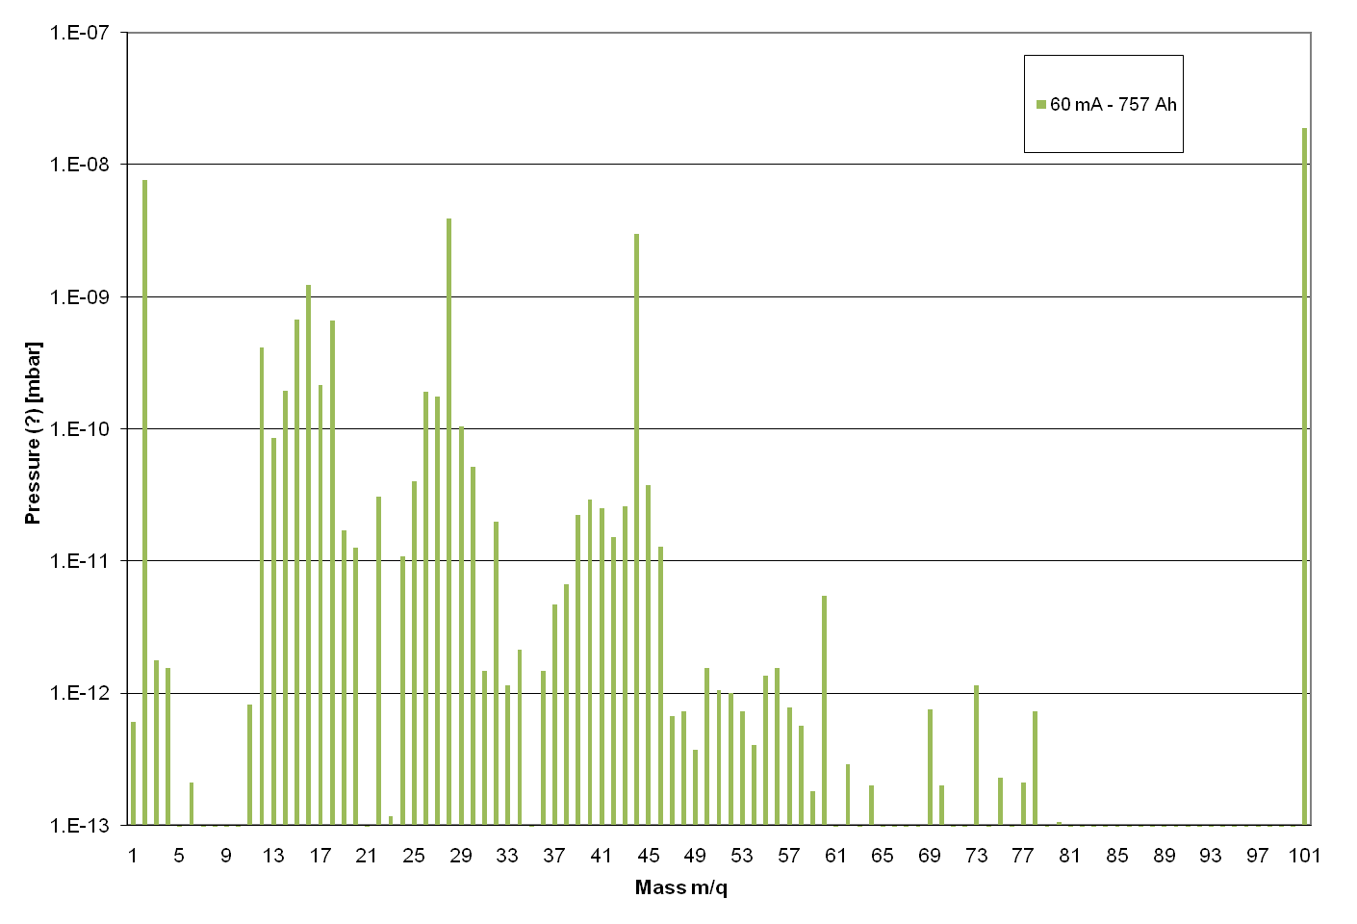
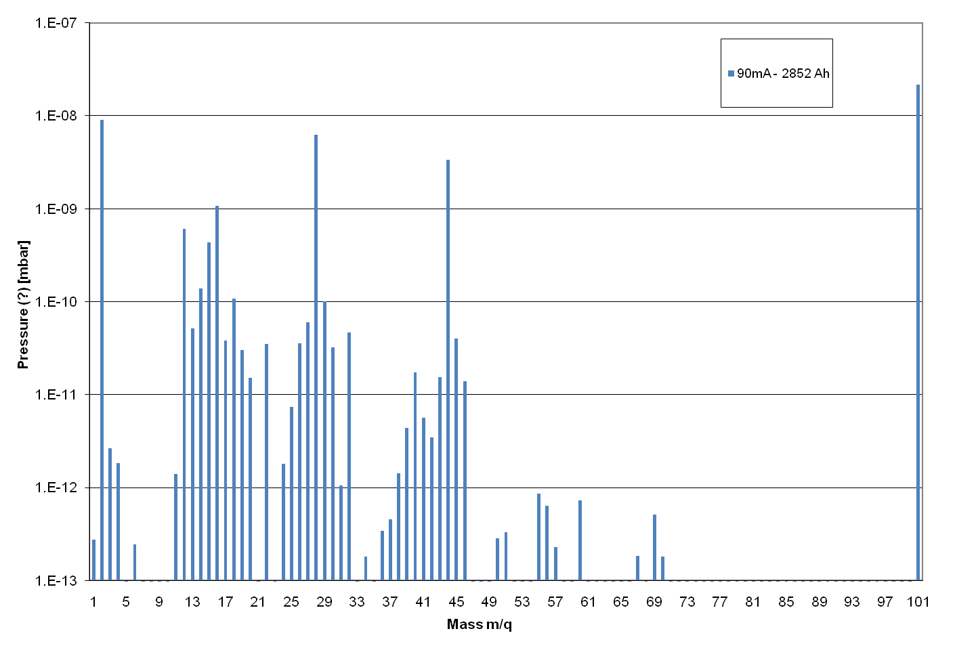
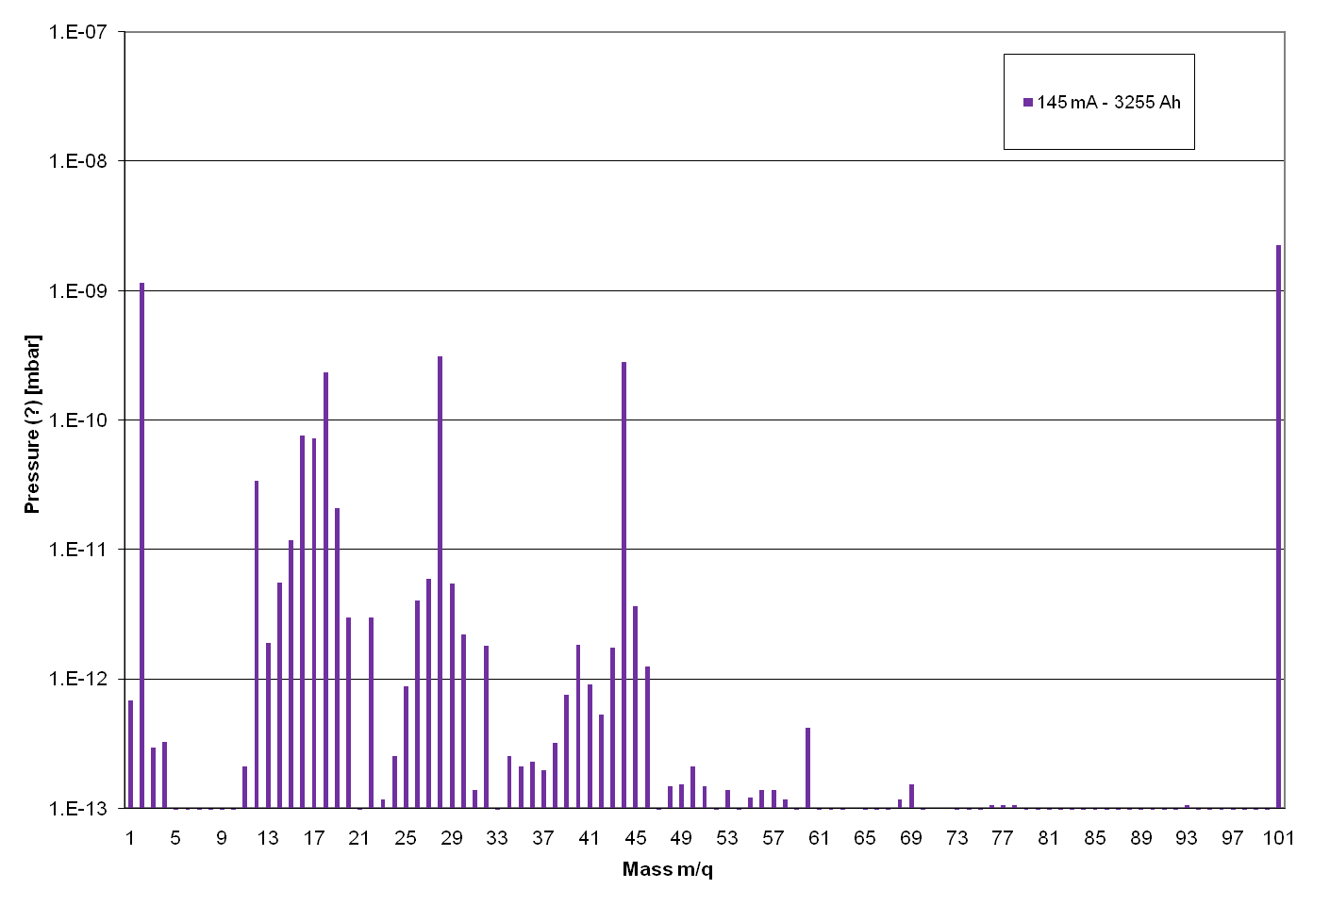
Scrubbing
Total pressure

Slide 22
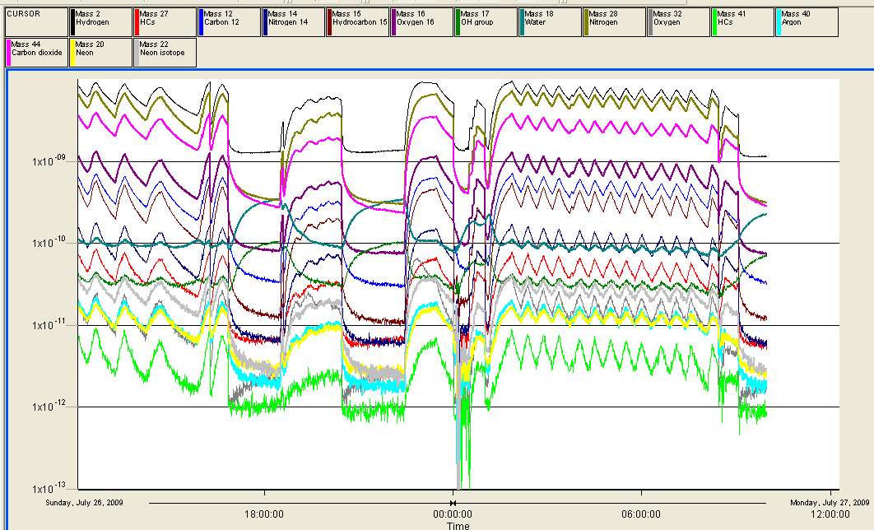
Beam ON
Beam OFF

Slide 23
CESR-TA Sample: contamination?
12/6/2009 (Initial SEY measured on a CERN sample) | 0.98
13/7/2009 (Witness back from USA) | 1.5
14/7/2009 (CERN sample) | 1.12
Cannot remove the silicon contamination via 150C/200C bakeout (tested in SEY+XPS machine)
Less silicon remained after 200C heating than after 150C heating.
Slide from CYV

Slide 24
CArp14_A
Heated up to 150C with
kapton tape for 24 h.
Directly stored in a plastic
bag from Cornell.
The silicon contamination obviously comes from the kapton tape during heating.
Slide from CYV

Slide 25
Conclusions and perspectives
Photoyield of a-C carbon films is much lower than for uncoated Al
The nonlinear behavior of the electron flux measured over an intensity scan seems to suggest that there is multipacting, at least in the central part of the chamber. Contamination may have contributed to increased SEY
Preliminary ECLOUD simulations do not predict multipacting dominated electron cloud for SEYs up to 2.0. It appears that the nonlinear behavior of the electron flux as a function of the beam current in the central region of the chamber can also occur for an electron cloud dominated by photoelectrons.
Personal picks for further studies
A direct photoyield measurement would be of interest for CLIC/ILC damping ring purposes
Vacuum measurements with direct RGA comparison with witness chamber (and improved vacuum layout)

