Slide 1
Part 2

Slide 2
Searches for dark matter at the LHC
Can only check for a stable particle at the collider scale not cosmological scale

Slide 3
Beyond the standard model
For many years – clear direction on how to explore BSM/DM
Start with problems with SM: symmetry breaking, Higgs, unification, fermion masses …
Interplay Collider, dark matter searches, cosmology
But there are more possibilities for WIMPs and for DM
Interplay Collider, dark matter searches, cosmology
SUSY
XtraDim
Little Higgs
….
One of the problems with SM
Discrete symmetry
WIMP
Dark matter

Slide 4
Another appproach, bottom-up
Start with stable neutral particle, and build from there (mediator, other dark particles) exploiting hints from data at LHC or astroparticle searches
…

Slide 5
DM production at LHC
The traditional searches - DM in decay chain of new particles preferably coloured or charged, e.g. neutralino in SUSY
Signature : MET + jet, leptons… model dependent

Slide 6
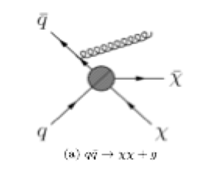
DM production at LHC
The model independent approach
Direct production of DM and Initial state radiation of gluon, photon.. serves as a trigger : monojet, monophoton, monoX
Signature : jet + large missing ET

Slide 7
DM production at LHC
Exploiting the Higgs : search for invisible decays of the Higgs (relevant only if m_{DM}<m_{h}/2)
Charged tracks and displaced vertices - for long-lived–next-lightest dark sector particle : typically small mass splitting or very weak interactions
Search for new particle (mediator) in SM final states

Slide 8
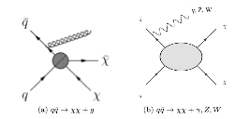
EFT/simplified model approach
Direct production of pairs of DM + radiation : high ET miss + single jet/photon/boson
For each operator : monojet limit compared to limit from direct detection -> Bjorn’s lecture
Effective interaction
operators
Caveats : monojet limit valid assuming scale NP large, may not be valid at LHC energies-> simplified models

Slide 9
Simplified models
Capture essential features with small number of parameters/assumptions
SM + mediator +DM + some Z₂ symmetry
4 parameters : g_{q}, g_{DM}, M_{M}, M_{DM}
Looking for monojet within large SM background –less background at large Etmiss
No excess –> constraint on DM model

Slide 10
Constraints from monojet – for different mediators vs (in)direct detection
CMS 1703.01651
Assume M_{DM}<M_{med}/2
D5
Allowed
D8

Slide 11
Portals – dark sector
Visible sector SM
Dark sector
Portal
h, Z’, S...
Higgs-field portal into hidden sectors
Patt, Wilczek 0605188
DM and the Higgs portal
  Bertolami,Rosenfeld, 0708.1794; March-Russell et al, 0801.3440; J. Mcdonald, Sahu, 0802.3847, 0905.1312; Tytgat, 0906.1100; Aoki et al, 0912.5536; Andreas et al, 1003.3295; Arina et al, 1004.3953; Cheug,Nomura (singlet)1008.5153; Djouadi et al, 1112.3299 ..
DM and the Z’ portal
  Krokilowski, 0712.0505; Chu et al, 1112.0493; Dudas et al, 0904.1745....; Arcadi et al 1402.0221

Slide 12
Z’ portal
- Well motivated extension of SM, e.g. in GUT
SU(3)XSU(2)XU(1)XU(1)
- Discrete symmetry
Dark matter: neutral fermion or scalar in dark sector
Many constructions possible (popular simplified model)
Coupling to quarks and leptons +dark matter → dijet and dilepton limits
Dark matter observables :

Slide 13
Z’ portal at LHC
For g_{q}<< g_{DM} dijet limit shrinks
DM properties (relic) also sensitive to other particles in spectrum
Could relax limits on Z’->SM with Z’ -> invisible but too large coupling to DM
-> Direct detection limit, Arcadi et al, 1402.0221

Slide 14

Pseudoscalar mediator
Specific example : pseudoscalar mediator, fermion DM, also assume couplings proportional to Yukawas-> 3rd generation
Loop coupling to two-gluons and two-photons

Slide 15
At the LHC
Several probes :
  monojet
  searches for mediator in visible (γγ,ττ,tt)or invisible decays,
  contribution of mediator to di-top cross section,
  associated production of mediator, ttA, bbA

Slide 16
At the LHC
Several probes : monojet, searches for mediator in visible or invisible decays, contribution of mediator to di-top cross section
Large couplings of A to quarks
Banerjee, Barducci, GB, Fuks, Goudelis, Zaldivar, 1705.xxx

Slide 17
At the LHC
LHC constraints strongly depend on mediator couplings to quarks
Independent of coupling to DM in visible channels – allow to cover the region m_{DM}~m_{A}/2 with very small coupling hard for indirect detection

Slide 18
Wimp dark matter candidates

Slide 19
Extended scalar sector
Generic in extensions of the SM
Much studied from Higgs point of view (e.g. two-Higgs doublet model) compatible with all Higgs data as long as 125GeV is SM-like (in particular HWW couplings)
To also provide DM candidate – impose discrete symmetry to guarantee stability of lightest particle in the ‘dark’ sector
Usually a Z₂ symmetry (R-parity in SUSY or KK parity)
Improves stability of Higgs potential

Slide 20
Improved with additional couplings, positive contribution to β function, prevents λ from running negative -> stability at large scale, eg. SM + singlet

Slide 23

LHC has discovered a Higgs boson with couplings close to SM,
  invisible width of the Higgs <23 % of total width – combination of direct search in VBF and fits of couplings of 125GeV Higgs – ATLAS 1509.00672
  In singlet scalar DM model, relic density requires coupling that leads to large invisible branching → ms>55GeV
Generally in Higgs portal type model, both invisible width and SI cross section depend on h coupling to DM
Light DM model are constrained
Djouadi et al 1205.3169

Slide 24
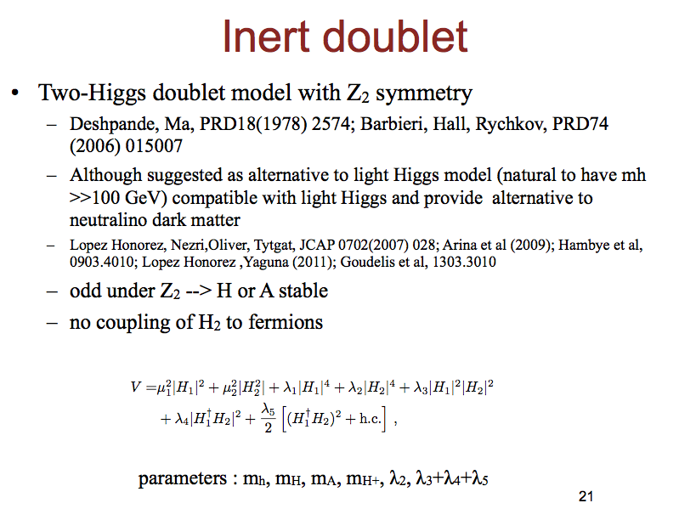
=λ_{L}

Slide 25
Eitenauer et al 1705.01458
Fiitn GC excess

Slide 26
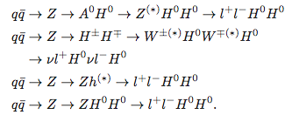
IDM at LHC
Constraints from electroweak precision : corrections to gauge bosons self energies
LHC : Higgs pair production – cross sections are small
At LHC8 TeV : some constraints from
  dileptons + missing E_{T}
  trileptons Miao, Su, Thomas, 2010
  multileptons - Gustafsson et al 2012
Dominant process AH, only depends on masses
Only process that depends on λ_{L}, already constrained by Higgs invisible with

Slide 27
LHC8TeV constraints
Reinterpretation of SUSY searches + Higgs results
  GB, Dumont, Goudelis, Herrmann, Kraml, Sengupta
Constraints generic (no dependence on λ_{L})
LHC exclusions of region also excluded by DD + relic – more at 13TeV

Slide 28
Monojet signature
Potential to extend constraint to ~80 GeV
  Belyaev et al, 1612.00511

Slide 29
Dark sector
Many more possibilities for dark sector : more singlets, doublet (Deshpande, Ma 1978), doublet+ singlet, more doublets, triplet (Fileviez Perez 2012), triplet+ singlet (Wang, Han, 2012, Fisher, Van der Bij 2013) ….
Or alternate discrete symmetry – lead to semi-annihilation, possibility of two dark matter (Hambye 0811.0172, Adulpravitchai et al 1103.3053, Boucenna et al, 1101.2874, GB et al, 1211.1014, Esch, Klasen,Yaguna 1406.0617… )
Or fermion dark matter, new Z’ ….
Some with peculiar DM properties : isospin violation
Signatures at LHC : Higgs searches, Z’ searches, new fermions …

Slide 30
Top- down approach
Supersymmetry &extra dimensions

Slide 31
Supersymmetry
Motivation: unifying matter (fermions) and interactions (mediated by bosons)
  Symmetry that relates fermions and bosons
Prediction: new particles supersymmetric partners of all known fermions and bosons : differ spin 1/2
  Not discovered yet
Hierarchy problem
  SUSY particles (~TeV) to stabilize Higgs mass against radiative corrections →should be within reach of LHC
R-parity and dark matter

Slide 32
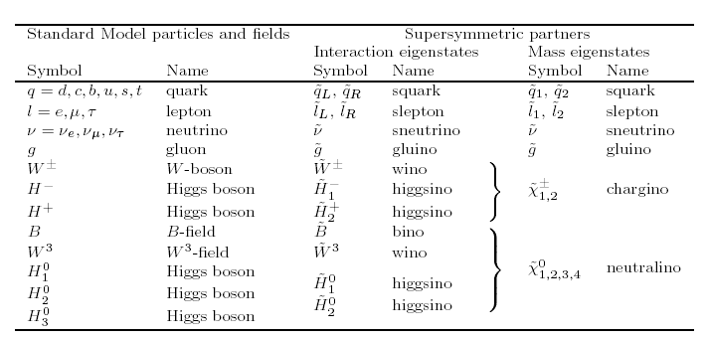

Minimal supersymmetric standard model
Minimal field content : partner of SM particles and two higgs doublets (for fermion masses)
Neutralinos : neutral spin ½ partners of gauge bosons (bino,wino) and Higgs scalars (higgsinos)

Slide 33
Susy features
New particles stabilize Higgs mass (~100GeV) against radiative corrections
If supersymmetry is exact each SM fermion contribution is cancelled by that of two scalar partners (λ_{S}= λ_{F}²)
Quadratic divergences still cancelled if only soft susy breaking terms
SU(3), SU(2), U(1) coupling constants unification at high scale in MSSM but not in SM
No susy particle found
Each increase quadratically with energy

Slide 34
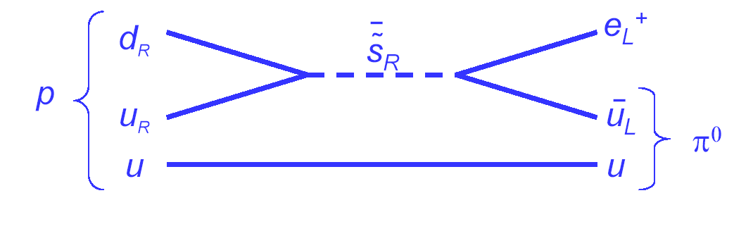
R-parity
Proton decay
To prevent this introduce R parity
  R=(-1) ^{3B-3L+2S;} R=1: SM particles R=-1 SUSY
The LSP is stable : could be a suitable DM candidate if neutral

Slide 35
Minimal Supersymmetric Standard Model

Slide 36
MSSM – soft terms
Supersymmetry must be broken - many possibilities : write most general Lagrangian which violate SUSY without disturbing cancellation of quadratic divergences in scalar mass (Grisaru and Girardelo 1982)
Real parameters and no flavour structure : reduce from 105 to 22 or 19 parameters

Slide 37
Neutralino dark matter
No theoretical prejudice
Simplified discussion : consider only parameters relevant for neutralino sector – assume all sfermions are heavy
Neutralino is mixed state – exact nature will determine its annihilation properties - wide range of predictions for DM interactions

Slide 38
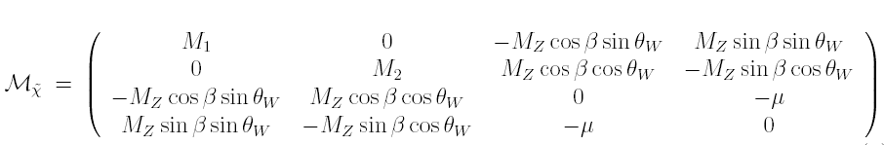
The neutralino mass matrix
  Mass and nature of neutralino LSP : determined by smallest mass parameter
    M₁ < M₂, μ bino
    μ < M₁, M₂ Higgsino ( in this case mχ₁ ~mχ₂ ~mχ₊)
    M₂ < μ , M₁ wino
  Determine couplings of neutralino to vector bosons, scalars…
  In most studied SUSY model CMSSM the LSP is usually bino -> theoretical bias

Slide 39
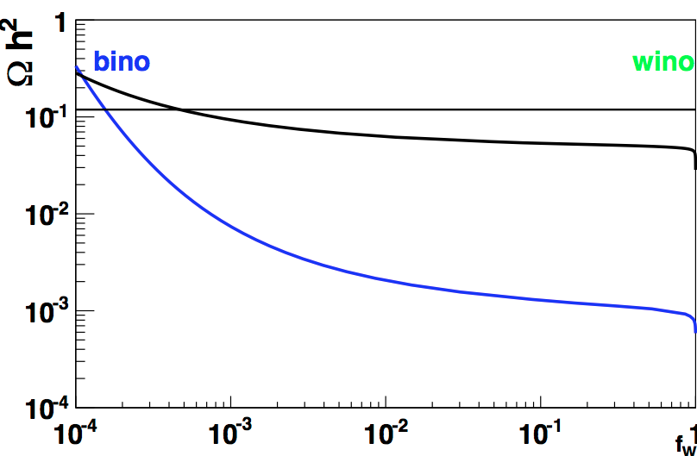
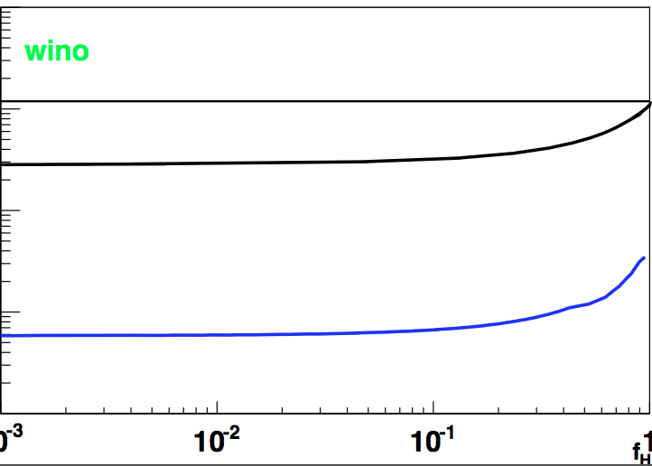
Relic density of neutralino
Wino
1000GeV
150GeV
LSP composition
Vary μ, Μ₁, Μ₂ to change nature of LSP
tanβ = 10, all other SUSY parameters set to 4TeV
In general neutralino LSP can only be subdominant DM component unless TeV scale
Exception : bino overdominant
Higgsino and wino mean degenerate particles-

Slide 40
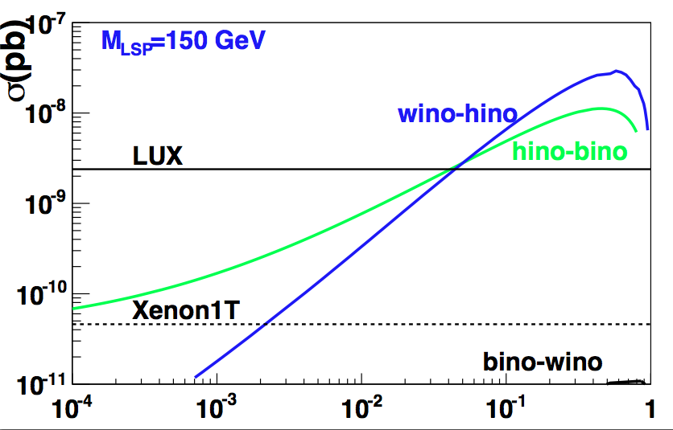
Direct detection
Correct relic
LUX 2016
Constraints from DD (LUX) on neutralinos (mixed higgsino-bino) that naturally reproduce measured relic density
Bino-wino escape detection

Slide 41
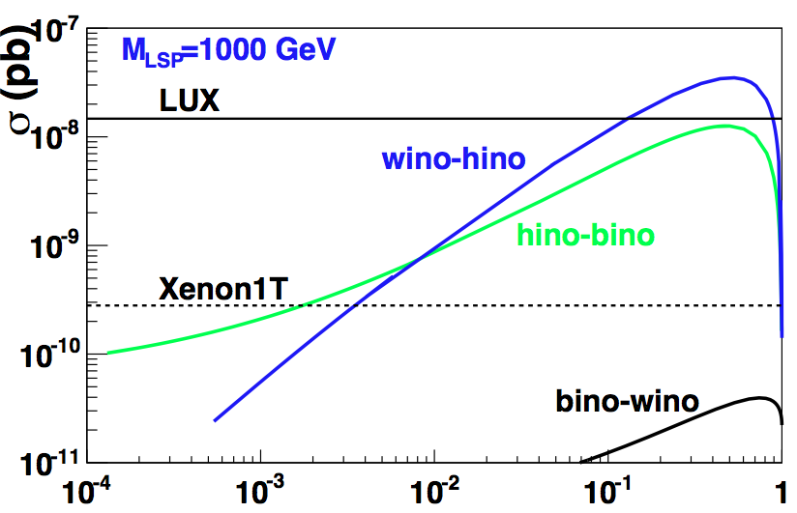
Direct detection
Coupling of LSP to Higgs maximal for mixed gaugino/higgsino
LUX2016
1TeV Mixed higgsino/bino mostly compatible with relic+DD
Correct relic

Slide 42
Neutralino LSP
Relic density constraint + exclusion by direct detection -> favours neutralino DM at TeV scale or mixed bino/wino or requires an additional DM candidate
Way out?
  Theoretical input: impose specific conditions on spectrum
  For example : bino LSP with special mechanism to reduce relic density – coannihilation with sfermions or m_{LSP}= m_{H}/2 (resonant annihilation)
Problem μ at TeV scale is not natural from Higgs points of view

Slide 43
Light Higgs mass
Upper bound on Higgs mass
X_{t}=A_{t}-μ/tanβ

Slide 44


The MSSM case
Fine-tuning issue
Unless µ ~O(100)GeV (natural SUSY) need large cancellation
– implications for DM since µ determines the Higgsino component of the LSP
Fine-tuning also from radiative corrections – m_{Hu} strong dependence on parameters of stop sector

