Slide 1
Collider Codes – the experimentalist’s standpoint
Jon Butterworth
Corfu, 12 Sept 2017

Slide 2
Collider Codes – the experimentalist’s standpoint
Jon Butterworth
Corfu, 12 Sept 2017
A personal view, I speak for no one but myself…

Slide 3
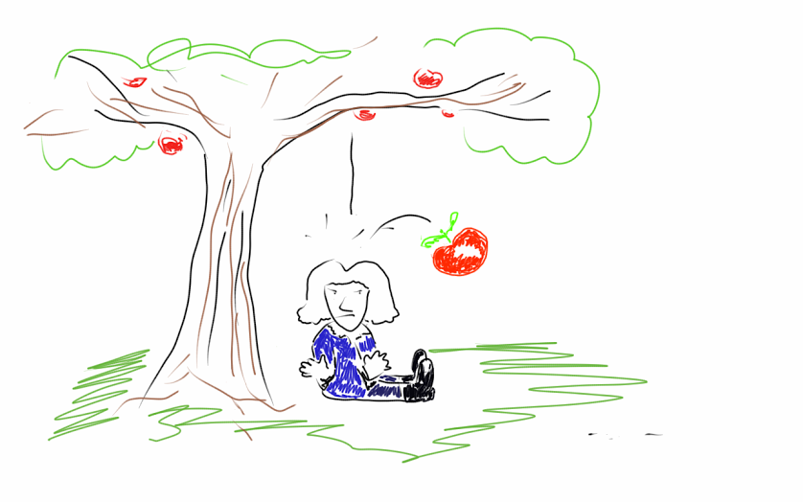
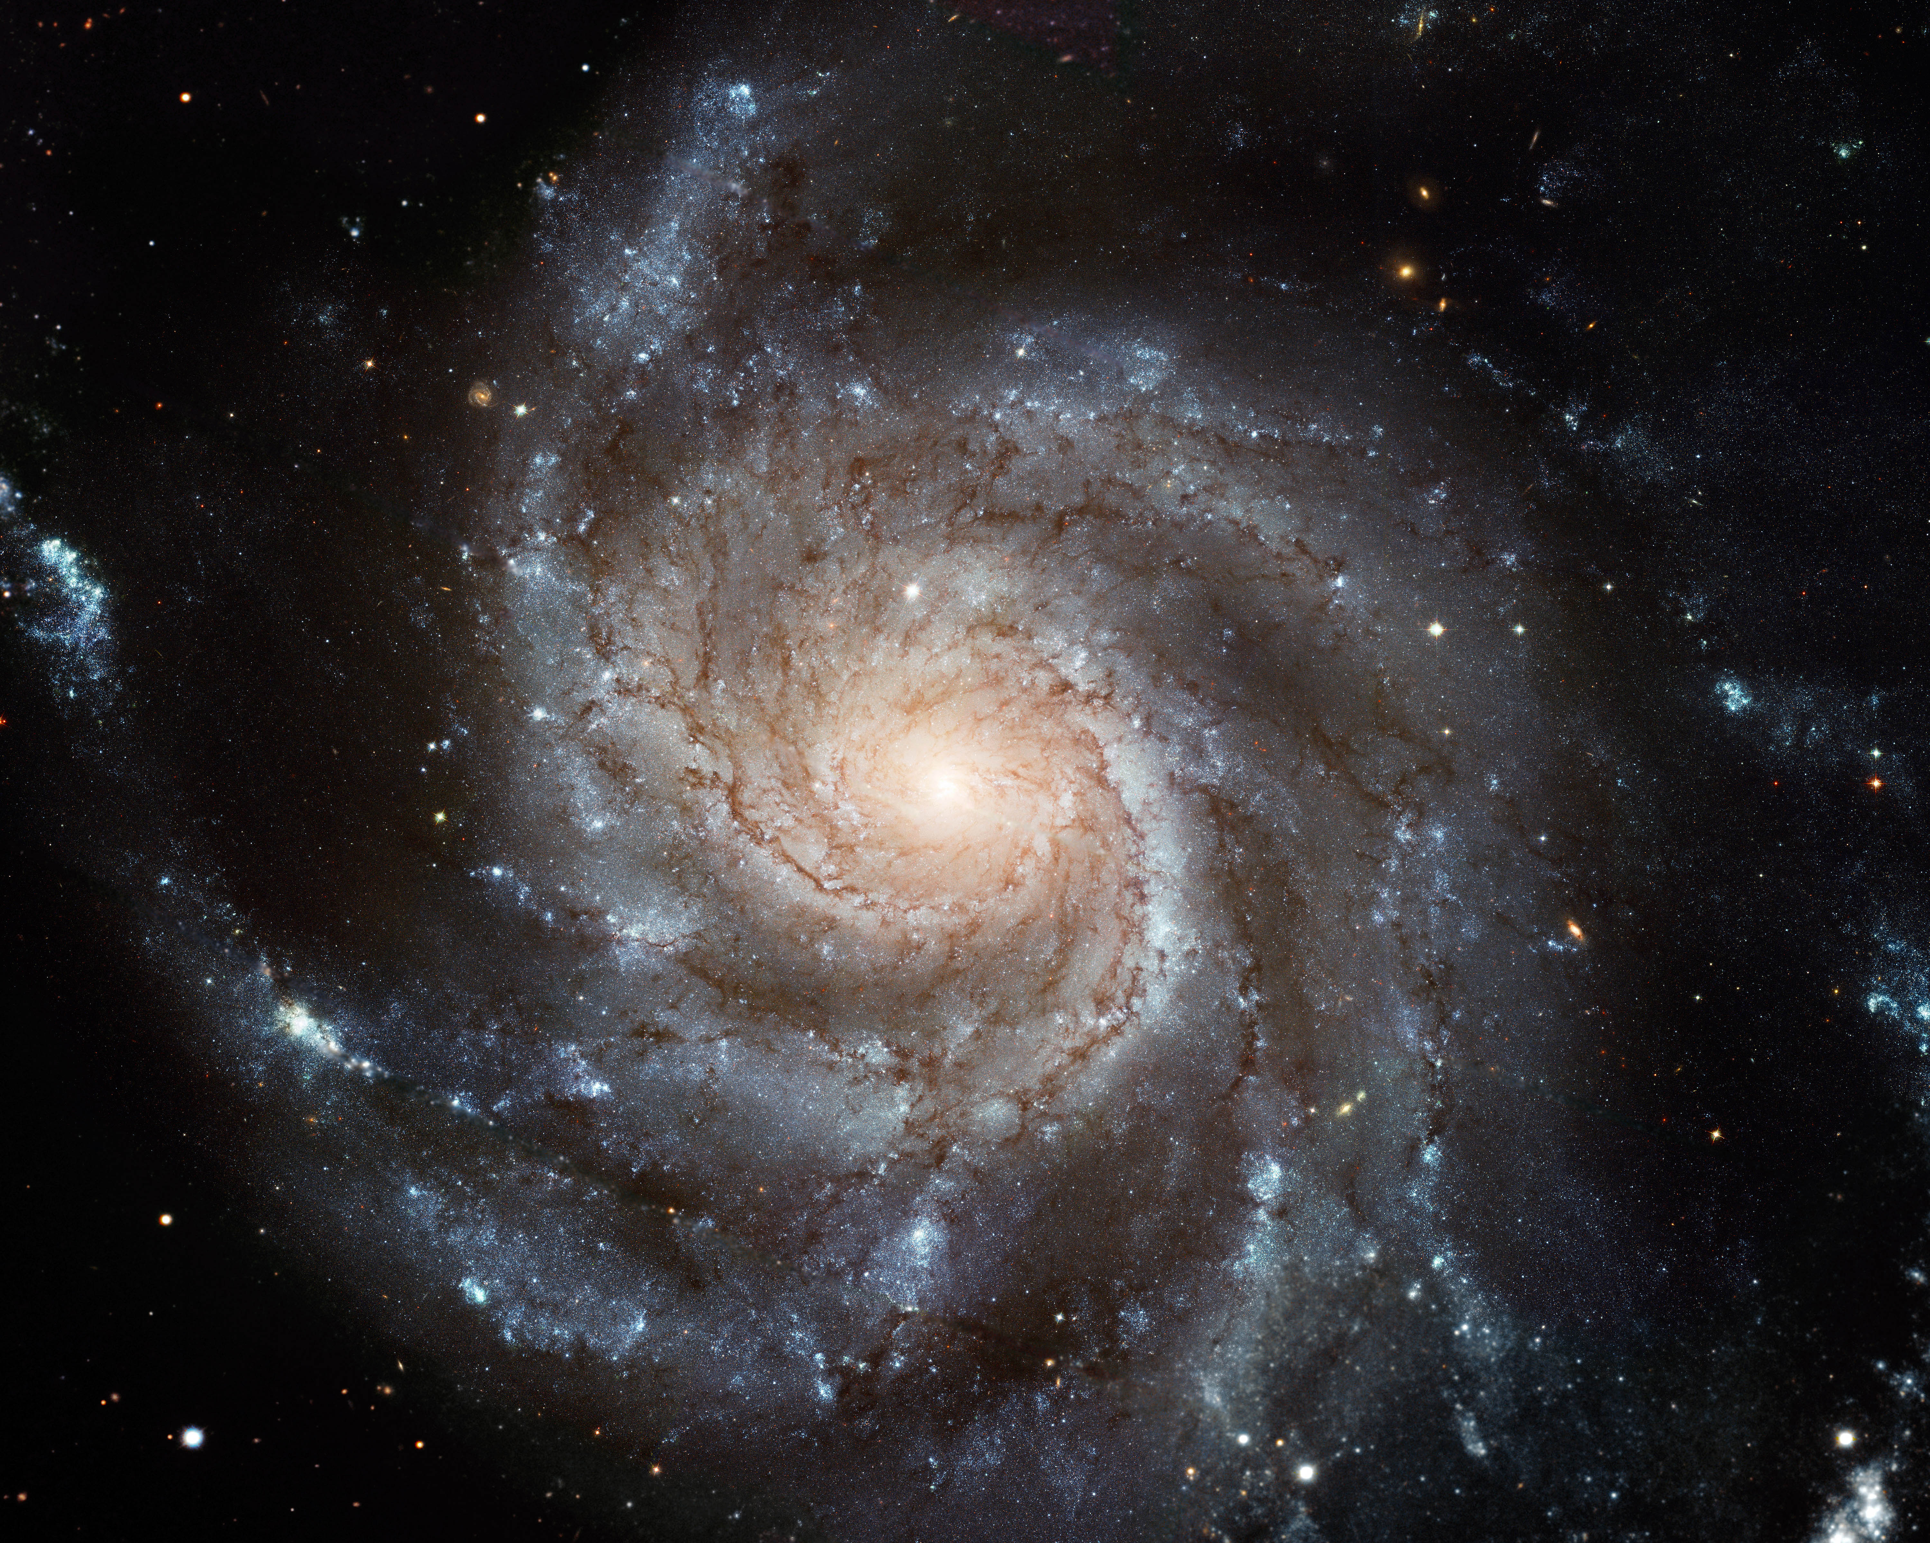
Dual/overlapping role of the LHC
Searching for Physics Beyond the SM
  Well motivated
Beyond the Standard Model!
Beyond the Standard Model and General Relativity!

Slide 4
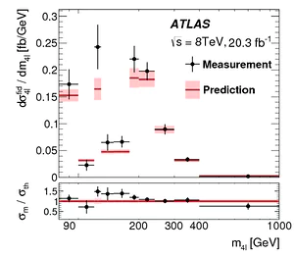
Dual/overlapping role of the LHC
Searching for Physics Beyond the SM
  Well motivated
Measure the Standard Model
Measure what happens, and compare to the predictions of the Standard Model

Slide 5
Tension between
“universal measurement” with meaning beyond that particular experiment and “universal measurement” with meaning beyond that particular theory
  “We counted charged particles in this particular region of phase space with these particular beams and this particular detector”
  “We extracted the top mass under the assumption that this particular version of this MC is true”
The best, most sensitive search for a very a very specific piece of BSM physics
A search which is a general and model-independent as possible

Slide 6
Simulation and Experiment
Particle Four-Vectors
MC Event Generator
Digitized Readout
Detector & Trigger Simulation
Data for Analysis
Event Reconstruction

Slide 7
Simulation and Experiment
Particles
Collider!
Digitized Readout
Detector & Trigger
Data for Analysis
Event Reconstruction

Slide 8
Simulation and Experiment
Particle Four-Vectors
MC Event Generator
Digitized Readout
Detector & Trigger Simulation
Data for Analysis
Event Reconstruction
Unfolding & Data Correction: Test and evaluate

Slide 9
Simulation and Experiment
Particles
Collider!
Digitized Readout
Detector & Trigger
Data for Analysis
Event Reconstruction
Unfolding & Data Correction: Make the measurement!

Slide 10
Simulation and Experiment
Particles
Collider!
Digitized Readout
Detector & Trigger
Data for Analysis
Event Reconstruction
Smear for efficient/external reinterpretation

Slide 11
Important considerations for searches & measurements
What is your final state?
  A common choice is place a lifetime cut at 10ps, and where necessary to draw further distinction, draw the line at hadronisation.
  Stable objects (hadrons, leptons, photons) can be combined algorithmically to give well-defined objects (jets, dressed leptons, isolated photons, missing E_{T}…)
  Remember, this is about defining “truth”, i.e. what we correct back to within some systematic uncertainty

Slide 12
Fiducial or not?
Difference between “efficiency corrections” or “unfolding”, and “acceptance corrections”.
  The first two generally mean correction for detector effects, which no one but the experimentalists can do.
  The third means extrapolating into kinematic regions which have not been measured at all
Beware of the third, especially as we go to higher energies…

Slide 13

Unfold

Slide 14


Slide 15
Increase acceptance

Slide 16
Increase acceptance

Slide 17
Extrapolate

Slide 18
Extrapolate

Slide 19
But how reliably?

Slide 21
Concept of a “fiducial” cross section
Defines a region in which acceptance is ~100%
Implies that some kinematic cuts must be implemented in whatever theory the data are compared to (easy for MC, less so for some high-order calculations)

Slide 22
Inaccessible. Removed by kinematics cuts, and not part of the fiducial cross section

Slide 23
Concept of a “fiducial” cross section
Defines a region in which acceptance is ~100%
Implies that some kinematic cuts must be implemented in whatever theory is compared to (easy for MC, less so for some high-order calculations)
Ideally of course, build an experiment which covers all the phase space of interest…
Fiducial cross section should be defined in terms of the “ideal” or “true” final state

Slide 24
NB This has always been true, but becomes more relevant the more phase space you open. Hence at LHC, this now impacts electroweak-scale objects much more than it did at LEP or Tevatron

Slide 25
Tools needed to…
Predict an exclusive final state
  To “fold” with detector smearing and efficiency
  To compare to unfolded fiducial cross sections
  (To derive the unfolding correction)
Well-defined theoretical framework
  To allow comparisons between different measurement
  To draw physics conclusions!

Slide 26
“Unfolding”
Some people really don’t seem to like it…
If the cross section is well-defined, unfolding and its uncertainties can be well-defined
  Fiducial region, matches the experimental acceptance well
  True final-state obects
Both require simulation of the full final state
  Inclusive calculation is not enough on its own
  MC generator are key tools
Standard unfolding tools, e.g.
  RooUnfold https://arxiv.org/abs/1105.1160
  SVD, …

Slide 27
Shopping List
General purpose event generators
Precision add-ons
Common reconstruction tools
Analysis preservation
Data preservation
Comparison tools

Slide 28
Shopping List
General purpose event generators
  Precision where available
  Full final state, requires non-perturbative physics
    PDFs
    Hadronisation
    Underlying event
    Hadronic decays
    …
  Herwig, Pythia, Sherpa

Slide 29
Shopping List
General purpose event generators
Precision add-ons
Common reconstruction tools
Analysis preservation
Data preservation
Comparison tools

Slide 30
Shopping List
General purpose event generators
Precision add-ons
  Very active area
  NLO, NNLO
  Loops and or high mulitplicities
  Matching and merging → general purpose generators
  Automation for new processes
  MadGraph, MC@NLO, POWHEG &c, GoSam, OpenLoops, Whizard, BlackHat…

Slide 31
Shopping List
General purpose event generators
Precision add-ons
Common reconstruction tools
Analysis preservation
Data preservation
Comparison tools

Slide 32
Shopping List
General purpose event generators
Precision add-ons
Common reconstruction tools
  Fastjet
  Rivet
  MadAnalysis, Delphes
  …

Slide 33
Shopping List
General purpose event generators
Precision add-ons
Common reconstruction tools
Analysis preservation
Data preservation
Comparison tools

Slide 34
Shopping List
General purpose event generators
Precision add-ons
Common reconstruction tools
Analysis preservation
  Rivet
  MadAnalysis
  …

Slide 35
Shopping List
General purpose event generators
Precision add-ons
Common reconstruction tools
Analysis preservation
Data preservation
Comparison tools

Slide 36
Shopping List
General purpose event generators
Precision add-ons
Common reconstruction tools
Analysis preservation
Data preservation
  Journals
  HEPDATA
  CERN open data

Slide 37
Shopping List
General purpose event generators
Precision add-ons
Common reconstruction tools
Analysis preservation
Data preservation
Comparison tools

Slide 38
Shopping List
General purpose event generators
Precision add-ons
Common reconstruction tools
Analysis preservation
Data preservation
Comparison tools
  Professor, Gambit, Contur, SModelS, CheckMate, FastLim…
  PDF fitters
  Other Fitters: electroweak precision, SUSY, etc

Slide 39
Shopping List
General purpose event generators
Precision add-ons
Common reconstruction tools
Analysis preservation
Data preservation
Comparison tools
See for example MC4BSM at SLAC, May 2017:
https://indico.cern.ch/event/568875/timetable/

Slide 40
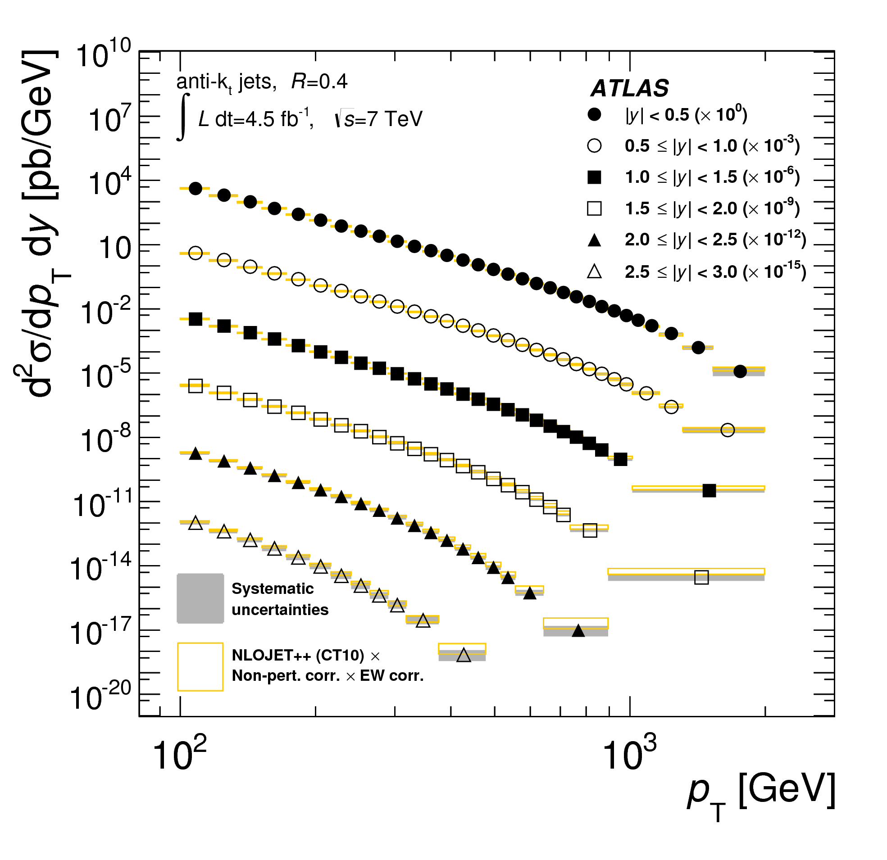
Precision ‘Standard Model’ Measurements
They should not (and mostly do not) assume the SM
They agree with the SM
Thus they can potentially exclude extensions

Slide 41
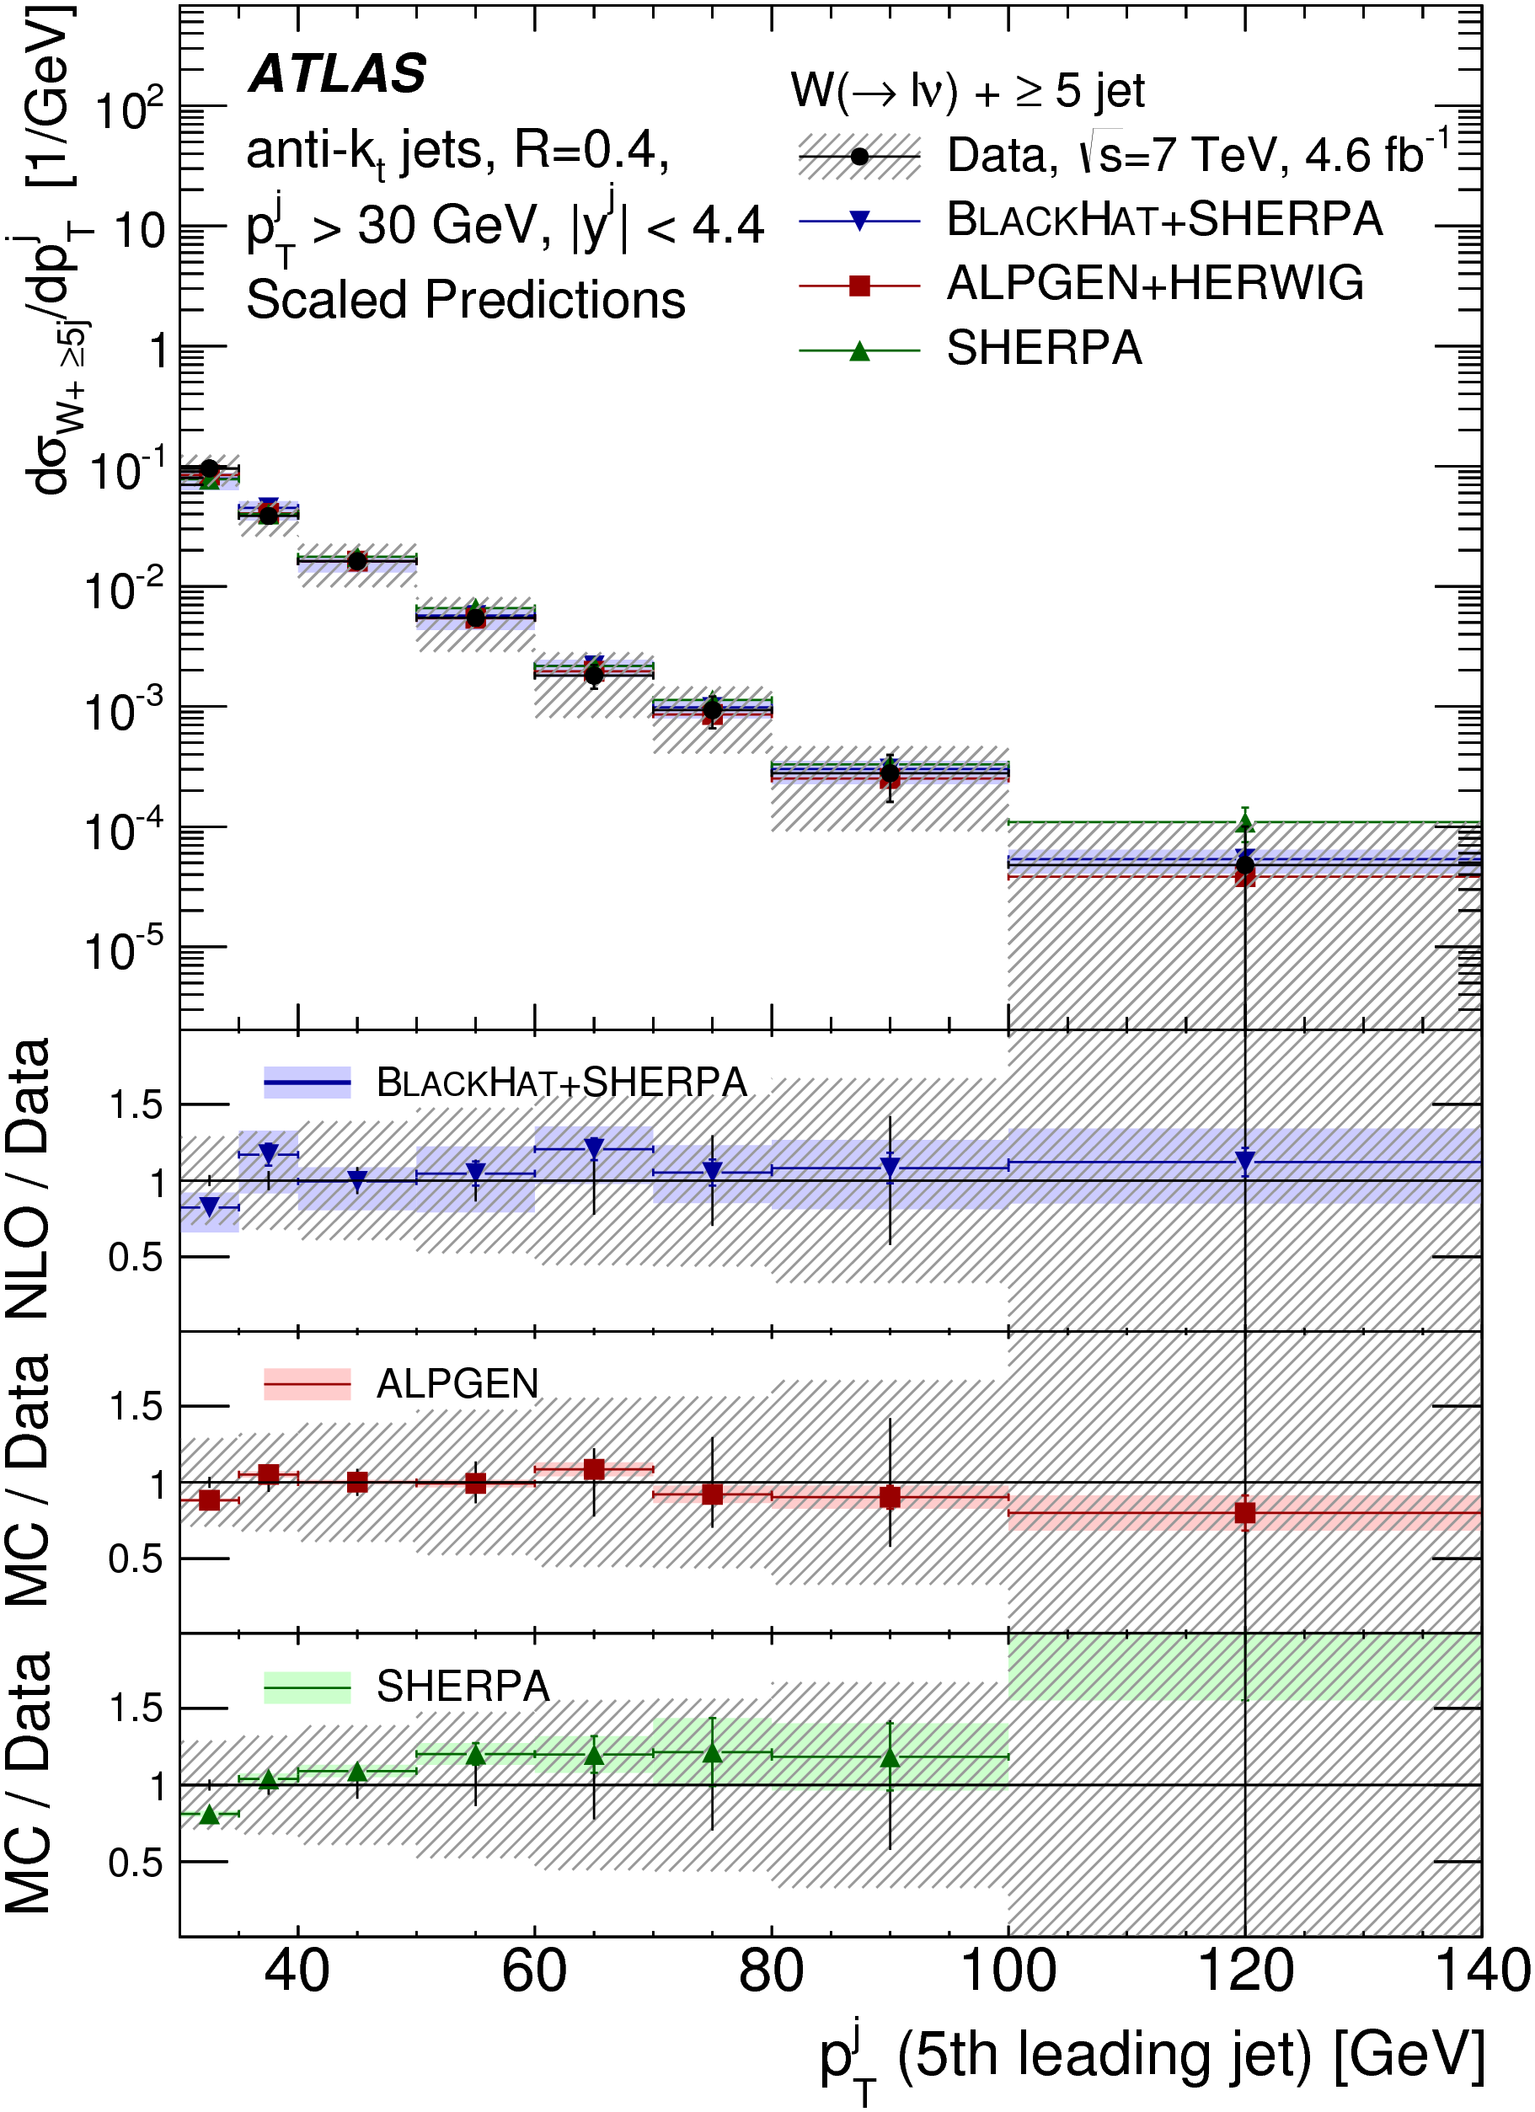
Precision ‘Standard Model’ Measurements
They should not (and mostly do not) assume the SM
They agree with the SM
Thus they can potentially exclude extensions

Slide 42
A (biased) example: Contur
UFO interface
BSM Model in FeynRules
Final State Particles
(HepMC)
New processes in Herwig7
Exclusion
Rivet, and data from HepData
Constraints On New Theories Using Rivet
arXiv:1606.05296 (JHEP 2017 078)
https://contur.hepforge.org/

Slide 43
Strategy
Use measurements shown to agree with the Standard Model
  Not a search! Guaranteed not to find anything
  Measurements take longer, but more general and less model dependent
  (Currently) assume the data = the background!
Key for constraining new models if there is a signal (unintended consequences)
Key for constraining scale of new physics if there is no signal

Slide 44
Statistics
Construct likelihood function using
  BSM signal event count
  Background count (from central value of data points)
  Gaussian assumption on uncertainty in background count, from combination of statistical and systematic uncertainties
  BSM signal count error from statistics of generated events (small!)
Make profile likelihood ratio a la Cowan et al (Asimov data set approximation is valid)
Present in CL_{s} method (A. Read)
Systematic correlations not fully treated - take only the most significant deviation in a given plot (conservative)

Slide 45
Dynamic data selection
SM measurements of fiducial, particle-level differential cross sections, with existing Rivet routines
Classify according to data set (7, 8, 13 TeV) and into non-overlapping signatures
Use only one plot from each given statistically correlated sample
Jets, W+jets, Z+jets, γ (+jets), γγ, WW, ZZ, W/Z+γ
  “jets” includes heavy-flavour jets where available
  No Missing E_{T}+jets (though one just published by ATLAS)
  8 TeV & 13 TeV now added
  Also now using fiducial/differential/particle-level Higgs and top measurements
Most sensitive measurement will vary with model and model parameters

Slide 46
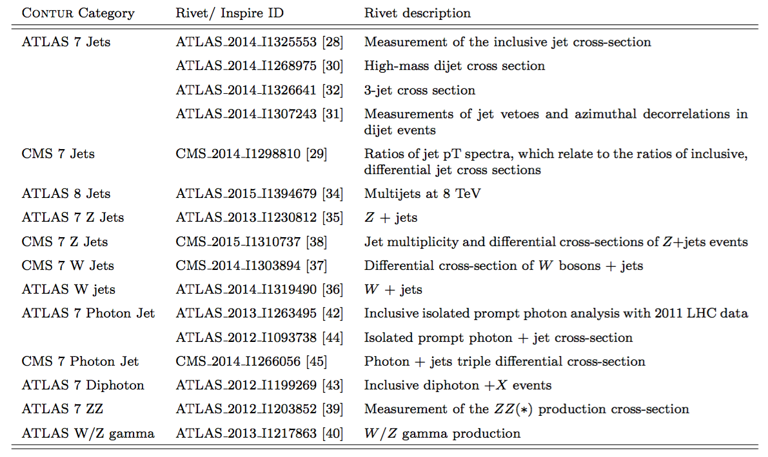

Slide 47

Simplified Model(s)
Effective lagrangian including minimal new couplings and particles
Our starter example: leptophobic Z’ with vector coupling to u,d quarks, axial vector to a DM candidate ψ.

Slide 48
Parameter Choices
Scan in M_{DM} and M_{Z’}
Four pairs of couplings:
  Challenging: g_{q} = 0.25; g_{DM} = 1
  Medium: g_{q} = 0.375; g_{DM} = 1
  Optimistic: g_{q} = 0.5; g_{DM} = 1
  DM-suppressed g_{q} = 0.375; g_{DM} = 0.25

Slide 49
Data Comparisons

Slide 50
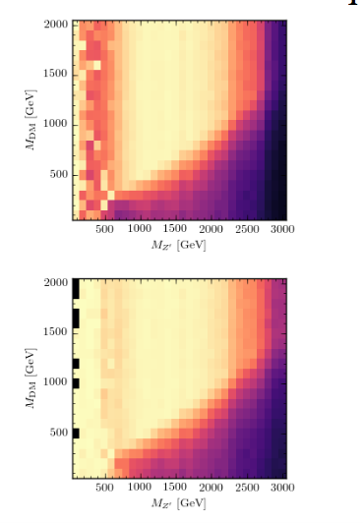
Example Scan in M_{DM} and M_{Z’}
  Medium: g_{q} = 0.375; g_{DM} = 1
(Prelim plots from Kyeog Ro Lee, summer student))

Slide 51
Look at “all flavours” model
g_{q} = 0.375, M_{DM}=600 GeV, M_{Z’}=1 TeV (plots made in Les Houches…)

Slide 52
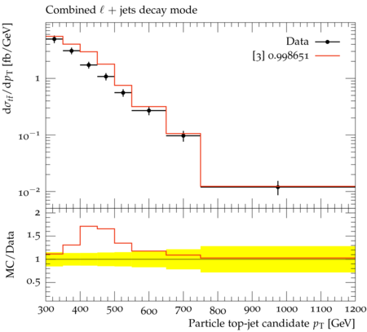
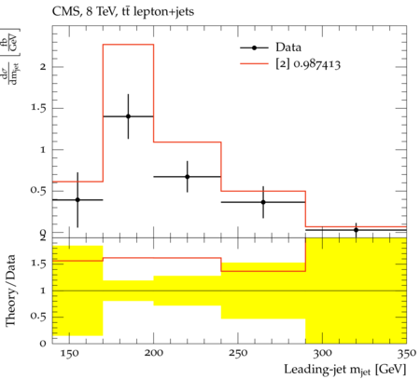
Look at “all flavours” model
ATLAS & CMS Boosted top constraining DM simplified model
g_{q} = 0.375, M_{DM}=600 GeV, M_{Z’}=1 TeV

Slide 53
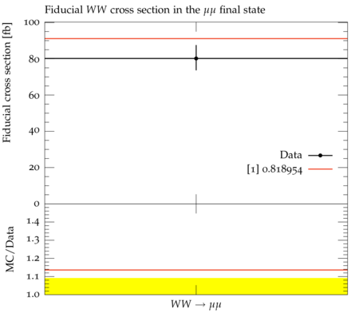
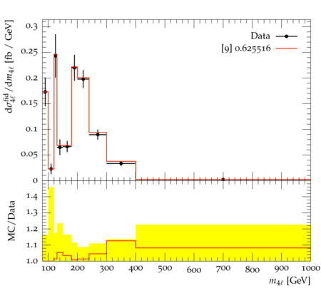
Les Houches studies of several new models underway within a few projects, aim for proceedings
e.g 2 Higgs Double Model (Ken Lane et al) (Prelim/Work in progess)
WW & 4l measurements constraining 2HDM

Slide 54
Conclusions
Particle-level measurements not only measure what is happening in our collisions, they constrain what is not happening.
Limit-setting procedure developed; even with conservative treatment of correlations, limits are competitive with dedicated searches using comparable data-sets
General framework developed:
  consider all new processes in a given (simplified) model
  consider all available final states. (e.g. V+jet shows previously unexamined sensitivity to the model considered)

Slide 55
Future work on Contur
Highly scalable to other models & new measurements – plan continuous rolling development
Include (latest) Standard Model predictions and uncertainties directly
Treat correlations better, where available
See and references therein, and contur.hepforge.org
We want your UFO files…

Slide 56
The Importance of Interfaces
LHEF
  Les Houches Event Files standard format
  parton-level output from ME generators → parton shower/hadronisation/full event simulation
  Alwall et al, https://arxiv.org/abs/hep-ph/0609017
  (also BLHA)
HepEvt
  Full final state from general-purpose event generator
  Also used by GEANT4 material/detector simulation
  http://hepmc.web.cern.ch/hepmc/
UFO
  Universal FeynRules Interface https://arxiv.org/abs/1108.2040
  FeyRules model → general purpose generator

Slide 57
The Importance of Interfaces
Yoda
  Rivet/HepData/Plotting
Root
  Much experiment analysis, plotting
Analysis/cut definitions?
  MadAnalysis/Rivet/ATOM/Experiments…??
  Exercise in Les Houches 2017 to benchmark/translate analyses, see what the issues are.

Slide 58
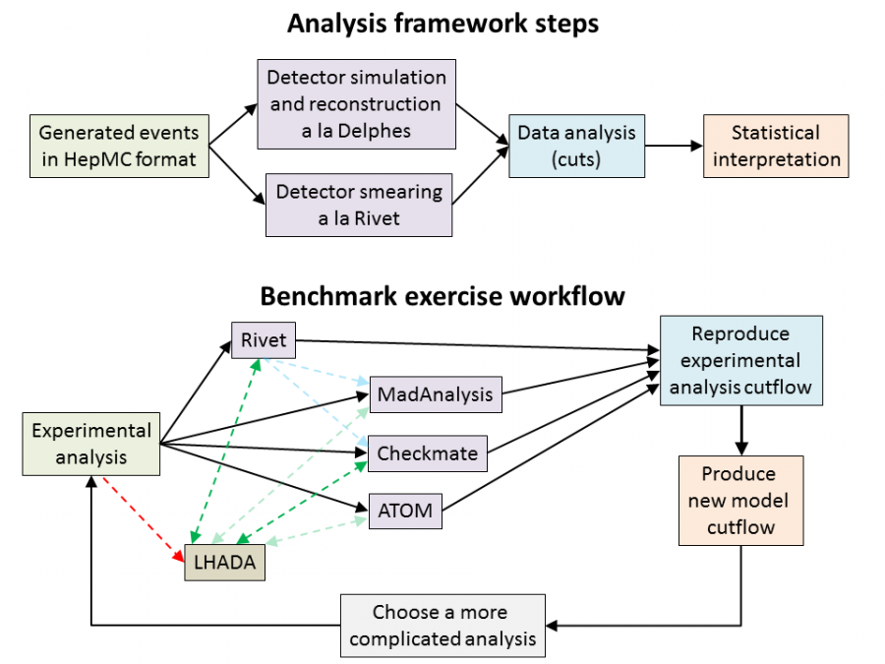
The Importance of Interfaces

Slide 59
Conclusion
Wide range of tools available that cross between experiments, and between experiment and theory
Great improvement on previous practice
  Open source codes, common standards and interfaces, reproducibility, future-proofing, many-eyes…
Risks of common-mode failure, “group think”
  Mitigated by having diversity of packages from different authors, which can nevertheless interoperate to a large extent → interfaces, standards

Slide 60
Conclusion
Significant and growing effort on “reinterpretation” of limits BSM models
Within and beyond the experiments
Aim for many advantages on the previous slide
  Reproducibility, future-proof etc…
Legacy of the LHC (including high lumi?)
Watch this space (or get involved)
  Next meeting FNAL, October 16-18:
  https://indico.cern.ch/event/639314/

