Slide 1

Availsim3
By Mikael Motyka & Enric Bargallo
6th April, 2017

Slide 2





Outline
Availability Analysis
Availsim History
Availsim3
Benchmarking
Repository
Why?
Availsim1
Introduction
Reliasoft
Learn more
Ways of modelling
Availsim2
Functionality
Example Scenario
Why Availsim?
Notes:
Outline for the presentation

Slide 3

Availability Analysis
Notes:
First availability and reliability analysis WW2, with the goal to make the rockets as well as radars more reliable

Slide 4





Why?
Estimate the availability of the machiene
Identify weak points in the design
Identify critical components
Understand component interdependencies
Estimate allocated resources, labors, spares
Notes:
Introduce the concept of Availability analysis:
Why is it important?
To beforehand, estimate the availability for the machiene
Identify critical system parts, and if necessary, treat them accordingly

Slide 5
Ok... but why?
Produce a better and more reliablie machine
The earlier weak points in the design can be identified, the less it will cost to improve
Notes:
Introduce the concept of Availability analysis:
Why is it important?
To beforehand, estimate the availability for the machiene
Identify critical system parts, and if necessary, treat them accordingly
”Whats the point in having a machiene if it is not working when we need it?”

Slide 6
Ways of modelling
Reliability Block Diagram (RBD)
Fault Tree Analysis (FTA)
Markov Modeling
Excell sheets
Failure Mode and Effect Analysis
Simulation (Monte Carlo), often coupled with some of the above concepts
Notes:
Approaches:
RBD
FTA
Markov Chain
Excell sheets
Multiple commercial and privately developed software in existance

Slide 7
Why Availsim?
Commercial software
  Mainly based on RBD
  Usually productivity oriented
  Limited to the amin customers’ needs
  Some accelerator specific needs are not considered
Special-made software
  Availsim (the only software found that explicitly targets particle accelerators)
Notes:
Although plenty of options in how to conduct the analysis exists, the commercial software have some limitation when used in the accelerator domain, which is why special-made software is required

Slide 8

Availsim History
Notes:
(Although, with all the previous software in existance, the tools was still not satisfactory for Accelerator Availability analysis)
”The approach taken here was to write a simulation which could allow several complexities to be handled that would have been nearly impossible in a spreadsheet and quite difficult in the commercial software packages.”
Therefore, Tom Hiemel and his team developed the first version of Availsim.
Why was Availsim (at all) developed? (commercial tools were not sufficient enough / additional stuff was required)
Explain version 1 and version 2. Mention functionalty, author and the purpose of the software. (Stanford / IFMIF)

Slide 9
Availsim 1
Tom Hiemel and his team
SLAC, written in MATLAB
Include complexities not possible in commercial tools such as:
Smart repairs
Scheduled maintenance shutdown
Recovery
”kludge repairs”
Notes:
Used for decisions in SLAC

Slide 10
Availsim 2
Advantages
Tailor made for IFMIF RAMI analysis
Availsim 1 features and in addition:
  Different failure modes for components
  Individual component threatment
  Flexible (maintenance offset/component locations/redundancies)
  Introduced ”Functions” to enable complex degradation and redundancis
  Best corresponds to reality
Disadvantages
Very specific for IFMIF
Hard to manage/understand (Even with in-depth knowledge)
Not modular
Require Matlab license
Notes:
IFMIF in japan, to account for specific conciderations in their RAMI analysis

Slide 11
Availsim3
Notes:
Software Introduction

Slide 12
Introduction
Developed from scratch in Python 3 (no Matlab license)
Consists of”modules” to add/remove functionality more easily
A simulation in discrete time that uses a so called ”three-phased” approach (Pidd, 1998).
Under continuous development and testing.
Notes:
Software Introduction
ADD PUZZLE

Slide 13
Functionality - current
Function | Description
Grouping | Group failures so that only one failure can occur at a time
Repair Prioritizing | Choose whether to repair everything or just the last failed device
Different redundancy types | Model redundancies with parameters and/or devices
Higher level result (systems) | Results are summarized for each system to easier see which system contributes most to downtime
Different failtime distributions | Random failures with 1p-Exponential/1p-Weibull or Gumble
Hot-swappable devices | Choose wether a device is accesible for repair with or without tunnel access (shutting down facility)
Track ageing of devices | Track the number of hours a device has been operating
Complex dependencies | Operation Decision Enables the user to program extra considerations throughout the simulation
Usage of spares | Define the number of spares
Extra repair factor | Add extra repair-time to account for ignored failures during repair
Automatically generated log to track sequence of events | To see all the operations performed by the software during the simulation
Display parameter graphs | Plot parameters for a visual representation of their values
Notes:
To give an overview of what can be done

Slide 14
Functionality - future
Function | Description
Manpower | Track allocated resources such as repairmen, controlling the maximum number of people inside the tunnel performing repairs.
Flexible maintenance | Change the start time of the scheduled maintenance if so is deemed necessary.
Order spares | If a spare is required but no more is available, we need to order new spares
Additional consequences | Add more consequence types, e.g. Parameter based optimization.
Notes:
How it works

Slide 15








Availsim 3
Common input files format
Facility
Failures
Consequence
Devices
Inputs
Parameters
Parameters
Devices
Failures
Output

Slide 16

Idea
Consequence
Beam off
(MTTR + Access + Restart) * extra factor
For each device
Parameters
Devices
Modulator
Pump 1
Pump 2
Pump 3
Klystron 1
Klystron 2
Failures
Modulator failure
Pump failure
Klystron failure
Notes:
Software Idea. To give an example of how the software operates:
Also mention how downtime is calculated (give some flow of evens, something in between the puzzle and the detailed description)

Slide 17
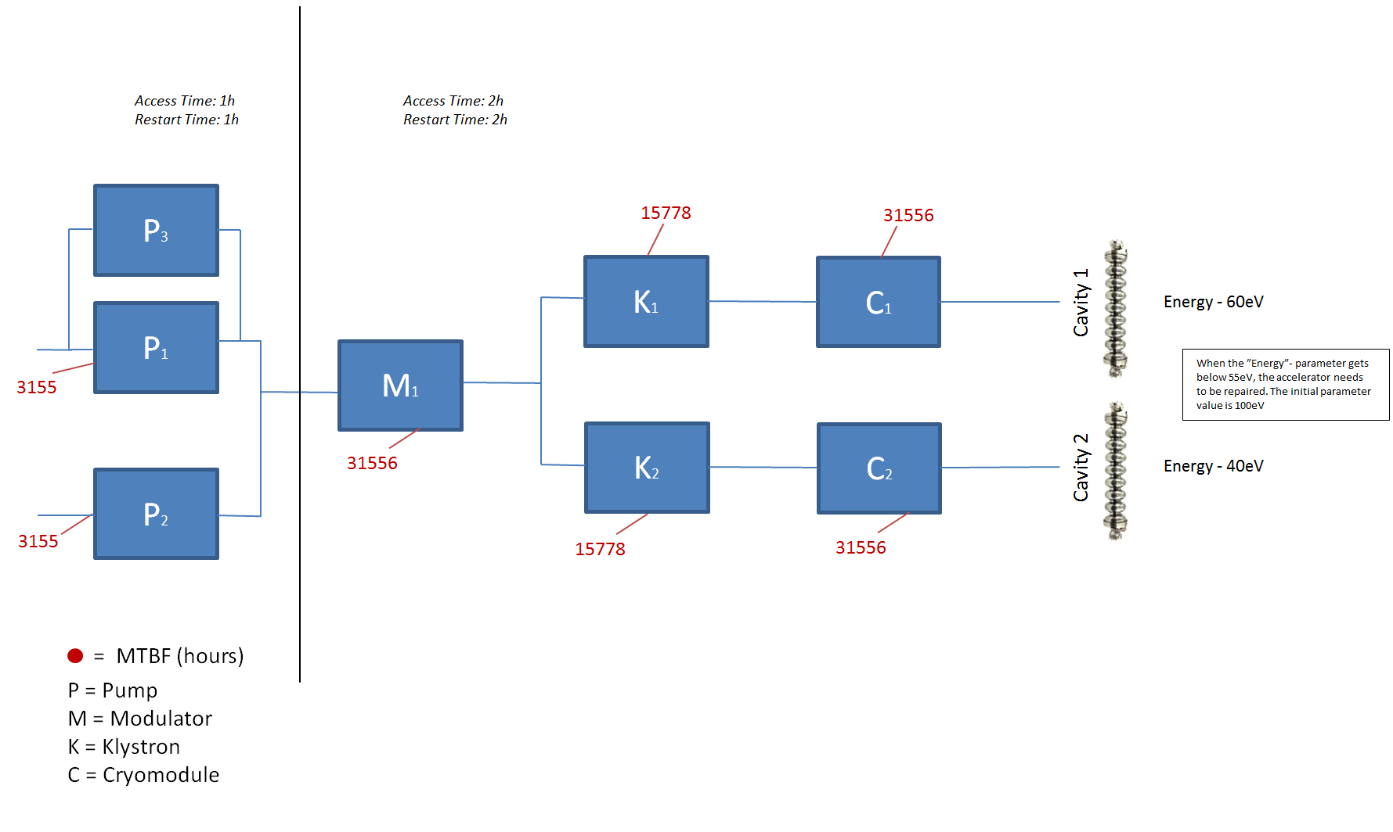
Introduction
Notes:
Software Introduction
Example of what we would like to model:
FTA and RBD, only consider 1/0, either working or not working. Which is, generally the same for availsim regarding components. Howevr, with the help of parameters, we have an additional ”layer” where we can decide wether the system is up or not, regardless of the components that have failed.

Slide 18
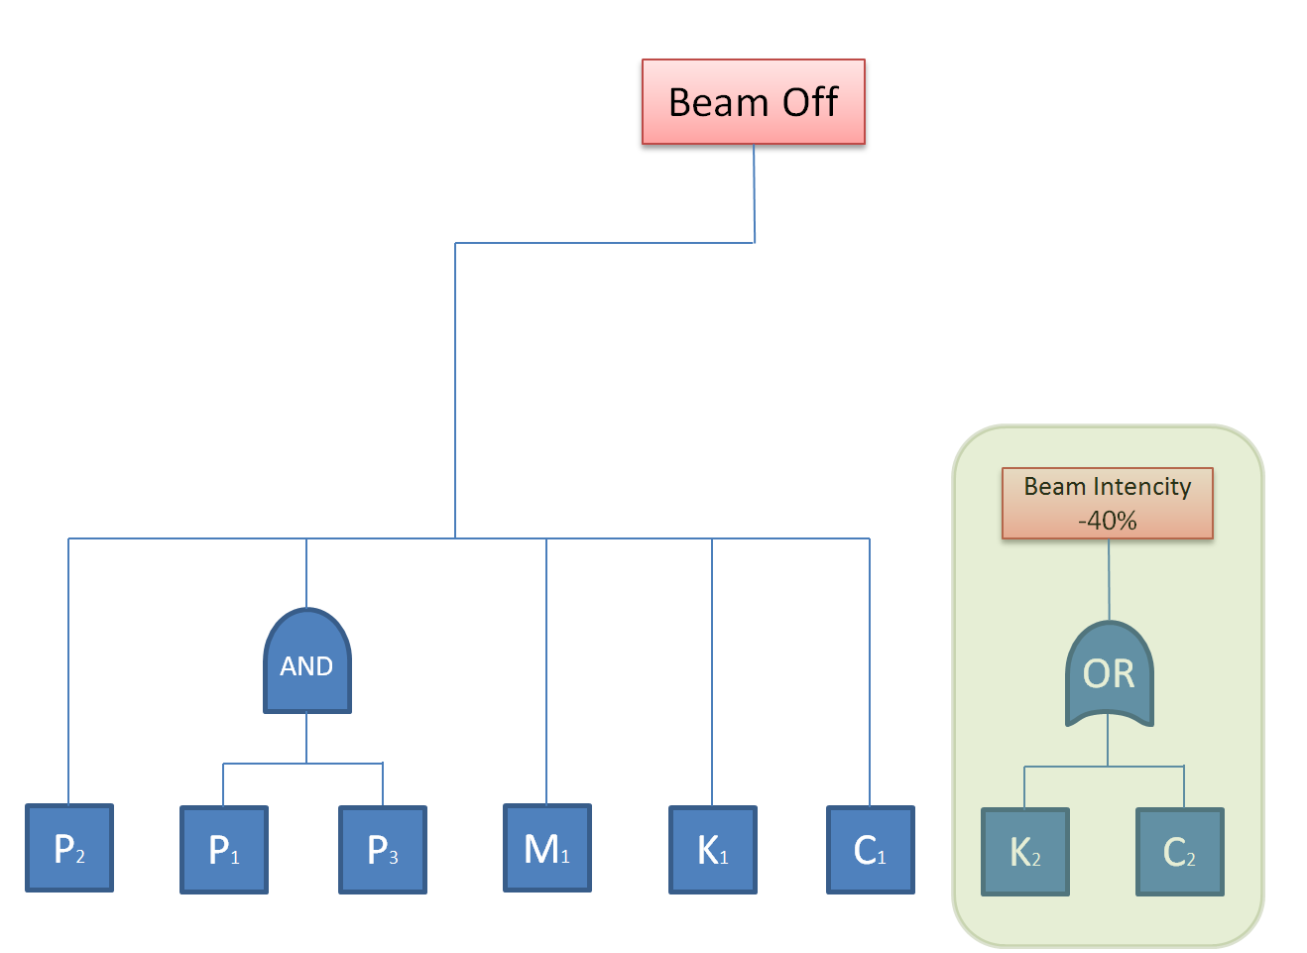
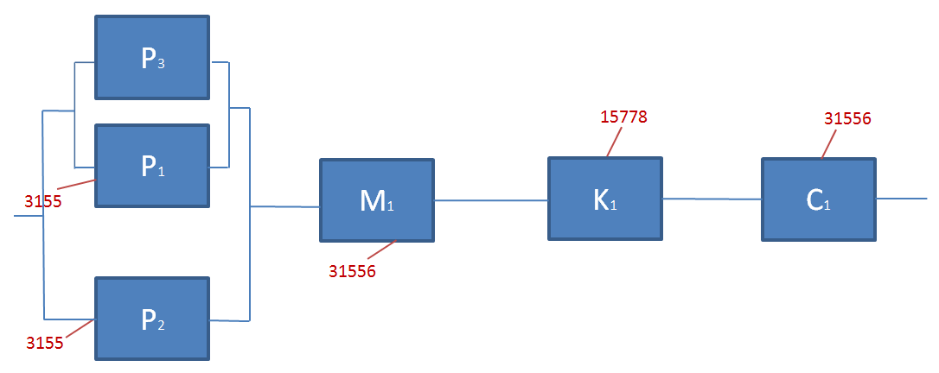
Modelling example
FTA
RBD
Notes:
FTA & RBD
Works with components, either ”ON” or ”OFF”.

Slide 19
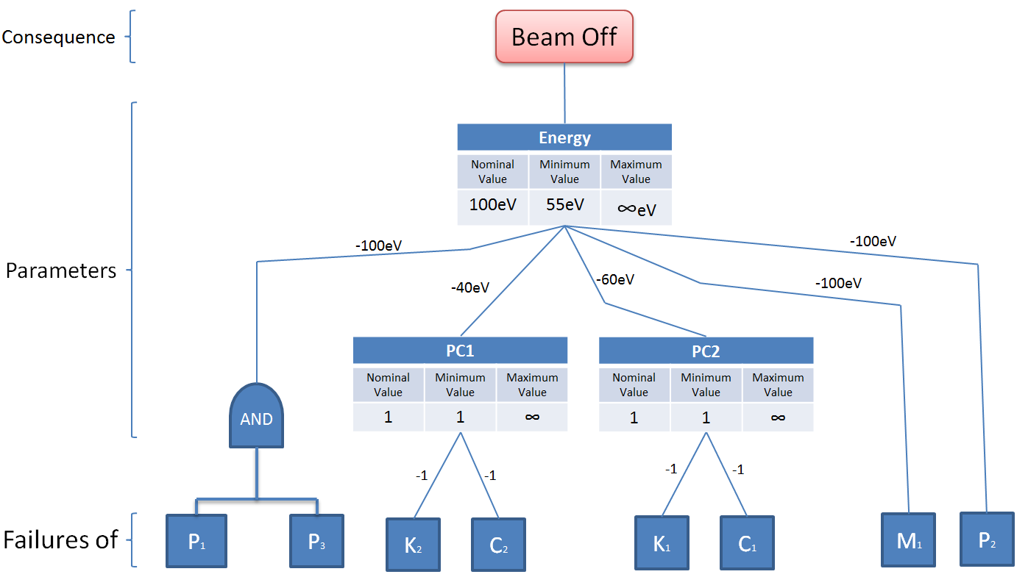
Modelling Availsim
Notes:
Software Idea

Slide 20
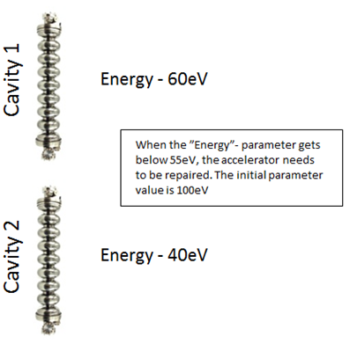
Example Scenario
Access Time: 1h
Restart Time: 1h
Access Time: 2h
Restart Time: 2h
Pump
Pump
Klystron
Modulator
Pump
Klystron
Notes:
Example result / live demo

Slide 21
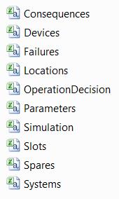
Approach
What we need to do define:
Notes:
Mention + add common input files
What we need to do:
Fill out input fields
Define:
Failures
Parameters
Consequences
Devices

Slide 22
Simulation.csv
RepairScheduling: Defines whether, during downtime,
we should repair all of the failed components (2), or only the last failed one (1)
Extra repair factor: Extra multiplier for each repair
Notes:
How it works

Slide 23
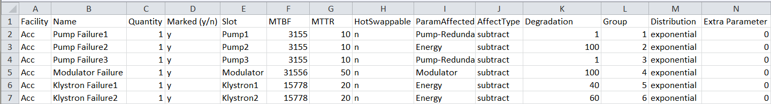
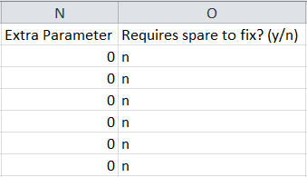
Failures.csv
Notes:
How it works

Slide 24
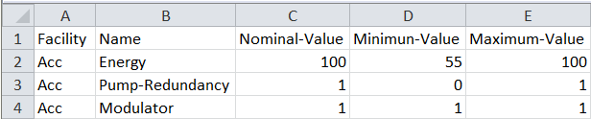
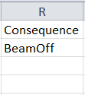
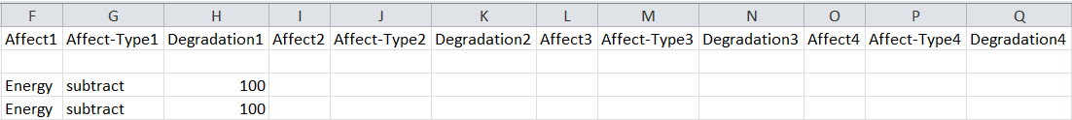
Parameters.csv
. . .
Parameter 1
Parameter 2
Parameter 3
Parameter 4
Notes:
How it works

Slide 25

Consequences.csv
Consequence Types | Function
Delay | Bring the facility down for ”Time” duration, then continue operation
”Other” | Bring the facility down and schedule repairs according to the repair scheduler
Notes:
How it works

Slide 26
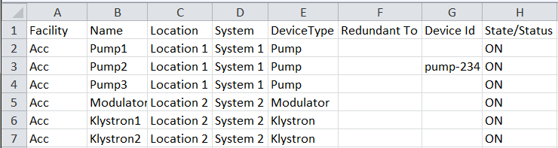
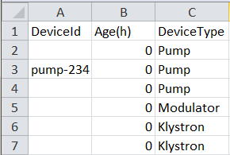
Slots.csv & Devices.csv
Notes:
How it works

Slide 27
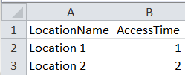
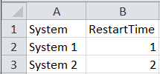
Locations.csv and Systems.csv
Notes:
How it works

Slide 28
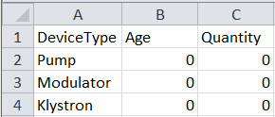
Spares.csv
Notes:
How it works

Slide 29

OperationDecision.csv
Name: Name of the decision
Condition: A condition written in Python. When true, the action is performed.
E.g. If age of device > 5000h, or if a specific parameter is equal to 3.
Action: The changes to be made.
E.g. MTBF of some failures will be halved, or make a slot take twice the time to be
repaired
Notes:
How it works

Slide 30
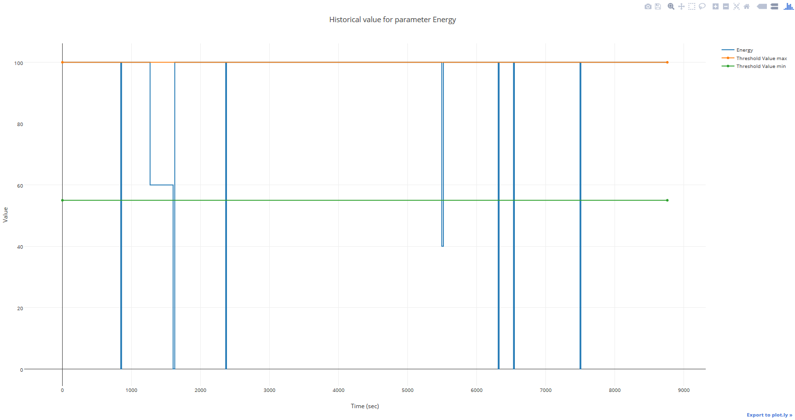
Result - Graph

Slide 31
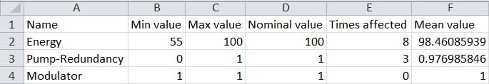
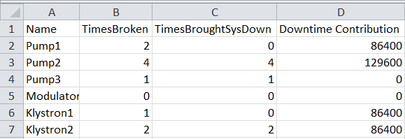
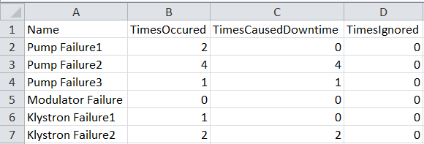

Result
facilities
Parameters
Slots (Devices)
Failures
Systems

Slide 32
Benchmarking

Slide 33
Comparison
Model 1
Model 2
Model 3
Model | Reliasoft |  | Availsim
 | Availability Times Down |  | Availability | Times Down
Model 1 | 98.4842% | 13.2956 | 98.4944% | 13.2054
Model 2 | 99.5143% | 4.2601 | 99.5179% | 4.2297
Model 3 | 99.6165% | 3.3637 | 99.61697% | 3.3593

Slide 34

Repository
Notes:
Repository for easier access to software + documentation

Slide 35
Learn more
https://confluence.esss.lu.se/display/AS/AvailSim+3.0
Installation guide
Explanation of functionalities
Detailed description of input files

Slide 36
Thank You

Slide 37
Extra slides

Slide 38
Complete functionality list

