Slide 1

A Generic and Modular Protocol Scheme for Inter-FPGA Communication using Serial Links
Presented by Cédric Vulliez
12 April 2017

Slide 2
Plan
  Challenges
  Aim of the Master thesis
  Demands/requirements
  Architecture
  Development
  Simulation
  Physical Testing
  Conclusion

Slide 3
1. Challenges
BWS Communication Challenges:
Determinist latency
  Scan Start time critical (~100 ns jitter)
High burst bandwidth needs
  Memory transfer before next scan (up to 2200Mbps)
Multiple Data Source with different needs
Subject to transmission Errors (High speed Optical Link)

Slide 4

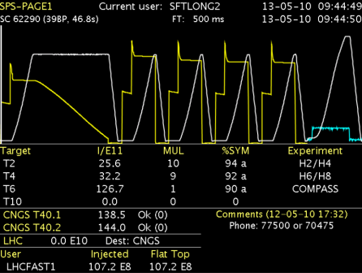

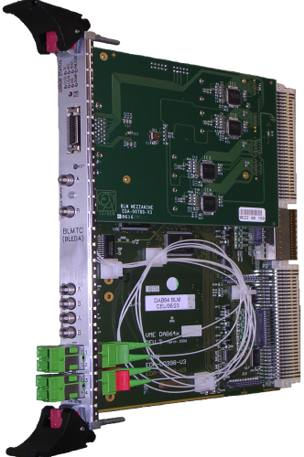

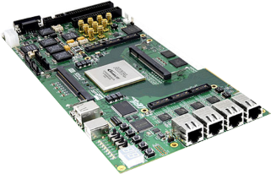
2. Aim of the Master Thesis
General Machine Timing (GMT)
Low jitter < 1ns, Granularity: 1ms
Beam Synchronous timing (BST)
Bunch synchronisation
(25 ns accurate clock)
Revolution frequency synchro
Triggers: scan start, post-mortem Granularity: 89us (LHC), low jitter < 1ns
Beam Energy and Intensity
CISV or BCT
Expert monitoring
FESA class
CPU
T IMING
BST receiver
Settings
Ethernet TCP/IP – RJ45/SFP+
CISV receiver ?
Optical link
Optical link – SFP+
Control room (CCC)
Trigger input
Logging storage
Long term storage for offline analysis
INTELLIGENT DRIVE
Communication link
ACQUISITION AND SUPERVISION
PHASE 1
PHASE 2

Slide 5
2. Aim of the Master Thesis

Slide 6

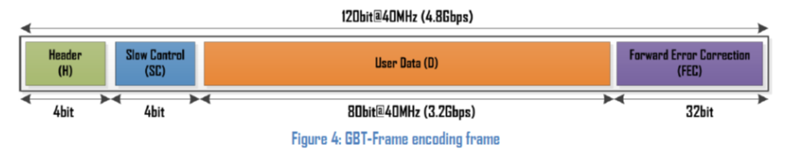
2. Aim of the Master Thesis
Commun Situations with designs only using the GBT physical layer
ADC 1
ADC 2
ADC 3
/16
/16
/16
Used bits <= GBT User data
48 bits vector

Slide 7
2. Aim of the Master Thesis
Why is the GBT physical layer not enough?
Memory Transfer
(Avalon /Wishbone)
ADC 1
ADC 2
ADC 3
/32
Add
/32
Data
/16
/16
/16
112 bits vector
Too big for 1 frame

Slide 8
2. Aim of the Master Thesis
Reaction:
Too much information (bandwidth)
48+64=112bits=4.48Gbps
3 ADC @40MS =48 bits constant streaming = 1.92Gbps
Memory transfert = 64bits but single transfert =/ 2.56Gbps
Problematic:
Enough overall bandwidth but peak need exceeding 100% usage
How to efficiently use the bandwidth without complexity for the user?

Slide 9
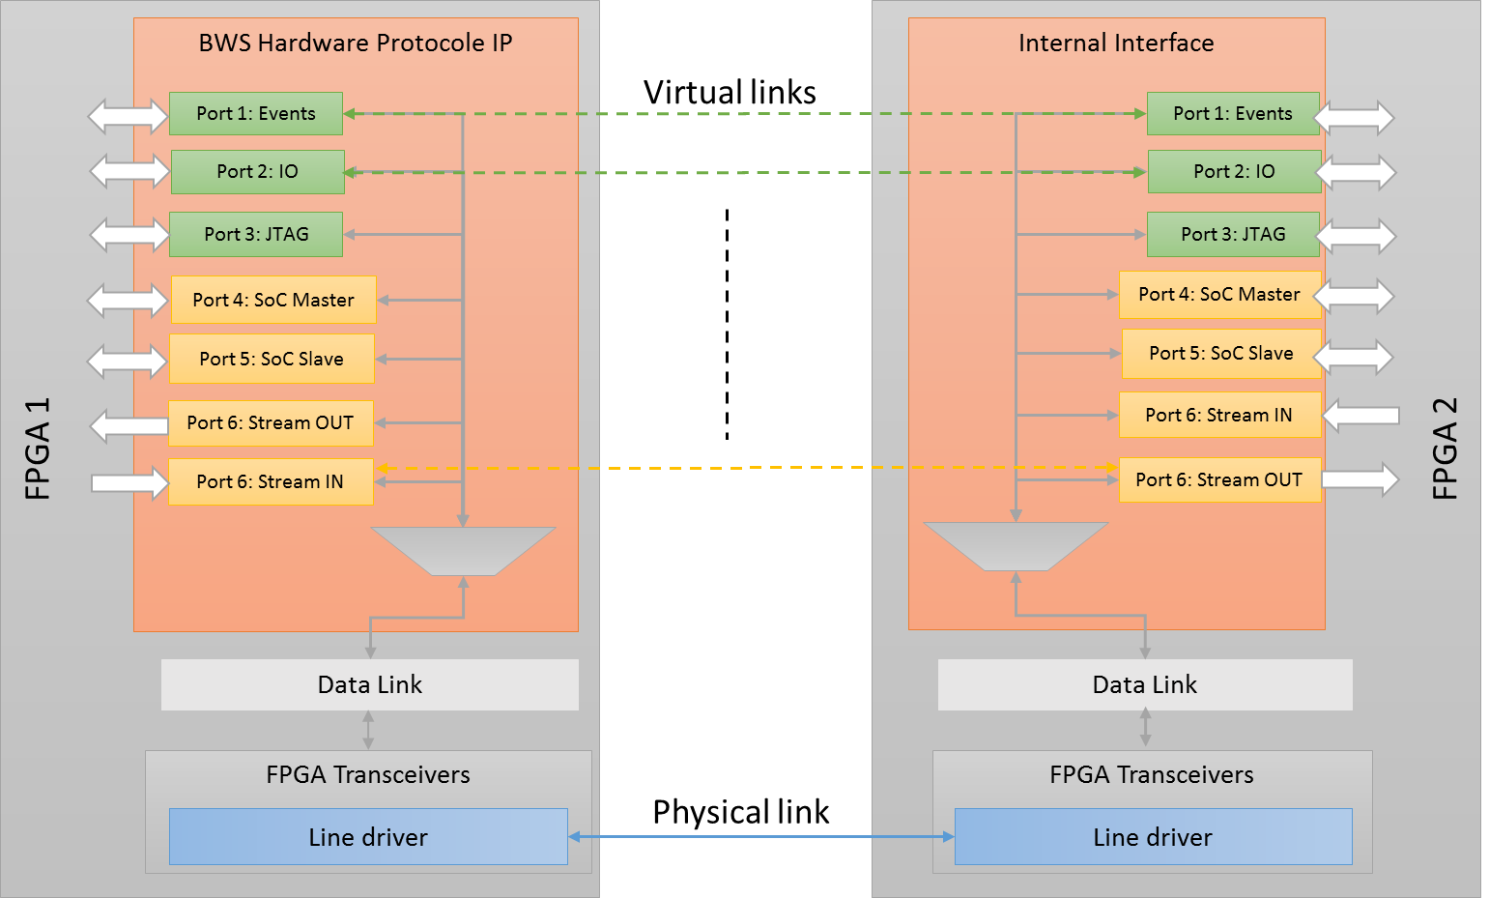
2. Aim of the Thesis
Protocol can handle:
1
2
2
1
Generic number of interface
Unification
Multiplexing
3
3

Slide 10
3. Demands/Requests
Create a Modular and Generic protocol fulfilling CERN BWS requirements:
Transparent Interconnect SoC Bus
    Interconnection of internal FPGA bus transparently (Memory Mapping)
Streaming links & Bandwidth Priority
    Interconnection of internal FPGA bus transparently
Fix Latency Event transport
    Trigger and IO port replication between the 2 ends
    Link latency jitter < 0.1us
Data integrity
    Error detection, correction and/or retransmission

Slide 11
4. Architecture
  Research
    Find an architecture
    Modular approach
    Existing usable parts?
  Development
    Develop the protocol
    Implement requests
    Validation with Simulation
  Physical Testing
    On Development boards
    Validation

Slide 12
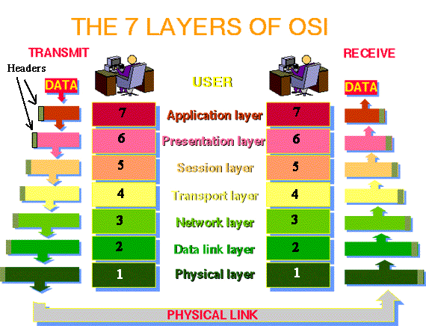
4. Architecture

Slide 13
4. Architecture
Specific Requirement Task per layer
  Unification
  Arbitrage
  Data Integrity
  Modularity
  Latency
Payload communication
but
Records Fields Manipulation
For all Layers
  Genericity
Not VHDL native
VECTOR <= PACK_FUNCTION(RECORD)
RECORD <= UNPACK_FUNCTION(VECTOR)
The Physical Layer (1):
  Not developed in this Thesis

Slide 14
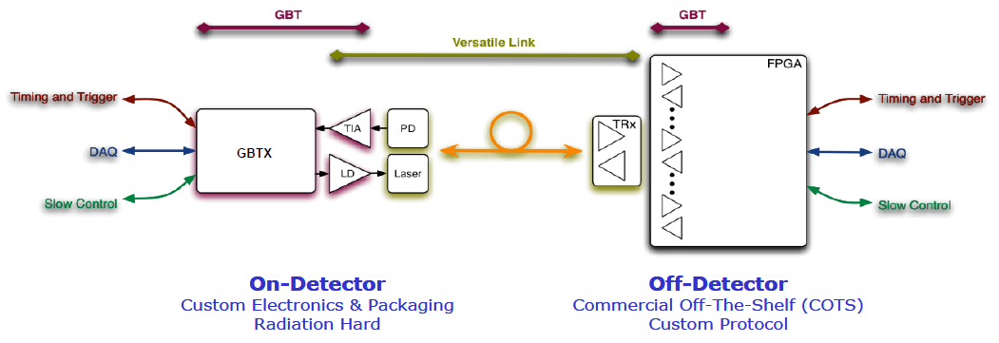
4. Architecture
What currently exist and what can be reused.
Starting Question:
“Can an existing protocol or part be reused?”
Asked to use the GBT Physical layer.
  Internal CERN Project
  Largely used at CERN

Slide 15

4. Architecture
CERN PHYSICAL LAYER: GBT
THESIS Needs | THESIS SPECIFICATIONS | GBT SPECIFICATIONS | Validation
Latency Jitter | < 100 ns | <= 25 ns
High bandwidth | 2200 Mbps | 3200 Mbps
Error Detection (Physical) | Yes | Yes
Error Recovery (Optional) | Reliable, Transparent | Yes with Forward Error Correction
as a first step

Slide 16
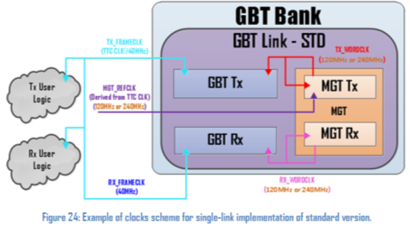
4. Architecture
Notice:
2 FPGA using their own frequencies for the GBT
For Tx User logic and Rx User logic
to use the same Clock:
Elastic FIFO needed!! Not handle by the GBT on its own

Slide 17
5. Thesis Approach
  Research
    Find an architecture
    Modular approach
    Existing usable parts?
  Development
    Develop the protocol
    Implement the 4 main requests
    Validation with Simulation
  Physical Testing
    On Development boards
    On BWS

Slide 18
5. Development
Transparent User interconnection
  Application Service Templates
  Easy to Add/remove Services
Application Service Templates
    Avalon Interface
    Avalon Streaming
    I/O reproduction
    Wishbone

Slide 19
5. Development
2. Streaming links & Memory mapping
Independencies problematic
Priority Problematic

Slide 20
5. Development
Transparent User interconnection
Streaming links
  Independent Services Streaming (Buffers)
  Generic priority system (Arbiter)
  weighted system (Bandwidth)

Slide 21
5. Development
weighted system (Bandwidth)
  Generic code
  No modification needed when adding /Removing Services

Slide 22
5. Development
Transparent User interconnection
Streaming links
Fix Latency Event transport
  By Pass Priority System (fixed Latency)
  Present in all Frames (reliable)
Triggers Events

Slide 23



5. Development
Transparent User interconnection
Streaming links
Fix Latency Event transport
Data integrity
  Physical Layer GBT can correct 16 bits
  Transaction Validation
  Transparent Retransmission
good???
Data Valid
Data
Data
Acknowledge
Valid / Not Valid

Slide 24
5. Development
Transparent User interconnection
  Application Service Templates
  Easy to Add/remove Services
Application Service Templates
    Avalon Interface
    Avalon Streaming
    I/O reproduction
    Wishbone

Slide 25

5. Development
Exemple
  Only 4 steps to Add a new existant Service template:
  1) Change constant Package
  2) Add interface record
  3) Add Application service template (Port Map)
  4) Connect signals to your design
1. Change the package constant

Slide 26
5. Development
2. In the package:
- Add the (existing) interface record into the FPGA_top record

Slide 27
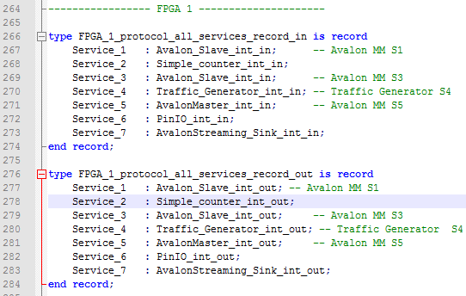
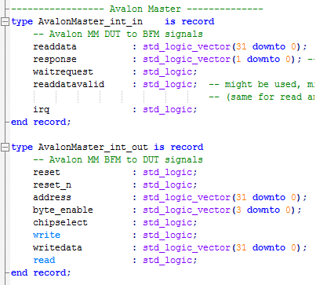
5. Development
2. In the package:
- Add the (existing) interface record into the FPGA_top record

Slide 28
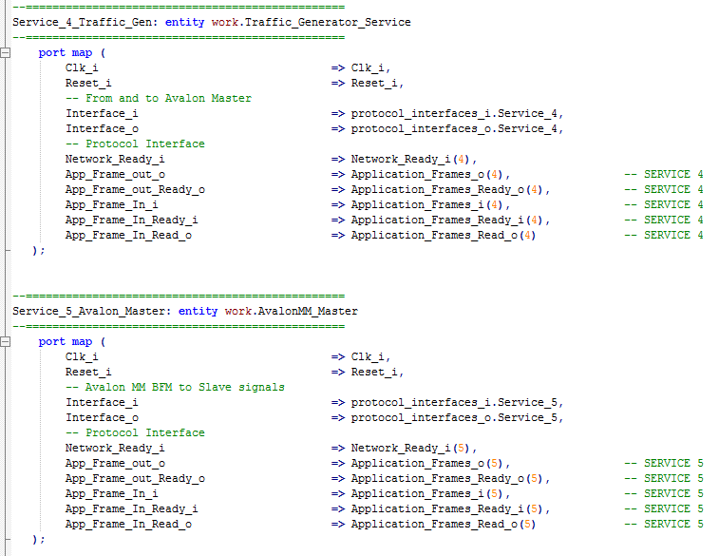
5. Development
3. In the 2 Application layers:
Add the port map of the Service template
- copy paste
- change Service number

Slide 29
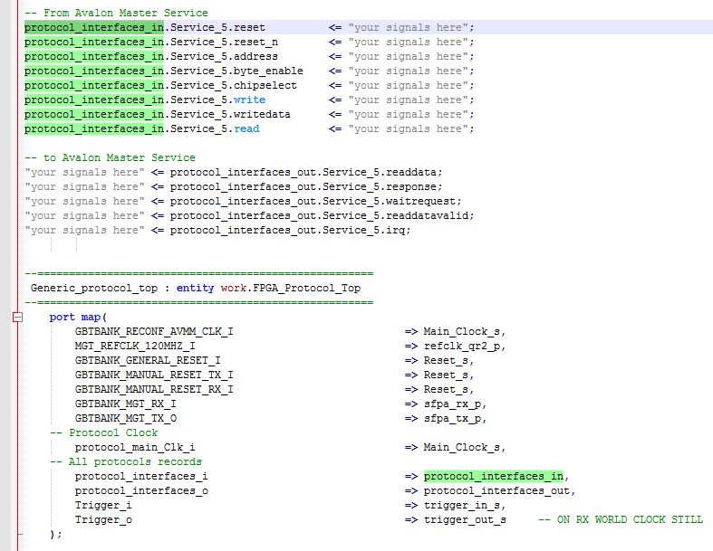
5. Development
4. In your Design:
Connect the wanted signals to the protocol records.
In signals
out signals
5. done!

Slide 30
6. Simulation
Simulation validation process:
  Parallel to Development
  RTL (Register Transfer Level)
  TLM (Transaction Level Modeling)
Fully automated Test bench developed
Using the UVVM Framework
Complex scenarios
Validates the design

Slide 31
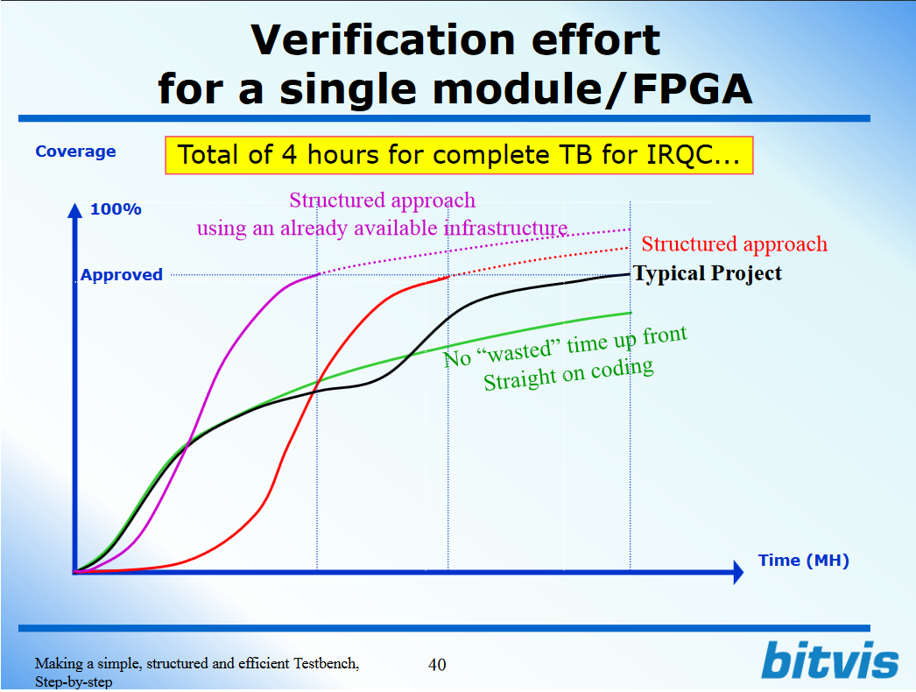
6. Simulation
Why Verification effort
is important

Slide 32
6. Simulation
Why Verification effort
is important

Slide 33

6. Simulation
Bitvis (Norwegian company)
Independent Design Centre for Embedded Software and FPGA/ASIC
UVVM:
Free, open source Framework
Complete VHDL verification environment
Transaction based (TLM)
Simultaneous command executing
Verbosity control & Command tracking
Efficient reuse
Supports Constrained Random stimuli

Slide 34
6. Simulation
UVM Test Bench Architecture
→ In System Verilog
Sequences
UVM Sequencer
UVM Agents

Slide 35
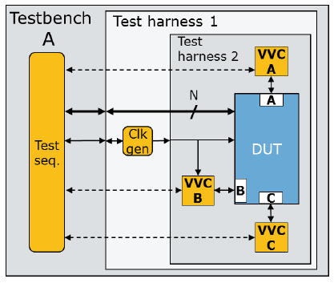
6. Simulation
UVVM Test Bench Architecture
→ In VHDL 2008
DUT (Design Under Test)
Test Sequencer
Agents (VVC)
(VHDL Verification Components)

Slide 36
6. Simulation
How a VVC works:
Commands from TB:
Can be executed instantly
Can be queued
Command types:
Any user BFM Action (Bus Functional Model)
Delays, etc

Slide 37
6. Simulation
Handle transactions at a high level
  E.g. Read, Write, Send packet, Config, etc
  More understandable for anyone
  Simpler code & Improved overview
  Uniform style, method, sequence, result
  Easy to add several very useful features
Example: BFM for a CPU access to a module's register
E.g. write 0xF0 (“11110000”) into a register at address 0x22 (“100010”)
cs <= ’1’;
we <= ’1’;
addr <= ”00100010”;
data <= ”11110000”;
wait until rising_edge(clk);
wait until falling_edge(clk);
Cs <= ’0’;
we <= ’0’;
Replaced by
write(x”22”, x”F0”);

Slide 38
6. Simulation
Example:
2 Avalon Masters on FPGA1
2 Avalon Slaves on FPGA2

Slide 39
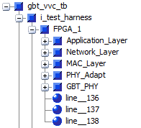
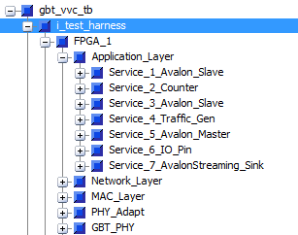
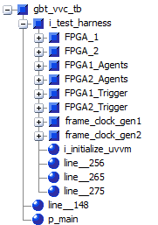
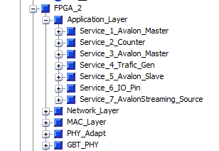
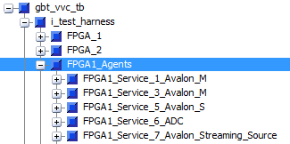
6. Simulation

Slide 40
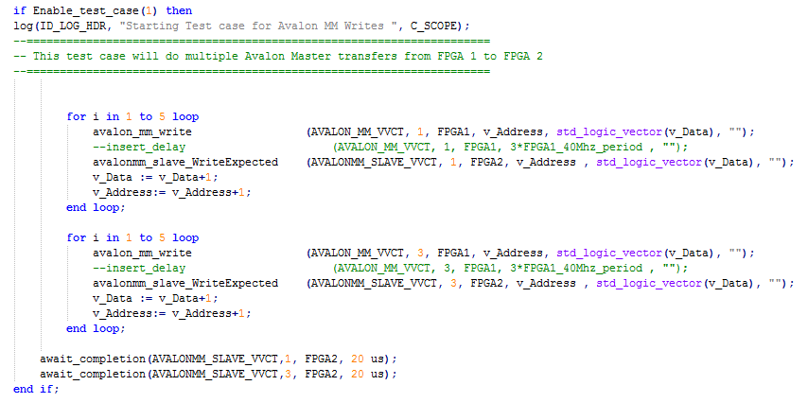
6. Simulation
(1)
(1)
(1)

Slide 41
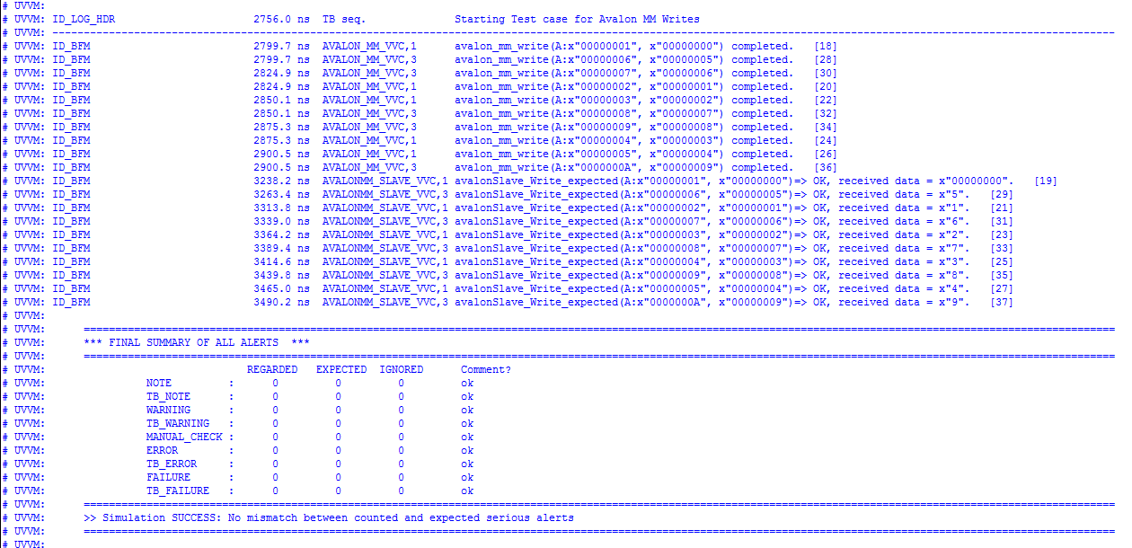
6. Simulation
Master (1)
Slave (2)
(1)
(2)

Slide 42
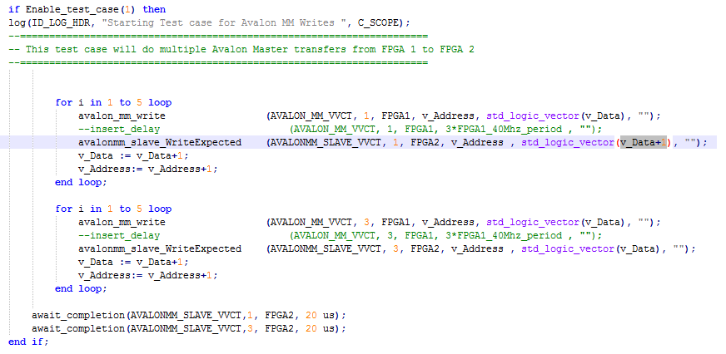
6. Simulation
Wrong Expected Data

Slide 43
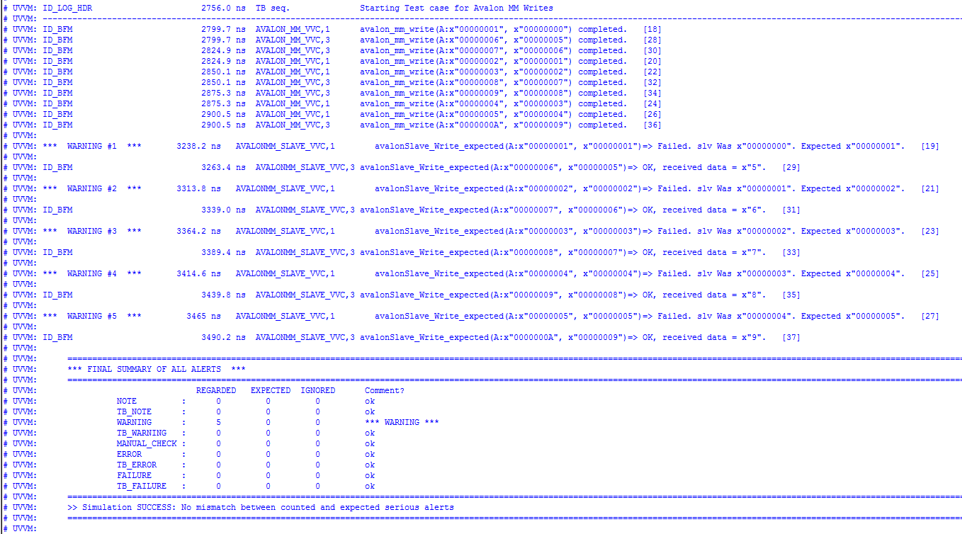
6. Simulation
Wrong Data

Slide 44
6. Simulation
A UVVM Test Bench:
A single sequence for all Verification Components
  1 single Process : simple but powerful test cases
  Time synchronization made easy
Validates Data communication and order
Validates that all transactions went through
  Timouts limits

Slide 45
Thesis Approach
  Research
    Find an architecture
    Modular approach
    Existing usable parts?
  Development
    Develop the protocol
    Implement the 4 main requests
    Validation with Simulation
  Physical Testing
    On Development boards

Slide 46
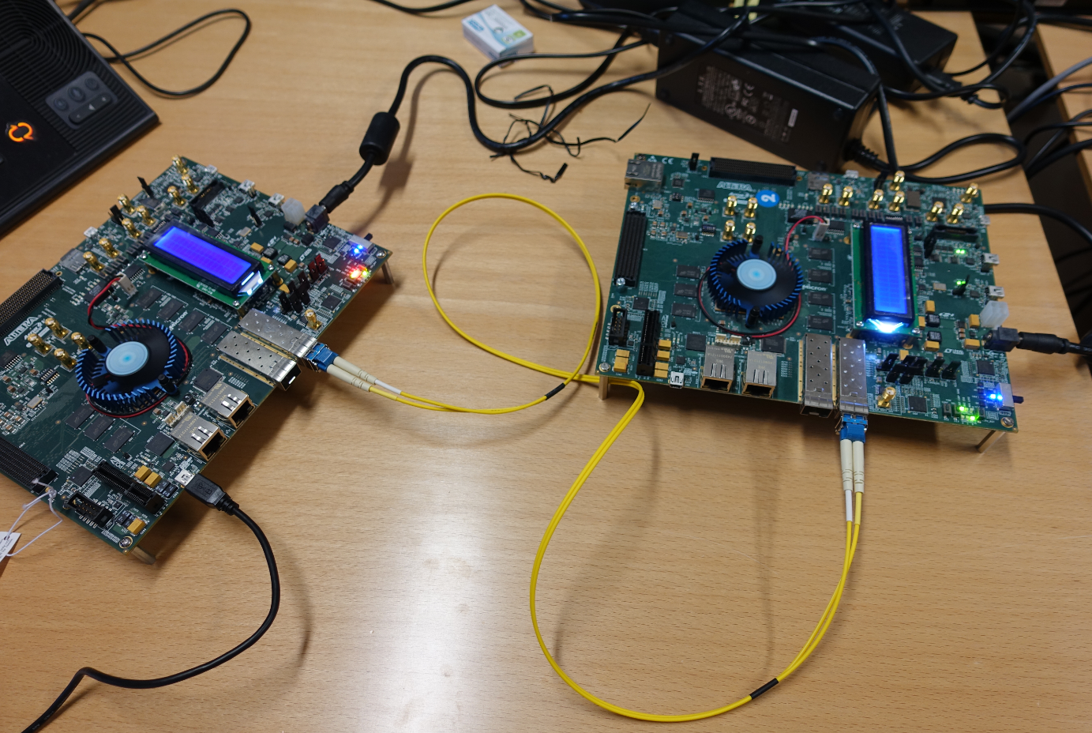
7. Physical Testing
With ArriaV SoC Evaluation Kit
Single board LoopBack Tests
Dual boards Test
Due to limited time :
- Simple physical tests done with signal Tap (internal signals)
First Results
Link Validation
Latency
bandwidth

Slide 47
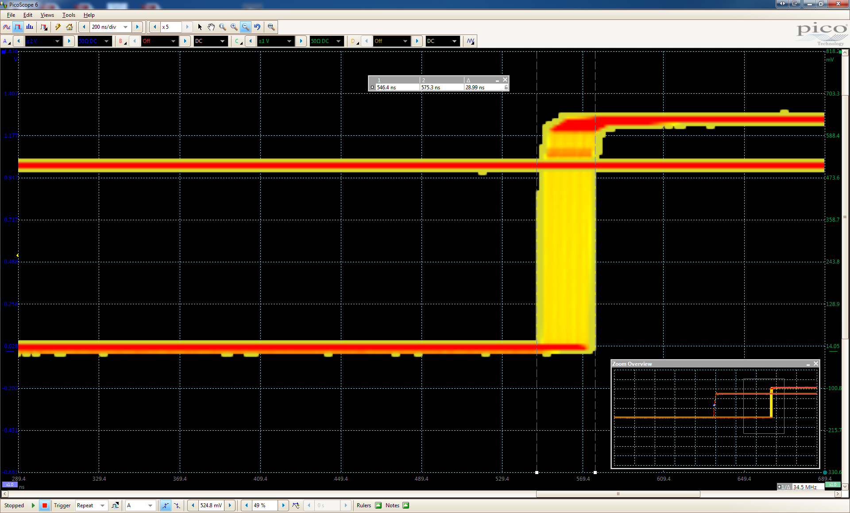
7. Physical Testing
With ArriaV SoC Evaluation Kit
Triggers Physical Testing:
Up to 25ns jitter upon reset (GBT normal version)
Up to 25ns jitter from sampling periode (40Mhz Clock)
Total Trigger Jitter= 25+25=50 ns
Same as GBT

Slide 48
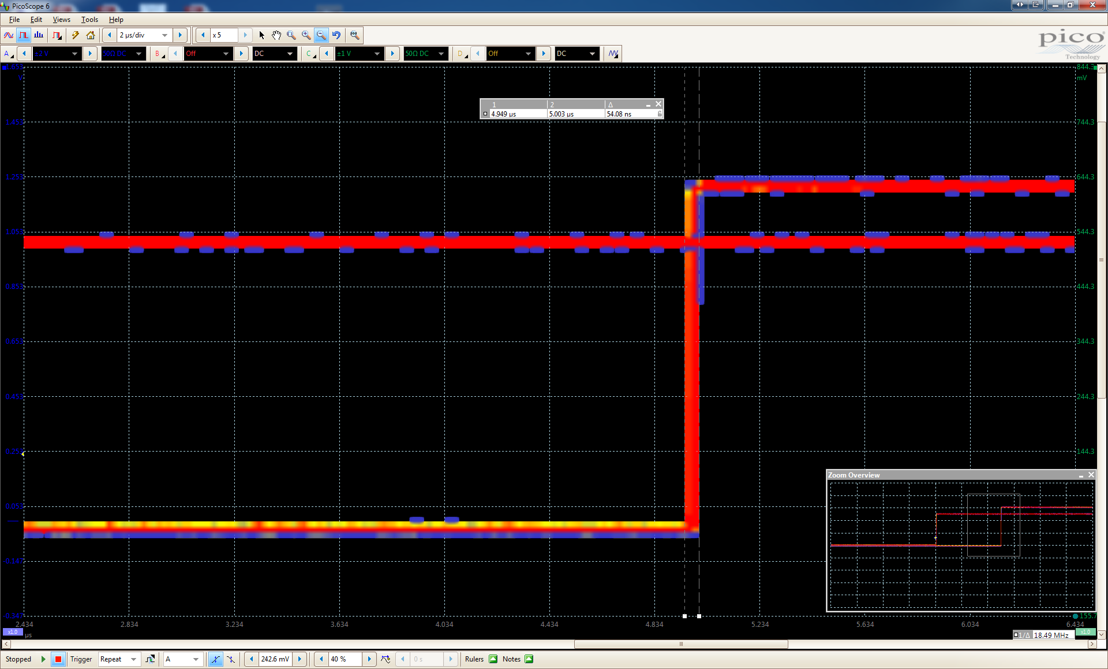
7. Physical Testing
With ArriaV SoC Evaluation Kit
IO reproduction Physical Testing:
Higher Delay (buffer time to avoid FIFO Underflow)
  Deterministic Delay (Set in design)
Total IO Jitter= 50 ns < 100ns

Slide 49
7. Physical Testing
With ArriaV SoC Evaluation Kit
Traffic Generator (25%, 50%, 75%, 100%)
Signal Tap check

Slide 50
8. Conclusion
Transparent SoC bus interconnect
  Interconnection of internal FPGA bus transparently (Memory Mapping)
  Data blocks transfer between FPGA (2 directions)
Event transport
  Trigger and IO port replication between the 2 ends
  Link latency jitter <0.1us
Streaming links
  Interconnection of internal FPGA bus transparently
  Transparent connections for streaming mechanism
Data integrity
  Error detection, correction and/or retransmission.
  Notification
Generic and Modular
  Number of services
  Layers communication

Slide 51

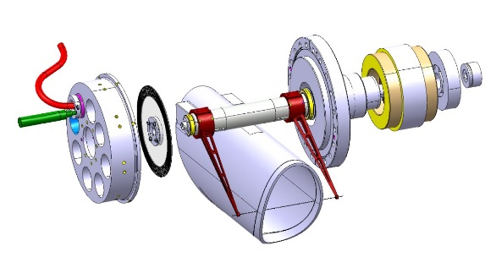
8. Conclusion
Old System:
- 1 FPGA
FPGA 1
Internal Interface
Port 1: Events
Port 2: IO
Port 3: JTAG
Port 4: SoC Master
Port 5: SoC Slave
Port 6: Stream IN
Port 6: Stream OUT

Slide 52
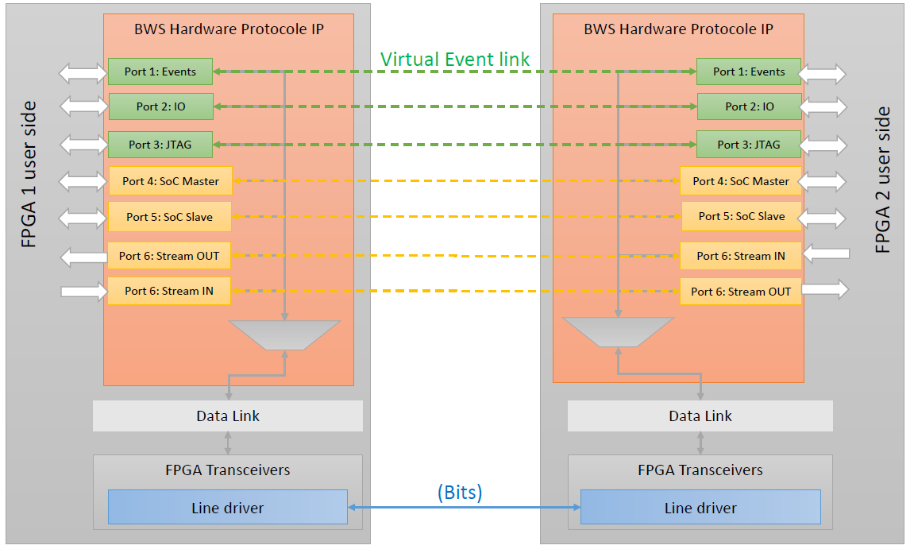
8. Conclusion
New System:
- 2 FPGA
Same interfaces

Slide 53
Additional Slides

Slide 54
5. Thesis Approach (Architecture)

Slide 55
Specific aspects
Unification and Genericity

Slide 56
Additional Slides

Slide 57
Specific aspects
Unification and Genericity

Slide 58
Specific aspects
Unification and Genericity

Slide 59
Specific aspects
Unification and Genericity

Slide 60
Specific aspects
Unification and Genericity

Slide 61
Specific aspects
IO Pin Service
→ Generic size
→ Generic down sample factor

Slide 62
Additional Slides
TX communication
overview

Slide 63
Additional Slides
RX communication
overview

Slide 64
Additional Slides
MAC communication
Overview

Slide 65
Additional Slides
Retransmission
Frame Generator:
Can group up to 32 frames state in a single Ack Ctl Frame
Sends ID+ state

Slide 66
Additional Slides
Retransmission

Slide 67
Additional Slides
Retransmission
FIFO read needs the same speed as FIFO Write
Complex: Ack frame can contain up to 32 frames ➔ 32 Read cycles

Slide 68
Additional Slides
GBT clocking Architecture

Slide 69
Additional Slides
GBT clocking Architecture

Slide 70
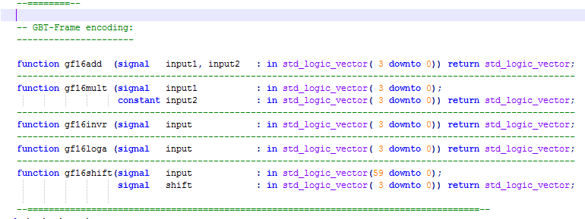
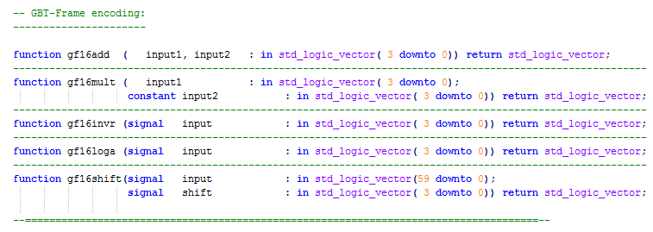
Additional Slides
GBT Changes needed:
1. In gbt_bank_package.vhd
Removing the «signal» constraint for the input signals for simulation

Slide 71
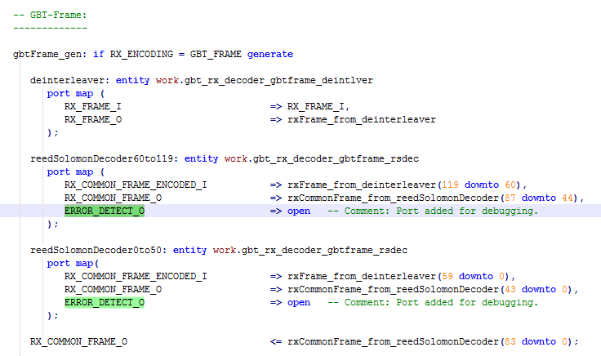
Additional Slides
GBT Changes needed:
2. In gbt_rx_decoder.vhd
Using Error_Detect from the FEC to mask the RX_ISDATA_FLAG, to only have valid uncorrupted data frames.

