Slide 1


Beam-Beam Studies for FCC-HH
J. Barranco, X. Buffat, M. Crouch, S. V. Furuseth,
P. Goncalves, T. Pieloni, C. Tambasco, R. Tomas
Laboratory of Particle Accelerator Physics, EPFL
And CERN Teams
Acknowledgements: D. Schulte, L. Rivkin, A. Seryi and IR team, R. Martin, B. Dalena, R. DeMaria, W. Herr, M. Giovannozzi.

Slide 2
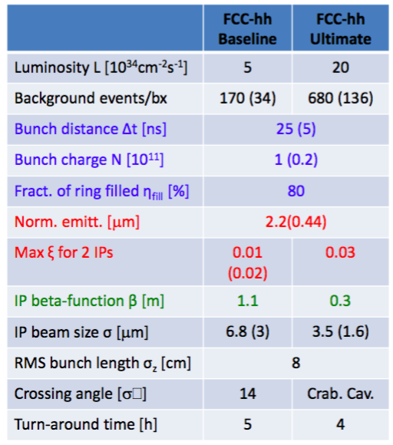
Cases
Flat Optics Alternative → No/reduced crab cavities x_{bb} = 0.03
Beta-beating and beam-beam studies
Correlate losses to Dynamic Aperture: what is a safe margin learning from LHC?
Emittance evolution and losses with beam-beam effects
Landau damping and instabilities
GREEN = Ready for Berlin
BLUE = started not sure for Berlin
RED = for CDR

Slide 3
Scope of studies foreseen for CDR what for Berlin
Robust Baseline scenario Round Optics + Ultimate:
Dynamic Aperture Studies (HL-LHC, LHC optics and scale)→ x-ing angles and schemes, PACMAN effects, intensity limitations, op scenario
FCC-hh lattice checked (thanks Barbara&Co.): stable results now for DA and studies been repeated and confirm Barcelona--> NO-MARGINS 180μrad
PACMAN studies and crossing schemes (HV versus HH and VV)
Preliminary DA with IR errors and corrections from Emilia encouraging (from 0 to 10 σ) → we will start now adding Beam-beam to quantify how much margins we need to add to BB separation
Octupoles not yet available possible use for compensation of LR effects (evident on paper for HL-LHC optics: still under study )
High chromaticity dynamics will need margins: on-going studies
2 Low Lumi experiments to be added→ Head-on Beam-Beam too large! Long-range effects too strong since no margins are available for IPA&G case
Compensations techniques (wires, octupoles+ATS optics, electron lenses)

Slide 4
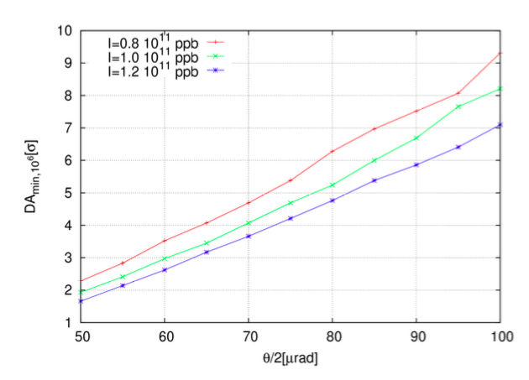
Round Optics: 2 high lumi experiments
FCC New Lattice
Intensity Effects
Crossing angle 180 μrad needed for high chromaticity
Intensity effects will require roughly 5-10 μrad for 10-20% fluctuations
Chromaticity Effects
Still to be addressed:
Multipolar errors
Landau Octupoles
Will need to have more margins
This only for two IPs

Slide 5
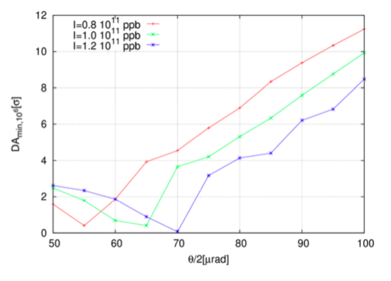
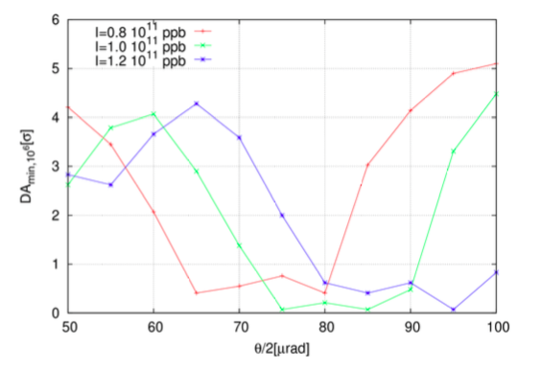
Crossing Schemes
H/H
V/V
H/H Crossing seems equivalent to H/V in terms of DA for nominal bunches
V/V is worse (3rd order resonance effect) might need newer working point
On-going PACMAN bunches studies
H/V
Angle rough estimates: 85 (nominal) + 5 (15 Units Chroma) + 3 (10% intensity) + 5 (0.5 s effect of Multipolar errors) +/- Octupoles (difficult to judge) = 98 μrad + octupoles tbc

Slide 6
Octupoles studies: using HLLHC as study case
Octupoles could be used to compensate Long-range effects but needs HL-LHC ATS optics
Study in-going but we will use this as a possible compensation technique and might help angle margins

Slide 7
2 Low Luminosity IRs
For the moment they will need to be setted in shadow of main experiments (no margins from DA)
Luminosity should be leveled by separation (reduced Head-on 0.03 total maximum allowed)
Long-range separation should be set to twice the main IPs (29 σ) → larger betas or larger angles or combination…to be defined with IR design people.
→ For Berlin will define Luminosity limit for these two extra IPs

Slide 8
Scope of studies foreseen for CDR and what for Berlin
Robust Baseline scenario Round Optics:
Head-on Limits → impact of large Head-on for Ultimate 0.03 tune shift
Predicting losses from Head-on - comparisons to measurements LHC
Noise on colliding beams – comparison to measurements LHC
beta-beating due to beam-beam and possible correction scheme
Orbit effects → lumi loss and x-ing angles
TRAIN code benchmark to LHC and extension to FCC
Stability in the presence of beam-beam effects → impact of beam-beam on beam stability (Landau damping, feedback effects and coherent modes)
Landau damping over OP cycle
Compare to LHC measurements to understand important contributions
Transverse feedback effects on coherent BB+Impedance modes overlap.

Slide 9
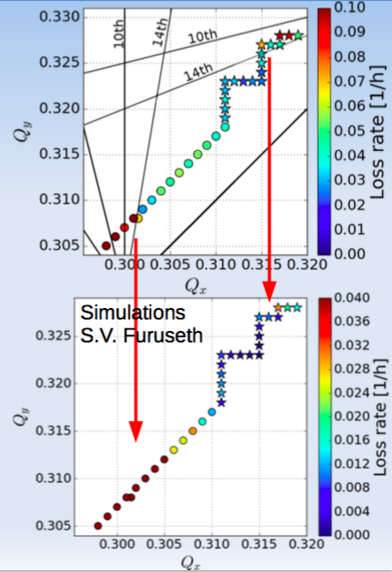
Head-on Limit: Losses and Emittance growth
BB parameter of 0.02 (Ultimate is 0.03)
GPU accelerated 6D simulations compared to measured losses in the LHC.
Clear impact of Piwinski angle to loss mechanism
Good qualitative agreements
Work on going on quantitative estimates

Slide 10
Scope of studies foreseen for CDR and what for Berlin
Robust Alternative scenario Flat Optics:
DA→ round versus flat long-range separations
Dynamic aperture studies round versus flat
Chromaticity differences
Orbit effects
Head-on studies→ impact of crossing angles on losses and emittance behaviour
Predicting losses from Head-on, Piwinski angle dependency.
Comparing to measurements
Study the 5 ns bunch spacing case:
DA, Orbit effects→ round versus flat long-range separations
Repeat what done for the baseline and ultimate for a 5 ns spacing case

Slide 11
Flat Optics
Study Case (HL-LHC optics)
Flat vs Round 43% more separation
Compensating LR tune shifts: 26% more
Need to compensate for the head-on contribution
Working on aspect ratio of betas
Differences in peak Luminosity respect to round case:
-30% with 43% larger separations
-20% applyin correction and assuming 26% larger separation

Slide 12
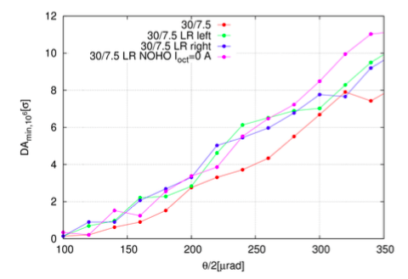
PACMAN effects
Dynamic Aperture is defined by nominal bunches PACMAN bunches will have larger DA
better

Slide 13
Summary
For the Ultimate round optics case we will need larger crossing angles: rough estimates now x-ing angle 196 μrad will be required
Still missing estimates of : Octupole magnets, multipolar errors and 2 low luminosity Experiments
2 Low Lumi experiments will have limited lumi reach defined by the need to :
  Level luminosity by separation → reduced Head-on effect (already at 0.03 for ultimate)
  Larger beam-beam separations at LRs → combination of beta* and x-ing angles to bring d_{sep} = 29 σ
Flat optics requires larger beam to beam separation (from HL-LHC scaled 48% - 26% with tune correction). Partial separation can be recovered with tune shifts while head-on part still under investigation.
Nominal Bunches are the one defining x-ing angles also for the case of broken passive compensation.
Head-on limit studies still on-going

