Slide 1
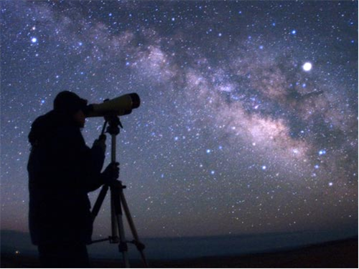
Need for antiparticle production cross sections for interpretation of cosmic-ray data
Fiorenza Donato
Torino University and INFN
NA61/Shine Beyond 2020 Workshop
University of Geneva, 27.07.2017

Slide 2
A strong motivation for studying antimatter in cosmic rays is the possible presence of a DARK MATTER signal

Slide 3
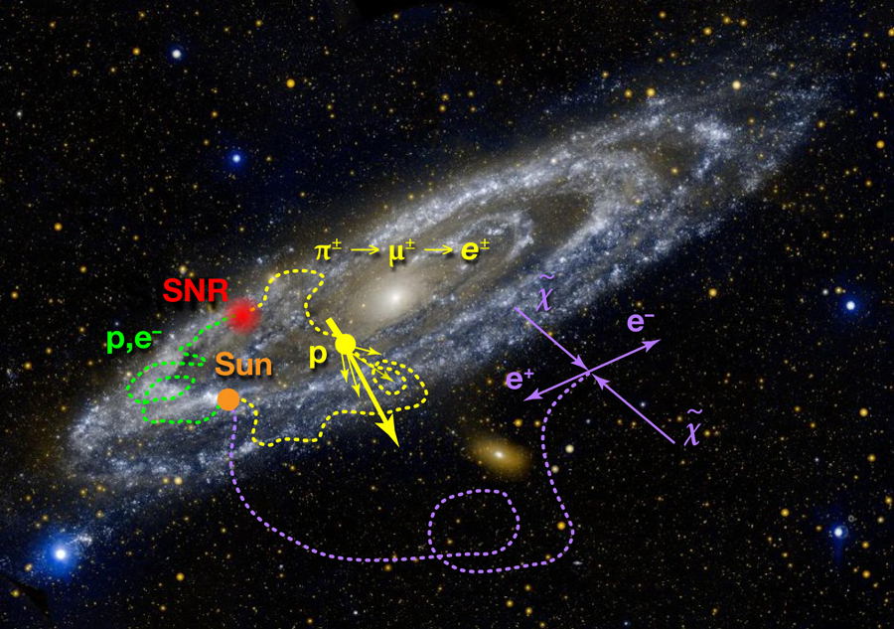
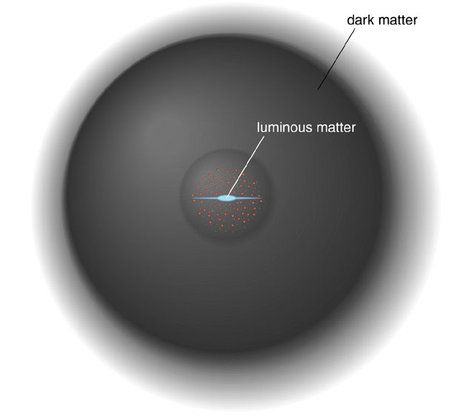
Indirect DARK MATTER searches
Dark matter can annihilate in pairs with standard model final states.
Low background expected for cosmic ANTIMATTER, and for NEUTRINOS and GAMMA RAYS coming from dense DM sites.
Tine DM signals are searched for in cosmic antimatter and photons
p
γ, ν
p⁻

Slide 4
WIMP INDIRECT SIGNALS
Annihilation inside celestial bodies (Sun, Earth):
  ν at neutrino telescopes as up-going muons
Annihilation in the galactic halo:
 γ-rays (diffuse, monochromatic line), multiwavelength
 antimatter, searched as rare components in cosmic rays (CRs)
ν and γ keep directionality
→ SOURCE DENSITY
Charged particles diffuse in the galactic halo
→ ASTROPHYSICS OF COSMIC RAYS!

Slide 5
Antimatter sources from DARK MATTER
Annihilation
Decay
DM density in the halo of the MW
m_{DM} DM mass
thermally averaged annihilation cross section in SM channel f
DM decay time
e+, e- energy spectrum generated in a single annihilation or decay event

Slide 6
Cosmic Rays (CRs) in the Galaxy
Primaries = produced in the sources:
Nuclei: H, He, CNO, Fe; e-, (e+) in SNR (& pulsars)
e⁺, p⁺, d⁺ from Dark Matter annihilation
Secondaries = NOT present in sources, produced by
spallation of primary CRs (p, He, C, O, Fe) on
the interstellar medium (ISM)
Nuclei: LiBeB, sub-Fe; e⁺, p⁺, d⁺; …
All species propagate in the Galaxy, dominated by diffusion on the magnetic fields and/or by intense energy losses (leptons)
See talk by D. Maurin

Slide 7
The solution to the diffusion equation: the role of cross sections
Γ^{kj} = n_{ISM} σ^{kj} v
Production
Γ^{kj} = n_{ISM} σ^{tot} v
Destruction

Slide 8
Production cross sections in the galactic cosmic ray modeling
H, He, C, O, Fe,… are present in the supernova remnant surroundings,
and directly accelerated into the the interstellar medium (ISM)
All the other nuclei (Li, Be, B, p-, and e+, gamma, …) are produced by spallation of heavier nuclei with the atoms (H, He) of the ISM
We need all the cross sections σ^{kj} - from Nichel down to proton -
for the production of the j-particle from the heavier k-nucleus scattering off the H and He of the ISM
Remarkable for DARK MATTER signals is productions of:
antiproton, antideuteron, positron and gamma rays.

Slide 9
The case for
antiprotons

Slide 10
Antiproton data as of 2017
AMS Coll., PRL 2016
Giesen+ 1504.04276
AMS-02 results from below GeV up to 400 GeV
Could be explained by secondary production in the Milky Way
The most relevant theoretical uncertainty is due to production CROSS SECTIONS

Slide 11
Antiproton production cross sections
FD, Korsmeier, Di Mauro PRD 2017
Source term
i, j = proton, helium
(both in the CRs and in the ISM)
pp
Reasonable agreement for 10 GeV <T <100 GeV
Deviations for T<10 GeV

Slide 12
The antiproton source term
Uncertainty in
the cross sections
reflect directly
on the source term
and then in the flux
predicted at the Earth

Slide 13

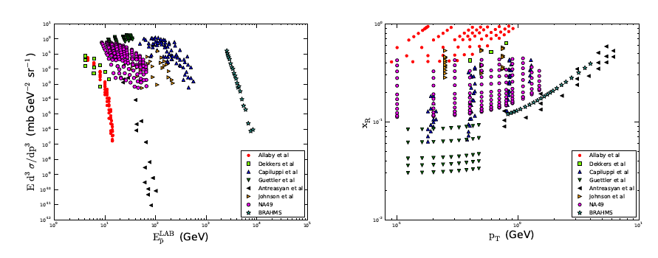

p-p→pbar cross section data
Di Mauro, FD, Goudelis, Serpico PRD 2014, 1408.0288; Kappl, Winkler 1408.0299
Existing data on p-p → pbar + X

Slide 14
What do we need?

Slide 15
Requirement on the cross section
Which level of accuracy on cross section
do we need in order
to match (not exceed) the accuracy in CR data?

Slide 16
Parameter space to be covered
Fixed target
Lab frame
AMS02 accuracy is reached if pp→pbar cross section is measured with
3% accuracy inside the regions, 30% outside.

Slide 17
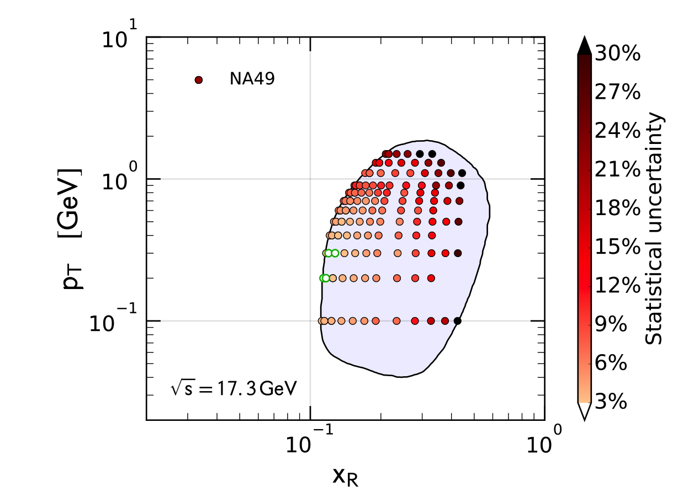
Comparison with pp data
The covered parameter
space is appropriate
The level of accuracy
is not adequate
NA61 data are
strongly welcome

Slide 18
LHCb pHe → p- cross section data
G Graziani for LHCb, Moriond 2017
First data ever has been collected by LHCb in fixed target mode
FD, Korsmeier, Di Mauro in preparation

Slide 19
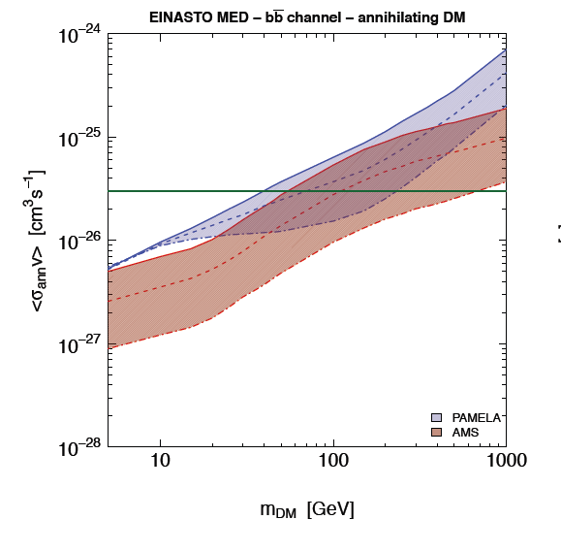
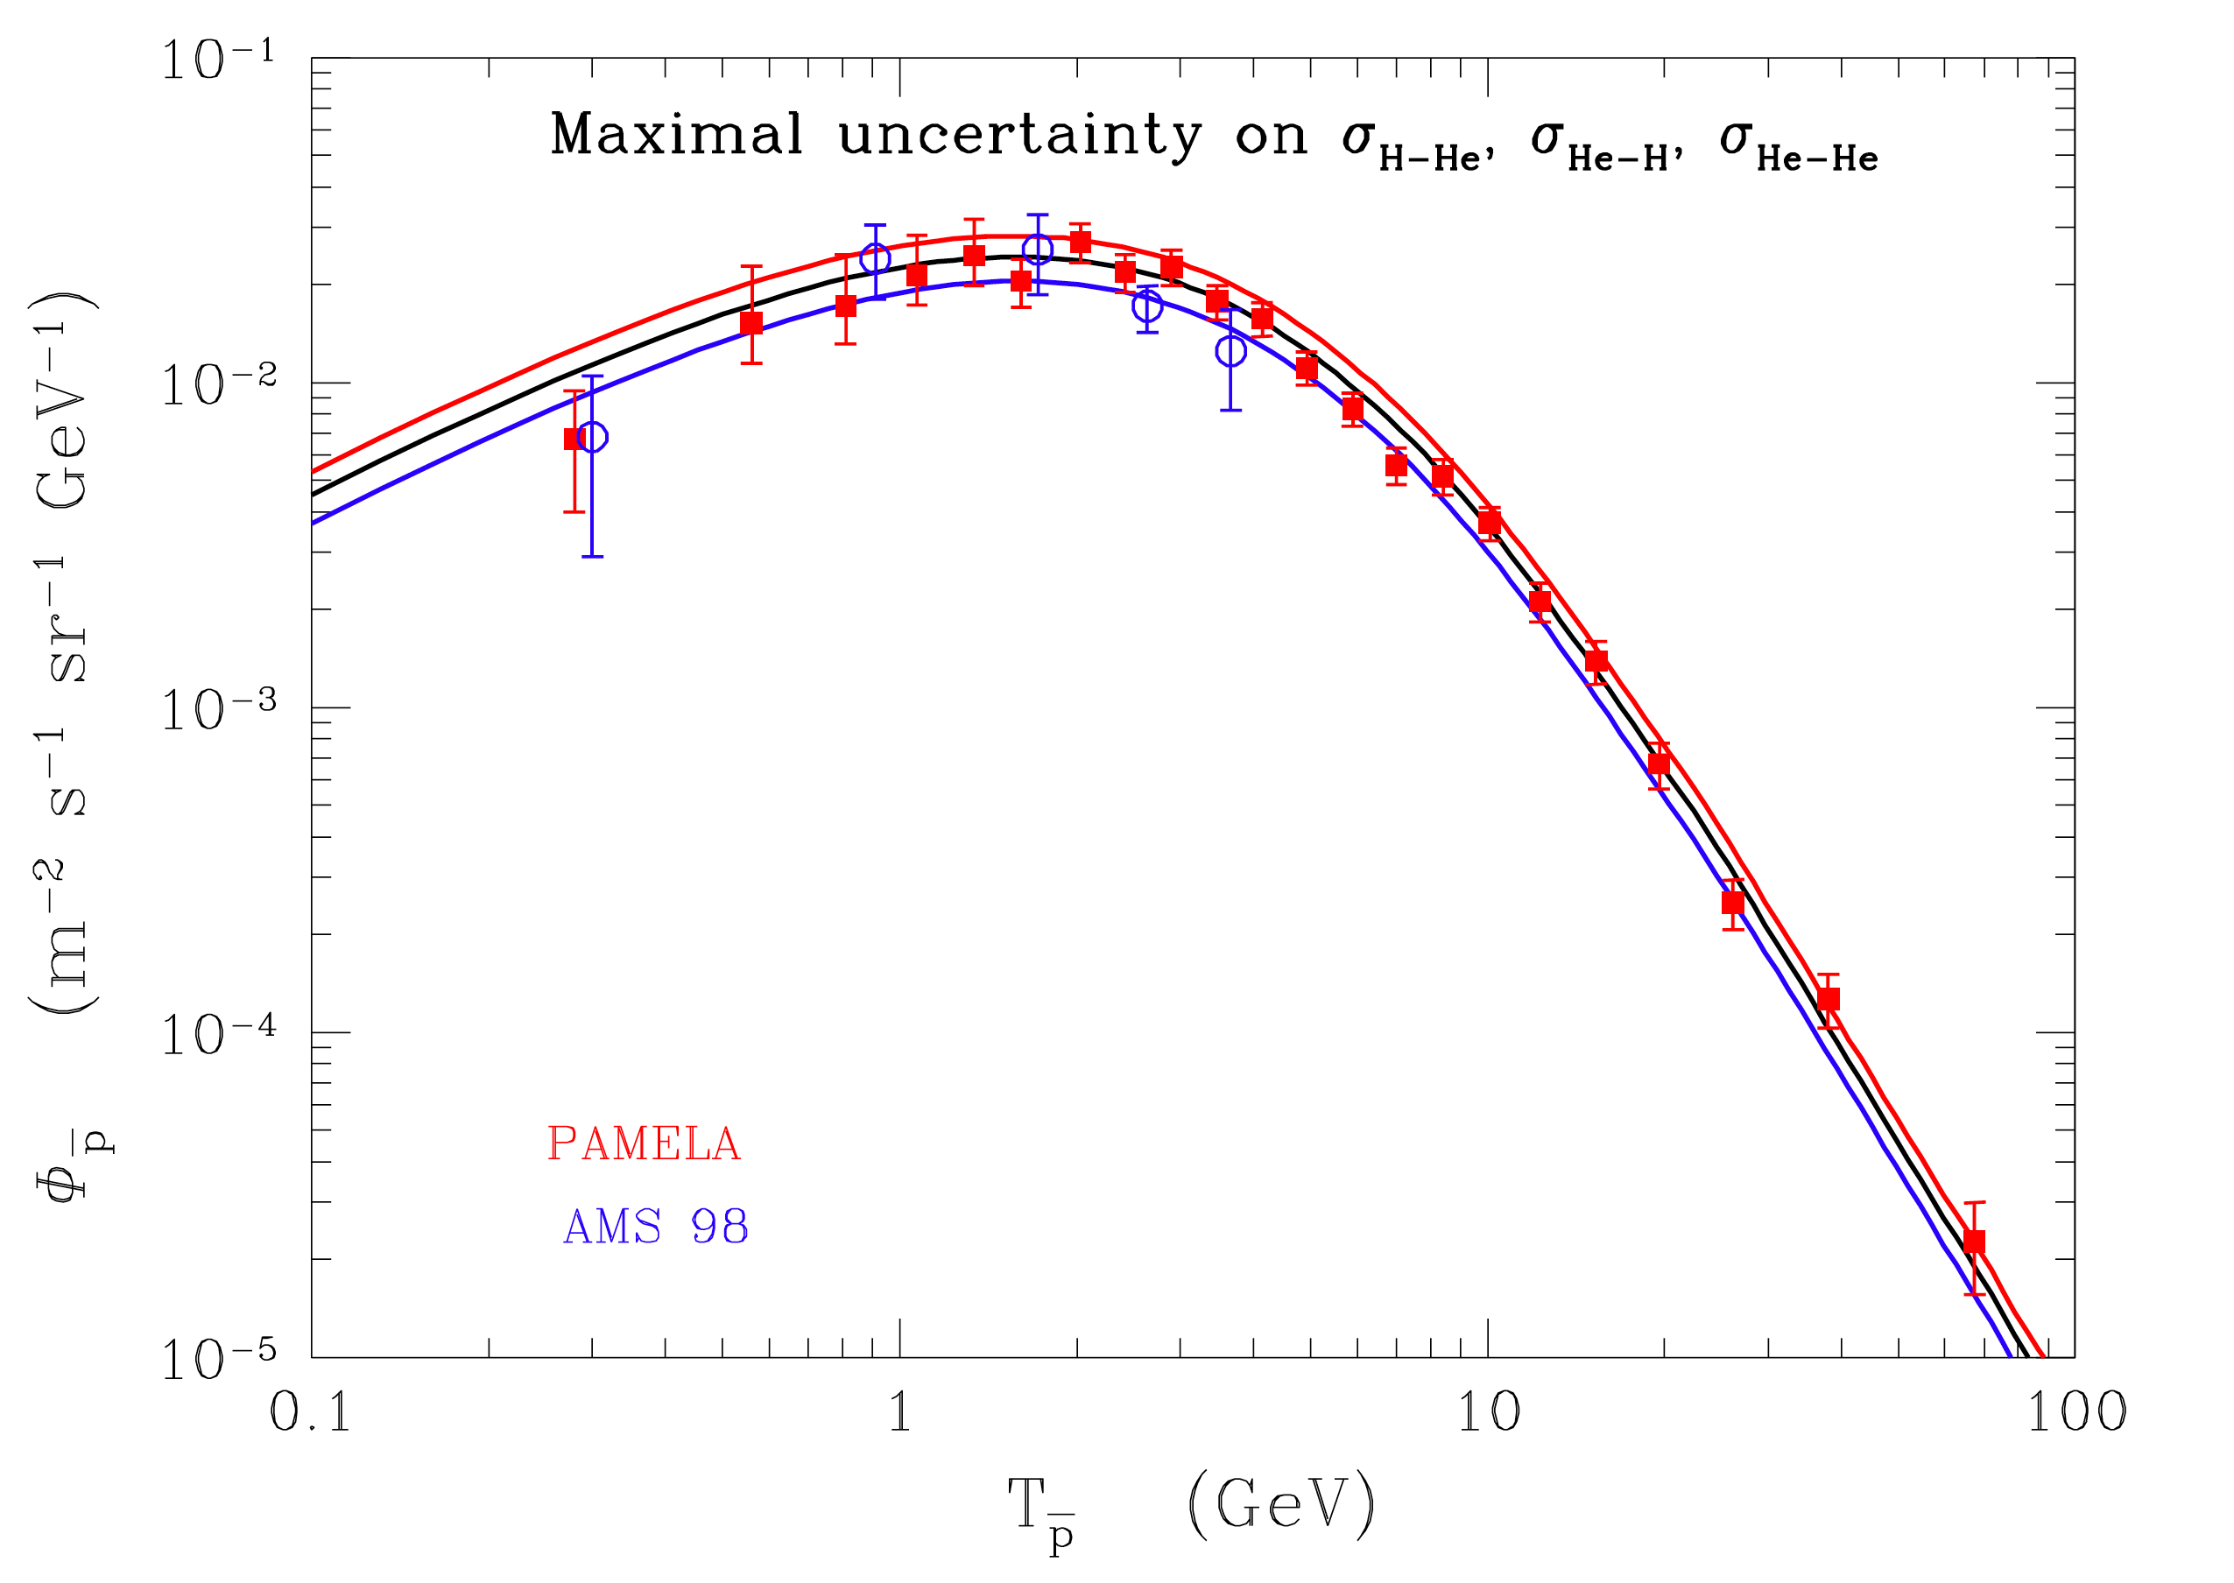
Reactions involving helium & higher energies
Uncertainties due to helium
reactions range 40-50% on
Secondary CR flux
Effect of cross section uncertainty
on DARK MATTER interpretation
Fornengo, Maccione, Vittino JCAP2014
FD+2013
AMS-02 is providing data with much
higher precision up to hundreds of GeV
Their interpretation risks to be seriously
limited by nuclear physics

Slide 20
The case for positrons

Slide 21
Sources of e⁺ and e⁻ in the Galaxy:
1. Secondary e⁺ e⁻: spallation of cosmic p and He on the ISM (H, He)
* p+H(He) → p+Δ⁺ → p+π⁰ & n+π⁺ (mainly below 3 GeV)
* p+H(He) → p+n+ π⁺
* p+H(He) → X + K±
2. Primary e- and e+ from Pulsars (PSR):
pair production in the strong PULSAR magnetoshpere
3. Primary e- from SNR: 1° type Fermi acceleration mechanism
4. Primary e⁺ e⁻ from exotic sources (DARK MATTER)
Sources of positrons in the Milky Way

Slide 22
Secondary positron production
Spallation of proton and helium nuclei on the ISM (H, He)
p+H → p+Δ⁺ → p+π⁰ & n+π⁺ (mainly below 3 GeV)
p+H → p+n+ π⁺
p+H → X + K±
Different parameterizations of p+p → e⁺ + X cross
Proton beam energy

Slide 23
The positron source term
Uncertainties on the production cross sections up to factor 2
Secondary positrons relevant
for E < 50 GeV
(upper)
(lower)
secondary
Data needed for
p+p and p+He → e⁺ + X

Slide 24
The case for antideuterons

Slide 25
COSMIC ANTIDEUTERONS
FD, Fornengo, SalFD, Fornengo, Maurin PRD 2001; 2008; Kadastik, Raidal, Strumia PLB2010; Ibarra, Wild JCAP2013;
Fornengo, Maccione, Vittino JCAP 2013; …ati PRD (2000) ADD
See talk by Nicola Tomassetti
In order for fusion to take place, the two antinucleons
must have low kinetic energy
Kinematics of spallation reactions
prevents the formation of very low antiprotons (antineutrons).
At variance, dark matter
annihilate almost at rest
N.B: Up to now, NO ANTIDEUTERON has been detected yet.
Several expreriments are on the road: AMS/ISS, BESS-Polar, GAPS …

Slide 26
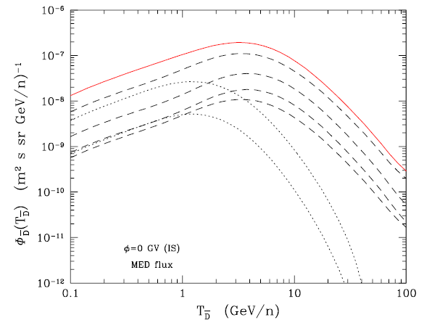
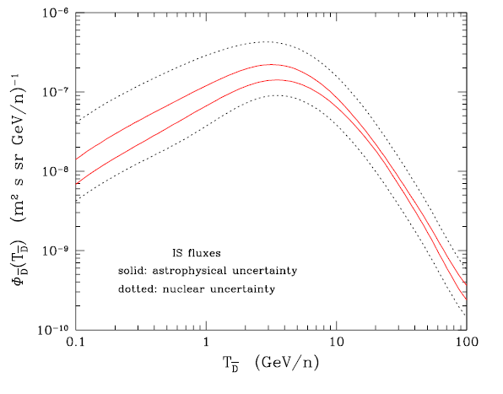
Secondary antideuterons
FD, Fornengo, Maurin PRD 2008
Contributions to secondaries
Propagation uncertainties
Compatibility with B/C
p-p, p-He,
He-H, He-He
H- pbar, He-pbar
Nuclear uncertainties
Production cross sections & P_{coal}
Production from antiprotons
Non-annihilating cross sections

Slide 27
Conclusions
ANTIMATTER (antiproton, antideuterons) in cosmic rays is a clue ingredient in order search for (or set limits) to dark matter
annihilating in the halo of the Milky Way
Propagation uncertainties are now confined to <10-20%, and are going to be further reduced by AMS-02 data
Cosmic antiproton data are expected with few% errors,
while nuclear physics may bring uncertainties ~ 50%
The lack of data on several lab cross section puts serious limits in the interpretation of forthcoming cosmic ray data.
A direct measurement of p-, γ,e⁺,D⁻ production from
p + p, and p+He → p- + X, ….
is mandatory in order to interpret unambiguously
future cosmic ray data.

Slide 28
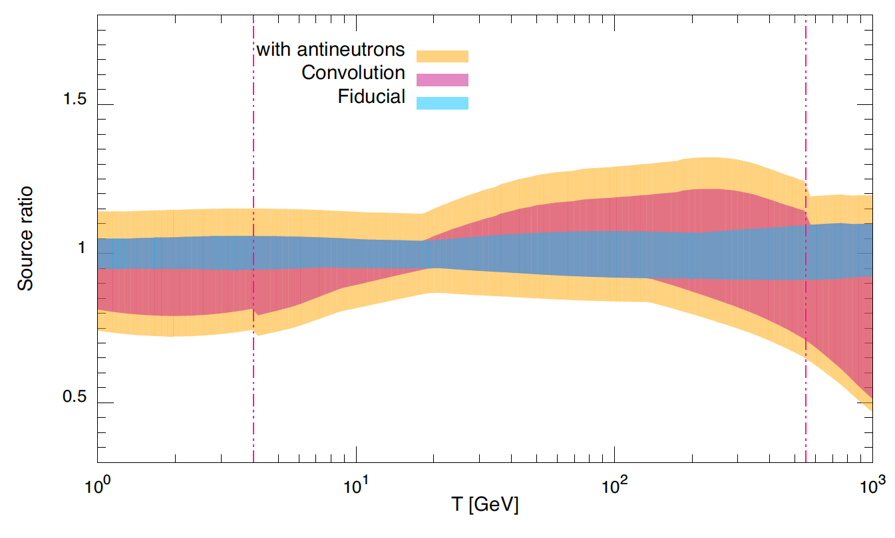
Uncertainties due p-p scattering
Di Mauro, FD, Goudelis, Serpico PRD 2014
Uncertainties in the pbar production spectrum from p-p
scattering are at least 10%.
Conservative: 20% at low energies (GeV) up to 50% (TeV) (data expected at least up to ~ 500 GeV)

Slide 29
BACKUP SLIDES

Slide 30
Antiprotons:
secondary vs Dark Matter component
Uncertainties due to propagation in the Galaxy
Bringmann & Salati, PRD 2007
Dark matter

Slide 31
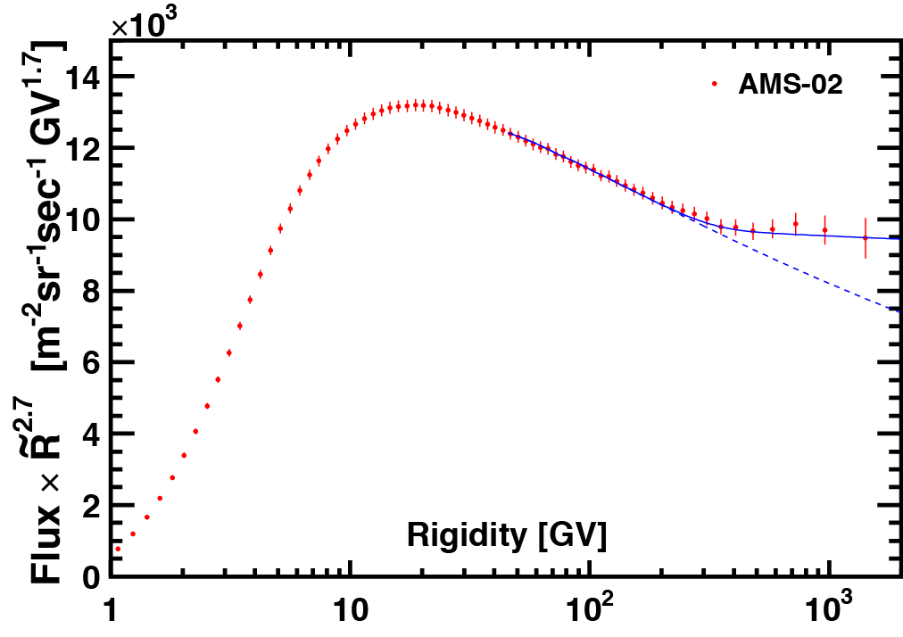
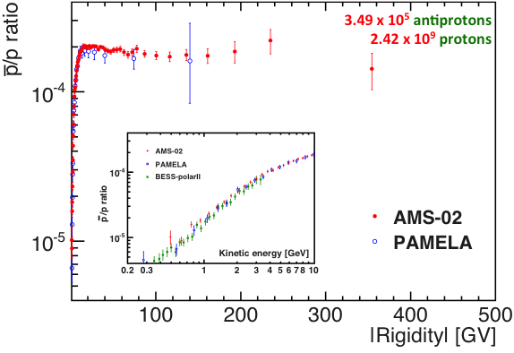
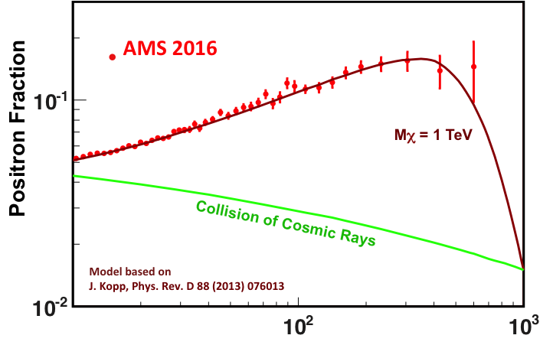
AMS on the International Space Station
Unique instrument in space:
no other magnetic spectrometer planned for next 20 years.
Simultaneous measurements of all CR components with different sub-detectors: redundant particle identification and reduced systematics uncertainties.
Courtesy of B. Bertucci
Operating since May 19, 2011 onboard the ISS :
> five years in orbit, > 90 billion events collected
- all detectors fully operational. ISS lifetime ≥ 2024
Fundamental physics:
- Indirect DM search with anti-particles:
Measurement of: e⁺, e⁻, anti-p, (anti-d) in an unexplored energy range and O(%) accuracy
- Baryogenesis & search for nuclear anti-matter: anti-He, anti-nuclei (Z>2)
Energy and precision
Energy range from GeV to TeV
Max energy for
primary nuclei (P, He, C, O)
Unlimited by statistics.
For p-, e+ and second. nuclei
Stat. limits at O(100) GeV
(20-30% at higher energies)
Low energy systematics is 2-3%
AMS 2016
up to 450 GeV

Slide 32
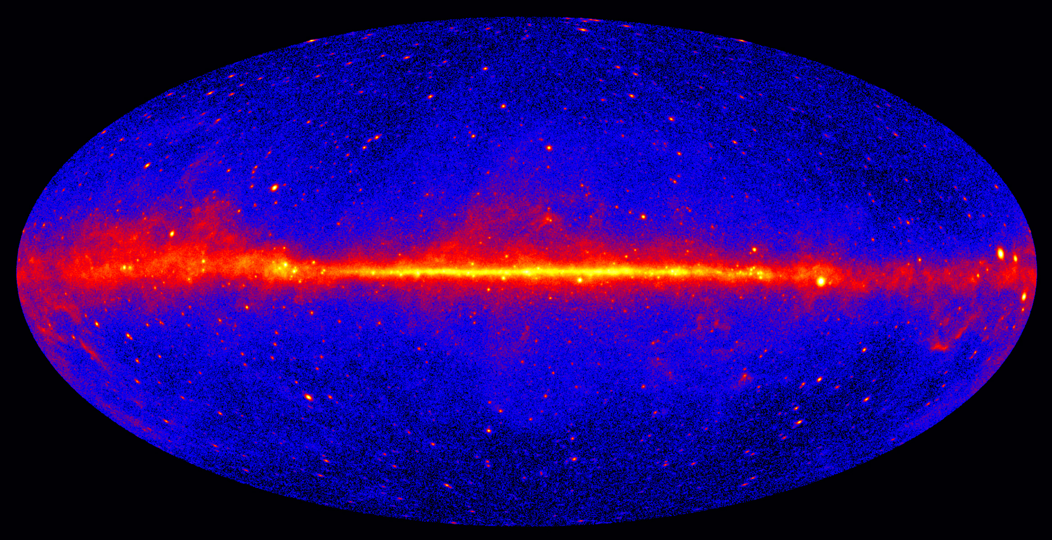
The Fermi-LAT has brough unprecedented progress in the γ-ray band
Photons from ~0.5 GeV up to 2 TeV (2000 at > 500 GeV!)
Galactic and extragalactic sources, close external galaxies, diffuse emission at all latitudes, transients, dark matter studies, electrons, …. and trigger in other wavelengths
Systematics in the Gal. Center excess and in most of
Fermi-LAT data are heavily due the
GALACTIC DIFFUSE EMISSION MODELING
It accounts for:
- the π⁰ decay (Models for protons and helium at the GC, gas distribution, cross sections for p and He off the gas)
- Inverse Compton (electrons off Interstellar Radiation Field – CMB, IR, optic)
- Bremsstrahalung (Models for electrons at the GC, gas distribution)

Slide 33
