Slide 1




Ideas on new NA61/SHINE Vertex Detector Design
Grigory Feofilov, Saint-Petersburg State University
Beyond 2020 -VD NA61 meeting, Geneve University, 26-28 of July 2017
https://indico.cern.ch/event/629968/
.

Slide 2
LAYOUT
Motivations for the new Vertex Detector (VD)
Challenges to be met and general approach
The baseline proposal of VD
Additional options of VD
Prototyping and the first tests
Summary

Slide 3
Vertex Detector for NA61

Slide 4
1) Open charm [1,2]
[1] T. Matsui and H. Satz, Phys. Lett. B 178 (1986) 416.
[2] Helmut Satz, Calibrating the In-Medium Behavior of Quarkonia, arXiv: 1303.3493, 12 April 2013
2) The enhanced relative yield of strange and multi-strange particles in AA collisions with respect to pp and pA interactions
Motivations for the new VD:
[1] J.W. Harris, B. Müller, Annu. Rev. Nucl. Part. Sci., 46 (1996), p. 71
[2] J. Rafelski, B. Müller, Phys. Rev. Lett., 48 (1982) 1066; 56 (1986) 2334.
[3] J. Rafelski, Phys. Lett. B, 262 (1991), p. 333
3) Correlations of cumulative particles with strangeness and charm production
[1] M.A. Braun, V.V. Vechernin, Theor.Math.Phys. 139, 766 (2004)
[2] see strangeness production in : E.G. Ferreiro, C. Pajares, J.Phys.G23:1961-1968, (1997)
4) Precise measurements of production of charged pions and kaons out of a replica of the T2K target→ See reports by Matej Pavin and Alain Blondel at this workshop
[1] http://cerncourier.com/cws/article/cern/47836
5) Electromagnetic effects in AA collisions → See report by Nikolaos Davis at this workshop
.

Slide 5
Motivation-6
Availability of new detector technologies
.

Slide 6
  Design goals to be met:
Coverage in transverse momentum to be as complete as possible, in particular down to very low momenta.
2. Very accurate identification of secondary vertices from decaying charm or beauty (D, J/psi, c, b ).
CERN-LHCC-2012-013 (LHCC-P-005)

Slide 7
PIXEL Chip – General Requirements
L.Musa, ITS_Upgrade_Overview-May-2016
Notes:
(*) Colour code: ALPIDE specifica:ons if different from requirements
(**) 10 x radia:on load integrated over approved programme (~ 6 years of opera:on)

Slide 8
CMOS Pixel Sensor
J. Phys. G: Nucl. Part. Phys. 41 (2014) 087002
CMOS Pixel Sensor using TowerJazz 0.18μm CMOS Imaging Process
Schematic cross section of a MAPS pixel in the TowerJazz 0.18 μm imaging CMOS with the deep p-well feature.
High-resistivity (> 1kΩ cm) p-type epitaxial layer (25μm) on p-type substrate
Small n-well diode (2 μm diameter), ~100 <mes smaller than pixel => low capacitance
Application of (moderate) reverse bias voltage to substrate (contact from the top) can be used to increase depletion zone around NWELL collection diode
Deep PWELL shields NWELL of PMOS transistors to allow for full CMOS circuitry within active area

Slide 9
pALPIDE chips -1,2,3

Slide 10
Tests of ALICE pALPIDE chips
Characterization of MAPS: Electrical tests (digital and analogue), noise, thresholds, fake hit rates vs. staring material, temperature, supply voltage, radiation, tests with γ- and β- sources, etc.

Slide 11

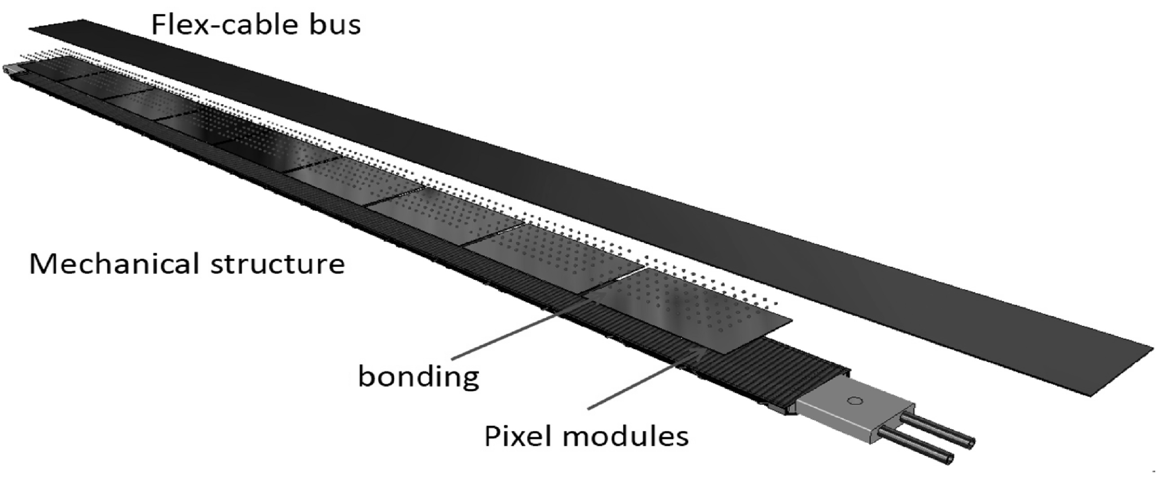
ALICE technology for ITS: record level of radiation transparency <0.3% X/Xo
ALPIDE chip
JINST 9 P06005(2014)

Slide 12
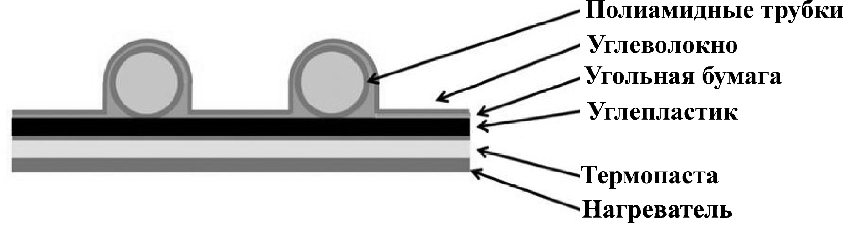
Material budget of CF stave for VD NA61
-- polyimide cooling pipe (D=1mm)
-- carbon fleece (20 μm)
-- graphite foil (30μm)
-- carbon fiber plate K13D2U (70 μm)
--- thermal greese
--- Si-sensor (50μm)
Estimated contributions to the material budget
Material | Thickness (μm) | Xo (cm) | X/Xo (%)
Polyimide cooling pipe wall | 25 μm | 28.41 | 0.003
Carbon fleece | 40 μm | 106.8 | 0.004
Water | 1mm | 35.76 | 0.032
Carbon fiber plate K13D2U | 70 μm | 26.08 | 0.027
Graphite foil | 30μm | 26.56 | 0.011
Thermal greese (glue) | 100μm | 44.37 | 0.023
Si-sensor | 50μm | 9.36 | 0.064
Total (without FPC) |  |  | 0.154
Total with FPC |  |  | <0.3

Slide 13
ALICE technology for MFT: disks with ~ 0.6 X/Xo
(reported today by Raphael Tieulent)
JINST 9 P06005(2014)

Slide 14
Challenges
for open charm at SPS

Slide 15
First feasibility studies for open charm measurements with NA61/SHINE
→ see the next report by Szymon Mateuzh Pulawski at this workshop
NA61/SHINE simulations
Yasir Ali and Pawel Staszel for the NA61/SHINE collaboration, in Proceedings of 14th International Conference on Strangeness in Quark Matter (SQM2013), Journal of Physics: Conference Series 509 012083(2014).
Yasir Ali, Pawel Staszel, EPJ Web of Conferences, 71, 00004 (2014).
Yasir Ali, Pawel Staszel, Acta Physica Polonica B Proceedings Supplement 6, No 4,1081 (2013)
Yasir Ali†, Paweł Staszel, Antoni Marcinek Janusz Brzychczyk, Roman Płaneta, Acta Phys. Pol. B44, 2019(2013).
Based on models:
AMPT (A Multi-Phase Transport model): Phys.Rev.C72:064901.2005
HSD(Hadron String Dynamics model) Int.J.Mod.Phys.E17 1367
PYTHIA: Comput.Phys.Commun.135,238(2001)
-> Challenges ->

Slide 16
Challenges for open charm measurements
Reconstruction from hadronic decay channels
Challenge-1: Short life-time

Slide 17
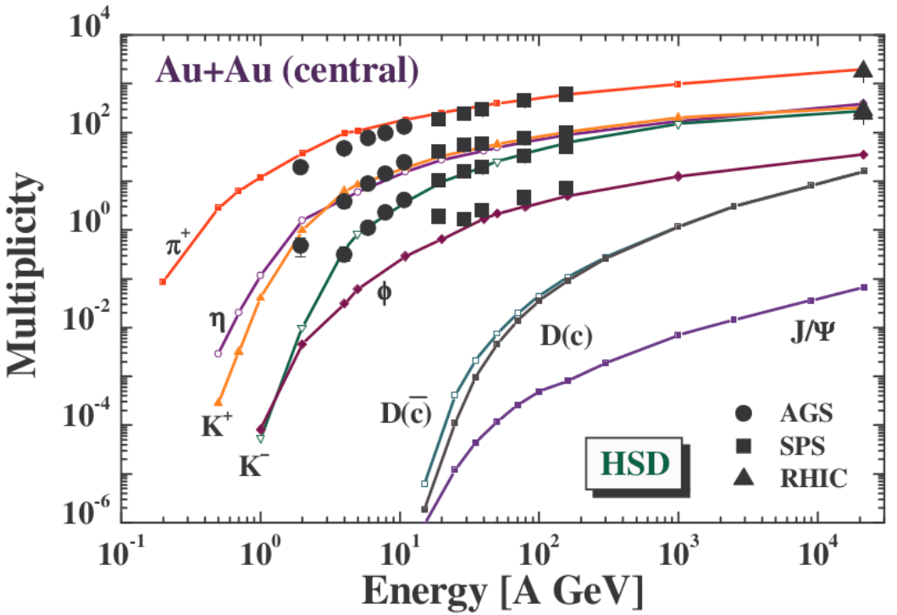
Challenge-2: Low yields
Acta Phys. Pol. B44, (2013) 2019
Notes:
Fig.2. Overview of the experimental meson multiplicities observed in central Au+Au collisions as a function of the collision energy from SIS to RHIC ener- gies [10]. The lines show the Hadron String Dynamics (HSD) model predictions.

Slide 18
General requirements:
Precise vertexing (at the level of better ~20 -30μm for particles with pT> 1 GeV/c)
Fast detectors (< 30 μs) with high granularity
The low material budget (<0.3% X\Xo)
4) Large acceptance is desirable to accept 100% of the D0s produced and to match the VTPC-1 of NA61/SHINE
VD should be considered with the account of various targets (including the Long Target replica for T2K) to be used
in future physics programme of NA61/SHINE
→ NA61/SHINE Vertex Detector project is based on CMOS pixel detectors

Slide 19
Baseline proposal:
Large Acceptance VD -- 6 detector planes
Layout is still to be optimized
by simulation
PRIORITIES:
the highest granularity
the lowest material budget
of the innermost layers
TPC-VD track matching
high-precision (~ 10 μ potential
capabilities)
determination of secondary vertices
for open charm
secondary vertices determination
for strange and multi-strange
particles
NA61/SHINE Vertex Detector
is based on CMOS pixel detectors
.

Slide 20
^{(Anastasiya Merzlaya,} ^{08.05.2017)}

Slide 21

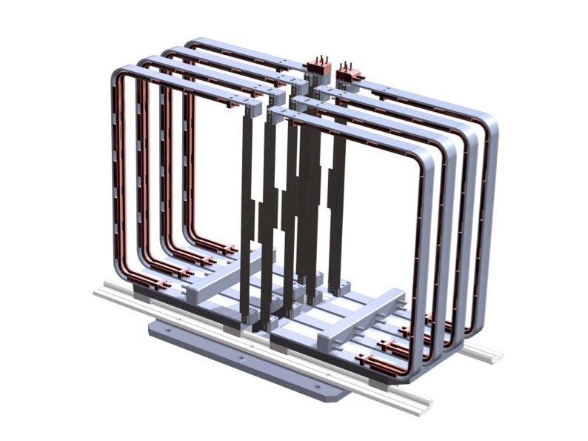
Small Acceptance VD layout
Mimosa-26 sensors mounted
on extra-lighweight CF cooling panels
VD housing box filled with He
C-shape support frames
Notes:
Small Acceptance Vertex Detector (SAVD) is built from only 16 sensors with a total surface of ∼ 32 cm2.
. Despite its small surface, it is expected to detect about 4% of all D0 → K + π decays at the top SPS energy,
due to the strong forward boost of the particles at this energy.

Slide 22
Small Acceptance VD at the pilot run at the SPS in 2016
.

Slide 23
July 2016: the 1st in-beam tests of VD telescopes…
Accumulated cluster
map of one sensor
(July 2016)
Correlation between hits
in sensor columns of stations 3 and 4

Slide 24
^{Primary vertex resolution}
for HighThreshold (HThrs) December 2016 runs
^{From} ^{the} ^{slides on the VD data analysis} by Dag Larse and Anastasiya Merzlaya 11.05.2017

Slide 25
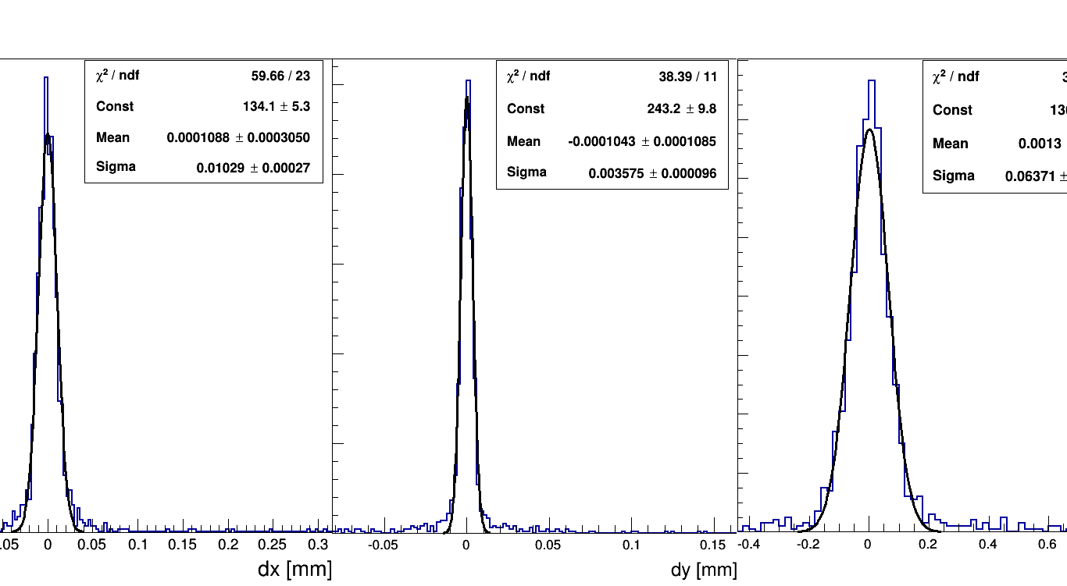
Primary vertex resolution December pilot run
^{From} ^{the} ^{slides on the VD data analysis} ^{by Pawel Staszel}
σ_{x} `10μ σ_{y} ~ 3 μ σ _{z} ~ 63μ
Work for D0s is in progerss!

Slide 26
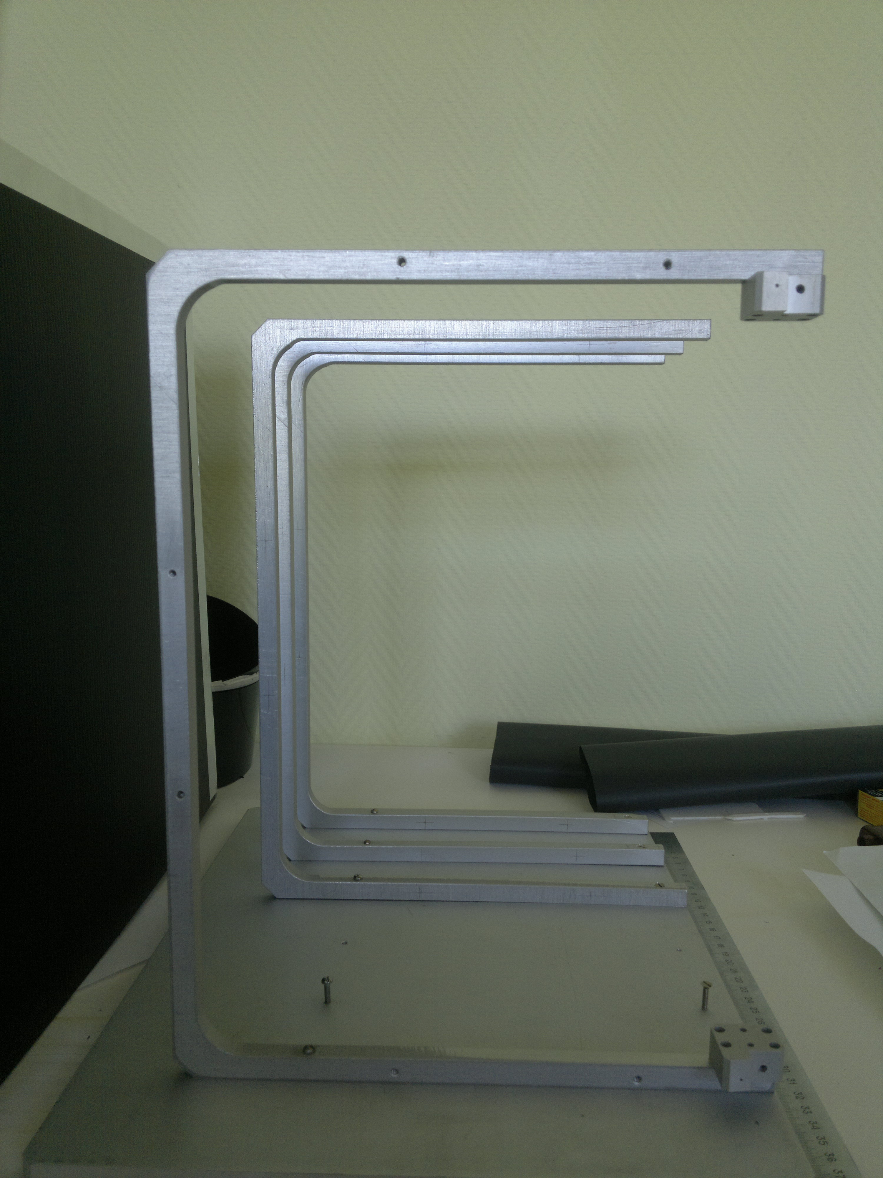
Prototyping for Large Acceptance VD
C-shape frames mounted
on the Al-platform
.

Slide 27
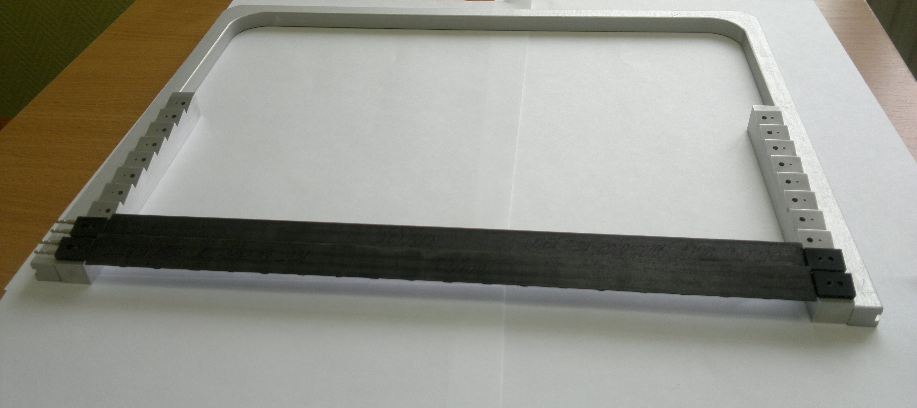
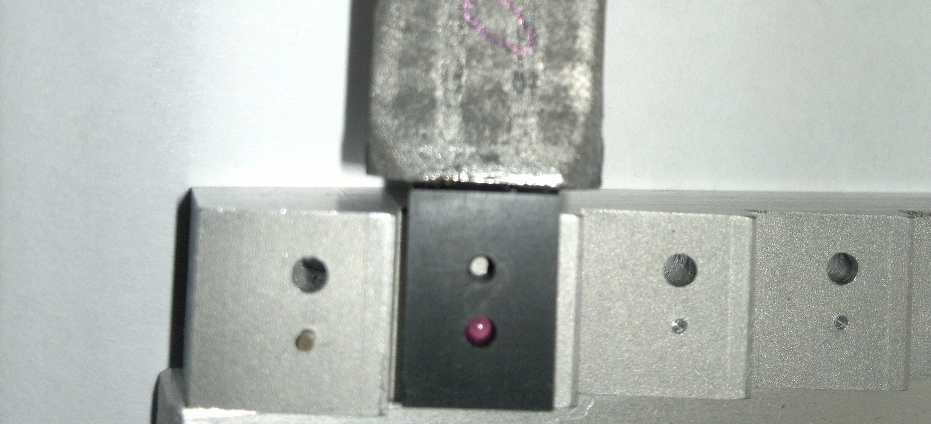
New “Saw” type elements on the C-frame and precise positioning (~10 μ) with ruby balls and fixation
ruby ball
PRECISE POSITIONING of the VD staves with ruby balls
Drilled ball 2mm Ruby Reninshaw
^{2mm G10 DIN 5401}
^{www.saphirwerk.com}

Slide 28
PRECISE POSITIONING on C-SHAPE FRAMES for NA61 VD
“PICK-UP” and “RETURN”
From : CERN / LHCC 99–12 ALICE TDR 4, 18 June 1999
ALICE Technical Design Report of the Inner Tracking System (ITS)

Slide 29
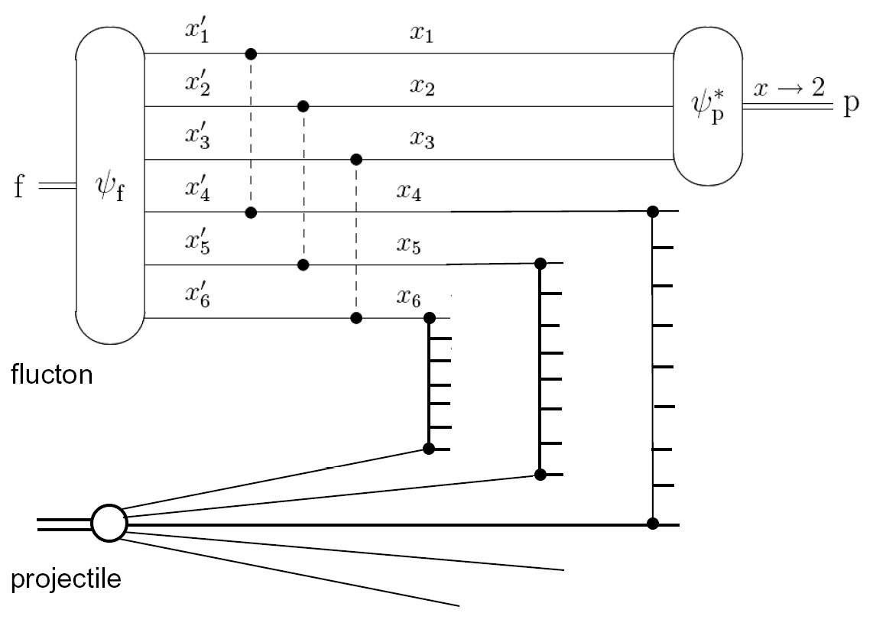
    Future studies of correlations of cumulative particles with strangeness and charm production
Multi-quark configuration in nucleus
(fluctons)
and formation of cumulative proton
and
of the donor strings
(all donors interact with the projectile, strong overlapping strings and string fusion mechanism)
[1] M.A. Braun, V.V. Vechernin, Phys.Atom.Nucl. 60, 432 (1997)
[2] [1] M.A. Braun, V.V. Vechernin, Theor.Math.Phys. 139, 766 (2004)
[3] see strangeness production in : E.G. Ferreiro, C. Pajares, J.Phys.G23:1961-1968, (1997)

Slide 30
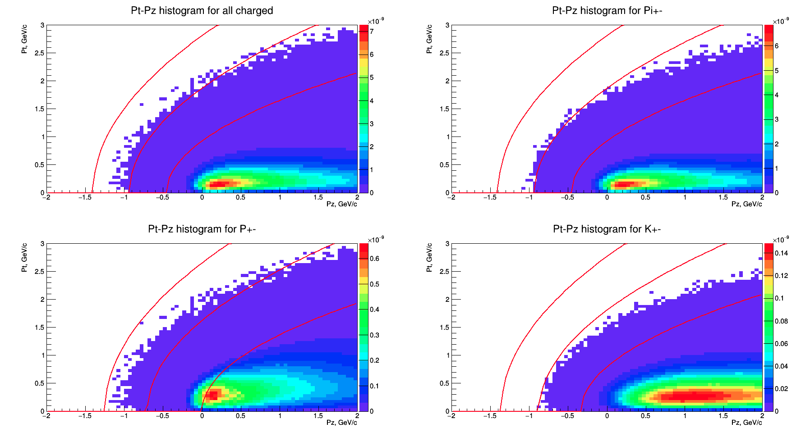



UrQMD simulation of cumulative particles and D mesons in p+C collisions
p-C at plab=400 GeV/c UrQMD default
$x=3$
$x=2$
$x=1$
G.Feofilov, V.Kovalenko, V.Vechernin, Future studies of correlations between cumulative particles and heavy flavor production in relativistic nucleus-nucleus collisions, Reported by Grigory Feofilov, QFTHEP-2017, Yaroslavl, 28 June 2017

Slide 31
Concept of new detector for studies of multiquark configurations in nuclei related to strange and multistrange particles, charm and correlations with cumulative particles formation
Target
beam

Slide 32
Summary-1:
The ITS/ALICE technology for the NA61/SHINE VD : the record level of radiation transparency <0.3% X/Xo for the innermost layers can be achieved to ensure ~10-20 μ accuracy in secondary vertices determination
The ITS/ALICE technology provides the possibility of easy replacement of detector staves and keeping ~10 μ positioning accuracy
Flexibility to add layers of detectors
Prototyping in the ALICE/ITS technology of the mechanical layout of the LAVD is ongoing. The goal – to provide in October 2017 the setup for application of several ALICE Hybrid Integrated Circuits (HICs) to be used in the NA61/SHINE at the SPS beam tests.

Slide 33
Summary-2:
5) The VD project is well on track.
6) Small Acceptance VD is ready and data analysis of the 1st beam tests are ongoing.
7) Development of Large Acceptance VD is being continued in 2017
--- To be ready after LongShutdown-2 in 2020
8) Open charm measurements by NA61/SHINE, as well as studies of strange and multistrange particles production in A+A collisions at top SPS energy, are possible after construction of the Large Acceptance Vertex Detector
9) Precise measurements of production of charged pions and kaons out of a replica of the T2K target are being discussed by the collaboration.
NA61

Slide 34
National Nuclear Research Center, Azerbaijan
Faculty of Physics, University of Sofia, Bulgaria
Ruder Boskovic Institute, Croatia
LPNHE, University of Paris VI and VII, France
Karlsruhe Institute of Technology, Germany
Fachhochschule Frankfurt, Germany
Institut für Kernphysik, Goethe-Universität, Germany
Nuclear and Particle Physics Division, University of Athens, Greece
Wigner RCP, Hungary
Institute for Particle and Nuclear Studies (KEK), Japan
University of Bergen, Norway
Institute of Physics, Jan Kochanowski University, Poland
National Center for Nuclear Research, Poland
Institute of Physics, Jagiellonian University, Poland
Institute of Physics, University of Silesia, Poland
Faculty of Physics, University of Warsaw, Poland
Department of Physics and Astronomy, University of Wroclaw, Poland
Faculty of Physics, Warsaw University of Technology, Poland
Institute for Nuclear Research, Russia
Joint Institute for Nuclear Research, Russia
St. Petersburg State University, Russia
National Research Nuclear University MEPhI (Moscow Engineering Physics Institute), Russia
University of Belgrade, Serbia
ETH Zürich, Switzerland
University of Bern, Switzerland
University of Geneva, Switzerland
University of Colorado Boulder, USA
Los Alamos National Laboratory, USA
Department of Physics and Astronomy, University of Pittsburgh, USA
Fermilab, Neutrino Division, USA

Slide 35
Back-up slides

Slide 36
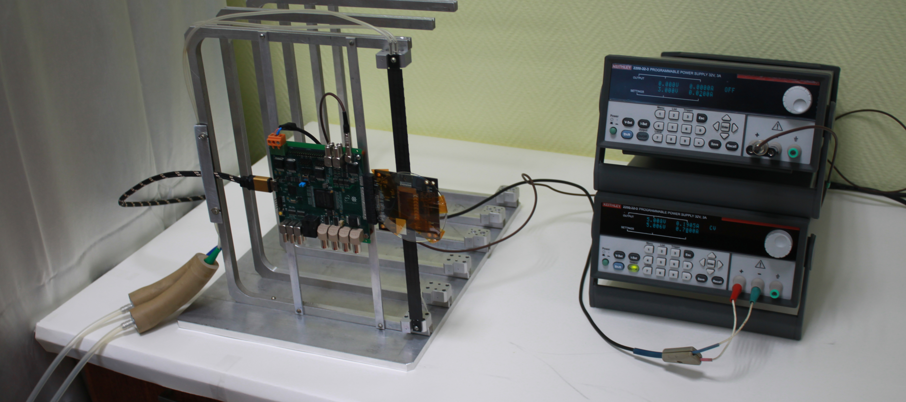
Prototyping of the LAVD:
ALPIDE chip with electronics mounted on the first C-shape frame (job in progress) the 1st station (with one chip)

Slide 37
Benefits of the baseline VD design:
Record level of radiation transparency ( <0.3% X/Xo) of pixel detector layers could be achieved in the ALICE/ITS technology to provide the accuracy of D0’s vertex determination at the level
of ~ 10μ for tracks with pT>1 Gev/c
Proved technology
ALICE ITS IB staves complete compatibility
Flexibility in station configurations and possibility of stave replacement without loss of precise positioning of staves (~10μ)

Slide 38
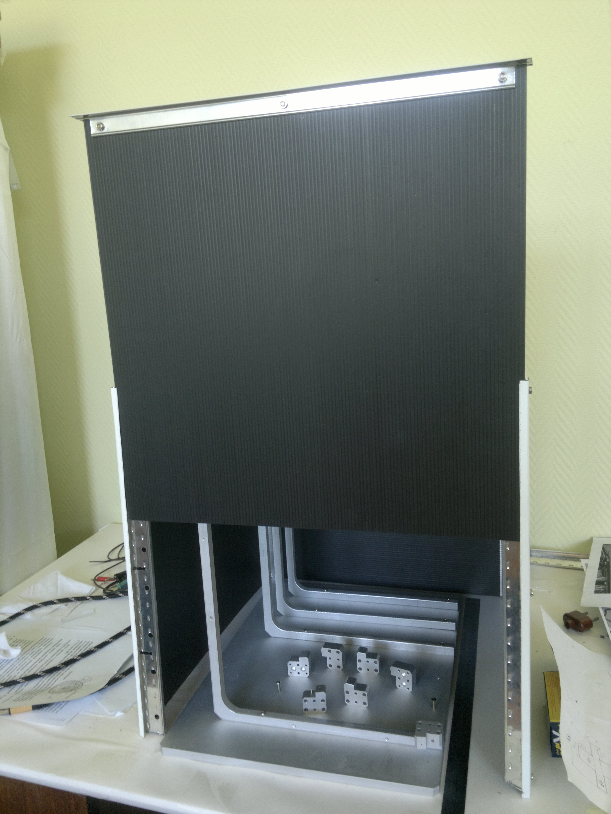

Slide 39

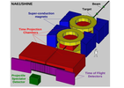
Some examples of St.Petersburg University technologies for NA61(SHINE)
Goal: Search for the critical point of strongly interacting matter
Left: Extra-thin double-wall
He beam pipe installed in 2012
in the gas volume between two
field cages in the VTPC-1
of NA61(SHINE).
This He beam pipe reduces
the background interactions
in the VTPCs by about a factor of 10.

Slide 40
He beam pipe for NA61
General design and peculiarities:
2 concentric tubes (pipes) with very thin walls (tedlar, 30 mkm)
He is in the central pipe, the protective gap between the 1st and the 2nd pipes is filled with CO2 or N2 Pressure of He –slighly above normal – to keep stability, Pressure of CO2 in the 2nd circuit is slighly above normal but a bit lower pressure of He
P_{Ar}<P_{CO2 (or N2)}<P_{He}

Slide 41
Motivation-4 precise measurements of production of charged pions and kaons out of a replica of the T2K target
(from Alain slides)
The NA61/SHINE experiment at CERN measures the production of charged pions and kaons out of a a replica of the T2K target (a 90-centimetre graphite cylinder) to allow for precise calculations of the initial neutrino fluxes and beam composition at J-PARC [1].
Precise determination of charged particle tracks coming from the Long Target(LT) migh require
----either a new Vertex Detector Layout or
----the LT inside the VTPC-1
[1] http://cerncourier.com/cws/article/cern/47836

Slide 42
neutrino
(from Alain slides)
slide from Alain’ talk 2015
[1]
[2]

Slide 43
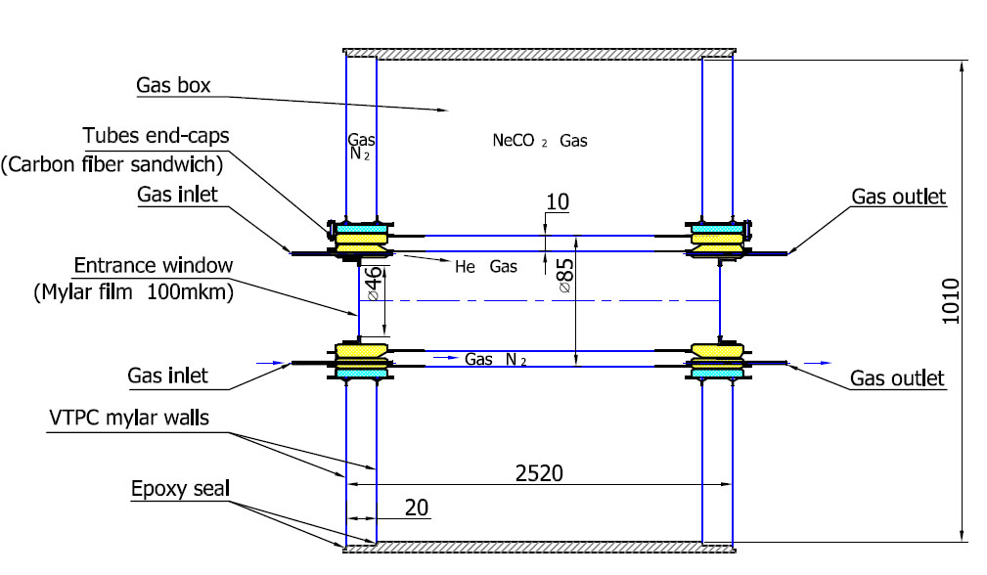
Thin walls (60 mkm) double layers He beam pipe for NA61 inside the VTPCs-1&2
The feasibility of this option-2 for LT inside the VTPC
is being discussed: It is NOT so simple just to open/close the beam-pipe for the LongTarget implementation – but it is possible

Slide 44
Additional options of tracking detector relevant to the precise measurements with T2K replica target

Slide 45
Position of Replica of the T2K target ?
slide from Alain Blondel talk 2015
.

Slide 46
Position of Replica of the T2K target ?
Options are being discussed:
Option-1: tracking to the target by using the MFT disks around the LT, situated in front of the VTPC1
Option-2: to move the LT is inside the VTPC1
Both options will provide tracking in wider angular acceptance coverage of tracks from the LT (including the backward region)

Slide 47
Vertexing for T2K LongTarget (LT) replica ?
Conceptual Option-1
(is still to be checked by simulations)
MFT disks around the LT disk-1: Rin=25mm, Rout=170mm
Extra-thin double-wall
He beam-pipe
LongTarget (90 cm)
beam
VTPC-1

Slide 48
Vertexing for T2K LongTarget (LT) replica ? Option-2:
(is still to be checked by simulations) the LT inside the VTPC-1
○
○
○
○
beam
VTPC-1
The feasibility of this option
is being discussed
It is NOT so simple just to open/close the beam-pipe for the LongTarget implementation – but it is possible

