Slide 1
ALICE PC Cooling
System Sensor
Giulia Fanti
Marco Boccioli
André Augustinus

Slide 2
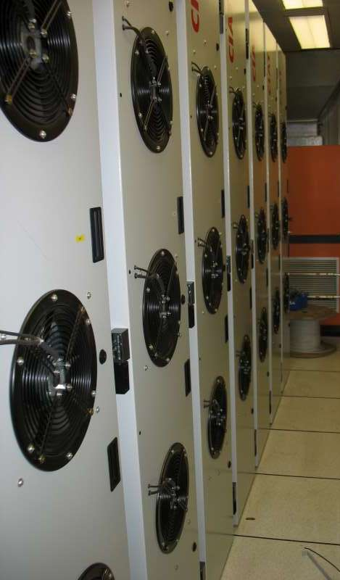
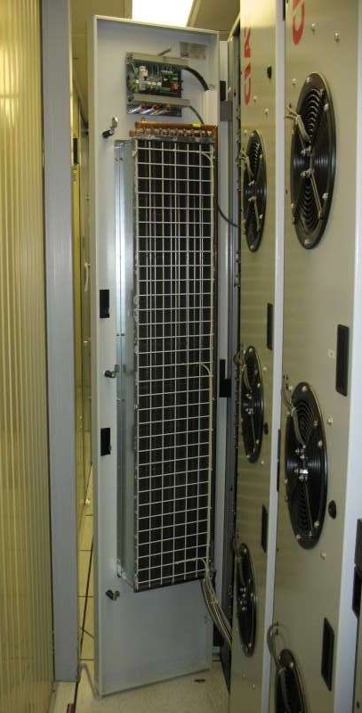
ALICE PC Cooling System
Horizontal cooling
Water to air heat exchanger
System mounted on door
3 fans per door
100 racks

Slide 3
Objective
Sense whether cooling system is functional
  Door closed
  Fans operational
Provide clear UI to allow user to monitor situation
Secondary method to sense cooling
  Temperature sensors already in place
  Allow action before temperature rises too much

Slide 4
Implementation
I/O System: WAGO
  Siemens PLC more expensive
  Non-critical system
  Moderately large-scale execution
3-part hardware system
  PFC (or fieldbus coupler)
  I/O Modules
  End module
PVSS (SCADA)
  Interface between PFC and user

Slide 5
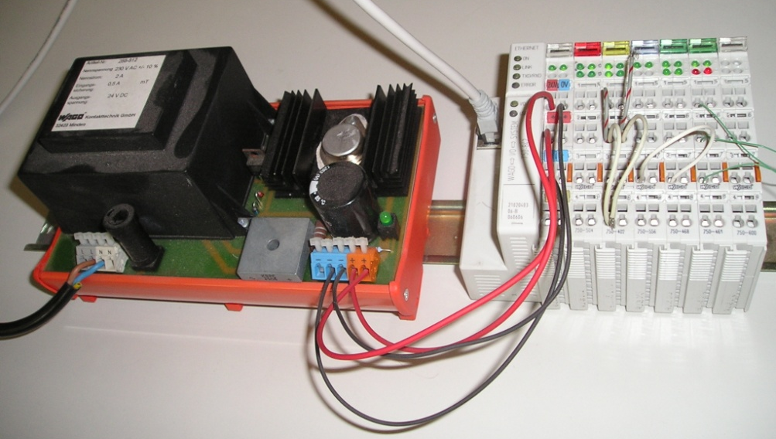
Current State
Small-scale proof of concept
Use available PFC

Slide 6
Next Steps
Decide what is important
  How many sensors are necessary?
  How much information do we want?
Extend to larger scale
  Mass parameterization in PVSS
  Obtain materials

