Slide 1
Understanding LHC Splice Resistances and Quench Protection
Alex Tuna
2 July 2009
Advisor: Mike Koratzinos, TE-MPE
(with Howie Pfeffer and Bob Flora)

Slide 2
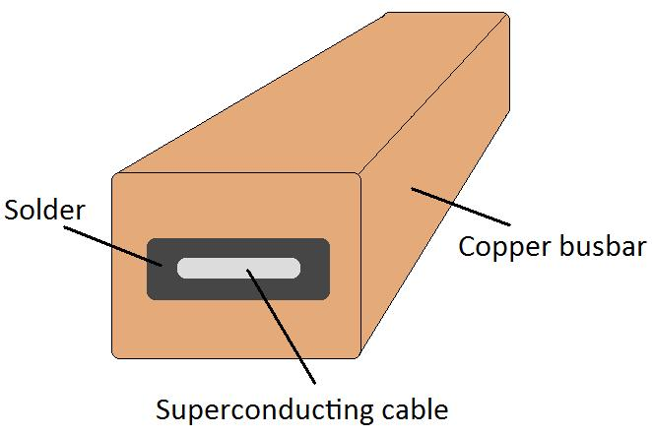
Project Description
Problem: Copper bus splice resistances may be higher than expected. A quench could result in catastrophe. See: September 19
Solution: Investigate said
resistances as quickly and
thoroughly as possible.
Fix if necessary.

Slide 3
Project Description
Measurement methods
How can a summer student help?
80K vs 300K
Quench simulation

Slide 4
Quench simulation

Slide 5
80K vs 300K

Slide 6


Rofl Heuer
Issue No. 26-27/2009
“We’re warming up this sector because we have developed a new non-invasive technique for investigating the splices.”
“A tremendous amount of work has been done to understand fully the splices in the LHC’s superconducting cable and copper stabilizers. One of these splices was the root cause of the incident last September that brought the LHC to a standstill.”
“4 TeV should require no further repairs…whereas 5 TeV could call for more work. The measurements…will allow us to make that decision, determining the initial operating energy of the LHC in the range 4-5 TeV, and the start date for the first run.”

Slide 7
First Two Weeks
Plotting with Microsoft Excel
  Data analysis GUI
  Commonly used among TE-MPE
  Good for plotting points
Familiarizing myself with superconductor magnets
Learning to use Timber
  LHC data retrieval GUI

Slide 8
Direction of project
Identify study(ies) I could best serve
  Advisor returns from holiday this weekend
Begin analysis
  Temperature correction?

