Slide 1

ATLAS Muon Spectrometer Calibrations
Jason Hindes
Dan Levin

Slide 2
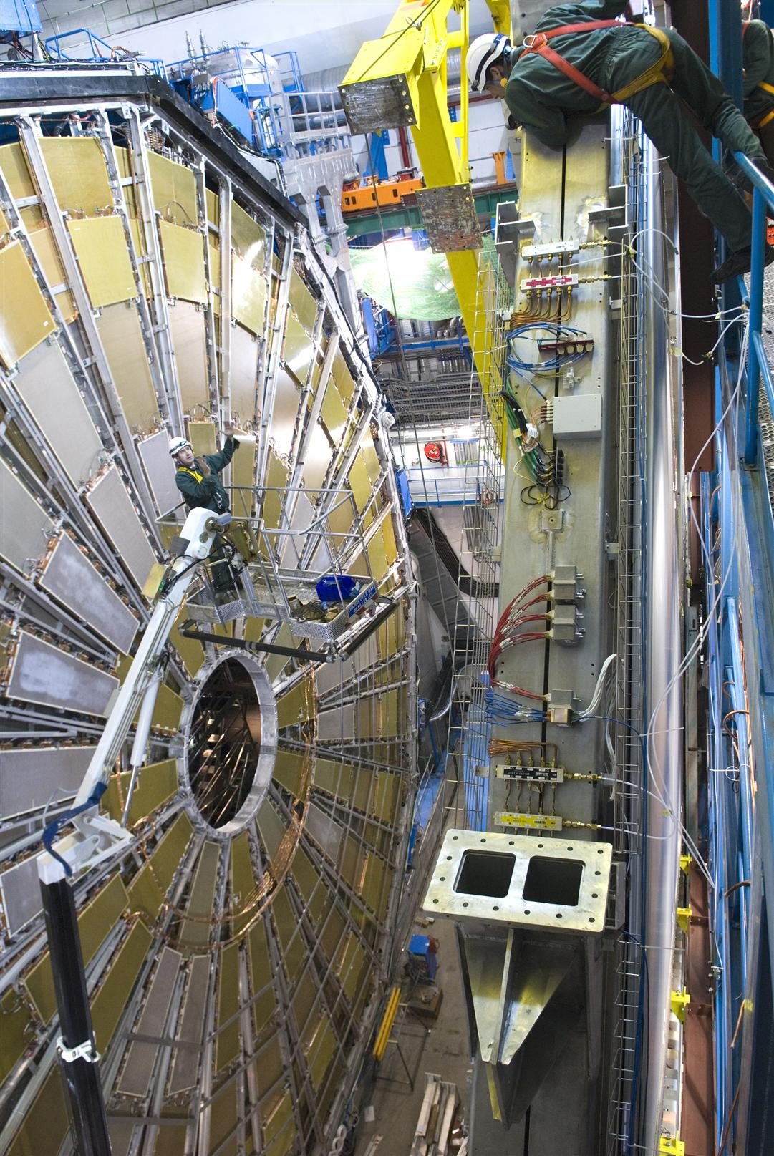
Muon Spectrometer: Why?
Answer 1: Muons are weakly interacting:
Answer 2: One Visible signal is H->2Z-> 4l the cleanest is 4 μ (lowest background).
What we need: muon energy and momentum

Slide 3
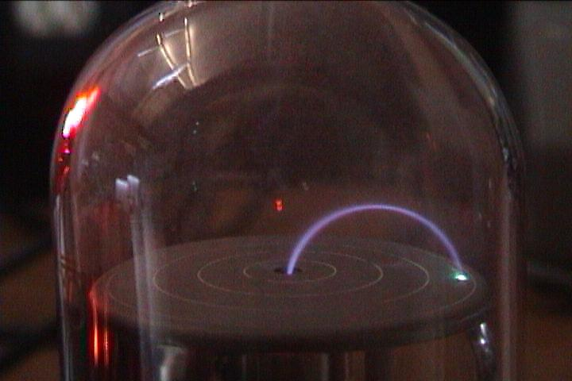
How?
JJ Thompsom measurement of e/m by bending electrons in a magnetic field.
More complicated, but same principle: Curved path is function of momentum
If we can measure the curvature, we can measure the momentum.

Slide 4
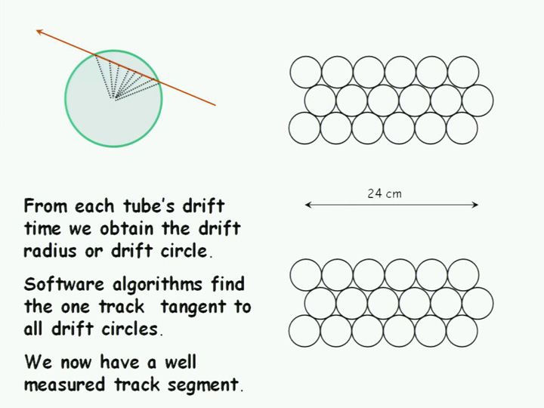
The Story: Drift Tubes and RTs
Drift Tubes permeate the entire spectrometer. Design: 1-6m length, high voltage anode wire, grounded aluminum outer wall, and gas (93Ar 7CO2)
Our Stop Watch: External Trigger, Time of Pulse
RT from some autocalibration procedure converts drift times into drift radii.
Connect the drift radii from different tubes to determine track.

Slide 5
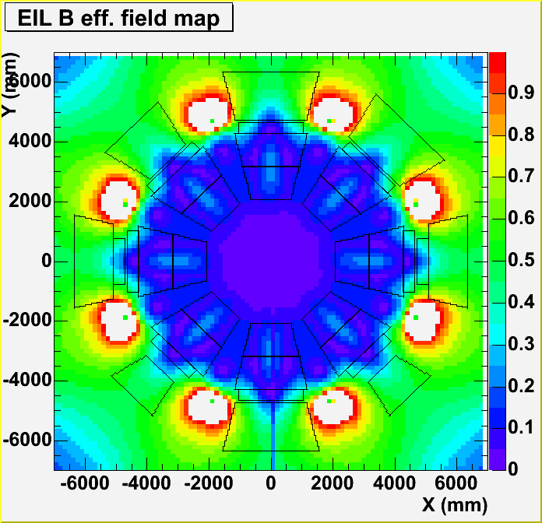
Current Work
Autocalibration procedure that we like to use outputs RTs under standard conditions
Correct this function for local chamber conditions: temperature, B-Field, wire sag
Without corrections, determination of a muon’s track can’t be accurately determined => 7kiloton piece of junk.
How we solve this is pretty cool, but I’ll tell you about it next time!

