Slide 1
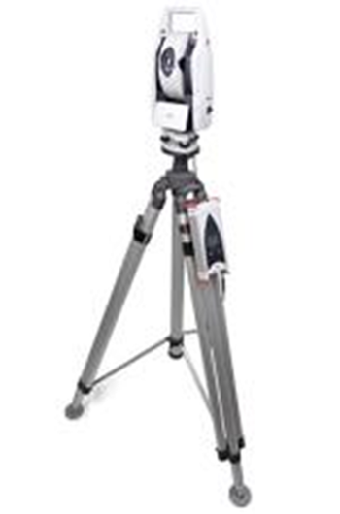
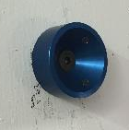
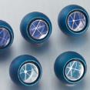
SURVEY (EN-ACE-SU)
NETWORK
  Installation of 4 pillars per bench and additional “nests” for reflectors,
  Equipment ready, will be delivered in building 180 soon,
  Need drawing with pillars / laser tracker positions or magnet installation in order to evaluate the constraints and optimize the network installation
SOFTWARE
  Spatial Analyzer (SA) will be used for acquisition (stages, fiducials, flanges, ….) and computing (bundle, frame, ….) of the data,
  Development of SA measurement plans : Technical student : ~ 3 months budget
  Need few magnet measurements to optimize the “script automatization”
COLD MASS MONITORING (two Super-FRS)
  Determination of cold mass deformation and movements
  Status of the theodolite process ? (ES : Q-FO-QM-0005, May 2016)
  Plan B : Measurements of RFI reflectors fixed on the helium vessel through the view ports :
    Angle and distance corrections need to be applied
    Laser tracker position : need 1.5 m minimal distance from view port / need to find a solution for the 2.7 m position
To be discussed (25-27/04/2017)

