Slide 1
Scintillators - Applications
Paul Lecoq
CERN, Geneva

Slide 2
Outlook
Lecture 1: Scintillator fundamentals
  Organic scintillators
  Inorganic scintillators
    Scintillation mechanisms
    Limits to the light yield and decay time
    Energy resolution and non-proportionality
Lecture 2: Scintillator applications
  Crystal growth techniques
  High energy physics and dark matter searches
  Space borne missions
  Medical applications
  Geophysical exploration
  Homeland security

Slide 3
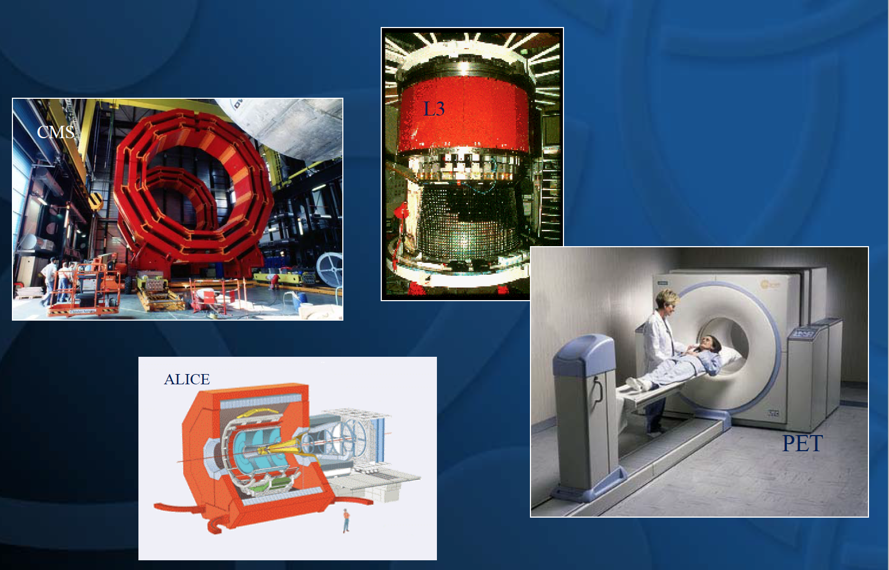
What drives sthe devlopment of new scintillators

Slide 4
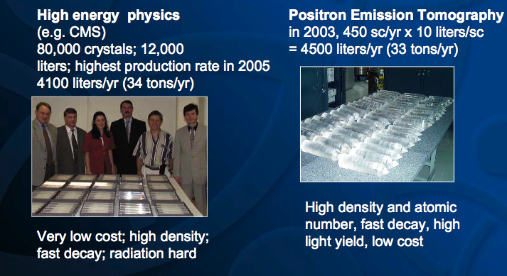
HEP and PET use the largest volume of scintillators

Slide 5
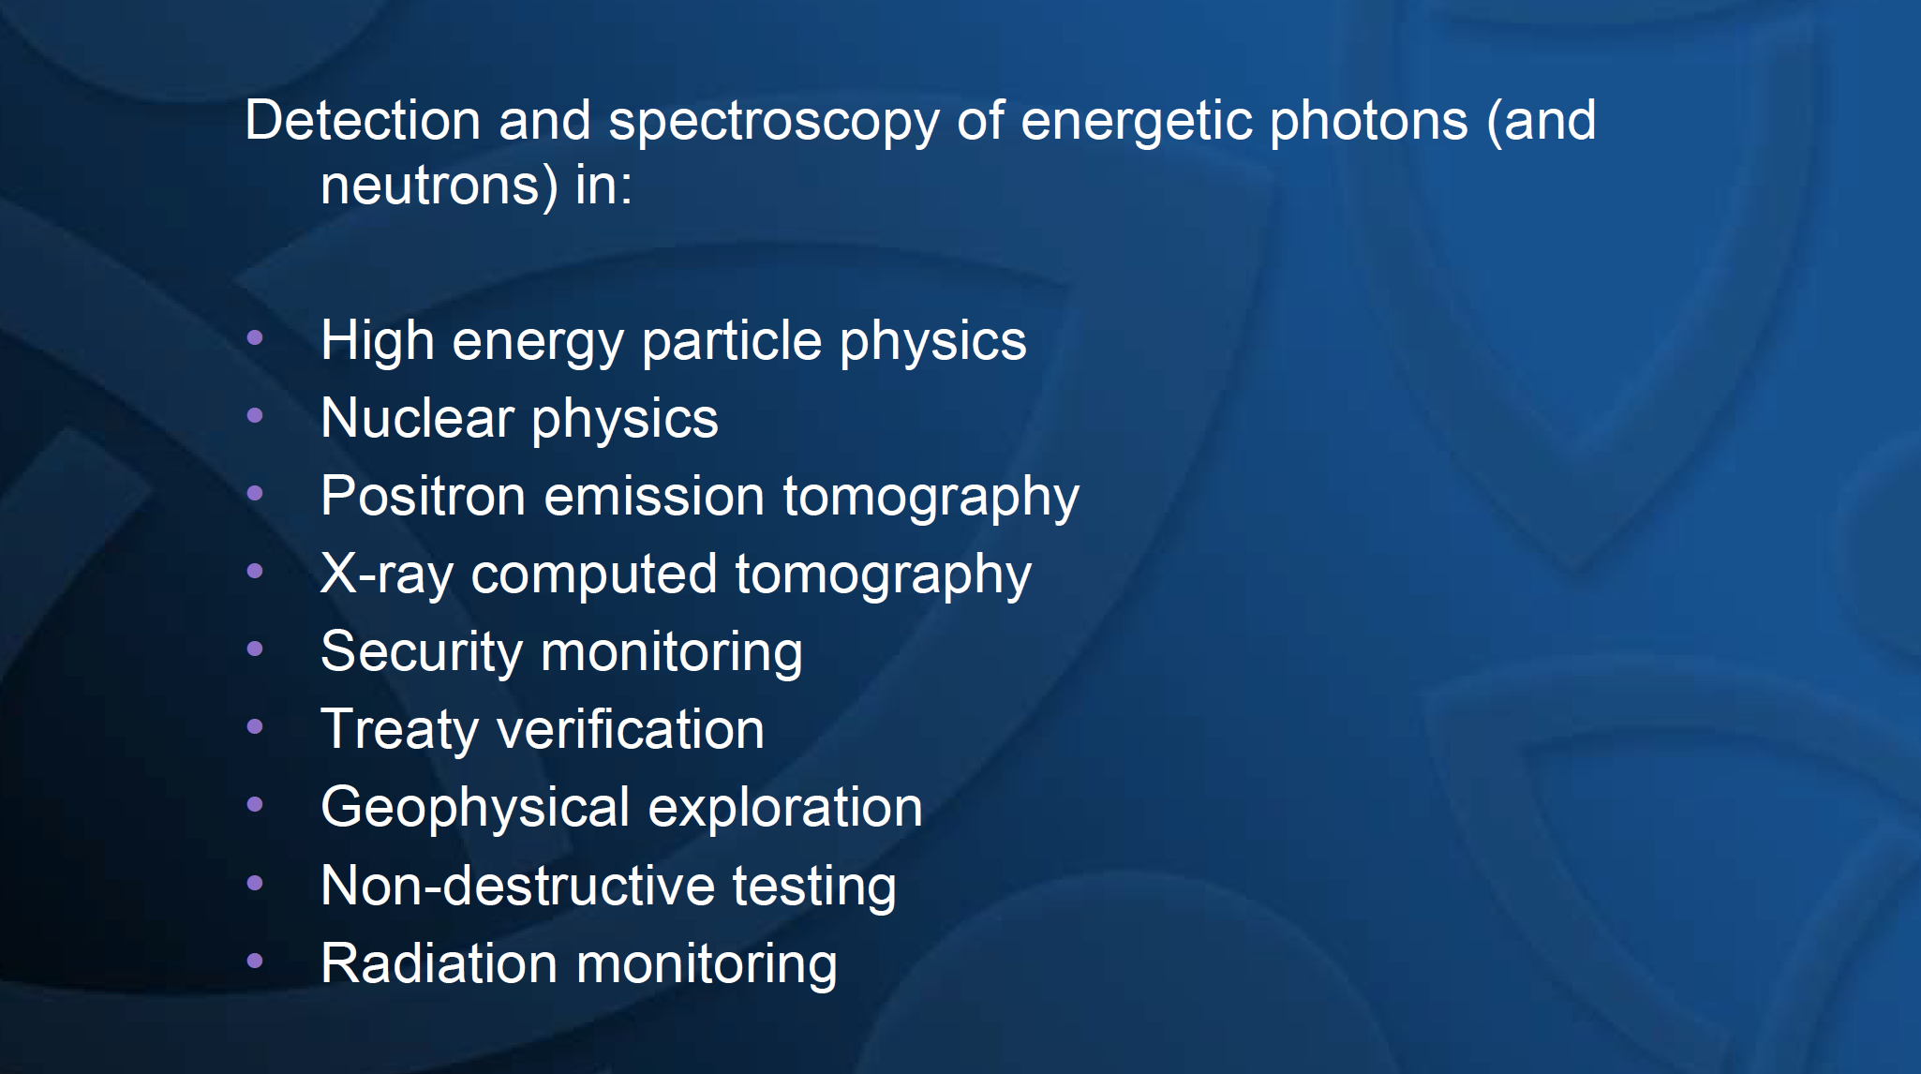
Various appelications of scintillators

Slide 6
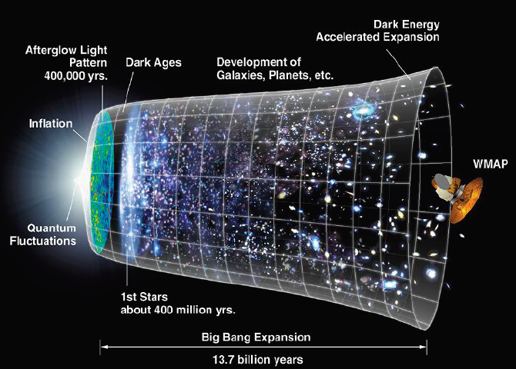
Back to Creation
Possible use of crystals
Notes:
The goal of LHC is to understand the origin of the universe
As I am a partcle physicist I will start withan exemple of application of scintillators in particule physics
But at he end of my talk I will also show that scintillators are also used to understand the universe as it is today with space missions

Slide 7
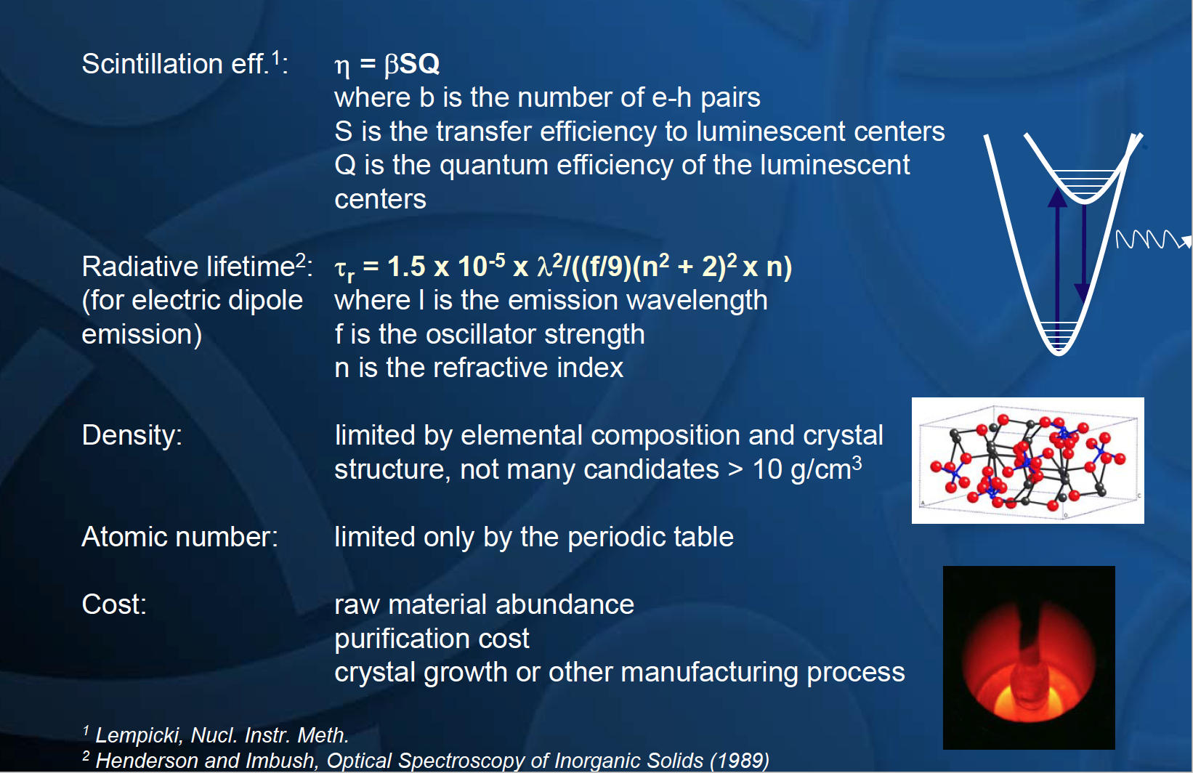
Limits of scintillator properties

Slide 8
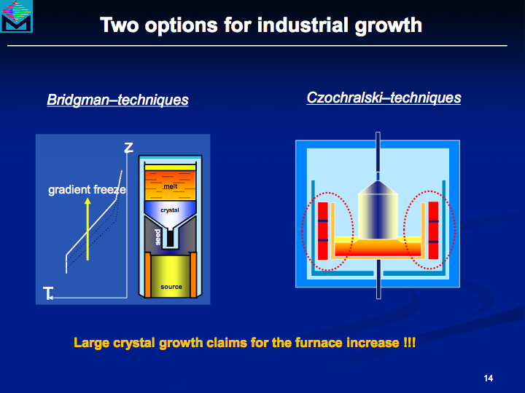
Most frequently used crystal growth technologies

Slide 9
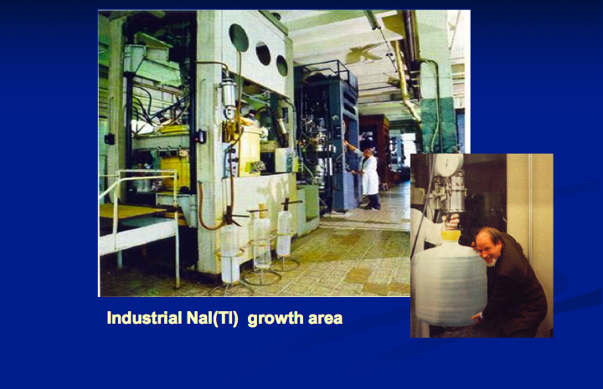
From principles to practice

Slide 10
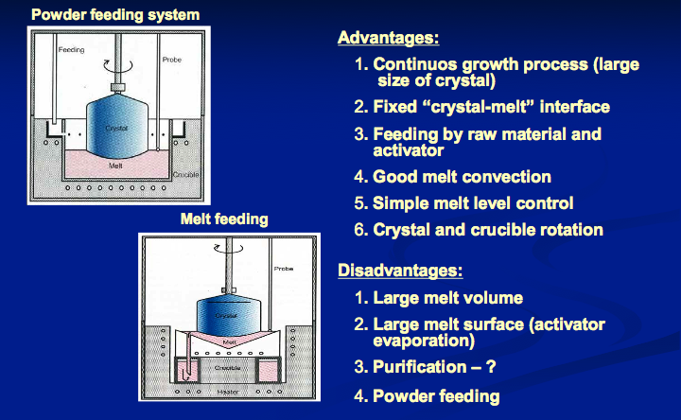
Continuous crystal growth

Slide 11
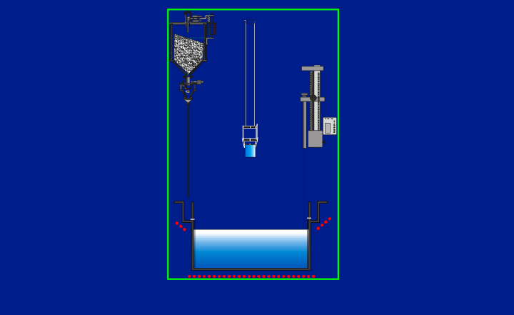
Continuous crystal growth

Slide 12
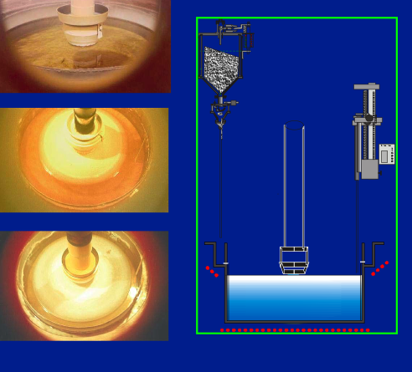
Continuous crystal growth

Slide 13
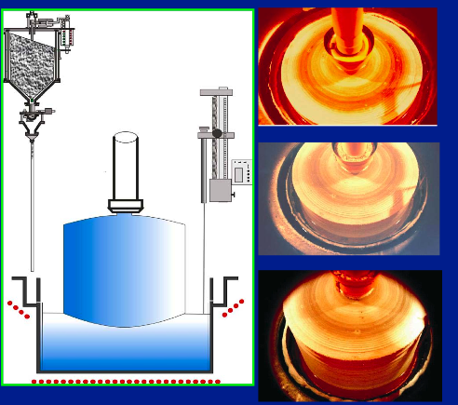
Continuous crystal growth

Slide 14
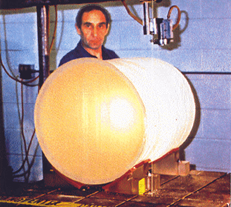
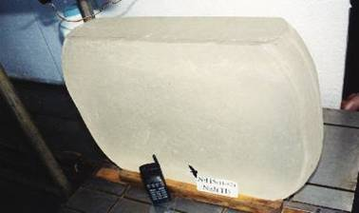
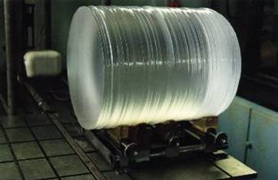

Preparation of large size plates for SPECT cameras
NaI:Tl single crystal
520 mm,
mass > 550 kg
After growth the NaI:Tl crystal is cut and pressed at high temperature to prepare large area plates for SPECT cameras
Institute of Single Crystals
Kharkhov, Ukraine

Slide 15
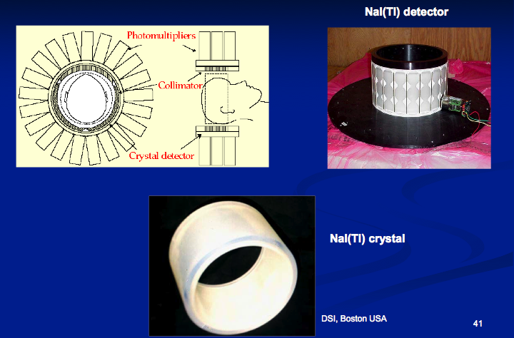
NaI cylindrical detectors

Slide 16
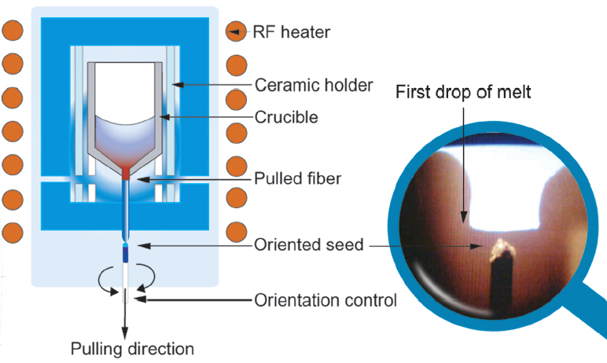
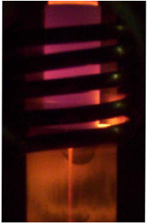
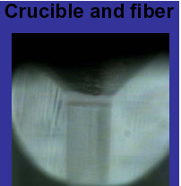



Micro-pulling-down crystal fiber growth
BGO
Φ=400μm
YAG:Ce
Φ=1mm
LYSO:Ce
Φ=2mm
YAP:Ce
Φ=2mm
Courtesy Fibercryst, Lyon
Notes:
Production cost of small cross-section crystal pixel m,ay become prohibitive with standard production technologies. In particular the cost of surface treatment may become a dominant cost driver
Hole at the bottom of crucible, with a capillary. When the first drop of melt reaches the seed, the fiber is pulled down at an impressive speed several cm/mn compared to a few mm/hour

Slide 17
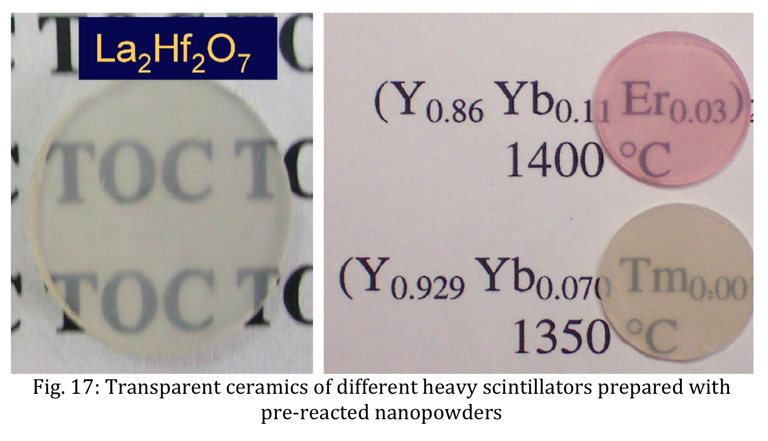
Ceramics

Slide 18
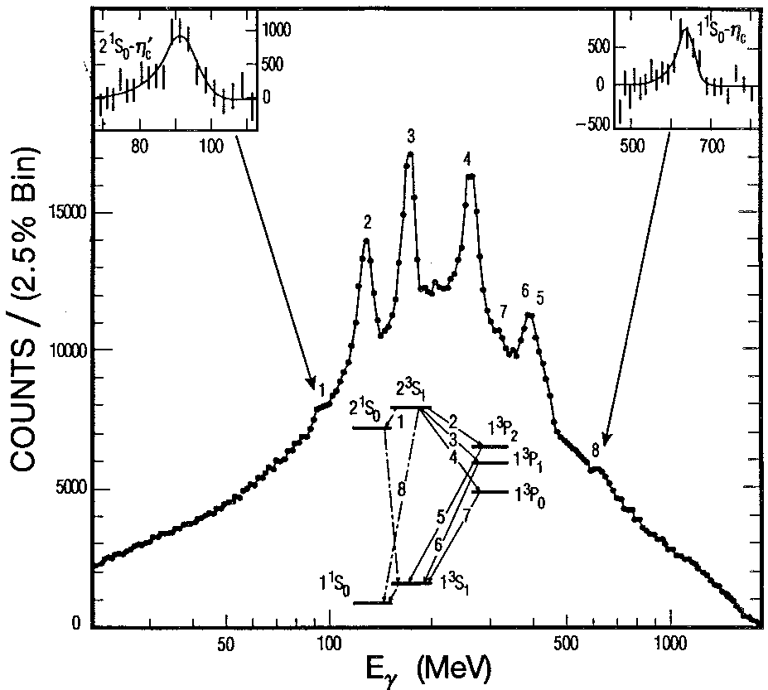
Crystal Calorimetry: a Powerful Tool for Particles Spectroscopy
Charmonium spectroscopy – Crystal Ball - SLAC
50cm diameter spherical ball of NaI(Tl) crystals
672 crystals 42cm long, PMT readout
Very good resolution allowed precise spectroscopic study of charmonium states

Slide 19
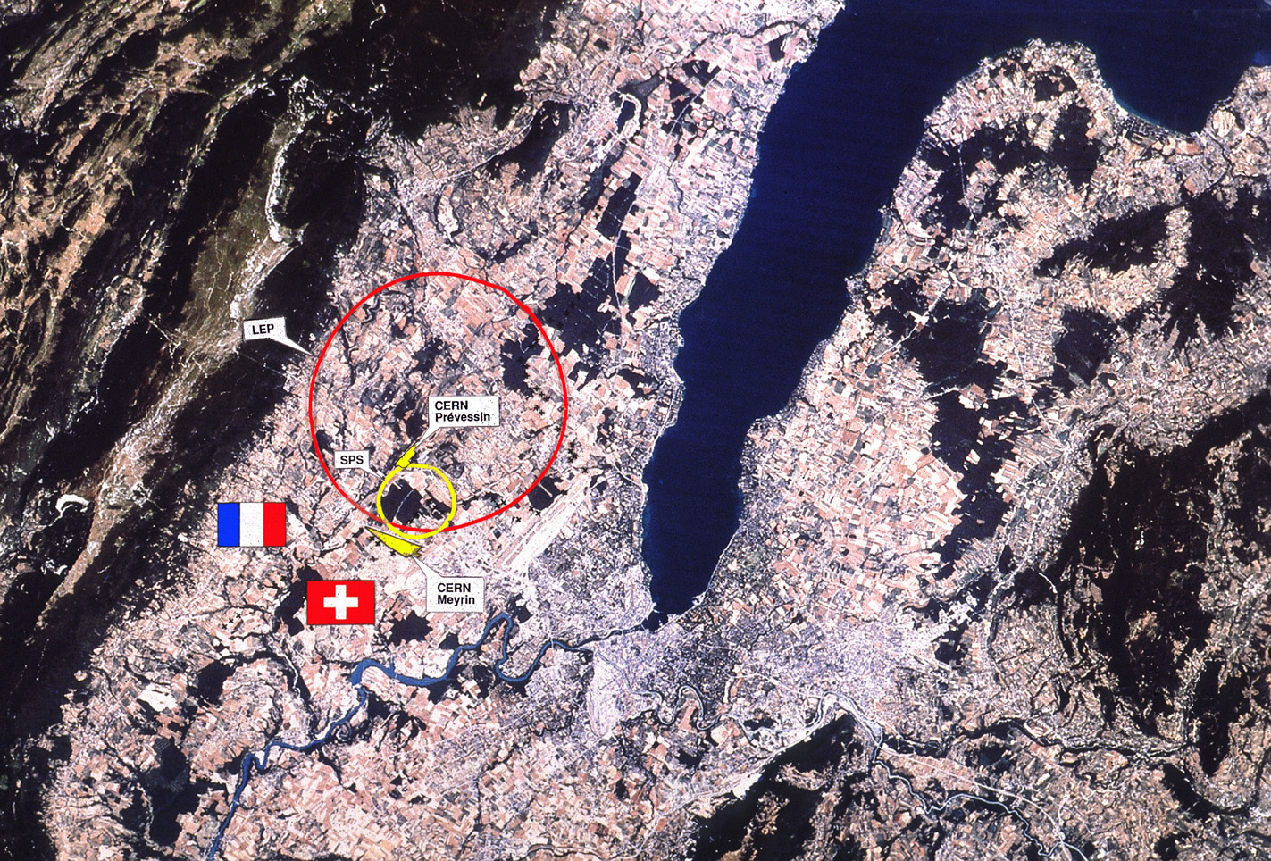
CERN in Geneva area

Slide 20
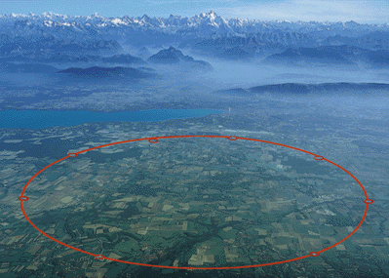
The Large Hadron Collider LHC
Mt Blanc
Lake of Geneva
ATLAS
LHCb
Large Hadron Collider
27 km circumference
CMS
ALICE

Slide 21
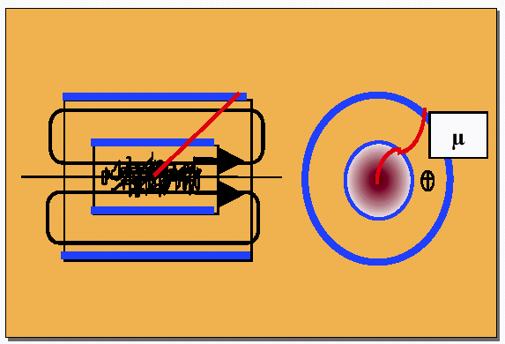
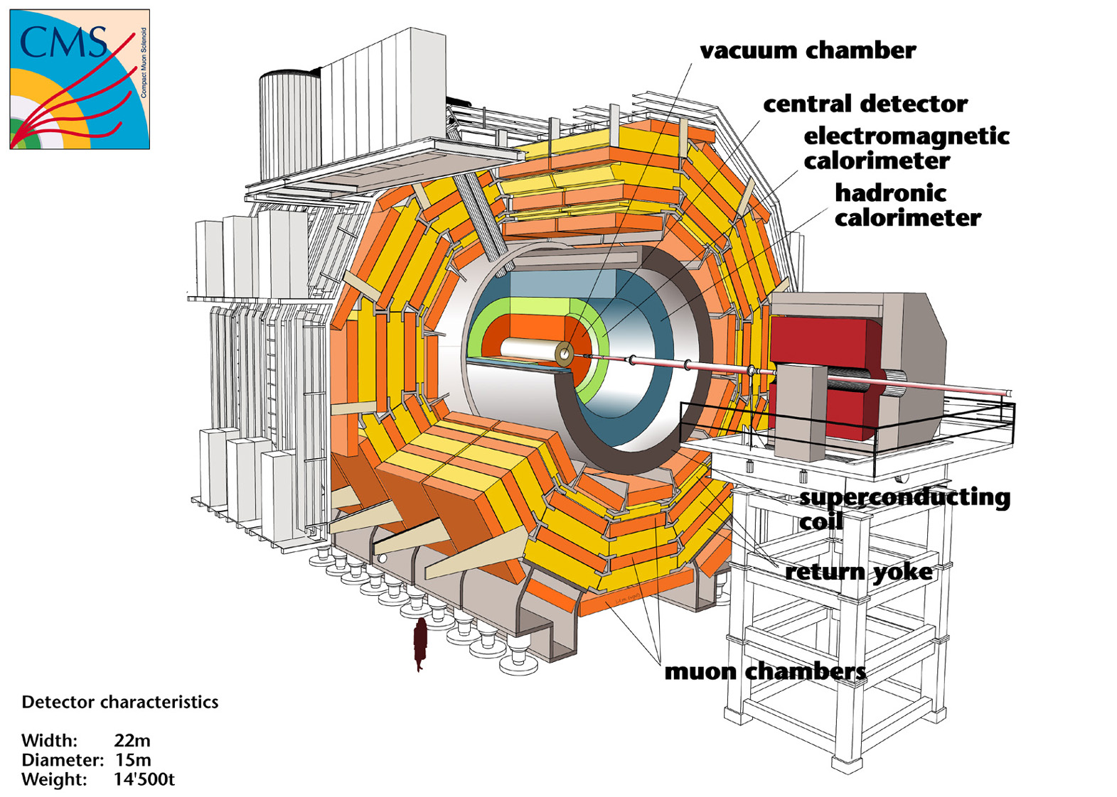
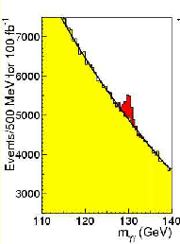

Compact Muon Solenoid
4 T magnetic field
Main CMS goal:
search for Higgs
and new physics
Length ~ 22 m
Diameter ~ 15 m
Weight ~ 14500 t
For a light Higgs (as suggested by present data)
H→γγ best channel. Narrow width, irreducible background:
ECAL resolution crucial !

Slide 22

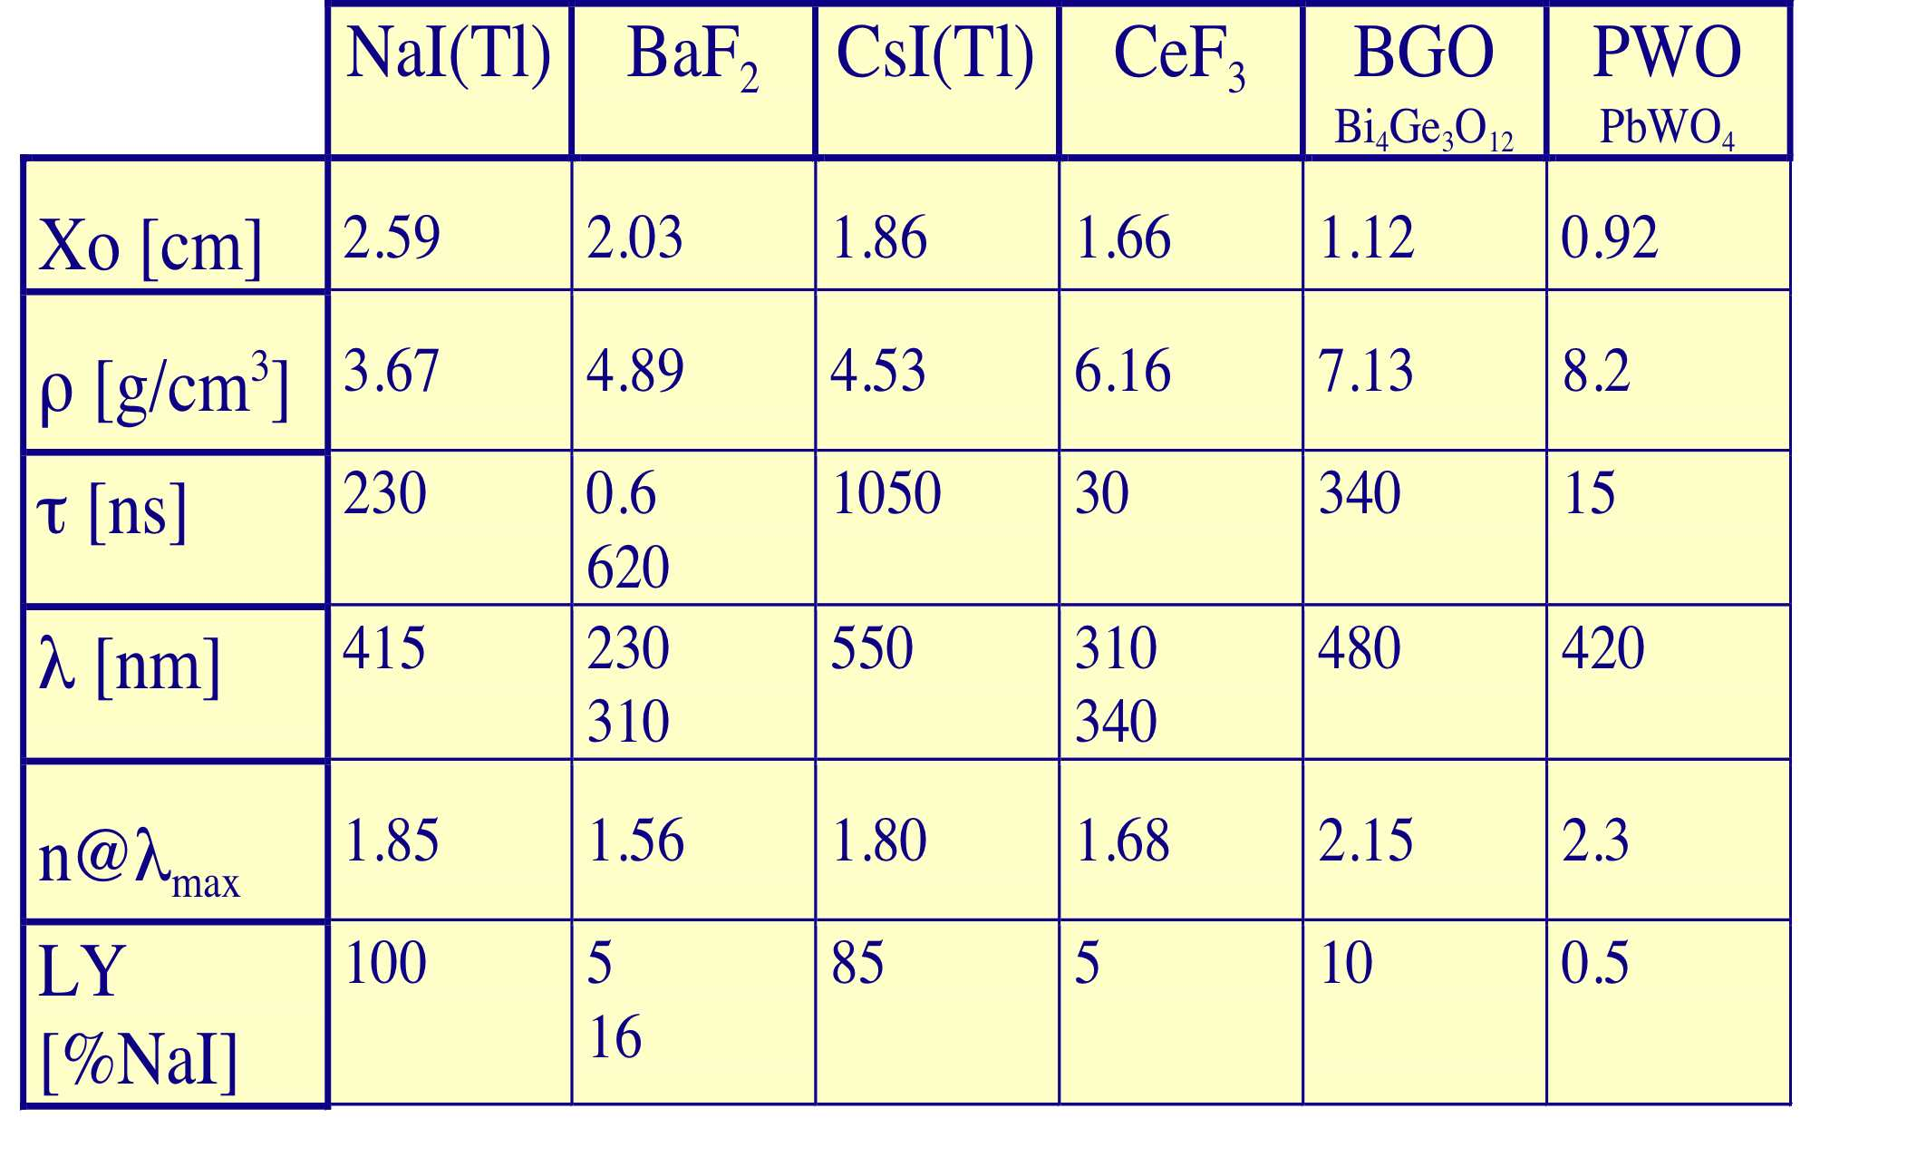
Some popular crystals in HEP
Notes:
Through the study and development of these crystals we have learned a lot
1- about fundamental mechanisms fro cross luminescent crystals, necessarily:
UV emitting
fast
low light yield
2- about Ce3+ as one of the most promising activator for fast scintillators
3- about mechanisms of energy relaxation in crystals (scintillation efficiency)
4- about the role of impurity and defects on:
scintillation efficiency
decay time (quenching and slow components)
Radiation hardness

Slide 23
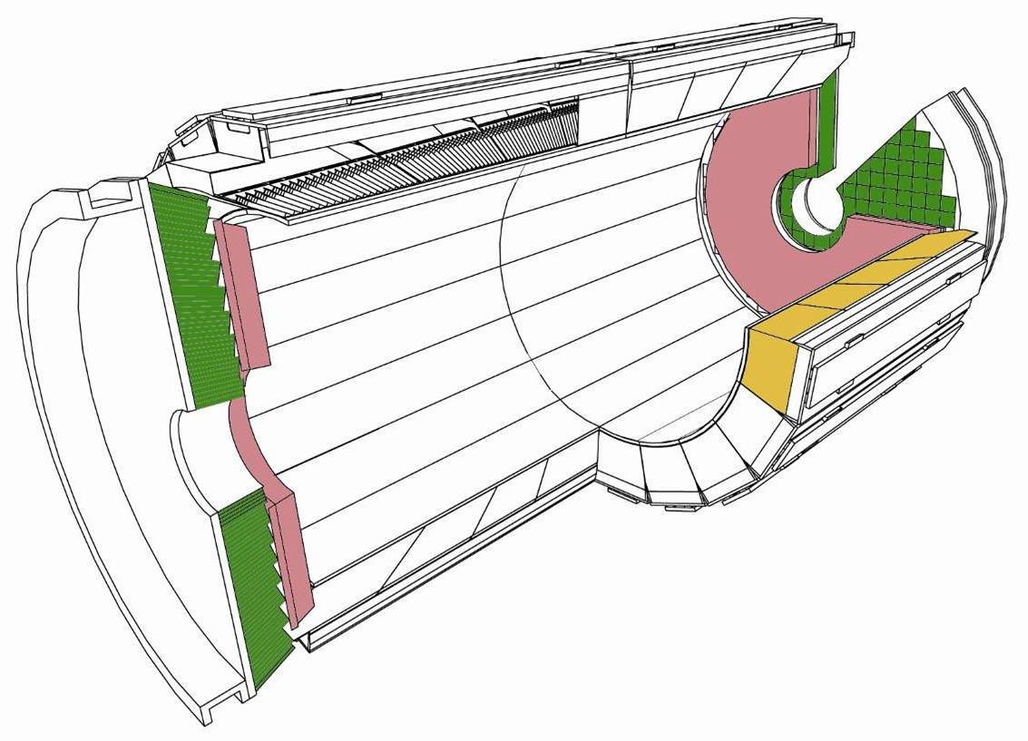
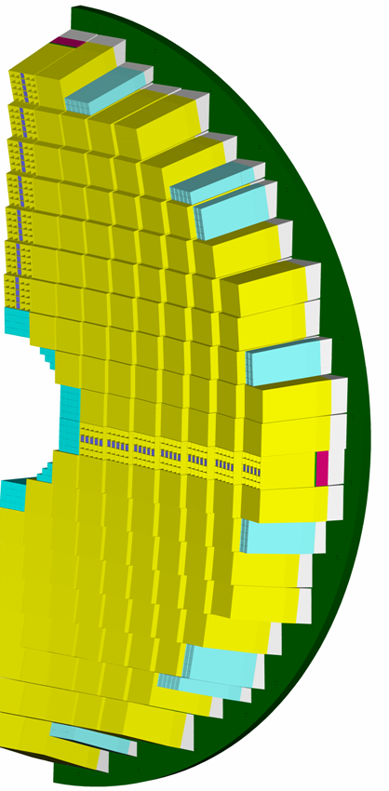
ECAL layout
PWO: PbWO₄
about 10 m³, 90 t
barrel cystals
Pb/Si preshower
endcap
supercystals
(5x5 crystals)
barrel
Super Module
(1700 crystals)
EndCap “Dee”
3662 crystals
Barrel: |η| < 1.48
36 Super Modules
61200 crystals (2x2x23cm³)
EndCaps: 1.48 < |η| < 3.0
4 Dees
14648 crystals (3x3x22cm³)

Slide 24
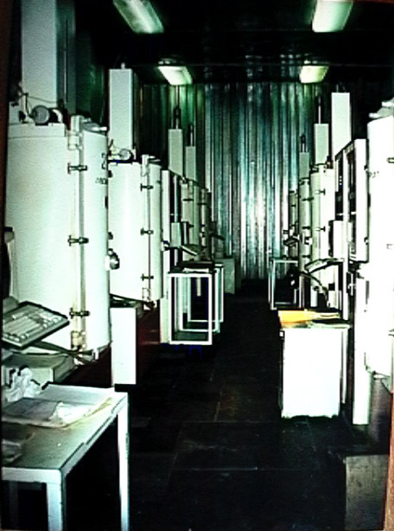
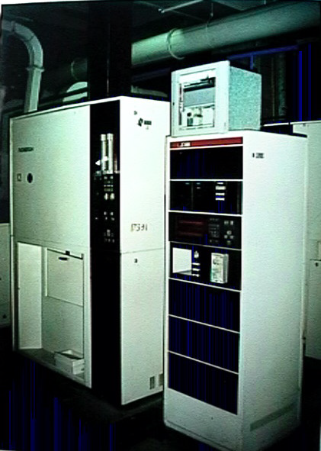
Production facilities in Bogoroditsk
12 low gradient annealing ovens
159 Lazurit 3M growth ovens

Slide 25
Some important steps in radiation hardness progress
1994: Nb doping
  Suppress stable di-hole centres
  Suppress induced 620nm band
    MRS Proceedings Vol348 p99
    NIM A 365(1995) p291
1996: Y doping
  Suppress stable e⁻ centre on Vo
  Suppress induced bands in visible
  1318: best crystal in test beam
    CMS LHCC 1996-146
1997: Stoechiometry tuning
  Suppress Vc and Vo centres
    CMS Note 1997/55
    Rad. Measurements Vol29, p27
1318

Slide 26
Some important steps in radiation hardness progress
1997: More trivalent doping
  La, Lu, Y, Al
  Improves transmission and decay
  Improves Rad. hardness (see Y)
    Kobayashi for La: KEK 1997-12
    CMS Note 97/54, NIM A 402(1998) p75
1998: New raw material optimization +La codoping
  Factor 2 better than Nb or La
  No sign of drawback seen with La
    NIM letter to editor, snbmitted Sept 98
Dose (Gy)
Front irradiation : ⁶⁰Co 0.15Gy/h

Slide 27
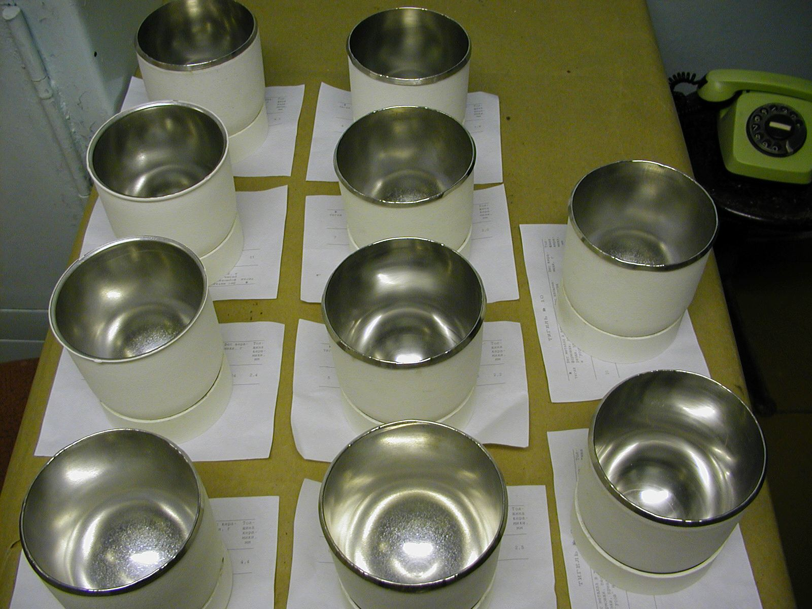
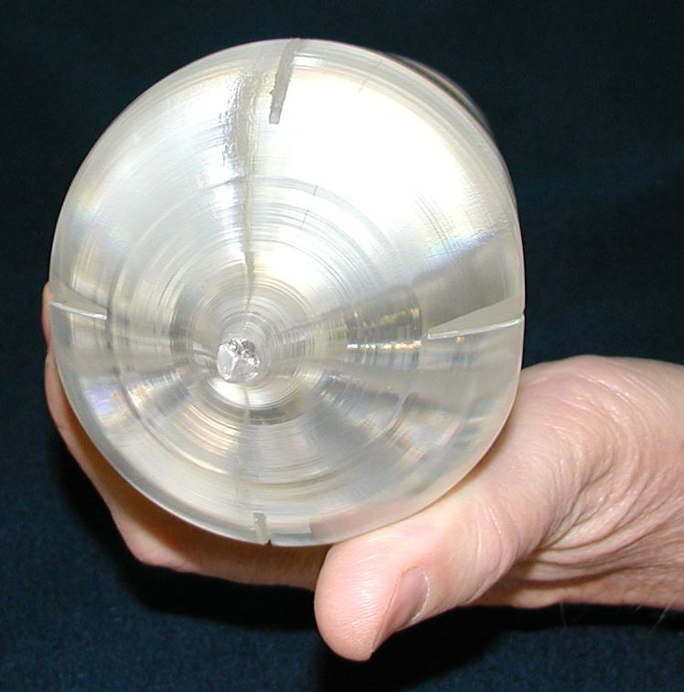
PWO growth of large ingots
Upgrade the Rf power cycle for heating, smelting, pulling and cooling
Optimization of procedure for crystal ingot extraction from crystallization unit
Replace 120mm Pt crucible by new 170mmcomposite Pt crucibles
Notes:
We wanted to grow larger size ingots (endcaps and higher productivity) but we had only 700kg Pt available

Slide 28
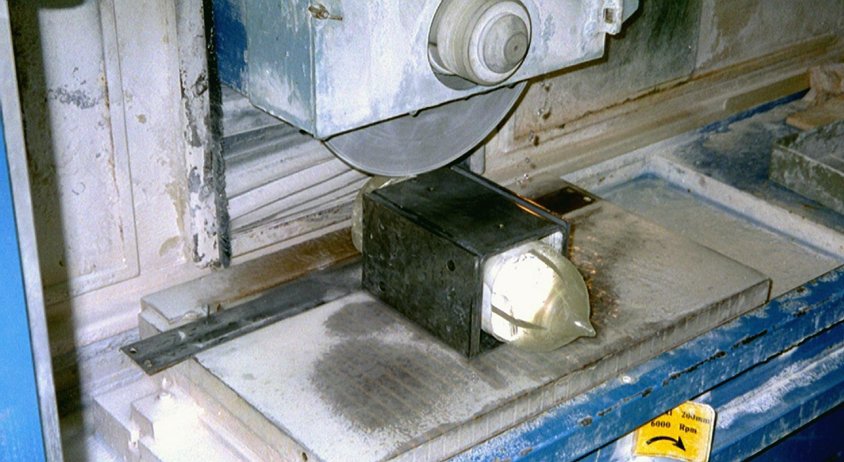
Square end cut 85mm

Slide 29
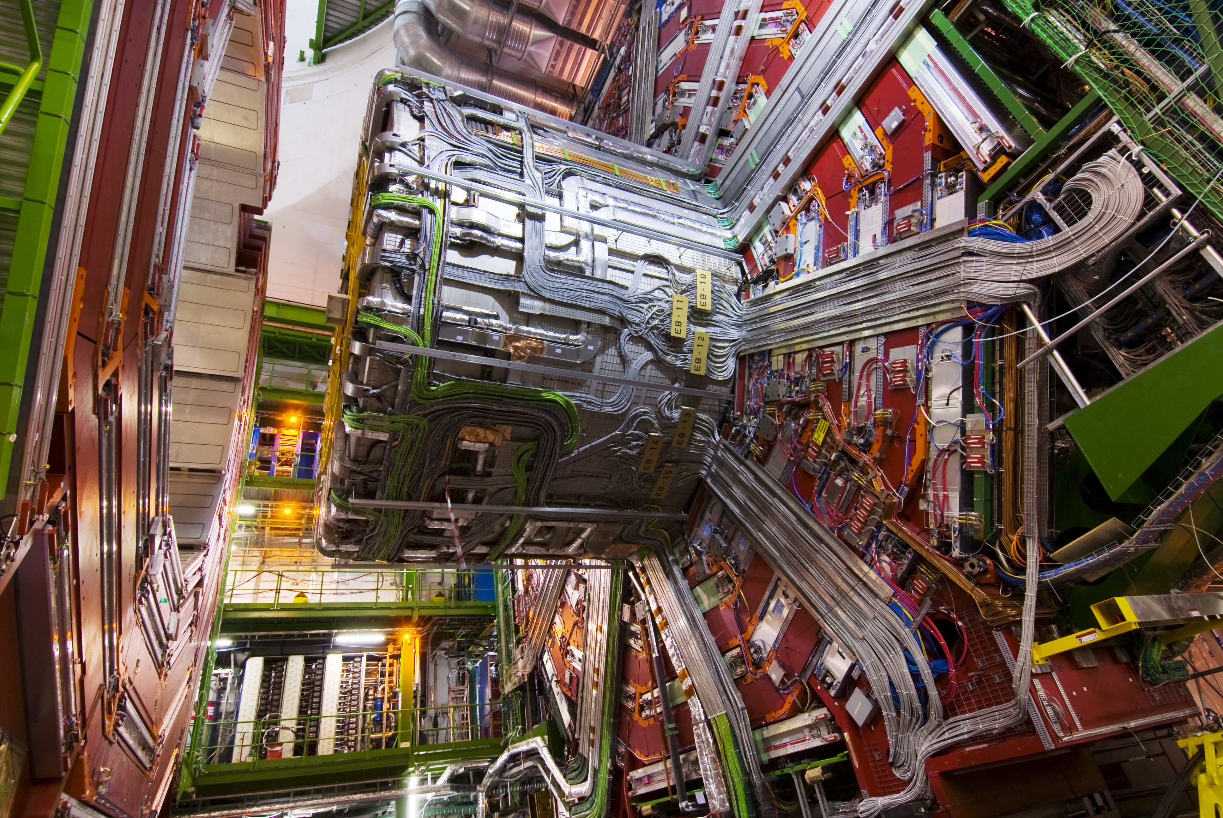
CMS Barrel

Slide 30
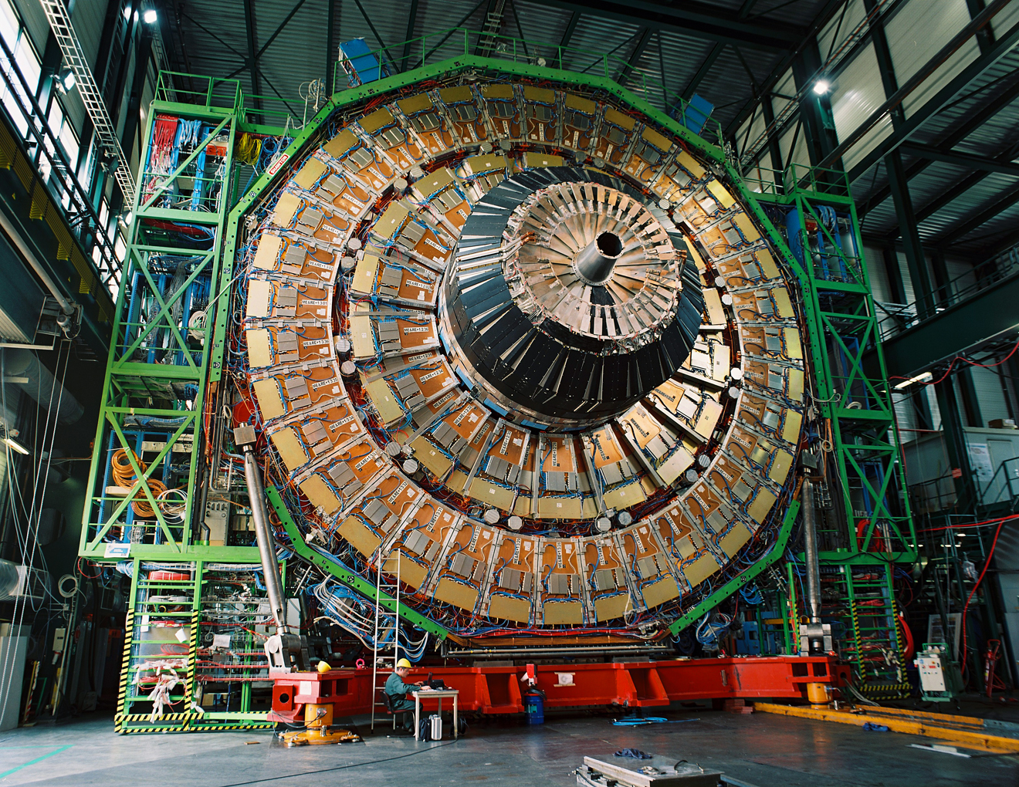
CMS Endcaps
16 years of effort

Slide 31
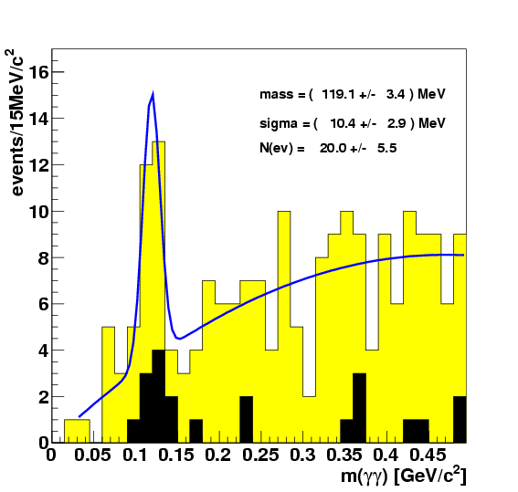
First results
Cosmics event
π⁰ invariant mass
Events/15 MeV/c²
m(γγ) [GeV/c²]

Slide 32
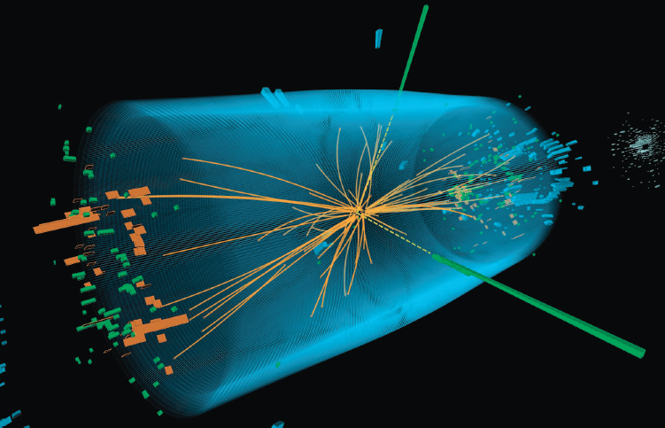
And finally!!
H ➝ γγ

Slide 33
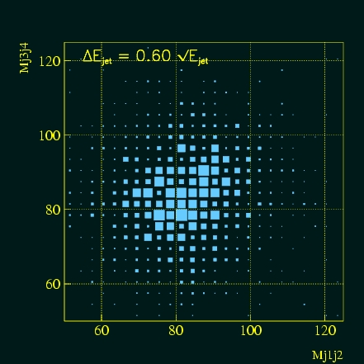
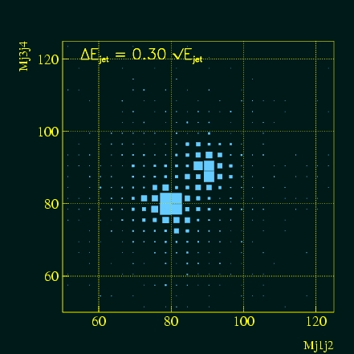
A different detector concept for precise jet calorimetry
A conventional approach is limited to about 60% - 70%/ √E
ALEPH resolution
New approaches have been proposed
Particule Flow for a 3D imaging calorimeter
  Each particle in a jet measured individually
  Requires very high granularity
  Limitations
    Complex Integration due to huge number of channels
    Identification of individual particles in a jet challenging at very high energy
Dual readout method
  Measure event by event the electromagnetic fraction of the hadronic shower by separating Cerenkov and scintillation light
ILC goal

Slide 34
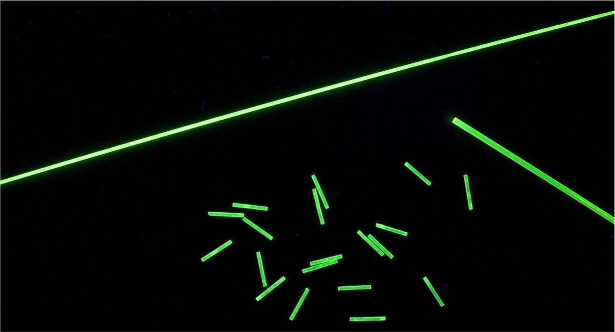
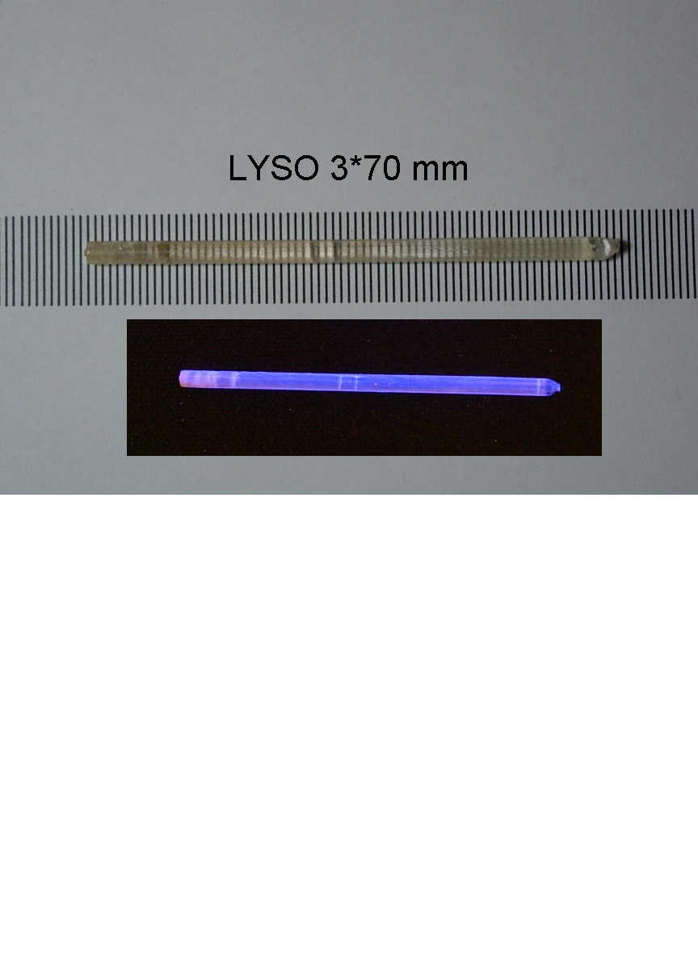
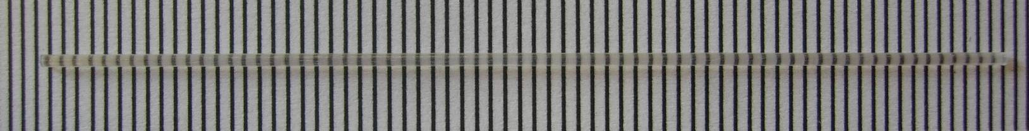
Some crystal fibers
YAG and LuAG up to 2m
BGO (φ : from 0.6 mm to 3 mm ; Length up to 30 cm)
LYSO:Ce (φ : from 0.6 mm to 3 mm ; Length up to 20 cm)
UV excitation

Slide 35
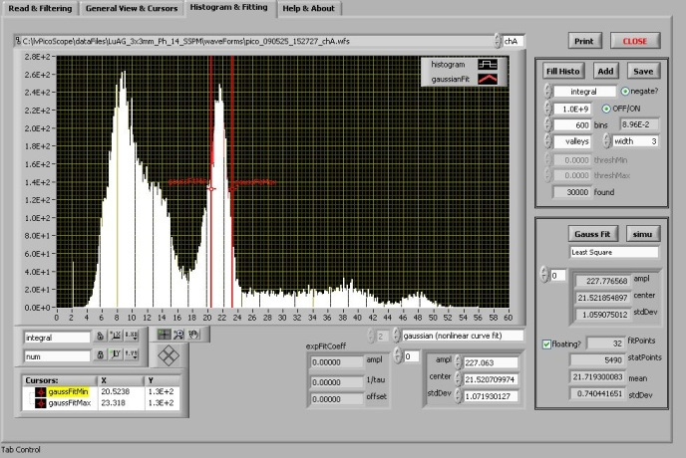
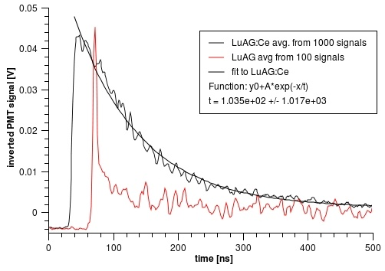
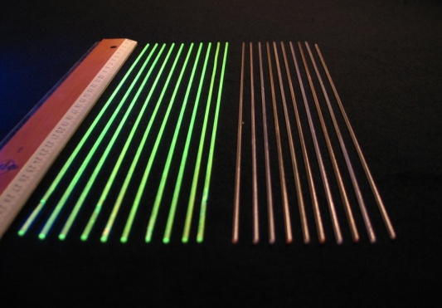
Dual readout based on Metamaterials
Select a non-intrinsic scintillating material (unlike BGO or PWO) with high bandgap for low UV absorption
The undoped host will behave as an efficient Cerenkov: heavy material, high refraction index n, high UV transmission
Cerium or Praesodinum doped host will act as an efficient and fast scintillator
  ≈ 60ns decay for Ce
  ≈ 20ns decay for Pr
SiPMTs
MOEMS diffractive optics
light concentrator
MOEMS diffractive optics
light concentrator
SiPMTs
Energy Resolution
12%
LuAG is an excellent candidate
Ø 2mm
Decay time
30cm
Scintillating fibers bundle
undoped fibers bundle
Ce doped LuAG
undoped LuAG
Fibercryst

Slide 36
WIMP-Dark matter searches
Evidence of Dark Matter
Rotation curve of spiral galaxies
Direct detection - elastic scattering off nuclei
Features:
1. Low energy → Low energy threshold (~10 keV)
2. Expected event rate < 0.1/kg day
Detector mass 1kg-100 kg
High radiopurity of detector
and construction materials
L.Bergstrom Rep.Progr.Phys.63 (2000) 793
Underground location
V=(GM/r)^{1/2}
Ω_{M}~0.3 Ω_{X}~0.7
Background rejection

Slide 37
Why cryogenic scintillator?
CREST detector
Sensitivity + Selectivity
high-energy resolution of cryogenic phonon detector + discrimination of events with low detection threshold (≤10 keV)
W-thermometer (phonon detector)
WIMP
Crystal
β+γ
Reflector
Phonons
Light
neutrons
P.Meunier et al, Appl.Phys.Let 75 (1999) 1335
light detector

Slide 38
Scintillator requirements
high light yield at low temperatures
  low threshold,
  good energy resolution
Radiopurity (ex Lu, Rb, K, U, Th)
Suitable thermodynamics characteristics
Possible candidates
  CaWO₄ – satisfactory choice, currently in use, large ongoing effort to improve the material
  ZnWO₄ – scintillator under development for cryogenic application
  CaMoO₄ and CdMoO₄– material under investigation

Slide 39
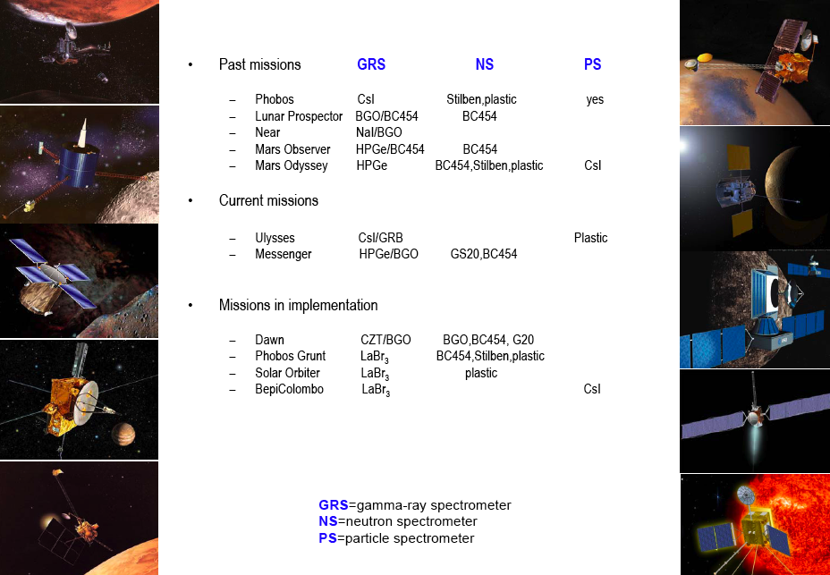
Scintillation Detectors on
Space Missions

Slide 40
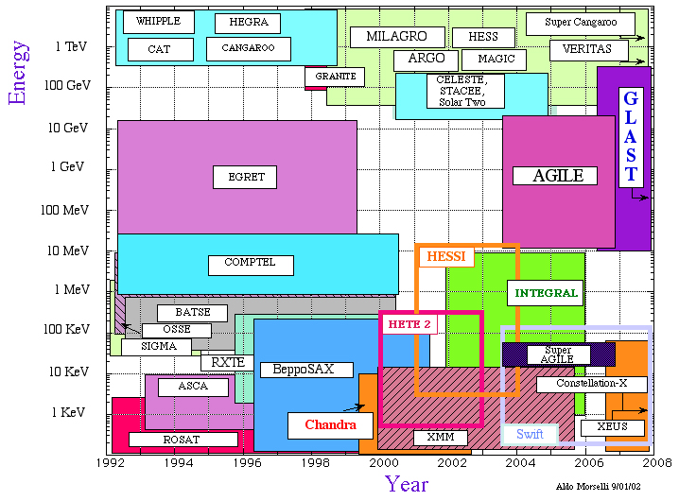
Important Projects for Gamma Astrophysics
Parameter | EGRET | GLAST (Minimum Spec.)
Energy Range | 20 MeV - 30 GeV | 20 MeV – 300 GeV
Peak Effective Area¹ | 1500 cm² | >8000 cm²
Field of View | 0.5 sr | >2 sr
Angular. Resolution² | 5.8° (100 MeV) | <3.5° (100 MeV) <0.15° (>10 GeV)
Energy Resolution¹ | 10% | <10%
Deadtime per Event | 100 ms | <100 μs
Source Location Determination⁴ | 15' | <0.5'
Point Source Sensitivity⁵ | -І x 10^{–7}cm^{–2} s^{–1} | <6 x 10^{–9} cm^{–2} s^{–1}
EGRET – Energetic Gamma Ray Experiment Telescope
GLAST – Gamma Ray Large Area Space Telescope

Slide 41
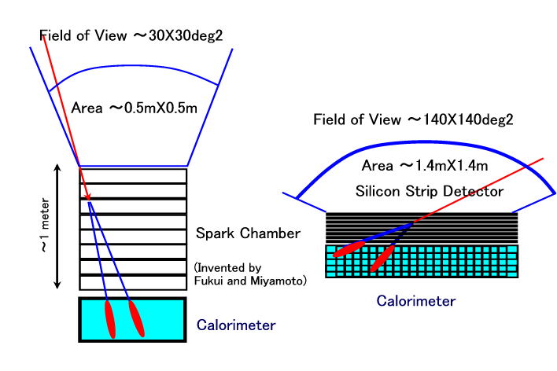
EGRET versus GLAST
NaI
CsI
EGRET on Compton GRO (1991-2000)
GLAST Large Area Telescope (2006-2015)

Slide 42
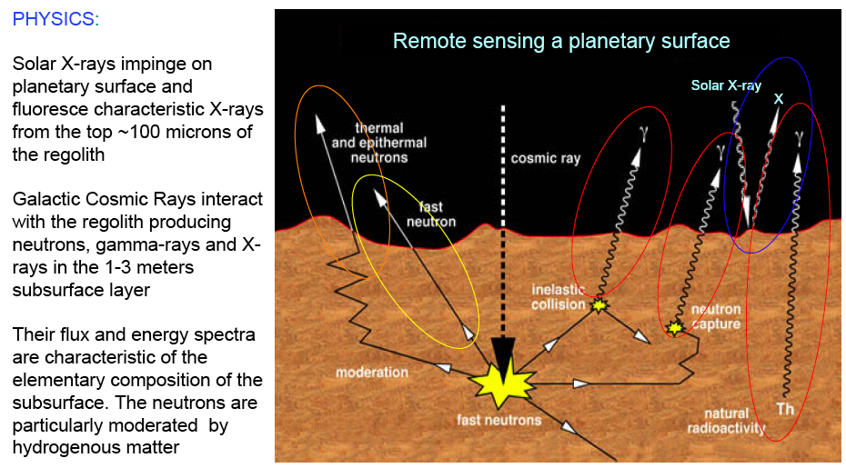
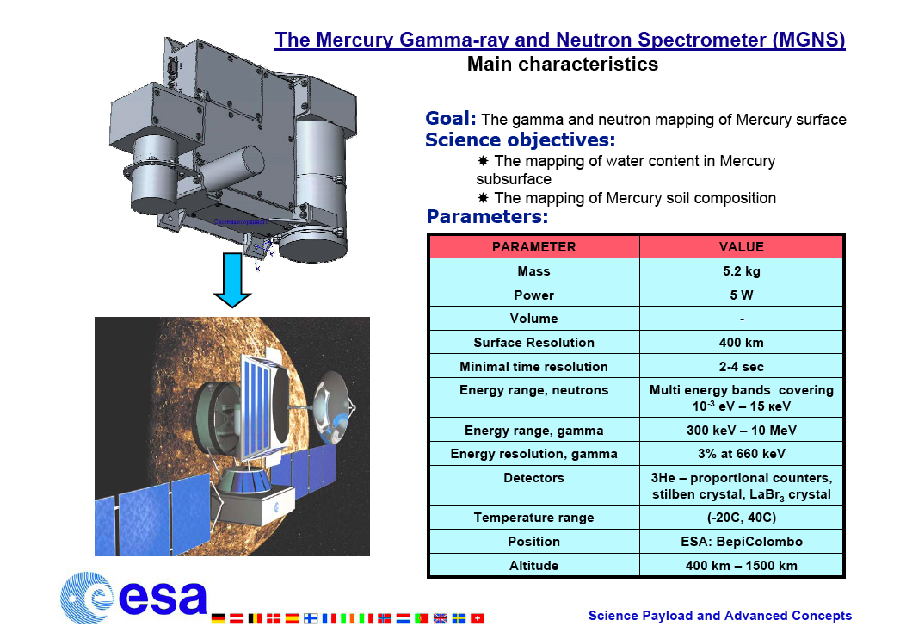
The BepiColombo Mercury mission

Slide 43


History- LaBr₃ development program

Slide 44
Scintillators in nuclear medicine
High detection efficiency for different type of radiations, particularly γ-rays
Good energy resolution
Very good timing
High counting rate capability
Great variety in size and composition

Slide 45

SPECT principle
Spatial resolution

Slide 46

SPECT requires large size crystals

Slide 47




PET Principles
n
n
p
p
n
e⁺
e⁺
Acolinearity
(α D)
p
p
n
e⁺
e⁻
n
p
¹⁸FDG
injection
p
n
p
Positron range (r)
Neutron-deficient
isotope
Coincidences
2τ
(6p; 5n)➔(5p; 6n)
PET data acquisition
Projection
x
z
φ
φ
φ
s
Reconstruction
z
s
Parallel projections
PET data (sinograms)
PET images
Notes:
Neutron defficient isdotope, for instance 18F, attached to a molecule involved in some metabolic process we want to study. Very often this is FDG, easily fixed in cancer cells and inflamatory areas.
PET is a fantastic tool to see organs at work.

Slide 48

Scintillators for PET
Scintillators for PET
1962
1977
1995
1999
2001
2003
2007
NaI BGO GSO:Ce LSO:Ce LuAP:Ce LaBr₃:Ce LuAG:Ce
Density (g/cm³)
Atomic number
Photofraction
Decay time (ns)
Light output (hν/MeV)
Peak emission (nm)
Refraction index
3.67
51
0.17
230
43000
415
1.85
7.13
75
0.35
300
8200
480
2.15
6.71
59
0.25
30-60
12500
430
1.85
7.40
66
0.32
35-45
27000
420
1.82
8.34
65
0.30
17
11400
365
1.97
6.73
63
0.30
60
>25000
535
1.84
5.29
47
0.13
18
70000
356
1.88
Notes:
Better timing requires faster crystals with high LY

Slide 49
Parallax error in PET
Spatial Resolution -
Depth-of-interaction
DOI
Depth-of-interaction
(DOI) information is
needed to maintain good
resolution at off-centre positions
incorrect LOR

Slide 50
Phoswich configuration in PET
columns
LuAlO₃:Ce
Lu₂SiO₅:Ce
DOI
LuAlO₃:Ce
Lu₂SiO₅:Ce
APD array
or
multi-anode PMT
Different response
time and/or
wavelength

Slide 51



The AXPET concept
2.5 to 4mm FWHM position resolution for 10cm long crystals
Depending on surface state and wrapping conditions

Slide 52



Time of Flight PET
Detector B
Δt = t_{A} – t_{B} = [(d+d₁) – (d-d₁)]/c
d₁ = c Δt/2
t_{B}
d
d₁
Patient
e⁺
10ps TOF resolution
δx = 1.5mm
SNR_{TOF}/SNR_{CONV}= 16!
e⁻
t_{A}
SNR_{TOF} = √(2D/cDt) · SNR_{conv}
Detector A
δt (ps)
δx (cm)
SNR*
10
100
300
500
0.15
1.5
4.5
7.5
16
5.2
3.0
2.3
State-of-the-art
* SNR gain for 40 cm phantom
Notes:
But there is also a request for good timing resolution for another important application of scintillating crystals. PET scanners.

Slide 53

Scintillators for Geophysical Exploration

Slide 54



Oil Well Logging
Far detector
Near detector
Shielding
Neutron/Gamma
generator

Slide 55


Nuclear Tools

Slide 56


Desirable Scintillator Properties
LuAP ?

Slide 57

Homeland security

Slide 58

Passive instrumentation

Slide 59

Active Instrumentation

Slide 60

Border control

Slide 61
Conclusion 1
Scintillators are widely used in a large number of scientific and industrial domains
The ideal scintillator does not exist and research should continue on new materials and new production technologies (micro-pulling down)
Structuring at the nanoscale gives access to quantum confinment phenomena and increases the range of optical electric and magnetic properties that can be engineered
Metamaterials based on quantum dots, photonic crystals and photonic crystal fibers can open the way to new detection paradigms with huge design flexibility

Slide 62
Conclusion 2
A number of good scintillators have been discovered that have proved difficult to manufacture – e.g. LuPO4:Ce
An alternative approach is to start with materials of known manufacturability, and improve the scintillation properties – e.g. PWO, YAG, GGG
“One of the continuing scandals in the physical sciences is that it remains in general impossible to predict the structure of even the simplest crystalline solids from a knowledge of their chemical composition.” John Maddox, editor of Nature (1988)
Not true anymore!!!

Slide 63
PWO: The Problem to be solved
Historical background
  Lead Tungstate (PbWO₄) first time introduced as material for HEP in 92 at CRYSTAL 2000 Chamonix conference by Nagornaya (Kharkhov) and Katchanov (IHEP)
  Crystal Clear collaboration at CERN initiated a worldwide R&D effort since 92
  First growth technology developed by INP Minsk and Kharkhov and transferred to Bogoroditsk at the end of 92
  PbWO₄ chosen as ECAL baseline by CMS in Oct 94
Challenging problem: How to
  technically develop
  Install production infrastructure
  Mass produce 76’000 crystals (11 m³, 90 tons)
in about 10 years
at an affordable price for European tax payers

Slide 64
PWO: The solution to the problem
Take advantage of the large effort made in the field of crystallography during the cold war in former Soviet Union, which resulted in
  Availability of many highly skilled people
    Academic experts in all the fields related to crystallography
    Excellent technologists
  Impressive crystal growth infrastructure installed in several plants, to produce large quantities of crystals for military applications
Once this situation has been understood and correctly evaluated, we have
  Selected the Bogoroditsk Techno-Chemical Plant after an audit of several companies
  Started a fruitful collaboration with ISTC

Slide 65


PWO: The 4 phases of the project (1 & 2)
R&D phase- CERN-ISTC
Project #354 from July 96 to July 98
350K$ CERN + 350K$ ISTC
Demonstrate that PbWO₄ crystals could
reach the level of performance imposed
by the very challenging requirements of our experiment
Technology development phase- CERN-ISTC
Project #354b from July 99 to July 2000
1.3M$ CERN + 1.3M$ ISTC
Implement a production technology to mass produce PbWO₄ crystals with a consistent
quality at an affordable price
6000 preproduction crystals

Slide 66


PWO: The 4 phases of the project (3 & 4)
Implementation of a modern industrial culture
CERN-ISTC Partnership #1718: 8.7M$ CERN
30’000 barrel crystals from Aug. 2000 to end 2004
On the basis of a sizable fraction of CMS needs
    organize a modern managerial structure
    implement a Quality Assurance policy
    install modern communication tools
    develop a Marketing strategy
Towards commercial contracts
Implementation of a new technology for large ingots
Allows endcap crystals (larger) to be grown
Allows higher productivity for barrel and endcaps
CERN-ETHZ contract for 26’000 barrel crystals and 16’000 endcap crystals
Last crystal delivered in February 2008

Slide 67

Monolithic scintillation detectors
APD arrays
LSO
511 keV
gamma
photon
DOI by light distribution
GEANT4 Monte Carlo simulation of an LSO block read out by two APD arrays.
A small fraction of the optical photons produced by the absorption of a 511 keV annihilation photon is shown.

Slide 68

BrainPET insert detectors
4 rings (ø=40 cm, H= 4x18.6 mm) with 52 detector
modules each
Dual layer of trapezoidal LSO blocks and two APDs per block
Dedicated ASIC summing preamplifier (64 inputs, 16 summed outputs, 1 total energy sum, < 1000 e⁻ rms noise per sum channel)
Complete MRI compatibility is not the main goal but it gives us some first experience in designing MR compatible PET technology for future version.
Current CCC project (Jülich, Ciemat, VUB)

Slide 69



From EGRET to GLAST
ERGET (Phases 1-5)
GLAST Sky Survey
Telescope resolution is a core
to identify the sources

Slide 70




ClearPET®, small animal PET
Crystal Clear Collaboration
20cm
8cm
phoswich with 2 crystals LYSO and LuYAP
each crystal is 2 x 2 x 10mm
80 PM with 64 photocathodes each
Spatial resolution 1.5 mm at centre

