Slide 1
Lasers for the polarimeter
requirements
-- laser parameters
(1) What beam power in green ? 100Hz 125 mJ per pulse, pulse of 5ns.
(2) what power stability 1 % ? 0.1 % (I think rather optical stability)
(3) 24/24 operation? what lifetime?
yes 24/24 and life time of a year at least – maintenance possible every week/month/year
(4) beam quality?
Spot of 100 microns at 100m after going through a mirror with 2cm face.
(5) Price ?
(6) photon Calorimeter à photons. Can now afford pixels 32x32 1mm^2 pixels.
= 1024 pixels. X 5 depths.
depolariser → this of LEP (adjusting to the right frequency) should do.

Slide 2
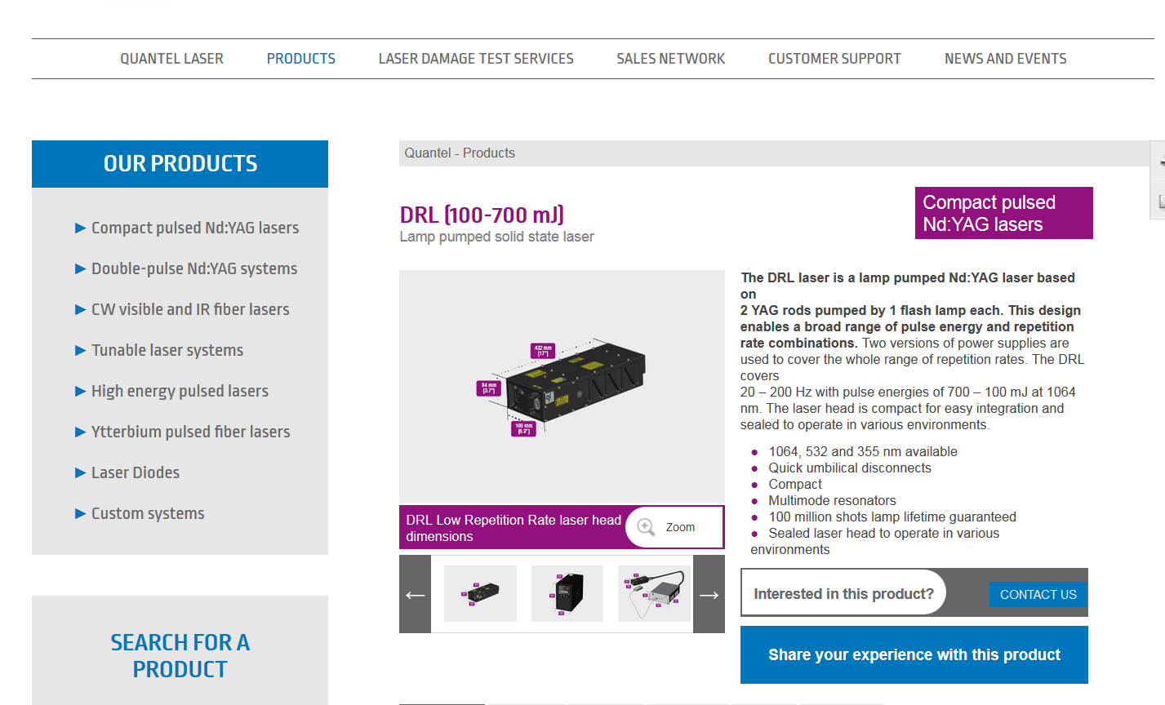

Slide 3
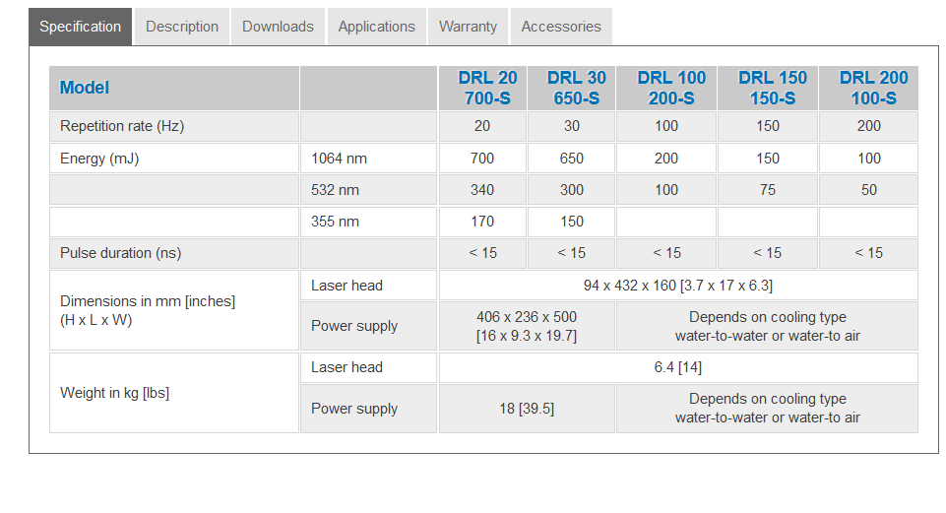

Slide 4
